Slide 1
Stocks 101: Owning a Piece of a Company
Buying a stock makes you a part-owner; learn how dividends and capital gains can create returns—and why prices can still fall.
© More Lessons Less Planning | morelessonslessplanning.com
Notes:
Open with the big idea of the lesson: a STOCK is ownership of a small piece of a real company, and buying stock is how ordinary people become part-owners of businesses. Where the last two toolkits explained why to save (Why Save) and how money grows by compounding (Compound Interest), this lesson turns saving into INVESTING in companies. When you buy a SHARE of a company's stock, you become a SHAREHOLDER - a part-owner entitled to a slice of the company's success. Investors make money from stocks in TWO ways, and the whole lesson is built around them: DIVIDENDS, a share of the company's profit paid out to shareholders, and CAPITAL GAINS, the profit from selling a share for more than you paid. Students follow Jordan Reyes, a first-time investor who buys 10 shares of GreenLeaf Foods at $50 each (a $500 cost basis), collects a $2-per-share dividend each year, and after 3 years sells the shares at $65 each. Jordan's dividends add up to $60 and the capital gain is $150, for a $210 total return on the $500 invested - 42%. Students will also learn that stock prices rise and fall, so a stock is never a guaranteed return, and see the simple steps to buy a first share. This is the third toolkit of Unit 6: saving becomes ownership.

Slide 2
Learning Targets
Explain what a stock is and what it means to own a share as a shareholder
★
Describe the two ways investors make money: dividends and capital gains
★
Calculate a simple total return: TOTAL RETURN = CAPITAL GAIN + DIVIDENDS
★
Explain why stock prices rise and fall, so a stock is not guaranteed
★
© More Lessons Less Planning | morelessonslessplanning.com
Notes:
Read the four targets aloud. Tell students the lesson follows Jordan Reyes, who buys 10 shares of GreenLeaf Foods at $50 and holds them for 3 years. Target 1 is the core idea: a STOCK is ownership of a small piece of a company, a SHARE is one unit of that ownership, and a SHAREHOLDER is a part-owner. Target 2 is the two ways investors make money: DIVIDENDS (a share of the company's profit paid to shareholders) and CAPITAL GAINS (selling a share for more than you paid). Target 3 is a light calculation - the labeled model TOTAL RETURN = CAPITAL GAIN + DIVIDENDS - which for Jordan is $150 + $60 = $210 on the $500 invested. Target 4 is the honest caution: stock prices rise and fall as buyers and sellers trade, so a stock is not a guaranteed return - if the price falls below what you paid, selling produces a capital LOSS. By the end, students can explain ownership, name and calculate the two ways stocks pay, and reason about risk.

Slide 3
What Is a Stock?
Stock
A STOCK is a type of investment that represents ownership of a small piece of a company - buying it makes you a part-owner, not a lender
Share
A SHARE is one unit of a company's stock; owning 10 shares means you own 10 small pieces of that company
Companies sell stock to raise money
Companies sell shares of stock to raise money to grow; in return, buyers get a piece of the company and a claim on its future success
Stock price
The STOCK PRICE is what one share costs right now; Jordan buys GreenLeaf Foods at a $50 stock price, so 10 shares cost $500
Key Concept: A STOCK is ownership of a small piece of a company; a SHARE is one unit of it. Buy a share and you own a piece of the business.
© More Lessons Less Planning | morelessonslessplanning.com
Notes:
Define the foundation of the whole lesson. A STOCK is a type of investment that represents ownership of a small piece of a company - when you buy stock you are buying a part of the actual business, not lending it money like a bond or a bank. A SHARE is one unit of a company's stock; if you own 10 shares, you own 10 small pieces of that company. Explain WHY companies sell stock: companies sell shares to raise money to grow - to build factories, hire workers, or launch products - and in return the buyers get a piece of the company and a claim on its future success. The STOCK PRICE is what one share costs right now. In our scenario, Jordan Reyes buys GreenLeaf Foods at a $50 stock price, so 10 shares cost $50 x 10 = $500 - that $500 is what Jordan paid to own 10 pieces of the company. Emphasize the ownership framing over and over: a stock is not a lottery ticket or a bet; it is a real slice of a real business. Students often think of the stock market as gambling; the anchor idea here is ownership.

Slide 4
You Own a Piece of the Company
Buying a share makes you a shareholder
What owning a piece gets you
A SHAREHOLDER owns one or more shares and is a part-owner
Jordan owns 10 GreenLeaf shares and therefore shares in profits and growth
COST BASIS is the amount paid: $50 x 10 shares = $500
A claim on profits (dividends) and company growth (a higher share price)
Often, a vote on big company decisions
No guarantee: owners also share the risk when a company struggles
Key Concept: A SHAREHOLDER is a part-owner of the company. Jordan's 10 shares cost a $500 COST BASIS - the total amount paid to own that piece.
© More Lessons Less Planning | morelessonslessplanning.com
Notes:
Build directly on the definition of a share: buying one makes you a SHAREHOLDER - a person who owns one or more shares of a company's stock, which makes you a part-owner of the business. Jordan buys 10 shares of GreenLeaf Foods, so Jordan is now a shareholder of GreenLeaf Foods, a part-owner alongside everyone else who holds its stock. As a part-owner, Jordan shares in the company's profits and its growth. Introduce the COST BASIS here as a plain-English term: the cost basis is the total amount you paid to buy the investment - the buy price times the number of shares - so Jordan's cost basis is $50 x 10 = $500. That $500 is the number every return is measured against later. On the right, spell out what owning a piece actually gets you: a claim on a slice of the company's profits (paid out as dividends), a share of the company's growth (which shows up as a higher stock price over time), and often a vote on big company decisions (usually one vote per share). But stress the flip side: ownership is NOT a guarantee - owners also share the risk, so if the company struggles the shares can lose value. Being a part-owner means sharing both the upside and the downside.

Slide 5
Two Ways to Make Money From Stocks
Way 1: Dividends
Way 2: Capital gains
A DIVIDEND is company profit paid to shareholders, often per share
GreenLeaf pays $2 per share; Jordan's 10 shares earn $20 each year
Over 3 years, Jordan receives $60 while still owning the shares
A CAPITAL GAIN is profit from selling above the purchase price
Jordan buys at $50 and sells at $65: a $15 gain per share
Across 10 shares, ($65 - $50) x 10 = $150 when the shares are sold
Key Concept: Two ways to make money - DIVIDENDS (profit while you hold) and CAPITAL GAINS (selling for more than you paid). Jordan: $60 + $150.
© More Lessons Less Planning | morelessonslessplanning.com
Notes:
This is the heart of the lesson: investors make money from a stock in exactly TWO ways. WAY 1 is DIVIDENDS. A dividend is a share of the company's profit paid out to its shareholders, usually as a set amount per share. GreenLeaf Foods pays a $2.00-per-share dividend each year, and because Jordan owns 10 shares, Jordan collects $2 x 10 = $20 a year. Held for 3 years, that adds up to $60 in dividends - and the key point is that this is money Jordan collects WHILE still owning the shares, without selling anything. Not every company pays dividends (young, fast-growing companies often reinvest instead), but many established ones do. WAY 2 is CAPITAL GAINS. A capital gain is the profit from selling a share for MORE than you paid for it. Jordan bought at $50 and sells at $65, a $15-per-share gain; across all 10 shares that is ($65 - $50) x 10 = $150. The crucial detail: you only lock in a capital gain when you SELL - until then it is a paper gain that can still rise or fall with the price. Put the two together: Jordan's $60 in dividends plus the $150 capital gain is a $210 total return. The next slide shows this split as a bar chart so students can see the two parts stacking up to the total.

Slide 6
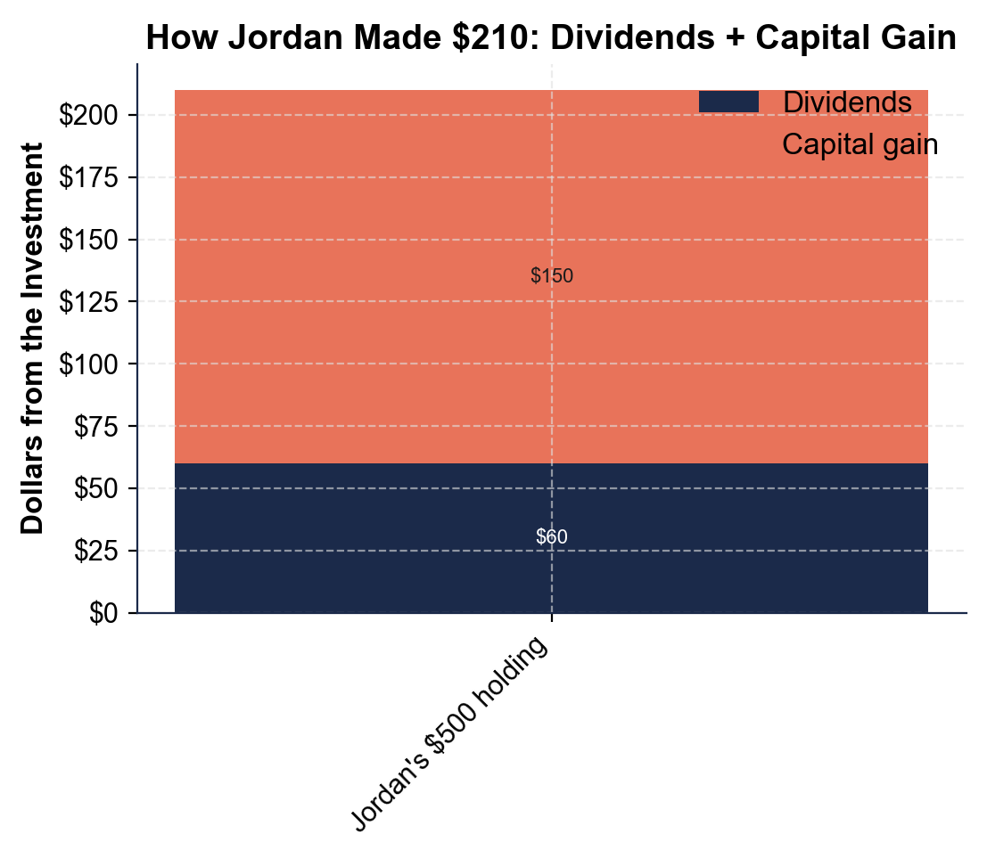
How Jordan Made $210: Dividends + Capital Gain
Jordan's $210 total return: $60 in dividends stacked under a $150 capital gain.
© More Lessons Less Planning | morelessonslessplanning.com
Notes:
Have students read the stacked bar chart. The single bar shows the total return on Jordan's one $500 holding, split into the two ways money was made. The bottom segment is DIVIDENDS: $60.00 collected over 3 years ($2 per share x 10 shares x 3 years). The top segment is the CAPITAL GAIN: $150.00 from selling 10 shares for $15 more than the $50 paid. Stacked together, the two segments reach the $210.00 TOTAL RETURN. The picture makes the lesson concrete: the two ways an investor makes money are not competing - they ADD together into the total return, and here the capital gain is the bigger slice while the dividends are the steady, smaller slice. On the $500 invested, that $210 is a 42% total return. This is the chart Activity Part 3 reads.
Reference labels (point to these chart features when teaching): Dividends: $60; Capital gain: $150 (of $210)

Slide 7
Dividends Explained
A dividend is your cut of the profit
A DIVIDEND is a share of the company's profit paid out to shareholders, usually a set amount per share, often every three months (quarterly)
✔
More shares = more dividend dollars
GreenLeaf pays $2.00 per share a year; Jordan's 10 shares collect $2 x 10 = $20 a year, or $60 over the 3 years held
✔
Dividend yield shows the income
DIVIDEND YIELD is the yearly dividend as a percent of what you paid: $20 a year on the $500 cost basis is a 4% dividend yield
✔
You keep dividends without selling
Dividends are income you collect while you still OWN the shares - unlike a capital gain, you do not have to sell to get them
✔
Key Concept: A DIVIDEND is your share of the company's profit, paid per share. Jordan's $20 a year on a $500 cost basis is a 4% DIVIDEND YIELD.
© More Lessons Less Planning | morelessonslessplanning.com
Notes:
Zoom in on the first way investors make money: DIVIDENDS. A dividend is a share of the company's profit paid out to its shareholders - the company earns money, and it hands some of that profit back to the people who own it. Dividends are usually paid as a set amount per share, and many companies pay them every three months (quarterly). The more shares you own, the more dividend dollars you collect: GreenLeaf Foods pays $2.00 per share each year, so Jordan's 10 shares collect $2 x 10 = $20 a year, which adds up to $60 over the 3 years Jordan holds the stock. Introduce DIVIDEND YIELD as a simple way to compare the income a stock pays: the dividend yield is the yearly dividend as a percent of what you paid. Jordan collects $20 a year on a $500 cost basis, which is $20 / $500 = 4%, a 4% dividend yield. The most important feature of dividends: you collect them while you STILL OWN the shares - you do not have to sell anything to get them, which makes dividends a source of steady income, unlike a capital gain that you only get when you sell. Note that not every company pays dividends; fast-growing companies often reinvest their profits instead, aiming to reward shareholders through a rising price (a capital gain) rather than cash payments.

Slide 8
Capital Gains Explained
A capital gain is your selling profit
A CAPITAL GAIN is the profit from selling an investment for MORE than you paid: (sell price - buy price) times the number of shares
✔
Jordan's capital gain
Jordan buys at $50, sells at $65 - a $15-per-share gain; across 10 shares: ($65 - $50) x 10 = $150 capital gain
✔
You lock it in only when you sell
Until you sell, a rising price is a 'paper' gain that can still fall; selling turns it into a real, locked-in capital gain
✔
Total return puts both together
TOTAL RETURN is the full amount an investment EARNED - the capital gain PLUS any dividends received; Jordan's $150 + $60 = $210 (42%)
✔
Key Concept: CAPITAL GAIN = (sell - buy) x shares = ($65 - $50) x 10 = $150. TOTAL RETURN = CAPITAL GAIN + DIVIDENDS = $150 + $60 = $210.
© More Lessons Less Planning | morelessonslessplanning.com
Notes:
Zoom in on the second way investors make money: CAPITAL GAINS. A capital gain is the profit from selling an investment for MORE than you paid for it. As a labeled model: CAPITAL GAIN = (sell price - buy price) x number of shares. Work Jordan's numbers: Jordan bought GreenLeaf Foods at $50 per share and sells at $65 per share, a $15-per-share increase; across all 10 shares that is ($65 - $50) x 10 = $15 x 10 = $150 capital gain. Stress the timing rule students most often miss: a capital gain is only real once you SELL. Until you sell, a rising price is just a 'paper' gain - the value on the screen - and it can still fall before you cash out. Selling is what turns a paper gain into a locked-in, real capital gain (and if the price had fallen below $50, selling would lock in a capital LOSS instead). Finally, bring the whole lesson together with the labeled model TOTAL RETURN = CAPITAL GAIN + DIVIDENDS. Jordan's total return is the $150 capital gain plus the $60 in dividends = $210. Measured against the $500 invested, that is a 42% total return. This is exactly the calculate-the-total-return work students do for Jordan in Part 4 of the activity.

Slide 9
Stock Prices Go Up AND Down
Prices move as people trade
The STOCK PRICE rises and falls all day as buyers and sellers trade; good news lifts it, bad news drops it - no price is guaranteed
Capital loss
A CAPITAL LOSS is the loss from selling for LESS than you paid; if a $40 stock falls to $34, selling 5 shares locks in a ($34 - $40) x 5 = -$30 loss
A stock is not guaranteed
Unlike a savings account, a stock can lose value; you can lose part or all of what you invested if the company does poorly
Time and spreading out lower the risk
Holding for the long run and spreading money across many stocks (not betting on one) smooths out the ups and downs over time
Key Concept: Stock prices go UP and DOWN, so a stock is not guaranteed. Selling for less than you paid is a CAPITAL LOSS - the opposite of a gain.
© More Lessons Less Planning | morelessonslessplanning.com
Notes:
Give students the honest, balanced picture of risk. The STOCK PRICE rises and falls all day long as buyers and sellers trade shares: good news about a company (strong sales, a new product) pushes the price up, and bad news pushes it down - no stock price is guaranteed to go anywhere. Introduce the mirror image of a capital gain: a CAPITAL LOSS is the loss you take when you sell an investment for LESS than you paid for it. Use a quick example (the same one students calculate in Part 4): if a stock bought at $40 falls to $34 and you sell 5 shares, the capital loss is ($34 - $40) x 5 = -$6 x 5 = -$30. Even a small dividend collected along the way may not cover a loss like that. Make the key contrast with earlier units explicit: unlike a savings account, which is guaranteed and insured, a stock can LOSE value, and you can lose part or even all of what you invested if the company does poorly. This is the trade-off for the higher long-run growth stocks can offer. Close on how investors manage this risk without giving up on stocks: holding for the long run (so short-term dips have time to recover) and spreading money across MANY different stocks instead of betting everything on one company both smooth out the ups and downs. The takeaway is not 'avoid stocks' but 'respect the risk and manage it with time and diversification.'

Slide 10
Buying Your First Share
The simple steps to buy a share
Smart first moves
Open a brokerage account: an app or website for buying and selling stocks
Add money, find the company by its ticker, choose an amount, and place the order
Fractional shares let you buy $10 of a $200 stock
Start small with money you will not need soon; stocks can dip
Spread money across companies instead of betting on one
Hold for years and reinvest dividends to grow ownership over time
Key Concept: To buy a share, open a brokerage account, add money, and place an order. Start small, spread it out, and plan to hold for the long run.
© More Lessons Less Planning | morelessonslessplanning.com
Notes:
End the lesson by making stock ownership feel doable, not intimidating. Walk the simple steps to buy a first share. First, open a BROKERAGE ACCOUNT - an app or website (a broker) that lets you buy and sell stocks; many are free to open and have no minimum. Second, add money to the account (transfer it from a bank account). Third, search for the company by its ticker symbol - a short code that identifies the stock - to find it. Fourth, choose how many shares to buy (or how many dollars to invest) and place the order. Point out a modern feature that lowers the barrier: many brokers now allow FRACTIONAL SHARES, so you can buy $10 worth of a $200 stock instead of needing the full $200 - you can start investing with almost any amount. On the right, give students the smart first moves that tie the whole lesson together: start SMALL with money you will not need soon (because stocks can dip in the short term), SPREAD your money across several different companies instead of betting everything on one (diversification lowers risk), plan to HOLD for years so the ups and downs have time to even out (connecting back to time in the market from the last toolkit), and REINVEST DIVIDENDS - use the dividend cash to buy more shares - which grows your ownership and your future dividends over time. The message: owning a piece of a company is within reach, and starting young and steady is the smart way in.

Slide 11
Key Takeaways
A STOCK is ownership of a small piece of a company; a SHARE is one unit of it
★
Buying a share makes you a SHAREHOLDER - a part-owner of the business
★
Two ways to make money: DIVIDENDS and CAPITAL GAINS (selling higher)
★
TOTAL RETURN = CAPITAL GAIN + DIVIDENDS: Jordan's $150 + $60 = $210 on $500
★
Stock prices go up AND down - a stock is NOT a guaranteed return
★
© More Lessons Less Planning | morelessonslessplanning.com
Notes:
Read each takeaway and connect it to the learning targets. T1 (explain a stock) -> a STOCK is ownership of a small piece of a company, and a SHARE is one unit of that ownership, so owning 10 shares means owning 10 pieces of the business. T1 (shareholder) -> buying a share makes you a SHAREHOLDER, a part-owner who shares in the company's profits and growth (and its risks). T2 (two ways to make money) -> investors make money two ways: DIVIDENDS, a share of the company's profit paid to shareholders while they hold ($60 for Jordan), and CAPITAL GAINS, the profit from selling for more than you paid ($150 for Jordan). T3 (calculate total return) -> the labeled model TOTAL RETURN = CAPITAL GAIN + DIVIDENDS gives Jordan $150 + $60 = $210 on the $500 invested, a 42% return. T4 (risk) -> stock prices go UP and DOWN as people trade, so a stock is not a guaranteed return - you can take a capital LOSS - but holding for the long run and spreading money across many stocks manages that risk. The spine of the lesson: a stock is a real piece of a real company, it can pay you two ways, and it rewards patient, spread-out ownership. As the third toolkit of Unit 6, this turns saving and compounding into owning.

