Slide 1
Stimulus Checks: Did They Actually Work?
Three checks, three recessions, one big question - did the cash actually help?
© More Lessons Less Planning | morelessonslessplanning.com
Notes:
Open with the headline question: did the 2008, 2020, and 2021 federal stimulus checks actually work? Frame the persona for the activity: students play Jordan Park, a junior Economist at the Council of Economic Advisers (CEA), preparing a retrospective briefing for the agency's senior staff. Today the class answers four questions: (1) WHAT was each check (size, eligibility, total cost); (2) HOW did the multiplier effect amplify them; (3) WHAT was the aggregate-demand impact computed via MPC; (4) DID they work - Keynesian defense vs saved-not-spent + inflation critique. Big idea: there is genuine disagreement among economists; we teach the disagreement, not a partisan side.

Slide 2
Learning Targets
Identify the three U.S. stimulus episodes (2008, 2020, 2021) by size and cost.
★
Explain the multiplier effect and the MPC formula.
★
Calculate aggregate-demand impact at different MPC values.
★
Evaluate the Keynesian defense vs the saved-not-spent + inflation critique.
★
© More Lessons Less Planning | morelessonslessplanning.com
Notes:
Read each target aloud and have students mark which one they feel LEAST confident about. Target 1 (identify the three episodes) is recall. Target 2 (multiplier effect) is the conceptual core - the formula 1 / (1 - MPC) is the load-bearing equation of the whole lesson. Target 3 (calculate at different MPC values) is the quantitative core - students will compute at MPC = 0.6 and MPC = 0.4. Target 4 (evaluate the debate) is the analytical synthesis - keep BOTH sides present, do not take a partisan side.

Slide 3
What Is a Stimulus Check and Why Send One
Direct cash payment from the federal government to households.
Goal: BOOST aggregate demand (C) when consumers cut spending.
Different from unemployment insurance - not tied to job loss.
Eligibility usually phases out above a household income threshold.
Key Concept: A stimulus check is FISCAL POLICY - cash from the federal government to consumers to raise aggregate demand in a recession.
© More Lessons Less Planning | morelessonslessplanning.com
Notes:
Define the term concretely. A stimulus check is FISCAL POLICY - the federal government raising the C component of aggregate demand directly by handing households cash. Contrast with monetary stimulus (the Fed cutting interest rates) and other fiscal tools (extended unemployment insurance, infrastructure spending). The phase-out matters: 2008 phased out for higher earners, 2020 phased out at $75K single / $150K married, 2021 ARP cut off sharply. Anchor the transfer-payment distinction: checks show up in personal income but only in GDP when actually spent.

Slide 4
The 2008 Bush Rebate (Economic Stimulus Act)
Per-adult check size
$600 per individual adult; $1,200 per married couple filing jointly; +$300 per qualifying child. Phased out for higher incomes.
Total federal cost
~$152 billion under the Economic Stimulus Act of 2008. Signed by President George W. Bush in February 2008.
Timing and economic context
Mailed May-July 2008 during the SLOW-DEVELOPING start of the 2008 recession - before the Lehman Brothers collapse in September.
Outcome
Recession deepened anyway - but research found 25-40% of the check was spent within 3 months, raising consumer spending modestly.
Big Idea: The 2008 checks were SMALL but COMPARATIVELY EFFECTIVE - sent during a slow recession, mostly spent within 3 months.
© More Lessons Less Planning | morelessonslessplanning.com
Notes:
Walk the four rows in order. (1) SIZE: $600 individual / $1,200 couple / +$300/child. Small by today's standards. (2) COST: ~$152B total, signed by Bush in February 2008. (3) TIMING: mailed May-July 2008, BEFORE the September Lehman collapse, during the slow first half of the recession. (4) OUTCOME: research (Parker, Souleles et al. 2013) found 25-40% spent within 3 months, raising consumer spending modestly. Recession deepened anyway because the bigger financial crisis hit in September. Note: this episode is the BASELINE comparison; students will measure 2020 and 2021 against it.

Slide 5
The 2020 CARES Act Checks
$1,200 per adult + $500 per child; signed March 27, 2020 by Trump.
Total cost ~$292 billion in checks (within a $2.2T rescue package).
Sent April-May 2020 during the SHARP COVID lockdown recession.
U.S. personal savings rate spiked to ~33% in April 2020 - much was saved.
Big Idea: The 2020 checks were LARGE and TIMELY - sent during a SHARP recession when 22M jobs vanished. Mixed evidence: spent or saved?
© More Lessons Less Planning | morelessonslessplanning.com
Notes:
The 2020 CARES checks are the strongest TEST CASE for stimulus. Sent during a 22-million-job sudden COVID-lockdown recession (April 2020 unemployment hit 14.7%, the worst since the Great Depression). Per-adult amount = $1,200, twice the 2008 amount. Per-child = $500. Total check cost ~$292B (part of the larger $2.2T CARES rescue package). BUT: U.S. personal savings rate spiked to ~33% in April 2020 (vs ~7% pre-pandemic), evidence that households SAVED much of the check rather than spending it. The 'did it work' verdict depends on whether you measure consumer spending (mixed) or prevented poverty / prevented default (strong evidence yes).

Slide 6
The 2021 American Rescue Plan Checks
Per-adult check size
$1,400 per adult + $1,400 per child. Signed March 11, 2021 by President Joe Biden. Per-child amount nearly tripled from 2020's $500.
Total federal cost
~$402 billion in checks (within a $1.9 trillion ARP rescue package). Largest single round of stimulus checks in U.S. history.
Timing and economic context
Sent March-April 2021 during the REOPENING - after vaccines were rolling out and consumer spending had already started recovering.
Inflation critique
Critics (Summers, Blanchard) tie this round to the 2021-22 inflation surge. CPI peaked at 9.1% in June 2022, highest in 40 years.
Big Idea: 2021 ARP = LARGEST EVER at $1,400 per adult and $1,400 per child. Sent AFTER vaccines. Critics tie it to 2021-22 inflation.
© More Lessons Less Planning | morelessonslessplanning.com
Notes:
The 2021 ARP checks are the LARGEST stimulus checks in U.S. history at $1,400 per adult + $1,400 per child (note: per-child amount nearly tripled from 2020's $500). A family of four received $5,600 in 2021 vs $3,400 in 2020. Total check cost ~$402B (part of the larger $1.9T ARP rescue package). Sent March-April 2021 - AFTER vaccines were rolling out and consumer spending had already started recovering. Critics (including Larry Summers and Olivier Blanchard) argue this round was too large and too late, contributing to the 2021-22 inflation surge. CPI peaked at 9.1% in June 2022. Defenders argue inflation came from supply-chain disruptions and energy shocks, not stimulus. Keep BOTH sides present.

Slide 7
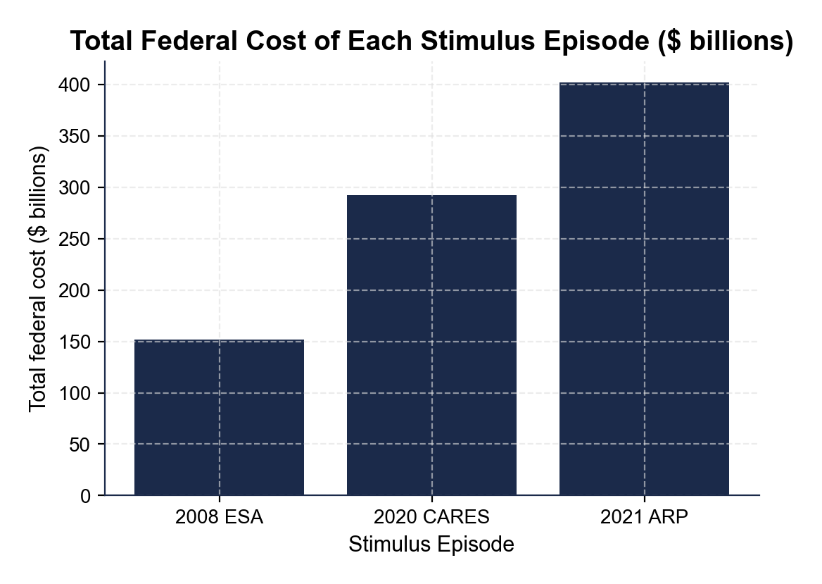
Total Federal Cost of Each Stimulus Episode
Fact: 2021 ARP at ~$402B was more than 2.5x the 2008 ESA at ~$152B.
© More Lessons Less Planning | morelessonslessplanning.com
Notes:
Have students read each total cost off the bar chart: $152B (2008), $292B (2020), $402B (2021). Anchor: the 2021 ARP at $402B was more than 2.5x the 2008 ESA at $152B. Even adjusting for inflation, the 2021 episode was the largest in real terms. Combined federal cost across all three episodes ~$846B. Connect to the multiplier-effect lesson: at MPC = 0.6, the combined stimulus had a theoretical aggregate-demand impact of ~$846B x 2.5 = ~$2.1 trillion. At MPC = 0.4, ~$1.4 trillion. Whether the realized impact matched the theory is the central debate.
Reference labels (point to these chart features when teaching): 2008 ESA: ~$152B; 2021 ARP: ~$402B

Slide 8
The Multiplier Effect - How MPC Amplifies Stimulus
MPC (marginal propensity to consume) = share of an extra $1 a household SPENDS.
Multiplier formula: 1 / (1 - MPC). At MPC = 0.6, multiplier = 2.5.
Worked example: $1,000 -> $600 -> $360 -> ... -> $2,500 total at MPC = 0.6.
Higher MPC = bigger multiplier; lower MPC (more saving) = smaller multiplier.
Key Concept: Multiplier = 1 / (1 - MPC). At MPC = 0.6, every $1 of stimulus generates $2.50 in total economic activity across all spending rounds.
© More Lessons Less Planning | morelessonslessplanning.com
Notes:
This is the MOST IMPORTANT conceptual slide of the lesson. Walk the multiplier carefully. MPC = the fraction of an additional dollar a household spends (not saves). MPC is a number between 0 and 1. Higher for lower-income households (who have less ability to save). The multiplier formula is 1 / (1 - MPC). At MPC = 0.6, multiplier = 1 / 0.4 = 2.5. At MPC = 0.4, multiplier = 1 / 0.6 = ~1.67. At MPC = 0.8, multiplier = 5. Practice with two values on the board before showing the chart on the next slide. The logic: I receive $1, spend $0.60. The store owner receives $0.60, spends $0.60 x 0.60 = $0.36. The next person spends $0.60 x $0.36 = $0.216. And so on. The infinite sum is $1 / (1 - 0.6) = $2.50.

Slide 9
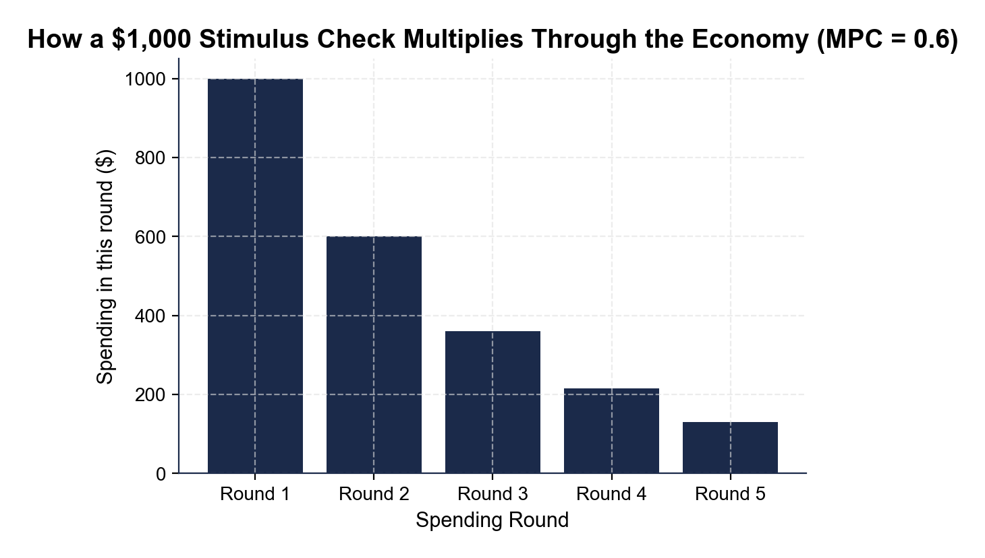
How a $1,000 Stimulus Check Multiplies (MPC = 0.6)
Fact: Round 1 $1,000 -> Round 2 $600 -> Round 3 $360 -> Total $2,500 at MPC=0.6.
© More Lessons Less Planning | morelessonslessplanning.com
Notes:
Have students read each round off the chart: Round 1 = $1,000, Round 2 = $600, Round 3 = $360, Round 4 = $216, Round 5 = $130. Each round is 60% of the prior round (because MPC = 0.6). The infinite sum across all rounds = $1,000 / (1 - 0.6) = $2,500. The bars decrease in height because each round transfers only 60% of the prior round's spending. Practice the same chart at MPC = 0.4 on the board: Round 1 = $1,000, Round 2 = $400, Round 3 = $160, Round 4 = $64, Round 5 = $26. Infinite sum = $1,000 / 0.6 = ~$1,667. Connect to Part 3 of the activity: students will redo this calculation for $1,400 ARP checks at three different MPC values.
Reference labels (point to these chart features when teaching): Round 1: $1,000; Round 5: $130

Slide 10
Did Stimulus Work? The Keynesian Defense
Prevented collapse
2020 GDP fell 8.4% in Q2 then SNAPPED BACK to grow 7.9% in Q3 - the fastest recovery in modern U.S. history. Keynesians credit stimulus.
Cut child poverty in half
Census Bureau: 2021 ARP checks plus expanded Child Tax Credit cut U.S. child poverty rate from 9.7% to 5.2% in one year.
Spending rose where checks went
Studies (Chetty et al., Baker et al.) found within-week spikes in consumer spending in zip codes where checks were deposited.
Multiplier worked
JP Morgan, Goldman, and CBO estimates put the multiplier on 2020-21 checks around 1.5-2.0 - meaning each $1 raised GDP by $1.50-$2.00.
Big Idea: The Keynesian defense - the checks PREVENTED a deeper recession, CUT child poverty in half, multiplier ~1.5-2.0.
© More Lessons Less Planning | morelessonslessplanning.com
Notes:
Walk the four pieces of Keynesian evidence in order. (1) PREVENTED COLLAPSE: 2020 Q2 GDP fell 8.4%, then Q3 snapped back 7.9% - the fastest recovery in modern U.S. history. Keynesians credit fiscal stimulus including the CARES checks. (2) CUT CHILD POVERTY IN HALF: per Census Bureau, the 2021 ARP checks combined with the expanded Child Tax Credit cut the U.S. child poverty rate from 9.7% to 5.2% in 2021. (3) SPENDING ROSE: Chetty et al. (Opportunity Insights) and Baker et al. found within-week consumer spending spikes in zip codes where checks were deposited. (4) MULTIPLIER WORKED: JP Morgan, Goldman, and CBO put the realized multiplier around 1.5-2.0. Important framing: the answer depends on the counterfactual. Compared to no stimulus, the checks unambiguously helped. Compared to perfect stimulus, they had problems - which is what the next slide covers.

Slide 11
Did Stimulus Work? The Saved-Not-Spent + Inflation Critique
Savings rate spiked
U.S. personal savings rate jumped from ~7% (pre-pandemic) to ~33% in April 2020. Households SAVED much of the 2020 CARES checks instead of spending them.
Lower-than-expected MPC
Research found MPC for 2020 checks was ~0.3 (lower than the 2008 estimate of 0.3-0.4 - the recession was so abrupt households couldn't spend).
2021-22 inflation
Critics (Summers, Blanchard) argue the 2021 ARP was too large + too late, pushing demand above supply capacity. CPI peaked at 9.1% in June 2022.
Imperfect targeting
2020-21 checks went to many households that DID NOT need them (jobs intact, savings rose). Targeted unemployment insurance had a higher MPC.
Big Idea: The critique - much of the 2020 cash was SAVED, not spent. The 2021 ARP was too large and likely fed 2021-22 inflation.
© More Lessons Less Planning | morelessonslessplanning.com
Notes:
Walk the four critique points in order. (1) SAVINGS RATE SPIKED: from ~7% pre-pandemic to ~33% in April 2020 - a record-high level. Households SAVED much of the 2020 checks. (2) LOWER MPC: research (Coibion-Gorodnichenko, Karger-Rajan, and others) found the realized MPC on 2020 checks was around 0.3 - lower than expected, because the lockdown made it impossible to spend on travel, restaurants, services. (3) INFLATION CRITIQUE: Larry Summers (Feb 2021 op-ed in WaPo) and Olivier Blanchard publicly argued the 2021 ARP was too large for a recovering economy. CPI peaked at 9.1% in June 2022, the highest in 40 years. (4) IMPERFECT TARGETING: 2020-21 checks went to many households that did not lose income. Targeted unemployment insurance (also part of CARES + ARP) had higher MPC. Stress: both sides agree the checks reduced poverty. They disagree about whether stimulus was the optimal TOOL or whether targeted UI + business loans would have done more per dollar.

Slide 12
Verdict: What Does the Evidence Support?
2008 ESA: Modestly helpful. MPC ~0.3-0.4. Didn't stop the 2008 crash.
2020 CARES: Strong evidence YES on poverty + cash-flow; mixed on spending.
2021 ARP: Cut child poverty in half BUT likely contributed to 2021-22 inflation.
OVERALL: Imperfect tool, but better than no stimulus at all.
Key Concept: The honest answer is 'YES, BUT' - checks DO raise spending and cut poverty, but SIZE and TIMING matter enormously.
© More Lessons Less Planning | morelessonslessplanning.com
Notes:
Walk the verdict episode-by-episode. (1) 2008 ESA: modestly helpful. MPC around 0.3-0.4. Didn't stop the recession but raised consumer spending at the margin. (2) 2020 CARES: strong evidence YES on poverty reduction and cash-flow protection; mixed evidence on spending because of the savings spike. (3) 2021 ARP: cut child poverty in half (9.7% to 5.2%) BUT likely contributed to 2021-22 inflation. CPI peaked at 9.1%. (4) OVERALL: imperfect tool, but better than no stimulus. The honest verdict is 'YES, BUT' - the checks did raise spending and cut poverty, but the SIZE and TIMING matter. Stimulus during a DEEP recession (2020) is more effective than stimulus during a RECOVERY (2021). Reinforce: this is the kind of question where reasonable economists disagree. Teach the disagreement.

Slide 13
Key Takeaways
Three episodes: 2008 ($600), 2020 ($1,200), 2021 ($1,400) - growing in size.
Multiplier = 1 / (1 - MPC). At MPC = 0.6, $1 of stimulus -> $2.50 spending.
Defense: prevented collapse, cut child poverty in half, multiplier 1.5-2.0.
Critique: savings spike, lower MPC than expected, 2021 ARP fed inflation.
Takeaway: Stimulus checks are a TOOL with TRADE-OFFS - boost demand fast but can overshoot if timed wrong. YES with caveats.
© More Lessons Less Planning | morelessonslessplanning.com
Notes:
Recap the lesson in four bullets. (1) THREE EPISODES: 2008 ($600/adult, $152B total), 2020 ($1,200/adult, $292B total), 2021 ($1,400/adult, $402B total). Growing in size over time. (2) MULTIPLIER: 1 / (1 - MPC). At MPC = 0.6, $1 stimulus produces $2.50 spending. (3) DEFENSE: prevented Q2-2020 collapse from extending into 2021, cut child poverty in half, multiplier 1.5-2.0. (4) CRITIQUE: savings spike to 33% in April 2020, lower MPC than expected (~0.3), 2021 ARP likely contributed to 2021-22 inflation. Close with the voting connection: every recession produces a new stimulus debate. Knowing the size, the multiplier formula, and the both-sides case is the way to read the headlines next time.

