Slide 1
Sparks of the Industrial Revolution
Why Britain, with its coal, capital, and steam power, became the birthplace of the machine age
© More Lessons Less Planning | morelessonslessplanning.com
Notes:
Open with the lesson question: why did the Industrial Revolution begin in Britain and not somewhere else? Preview the answer: coal, iron, farm surplus, capital, colonial markets, and stable government all came together in Britain, and the steam engine tied them into a system of machine production.

Slide 2
Learning Targets
Explain what the Industrial Revolution was and why it began in Britain
★
Identify Britain's advantages in coal, iron, farming, capital, and markets
★
Explain how the Agricultural Revolution and enclosure freed labor for factories
★
Describe how James Watt's steam engine and the factory system changed work
★
Explain how the division of labor multiplied output in Smith's pin factory
★
© More Lessons Less Planning | morelessonslessplanning.com
Notes:
The five targets keep the lesson centered on what the Industrial Revolution was, Britain's preconditions, the freeing of farm labor, the steam engine and factory system, and the division of labor.

Slide 3
What Was the Industrial Revolution?
It was the shift from making goods by hand to making them by machine.
It began in Britain around 1760 and then spread across the world.
Goods once made slowly at home were now mass-produced in factories.
New machines powered by coal and steam did work that once took many hands.
This change transformed how people worked, traveled, and lived.
Key Concept: The Industrial Revolution was the shift, beginning in Britain around 1760, from making goods by hand to making them by machine.
© More Lessons Less Planning | morelessonslessplanning.com
Notes:
The Industrial Revolution was a shift from making goods by hand to making them by machine, and it began in Britain around 1760 before spreading across the world. Goods that were once made slowly at home were now mass-produced in factories. New machines powered by coal and steam did work that once took many hands, and this change transformed how people worked, traveled, and lived.

Slide 4
Why Britain? The Preconditions Come Together
What Britain Had
Why It Mattered
Britain had large supplies of coal and iron to fuel and build machines
Its farms produced more food with fewer workers, freeing people for factory work
Wealthy banks and investors had capital to build new factories
Colonies and trade gave Britain raw materials and markets to sell goods in
Stable government and property laws made business safe to invest in
No single cause was enough; Britain had all of them at once
Key Concept: Britain industrialized first because coal, iron, farm surplus, capital, markets, and stable government all came together at once.
© More Lessons Less Planning | morelessonslessplanning.com
Notes:
Britain industrialized first because several advantages came together in one place. It had large supplies of coal and iron to fuel and build machines, and its farms produced more food with fewer workers, freeing people for factory work. Wealthy banks and investors had capital to build new factories, colonies and trade gave Britain raw materials and markets to sell goods in, and a stable government with property laws made business safe to invest in. No single cause was enough on its own; Britain had all of them at once.

Slide 5
Coal and Iron: Fuel and Materials
Britain sat on huge deposits of coal, the fuel that powered the revolution.
Coal was burned to heat furnaces and to drive steam engines later on.
Iron was smelted from British ore using coal in giant furnaces.
Iron was the strong metal used to build machines, engines, and rails.
Together, cheap coal and iron gave Britain the raw power of industry.
Key Concept: Coal was the fuel and iron was the building material; Britain's rich supplies of both gave it the raw power to industrialize first.
© More Lessons Less Planning | morelessonslessplanning.com
Notes:
Britain sat on huge deposits of coal, the fuel that powered the revolution. Coal was burned to heat furnaces and, later, to drive steam engines. Iron was smelted from British ore using coal in giant furnaces, and iron was the strong metal used to build machines, engines, and rails. Together, cheap coal and iron gave Britain the raw power of industry.

Slide 6
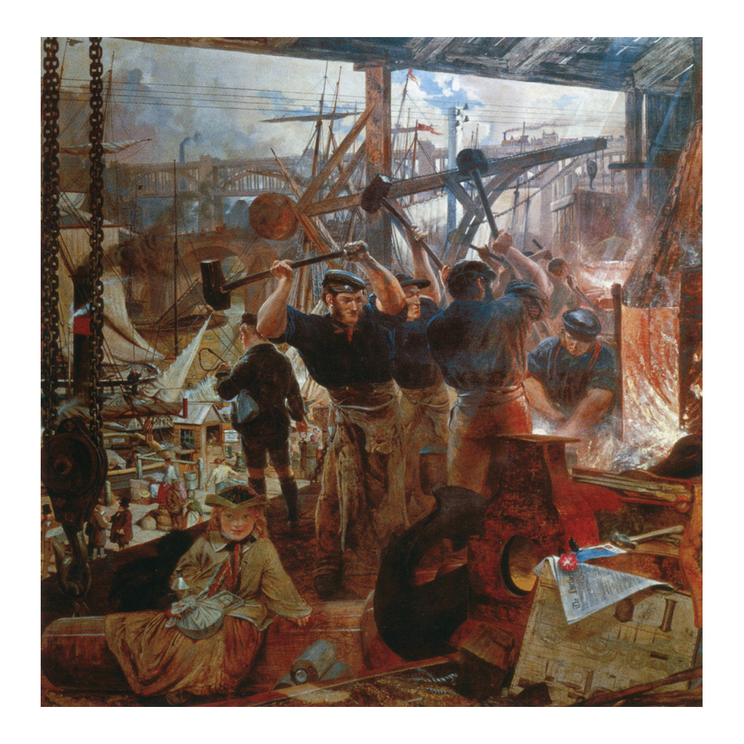
A Scene of British Industry
Iron and Coal (1861) by William Bell Scott, a scene of British industry
© More Lessons Less Planning | morelessonslessplanning.com
Notes:
This is a period painting of British industry showing iron work, coal, and steam power. Use it as a reference image to picture the age of coal and iron, not as evidence for any specific claim.

Slide 7
The Agricultural Revolution Frees Labor
Better Farming
The Enclosure Movement
New tools, crops, and methods grew far more food than before
Fewer farm workers were now needed to feed the whole country
This left many rural workers without steady farm jobs
Landowners fenced off shared farmland into private fields, called enclosure
Families who once farmed common land were pushed off it
These workers moved to cities, becoming labor for the new factories
Key Concept: The Agricultural Revolution grew more food with fewer workers, and enclosure pushed families into the cities to become factory labor.
© More Lessons Less Planning | morelessonslessplanning.com
Notes:
The Agricultural Revolution used new tools, crops, and methods to grow far more food than before, so fewer farm workers were needed to feed the whole country, leaving many rural workers without steady farm jobs. At the same time, landowners fenced off shared farmland into private fields, a change called enclosure. Families who once farmed common land were pushed off it, and these displaced workers moved to the cities, becoming the labor force for the new factories.

Slide 8
Capital, Banking, and Colonial Markets
Money to Invest
Raw Materials and Markets
Britain's banks and wealthy investors had capital to risk on new businesses
Investors used capital to build factories and to buy new machines
A stable government and clear property laws made investment safe
Britain's colonies supplied cotton, sugar, and other raw materials
A worldwide empire gave British goods huge markets to sell in
Trade profits flowed back to fund even more factories
Key Concept: British capital built the factories, while colonies supplied raw materials and provided markets to sell the finished goods.
© More Lessons Less Planning | morelessonslessplanning.com
Notes:
Britain's banks and wealthy investors had capital, the money to risk on new businesses, and they used it to build factories and buy new machines. A stable government and clear property laws made that investment safe. At the same time, Britain's colonies supplied cotton, sugar, and other raw materials, and a worldwide empire gave British goods huge markets to sell in. Trade profits flowed back to fund even more factories.

Slide 9
The Steam Engine: Watt's Accelerant
Early machines depended on water wheels and had to sit beside rivers.
The steam engine burned coal to create power anywhere it was needed.
James Watt, a Scottish engineer, greatly improved the steam engine.
Watt's engine was more efficient and reliable, using far less coal.
Steam power let factories be built anywhere, not just next to rivers.
Key Concept: James Watt's improved steam engine burned coal to power machinery anywhere, freeing factories from rivers.
© More Lessons Less Planning | morelessonslessplanning.com
Notes:
Early machines depended on water wheels and so had to sit beside rivers. The steam engine changed that by burning coal to create power anywhere it was needed. James Watt, a Scottish engineer, greatly improved the steam engine in the 1760s and 1770s, making it more efficient and reliable while using far less coal. With steam power, factories could be built anywhere, not just next to rivers, which accelerated the whole revolution.

Slide 10
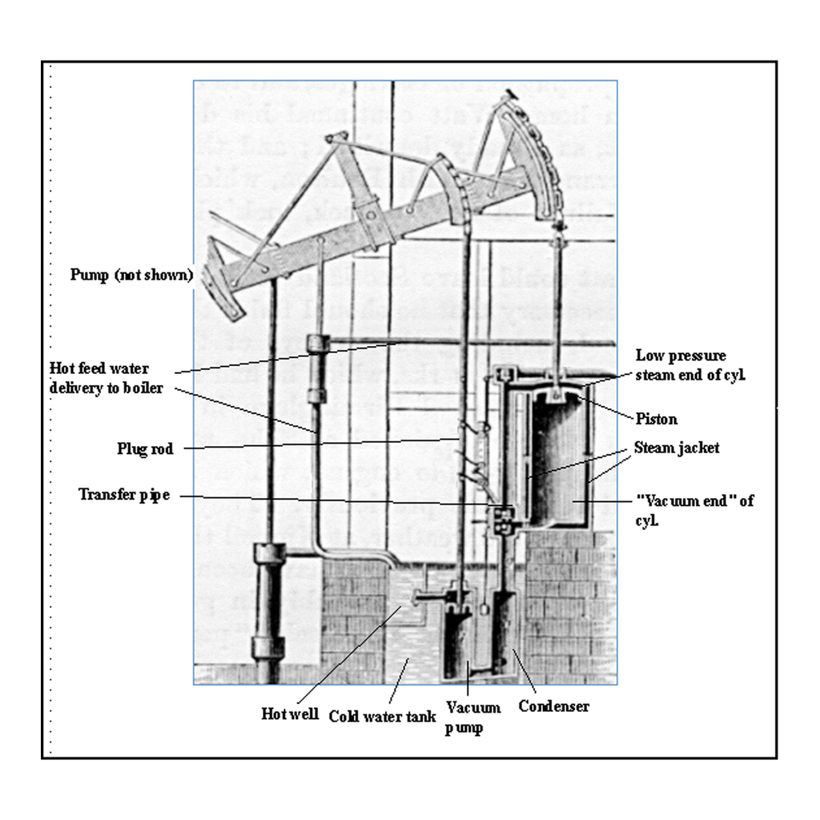
An Early Steam Engine
An early steam engine of the kind improved by James Watt.
© More Lessons Less Planning | morelessonslessplanning.com
Notes:
This is an illustration of an early steam engine of the kind improved by James Watt. Use it as a reference image to picture the machine that powered the revolution, not as evidence for any specific claim.

Slide 11
The Factory System and Textiles
The Factory System
The First Factories: Textiles
The factory system brought workers and machines together under one roof
Instead of working at home, people now worked in large factories
Machines set the pace, and work ran by the clock and the whistle
Textiles, the making of cloth, led the way into the factory age
Machines like the spinning jenny and power loom made cloth quickly
One factory could now produce more cloth than a whole village once did
Key Concept: The factory system gathered workers and machines under one roof, and textile mills making cloth were the first great factories.
© More Lessons Less Planning | morelessonslessplanning.com
Notes:
The factory system brought many workers and machines together under one roof, so instead of working at home, people now worked in large factories where machines set the pace and work ran by the clock and the whistle. Textiles, the making of cloth, led the way into the factory age. Machines like the spinning jenny and the power loom made cloth quickly, so that one factory could produce more cloth than a whole village once did.

Slide 12
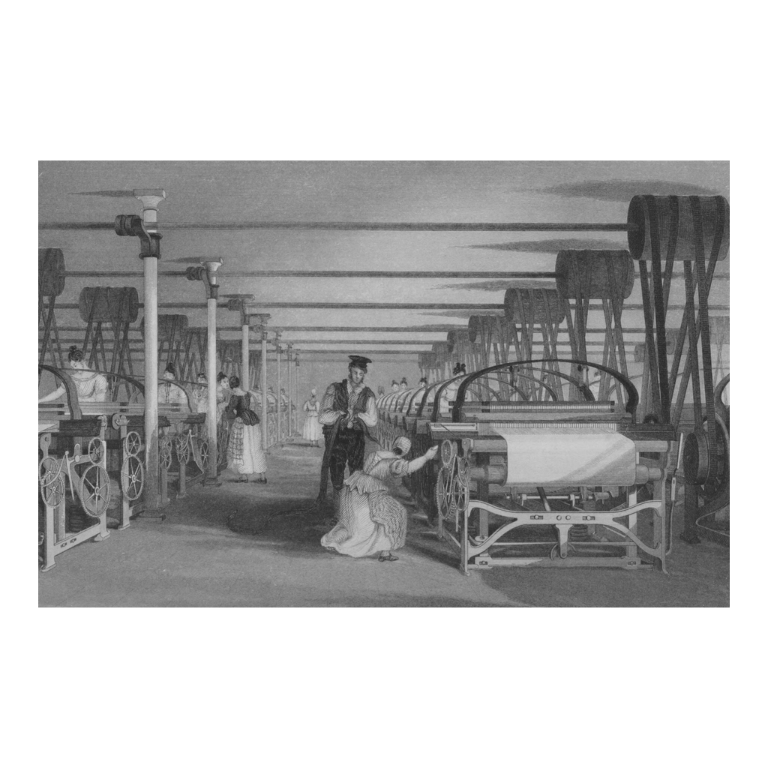
A Textile Mill
Power-loom weaving in a textile mill, an 1835 engraving
© More Lessons Less Planning | morelessonslessplanning.com
Notes:
This is an 1835 engraving of a power-loom weaving shed in a textile mill. Use it as a reference image to picture the first factories, not as evidence for any specific claim.

Slide 13
The Division of Labor and Adam Smith
Factories also changed how work was done, not just where it happened.
The division of labor breaks a job into small, specialized steps.
Each worker repeats one step, so the whole group produces far more.
In 1776 Adam Smith described this in his book The Wealth of Nations.
His famous pin factory showed how specialization multiplies output.
Key Concept: The division of labor breaks a job into small, repeated steps so workers produce far more, as Adam Smith showed with his pin factory.
© More Lessons Less Planning | morelessonslessplanning.com
Notes:
Factories also changed how work was done, not just where it happened. The division of labor breaks a job into small, specialized steps, so that each worker repeats one step and the whole group produces far more than they could alone. In 1776 Adam Smith described this in his book The Wealth of Nations, and his famous pin factory showed how specialization multiplies output. This is the reading you will analyze in the Primary Source Spotlight.

Slide 14
Why It Started in Britain
All the Pieces in One Place
A World Transformed
Coal, iron, capital, workers, and markets all came together in Britain
No rival country had every one of these at the same time
The steam engine tied them together into a system of machine production
Britain became the first industrial nation and the workshop of the world
Industrialization later spread to Europe, the United States, and beyond
It reshaped work, cities, and daily life for generations to come
Key Concept: Britain industrialized first because coal, iron, capital, labor, markets, and steam power all came together there.
© More Lessons Less Planning | morelessonslessplanning.com
Notes:
Britain industrialized first because coal, iron, capital, workers, and markets all came together there, and no rival country had every one of these advantages at the same time. The steam engine tied them together into a system of machine production. Britain became the first industrial nation and the workshop of the world, and industrialization later spread to Europe, the United States, and beyond, reshaping work, cities, and daily life for generations to come.

Slide 15
Reference Guide: The Change and Its Materials
Industrial Revolution
The shift in Britain, around 1760, from making goods by hand to by machine.
coal
The fossil fuel, plentiful in Britain, burned for steam engines and to smelt iron.
iron
The strong metal, smelted from British ore, used to build machines and engines.
Agricultural Revolution
Farming gains that grew more food with fewer workers, freeing factory labor.
enclosure
Fencing shared farmland into private fields, pushing rural workers to cities.
Tip: These five terms name the change itself, its two raw materials, the farm boom, and the land change that sent workers to the cities.
© More Lessons Less Planning | morelessonslessplanning.com
Notes:
Review the first five terms exactly as defined: the Industrial Revolution, coal, iron, the Agricultural Revolution, and enclosure. Students use these definitions to complete the Reference Guide in the Activity.

Slide 16
Reference Guide: The Machine, the Mill, and the Method
capital
The money Britain's banks and investors supplied to build factories.
steam engine
The coal-powered machine, improved by James Watt, that ran factory machinery.
James Watt
The Scottish engineer who improved the steam engine to be efficient and reliable.
factory system
Bringing many workers and machines together in one building to make goods.
division of labor
Splitting a job into small, specialized steps so workers produce far more.
Tip: These five terms name the money, the machine, the inventor, the workplace, and the work method that drove industry.
© More Lessons Less Planning | morelessonslessplanning.com
Notes:
Review the next five terms exactly as defined: capital, the steam engine, James Watt, the factory system, and the division of labor. Students use these definitions to complete the Reference Guide in the Activity.

Slide 17
Key Takeaways
Goods shifted from hand-made to machine-made, starting in Britain around 1760.
★
Britain had coal, iron, capital, markets, and stable government all at once.
★
The Agricultural Revolution and enclosure freed workers for the new factories.
★
James Watt's steam engine powered factories anywhere, not just beside rivers.
★
The factory system and division of labor multiplied how much workers produced.
★
Adam Smith's pin factory showed ten workers making about 48,000 pins a day.
★
© More Lessons Less Planning | morelessonslessplanning.com
Notes:
Close with the essential question of why the Industrial Revolution began in Britain. Each takeaway connects the definition, Britain's advantages, the freeing of farm labor, the steam engine, the factory system and division of labor, and Adam Smith's pin factory.

