Slide 1
Songhai and Timbuktu Scholarship
How Songhai's Askia Muhammad made Timbuktu a world center of Islamic learning and books.
© More Lessons Less Planning | morelessonslessplanning.com
Notes:
Opening slide. In the late 1400s and early 1500s the West African empire of Songhai, and above all its ruler Askia Muhammad, turned the city of Timbuktu into one of the great centers of Islamic scholarship and manuscript culture in the medieval world. Set the frame from the first minute, in a respectful, academic tone: this is the history of a real and thriving center of learning, and we describe it accurately. Two honest anchors run through the whole lesson. First, Timbuktu was under SONGHAI (not Mali) at its scholarly height - Mali came first, and Timbuktu passed from Mali to Songhai in 1468. Second, our most famous outside description comes from Leo Africanus, a well-traveled North African who visited Timbuktu and later wrote about it as an OUTSIDE observer, not a Songhai insider. The payoff: a West African city became famous across the Islamic world for its scholars, its schools, and a book trade so rich that manuscripts sold for more than almost any other goods.

Slide 2
Learning Targets
Explain how Songhai rose after Mali and how Askia Muhammad supported learning.
★
Describe Timbuktu and the Sankore complex as a center of scholarship.
★
Explain Timbuktu's manuscript and book trade and what scholars studied.
★
Analyze Leo Africanus's account and explain how the golden age ended.
★
© More Lessons Less Planning | morelessonslessplanning.com
Notes:
Read the four learning targets. Keep two anchors in mind throughout. First, we treat this as the achievement of a real West African empire, described accurately: Timbuktu flourished under SONGHAI, whose ruler Askia Muhammad was a devout Muslim and a patron of learning. Second, we read our main outside source - Leo Africanus's description of Timbuktu - critically, remembering that he was a visitor writing from memory, not a Songhai insider. Pay special attention to target three (the manuscript and book trade), because the idea that books were among the most valuable goods in the city is the memorable hook of the lesson, and to target four (Leo Africanus and the 1591 fall), because that source and that ending are what students analyze and explain in the activity.

Slide 3
The Rise of Songhai
After Mali
Songhai takes Timbuktu
The empire of Songhai rose after Mali in the western Sahel.
Songhai took over Mali's lands, cities, and trade routes.
It became the largest of the West African empires.
In 1468 the conqueror Sunni Ali took Timbuktu from Mali.
Timbuktu now passed under Songhai control, not Mali.
Its golden age of scholarship belongs to Songhai.
Key Concept: SONGHAI rose after Mali and controlled Timbuktu at the height of its scholarship; Timbuktu passed from Mali to Songhai in 1468.
© More Lessons Less Planning | morelessonslessplanning.com
Notes:
Start by placing the empire. SONGHAI was the West African empire that rose after Mali in the western Sahel - the belt of grassland just south of the Sahara - and it grew into the largest of the three great empires of the region. Make the sequence clear and accurate: Ghana came first, then Mali, then SONGHAI; do not blur them together. Songhai took over the lands, cities, and trans-Saharan trade routes that Mali had held. The key city for our lesson, TIMBUKTU, had grown famous under Mali, but in 1468 the Songhai conqueror Sunni Ali captured it - so Timbuktu passed from Mali to Songhai control. This matters for accuracy: Timbuktu's greatest golden age of scholarship, the one this lesson is about, belongs to SONGHAI, not to Mali. This is the empire whose ruler, Askia Muhammad, would make Timbuktu a world center of learning.

Slide 4
Askia Muhammad, Patron of Learning
A devout Muslim ruler
A patron of scholars
Askia Muhammad ruled Songhai from 1493 to 1528.
He was a devout Muslim who made the Hajj to Mecca.
He governed Songhai at the height of its power.
A patron is a supporter who funds and protects scholars.
Askia Muhammad invited and paid learned men in Timbuktu.
His support made scholarship in Timbuktu flourish.
Key Concept: ASKIA MUHAMMAD (r.1493-1528), a devout Muslim who made the HAJJ, was a PATRON of learning who made Timbuktu's scholarship flourish.
© More Lessons Less Planning | morelessonslessplanning.com
Notes:
Now the ruler at the center of the lesson. ASKIA MUHAMMAD ruled Songhai from 1493 to 1528, at the height of its power. Like Mansa Musa of Mali before him, he was a devout MUSLIM, and his faith led him to make the HAJJ - the pilgrimage to Mecca that every able Muslim tries to make at least once - which he did in 1496-97. Just as important for this lesson, Askia Muhammad acted as a PATRON of learning. A patron is a wealthy or powerful supporter who funds and protects scholars - paying their salaries, building schools, and inviting learned men to settle. Askia Muhammad invited scholars, judges, and teachers to Timbuktu, supported them at his own expense, and built up its schools and libraries. Present his faith factually and respectfully: his religion and his role as a patron of Islamic learning are the reasons Timbuktu's scholarship reached its height under his rule.

Slide 5
Timbuktu Under Songhai
A famous city of learning
Timbuktu became one of the great centers of Islamic scholarship in the medieval world.
✔
A crossroads of trade
It sat where the Sahara caravan routes met the Niger River, bringing wealth and travelers.
✔
Scholars follow the wealth
The city's wealth, and Askia Muhammad's support, drew scholars, judges, and teachers.
✔
Key Concept: Under Songhai, TIMBUKTU became one of the great centers of Islamic scholarship and manuscript culture in the medieval world.
© More Lessons Less Planning | morelessonslessplanning.com
Notes:
Now the city itself. TIMBUKTU sat at a crossroads where the trans-Saharan caravan routes met the Niger River, so goods, gold, salt, and travelers flowed through it - which made it rich. Under SONGHAI, and especially under Askia Muhammad's patronage, that wealth turned into something more: Timbuktu became one of the great centers of Islamic SCHOLARSHIP and manuscript culture in the whole medieval world. Its wealth and its ruler's support drew scholars, judges, and teachers from across the Islamic world to live, teach, and study there. Be accurate and respectful about the scale of the achievement: this was a genuine, thriving intellectual center in West Africa, famous far beyond the Sahara - not a legend but a documented reality, confirmed today by the tens of thousands of surviving Timbuktu manuscripts.

Slide 6
The Sankore Complex
The heart of learning
A network, not one university
Sankore was a mosque-and-school complex in Timbuktu.
Scholars taught students in its courtyards and nearby homes.
It was the most famous center of study in the city.
Sankore was a network of scholars and mosque schools.
It was NOT a single modern-style university building.
Teaching happened around teachers, not a fixed campus.
Key Concept: SANKORE was Timbuktu's mosque-and-school complex - a NETWORK of scholars and schools, not a single modern university.
© More Lessons Less Planning | morelessonslessplanning.com
Notes:
Now the physical heart of Timbuktu's scholarship, with an honesty anchor built in. SANKORE was a mosque in Timbuktu, and around it grew the city's most famous center of study - what is often called the University of Sankore. Scholars taught circles of students in its courtyards, in nearby homes, and in other mosque schools around the city. Here is the honest anchor: the Sankore 'university' was NOT a single modern-style institution with one campus, a fixed faculty, and printed diplomas. It was a NETWORK of individual scholars and mosque schools, where learning gathered around respected teachers - a student studied with a particular master and earned recognition from him. That is still a remarkable achievement: a rich, organized culture of higher learning centered on Sankore. Keep the description accurate - impressive and real, but a network of scholars and schools rather than a modern university. The next slide shows the Sankore Mosque itself.

Slide 7
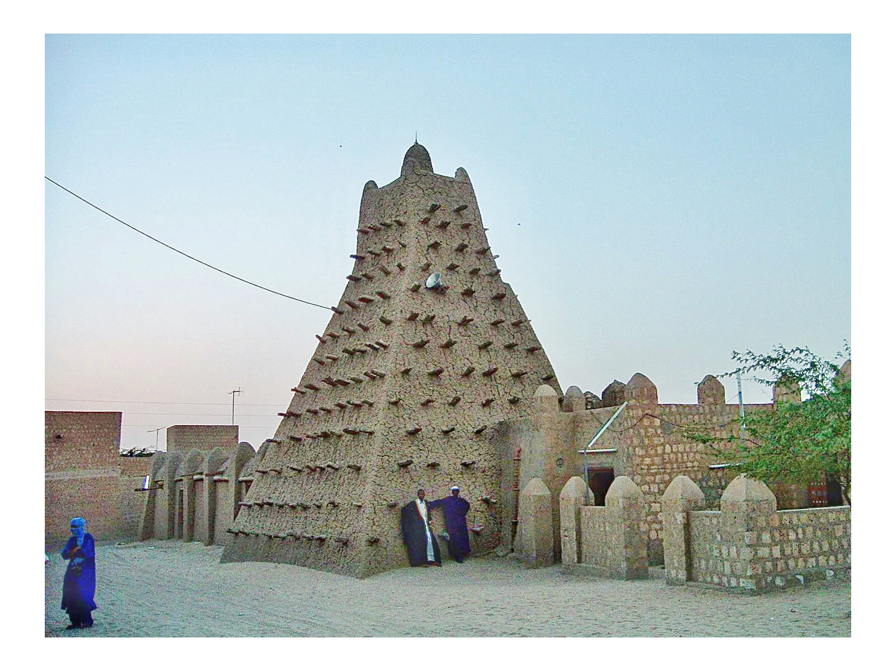
The Sankore Mosque, Timbuktu
The Sankore Mosque at Timbuktu, the heart of the city's scholarship.
© More Lessons Less Planning | morelessonslessplanning.com
Notes:
A real public-domain photograph: the Sankore Mosque at Timbuktu, in present-day Mali. Use it purely as a reference image to make the heart of Timbuktu's scholarship concrete. Point out two things: the earthen MUD-BRICK walls, the traditional building style of the western Sahel; and the wooden BEAMS that project from the walls, used as permanent scaffolding for the regular re-plastering the building needs. Explain that around this mosque grew the famous center of study - the network of scholars and mosque schools often called the University of Sankore - where teachers taught circles of students and manuscripts were read and copied. Note honestly that the building standing today has been rebuilt and re-plastered many times over the centuries, so it is not a frozen snapshot of the 1500s; what it shows is the enduring physical center of Timbuktu's scholarly life. Image: photograph of the Sankore Mosque, Timbuktu, via Wikimedia Commons (public domain).
Reference labels (point to these chart features when teaching): Earthen walls: mud brick; Wooden beams: scaffolding

Slide 8
The Community of Scholars
Who the scholars were
A scholar is a learned person devoted to study; Timbuktu held a large community of them.
✔
Judges and teachers
The city had many judges, religious teachers, and doctors of law, all highly respected.
✔
Paid by the ruler
Many were maintained at the king's expense, so they could devote themselves to study.
✔
Key Concept: Timbuktu held a large community of SCHOLARS - judges, teachers, and doctors of law - many maintained at the king's expense.
© More Lessons Less Planning | morelessonslessplanning.com
Notes:
Now the people who made Timbuktu famous. A SCHOLAR is a learned person devoted to study - here, above all, to the study of Islamic knowledge. Under Songhai, Timbuktu held a large and respected COMMUNITY of scholars: judges (qadis) who decided legal cases, religious teachers who led circles of students, and 'doctors' - meaning learned masters of law and religion, not physicians in the modern sense. These men held high status in the city, and many of them, as Leo Africanus reports, were maintained at the king's expense - given salaries and support so that they could devote themselves fully to teaching, judging, and writing. Emphasize the point students should carry into the primary source: Timbuktu's fame rested not just on its wealth but on this genuine, organized community of learned men, honored and paid to keep learning alive.

Slide 9
Manuscripts and the Book Trade
Books by hand
A manuscript is a handwritten book; every book in Timbuktu was copied out by hand.
✔
A trade in books
Manuscripts were bought, sold, and copied in Timbuktu as valuable goods.
✔
More profit than most goods
Leo Africanus reported that books sold for more money than almost any other merchandise.
✔
Key Concept: A MANUSCRIPT is a handwritten book; in Timbuktu manuscripts were copied and traded as some of the most profitable goods in the city.
© More Lessons Less Planning | morelessonslessplanning.com
Notes:
Here is the memorable heart of the lesson. Before the printing press reached this part of the world, every book was a MANUSCRIPT - a book written out by hand, copied one page at a time by trained scribes. In Timbuktu, manuscripts were not just read; they were a major TRADE. Booksellers, copyists, and scholars bought, sold, and copied manuscripts across the city, and Timbuktu built up great private and school libraries of them. The single most famous fact about Timbuktu's book trade comes straight from Leo Africanus: he reported that handwritten books brought from North Africa (the land of Barbary) were sold in Timbuktu 'for more money than any other merchandise' - in other words, books were among the most valuable and profitable goods in the whole market. Stress this to students: in Timbuktu under Songhai, a book could be worth more than gold, cloth, or salt. That is the surprising, sticky fact that captures how much this society valued learning, and it is exactly what the primary source in the activity describes.

Slide 10
What the Scholars Studied
Religion and law
Science and more
Scholars studied the Qur'an and Islamic religious knowledge.
They studied Islamic law, used by the city's judges.
Religion and law were the core of Timbuktu's learning.
They also studied astronomy - the study of the stars.
They studied mathematics, grammar, history, and medicine.
The surviving manuscripts cover all of these subjects.
Key Concept: Timbuktu's scholars studied Islamic law and theology at the core, plus ASTRONOMY, mathematics, grammar, history, and medicine.
© More Lessons Less Planning | morelessonslessplanning.com
Notes:
Now what all these scholars actually studied. At the core of learning in Timbuktu was Islamic religious knowledge - the Qur'an, theology, and above all Islamic LAW, which the city's judges applied in real cases. But the learning went well beyond religion. Timbuktu's scholars also studied ASTRONOMY - the careful study of the stars and their movements, important for the calendar and for prayer times - along with mathematics, grammar and language, history, geography, and medicine. We know this in detail because so many of the manuscripts survive: tens of thousands of Timbuktu manuscripts, now being preserved and studied, cover exactly these subjects in the scholars' own hands. Make the point respectfully and accurately: this was a broad, sophisticated intellectual culture, rooted in Islamic scholarship but reaching into the sciences - not narrow, and not a myth, but a documented body of real learning.

Slide 11
Leo Africanus: An Outside Observer
Who Leo Africanus was
An outside observer
Born al-Hasan al-Wazzan, a North African traveler (c.1494).
He visited Timbuktu under Songhai in the early 1500s.
Captured by pirates, he was later baptized in Rome.
He wrote his description from memory, in Rome, around 1526.
He was a visiting observer, NOT a Songhai insider.
His book was later translated into English by John Pory.
Remember: LEO AFRICANUS VISITED Timbuktu and described it from memory as an OUTSIDE observer - a visitor, not a Songhai insider.
© More Lessons Less Planning | morelessonslessplanning.com
Notes:
Before students read Leo Africanus's words in the activity, they need to know exactly what kind of source he is - this is the sourcing anchor of the lesson. LEO AFRICANUS was the name given in Europe to al-Hasan al-Wazzan, a well-traveled North African (born around 1494) who journeyed widely across Africa, including a visit to TIMBUKTU while it was under Songhai rule in the early 1500s. On a later voyage he was captured by pirates, given to the Pope, and baptized in Rome, where he wrote a long description of Africa - originally in Italian, around 1526 - drawing on his travels from MEMORY. That makes him a valuable but limited source, and students must hold the honest anchor: Leo Africanus was an OUTSIDE OBSERVER - a visitor recalling what he saw, writing years later and far away in Rome - NOT a Songhai insider or an official record. His account is one of the fullest outside descriptions we have of Timbuktu's scholars and book trade, which is why it is so famous; but it is a traveler's report, so read it as the impression of an outsider. Also note the attribution students will see: they will read his account as it was translated into English by John Pory in 1600 and reprinted in 1896. Keep straight that al-Hasan al-Wazzan / Leo Africanus is the observer, and Pory is the later translator.

Slide 12
The End of the Golden Age
A Moroccan invasion
In 1591 a Moroccan army marched across the Sahara to attack Songhai.
✔
Gunpowder wins the day
At the Battle of Tondibi, Moroccan guns and cannon defeated Songhai's larger army.
✔
Timbuktu's golden age ends
Songhai fell apart, scholars were scattered or arrested, and the golden age ended.
✔
Key Concept: In 1591 a Moroccan gunpowder army defeated Songhai at the Battle of TONDIBI - ending Timbuktu's golden age of scholarship.
© More Lessons Less Planning | morelessonslessplanning.com
Notes:
Close the story honestly with how the golden age ended - it did not continue uninterrupted. In 1591, the sultan of Morocco sent an army south across the Sahara to seize control of the gold and salt trade and the rich cities of Songhai. At the Battle of TONDIBI, near the Niger River, this Moroccan force - though far smaller than the Songhai army - won a decisive victory because it carried GUNPOWDER weapons: muskets and cannon that Songhai's larger army of cavalry and spearmen could not match. Songhai collapsed as a great empire. In the years that followed, Timbuktu's scholarly golden age came to an end: the city was occupied, and many of its leading scholars were scattered, silenced, or even arrested and deported to Morocco. Make the honest anchor clear: the flowering of Timbuktu's learning under Songhai was real and remarkable, but it was tied to the empire's strength, and when Songhai fell to gunpowder in 1591, that golden age ended. The manuscripts, though, survived - hidden and passed down through families - which is how we still know this story today.

Slide 13
Key Takeaways
Songhai rose after Mali and controlled Timbuktu at its scholarly height.
★
Askia Muhammad, a devout Muslim, was a patron of Timbuktu's learning.
★
Sankore and its scholars made Timbuktu a center of Islamic study and books.
★
Manuscripts sold for more than most goods; the golden age ended in 1591.
★
© More Lessons Less Planning | morelessonslessplanning.com
Notes:
Let us recap Songhai and Timbuktu's scholarship. First, the empire: SONGHAI rose after Mali in the western Sahel and controlled TIMBUKTU at the height of its scholarship, which passed from Mali to Songhai in 1468. Second, the ruler: ASKIA MUHAMMAD (r.1493-1528), a devout Muslim who made the Hajj, acted as a generous PATRON of learning, funding scholars and schools. Third, the heart of it: the SANKORE mosque-and-school complex - a network of scholars and mosque schools, not one modern university - anchored a large community of SCHOLARS, judges, and teachers, and the city's famous book trade, in which MANUSCRIPTS sold for more money than almost any other goods. Fourth, the source and the ending: our fullest outside description comes from LEO AFRICANUS, a North African traveler who saw Timbuktu and later wrote about it from memory in Rome as an outside observer; and in 1591 a Moroccan gunpowder army defeated Songhai at the Battle of TONDIBI, ending the golden age - though the manuscripts survived to tell us the story. We have studied Timbuktu respectfully as the achievement of a real and thriving West African center of learning.

