Slide 1
Simon Bolivar and Latin American Independence
How The Liberator fought to free South America from Spanish rule and dreamed of uniting it
© More Lessons Less Planning | morelessonslessplanning.com
Notes:
Open with the lesson question: could one leader free an entire continent from a European empire, and could those freed lands stay united? Preview the answer: Simon Bolivar freed six nations from Spain, but his dream of a single united Spanish America fell apart.

Slide 2
Learning Targets
Explain how colonial rule and creole grievances led to independence
★
Describe Bolivar's rise as The Liberator and his 1815 Letter from Jamaica
★
Explain Bolivar's key victories from Boyaca and Carabobo to Ayacucho
★
Explain what Gran Colombia was and why the dream of unity fractured
★
Connect Bolivar's fight to Enlightenment liberty and natural rights
★
© More Lessons Less Planning | morelessonslessplanning.com
Notes:
The five targets keep the lesson centered on the causes of revolt, Bolivar's rise and vision, his military victories, the union of Gran Colombia and its collapse, and the Enlightenment connection.

Slide 3
Spanish Colonial Rule and Creole Grievances
For about 300 years Spain ruled a vast empire across South America.
Spain controlled colonial trade and reserved the highest offices for itself.
Peninsulares, colonists born in Spain, held the top government and church posts.
Creoles were American-born people of Spanish descent, shut out of power.
Creole resentment of Spanish control drove the independence movements.
Key Concept: Creoles were wealthy American-born colonists who resented being ruled by Spain and shut out of the top offices held by peninsulares.
© More Lessons Less Planning | morelessonslessplanning.com
Notes:
For about three centuries Spain ruled a vast South American empire, controlling colonial trade and keeping the highest offices for itself. Peninsulares, colonists born in Spain, held the top government and church posts, above the American-born creoles. Creoles were people of Spanish descent, often wealthy, but they were shut out of real power, and their resentment of Spanish control became the engine of the independence movements.

Slide 4
The Wave of Independence, 1808-1826
The Spark in Spain
A Continent in Revolt
In 1808 Napoleon invaded Spain and removed its king
With Spain's king gone, colonists questioned who they owed loyalty to
Between 1808 and 1826 independence movements swept Spanish America
Enlightenment ideas of liberty and natural rights inspired the leaders
The American, French, and Haitian Revolutions had shown empires could fall
Creole leaders like Bolivar turned the unrest into wars for independence
Key Concept: After Napoleon removed Spain's king in 1808, independence movements swept Spanish America from 1808 to 1826.
© More Lessons Less Planning | morelessonslessplanning.com
Notes:
In 1808 Napoleon invaded Spain and removed its king, and with the king gone colonists began to question who they owed loyalty to. Between 1808 and 1826 independence movements swept across Spanish America. Enlightenment ideas of liberty and natural rights inspired the leaders, and the American, French, and Haitian Revolutions had already shown that empires could fall. Creole leaders like Bolivar turned this unrest into organized wars for independence.

Slide 5
Who Was Simon Bolivar?
Simon Bolivar was born in 1783 into a wealthy creole family in Venezuela.
He was educated in Enlightenment ideas and admired the American Revolution.
He became the greatest military leader of South American independence.
His victories earned him the title El Libertador, The Liberator.
He aimed not only to defeat Spain but to unite Spanish America.
Key Concept: Simon Bolivar, a wealthy creole educated in Enlightenment ideas, became The Liberator of South America.
© More Lessons Less Planning | morelessonslessplanning.com
Notes:
Simon Bolivar was born in 1783 into a wealthy creole family in Venezuela and was educated in Enlightenment ideas, admiring the American Revolution. He became the greatest military leader of South American independence, and his victories earned him the title El Libertador, The Liberator. From early on his goal was not just to defeat Spain but to unite Spanish America into one great republic.

Slide 6
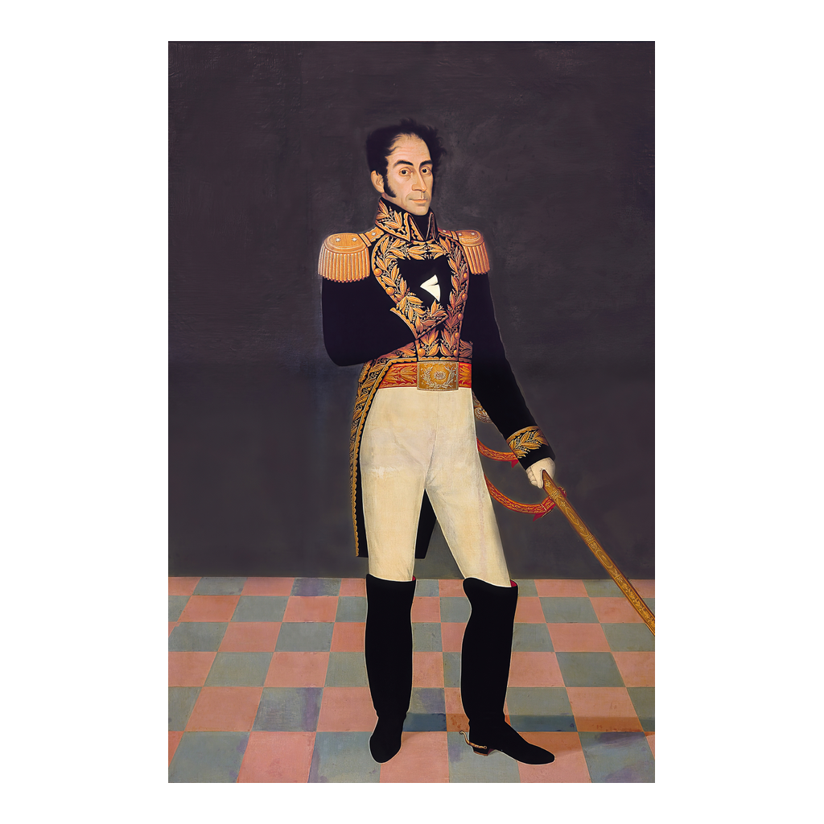
Period Portrait of Simon Bolivar
Period portrait of Simon Bolivar, El Libertador
© More Lessons Less Planning | morelessonslessplanning.com
Notes:
This is a period portrait of Simon Bolivar painted in his own era. Use it as a historical reference image to put a face to The Liberator, not as evidence for any claim beyond identifying him.

Slide 7
The Letter from Jamaica and Bolivar's Vision
Early defeats forced Bolivar into exile on the island of Jamaica in 1815.
There he wrote the Letter from Jamaica, analyzing why Spain must lose America.
He argued Spanish America shared one origin, language, and religion.
Bolivar dreamed of uniting the former colonies into a single great nation.
But he warned that distance and differing interests might keep them apart.
Key Concept: In the 1815 Letter from Jamaica, Bolivar argued for independence and dreamed of a united Spanish America, while fearing division.
© More Lessons Less Planning | morelessonslessplanning.com
Notes:
Early defeats forced Bolivar into exile on the island of Jamaica in 1815, and there he wrote the Letter from Jamaica, a famous essay analyzing why Spain must lose its American colonies. He argued that Spanish America shared one origin, one language, and one religion, and he dreamed of uniting the former colonies into a single great nation. Yet even here he warned honestly that distance and differing interests might keep the new nations apart, foreshadowing the fracture to come.

Slide 8
Crossing the Andes and the Battle of Boyaca, 1819
A Daring March
The Battle of Boyaca
In 1819 Bolivar led his army on a daring march across the Andes
His troops crossed flooded plains and freezing mountain passes
The hard crossing let him surprise the Spanish in New Granada
The Battle of Boyaca was fought on August 7, 1819
The victory secured the independence of New Granada, today Colombia
Bolivar entered Bogota and freed the heart of the viceroyalty
Key Concept: After a daring 1819 crossing of the Andes, Bolivar's victory at the Battle of Boyaca secured the independence of New Granada.
© More Lessons Less Planning | morelessonslessplanning.com
Notes:
In 1819 Bolivar led his army on a daring march across the Andes, crossing flooded plains and freezing mountain passes that the Spanish thought no army could survive. The hard crossing let him surprise the Spanish in New Granada. The Battle of Boyaca, fought on August 7, 1819, was the result, and the victory secured the independence of New Granada, today Colombia. Bolivar then entered Bogota and freed the heart of the viceroyalty.

Slide 9
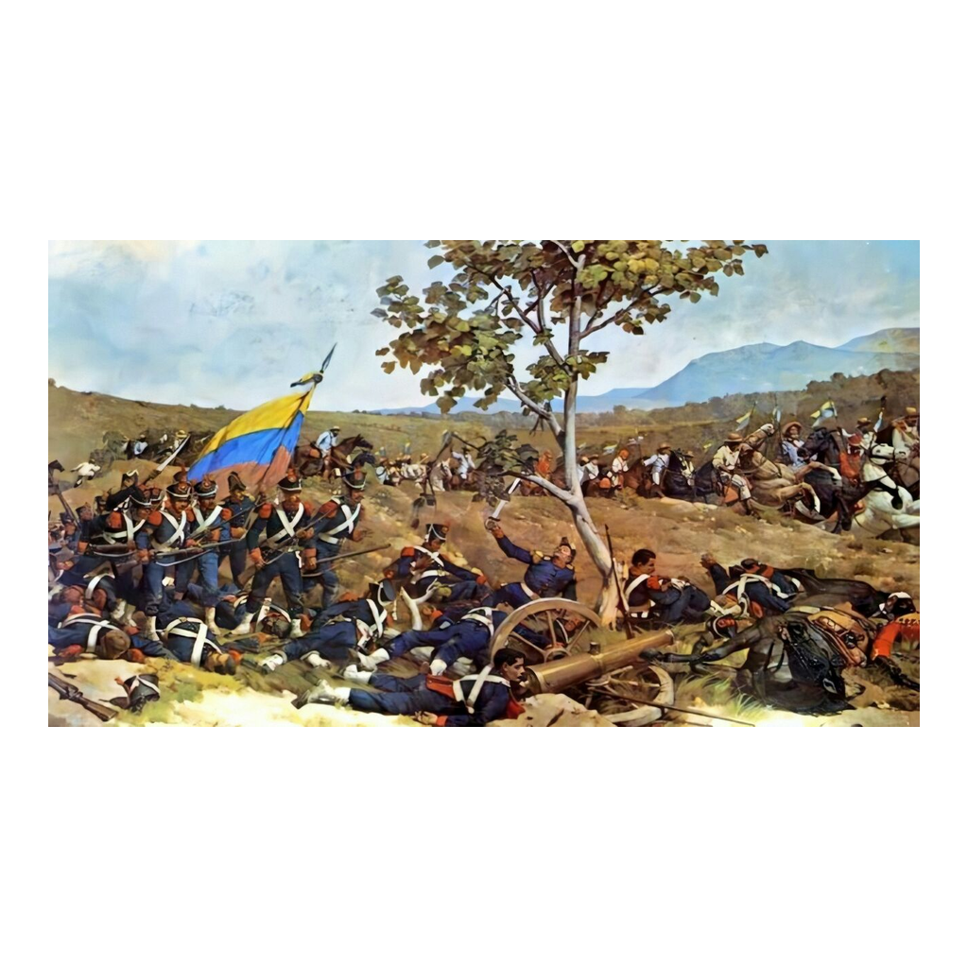
Period Painting of a Battle for Independence
Period painting of a battle of the South American wars of independence
© More Lessons Less Planning | morelessonslessplanning.com
Notes:
This is a period painting of a battle from the South American wars of independence. Use it as a reference image to picture the fighting that won independence, not as evidence for any specific claim.

Slide 10
Carabobo and the Liberation of the North, 1821
Venezuela Freed
Ecuador Freed
The Battle of Carabobo was won on June 24, 1821
Carabobo secured the independence of Venezuela
Bolivar's home region was now free of Spanish rule
Bolivar's general Antonio Jose de Sucre pressed the fight south
In 1822 the victory at Pichincha freed Ecuador
The whole north of Spanish South America was now liberated
Key Concept: The 1821 Battle of Carabobo secured Venezuela's independence, and by 1822 the north of South America was free.
© More Lessons Less Planning | morelessonslessplanning.com
Notes:
The Battle of Carabobo, won on June 24, 1821, secured the independence of Venezuela, so Bolivar's own home region was now free of Spanish rule. His most trusted general, Antonio Jose de Sucre, pressed the fight south, and in 1822 the victory at Pichincha freed Ecuador. With that, the whole north of Spanish South America was liberated, and Bolivar could turn toward Peru, Spain's last stronghold.

Slide 11
Gran Colombia: A United Republic
At the Congress of Angostura in 1819 Bolivar set out his republic plan.
Bolivar united Venezuela, New Granada, and Ecuador into one nation.
Historians call this union Gran Colombia, and Bolivar led it as president.
Gran Colombia was the first step toward a united Spanish America.
Bolivar hoped the union would grow strong enough to stand against any empire.
Key Concept: Bolivar united Venezuela, New Granada, and Ecuador into Gran Colombia, the first step toward his dream of a united Spanish America.
© More Lessons Less Planning | morelessonslessplanning.com
Notes:
At the Congress of Angostura in 1819 Bolivar set out his plan for a new republic. He then united Venezuela, New Granada, and Ecuador into a single nation that historians call Gran Colombia, and he led it as president. For Bolivar this union was only the first step toward his larger dream of a united Spanish America. He hoped it would grow strong enough to stand against any empire and keep the freed lands from being reconquered.

Slide 12
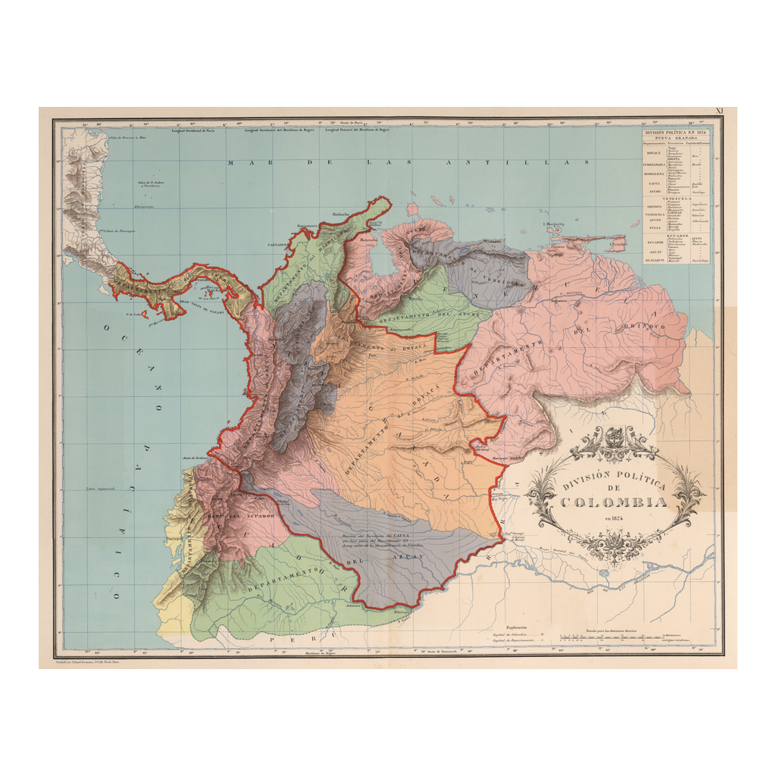
Map of Gran Colombia
Historical map of Gran Colombia, Bolivar's united republic
© More Lessons Less Planning | morelessonslessplanning.com
Notes:
This is a historical map showing the extent of Gran Colombia. Use it to help students picture how large Bolivar's union was, not as a reading or measurement task.
Reference labels (point to these chart features when teaching): Gran Colombia

Slide 13
Liberating Peru and Bolivia, 1824-1825
Finishing the Fight
The Last Victories
Bolivar carried the war south into Peru, Spain's last stronghold
In 1822 he met the southern liberator Jose de San Martin at Guayaquil
San Martin withdrew, leaving Bolivar to complete the liberation
In 1824 Bolivar and Sucre won the Battle of Ayacucho in Peru
The Battle of Ayacucho ended Spanish rule in South America
In 1825 a new nation was named Bolivia in Bolivar's honor
Key Concept: The 1824 Battle of Ayacucho ended Spanish rule in South America, and in 1825 the new nation of Bolivia was named for Bolivar.
© More Lessons Less Planning | morelessonslessplanning.com
Notes:
Bolivar carried the war south into Peru, Spain's last stronghold on the continent. In 1822 he met the southern liberator Jose de San Martin at Guayaquil, and San Martin withdrew, leaving Bolivar to complete the liberation. In 1824 Bolivar and Sucre won the Battle of Ayacucho in Peru, which ended Spanish rule in South America. In 1825 a new nation was carved out and named Bolivia in Bolivar's honor.

Slide 14
The Dream Fractures and the Enlightenment
The Union Falls Apart
A Disillusioned Liberator
Bolivar wanted one strong republic, but many regions wanted local control
Rivalries and long distances pulled Gran Colombia apart
By 1830 Gran Colombia split into Venezuela, Colombia, and Ecuador
A discouraged Bolivar said that serving a revolution was like plowing the sea
He died in 1830, having freed six nations from Spanish rule
His fight extended the Enlightenment ideal of natural rights to Spanish America
Key Concept: Gran Colombia fractured by 1830 and a disillusioned Bolivar died, but he had freed six nations from Spanish rule.
© More Lessons Less Planning | morelessonslessplanning.com
Notes:
Bolivar wanted one strong central republic, but many regions wanted local control, and rivalries and long distances pulled Gran Colombia apart. By 1830 the union split into Venezuela, Colombia, and Ecuador. A discouraged Bolivar said that serving a revolution was like plowing the sea, and he died in 1830, having freed six nations from Spanish rule. Even in failure his fight extended the Enlightenment ideal of liberty and natural rights, first claimed by the American, French, and Haitian Revolutions, across a whole continent.

Slide 15
Reference Guide: Grievances and the Liberator
Simon Bolivar
The Liberator, the general whose campaigns won independence for much of Spanish South America.
creoles
American-born people of Spanish descent who resented rule by Spain and led the independence movements.
peninsulares
Colonists born in Spain who held the highest colonial offices, above the creoles.
Letter from Jamaica
Bolivar's 1815 essay, written in exile, arguing that Spanish America must break from Spain.
Battle of Boyaca
The 1819 victory, after crossing the Andes, that secured the independence of New Granada.
Tip: These five terms name the Liberator, the two colonial classes, his famous 1815 essay, and his first great victory.
© More Lessons Less Planning | morelessonslessplanning.com
Notes:
Review the first five terms exactly as defined: Simon Bolivar, creoles, peninsulares, the Letter from Jamaica, and the Battle of Boyaca. Students use these definitions to complete the Reference Guide in the Activity.

Slide 16
Reference Guide: Victory, Union, and Legacy
Battle of Carabobo
The 1821 victory that secured the independence of Venezuela.
Gran Colombia
The union of Venezuela, New Granada, and Ecuador that Bolivar created and led.
Battle of Ayacucho
The 1824 victory, led by Bolivar's general Sucre, that ended Spanish rule in South America.
Bolivia
The nation carved out in 1825 and named in Bolivar's honor.
Congress of Angostura
The 1819 congress where Bolivar set out his plan for the new republic of Gran Colombia.
Tip: These five terms name Venezuela's victory, Bolivar's union, the final battle, the nation named for him, and its founding congress.
© More Lessons Less Planning | morelessonslessplanning.com
Notes:
Review the next five terms exactly as defined: the Battle of Carabobo, Gran Colombia, the Battle of Ayacucho, Bolivia, and the Congress of Angostura. Students use these definitions to complete the Reference Guide in the Activity.

Slide 17
Key Takeaways
Creole resentment of Spanish rule and the peninsulares drove revolt.
★
Simon Bolivar became The Liberator and dreamed of a united Spanish America.
★
Crossing the Andes, he won Boyaca in 1819 and Carabobo in 1821.
★
Ayacucho ended Spanish rule in 1824, and Bolivia was named for him in 1825.
★
Bolivar united Venezuela, New Granada, and Ecuador into Gran Colombia.
★
The union fractured by 1830, but Bolivar had freed six nations.
★
© More Lessons Less Planning | morelessonslessplanning.com
Notes:
Close with the essential question. Each takeaway connects the causes of revolt, Bolivar's rise and vision, his victories, the union of Gran Colombia and its collapse, and the Enlightenment connection with its honest cost.

