Slide 1
Shortages and Surpluses: When Markets Misfire
What happens when the price is held away from equilibrium?
© More Lessons Less Planning | morelessonslessplanning.com
Notes:
Title slide for the Unit 2 Shortages and Surpluses lesson. Follows Market Equilibrium (TK 13). Open with the hook: at equilibrium the market clears - no leftover goods, no empty shelves. But when a price is FORCED above or below that balancing point, the market misfires: either goods sell out (a shortage) or pile up unsold (a surplus). This lesson teaches both, using rent control and the minimum wage.

Slide 2
Learning Targets
Define a SHORTAGE and a SURPLUS and tell them apart
★
Explain why a price CEILING (rent control) causes a shortage
★
Explain why a price FLOOR (minimum wage) causes a surplus
★
Read a chart to measure the gap and predict shortage or surplus
★
© More Lessons Less Planning | morelessonslessplanning.com
Notes:
Read the four targets aloud. Target 1 defines the two outcomes. Target 2 is the price ceiling case (rent control -> shortage). Target 3 is the price floor case (minimum wage -> surplus). Target 4 is reading it off a chart.

Slide 3
The Big Idea: Price Held Away from Equilibrium
At Equilibrium
Price Held Away
Quantity demanded EQUALS quantity supplied
The market CLEARS - nothing left over
No shortage and no surplus
The price found its balancing point
Government sets a legal price limit
Price is STUCK above or below balance
Qd and Qs no longer match
The market MISFIRES into a gap
Key Concept: a market only clears at equilibrium - force the price away and a gap appears.
© More Lessons Less Planning | morelessonslessplanning.com
Notes:
Set up the core idea: equilibrium is the one price where the market clears. A price control forces the price to a different number, so quantity demanded and quantity supplied stop matching - that mismatch is a shortage or a surplus.

Slide 4
Shortage vs Surplus - The Two Ways a Market Misfires
Shortage (price too LOW)
Surplus (price too HIGH)
Quantity demanded is GREATER than supplied
Buyers want more than sellers provide
Goods SELL OUT - empty shelves, waitlists
Happens when price is below equilibrium
Quantity supplied is GREATER than demanded
Sellers offer more than buyers will take
Goods go UNSOLD - they pile up
Happens when price is above equilibrium
Remember: shortage = Qd > Qs (sold out). Surplus = Qs > Qd (piled up).
© More Lessons Less Planning | morelessonslessplanning.com
Notes:
Define both outcomes precisely. Shortage: Qd > Qs, price too low, goods sell out. Surplus: Qs > Qd, price too high, goods pile up. The next slide shows the equilibrium baseline where neither happens.

Slide 5
Start at the Balancing Point
Picture an apartment market with an equilibrium rent and quantity
At equilibrium, the rent is where the demand and supply curves CROSS
Quantity demanded equals quantity supplied - the market clears
Every renter who will pay the rent finds an apartment
Every landlord who will rent at that price finds a tenant
The next slide shows this clean crossing point on a chart
Tip: the equilibrium is the ONLY price with no shortage and no surplus.
© More Lessons Less Planning | morelessonslessplanning.com
Notes:
Setup slide paired with the equilibrium baseline chart. Establish the starting point: demand and supply cross at equilibrium (P=8, Q=50 in chart units). This is the reference students compare the two controlled cases against.

Slide 6
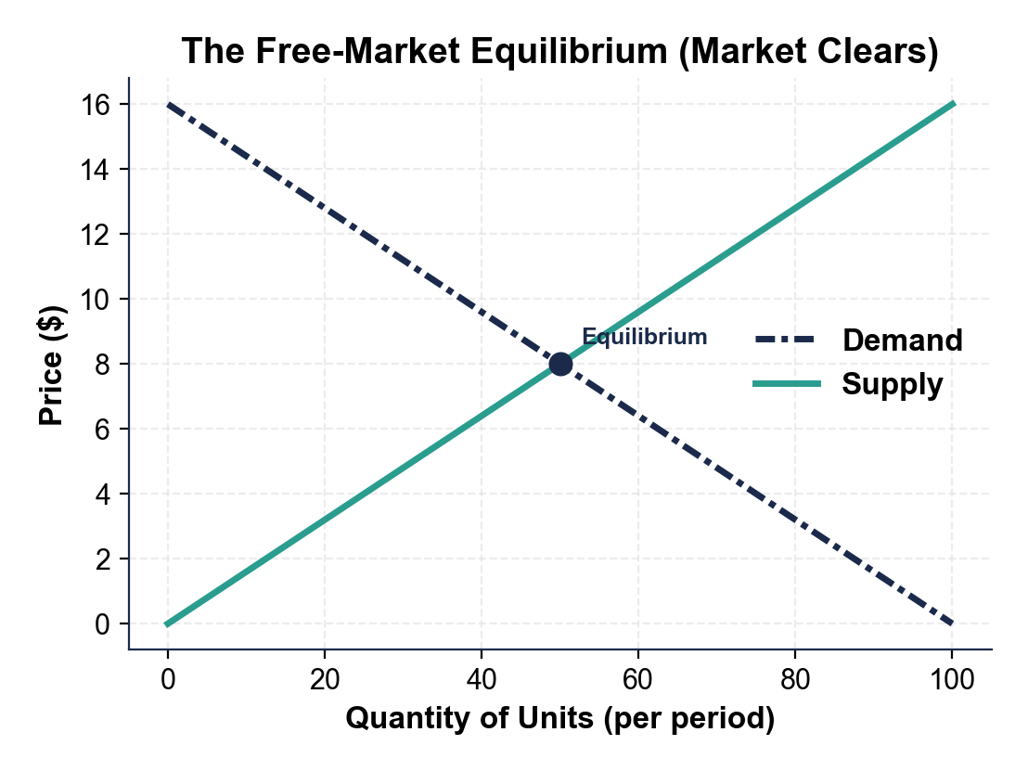
The Free-Market Equilibrium (No Shortage, No Surplus)
Demand and supply cross at equilibrium: Qd equals Qs.
© More Lessons Less Planning | morelessonslessplanning.com
Notes:
The equilibrium baseline chart. The downward demand curve and upward supply curve cross at the equilibrium (P=8, Q=50). At that price quantity demanded equals quantity supplied, so there is no shortage and no surplus. Students will compare this clean crossing against the two controlled charts.
Reference labels (point to these chart features when teaching): Curves CROSS = market clears; No gap here

Slide 7
Price Ceiling - A Legal MAXIMUM Price
What a Ceiling Does
Why a Shortage Follows
A government-set MAXIMUM legal price
Sellers may NOT charge more than it
Only bites when set BELOW equilibrium
Then the legal price is stuck too low
At the low price, buyers want a LOT (high Qd)
But sellers offer LITTLE (low Qs)
Quantity demanded exceeds quantity supplied
That gap (Qd > Qs) is a SHORTAGE
Key Concept: a ceiling caps the price LOW, so buyers want more than sellers supply.
© More Lessons Less Planning | morelessonslessplanning.com
Notes:
Define a price ceiling: a legal maximum. A ceiling below equilibrium is binding and forces the price down, where Qd > Qs - a shortage. A ceiling above equilibrium does nothing (non-binding). Sets up the rent control example.

Slide 8
Rent Control - A Price Ceiling on Apartments
A city caps apartment rent BELOW the equilibrium rent to help renters
At the lower legal rent, MORE renters want apartments (Qd rises)
But landlords offer FEWER apartments at that rent (Qs falls)
Quantity demanded now exceeds quantity supplied
The result is a housing SHORTAGE - long waitlists, no vacancies
The next slide shows the gap between Qd and Qs on the chart
Warning: rent control is meant to help renters, but the shortage means many cannot find a unit.
© More Lessons Less Planning | morelessonslessplanning.com
Notes:
Setup slide paired with the price-ceiling shortage chart. Rent control caps rent below equilibrium. At the ceiling (P=4 in chart units): Qd=75 on demand, Qs=25 on supply, shortage = 50. The chart on the next slide shows the gap.

Slide 9
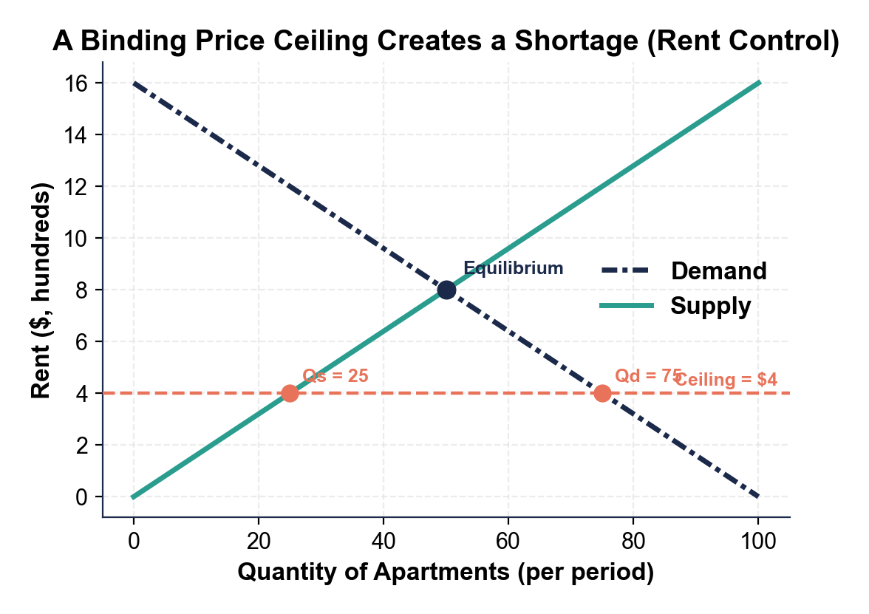
A Binding Price Ceiling Creates a Shortage
At the ceiling, Qd (75) exceeds Qs (25): a shortage of 50.
© More Lessons Less Planning | morelessonslessplanning.com
Notes:
The price-ceiling shortage chart. The coral dashed line is the legal rent ceiling, set below the equilibrium (P=8). At the ceiling (P=4) quantity demanded is 75 (read off the demand curve) and quantity supplied is 25 (read off the supply curve). Qd minus Qs = 50, the size of the shortage.
Reference labels (point to these chart features when teaching): Ceiling BELOW equilibrium; Qd > Qs = shortage

Slide 10
Why the Shortage Sticks Around
Price can't rise
Normally a shortage pushes price up until it clears - but the ceiling makes that illegal, so the price is stuck.
✔
The gap stays open
Because the price can't rise, quantity demanded keeps exceeding quantity supplied; the shortage does not fix itself.
✔
Non-price rationing
Apartments go by waitlists, connections, or luck instead of price - long lines for scarce units.
✔
Black markets appear
Some buyers pay extra under the table to get a scarce unit, an illegal price above the legal ceiling.
✔
Did You Know: in a free market a shortage is temporary - the ceiling is what makes it permanent.
© More Lessons Less Planning | morelessonslessplanning.com
Notes:
Explain why the shortage persists: normally a shortage drives price up until Qd=Qs, but a binding ceiling makes that illegal, so the gap stays open. Consequences: non-price rationing (waitlists), and black markets.

Slide 11
Price Floor - A Legal MINIMUM Price
A PRICE FLOOR is a government-set MINIMUM legal price
Buyers may NOT legally pay less than the floor
It only matters when set ABOVE equilibrium (a binding floor)
At that high price, sellers offer a LOT (high quantity supplied)
But buyers want LITTLE (low quantity demanded)
Qs is greater than Qd - that gap is a SURPLUS
Key Concept: a floor props the price HIGH, so sellers supply more than buyers want.
© More Lessons Less Planning | morelessonslessplanning.com
Notes:
Define a price floor: a legal minimum. A floor above equilibrium is binding and props the price up, where Qs > Qd - a surplus. A floor below equilibrium does nothing (non-binding). Sets up the minimum wage example.

Slide 12
Minimum Wage - A Price Floor on Labor
The wage is the PRICE of labor; a minimum wage is a floor on that price
Set ABOVE the equilibrium wage, more workers want jobs (Qs of labor rises)
But employers want to hire FEWER workers at that wage (Qd falls)
Quantity of labor supplied now exceeds quantity demanded
The result is a labor SURPLUS - what we call UNEMPLOYMENT
The next slide shows the gap between Qs and Qd on the chart
Warning: a minimum wage above equilibrium helps those who keep jobs but leaves a labor surplus.
© More Lessons Less Planning | morelessonslessplanning.com
Notes:
Setup slide paired with the price-floor surplus chart. A minimum wage above the equilibrium wage. At the floor (P=12 in chart units): Qs=75 on supply, Qd=25 on demand, surplus = 50. The labor surplus is unemployment. The chart on the next slide shows the gap.

Slide 13
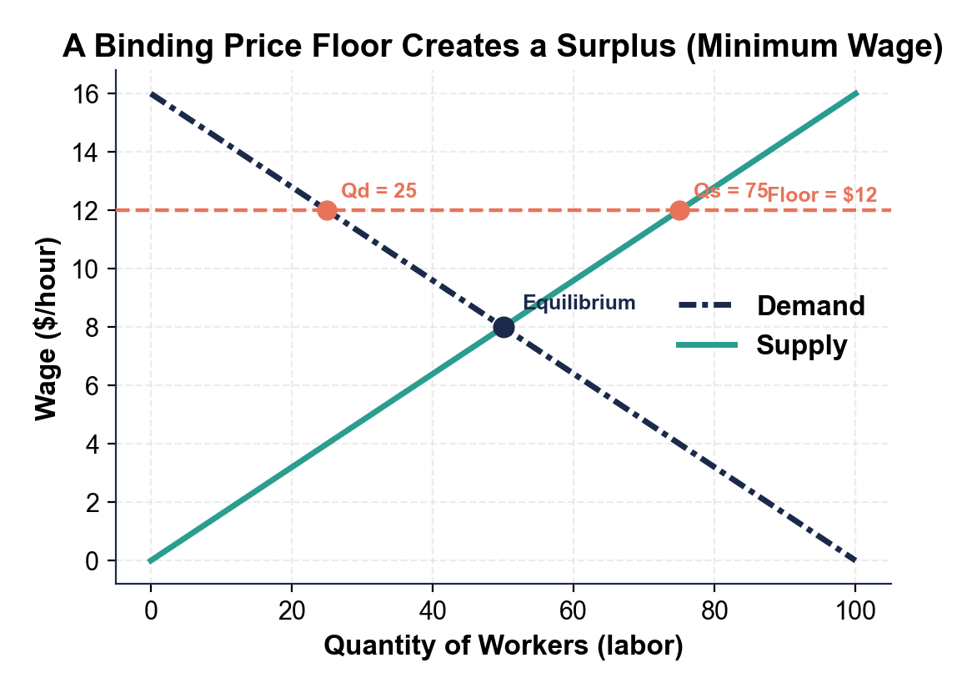
A Binding Price Floor Creates a Surplus
At the floor, Qs (75) exceeds Qd (25): a surplus of 50.
© More Lessons Less Planning | morelessonslessplanning.com
Notes:
The price-floor surplus chart. The coral dashed line is the legal minimum wage, set above the equilibrium (P=8). At the floor (P=12) quantity supplied is 75 (read off the supply curve) and quantity demanded is 25 (read off the demand curve). Qs minus Qd = 50, the size of the surplus (the labor surplus is unemployment).
Reference labels (point to these chart features when teaching): Floor ABOVE equilibrium; Qs > Qd = surplus

Slide 14
Why the Surplus Sticks Around
Price can't fall
Normally a surplus pushes price down until it clears - but the floor makes that illegal, so the price is stuck high.
✔
The gap stays open
Because the price can't fall, quantity supplied keeps exceeding quantity demanded; the surplus does not fix itself.
✔
Unsold goods or idle workers
Surplus goods pile up; in the labor market, the surplus is workers who want jobs but cannot find one.
✔
Government may buy it up
With farm price floors the government sometimes buys the surplus crop to keep the price propped up.
✔
Did You Know: a labor surplus has a familiar name - unemployment.
© More Lessons Less Planning | morelessonslessplanning.com
Notes:
Explain why the surplus persists: normally a surplus drives price down until Qs=Qd, but a binding floor makes that illegal, so the gap stays open. Consequences: unsold goods, or idle workers (unemployment), and sometimes government purchase of surplus.

Slide 15
Binding vs Non-Binding - When a Control Actually Bites
Binding Ceiling
Binding Floor
Non-Binding Control
Set BELOW equilibrium
Forces price down
Creates a SHORTAGE
Example: rent control below market rent
Set ABOVE equilibrium
Props price up
Creates a SURPLUS
Example: minimum wage above market wage
Ceiling set ABOVE equilibrium
Or floor set BELOW equilibrium
The market is already legal
No shortage and no surplus - no effect
Key Concept: a control only bites on the WRONG side of equilibrium - ceiling below, floor above.
© More Lessons Less Planning | morelessonslessplanning.com
Notes:
Critical nuance: a price control only changes the market when it is binding. A ceiling bites only when set below equilibrium; a floor bites only when set above. A ceiling above equilibrium or a floor below it is non-binding and does nothing.

Slide 16
Reading the Gap - Shortage or Surplus?
Step 1 - Find the legal price
Locate the coral price-control line on the chart and compare it to the equilibrium where the curves cross.
✔
Step 2 - Read Qd and Qs
Quantity demanded is how much buyers are willing to buy at a given price - read it off the DEMAND curve; read quantity supplied off the SUPPLY curve.
✔
Step 3 - Subtract for the gap
Shortage = Qd minus Qs (when Qd is larger). Surplus = Qs minus Qd (when Qs is larger).
✔
Step 4 - Name it
Price below equilibrium and Qd>Qs is a SHORTAGE. Price above equilibrium and Qs>Qd is a SURPLUS.
✔
Tip: the bigger quantity tells you the answer - if Qd is bigger it's a shortage, if Qs is bigger it's a surplus.
© More Lessons Less Planning | morelessonslessplanning.com
Notes:
The four-step method for reading any price-control chart: (1) find the legal price line; (2) read Qd off demand and Qs off supply at that price; (3) subtract for the gap; (4) name it a shortage (Qd>Qs) or surplus (Qs>Qd).

Slide 17
Shortages and Surpluses Vocabulary (1 of 2)
Shortage
Quantity demanded is GREATER than quantity supplied; goods sell out. Happens when price is below equilibrium.
Surplus
Quantity supplied is GREATER than quantity demanded; goods pile up unsold. Happens when price is above equilibrium.
Price ceiling
A government-set MAXIMUM legal price; binding (causes a shortage) only when set BELOW equilibrium.
Price floor
A government-set MINIMUM legal price; binding (causes a surplus) only when set ABOVE equilibrium.
Remember: ceiling caps the price LOW (shortage); floor props the price HIGH (surplus).
© More Lessons Less Planning | morelessonslessplanning.com
Notes:
First four vocabulary terms: shortage, surplus, price ceiling, price floor. These are the foundation terms students complete in the Activity Reference Guide.

Slide 18
Shortages and Surpluses Vocabulary (2 of 2)
Rent control
A price CEILING on apartment rent; below equilibrium it causes a housing SHORTAGE.
Minimum wage
A price FLOOR on the wage (the price of labor); above equilibrium it causes a labor SURPLUS, called unemployment.
Binding price control
A ceiling or floor on the WRONG side of equilibrium (ceiling below, floor above) that actually changes the market.
Black market
An illegal market that appears when a binding ceiling creates a shortage and buyers pay more than the legal price.
Tip: a control only bites when it is BINDING - on the wrong side of equilibrium.
© More Lessons Less Planning | morelessonslessplanning.com
Notes:
Final four vocabulary terms: rent control, minimum wage, binding price control, black market. Completes the 8 terms students see; the Activity Reference Guide has 10 (adds equilibrium and quantity demanded).

Slide 19
Key Takeaways
A market clears ONLY at equilibrium, where Qd equals Qs.
★
A price CEILING below equilibrium causes a SHORTAGE (Qd > Qs): rent control.
★
A price FLOOR above equilibrium causes a SURPLUS (Qs > Qd): minimum wage.
★
A control only bites when BINDING; read the chart to name shortage or surplus.
★
© More Lessons Less Planning | morelessonslessplanning.com
Notes:
Synthesis. Equilibrium clears; ceiling below = shortage; floor above = surplus; controls only bite when binding. This is the Tier B synthesis section - guided notes blanks here may draw from anywhere in the deck.

