Slide 1
September 11: The Day and the Response
Reconstructing the Timeline of September 11, 2001
© More Lessons Less Planning | morelessonslessplanning.com
Notes:
Title slide.

Slide 2
Learning Targets
Put the events of September 11, 2001 in the right order.
★
Explain how the FAA and NORAD tried to track the hijacked planes.
★
Describe how first responders reacted at the World Trade Center.
★
Explain how the government responded to the attacks that day.
★
Explain why it was hard for agencies to work together that day.
★
© More Lessons Less Planning | morelessonslessplanning.com
Notes:
Learning targets slide.

Slide 3
A Clear Morning
Tuesday, September 11, 2001 began clear and mild on the East Coast.
Four passenger jets left airports in Boston, Newark, and Washington.
Some of the hijackers had trained as pilots; all carried box cutters or knives.
By 8:00 a.m., all four flights were airborne and on course.
Within two hours, all four planes had crashed.
Key Concept: All four flights were in the air and on schedule before 8:15 a.m.
© More Lessons Less Planning | morelessonslessplanning.com
Notes:
Set the scene: four flights depart, hijackers aboard.

Slide 4
The Four Flights
Flight | Departure | Destination | Crash Site
American 11 | Boston Logan | Los Angeles | North Tower, 8:46 a.m.
United 175 | Boston Logan | Los Angeles | South Tower, 9:03 a.m.
American 77 | Washington Dulles | Los Angeles | Pentagon, 9:37 a.m.
United 93 | Newark | San Francisco | Pennsylvania field, 10:03 a.m.
Note: All four flights were transcontinental, chosen for full fuel tanks.
© More Lessons Less Planning | morelessonslessplanning.com
Notes:
Table of the four hijacked flights.

Slide 5
American 11 Strikes the North Tower
American 11 was hijacked shortly after 8:14 a.m.
Air traffic controllers lost radio contact with the flight.
At 8:46 a.m., American 11 crashed into the North Tower.
The impact killed everyone aboard and an unknown number inside.
A transponder sends a plane's location and flight number to radar.
Key Concept: 8:46 a.m. is the first confirmed impact time of the day.
© More Lessons Less Planning | morelessonslessplanning.com
Notes:
First impact of the day.

Slide 6
United 175 Strikes the South Tower
Flight Plan
What Happened
Scheduled Boston to Los Angeles
Took off at 8:14 a.m.
Cruising at 31,000 feet by 8:33
Hijacked between 8:42 and 8:46 a.m.
Deviated off course toward New York City
Struck the South Tower at 9:03 a.m.
Note: The second crash was broadcast live on national television.
© More Lessons Less Planning | morelessonslessplanning.com
Notes:
Second impact.

Slide 7
The Pentagon Is Struck
Hijackers seized American 77 between 8:51 and 8:54 a.m.
The hijackers switched off the device that identified the flight on radar.
Controllers watched the flight vanish from their radar screens.
At 9:37 a.m., Flight 77 struck the western side of the Pentagon.
Military and civilian personnel inside were killed.
Key Concept: The Pentagon is the headquarters of the U.S. Department of Defense.
© More Lessons Less Planning | morelessonslessplanning.com
Notes:
Third impact.

Slide 8
United 93: The Fourth Plane
United 93's takeoff was delayed 25 minutes by heavy Newark traffic.
United 93 was hijacked around 9:28 a.m., later than the others.
Passengers learned of the attacks by phone and moved to retake the cockpit.
The plane crashed in a field near Shanksville, Pennsylvania.
Investigators believe the hijackers' target was in Washington.
Key Concept: United 93 crashed at 10:03 a.m., the last of the four.
© More Lessons Less Planning | morelessonslessplanning.com
Notes:
Fourth impact, Pennsylvania.

Slide 9
Air Traffic Control Loses the Picture
FAA
Manages U.S. air traffic control and civil aviation safety nationwide.
Hijacking
The illegal seizure of an aircraft by armed attackers.
NORAD
Joint U.S.-Canada command that watches North American airspace.
NEADS
Northeast Air Defense Sector, the NORAD unit for the northeastern United States.
Key Concept: Controllers use transponder codes to identify each plane.
© More Lessons Less Planning | morelessonslessplanning.com
Notes:
Vocabulary: FAA, transponder, hijacking, NORAD.

Slide 10
NORAD and NEADS Scramble Fighters
9:21 a.m.
NEADS hears a report that American 11 is still flying.
✔
9:23 a.m.
Fighters are scrambled toward the Washington area.
✔
9:24 a.m.
The scramble order reaches Langley Air Force Base.
✔
9:30 a.m.
The fighters are airborne, but a generic flight plan sends them east over the ocean.
✔
Key Concept: NEADS is the Northeast Air Defense Sector, part of NORAD.
© More Lessons Less Planning | morelessonslessplanning.com
Notes:
The scramble order timeline.

Slide 11
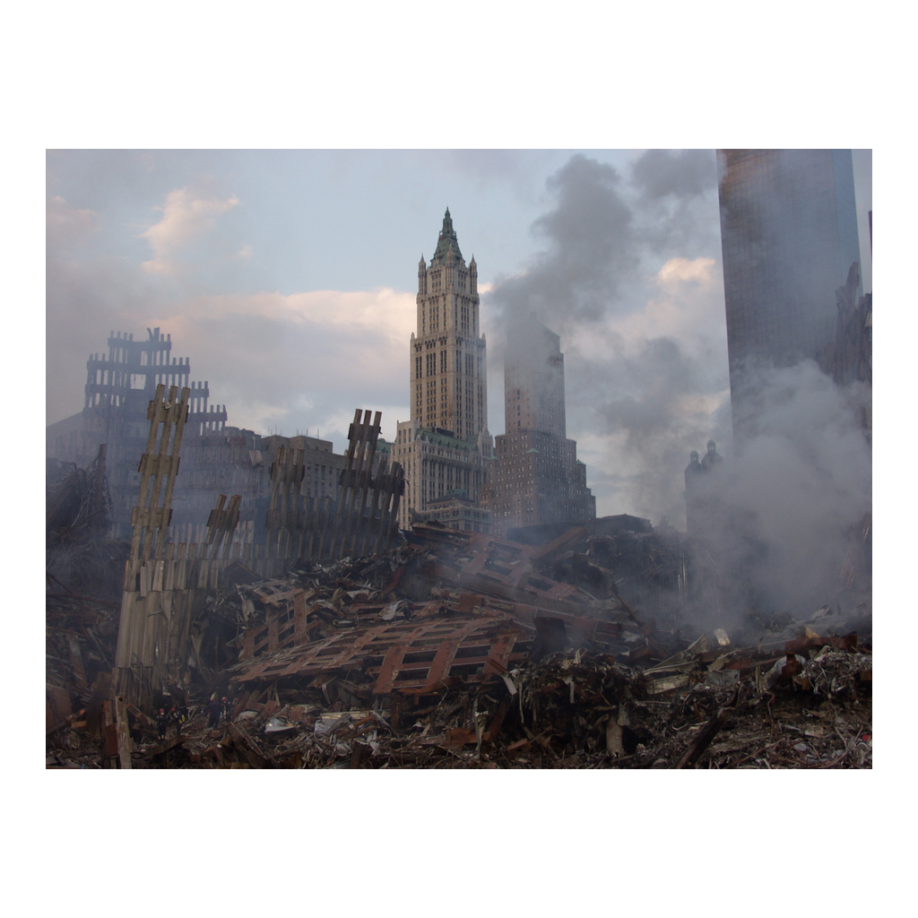
The World Trade Center Site After the Attacks
The World Trade Center site in the days after September 11, 2001. (FEMA)
© More Lessons Less Planning | morelessonslessplanning.com
Notes:
Paired image for the NEADS/scramble slide - the site in the days after the attacks.
Reference labels (point to these chart features when teaching): World Trade Center Site; September 2001

Slide 12
Confusion in the Chain of Command
"We're looking—we also lost American 77."
— a Washington Center manager telling NEADS, 9:34 a.m.
Note: The military found out mostly by chance that a plane was missing.
© More Lessons Less Planning | morelessonslessplanning.com
Notes:
Paraphrase pointing at the primary source studied in the Activity.

Slide 13
First Responders Rush In
FDNY firefighters and NYPD officers arrived within minutes.
Responders set up incident command posts near both towers.
Crews began guiding workers down crowded stairwells.
Emergency medical teams treated the injured as they escaped.
Many responders climbed toward the fires to help others out.
Note: Responders came from fire, police, and medical services across the region.
© More Lessons Less Planning | morelessonslessplanning.com
Notes:
FDNY, NYPD, PAPD response.

Slide 14
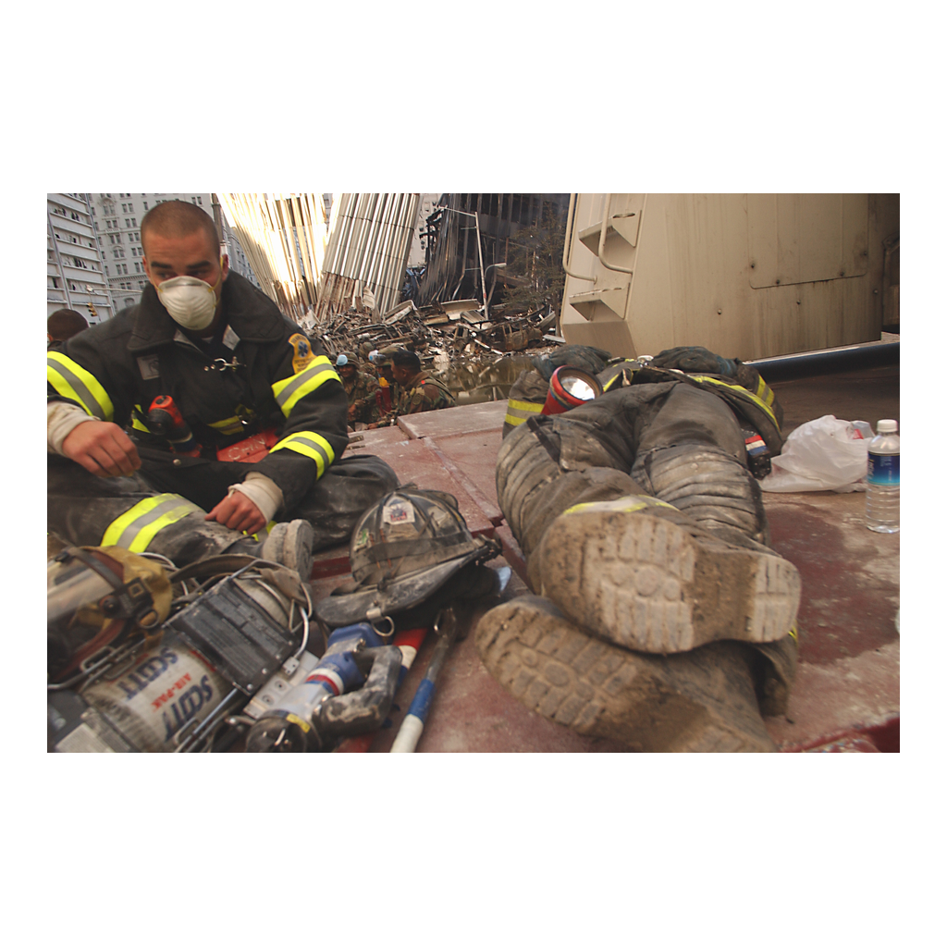
Emergency Crews Respond
Firefighters rest near the World Trade Center site, September 19, 2001. (FEMA)
© More Lessons Less Planning | morelessonslessplanning.com
Notes:
Paired image for the first-responders slide.
Reference labels (point to these chart features when teaching): FDNY / NYPD; September 19, 2001

Slide 15
Evacuating the Towers
Tens of thousands of workers evacuated both towers that morning.
Stairwells became the only way down once elevators stopped.
Coworkers and building staff helped each other reach the street.
The South Tower collapsed at 9:59 a.m., 56 minutes after impact.
The North Tower collapsed at 10:28 a.m.
Note: Most occupants below the impact zones evacuated safely.
© More Lessons Less Planning | morelessonslessplanning.com
Notes:
Evacuation and collapse.

Slide 16
The Federal Government Responds
President Notified
President Bush was informed of the attacks while in Florida.
✔
Air Force One
Air Force One flew the President to secure bases far from Washington.
✔
Vice President
The Vice President was taken to a protected shelter under the White House.
✔
National Ground Stop
At 9:45 a.m., the FAA grounded all flights in U.S. airspace.
✔
Shootdown Authority
Officials debated shootdown authority for hijacked aircraft.
✔
Key Concept: This was the first nationwide grounding of civil flights.
© More Lessons Less Planning | morelessonslessplanning.com
Notes:
National crisis management.

Slide 17
Ground Zero Recovery Begins
Recovery work at the World Trade Center site began immediately.
Ground Zero is the name given to the site after the attacks.
Engineers, firefighters, and volunteers worked around the clock.
The U.S. Navy and other federal agencies supported the effort.
Recovery work continued for months after September 11.
Note: The recovery effort at the site officially ended in May 2002.
© More Lessons Less Planning | morelessonslessplanning.com
Notes:
Recovery operations.

Slide 18
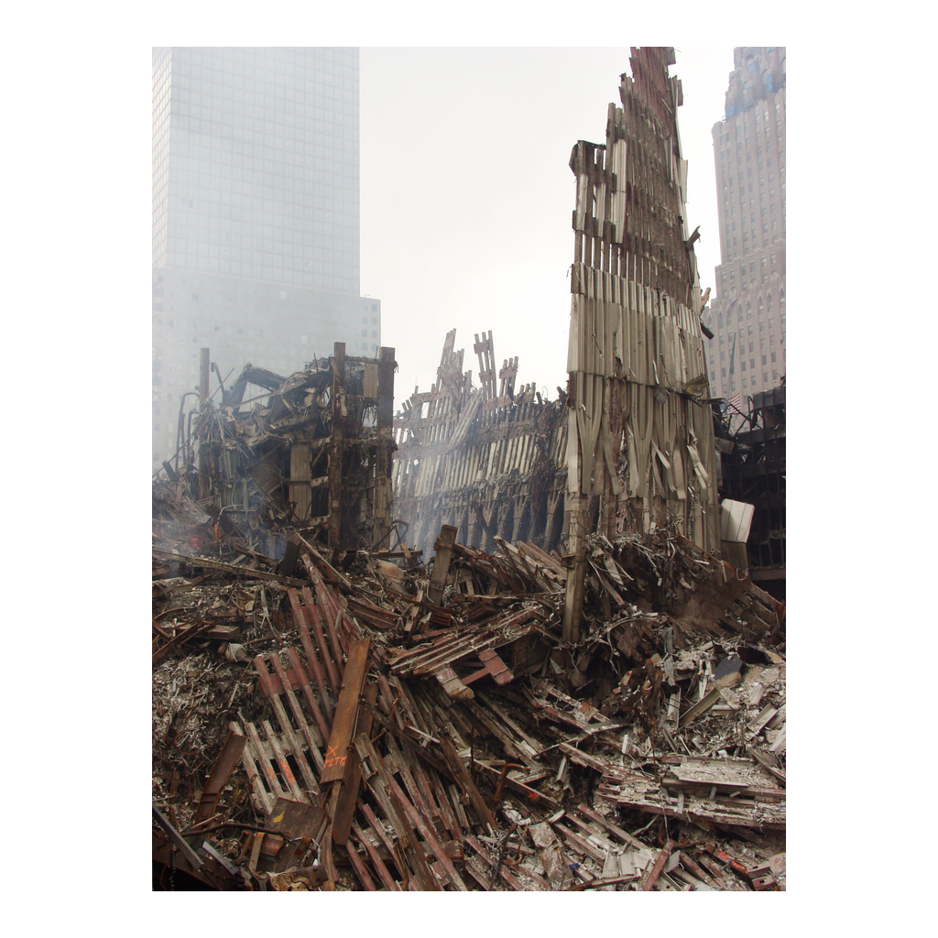
Recovery Operations at Ground Zero
Federal crews support recovery operations at Ground Zero. (FEMA)
© More Lessons Less Planning | morelessonslessplanning.com
Notes:
Paired image for the recovery slide.
Reference labels (point to these chart features when teaching): Ground Zero; Recovery Operations

Slide 19
Building the Official Record
Scramble
To launch fighter jets quickly to respond to an air threat.
First Responders
Firefighters, police, and medics who arrive first at an emergency.
Incident Command
The organized system emergency responders use to manage personnel, equipment, and communication.
9/11 Commission
Federal panel created by Congress to investigate the attacks.
Ground Zero
The name given to the World Trade Center site after the attacks.
Key Concept: The 9/11 Commission published its report in July 2004.
© More Lessons Less Planning | morelessonslessplanning.com
Notes:
Vocabulary: scramble, first responders, incident command, 9/11 Commission, Ground Zero.

Slide 20
Lessons in Coordination
The FAA and NORAD did not always share information quickly.
Some agencies learned key facts about missing flights by chance.
Investigators later studied these gaps to improve coordination.
New systems now link aviation and defense agencies in real time.
The morning of September 11 changed how agencies communicate.
Note: Ground Zero is now the site of the 9/11 Memorial.
© More Lessons Less Planning | morelessonslessplanning.com
Notes:
Wrap-up / ties to primary source analysis in Activity.

Slide 21
Key Takeaways
Four flights were hijacked between 8:14 and 9:28 a.m. on 9/11/2001.
★
The FAA and NORAD struggled to track the flights in real time.
★
First responders reached the World Trade Center within minutes.
★
Federal leaders grounded U.S. airspace and secured the government.
★
The 9/11 Commission later built the official factual record.
★
© More Lessons Less Planning | morelessonslessplanning.com
Notes:
Closing slide.

