Slide 1
Self-Employment Taxes: The Gig Worker's Surprise
1099 income means no employer withholding - and a tax bill freelancers don't see coming.
© More Lessons Less Planning | morelessonslessplanning.com
Notes:
Open with the emotional hook that drives this whole lesson: a freelancer or gig worker files their taxes for the first time and gets hit with a bill far bigger than they expected - even though they made good money all year. Ask students to think about anyone they know who drives rideshare, sells freelance design or writing work, walks dogs, or does any kind of gig work. Tell them that unlike a W-2 job, gig work pays you in FULL with no tax taken out - and that convenience hides a real cost that shows up all at once at tax time. By the end of this lesson, students will be able to explain exactly why the self-employed owe extra tax, calculate that tax using the real 15.3% rate, understand why gig workers pay the IRS four times a year instead of once, and know how deducting real business expenses and setting money aside protects them from the surprise.

Slide 2
Learning Targets
Explain why self-employed workers owe extra tax a W-2 employee does not
★
Apply the LABELED SE tax model (12.4% + 2.9% = 15.3%) to calculate SE tax
★
Explain why gig workers pay quarterly estimated taxes instead of withholding
★
Calculate how deducting business expenses lowers SE tax on NET profit
★
© More Lessons Less Planning | morelessonslessplanning.com
Notes:
Read the four targets aloud and connect them to the arc of the lesson. Target 1 is the core idea: self-employed workers owe MORE tax than a W-2 employee on the same income, because there is no employer to cover half of the payroll tax. Target 2 is the math: the LABELED SE tax model, 12.4% Social Security plus 2.9% Medicare equals 15.3%, which students will apply to real gig income. Target 3 explains the practical consequence: because no employer withholds tax from a 1099 payment, gig workers must send the IRS estimated payments four times a year instead of having it handled automatically. Target 4 is the relief valve: business expenses reduce the NET profit that SE tax is calculated on, so keeping good records lowers the tax bill. By the end, students can calculate SE tax, explain quarterly payments, and reduce their own future tax bill through deductions.

Slide 3
The Gig Worker's Surprise
What the gig worker expected
What actually happened
Drove rideshare all year and got paid in FULL every week
No taxes ever came out of a gig payment
Assumed the money in the account was all theirs to keep
Filed taxes for the first time as a freelancer
Received a 1099 form instead of a W-2 - no withholding all year
Owed self-employment tax PLUS regular income tax, all at once
The tax bill was much bigger than expected
This lesson explains exactly why - and how to avoid the shock
Key Concept: Gig and freelance workers get 1099s, not W-2s. No employer withholds tax from a 1099 payment - so the full tax bill arrives all at once.
© More Lessons Less Planning | morelessonslessplanning.com
Notes:
Tell the story of a gig worker's first tax season. They drove rideshare (or did freelance design, dog walking, or any gig work) all year, and every payment showed up in full - no deductions, no line items, just the whole amount. It felt like a win. But when they filed taxes for the first time as a self-employed worker, they got a bill that shocked them: not just regular income tax, but an ADDITIONAL self-employment tax on top of it, and nobody had been setting any of it aside all year. The reason is simple once you see it: gig and freelance workers receive a 1099 form instead of a W-2, and a 1099 payment has NO tax withheld from it at all - unlike a W-2 paycheck, where taxes are already being taken out by an employer with every check. That difference is the whole story of this lesson. State plainly that this is not a punishment or a trick - it is simply that gig workers must handle taxes themselves that a W-2 job normally handles automatically. Key term - 1099 income: payment reported on a Form 1099-NEC instead of a W-2, the way freelance and gig workers get paid, with no employer withholding tax for them.

Slide 4
Why the Self-Employed Owe More
Payroll tax (normally split in two)
PAYROLL TAX (Social Security + Medicare) is normally split between a W-2 employee (about 7.65%) and their EMPLOYER (the other about 7.65%)
A W-2 employee's share
A W-2 employee only pays HALF of payroll tax out of their paycheck; the employer quietly pays the other half on their behalf
A self-employed worker has no employer
A freelancer or gig worker IS both the worker and the business - there is no employer to cover the other half
So the self-employed pay BOTH halves
This is exactly why the self-employment tax rate (15.3%) is DOUBLE the employee-only payroll tax rate (7.65%)
Key Concept: A W-2 employee pays HALF of payroll tax; their employer pays the other half. The self-employed have no employer, so they pay BOTH.
© More Lessons Less Planning | morelessonslessplanning.com
Notes:
This is the single idea that unlocks the whole lesson, so build it step by step. PAYROLL TAX - the combined Social Security and Medicare tax - is normally split in two: a W-2 employee pays about 7.65% out of their own paycheck, and their EMPLOYER quietly pays another 7.65% on top, on the employee's behalf. Most employees never see that employer half; it just happens automatically. Now ask: what happens when there is no employer? A self-employed person - a freelancer, a rideshare driver, anyone doing gig work - IS the business. There is no separate employer to cover that second half. So the self-employed worker has to pay BOTH halves themselves: their own share AND the share an employer would have paid. That is exactly why the self-employment tax rate is 15.3% - precisely double the 7.65% employee-only share. State this plainly: it is not an extra penalty, it is simply that one person is now covering a bill that used to be split between two parties (worker and employer). Key term - Freelancer / gig worker: a self-employed person paid per job or task (rideshare driving, freelance design) rather than earning a W-2 salary; they are both the worker and the business.

Slide 5
The 15.3% SE Tax - A Labeled Model
The SE TAX RATE (labeled formula)
SE TAX RATE = 12.4% Social Security + 2.9% Medicare = 15.3% total, paid on NET self-employment profit
What a W-2 employee normally pays
A W-2 employee pays only about 7.65% (their half); the employer pays the other about 7.65%
What a self-employed person pays
The self-employed person pays BOTH halves - the full 15.3% - because there is no employer to split it with
Applying the model
SE TAX = NET self-employment profit x 0.153 (15.3%)
Key Concept: SE TAX RATE = 12.4% Social Security + 2.9% Medicare = 15.3%. W-2 employees pay ~7.65% (half); the self-employed pay BOTH halves.
© More Lessons Less Planning | morelessonslessplanning.com
Notes:
Introduce the FIRST labeled model students will apply throughout this lesson. THE SE TAX RATE is built from two pieces: 12.4% for Social Security plus 2.9% for Medicare, which together equal 15.3%. Write the addition out on the board so students see exactly where 15.3% comes from - it is not an arbitrary number. Restate the comparison from the last slide in rate form: a W-2 employee normally pays only about 7.65% (their half) out of their paycheck, while the employer pays the other about 7.65% separately. A self-employed person has no employer, so they pay BOTH halves - the full 15.3% - on their own NET self-employment profit (more on 'net' soon). Give students the exact formula they will use in the activity: SE TAX = net self-employment profit multiplied by 0.153. Tell them the next slide shows this rate applied to a real dollar figure so they can see the size of the difference for themselves. Key term - Self-employment (SE) tax: the 15.3% tax (12.4% Social Security + 2.9% Medicare) that self-employed workers pay to cover BOTH the employee and employer shares of payroll tax.

Slide 6
Same Income, Different Tax Bill
Picture two workers earning the SAME $40,000
One is a W-2 employee; the other is a self-employed gig worker. Same income, same year
✔
The W-2 employee pays only their share
$40,000 x 0.0765 (employee half) = $3,060 in payroll tax; their employer quietly pays another $3,060
✔
The self-employed worker pays both shares
$40,000 x 0.153 (the full SE tax) = $6,120 - exactly double the W-2 employee's payroll tax
✔
You will read this exact comparison off a bar chart next
The next slide shows both tax bills side by side on the identical $40,000 income
✔
Key Concept: On the SAME $40,000 income, a W-2 employee owes $3,060 in payroll tax; a self-employed worker owes $6,120 in SE tax - exactly double.
© More Lessons Less Planning | morelessonslessplanning.com
Notes:
Set up the chart students are about to read by working the comparison live, in numbers, before they see the bars. Picture two workers who both earned exactly $40,000 in net income this year. The FIRST is a W-2 employee: they pay only their employee half of payroll tax, 7.65%, so $40,000 x 0.0765 = $3,060. Their employer, unseen by the employee, pays another $3,060 on their behalf. The SECOND worker is self-employed - a gig or freelance worker - who earned the identical $40,000. Because there is no employer to split the bill with, they pay the FULL 15.3% SE tax rate: $40,000 x 0.153 = $6,120. Point out plainly that $6,120 is exactly double $3,060 - which makes sense, because the self-employed worker is paying both the employee AND the employer share of the exact same payroll tax. Tell students the next slide shows this exact comparison as a bar chart, so they can see the gap visually before reading dollar values off of it in the activity.

Slide 7
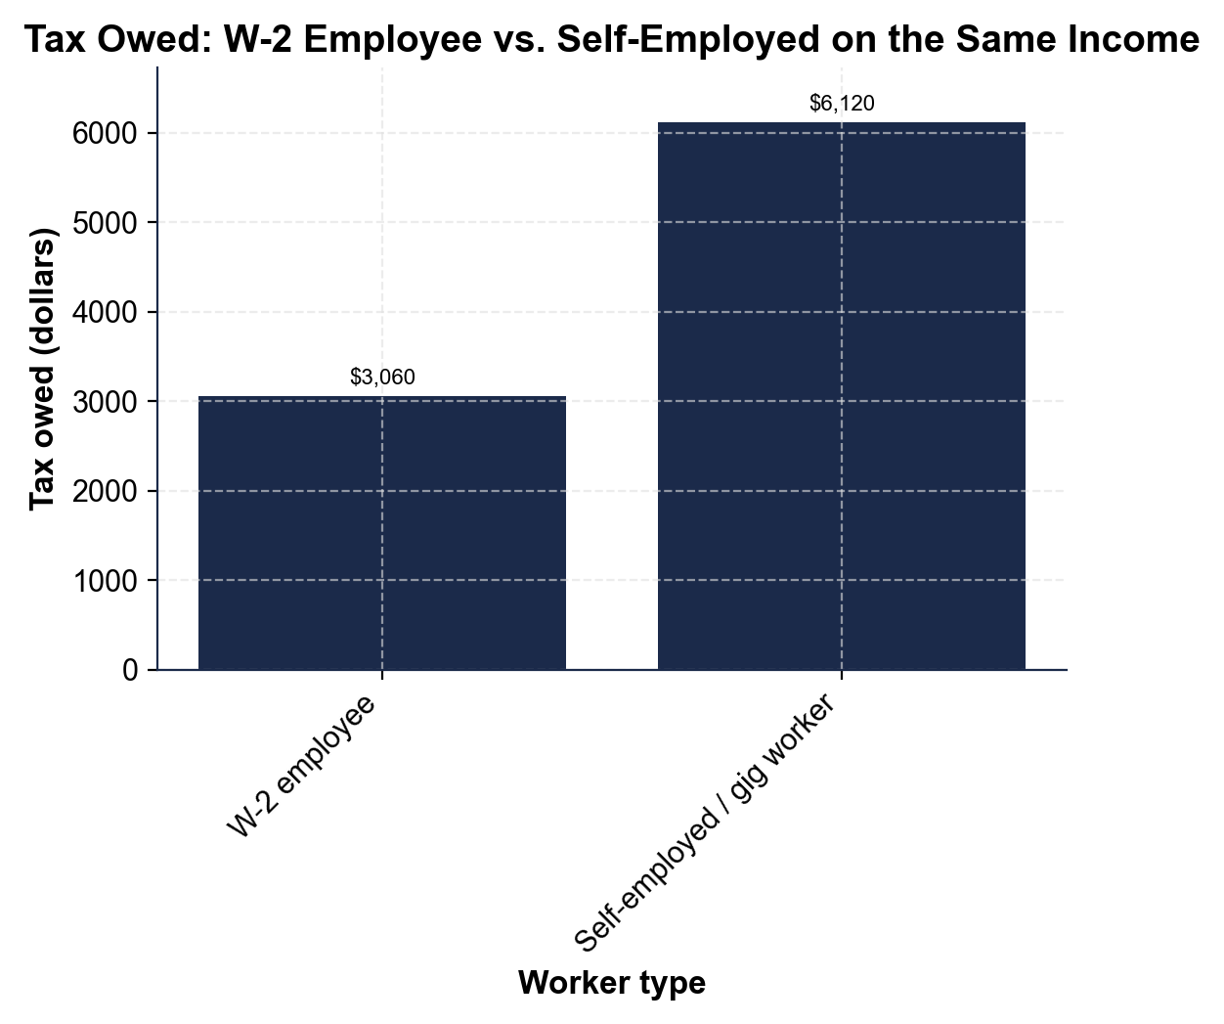
Tax Owed: W-2 Employee vs. Self-Employed on the Same Income
Same $40,000 income - the self-employed worker owes exactly double in tax.
© More Lessons Less Planning | morelessonslessplanning.com
Notes:
Give students a moment to read the two bars on their own before discussing. Both bars represent tax owed on the SAME $40,000 of net income. The W-2 EMPLOYEE bar shows $3,060 - just their 7.65% employee share of payroll tax. The SELF-EMPLOYED bar shows $6,120 - the full 15.3% SE tax, because there is no employer to split the bill with. Point out that the self-employed bar is exactly twice as tall as the W-2 bar. Ask students to state in their own words why the two bars are so different even though the income is identical: the self-employed worker is paying BOTH the employee half AND the employer half of the same payroll tax, while the W-2 employee's employer is quietly covering their half out of view. This is the chart Activity Part 4 reads and analyzes.
Reference labels (point to these chart features when teaching): W-2 employee $3,060; Self-employed $6,120

Slide 8
Quarterly Estimated Taxes
Why gig workers pay quarterly
With no employer WITHHOLDING, the IRS expects self-employed workers to pre-pay tax as they earn it, not all at once in April
Quarterly estimated taxes (defined)
QUARTERLY ESTIMATED TAXES are payments sent to the IRS four times a year instead of one bill at tax time
Roughly when they are due
Estimated payments are typically due around April, June, September, and January - four payments across the year
Splitting one tax bill into four
A gig worker who owes $5,508 in SE tax for the year sends the IRS $5,508 / 4 = $1,377 each quarter
Key Concept: No withholding means the IRS wants gig workers to pre-pay tax 4x/year - roughly Apr/Jun/Sep/Jan - instead of one bill in April.
© More Lessons Less Planning | morelessonslessplanning.com
Notes:
Explain the practical consequence of having no withholding. A W-2 employee never thinks about this: their employer takes tax out of every paycheck automatically, all year long. A self-employed or gig worker has NO employer doing that, so the IRS requires them to estimate their own tax and pre-pay it in four QUARTERLY ESTIMATED TAX payments across the year - roughly due around April, June, September, and January - instead of a single bill at filing time. Work a clean example: if a gig worker's full-year SE tax comes to $5,508, they do not wait and pay it all in April; they divide it into four payments of $5,508 / 4 = $1,377 each. Emphasize that this is a PLANNING tool, not a penalty - paying quarterly, on time, in smaller pieces protects a gig worker from a shocking lump-sum bill and from possible underpayment penalties. This directly answers why the surprise in slide 3 happens: the driver never made ANY quarterly payments, so the whole year's tax hit at once. Key term - Withholding: the tax an employer automatically takes out of a W-2 employee's paycheck; self-employed workers have none, so they must pay it themselves.

Slide 9
Deducting Business Expenses
Net profit (defined)
NET PROFIT = gross self-employment income minus ordinary and necessary BUSINESS EXPENSES
SE tax is on NET profit, not gross income
The self-employment tax is calculated on NET profit - deducting real expenses LOWERS the amount SE tax applies to
Worked example
$45,000 gross gig income minus $9,000 in business expenses = $36,000 NET profit
The tax impact of deducting
SE tax on the full $45,000 gross would be $6,885; SE tax on the correct $36,000 NET profit is $5,508 - a $1,377 savings from deducting expenses
Key Concept: SE tax is owed on NET profit (gross minus business expenses), not gross income. Deducting real expenses lowers the tax bill.
© More Lessons Less Planning | morelessonslessplanning.com
Notes:
Give students the relief valve that offsets the surprise from earlier slides. SE tax is NOT calculated on a gig worker's gross pay - it is calculated on their NET PROFIT, which is gross self-employment income minus ordinary and necessary BUSINESS EXPENSES (things like supplies, mileage, or equipment needed to do the work). Work the pinned example: a freelancer earns $45,000 gross for the year, and has $9,000 in real business expenses, leaving $45,000 - $9,000 = $36,000 in NET profit. Show the tax impact directly: if this worker mistakenly paid SE tax on the full $45,000 gross, they would owe $6,885; but calculated correctly on the $36,000 NET profit, they owe only $5,508 - a $1,377 savings just from properly deducting their real expenses. Make the practical point explicit: keeping receipts and mileage logs is not just bookkeeping, it directly and legally lowers a gig worker's tax bill. Key term - Business expense: an ordinary and necessary cost of doing gig or freelance work (like supplies or mileage) that can be deducted from gross income before SE tax. Gross income is the total amount a freelance worker is paid before business expenses are subtracted.

Slide 10
Setting Money Aside
The rule of thumb
Set aside about 25%-30% of every gig payment for taxes, before you spend any of it
✔
Why 25%-30%
That range covers SE tax (15.3%) plus a share of regular income tax, so the money is ready when quarterly payments or filing come due
✔
Worked example
A $1,200 gig payment: set aside $1,200 x 0.25 = $300 on the low end, up to $1,200 x 0.30 = $360 on the high end
✔
Make it automatic
Moving the reserve to a separate savings account the moment you're paid removes the temptation to spend it
✔
Key Concept: Set aside about 25%-30% of every gig payment for taxes. On a $1,200 payment, that is $300-$360, moved to savings right away.
© More Lessons Less Planning | morelessonslessplanning.com
Notes:
Give students the single most practical habit from this whole lesson. The rule of thumb: set aside about 25% to 30% of EVERY gig payment for taxes, the moment it arrives, before spending any of it. Explain why that range makes sense: it roughly covers the 15.3% SE tax plus a share of regular income tax that will also be owed on the profit, so the money is ready whether it is needed for a quarterly estimated payment or for filing at year's end. Work a clean example: on a single $1,200 gig payment, 25% is $1,200 x 0.25 = $300, and 30% is $1,200 x 0.30 = $360 - so a reasonable range to set aside from that one payment is $300 to $360. Give the practical tip that makes this actually happen: move that reserve into a SEPARATE savings account immediately, the same day you are paid, so the money is out of sight and out of the temptation to spend it on everyday things. This single habit is what would have prevented the tax-day shock from the very first slide. Key term - Set-aside rule of thumb: reserving about 25%-30% of every gig payment in a separate account to cover taxes owed later.

Slide 11
Calculate SE Tax on Gig Income - A Worked Example
The worker
A freelance gig worker earned $28,000 in NET self-employment profit this year
Applying the model
SE TAX = NET profit x 0.153 = $28,000 x 0.153 = $4,284
Breaking it into its two parts
Social Security portion: $28,000 x 0.124 = $3,472. Medicare portion: $28,000 x 0.029 = $812. Together: $3,472 + $812 = $4,284
Turning it into a plan
Quarterly payment: $4,284 / 4 = $1,071. Set-aside range on $28,000: 25% = $7,000 to 30% = $8,400
Key Concept: SE TAX = net profit x 0.153. On $28,000 net profit: SE tax = $4,284 ($3,472 Social Security + $812 Medicare); quarterly payment = $1,071.
© More Lessons Less Planning | morelessonslessplanning.com
Notes:
Work one complete, start-to-finish example that pulls every model from the lesson together, because the activity will ask students to do the same thing. A freelance gig worker earned $28,000 in NET self-employment profit this year (after business expenses were already subtracted). Apply the labeled SE tax model: SE TAX = net profit x 0.153, so $28,000 x 0.153 = $4,284. Show students they can also break that into its two labeled parts to double-check the math: the Social Security portion is $28,000 x 0.124 = $3,472, and the Medicare portion is $28,000 x 0.029 = $812; added together, $3,472 + $812 = $4,284, which matches the single-rate calculation exactly. Now turn the tax bill into a plan: split it into quarterly payments of $4,284 / 4 = $1,071 each, and calculate the set-aside range on the full $28,000 - 25% is $7,000 and 30% is $8,400 - so this worker should be keeping somewhere in that range in a separate account across the year. This worked example is the direct model for the activity's calculation task.

Slide 12
Key Takeaways
Self-employed workers get 1099s with NO tax withheld, unlike a W-2 paycheck
★
SE TAX = 15.3% (12.4% Social Security + 2.9% Medicare), paid on NET profit
★
Self-employed workers pay BOTH payroll-tax halves; a W-2 employee pays only one
★
No withholding means quarterly estimated payments 4x/year (Apr/Jun/Sep/Jan)
★
Deduct business expenses and set aside 25%-30% of every payment for taxes
★
© More Lessons Less Planning | morelessonslessplanning.com
Notes:
Read each takeaway and connect it back to the learning targets and the opening story. T1 (why the self-employed owe more) -> gig and freelance workers get 1099s with NO tax withheld all year, unlike a W-2 paycheck where an employer takes tax out automatically. T2 (apply the SE tax model) -> SE TAX = 15.3% (12.4% Social Security plus 2.9% Medicare), applied to NET self-employment profit, not gross income. T2 continued -> the reason the rate is 15.3% instead of 7.65% is that the self-employed pay BOTH the employee AND employer shares of payroll tax, because there is no employer to split it with. T3 (quarterly payments) -> with no withholding, gig workers pre-pay the IRS in four estimated payments across the year instead of one bill in April. T4 (deductions and planning) -> deducting real, ordinary and necessary business expenses lowers the NET profit that SE tax is calculated on, and setting aside 25%-30% of every payment keeps the money ready. Close by returning to the very first slide: this is exactly how a gig worker avoids the tax-day surprise - understand the rate, pay quarterly, deduct real expenses, and set money aside as it comes in.

