Slide 1
Security and Liberty After September 11
September 11 and Its Legacy - Unit 1
© More Lessons Less Planning | morelessonslessplanning.com
Notes:
Open by telling students this is a decision they will weigh for themselves, not a verdict handed to them. Both sides of the 2001 debate get equal time today.

Slide 2
Learning Targets
Explain why Congress passed two major new laws in late 2001.
★
Describe how airport screening became a federal job.
★
Explain what Section 215 let investigators ask a court to collect.
★
Name the First Amendment limit Congress wrote into the law.
★
Compare the arguments made for and against the law in 2001.
★
Explain how Congress set the surveillance law to expire unless renewed.
★
© More Lessons Less Planning | morelessonslessplanning.com
Notes:
Read target six aloud twice - it is the one students forget by the end of the period.

Slide 3
The Decision Facing Congress
Terrorists hijacked four planes and attacked the United States on September 11.
Congress met within weeks to decide new powers for investigators and airports.
Every new power came with a possible cost to personal freedom.
Lawmakers weighed law-enforcement authority against personal privacy.
Two new statutes would answer that question in two very different ways.
Key Concept: A new government power is never free - it buys safety at some cost to freedom.
© More Lessons Less Planning | morelessonslessplanning.com
Notes:
Anchor the whole lesson here: every slide that follows is one side or the other of this same trade-off.

Slide 4
Two Laws Within Ten Weeks
USA PATRIOT Act
The law signed on October 26, 2001 that expanded federal investigative powers after September 11.
Aviation and Transportation Security Act
The law signed on November 19, 2001 that created the TSA and made airport screening a federal job.
Public Law 107-56
The official number Congress gave the October statute once the President signed it.
Public Law 107-71
The official number Congress gave the November statute once the President signed it.
Note: Both statutes became law within about ten weeks of the September 11 attacks.
© More Lessons Less Planning | morelessonslessplanning.com
Notes:
Name both laws clearly here - the rest of the deck will call them 'the October law' and 'the November law' rather than repeat their full names.

Slide 5
Screening Becomes a Federal Job
The Core Change
A Brand New Agency
Law Enforcement On Site
Screening must be done by a Federal Government employee, not a contractor.
The rule applies to passengers, baggage, and cargo at every U.S. airport.
Congress wrote this requirement directly into the November statute.
Congress created a brand-new agency, known by the short name TSA.
Its uniformed supervisors can order the dismissal of any screener.
A Senate-confirmed federal official leads the new agency.
Armed federal officers must be posted at every checkpoint.
The 100 largest airports may need extra officers for safety.
These staffing rules came from the same November statute.
Key Concept: Congress did not just regulate screening - it made the job itself federal.
© More Lessons Less Planning | morelessonslessplanning.com
Notes:
Students often think TSA has always existed. It is a 2001 creation, and the agency name is worth writing down.

Slide 6
The Checked-Baggage Rules
Bag-Match Program
No checked bag flies unless the passenger who checked it is aboard the aircraft.
✔
Manual Search
Screeners physically search the checked baggage by hand.
✔
Canine Explosive Detection
Trained dogs work alongside other screening methods.
✔
Explosive Detection Systems
Machines that must screen all checked baggage nationwide by December 31, 2002.
✔
Remember: Congress wrote a hard deadline into the statute - December 31, 2002.
© More Lessons Less Planning | morelessonslessplanning.com
Notes:
Point out that these four methods are the interim tools used until every airport had explosive detection machines.

Slide 7
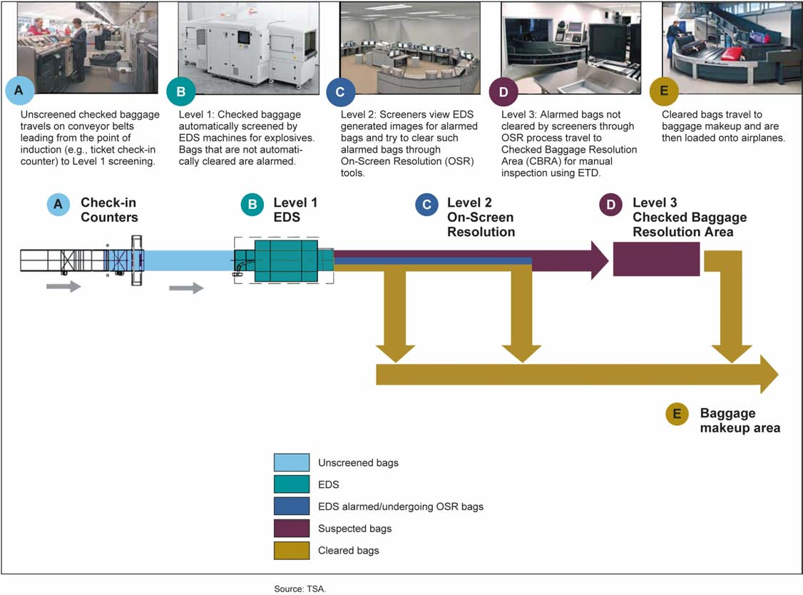
Inside a Checked-Baggage System
How a federal checked-baggage screening system works.
© More Lessons Less Planning | morelessonslessplanning.com
Notes:
Give the class fifteen silent seconds with the flow chart, then ask them to find where a bag goes if Level 1 flags it.
Reference labels (point to these chart features when teaching): Level 1: EDS machines; Level 3: manual search

Slide 8
Who Could Be Hired
The New Agency
The Transportation Security Administration is the federal agency created in 2001 to run screening at airports.
✔
Citizenship
Every screener the agency hires had to be a citizen of the United States.
✔
Education and English
Applicants needed a diploma or GED and enough English for the job.
✔
Veterans
A hiring preference went to military retirees drawing retired or retainer pay.
✔
Note: These hiring rules were a real cost - some willing applicants no longer qualified.
© More Lessons Less Planning | morelessonslessplanning.com
Notes:
Push on the citizenship requirement specifically. It is a concrete, checkable cost the law placed on real job applicants.

Slide 9
Congress Left an Exit Ramp
Feature | What the Statute Said
Program Length | Begins one year after enactment; ends three years after enactment
Airports Allowed | At most one airport from each of five airport security risk categories
Pay Floor | Screeners paid at least as much as federal screeners
Federal Backstop | Federal supervisors and law enforcement still cover the airport
Did You Know: Congress federalized screening but tested a private alternative at the very same time.
© More Lessons Less Planning | morelessonslessplanning.com
Notes:
This is the compromise that let the bill pass: full federalization plus a built-in pilot program to test the alternative.

Slide 10
The Other Law
The October law's changes were legal, not physical, so few people saw them.
USA PATRIOT is an acronym built from the statute's full, formal title.
Most of its sections amended existing surveillance and investigation laws.
Nothing changed at the airport, so its effects were harder to notice.
One of its most debated sections dealt with business records.
Key Concept: A law can change daily life without changing anything visible.
© More Lessons Less Planning | morelessonslessplanning.com
Notes:
Contrast this directly with the November law: one is visible at every checkpoint, the other is invisible unless you are the target of an order.

Slide 11
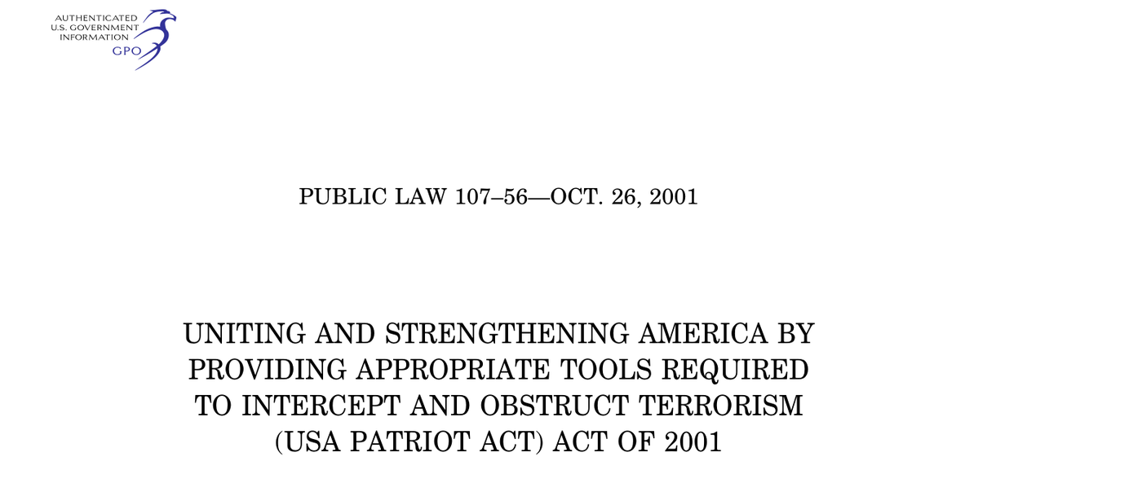
The Law as Congress Printed It
Public Law 107-56 as printed, October 26, 2001.
© More Lessons Less Planning | morelessonslessplanning.com
Notes:
Have students find the full name the acronym is built from, printed in the middle of the page.
Reference labels (point to these chart features when teaching): Acronym from full title; GPO authentication seal

Slide 12
Section 215: Business Records
Who Can Apply
The FBI Director, or a senior designee, may apply for the order.
✔
What It Can Reach
A person or business must turn over records tied to the investigation.
✔
Required Connection
The request must support a terrorism or clandestine intelligence investigation.
✔
Who Reviews It
The application goes to a specially designated federal judge.
✔
Tip: Section 215 is one small part of a much longer statute.
© More Lessons Less Planning | morelessonslessplanning.com
Notes:
This slide sets up the next two: what counts as a record, and who signs off on the order.

Slide 13
What Counts as a Record
The Statute's Phrase
The statute calls these tangible things, the phrase for physical items: books, records, papers, documents.
✔
Broader Than It Sounds
That phrase covers far more than paper files inside one filing cabinet.
✔
Examples
It could reach library records, business receipts, or membership lists.
✔
No Personal Suspicion Needed
A person could be required to hand these over without being suspected themselves.
✔
Warning: A single order could reach almost any paper record a business kept.
© More Lessons Less Planning | morelessonslessplanning.com
Notes:
Ask students to brainstorm their own list of 'tangible things' a library or a gym might keep on them.

Slide 14
The Limit Written Into the Law
The Solely Rule
An investigation of a U.S. person could not rest only on First Amendment activity.
Covered Freedoms
Speech, religion, the press, assembly, and petition all count here.
One Sentence, Two Jobs
The same sentence that created the power also set a limit on it.
Another Basis Needed
Investigators needed a reason tied to terrorism, not talk alone.
Did You Know: The same sentence that created the power also limited it.
© More Lessons Less Planning | morelessonslessplanning.com
Notes:
Read the actual statutory language aloud: 'not conducted solely upon the basis of activities protected by the first amendment.' Ask what work the word 'solely' is doing.

Slide 15
Who Approves the Order
ex parte
A decision made with only one side present to argue its case.
Foreign Intelligence Surveillance Court
The federal court that reviews government applications in national-security investigations.
Order Confidentiality
The approved order may not disclose the investigation it was issued for.
Section 501
The renumbered section of the surveillance law that Section 215 actually rewrote.
Note: Only the government's side of the request is ever in the room.
© More Lessons Less Planning | morelessonslessplanning.com
Notes:
Ask students to name every other kind of hearing they can think of where both sides normally get to argue.

Slide 16
How This Differs From an Ordinary Search
Ordinary Search
Police normally must show a judge probable cause before a search is approved.
✔
Section 215 Order
The FBI only had to state the records fit an authorized investigation.
✔
Who Finds Out (Search)
An ordinary search target usually learns about it right away.
✔
Section 215 Secrecy
A Section 215 recipient might never find out an investigation was underway.
✔
Warning: Section 215 used a lower bar of evidence than an ordinary search warrant.
© More Lessons Less Planning | morelessonslessplanning.com
Notes:
This is the comparison the whole lesson has been building toward. Make sure students can state the difference in their own words before moving on.

Slide 17
The Case Made For the Law
Senator Hatch's View
Sen. Orrin Hatch (R-UT) argued the country needed these tools right away.
✔
What the Bill Would Do
He said it let investigators find, track, and prosecute terrorists here.
✔
The Freedom Argument
He argued it preserved civil liberties, freedoms like speech and privacy.
✔
How It Was Written
He said the bill reflected weeks of bipartisan negotiation.
✔
Part of a Bigger Fight
He called these tools the domestic complement to the military fight overseas.
✔
Key Concept: Supporters argued the bill added tools without taking freedoms away.
© More Lessons Less Planning | morelessonslessplanning.com
Notes:
Hatch was the ranking member of the Senate Judiciary Committee - a senior voice for the bill's supporters, not a fringe figure.

Slide 18
The Case Made Against the Law
Senator Russ Feingold cast the Senate's only vote against the bill.
He argued a police state could catch more terrorists, but that is not America.
The country could lose the fight against terrorism if it gave up its freedoms.
He said the fight against terrorism was itself partly about those freedoms.
He found parts of the original proposal troubling before the final bill.
Note: One senator voted no, and he explained exactly why on the record that same day.
© More Lessons Less Planning | morelessonslessplanning.com
Notes:
Feingold was the only senator to vote no. In the House, 66 members also voted against the bill, so he stood alone in the Senate, not in Congress. Make sure students register how alone that made him on the Senate floor that day.

Slide 19
What Congress Actually Did
Vote | Result
House of Representatives | 357 yeas, 66 nays
Senate | 98 yeas, 1 nay
Sen. Hatch | Judiciary ranking Republican; voted yes
Margin | Both chambers passed the bill by more than five to one
Signed into law | President Bush signed the bill on October 26, 2001
Remember: The debate you just read was real, but the final vote was lopsided.
© More Lessons Less Planning | morelessonslessplanning.com
Notes:
Let this land in silence for a second. Ask why a debate with such a strong case on both sides still ended almost unanimous.

Slide 20
The Clock Congress Set
sunset provision
A part of a law that ends automatically on a set date unless Congress votes to renew it.
congressional oversight
The power of Congress to require reports on how an agency uses the authority it was given.
December 31, 2005
The date most of the surveillance title was set to expire under the original statute.
Twice-a-Year Reports
How often the Attorney General had to report Section 215 use to House and Senate committees.
Did You Know: Congress can hand itself a second chance to reconsider its own law.
© More Lessons Less Planning | morelessonslessplanning.com
Notes:
Close on this: the law that gave new power also gave Congress a built-in reason to look at that power again later.

Slide 21
Key Takeaways
Congress passed two very different new laws about ten weeks after September 11.
★
One law changed airport screening; the other changed how records are gathered.
★
The new power came with a written limit and a report back to Congress.
★
Both laws let Congress check back later - a report, a pilot, an end date.
★
The 2001 vote was almost entirely one-sided, though the arguments were not.
★
© More Lessons Less Planning | morelessonslessplanning.com
Notes:
Close on the framework, not a verdict: what a security measure buys, what it costs, and who checks it later.

