Slide 1
Schliemann Digs Up Troy
Spectacular finds, destructive methods: a case study in how NOT to do archaeology.
© More Lessons Less Planning | morelessonslessplanning.com
Notes:
Open the case. For nearly 3,000 years people wondered whether Homer's Troy was a real place. In the 1870s a wealthy, self-taught businessman named Heinrich Schliemann was so certain the Iliad pointed to a real city that he spent his fortune digging at the hill of Hisarlik in northwest Turkey - and he found gold. But this lesson is not a hero story. Schliemann's dig is famous for two opposite reasons: he really did prove a Bronze Age city lay under the mound, AND he did nearly everything a modern archaeologist is trained NOT to do. He cut a destructive trench, misnamed his greatest find, exaggerated the story, and smuggled the treasure out of the country. By the end, students should be able to weigh the man honestly - crediting the discovery while rejecting the methods and the myths.

Slide 2
Learning Targets
Describe who Schliemann was and what he actually found at Hisarlik
★
Explain why his methods and claims are a case study in how NOT to do archaeology
★
Weigh his real contribution against his flawed methods and false claims
★
© More Lessons Less Planning | morelessonslessplanning.com
Notes:
Read each target aloud. Target 1 maps to slides 3-4 (who Schliemann was and the site of Hisarlik). Target 2 maps to slides 5-11 (the great trench, 'Priam's Treasure,' the Troy II dating problem, the 1874 photograph, and the exaggeration and smuggling). Target 3 maps to slides 12-14 (his real contribution, the how-NOT-to lessons, and the honest verdict) and drives the Primary Source Spotlight, where students read Schliemann's own account critically. Stress that the goal is a weighed judgment - credit AND critique - not simple hero-worship or dismissal.

Slide 3
Who Was Heinrich Schliemann?
The Self-Made Treasure Hunter
A Man on a Mission
SCHLIEMANN was a wealthy 19th-century businessman
He was self-taught, with no formal archaeology training
He was obsessed with proving Homer's Troy was real
He used his own fortune to fund his digs
He treated Homer's Iliad as a map to a real city
In the 1870s he began digging at HISARLIK in Turkey
He wanted FAME as the man who found Troy
His ambition shaped how he dug - and how he told the story
Key Concept: SCHLIEMANN was a wealthy, self-taught 19th-century businessman who used his fortune to search for Homer's Troy at Hisarlik.
© More Lessons Less Planning | morelessonslessplanning.com
Notes:
Introduce the man honestly. Heinrich SCHLIEMANN was a wealthy 19th-century businessman who made a fortune in trade and then reinvented himself as an archaeologist - though he was SELF-TAUGHT and had no formal training. He was obsessed with the idea that Homer's Iliad pointed to a real Troy, and he used his own money to fund excavations to prove it. Two things about him matter for the whole lesson: first, he treated a poem as a treasure map, which drove him to dig where others doubted; second, he wanted FAME as the man who found Troy, and that hunger for glory shaped both how he dug and how he later told the story. Neither the wealth nor the ambition is a crime - but they help explain the mistakes students will see next.

Slide 4
Hisarlik: The Mound He Dug
Hisarlik
HISARLIK is the hill in northwest Turkey whose ruins most archaeologists identify as Troy; the mound holds many settlement layers stacked over thousands of years.
Nine layers
The mound holds NINE major settlement levels (Troy I to IX), each city built on the rubble of the one before it.
Stratigraphy
STRATIGRAPHY is the careful, layer-by-layer method archaeologists use to read a site like a stack of pages and record which layer each find comes from.
A slow, careful science
Good archaeology means digging slowly and recording every layer - the opposite of rushing to the bottom of the mound.
Key Concept: HISARLIK holds NINE stacked settlement layers; reading them in order is STRATIGRAPHY, the careful layer-by-layer method of archaeology.
© More Lessons Less Planning | morelessonslessplanning.com
Notes:
Establish the site and the RIGHT way to dig it, so Schliemann's mistakes land later. HISARLIK is a hill in northwest Turkey whose ruins most archaeologists identify as Troy. The key fact: the mound holds NINE major settlement levels, labeled Troy I to IX, stacked one on top of another because cities were rebuilt on the rubble of the last for thousands of years. Reading those layers in the right order is called STRATIGRAPHY - the careful, layer-by-layer method that lets archaeologists know which find belongs to which city and time. Stress the discipline: good archaeology is slow, patient, and obsessive about recording every layer. That standard is exactly what Schliemann will violate on the next slide, so plant it firmly now: at Hisarlik, the layers ARE the evidence, and destroying them destroys the story.

Slide 5
The Great Trench: Digging Too Fast, Too Deep
A Giant Cut Through History
Losing the Record
Schliemann cut a huge GREAT TRENCH straight down through the mound
He raced to the bottom, chasing Homer's Troy
His trench sliced through and destroyed upper layers
He wrecked the Late BRONZE Age level a real Trojan War would leave
Fast digging destroyed the site's PROVENANCE
PROVENANCE = the record of where and in which layer a find was made
Without it, objects lose most of their scientific meaning
The next slide shows the scale of his excavation trench
Fact: Schliemann's GREAT TRENCH cut straight down, destroying upper layers and the site's PROVENANCE - the record of where each find belonged.
© More Lessons Less Planning | morelessonslessplanning.com
Notes:
This is the heart of the 'how NOT to' case, and it must be stated as fact, not insult. In his hurry to reach Homer's Troy, Schliemann drove a huge GREAT TRENCH straight down through the mound at Hisarlik. Racing to the bottom, his trench sliced through and destroyed the upper layers - including much of the Late Bronze Age level, which is the very layer a real Trojan War (around 1200 BCE) would have left behind. The bitter irony: in his rush to find the Trojan War, he may have destroyed some of its best evidence. Just as damaging, his fast, sloppy digging destroyed the site's PROVENANCE - the record of exactly where and in which layer each object was found. Without provenance, even a spectacular find loses most of its scientific meaning, because you no longer know which city or century it belongs to. The next slide shows a photograph of the deep excavation trench so students can picture the scale.

Slide 6
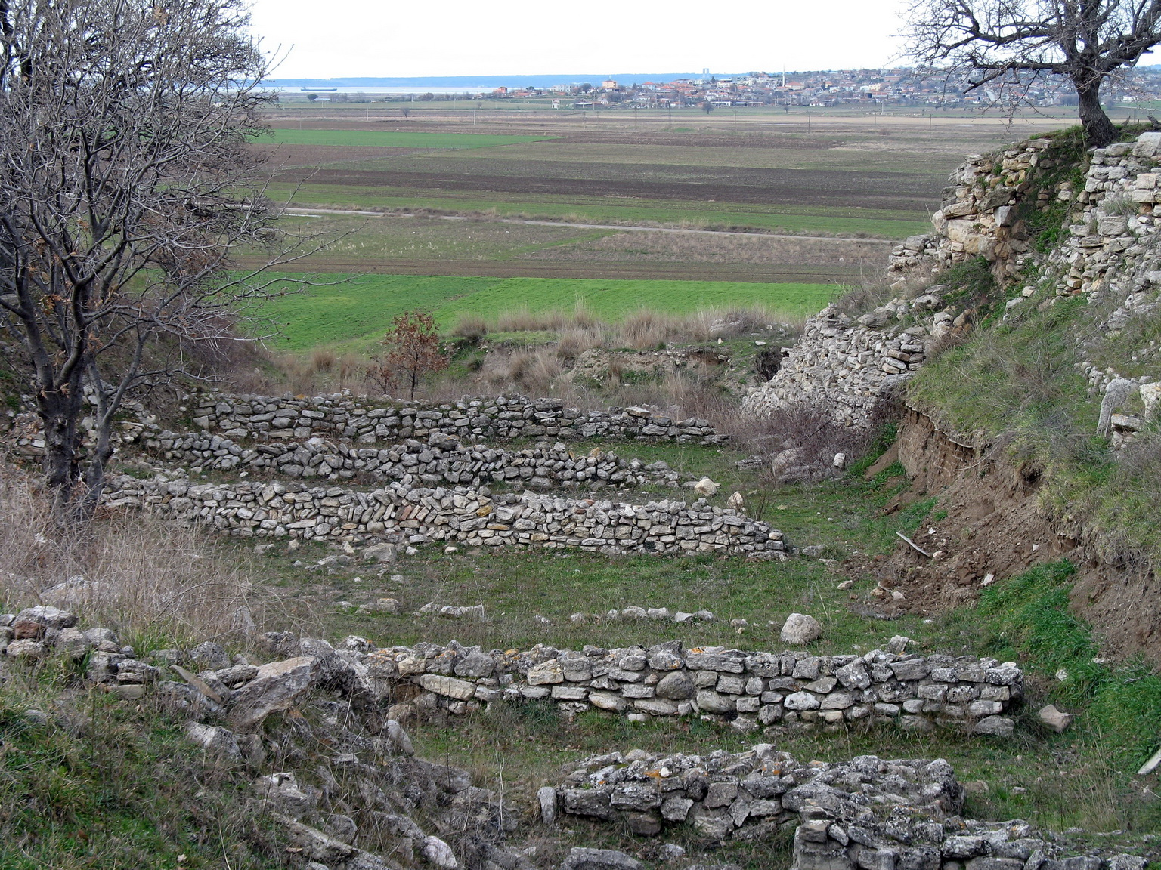
The Great Excavation Trench at Hisarlik
Excavated ruins of Hisarlik (Troy) at Schliemann's great trench
© More Lessons Less Planning | morelessonslessplanning.com
Notes:
This is a real photograph of the excavated ruins at Hisarlik, looking out over the Trojan plain from the area of Schliemann's great trench. Have students notice the stacked ruined stone walls of different building periods and the cut earth-and-stone face of the mound on the right, where the excavation sliced into the hill. Connect it to the previous slide: cutting into the mound this way, driven quickly, is exactly how upper layers - and the record of which layer each find came from - get destroyed. Point out that later, careful archaeologists could still read the exposed walls, but only after Schliemann had already cut through much of the site. The photo makes the scale of the dig concrete without sensationalizing it.
Reference labels (point to these chart features when teaching): stacked ruined stone walls; the cut into the mound

Slide 7
'Priam's Treasure': The Spectacular Find
A Glint of Gold, 1873
A Name, Not a Fact
In 1873 Schliemann uncovered a hoard of gold and jewelry
He named it PRIAM'S TREASURE, after the last king of Troy
Gold diadems, cups, and thousands of tiny gold rings
The find made him world-famous overnight
The name 'Priam's Treasure' was Schliemann's GUESS
He WANTED it to belong to Homer's King Priam
But naming it after Priam did not make it his
The dates, as the next slide shows, do not fit
Fact: In 1873 Schliemann found a real gold hoard he named 'PRIAM'S TREASURE' - a guess linking it to Homer's king, NOT a proven fact.
© More Lessons Less Planning | morelessonslessplanning.com
Notes:
Introduce the famous find, carefully. In 1873 Schliemann uncovered a genuine hoard of gold and jewelry at Hisarlik - gold diadems, cups, and thousands of tiny gold rings. It was a real, dazzling discovery that made him world-famous almost overnight. But watch the honesty line closely: he named the hoard 'PRIAM'S TREASURE' after King Priam, the last king of Troy in Homer's Iliad. That name was a GUESS driven by what he WANTED to be true, not a proven fact. Naming gold after Priam does not make it Priam's. Tell students plainly: the discovery is real and important, but the name is a claim - and on the next slide they will see exactly why that claim cannot be right. Do not let anyone leave thinking the gold 'belonged to King Priam' - it did not.

Slide 8
Too Old by a Thousand Years
Troy II
TROY II is the early city layer (around 2400 BCE) that the 'treasure' actually comes from - a real, wealthy Bronze Age town.
A thousand-year gap
Troy II is roughly a THOUSAND years older than the ~1200 BCE date scholars link to a possible Trojan War.
Misidentification
MISIDENTIFICATION means Schliemann wrongly labeled Troy II gold as King Priam's - off by about a thousand years.
Real, but not Priam's
The gold is genuine and important, but it cannot have belonged to Homer's Priam because it is far too old.
Key Concept: The gold comes from TROY II (~2400 BCE), about a THOUSAND years too old for Priam - Schliemann's MISIDENTIFICATION.
© More Lessons Less Planning | morelessonslessplanning.com
Notes:
This slide is the factual core of the honesty anchor, and every surface of the toolkit depends on it. The gold Schliemann called 'Priam's Treasure' actually comes from TROY II, an early city layer dated to around 2400 BCE - a real, wealthy Bronze Age town. But here is the problem: Troy II is roughly a THOUSAND years older than the approximately 1200 BCE date scholars associate with a possible Trojan War. So the gold is about a thousand years too old to have belonged to any Priam of the Trojan-War era. This is a classic MISIDENTIFICATION - Schliemann attached a famous name to the wrong layer, off by a millennium. Be crystal clear with students: the gold is genuine and historically important, but it cannot be King Priam's. A student who leaves saying 'Schliemann found King Priam's treasure' has missed the entire point of the lesson.

Slide 9
The 1874 Portrait: Sophia in the Gold
A Famous Portrait
The 'Jewels of Helen' Label
In 1874 SOPHIA SCHLIEMANN, Heinrich's wife, sat for a portrait wearing the gold
She wore Bronze Age diadems and jewelry from the hoard
The 1874 portrait traveled around the world
It turned the find into a romantic legend
Schliemann romantically called the gold the 'JEWELS of Helen'
Helen of Troy is a MYTH - a character in Homer's poem
The jewelry is real BRONZE Age gold, NOT proven to be any Helen's
Honest label: an 1874 portrait of Bronze Age gold finds
Fact: The 1874 portrait shows SOPHIA SCHLIEMANN wearing real Bronze Age gold; Schliemann's romantic label 'Jewels of Helen' is a myth, NOT a fact.
© More Lessons Less Planning | morelessonslessplanning.com
Notes:
Cover the most famous image of the whole story, honestly. In 1874 SOPHIA SCHLIEMANN, Heinrich's wife, was photographed wearing gold from the hoard - Bronze Age diadems and jewelry draped over her like a queen. The photograph traveled around the world and turned the find into a romantic legend. But notice the label Schliemann attached: he called the gold the 'JEWELS of Helen,' after Helen of Troy. Helen is a MYTH - a character in Homer's poem, not a proven historical person - so calling real Bronze Age gold her jewels is exactly the kind of legend-first thinking this lesson warns against. Be precise with students: the photograph is real and the gold is real Bronze Age gold, but the 'Jewels of Helen' name is romance, not fact. The honest caption is simply: an 1874 photograph of Sophia Schliemann wearing Bronze Age gold finds. The next slide shows the photograph.

Slide 10
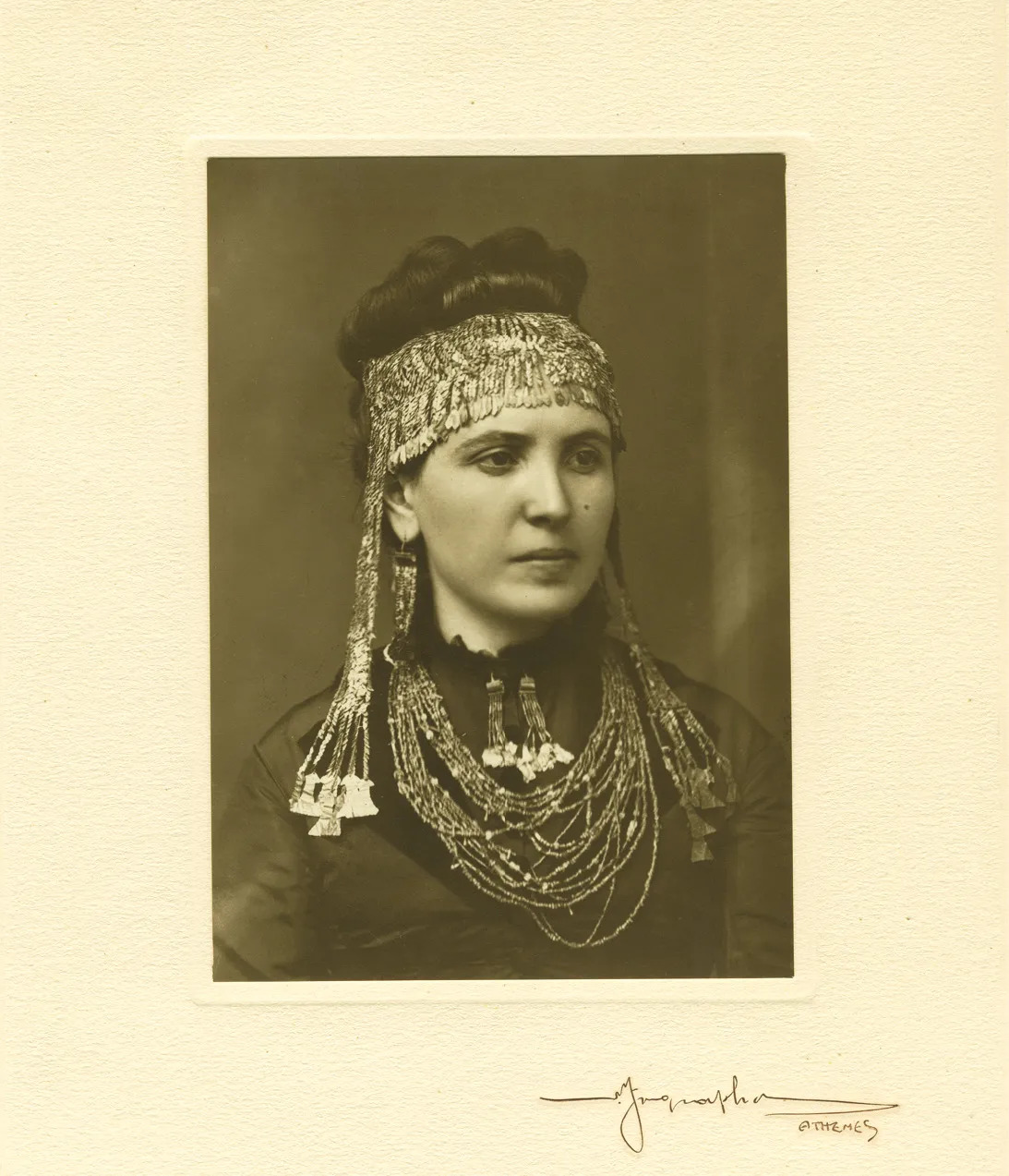
1874 Portrait of Sophia Schliemann Wearing Bronze Age Gold
1874 portrait: Sophia Schliemann in Bronze Age gold, not 'Jewels of Helen'
© More Lessons Less Planning | morelessonslessplanning.com
Notes:
This is the real 1874 photograph of Sophia Schliemann wearing Bronze Age gold finds from the Hisarlik hoard. Have students notice the gold diadem and headdress and the layered jewelry. Use the caption to model honesty: this is a genuine 1874 photograph of real Bronze Age gold, and that is all we can truthfully say. Schliemann's romantic name for the gold, the 'Jewels of Helen,' is a myth-driven label, not evidence about who owned it. Remind students the gold comes from Troy II (~2400 BCE), a thousand years too old to be connected to any Trojan-War figure - so the image is a beautiful piece of history that also shows how easily a legend gets attached to a real find.
Reference labels (point to these chart features when teaching): the gold diadem and headdress; the Bronze Age gold jewelry

Slide 11
Telling the Story His Way
Embellished accounts
Schliemann's accounts of the find were EMBELLISHED and inconsistent, shifting between his diary, letters, and books to make himself the hero.
The shawl story
He described his wife wrapping the treasure in her shawl - though historians show she may not even have been present that day.
Antiquities smuggling
ANTIQUITIES SMUGGLING is moving ancient artifacts out of a country; Schliemann smuggled the gold out of Ottoman TURKEY.
A broken agreement
The smuggling broke his agreement with the Ottoman government and led to lawsuits and lasting disputes over the treasure.
Fact: Schliemann EMBELLISHED his discovery story and committed ANTIQUITIES SMUGGLING, moving the gold out of Ottoman Turkey against his agreement.
© More Lessons Less Planning | morelessonslessplanning.com
Notes:
Cover the ethics honestly and without sensationalizing. Two problems sit beside the gold. First, Schliemann's accounts of the discovery were EMBELLISHED and inconsistent. The dramatic details - including the famous claim that his wife stood by wrapping treasure in her shawl - shifted between his private diary, his letters, and his published books, and historians have shown his wife may not even have been present that day. He repeatedly reshaped the story to make himself the daring hero. Second, the treasure was found in Ottoman TURKEY, and Schliemann engaged in ANTIQUITIES SMUGGLING - secretly moving the gold out of the country, which broke his agreement with the Ottoman government and led to lawsuits and lasting disputes over who owned it. State these as documented facts. They are not gossip; they are central to why his dig is a cautionary tale about honesty and ethics, not just about method.

Slide 12
What Schliemann Got Right
A Real Contribution
Standing on His Shoulders
Schliemann PROVED a real Bronze Age city lay under the mound
He showed Hisarlik was worth serious excavation
He drew the world's attention to Aegean prehistory
He helped launch the science of AEGEAN archaeology
Later archaeologists dug Hisarlik carefully and correctly
They used his SITE but rejected his rushed methods
His finds are still studied today
The real city under the mound is his greatest legacy
Fact: Schliemann really did PROVE a Bronze Age city lay under Hisarlik and helped launch AEGEAN archaeology - a genuine contribution.
© More Lessons Less Planning | morelessonslessplanning.com
Notes:
Restore the balance so the lesson is fair, not a hit piece. For all his flaws, Schliemann made a genuine contribution. He PROVED that a real, wealthy Bronze Age city lay buried under the mound at Hisarlik - something many scholars had doubted - and he showed the site was worth serious, sustained excavation. His dramatic finds drew the world's attention to Aegean prehistory and helped launch the whole science of AEGEAN archaeology. Later archaeologists built directly on his work: they dug the same SITE carefully and correctly, using proper stratigraphy, but rejected his rushed, destructive methods. His finds are still studied today. Tell students the honest takeaway is not 'Schliemann was a fraud' - it is that a real discovery and bad method can live in the same person. The city under the mound is real, and that is his greatest legacy.

Slide 13
How NOT to Do Archaeology
Do not dig too fast
Racing to the bottom with a GREAT TRENCH destroys the upper layers you cut through.
Do not lose provenance
Ignoring STRATIGRAPHY and PROVENANCE means finds lose the record of where they belonged.
Do not force the evidence
Naming a find 'Priam's Treasure' because you WANT it to be Homer's is MISIDENTIFICATION.
Do not embellish
Exaggerating and reshaping the discovery story is self-mythologizing, not science.
Big Idea: How NOT to do archaeology - dig too fast, destroy PROVENANCE, force the evidence to fit a legend, and embellish the story.
© More Lessons Less Planning | morelessonslessplanning.com
Notes:
Turn Schliemann's mistakes into a checklist of lessons - this is the payoff slide. Frame each as a rule modern archaeology follows because of cautionary tales like his. First, DO NOT dig too fast: racing to the bottom with a great trench destroys the upper layers you cut through, which is exactly what happened to the Late Bronze Age level at Hisarlik. Second, DO NOT lose provenance: ignoring stratigraphy and provenance means finds lose the record of where and when they belonged, and an object without context loses most of its scientific value. Third, DO NOT force the evidence: naming a find 'Priam's Treasure' because you want it to be Homer's is misidentification - the legend must not drive the label. Fourth, DO NOT embellish: exaggerating and reshaping the discovery story to make yourself the hero is self-mythologizing, not science. Each rule is a direct lesson from Schliemann's dig.

Slide 14
Weighing Schliemann
Pioneer AND cautionary tale
Schliemann was both a PIONEER who found a real city and a cautionary tale of bad archaeological method.
What we CAN say
A real, wealthy Bronze Age city (including Troy II) existed at Hisarlik - Schliemann helped prove it.
What we must NOT say
We must NOT say 'Priam's Treasure' belonged to King Priam or dates to the Trojan War - it is about a thousand years too old.
The honest verdict
CREDIT the discovery; reject the rushed methods and the exaggerations - weigh the man honestly.
Big Idea: Weigh Schliemann honestly - a real pioneer AND a cautionary tale; credit the city he found, reject his methods and his myths.
© More Lessons Less Planning | morelessonslessplanning.com
Notes:
Close the argument with a balanced verdict students can defend. Schliemann was both a PIONEER, who found a real city and helped launch a new science, AND a cautionary tale of bad method and worse honesty. State the two halves plainly. What we CAN say: a real, wealthy Bronze Age city - including the Troy II layer - existed at Hisarlik, and Schliemann helped prove it. What we must NOT say: that 'Priam's Treasure' belonged to King Priam or dates to the Trojan War, because the gold is about a thousand years too old. The honest verdict is to CREDIT the discovery while rejecting the rushed methods, the misidentification, and the exaggerations. That balance - confident about the real city, firm about the errors - is exactly what students should be able to explain and defend by the end of the lesson.

Slide 15
Key Takeaways
SCHLIEMANN found a real Bronze Age city at HISARLIK - a genuine contribution
★
His GREAT TRENCH destroyed layers and PROVENANCE - how NOT to dig
★
'Priam's Treasure' is really TROY II gold (~2400 BCE) - far too old for Priam
★
He EMBELLISHED his story and SMUGGLED the gold out of Ottoman Turkey
★
© More Lessons Less Planning | morelessonslessplanning.com
Notes:
Close the lesson. Review the four takeaways aloud. Students should be able to (a) credit that Schliemann found a real Bronze Age city at Hisarlik - a genuine contribution that helped launch Aegean archaeology; (b) explain that his great trench destroyed upper layers and the provenance of finds, the clearest example of how NOT to dig; (c) state firmly that 'Priam's Treasure' is Troy II gold from around 2400 BCE, about a thousand years too old to be King Priam's - a misidentification; and (d) explain that he embellished his discovery story and smuggled the gold out of Ottoman Turkey. The activity's Primary Source Spotlight will ask them to read Schliemann's own account of the find and judge it critically against these facts.

