Slide 1
Risk vs Reward: Why You Can't Win Without Risk
Higher potential returns bring bigger ups and downs—learn to match risk with your goals, time horizon, and diversification.
© More Lessons Less Planning | morelessonslessplanning.com
Notes:
Open with the big picture that frames the whole lesson: after learning the individual investment vehicles in TK53-TK57 (stocks, bonds, funds, the market, retirement accounts), students now meet the SINGLE IDEA that runs under all of them - the RISK/REWARD TRADEOFF. State it plainly: a higher possible reward always comes paired with higher risk, so you cannot win without risk, and the safest choices earn the least. Introduce Devin Carter, 24, who has $1,000 to invest for the first time and is comparing four places to put it - a savings account, bonds, stocks, and crypto. Preview the five ideas the lesson teaches: (1) no reward without risk (the tradeoff), (2) VOLATILITY - how much a value swings up and down, (3) RISK TOLERANCE - how much risk you personally can handle, (4) TIME HORIZON - how long until you need the money, which changes how much risk you can take, and (5) DIVERSIFICATION - spreading your money so no single investment can wreck your plan. The takeaway to plant now: the goal is not to avoid risk (that earns almost nothing) but to MANAGE it with time, honesty about your tolerance, and diversification.

Slide 2
Learning Targets
Explain the risk/reward tradeoff and why you cannot win without risk
★
Explain what investment risk and volatility are and name types of risk
★
Explain how risk tolerance and time horizon decide how much risk fits you
★
Explain how diversification lowers risk and build a mix that fits your goals
★
© More Lessons Less Planning | morelessonslessplanning.com
Notes:
Read the four targets aloud and tell students the lesson follows Devin Carter, 24, deciding how to invest $1,000 for the first time. Target 1 is the core principle: the RISK/REWARD TRADEOFF - a higher possible reward always comes paired with higher risk, so safe investments earn little and you cannot win without risk. Target 2 is the vocabulary of risk: RISK is the chance you lose value or earn less than you hoped, and VOLATILITY is how much a value swings up and down over time (the everyday face of risk); students will also see there are different TYPES of investment risk. Target 3 is how to size the right amount of risk for a person: RISK TOLERANCE (how much swing or possible loss you can handle without panic-selling) and TIME HORIZON (how long until you need the money - a long horizon can hold more risk). Target 4 is the tool that lowers risk: DIVERSIFICATION - spreading money across many investments so no single one can wreck the plan - and using all of it to build a mix that fits your goals. Emphasize the through-line: you do not avoid risk, you manage it.

Slide 3
No Reward Without Risk
Risk
RISK is the chance that an investment loses value or does not earn what you hoped - the possibility that you get back less than you put in
Return
RETURN is the money you earn on an investment, usually shown as a percent per year - the reward side of investing
The pairing
Safe places to put money (a savings account) earn a small return; the chance of a big return always comes with the chance of a big loss
Why you can't avoid it
The only way to earn almost no return is to take almost no risk - so to grow money you must accept some risk; you cannot win without risk
Key Concept: RISK is the chance of losing value; RETURN is the reward. Higher reward comes with higher risk, so you can't win without risk.
© More Lessons Less Planning | morelessonslessplanning.com
Notes:
Set up the whole lesson by pairing the two core ideas. First define RISK: it is the chance that an investment loses value or does not earn what you hoped - the possibility you get back less than you put in. Then define RETURN: the money you earn on an investment, usually shown as a percent per year, which is the reward side. Now make the pairing explicit and concrete for Devin: the safest place to put money (a savings account) earns only a small return, while the chance of a big return (stocks or crypto) always comes with the chance of a big loss. Drive home why you cannot dodge this: the only way to take almost no risk is to accept almost no return (money in a savings account barely grows), so to actually grow money you MUST accept some risk. That is the headline of the toolkit - you cannot win without risk. Reassure students this does not mean gambling: the rest of the lesson is about how to take SMART, managed risk (with time, tolerance, and diversification) rather than reckless risk. Every keyed term here - risk, return - is used again on the next slide when we name the tradeoff.

Slide 4
The Risk/Reward Tradeoff
The rule
Devin's four choices
RISK/REWARD TRADEOFF: higher possible reward comes with higher risk
A chance at a bigger return also brings a chance of a bigger loss
Risk rises from savings to bonds to stocks to crypto; VOLATILITY is the swing
Savings: about 4% return and 1% swing; bonds: 5% and 5%
Stocks: about 10% return and 18% swing
Crypto: about 15% return and 70% swing - highest reward and risk
Key Concept: The RISK/REWARD TRADEOFF means higher reward comes with higher risk. VOLATILITY (how much a value swings) is the face of risk.
© More Lessons Less Planning | morelessonslessplanning.com
Notes:
This is the heart of the lesson: name and illustrate the RISK/REWARD TRADEOFF. Teach the rule explicitly: a higher possible reward ALWAYS comes paired with higher risk. Safe investments earn little; the chance of a big return always comes with the chance of a big loss. Then show it with Devin's four choices, lined up from safest to riskiest by asset class - savings, bonds, stocks, crypto. Use the pinned illustrative figures (from gen_money.py; stress these are typical, illustrative, NOT guaranteed): a savings account earns about 4% a year with only about a 1% swing (very safe, low reward); bonds about 5% return with about a 5% swing; stocks about 10% return but an 18% swing (more reward, more ups and downs); crypto about 15% return but a huge 70% swing (highest reward, highest risk). Introduce VOLATILITY here as the everyday face of risk: it is how much an investment's value swings up and down over time - crypto swings the most, a savings account barely moves. The key thing students should see (and the chart on the next slide makes visible): as you move from savings to crypto, the RETURN goes up a little (4% to 15%) but the RISK/swing goes up a LOT (1% to 70%). Risk climbs far faster than reward - that is the tradeoff. The next slide shows this as a bar chart.

Slide 5
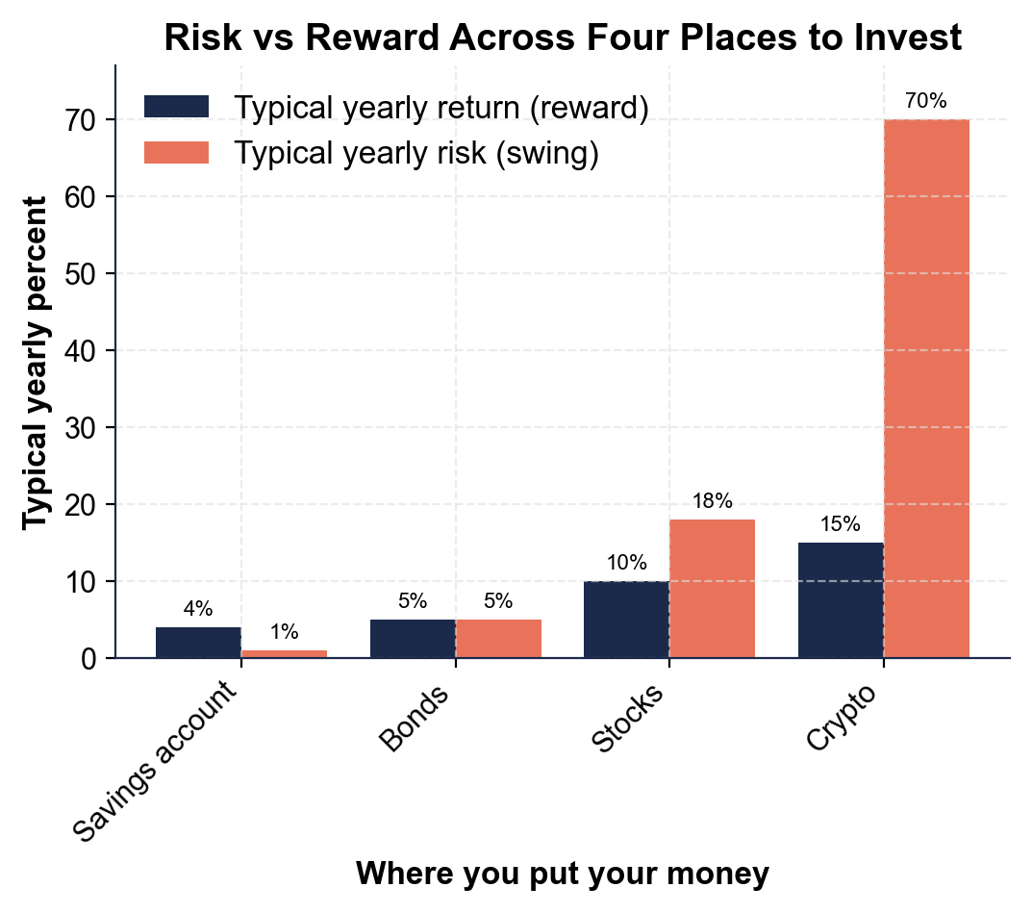
Risk vs Reward: The Tradeoff Made Visible
Return rises a little from savings to crypto, but risk rises far more.
© More Lessons Less Planning | morelessonslessplanning.com
Notes:
Have students read the grouped bar chart of typical return versus typical risk across Devin's four choices. The x-axis is where you put your money (savings account, bonds, stocks, crypto) and the y-axis is a typical yearly percent. Two bars sit at each asset class: Typical yearly return (the reward) and Typical yearly risk/swing (volatility). Trace the pattern with students left to right: savings has a 4% return and only a 1% risk; bonds 5% and 5%; stocks 10% return but an 18% swing; crypto 15% return but a 70% swing. The whole lesson is in the SHAPE of the two bars: the return bar climbs modestly (4% to 15%) while the risk bar climbs steeply (1% to 70%). Point out the two big reads: (1) both bars climb from savings to crypto, so higher reward always comes with higher risk, and (2) risk climbs FAR faster than reward - going from savings to crypto multiplies the return about 3.75 times but multiplies the risk 70 times. Remind students the numbers are illustrative typical figures, not guaranteed. This is the chart Activity Part 3 reads: students pull the exact return and risk percents off the bars and connect the faster-climbing risk bar to the risk/reward tradeoff they reason about in Parts 4 and 5.
Reference labels (point to these chart features when teaching): Return climbs 4% to 15%; Risk climbs 1% to 70%

Slide 6
Types of Investment Risk
Market risk
The whole market can drop at once (like a recession), pulling most investments down together no matter how good they are
Company (single-stock) risk
One company can fail on its own - bad news, bad management, bankruptcy - and take the money you put in it down with it
Inflation risk
Playing it too safe has a risk too: money in a low-return savings account can lose buying power if prices rise faster than it grows
Volatility risk
A very VOLATILE investment (like crypto) can swing so far so fast that you panic-sell at a low and lock in a big loss
Key Concept: Risk has types - market (whole market drops), company (one fails), inflation (too safe loses value), and volatility (big swings) risk.
© More Lessons Less Planning | morelessonslessplanning.com
Notes:
Show students that 'risk' is not one single thing - it comes in different types, and understanding them is how you manage risk instead of fearing it. MARKET RISK: the whole market can drop at once (a recession or crash, like the ones from TK56), pulling most investments down together no matter how good any single one is - this is the risk you cannot diversify away completely. COMPANY (single-stock) RISK: one company can fail on its own - bad news, bad management, even bankruptcy - and take the money you put in it down with it; this is the risk diversification DOES lower, because spreading across many companies means no single failure wrecks you. INFLATION RISK: the surprising one - playing it too safe has a risk too. Money sitting in a low-return savings account can actually lose buying power if prices (inflation) rise faster than it grows, so 'safe' is not risk-free. VOLATILITY RISK: a very volatile investment like crypto can swing so far, so fast, that the biggest danger is your own behavior - you panic-sell at a low and lock in a big loss. Tie it back to Devin: knowing these types tells Devin WHY diversification and a long time horizon (coming up) actually help - they target company risk and volatility risk. Keep it plain: different risks call for different tools.

Slide 7
Your Risk Tolerance
Risk tolerance
RISK TOLERANCE is how much risk - how big a swing or possible loss - you can handle, financially and emotionally, without panic-selling
The money side
Could you afford the loss? If you need the money soon or it is all you have, your ability to take risk is lower
The feelings side
Would a big drop make you panic and sell? If watching a 30% drop would keep you up at night, your comfort with risk is lower
Be honest
The right risk level is one you can STICK WITH in a downturn - picking more risk than you can handle leads to selling low
Key Concept: RISK TOLERANCE is how much risk you can handle - money-wise and emotionally - without panic-selling. Pick a level you can stick with.
© More Lessons Less Planning | morelessonslessplanning.com
Notes:
Turn the lens from the investments to the PERSON: how much risk is right depends on you. Define RISK TOLERANCE: how much risk - how big a swing or possible loss - YOU can handle, both financially and emotionally, without panic-selling. Break it into the two honest questions Devin should ask. The money side (ability): could you actually afford the loss? If you need the money soon, or it is all the money you have, your ABILITY to take risk is lower - a big drop would really hurt. The feelings side (willingness): would a big drop make you panic and sell? If watching your $1,000 fall to $700 would keep you up at night, your COMFORT with risk is lower, even if you could afford it. The key coaching point: the right risk level is the one you can STICK WITH during a downturn. Picking more risk than you can handle backfires, because the moment the market drops you sell low and lock in the loss (the classic mistake from TK56). So Devin should be honest, not brave - it is better to take a little less risk and hold on than to take too much and bail. Note that risk tolerance is personal and can differ between two people with the same amount of money. This sets up the next slide: your time horizon is a big part of how much risk you can afford.

Slide 8
Time Horizon Changes How Much Risk You Can Take
What time horizon is
Short vs long
TIME HORIZON is how long until you need the money
A LONG horizon (retirement is 40+ years away) can hold riskier investments
There is time to ride out the swings and recover from drops
So a long horizon can lean toward higher-reward stocks
A SHORT horizon (money needed next year) should stay safe and low-volatility
There is no time to recover if the market drops right before you need it
So short-horizon money belongs in a savings account, not crypto
Match the risk to WHEN you need the money
Key Concept: TIME HORIZON is how long until you need the money. A LONG horizon can take more risk (time to recover); a SHORT one stays safe.
© More Lessons Less Planning | morelessonslessplanning.com
Notes:
Teach the single biggest factor in how much risk a person can take: TIME HORIZON - how long until you need the money. Make the two cases crisp. A LONG horizon: Devin is 24 and retirement is 40+ years away, so money invested now has decades before it is needed. That long runway means Devin CAN hold riskier, higher-reward investments like stocks, because there is time to ride out the swings and recover from any drop before the money is actually needed - a crash at 30 is fully recovered long before Devin is 65 (connect back to TK56's recovery chart). A SHORT horizon: money you need next year - a car, rent, an emergency - should stay in safe, low-volatility places like a savings account, because there is NO time to recover if the market drops right before you need it. Imagine putting next month's rent in crypto and it swings down 30% the week before rent is due - a disaster. So the rule Devin should carry: match the risk to WHEN you need the money. Long-horizon money can take risk; short-horizon money should stay safe. This is why the same person can correctly hold crypto for retirement and a savings account for next year's expenses - same person, different time horizons, different right answers. Time horizon and risk tolerance together decide the right mix, which the last two slides build.

Slide 9
Diversification Lowers Risk
The idea
The $1,000 example
DIVERSIFICATION spreads money across many investments
No single investment can wreck the plan; do not put all eggs in one basket
It lowers risk without giving up much expected return; an index fund makes it easy
$1,000 in ONE investment that drops 50% becomes $500: a $500 loss
Split across 10 ($100 each); one 50% drop costs only $50
The other $900 is untouched: same event, $450 less lost
Key Concept: DIVERSIFICATION spreads money so no one investment wrecks your plan. $1,000 in one that drops 50% loses $500; split across 10, just $50.
© More Lessons Less Planning | morelessonslessplanning.com
Notes:
Teach the one tool that lowers risk without giving up much reward: DIVERSIFICATION - spreading your money across many different investments so no single one can wreck your whole plan. Give the classic phrase: 'don't put all your eggs in one basket.' The powerful part: unlike being extra-safe (which lowers reward too), diversification lowers RISK without giving up much expected RETURN - you still own stocks, you just own many of them. Point out students already met this in TK55: an index fund IS diversification, because one purchase owns hundreds of companies at once. Now make it concrete and quantitative with Devin's $1,000 (all figures pinned in gen_money.py). Case 1, all-in-one: Devin puts the whole $1,000 into ONE investment, and it drops 50% - the whole $1,000 falls to $500, a $500 loss. Case 2, diversified: Devin splits the $1,000 across 10 different investments, $100 each, and ONE of them drops 50% - only that $100 falls to $50, a $50 loss, while the other $900 is completely untouched. Same bad event (one investment drops 50%), but diversification cut the loss from $500 down to $50 - a $450 smaller loss. That is the whole case for diversification in one number. Students apply this exact example in the Activity. The takeaway: you do not lower risk by hoping nothing bad happens - you lower it by spreading out so one bad thing cannot sink you.

Slide 10
Building a Mix That Fits You
Step 1: Check your time horizon
How long until you need the money? A long horizon (like retirement) can hold more stocks; short-horizon money stays in savings
✔
Step 2: Be honest about your risk tolerance
Pick a risk level you can stick with in a downturn without panic-selling - a mix you can hold beats a bold one you bail on
✔
Step 3: Diversify
Spread money across many investments (an index fund is an easy way) so no single one can wreck your plan
✔
Step 4: Match risk to the goal
More risk for far-off goals with high reward potential; less risk for money you need soon - you don't avoid risk, you manage it
✔
Key Concept: Build a mix that fits YOU - check time horizon and risk tolerance, diversify, and match risk to the goal. Manage risk, don't avoid it.
© More Lessons Less Planning | morelessonslessplanning.com
Notes:
Turn the whole lesson into a concrete four-step plan Devin (and each student) can follow to build an investment mix that fits them. Step 1: check your TIME HORIZON - how long until you need the money. Long-horizon money (retirement, 40+ years for Devin) can hold more higher-reward stocks because there is time to recover from swings; short-horizon money (needed soon) stays in safe savings. Step 2: be honest about your RISK TOLERANCE - pick a risk level you can actually stick with during a downturn without panic-selling, because a slightly cautious mix you can HOLD beats a bold one you bail on at the bottom. Step 3: DIVERSIFY - spread your money across many investments so no single one can wreck the plan; remind students an index fund (TK55) is the easiest way to diversify with one purchase. Step 4: match the risk to the GOAL - take more risk for far-off goals with high reward potential, and less risk for money you need soon. Tie the whole toolkit together with the closing line: you do not AVOID risk (that earns almost nothing and even loses to inflation), you MANAGE it - with time, honesty about your tolerance, and diversification. For Devin's $1,000 with a 40-year horizon, that means a diversified, stock-heavy mix (like an index fund) is a sensible, managed way to take on risk - not reckless, and not overly timid. This is the judgment students should leave with.

Slide 11
Key Takeaways
RISK/REWARD TRADEOFF: higher reward means higher risk - can't win without risk
★
VOLATILITY (how much a value swings) is risk's face - crypto most, savings least
★
RISK TOLERANCE and TIME HORIZON set how much risk fits you - long horizons, more
★
DIVERSIFICATION lowers risk, keeps reward - $1,000 across 10 loses $50, not $500
★
You don't avoid risk - MANAGE it with time, risk tolerance, and diversification
★
© More Lessons Less Planning | morelessonslessplanning.com
Notes:
Read each takeaway and connect it to the learning targets. T1 (the tradeoff) -> the RISK/REWARD TRADEOFF means a higher possible reward always comes paired with higher risk; safe investments earn little and you cannot win without risk. T2 (volatility) -> VOLATILITY is how much an investment's value swings up and down, the everyday face of risk - crypto swings the most (a 70% swing for a 15% return), a savings account the least (a 1% swing for a 4% return). T3 (tolerance + horizon) -> your RISK TOLERANCE (how much swing/loss you can handle without panic-selling) and your TIME HORIZON (how long until you need the money) decide how much risk fits you - a long horizon can take more risk because there is time to recover. T4 (diversification) -> DIVERSIFICATION spreads money across many investments so no single one wrecks the plan, and it lowers risk without giving up much reward: Devin's $1,000 split across 10 loses only $50 when one drops 50%, versus a $500 loss all-in-one. T5 (the spine) -> you do not AVOID risk (that earns almost nothing), you MANAGE it - with time, honesty about your tolerance, and diversification. As the eighth toolkit of Unit 6, this connects the individual vehicles (stocks, bonds, funds, the market, retirement accounts) to the single principle that governs all of them: managed risk is how you grow money.

