Slide 1
Rise of Totalitarianism
How Crisis Handed Three Countries to Three Dictators
© More Lessons Less Planning | morelessonslessplanning.com
Notes:
Open by asking students to name any dictator they have heard of. Tell them today is about how three of them came to power in countries that had just tried democracy.

Slide 2
Learning Targets
Define totalitarianism and explain what makes it different.
★
Identify the crises that made three European countries unstable.
★
Explain how Mussolini, Hitler, and Stalin each took total control.
★
Compare the methods the three regimes used to hold power.
★
Use a 1933 U.S. diplomatic dispatch as evidence about Germany.
★
© More Lessons Less Planning | morelessonslessplanning.com
Notes:
Read the targets aloud. Point out that target five is the primary source they will analyse in the Activity.

Slide 3
Europe After the Great War
World War I broke apart four European empires and left millions dead.
New democracies replaced old monarchies across central Europe.
Most of those new governments were weak and only a few years old.
Inflation, unemployment, and street violence followed the war.
Many people began to want order more than they wanted a vote.
Key Concept: Democracy is easiest to attack when people believe it has already failed them.
© More Lessons Less Planning | morelessonslessplanning.com
Notes:
The four empires are the German, Austro-Hungarian, Russian, and Ottoman. Stress that the new republics that replaced them had no long habit of governing.

Slide 4
Three Words for a New Kind of Government
Totalitarianism
A system in which the state seeks total control over public and private life, allowing no rival parties, unions, or organizations
One-Party State
A country where only one political party is legal and every other party is banned
Fascism
A political movement that puts the nation and its leader above the individual and rejects both democracy and communism
Did You Know: Critics coined the word totalitarian in Italy in 1923, and Mussolini then adopted it proudly.
© More Lessons Less Planning | morelessonslessplanning.com
Notes:
The key word in the totalitarianism definition is total. A traditional dictator wants obedience; a totalitarian state wants every club, union, and newspaper too.

Slide 5
The Depression Breaks the Peace
The 1929 crash cut off the American loans propping up Europe.
Banks failed, savings vanished, and factories closed across Europe.
German unemployment hit about 30% in 1932, the worst in Europe.
Frightened voters abandoned the moderate parties that were in power.
Extreme parties grew fastest in the hardest years of the slump.
Note: The Nazi share of the German vote rose from 2.6% in 1928 to 37.3% in July 1932.
© More Lessons Less Planning | morelessonslessplanning.com
Notes:
The vote figures are the heart of this slide. The Nazis did not become popular in a boom; they became popular when a third of the country was out of work.

Slide 6
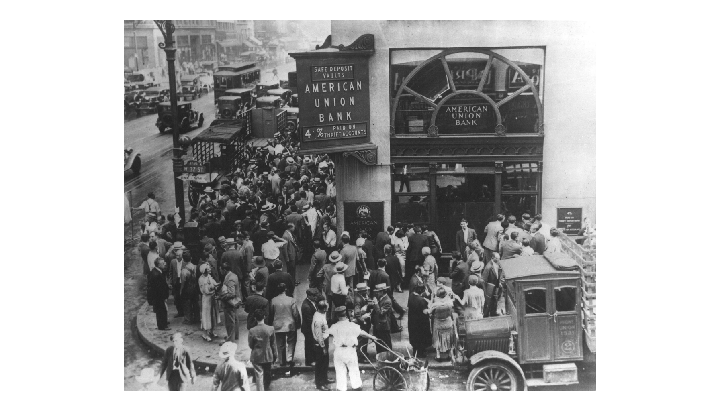
A Bank Closes Its Doors, New York, 1932
Note the crowd's size.
© More Lessons Less Planning | morelessonslessplanning.com
Notes:
This is New York, not Berlin, and say so. The same collapse ran through every industrial country; Germany's version is what put a third of its workers out of a job.
Reference labels (point to these chart features when teaching): Crowd fills the sidewalk; Bank sign advertising 4%

Slide 7
Three Countries, Three Crises
Country | The crisis | Who took total control
Italy | Strikes and riots the state could not stop | Benito Mussolini, 1922
Germany | 1923 hyperinflation, then 30% jobless by 1932 | Adolf Hitler, 1933
Soviet Union | Civil war, famine, and Lenin's death in 1924 | Joseph Stalin, 1929
Remember: In all three countries the dictator arrived after a crisis, not before one.
© More Lessons Less Planning | morelessonslessplanning.com
Notes:
Read the middle column aloud row by row. The crises are different, but every one of them made people willing to accept a strongman.

Slide 8
Italy: The First Fascist State
Italy won World War I but gained little land and heavy debts.
Strikes and street fights convinced many Italians the state had failed.
Mussolini's Blackshirts marched on Rome in October 1922.
The king made Mussolini prime minister rather than fight him.
By 1926 Mussolini had banned every other political party in Italy.
Key Point: Mussolini was handed power legally, then dismantled the system that gave it to him.
© More Lessons Less Planning | morelessonslessplanning.com
Notes:
The March on Rome was a threat that worked, not a battle. King Victor Emmanuel III could have called out the army and chose not to.

Slide 9
How a Regime Controls What People Think
Propaganda
Information shaped and spread by a government to promote its own message and shut out other views
Censorship
Government control over what newspapers, books, films, and radio are allowed to say
Cult of Personality
The use of propaganda to present a leader as heroic, all-knowing, and beyond criticism
Did You Know: Mussolini's government sent daily written orders telling editors what every newspaper could print.
© More Lessons Less Planning | morelessonslessplanning.com
Notes:
Propaganda and censorship are two halves of one job: put one story everywhere and remove every competing story. The cult of personality is the product.

Slide 10
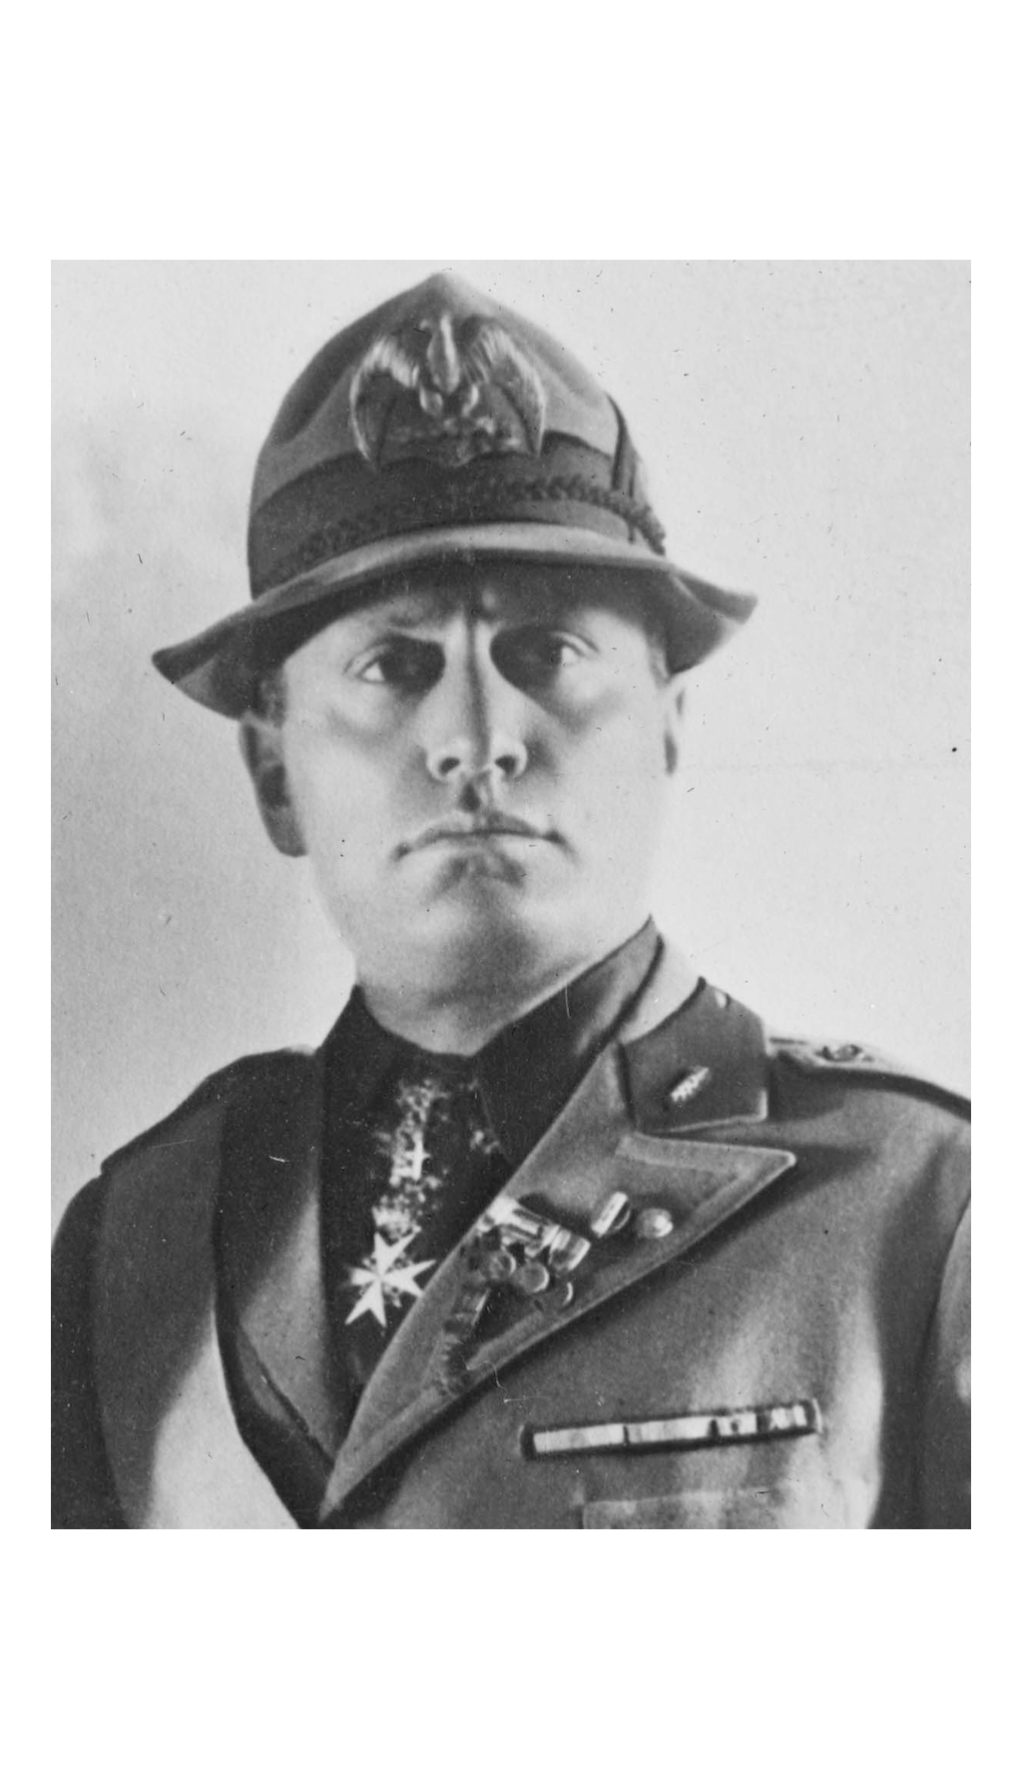
The Face the Regime Wanted Seen
Note the pose and medals.
© More Lessons Less Planning | morelessonslessplanning.com
Notes:
This is a press portrait, not a candid photograph. Ask what the uniform, the medals, and the level stare are doing, and who chose them. The Library of Congress caption card records no date for it.
Reference labels (point to these chart features when teaching): Military uniform, many medals; Level stare into the lens

Slide 11
Germany: From Chancellor to Dictator, 1933
Hitler was appointed chancellor on January 30, 1933.
After the Reichstag fire in February, civil liberties were suspended.
The Enabling Act of March 1933 let him make laws without parliament.
Every other political party was banned by July 1933.
When President Hindenburg died in 1934, Hitler took his powers too.
Key Concept: Each step looked legal on its own. Together they ended the republic in six months.
© More Lessons Less Planning | morelessonslessplanning.com
Notes:
Walk the dates in order: January appointment, February emergency decree, March Enabling Act, July one-party law. Six months from chancellor to dictator.

Slide 12
Gleichschaltung: Bringing Everything Into Line
Gleichschaltung
The Nazi policy of equal direction: every independent organization under party control
✔
Business groups
A Nazi official joined the national industry federation board in April 1933
✔
Farm societies
Hitler personally took over the newly united societies of German agriculture
✔
Chambers of Commerce
Chambers of commerce in Berlin, Cologne, and Koenigsberg reorganized
✔
Jews forced out
Nazi policy also drove Jews out of German business and professional life
✔
Warning: The clubs and associations stayed open. Only the people running them changed.
© More Lessons Less Planning | morelessonslessplanning.com
Notes:
An American diplomat in Berlin reported every one of these takeovers to Washington within days. Students read his dispatch in Activity Part 4.

Slide 13
The Soviet Union: Stalin's Revolution From Above
Lenin died in 1924 and left no clear successor.
Stalin outmaneuvered his rivals and controlled the party by 1929.
His Five-Year Plans set production targets to industrialize fast.
Farms were seized and combined; millions died in the famine that followed.
The Great Purge of 1936-1938 destroyed his rivals inside the party.
Note: Stalin's terror was aimed first at his own party, not only at outsiders.
© More Lessons Less Planning | morelessonslessplanning.com
Notes:
Stalin did not need an election or a march. He already belonged to the only legal party and won control of it from inside.

Slide 14
The Machinery of Fear
Secret Police
A police force that works outside the normal courts to find, arrest, and silence opponents of the regime
Purge
The removal of suspected opponents from a party, army, or government, often by arrest or execution
Five-Year Plan
Stalin's program setting production targets to industrialize the Soviet Union quickly under state control
Key Point: Each regime built a police force that answered to the party, not to a court.
© More Lessons Less Planning | morelessonslessplanning.com
Notes:
The phrase outside the normal courts is what matters. An ordinary police force must convince a judge; a secret police force does not.

Slide 15
The Tools of Total Control
Control the Message
Control the Groups
Control by Fear
Propaganda pushed one official story into every home.
Censorship removed every story the regime disliked.
Radio and film reached millions at once.
Rival political parties were banned outright.
Unions, clubs, and business groups were taken over.
Youth organizations trained the next generation.
Secret police watched, arrested, and silenced people.
Purges removed suspected opponents inside the party.
Neighbors were encouraged to report on neighbors.
Key Concept: A totalitarian state takes every organization a citizen might join, not just the government.
© More Lessons Less Planning | morelessonslessplanning.com
Notes:
This is the central slide of the lesson. Students should be able to name all three columns from memory before the Activity.

Slide 16
Three Dictators Compared
Question | Italy | Germany | Soviet Union
Leader | Benito Mussolini | Adolf Hitler | Joseph Stalin
In control by | 1922-1926 | 1933-1934 | 1929
Movement | Fascism | Nazism | Communism
Route to power | Threat of a march | Appointed, then law | Party infighting
Main weapon | Propaganda | Propaganda and terror | Terror and purges
Big Idea: Three different ideologies produced three very similar methods of control.
© More Lessons Less Planning | morelessonslessplanning.com
Notes:
Read the Movement row and the Main weapon row together. The beliefs are opposites; the tools are nearly identical.

Slide 17
How a Democracy Becomes a Dictatorship
1. Crisis
An economic or political emergency convinces people the current system has failed
✔
2. Legal entry
The leader is appointed or elected into office rather than installed by force
✔
3. Emergency powers
The crisis is used to suspend rights and rule without the legislature
✔
4. No rivals
Other parties, unions, and independent organizations are banned or taken over
✔
5. Permanent fear
Propaganda, censorship, and secret police make open opposition dangerous
✔
Big Idea: All three dictators followed roughly this order, in three different countries.
© More Lessons Less Planning | morelessonslessplanning.com
Notes:
Have students test the five steps against each country before they leave. Stalin's case fits step two differently, because his legal entry was inside a party rather than at a ballot box.

Slide 18
What an American Diplomat Saw, April 1933
...as a part of the general movement for obtaining control of every phase of German activity.
— George A. Gordon, U.S. Chargé d'Affaires in Berlin, dispatch to the Secretary of State, April 6, 1933
Gordon was reporting the Nazi takeover of Germany's industry federation, farm societies, and chambers of commerce.
Big Idea: Totalitarianism is not control of the government alone. It is control of every phase of activity.
© More Lessons Less Planning | morelessonslessplanning.com
Notes:
Gordon was writing a confidential report to Washington, not a speech. Students read a longer passage from this same dispatch in Activity Part 4.

Slide 19
Key Takeaways
Totalitarian states seek control of every organization, not just the state.
★
Crisis after World War I left new democracies weak and easy to attack.
★
Mussolini, Hitler, and Stalin each took power during a national emergency.
★
All three used propaganda, censorship, secret police, and one-party rule.
★
A U.S. diplomat watched Gleichschaltung reach German business in weeks.
★
© More Lessons Less Planning | morelessonslessplanning.com
Notes:
Close by asking students to state the five-step pattern from memory, then name the country where it moved fastest.

