Slide 1
Renting Your First Apartment: Leases, Deposits & Roommates
Learn to read a lease, add up the true cost of moving in, understand the security deposit, and split rent and costs with roommates.
© More Lessons Less Planning | morelessonslessplanning.com
Notes:
Open Unit 9, Major Purchases and Independent Living, with the first major purchase most students will make: renting a place to live. Tell students that renting an apartment is a real financial decision with a binding contract behind it - the lease - and up-front costs that surprise a lot of first-time renters. By the end of class they will be able to read a lease and pick out the rent, the lease term, the security deposit, and the fees; add up exactly how much cash it takes to move in; explain what the security deposit is and how to get it back; and split rent and a shared deposit with roommates. Set the practical tone: this is one of the first big money moves they will make as adults, and knowing how to read the lease protects them from paying for a landlord's mistakes or losing a deposit they should have gotten back.

Slide 2
Learning Targets
Read a lease and identify rent, term, deposit, late fee, and obligations
★
Calculate move-in cost = first month's rent + deposit + application fee
★
Explain what a security deposit is and how a tenant gets it back
★
Split rent and a shared deposit with roommates; know the joint-lease risk
★
© More Lessons Less Planning | morelessonslessplanning.com
Notes:
Read the four targets and connect them to the arc of the lesson. Target 1 is the core skill named in the curriculum: read a lease and find its key terms - the monthly rent, the lease term, the security deposit, the late fee, and the tenant's obligations. Target 2 is the money math: use a labeled model to add up the up-front cost of moving in (first month's rent plus the security deposit plus the application fee). Target 3 is the security deposit - what it is (money the landlord holds), why it exists (to cover damage or unpaid rent), and how a careful tenant gets it back. Target 4 is roommates: how to split the rent and a shared security deposit fairly, and why signing a joint lease means each person is on the hook for the whole rent. By the end, a student can look at a real lease and know what it costs, what it requires, and what to watch out for.

Slide 3
Your First Place - What Renting Means
You rent, you do not own
When you RENT, you pay a landlord to live in their property; you do NOT own it, so the LANDLORD owns the building
✔
The lease is a binding contract
A LEASE is a binding contract between landlord and TENANT that sets the rent, the term, and the rules of renting
✔
You are the tenant
The person who rents and lives in the home is the TENANT; signing the lease makes you legally responsible for its terms
✔
Rent is due every month
You pay RENT every month for the LEASE TERM (often 12 months), and the lease locks that rent in for the term
✔
Key Concept: Renting means you pay a LANDLORD to live in their property under a LEASE - a binding contract that sets your rent, term, and rules.
© More Lessons Less Planning | morelessonslessplanning.com
Notes:
Start with what renting actually is, because many students have never signed a contract. When you RENT, you pay a landlord a monthly amount to live in a home the landlord owns - you do not own the property, so you are not building equity, but you also are not responsible for the building itself the way an owner is. The document that makes it official is the LEASE: a binding contract between the LANDLORD (the owner) and the TENANT (you, the renter) that spells out the rent, how long you can stay (the LEASE TERM, often 12 months), and the rules both sides must follow. Stress the word binding: once you sign, you are legally responsible for paying the rent for the whole term, even if you change your mind - breaking a lease early usually costs money. The person who rents and lives there is the TENANT. Rent is due every month, and for the length of the lease term the landlord cannot raise it. Key terms - Lease: a binding contract between a landlord and tenant that sets the rent, term, and rules for renting a home. Lease term: the length of time the lease lasts, such as 12 months, during which the rent is locked in.

Slide 4
Reading a Lease - The Key Terms
Monthly rent and lease term
The MONTHLY RENT is what you pay each month ($1,200 in our sample); the LEASE TERM is how long the lease lasts (12 months)
Security deposit
The SECURITY DEPOSIT is money you pay up front (often one month's rent) that the landlord holds and returns if you leave the place undamaged
Late fee
The LATE FEE is an extra charge (a $50 example) the lease adds if you pay rent after the due date or grace period
Your obligations
The lease lists your OBLIGATIONS: pay rent on time, keep the unit clean and undamaged, and do not sublet without permission
Key Concept: A lease spells out MONTHLY RENT, the LEASE TERM, the SECURITY DEPOSIT, the LATE FEE, and your obligations - read it before you sign.
© More Lessons Less Planning | morelessonslessplanning.com
Notes:
Now teach students how to actually read a lease by naming the key terms they must find on every one. First, the MONTHLY RENT: the amount you pay each month - in our sample lease it is $1,200 - and the LEASE TERM, the length of the lease, usually 12 months, during which that rent is locked in. Second, the SECURITY DEPOSIT: money you pay up front, often equal to one month's rent (so $1,200 in our sample), that the landlord holds and returns to you at the end if you leave the place clean and undamaged and owe no rent. Third, the LATE FEE: an extra charge the lease adds if your rent is late - our sample uses a $50 late fee after a short grace period - so paying on time matters. Fourth, your OBLIGATIONS as the tenant: the lease lists what you must do - pay rent on time, keep the unit clean and undamaged, do not sublet (rent it out to someone else) without the landlord's written permission, and follow the rules on pets, guests, and noise. Teach the habit: never sign a lease you have not read line by line, because once you sign, every one of these terms is binding. Key terms - Security deposit: money paid up front that the landlord holds and returns if you leave the place undamaged. Late fee: an extra charge the lease adds when rent is paid after the due date or grace period.

Slide 5
The Security Deposit - What It Is and Getting It Back
What it is
The SECURITY DEPOSIT is money you pay up front - often one month's rent, $1,200 in our sample - that the landlord HOLDS, not keeps
Why the landlord holds it
The deposit protects the landlord: it covers unpaid rent or DAMAGE beyond normal wear and tear when you move out
How you get it back
You get the deposit BACK if you leave the place clean and undamaged, pay all rent, and give proper notice before moving out
Normal wear vs damage
Faded paint and small scuffs are normal WEAR (not charged); holes in the wall or a broken door are DAMAGE (charged to your deposit)
Key Concept: A SECURITY DEPOSIT is money the landlord HOLDS (usually one month's rent) and RETURNS if you leave the place clean and paid up.
© More Lessons Less Planning | morelessonslessplanning.com
Notes:
Now go deep on the security deposit, because getting it back is real money - often a full month's rent. The SECURITY DEPOSIT is money you pay up front, on top of your first month's rent, that the landlord HOLDS (does not spend or keep) during your tenancy. In our sample it is $1,200, equal to one month's rent, which is the most common amount. Explain WHY it exists: it protects the landlord against two things - unpaid rent if you leave owing money, and DAMAGE to the unit beyond normal wear and tear. If you move out clean and paid up, the deposit is YOURS and the landlord must return it (state laws set a deadline, often within a few weeks). Teach the crucial distinction between normal WEAR and DAMAGE, because it decides whether you get your money back: normal wear - faded paint, small carpet wear, tiny scuffs - is expected and cannot be charged to you; DAMAGE - holes in the wall, a broken door, a stained carpet, a missing appliance - can be deducted from your deposit. Give students the get-your-deposit-back checklist: take dated photos when you move IN and when you move OUT, report problems in writing, keep the place clean, pay all rent, and give the notice the lease requires (often 30 days). Do those things and the $1,200 comes back to you. Key term - Security deposit: money paid up front that the landlord holds and returns if you leave the place undamaged.

Slide 6
Move-In Cost - A Labeled Model
A LABELED MODEL (move-in cost)
MOVE-IN COST = first month's rent + security deposit + application fee - the total cash you need up front to move in
✔
The three parts
First month's rent ($1,200) + security deposit ($1,200) + application fee ($50) - it is far more than one month's rent
✔
Worked example
MOVE-IN COST = $1,200 + $1,200 + $50 = $2,450 to move into our sample apartment on day one
✔
Why it matters
Many first-time renters budget for rent but forget the DEPOSIT and fees, then cannot cover the $2,450 up front - save it before you sign
✔
Key Concept: MOVE-IN COST = first month's rent + security deposit + application fee. For our sample: $1,200 + $1,200 + $50 = $2,450.
© More Lessons Less Planning | morelessonslessplanning.com
Notes:
This is the quantitative heart of the lesson - teach the labeled model for move-in cost explicitly before students calculate with it. The single biggest surprise for first-time renters is how much CASH it takes just to move in - far more than one month's rent. Put the model on the board under a clear label: MOVE-IN COST = first month's rent + security deposit + application fee. Walk through the three parts using our sample lease. First month's rent is $1,200 - you pay the first month before you get the keys. The security deposit is another $1,200 (one month's rent), held by the landlord. And the application fee is $50, a one-time non-refundable charge to process your application. Add them: MOVE-IN COST = $1,200 + $1,200 + $50 = $2,450. Say it plainly: to move into a $1,200-a-month apartment, you need $2,450 in cash on day one - more than double the monthly rent. Explain why the model matters: many first-time renters budget only for the monthly rent, then are shocked when the landlord asks for the deposit and fees up front, and they cannot cover it - so they lose the apartment or borrow at a bad rate. The smart move is to SAVE the full move-in cost before you sign. Note that some places also ask for last month's rent, which would add another $1,200 - always read the lease to see exactly what is due at signing. Tell students Activity Part 3 asks them to compute move-in cost, and that all these figures are pinned examples. Key term - Move-in cost: the total up-front money to move in: first month's rent plus the security deposit plus any fees.

Slide 7
The Application and Credit Check
The rental application
A RENTAL APPLICATION is a form the landlord uses to check your income, rental history, and references before renting to you
The credit check
The landlord runs a CREDIT CHECK - a review of your credit report - to see if you pay bills on time and can be trusted with rent
The application fee
Most landlords charge a one-time APPLICATION FEE (a $50 example) to cover the cost of the background and credit check
How to get approved
Show steady income (often about 3x the rent), a clean rental history, and good credit - or add a co-signer if your credit is thin
Key Concept: Before you rent, the landlord reviews a RENTAL APPLICATION and runs a CREDIT CHECK - usually for a one-time APPLICATION FEE.
© More Lessons Less Planning | morelessonslessplanning.com
Notes:
Now teach the approval step, because students cannot just sign a lease - they have to be approved first, and that ties directly back to the credit unit. Before a landlord hands over a lease, you fill out a RENTAL APPLICATION: a form asking for your income, employer, current and past addresses, rental history, and references. The landlord uses it to decide whether you are a reliable tenant who will pay rent on time. A big part of that decision is the CREDIT CHECK: the landlord pulls your credit report to see whether you pay your bills on time, how much debt you carry, and whether you have any collections or evictions on record - the same credit score students learned about in Unit 4 now decides whether they can rent an apartment. Most landlords charge a one-time APPLICATION FEE - $50 in our example - to cover the cost of running that background and credit check; it is usually non-refundable, which is why it is part of your move-in cost. Teach students how to get approved: show steady income (many landlords want your gross monthly income to be about three times the rent, so about $3,600 a month for a $1,200 apartment), a clean rental history with no evictions, and good credit. If their credit is thin or low, a co-signer (often a parent) who agrees to pay if they cannot can get them approved. Tie it back: this is exactly why building good credit in Unit 4 matters - it is what lets you rent your first place. Key terms - Rental application: a form a landlord uses to check your income, rental history, and credit before renting to you. Credit check: a review of your credit report a landlord runs to decide whether to approve your application.

Slide 8
Roommates and Shared Costs - A Labeled Split Model
Roommates split the costs
ROOMMATES share a rented home and split the rent, the security deposit, and household costs so each person pays less
✔
A LABELED MODEL (roommate split)
ROOMMATE SPLIT = total monthly rent / number of roommates; each person also splits the shared security deposit
✔
Worked example
$1,200 rent / 2 roommates = $600 each; the $1,200 deposit / 2 = $600 each, so each pays $1,225 to move in ($2,450 / 2)
✔
The joint-lease risk
On a JOINT LEASE all roommates sign together, so if one roommate does not pay, the others owe the WHOLE rent - not just their share
✔
Key Concept: ROOMMATE SPLIT = total rent / number of roommates. $1,200 / 2 = $600 each. But a JOINT LEASE makes each liable for the WHOLE rent.
© More Lessons Less Planning | morelessonslessplanning.com
Notes:
Now teach the most common way young renters afford a first apartment - roommates - and the labeled split model plus its big risk. ROOMMATES are people who share a rented home and split the costs, which is how a $1,200 apartment becomes affordable on an entry-level income. Put the split model on the board: ROOMMATE SPLIT = total monthly rent / number of roommates. Work the example: a $1,200 apartment with 2 roommates is $1,200 / 2 = $600 each per month - half the rent. The shared SECURITY DEPOSIT splits the same way: $1,200 / 2 = $600 each. So each roommate's share of the up-front move-in cost is the total move-in cost split two ways: $2,450 / 2 = $1,225 each (their $600 rent share + $600 deposit share + $25 half of the $50 application fee). Point out how much roommates lower the barrier: one person needs $2,450 to move in alone, but two roommates each need only $1,225. Now teach the RISK, because this is where roommates go wrong. Most shared apartments use a JOINT LEASE: all roommates sign the same lease together, which means each person is legally responsible for the WHOLE rent, not just their share. If one roommate moves out or stops paying, the landlord can demand the full $1,200 from whoever is left - the others owe the missing share. Teach the protections: only room with people you trust, put the split in writing between yourselves, and understand that the landlord will hold ALL signers responsible. Tell students Activity Part 3 and Part 5 use this split model. Key terms - Roommates: people who share a rented home and split the rent, deposit, and household costs. Joint lease: a lease all roommates sign together, making each person responsible for the whole rent.

Slide 9
Reading a Sample Lease
Put the terms together on one page
A real lease gathers every term you learned - rent, term, deposit, fees, obligations - onto one document you must read and sign
✔
Find the money first
On any lease, find the MONTHLY RENT, the SECURITY DEPOSIT, the APPLICATION FEE, and the LATE FEE - those are your costs
✔
Then find the rules
Next find the LEASE TERM and your OBLIGATIONS - how long you are committed and what you must do to stay in good standing
✔
The next slide shows one
The next slide shows a sample RESIDENTIAL LEASE; Activity Part 4 asks you to read its terms and use them in the move-in math
✔
Key Concept: A lease puts every term on one page. Read the money first (rent, deposit, fees), then the rules (term, obligations).
© More Lessons Less Planning | morelessonslessplanning.com
Notes:
Bring the whole lesson together by teaching students how to approach an actual lease document, then hand them one to read. Explain that everything they have learned - the monthly rent, the lease term, the security deposit, the application fee, the late fee, and their obligations - all appear together on one document: the lease. A real lease can look intimidating, so give students a simple reading strategy. First, FIND THE MONEY: scan the lease for the four numbers that cost you - the MONTHLY RENT (what you pay each month), the SECURITY DEPOSIT (what you pay up front and hope to get back), the APPLICATION FEE (the one-time charge to apply), and the LATE FEE (what you owe if rent is late). Those four figures tell you your true move-in cost and your monthly obligation. Second, FIND THE RULES: locate the LEASE TERM (how long you are committed - usually 12 months) and your OBLIGATIONS (pay on time, keep it clean and undamaged, no unapproved subletting, follow the pet and guest rules). Tell students the next slide shows a sample RESIDENTIAL LEASE with all of these terms filled in, and that in Activity Part 4 they will read that same lease, pull out its terms, and use the rent and deposit to compute the move-in cost. Teach the golden rule one more time: never sign a lease you have not read - the whole document is binding the moment you sign. This slide sets up the image on the next slide; do not put the lease image here.

Slide 10
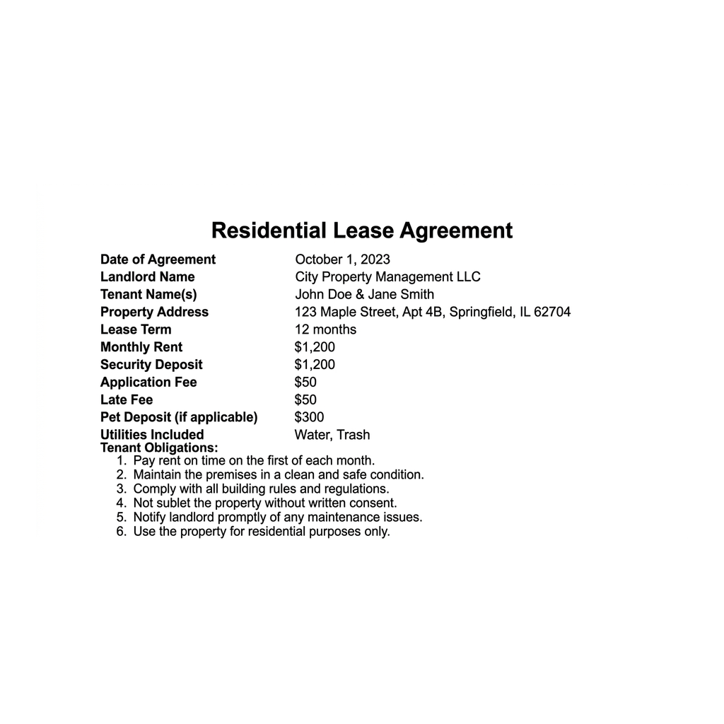
Sample Residential Lease
Sample lease: rent $1,200/mo, deposit $1,200, fees $50, 12-month term.
© More Lessons Less Planning | morelessonslessplanning.com
Notes:
Give students a moment to read the sample lease on their own before discussing. This is the concrete document the whole lesson has been building toward. Walk the class through it top to bottom the way they should read any lease. At the top are the parties: the LANDLORD (the owner) and the TENANT (the renter). Then the PROPERTY ADDRESS - what is being rented. Then the money and the rules students learned: the LEASE TERM is 12 months; the MONTHLY RENT is $1,200; the SECURITY DEPOSIT is $1,200 (one month's rent); the APPLICATION FEE is $50; the LATE FEE is $50 if rent is late. Below that are the tenant OBLIGATIONS: pay rent on time, keep the unit clean and undamaged, and do not sublet without written permission. Point out that every number students need for the move-in math is right here on the lease: first month's rent ($1,200) + security deposit ($1,200) + application fee ($50) = $2,450 to move in. This is the lease Activity Part 4 asks students to read - they will pull the rent and deposit off this document and use them to compute the move-in cost and the roommate split. Emphasize the habit one more time: a real renter reads every line before signing, because the lease is binding.
Reference labels (point to these chart features when teaching): Monthly Rent: $1,200; Security Deposit: $1,200

Slide 11
Tenant Rights and Duties
Your rights as a tenant
TENANT RIGHTS are the legal protections a renter has: a safe, habitable home, working heat and water, privacy, and the return of a fair deposit
Your duties as a tenant
Your DUTIES: pay rent on time, keep the unit clean and undamaged, follow the lease rules, and report repairs the landlord must fix
The landlord's duties
The landlord must keep the building safe and make major repairs (heat, plumbing, structure) - that is what your rent pays for
Put requests in writing
Ask for repairs and give notice IN WRITING, and keep copies - a paper trail protects your rights and your deposit
Key Concept: TENANT RIGHTS include a habitable home and a fair deposit return; your DUTIES are to pay on time and follow the lease.
© More Lessons Less Planning | morelessonslessplanning.com
Notes:
Now teach the two-way street of renting, because students should know both what they are owed and what they owe. Start with TENANT RIGHTS: as a renter you are legally entitled to a safe, HABITABLE home - working heat, hot and cold water, working plumbing and electricity, and a structure that is not falling apart. You have a right to privacy: in most places the landlord must give notice (often 24 hours) before entering your unit except in an emergency. And you have a right to the RETURN of your security deposit, minus only legitimate charges for damage or unpaid rent, within the deadline your state sets. Now the other side, your DUTIES as a tenant: pay your rent on time, keep the unit clean and undamaged, follow the rules in the lease (pets, guests, noise, no unapproved subletting), and report problems so the landlord can fix them. Explain the landlord's duties too: the landlord must keep the building safe and make the major repairs - heat, plumbing, the roof, the structure - because that is part of what your rent pays for; you are not on the hook to replace a broken furnace, but you are on the hook for damage you cause. Give students the one habit that protects all of this: put it IN WRITING. Ask for repairs in writing, give your move-out notice in writing, and keep copies and dated photos. A paper trail is how a tenant proves they did their part - and it is often what gets a deposit returned in full. Key term - Tenant rights: legal protections a renter has, such as a habitable home and the return of a fair deposit.

Slide 12
Renting Your First Apartment - The Process
Step 1 - Budget the move-in cost
Save the full MOVE-IN COST first: rent + deposit + application fee ($2,450 in our sample) - more than double the monthly rent
✔
Step 2 - Apply and pass the check
Fill out the RENTAL APPLICATION and pass the CREDIT CHECK; show income about 3x the rent, or add a co-signer
✔
Step 3 - Read the lease before signing
READ THE LEASE line by line - rent, term, deposit, late fee, obligations - because the whole document is binding once you sign
✔
Step 4 - Protect your deposit
Take move-in photos, keep the place clean, pay on time, and give proper notice so you get your SECURITY DEPOSIT back
✔
Key Concept: Rent in 4 steps - budget the move-in cost, apply and pass the credit check, READ the lease before signing, and protect your deposit.
© More Lessons Less Planning | morelessonslessplanning.com
Notes:
Turn the whole lesson into a repeatable process a student can run when they rent their first place. Step 1 - BUDGET THE MOVE-IN COST: before you even apply, save the full up-front cost - MOVE-IN COST = first month's rent + security deposit + application fee, which is $2,450 in our sample, more than double the monthly rent. Do not go apartment hunting until you have that saved, or you will lose the place you want. Step 2 - APPLY AND PASS THE CHECK: fill out the RENTAL APPLICATION honestly and completely, and know the landlord will run a CREDIT CHECK - so you want steady income (about three times the rent) and decent credit; if your credit is thin, line up a co-signer before you apply. Step 3 - READ THE LEASE BEFORE SIGNING: this is the non-negotiable one. Read the lease line by line and find the rent, the lease term, the security deposit, the late fee, and your obligations. Ask about anything you do not understand, and never sign until it is right, because the whole document is binding the moment you sign. Step 4 - PROTECT YOUR DEPOSIT: from day one, take dated move-in photos of every room, keep the place clean and undamaged, pay rent on time, report repairs in writing, and give the notice the lease requires when you leave - do these and your $1,200 deposit comes back. Run the sample through it: to rent our $1,200 apartment you save $2,450, apply and pass the credit check, read and sign the 12-month lease, and protect your deposit for a year. Tell students Activity Part 5 asks them to advise a first-time renter using exactly this process. This is the capstone skill of the lesson: reading a lease and renting on purpose.

Slide 13
Key Takeaways
A LEASE is a binding contract - read every term before you sign
★
MOVE-IN COST = first rent + deposit + fee = $1,200 + $1,200 + $50 = $2,450
★
A SECURITY DEPOSIT is money the landlord HOLDS and returns if you leave it clean
★
ROOMMATE SPLIT = $1,200 / 2 = $600 each; a JOINT LEASE makes each owe all rent
★
Landlords approve you with a RENTAL APPLICATION and a CREDIT CHECK
★
© More Lessons Less Planning | morelessonslessplanning.com
Notes:
Read each takeaway and connect it back to the learning targets and the process. T1 (read the lease) -> a LEASE is a binding contract between landlord and tenant; before you sign, find and understand the monthly rent, the lease term, the security deposit, the late fee, and your obligations, because every term is binding once you sign. T2 (move-in cost) -> the up-front cost to move in is far more than one month's rent: MOVE-IN COST = first month's rent + security deposit + application fee = $1,200 + $1,200 + $50 = $2,450, so save it before you sign. T3 (security deposit) -> the SECURITY DEPOSIT is money the landlord HOLDS (usually one month's rent), not keeps; you get it back if you leave the place clean and undamaged, pay all rent, and give proper notice - normal wear is not charged, real damage is. T4 (roommates) -> ROOMMATE SPLIT = total monthly rent / number of roommates ($1,200 / 2 = $600 each), which makes renting affordable, but a JOINT LEASE makes each roommate legally responsible for the WHOLE rent if someone does not pay. T5 (application and credit) -> landlords approve you through a RENTAL APPLICATION and a CREDIT CHECK for a one-time application fee, so the good credit from Unit 4 is exactly what lets you rent your first apartment. Close by returning to the opening promise: students can now read a lease, add up what it truly costs to move in, protect their security deposit, and split costs with roommates - the core skills of renting their first place.

