Slide 1
Renters & Homeowners Insurance: Protecting Your Stuff
Learn what renters and homeowners insurance cover, how they differ, and what a claim actually pays when your belongings are stolen or destroyed.
© More Lessons Less Planning | morelessonslessplanning.com
Notes:
Open where independent living is heading. Students have learned what insurance is, how a policy works, and the two big policies most adults carry (auto and health). Today's policies protect the place you live and the stuff inside it: renters insurance for people who rent, and homeowners insurance for people who own. Tell students that by the end of class they will know exactly what renters insurance covers, how homeowners insurance is different, why renters insurance is surprisingly cheap, and how to calculate what a claim pays for their belongings. Set the practical tone: nearly every one of them will rent an apartment before they own a home, and many landlords now require renters insurance - so this is a real-world skill they will use soon.

Slide 2
Learning Targets
Explain what renters insurance covers and what it does not cover
★
Explain how homeowners insurance differs by adding dwelling coverage
★
Calculate what a claim pays under replacement cost value vs actual cash value
★
Explain why renters insurance is cheap compared to replacing your belongings
★
© More Lessons Less Planning | morelessonslessplanning.com
Notes:
Read the four targets and connect them to the arc of the lesson. Target 1 is the shape of a renters policy: what it covers (personal property, liability, living expenses) and what it does not (the building, floods). Target 2 is the key difference between the two policies: homeowners insurance covers everything renters does plus the dwelling - the structure of the house - because when you own the home the building is yours to insure. Target 3 is the math and the heart of the lesson: students will calculate what a property claim pays under two settings, replacement cost value (RCV) and actual cash value (ACV), using a labeled model. Target 4 is the practical judgment: why renters insurance is cheap relative to the cost of replacing your belongings, which the chart makes concrete. By the end, students can read a renters or homeowners policy and know what it covers and what it would pay.

Slide 3
Protecting Your Stuff - Renters vs Homeowners
Two policies for where you live
RENTERS INSURANCE is for people who RENT; HOMEOWNERS INSURANCE is for people who OWN their home
✔
Renters covers your belongings
RENTERS INSURANCE covers your PERSONAL PROPERTY (your belongings) and your liability - but NOT the building
✔
The landlord insures the building
When you rent, the LANDLORD's own policy covers the structure; you only need to insure your STUFF
✔
Homeowners adds the structure
HOMEOWNERS INSURANCE covers your belongings AND the DWELLING - the physical structure of the house you OWN
✔
Key Concept: RENTERS INSURANCE covers a renter's belongings (not the building); HOMEOWNERS INSURANCE covers an owner's belongings PLUS the dwelling.
© More Lessons Less Planning | morelessonslessplanning.com
Notes:
Start with the big picture: there are two insurance policies for the place you live, and which one you need depends on whether you rent or own. RENTERS INSURANCE is for people who RENT an apartment or house. It covers your PERSONAL PROPERTY - your belongings, like furniture, electronics, and clothing - and your liability, but it does NOT cover the building itself. Explain why: when you rent, you do not own the building, so the LANDLORD carries their own insurance policy on the structure. If the building burns, that is the landlord's insurance problem; your renters insurance is there to replace YOUR stuff inside it. HOMEOWNERS INSURANCE is for people who OWN their home. It covers your belongings AND the DWELLING - the physical structure of the house - because when you own the home, the building is yours to insure, not a landlord's. So the single biggest difference is the building: renters insurance does not cover it (the landlord does), and homeowners insurance does. Everything else - covering your belongings, your liability, a deductible on a claim - works much the same way in both policies. Key terms - Renters insurance: insurance that covers a renter's belongings and liability, not the building. Homeowners insurance: insurance that covers the dwelling plus belongings and liability for an owner. Personal property: your belongings, such as furniture, electronics, and clothing.

Slide 4
Renters Insurance Basics - The Three Things It Covers
1. Personal property
PERSONAL PROPERTY coverage pays to replace your belongings - furniture, electronics, clothing - after a covered loss like fire or theft
2. Liability
LIABILITY COVERAGE pays if someone is injured in your place, or you damage someone else's property, and you are responsible
3. Additional living expenses
ADDITIONAL LIVING EXPENSES help pay for a hotel or temporary housing if your rental becomes unlivable after a covered event
You pay a premium and a deductible
You pay a PREMIUM to keep the policy active, and a DEDUCTIBLE first on a claim before the policy pays the rest
Key Concept: Renters insurance covers three things - PERSONAL PROPERTY (belongings), LIABILITY, and ADDITIONAL LIVING EXPENSES.
© More Lessons Less Planning | morelessonslessplanning.com
Notes:
Now go inside a renters policy and show the three things it covers, because students will see all three on any quote. First and most important, PERSONAL PROPERTY coverage: this pays to replace your belongings - furniture, electronics, clothing, and everything else you own - after a covered loss like a fire, theft, or certain kinds of water damage. This is the main reason people buy renters insurance. Second, LIABILITY coverage: this pays if someone is injured while in your rented place (a guest slips and gets hurt) or if you accidentally damage someone else's property, and you are found responsible - it can cover their medical bills or a legal claim up to your limit. Third, ADDITIONAL LIVING EXPENSES (sometimes called loss of use): if a covered event makes your rental unlivable - say a fire forces you out for two weeks - this helps pay for a hotel or temporary housing and extra meal costs while you are displaced. Finally, remind students of the money mechanics they already know: you pay a PREMIUM to keep the policy active (about $180 a year for renters), and when you file a claim you pay a DEDUCTIBLE first (an example is $250), then the policy pays the rest. Those three coverages plus the premium-and-deductible structure are the whole renters policy. Key terms - Liability coverage: coverage if someone is injured in your place or you damage another's property. Premium: the regular payment you make to keep your coverage active. Deductible: the amount you pay first on a property claim before the policy pays.

Slide 5
What Renters Insurance Covers - and Does NOT Cover
Covers: fire, theft, and more
COVERED losses include fire, theft, vandalism, and certain water damage that ruin your PERSONAL PROPERTY
✔
Covers your stuff away from home
Your belongings are often covered even OUTSIDE your apartment - a laptop stolen from your car can still be covered
✔
Does NOT cover the building
Renters insurance does NOT cover the BUILDING - the landlord's own policy covers the structure, not yours
✔
Does NOT cover floods or quakes
A standard policy does NOT cover FLOODS or earthquakes - those need a separate policy you buy on purpose
✔
Key Concept: Renters insurance COVERS fire and theft to your belongings; it does NOT cover the building or floods and earthquakes.
© More Lessons Less Planning | morelessonslessplanning.com
Notes:
Now make the boundaries of a renters policy clear, because students most often misunderstand what is and is not covered. On the COVERED side: a standard renters policy pays to replace your personal property after covered losses like fire, theft, vandalism, smoke, and certain kinds of water damage (like a burst pipe). A nice detail many renters do not know: your belongings are often covered even when they are OUTSIDE your apartment - a laptop stolen from your car or a phone taken while you travel can still be covered under your personal property. Now the NOT-covered side, which is just as important. First, renters insurance does NOT cover the BUILDING itself - not the walls, roof, or plumbing - because you do not own it; the landlord's own policy covers the structure. This is exactly why renters insurance is cheaper than homeowners insurance: it is not paying to rebuild a house. Second, a standard policy does NOT cover FLOODS (rising water from outside) or EARTHQUAKES - those specific disasters are excluded and require a separate policy that you buy on purpose if you live in a risky area. Teach students the shape of the rule: renters insurance covers YOUR STUFF against common losses, but not the building and not those two big natural disasters. Knowing the gaps is how a smart renter avoids assuming they are covered for something they are not.

Slide 6
Homeowners Insurance - Adds the Dwelling
Dwelling coverage (the big addition)
DWELLING COVERAGE is the part of homeowners insurance that pays to rebuild or repair the STRUCTURE of the house you own
Everything renters covers, too
Homeowners insurance ALSO covers your personal property, liability, and living expenses - just like a renters policy
Why it costs much more
Homeowners costs far MORE (about $1,500 a year vs $180 for renters) because it insures the whole building, not just your stuff
Same math, bigger dollars
You still pay a premium and a DEDUCTIBLE on a claim - the parts are the same, but the dwelling makes the numbers larger
Key Concept: HOMEOWNERS INSURANCE adds DWELLING COVERAGE (the structure) to everything renters covers, so it costs far more.
© More Lessons Less Planning | morelessonslessplanning.com
Notes:
Now teach the one big thing homeowners insurance adds: DWELLING COVERAGE. Dwelling coverage is the part of a homeowners policy that pays to rebuild or repair the physical STRUCTURE of the house you own - the walls, roof, foundation, and attached parts - after a covered event like a fire or a storm. This is the piece a renter never needs, because a renter does not own the building. Point out that a homeowners policy ALSO covers everything a renters policy does: your personal property (your belongings), your liability, and additional living expenses if your home becomes unlivable. So homeowners insurance is really renters insurance PLUS dwelling coverage for the structure. That addition is why homeowners insurance costs far more: a mid-range homeowners premium is around $1,500 a year, compared to about $180 a year for renters. The difference is not that homeowners are treated worse - it is that the policy is now insuring a whole building that could cost hundreds of thousands of dollars to rebuild, not just the stuff inside. Reassure students that the mechanics are the same ones they already know: you still pay a PREMIUM to keep the policy active and a DEDUCTIBLE first on a claim, and the claim still pays the covered loss minus your deductible - the dwelling just makes the dollar amounts much larger. Bottom line: rent, and you insure your stuff (cheap); own, and you also insure the building (expensive). Key term - Dwelling coverage: the part of homeowners insurance that covers the structure of the house.

Slide 7
Replacement Cost vs Actual Cash Value - A Labeled Model
A LABELED MODEL (RCV)
REPLACEMENT COST VALUE pays to buy the item NEW: RCV CLAIM PAYS = replacement cost - your deductible
✔
A LABELED MODEL (ACV)
ACTUAL CASH VALUE = replacement cost - DEPRECIATION; ACV CLAIM PAYS = actual cash value - your deductible
✔
Worked example - the SAME laptop
A $1,200 laptop, $250 deductible: RCV pays $1,200 - $250 = $950; ACV (worth $600 after $600 depreciation) pays $600 - $250 = $350
✔
Why the choice matters
RCV pays $950 but ACV pays only $350 - a $600 difference - so REPLACEMENT COST VALUE is worth choosing on your policy
✔
Key Concept: RCV CLAIM PAYS = replacement cost - deductible. ACV = replacement cost - DEPRECIATION, then minus deductible. RCV pays far more.
© More Lessons Less Planning | morelessonslessplanning.com
Notes:
This is the quantitative heart of the lesson - teach the labeled model explicitly before students calculate with it. When your belongings are damaged or stolen, HOW a property claim pays depends on one setting on your policy: replacement cost value or actual cash value. Put both on the board under a clear label. REPLACEMENT COST VALUE (RCV): the claim pays what it costs to buy the item NEW today, minus your deductible. RCV CLAIM PAYS = replacement cost - your deductible. ACTUAL CASH VALUE (ACV): the claim pays the item's DEPRECIATED value - what it is worth used, after years of wear - minus your deductible. First find the actual cash value: ACTUAL CASH VALUE = replacement cost - depreciation. Then ACV CLAIM PAYS = actual cash value - your deductible. Work one complete example on the SAME item so the difference is unmistakable: a laptop that costs $1,200 to replace new, with a $250 deductible. Under RCV: CLAIM PAYS = $1,200 - $250 = $950 - enough to buy the same laptop new. Under ACV: the laptop is 4 years old and has depreciated $600, so its actual cash value is $1,200 - $600 = $600; then ACV CLAIM PAYS = $600 - $250 = $350. Put the two side by side: RCV pays $950, ACV pays only $350 - a $600 difference on one laptop. Make the takeaway explicit: replacement cost value is the setting you want, because after a fire or theft it pays enough to actually replace your stuff, while actual cash value leaves you far short. RCV usually costs a little more in premium, but it is almost always worth it. Tell students the next slide is a chart showing how cheap renters insurance is compared to replacing your belongings, and Activity Part 4 asks them to read it. Key terms - Replacement cost value: a claim setting that pays to buy the item new, minus your deductible. Actual cash value: the item's depreciated value (replacement cost minus depreciation). Depreciation: the loss in value of an item from age and wear.

Slide 8
Why Renters Insurance Is So Cheap
It does not insure a building
Renters insurance only covers your STUFF, not the structure, so it costs far less than homeowners insurance
✔
About $180 a year
A mid-range renters PREMIUM is about $180 a year - roughly $15 a month, less than many streaming bundles
✔
It protects thousands of dollars
Replacing a first apartment's belongings out of pocket could cost about $7,000 - what $180 of coverage protects
✔
The math is lopsided in your favor
Replacing your stuff costs about 39 times one year of coverage; the chart on the next slide shows the gap
✔
Key Concept: Renters insurance is cheap (about $180/year) because it does not insure a building - yet it protects about $7,000 of belongings.
© More Lessons Less Planning | morelessonslessplanning.com
Notes:
Now make the value case for renters insurance concrete, because the biggest reason young renters skip it is that they assume it is expensive - and it is not. The core reason renters insurance is cheap is the one from earlier: it does NOT insure a building. It only covers your STUFF (and your liability), so the insurer is not on the hook to rebuild a house - which makes the premium a small fraction of a homeowners premium. Put a real number on it: a mid-range renters PREMIUM is about $180 a year, which is roughly $15 a month - less than many streaming or phone bundles students already pay for. Now show what that small premium protects. If a fire or a theft wiped out the belongings in a first apartment - furniture, a laptop and TV, clothing, kitchen items - replacing all of it out of pocket could easily cost about $7,000. So for about $180 a year, renters insurance protects roughly $7,000 of your belongings. Do the comparison out loud: replacing your stuff costs about $7,000 / $180 = about 39 times one year of coverage. The math is lopsided in the renter's favor: you pay a little to protect a lot. Tell students the next slide is a bar chart that puts these two numbers side by side - one year of renters insurance next to the cost to replace your belongings - and that Activity Part 4 asks them to read it and compute the gap. Frame the decision: skipping renters insurance to save $15 a month is a bad bet when one bad night could cost you $7,000. Key term - Premium: the regular payment you make to keep your coverage active.

Slide 9
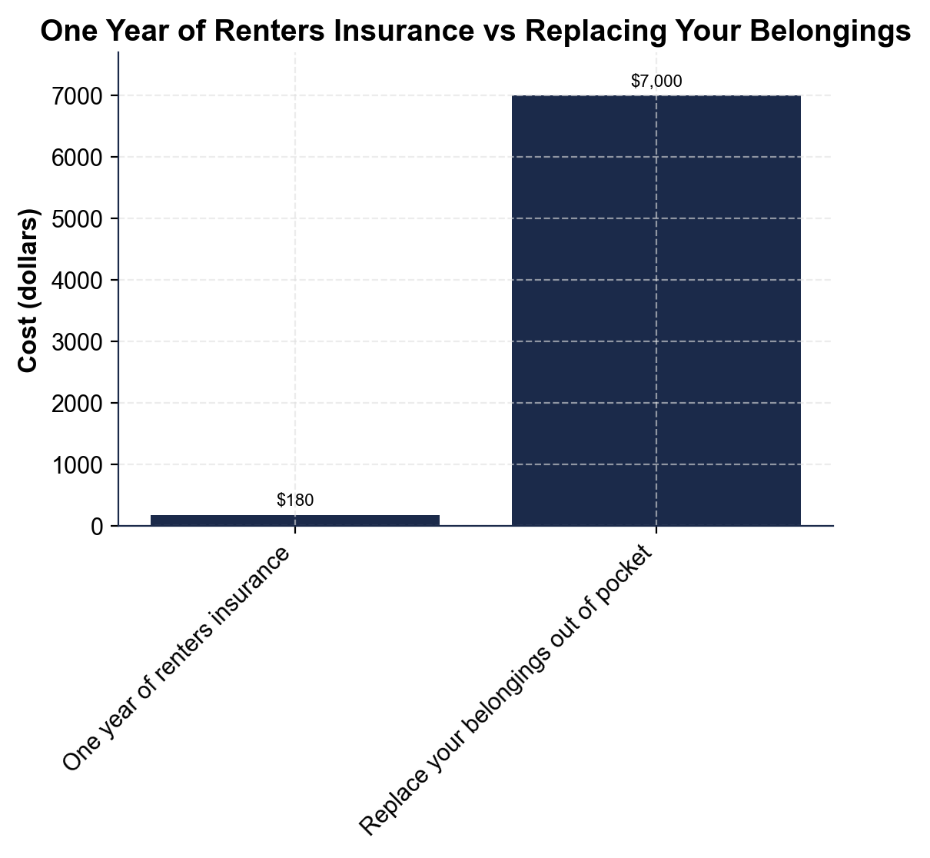
One Year of Renters Insurance vs Replacing Your Belongings
One year of renters insurance ($180) vs replacing your belongings ($7,000).
© More Lessons Less Planning | morelessonslessplanning.com
Notes:
Give students a moment to read the two bars on their own before discussing. The chart contrasts two costs. The short left bar is one year of renters insurance at about $180. The tall right bar is the cost to replace your belongings out of pocket at about $7,000. Point out the pattern that jumps out: the two bars are wildly different heights - the replace-your-stuff bar towers over the year-of-insurance bar. The gap between them is $7,000 - $180 = $6,820, and replacing your belongings costs roughly 39 times what a year of coverage costs. Explain WHY this matters: the whole point of insurance is to trade a small, certain cost (the $180 premium) for protection against a large, uncertain loss (the $7,000 if a fire or theft hits). The chart shows that trade is lopsided in the renter's favor. Connect it to the whole lesson: renters insurance is cheap because it only covers your stuff, not a building, yet it protects thousands of dollars of belongings. This is the chart Activity Part 4 reads and analyzes - students will read both values, compute the dollar gap, and explain why the coverage is worth it.
Reference labels (point to these chart features when teaching): Renters insurance: $180; Replace belongings: $7,000

Slide 10
What Affects Your Rate
How much stuff you cover
The more PERSONAL PROPERTY you insure (a higher coverage amount), the higher your PREMIUM - you are protecting more
Your deductible choice
A higher DEDUCTIBLE lowers your premium, because you take on more of each claim yourself before the policy pays
RCV vs ACV and where you live
Choosing REPLACEMENT COST VALUE and living in a higher-risk area both raise the premium a little
Still cheap either way
Even with more coverage, renters insurance stays inexpensive - the choices move the price by dollars, not hundreds
Key Concept: Your renters PREMIUM depends on how much you insure, your DEDUCTIBLE, RCV vs ACV, and where you live - but it stays cheap.
© More Lessons Less Planning | morelessonslessplanning.com
Notes:
Turn the value case into a practical picture of what moves a renters premium up or down, so students can see the choices they control. First, HOW MUCH STUFF you cover: your policy sets a coverage amount for your personal property (say $20,000 or $30,000 of belongings), and insuring more raises the PREMIUM because there is more to protect - a student with a lot of expensive electronics needs a higher amount than one with almost nothing. Second, your DEDUCTIBLE choice: exactly like the health and auto policies students already studied, a HIGHER deductible lowers your premium because you take on more of each claim yourself before the policy pays; a lower deductible costs a bit more each year. Third, the RCV-vs-ACV choice and WHERE YOU LIVE: choosing REPLACEMENT COST VALUE (which pays more on a claim) costs a little more than actual cash value, and living in a higher-crime or higher-risk area raises the rate a bit. But here is the reassuring part that ties back to the lesson: even after all these choices, renters insurance stays cheap. These factors move the price by a few dollars a month, not by hundreds - so a renter can afford replacement cost value and a reasonable deductible and still pay a small premium. The smart move is to insure enough of your stuff at replacement cost value with a deductible you could actually afford, and accept that the whole thing still costs about the price of a couple of pizzas a month. Key terms - Deductible: the amount you pay first on a property claim before the policy pays. Premium: the regular payment you make to keep your coverage active.

Slide 11
Often Required - and Why You Inventory Your Stuff
Landlords often REQUIRE it
Many landlords now REQUIRE renters insurance in the lease before you can move in - so you may have no choice
Make a home inventory
A HOME INVENTORY is a list of your belongings with their value - it proves what you owned if you file a claim
Photos and receipts help
Photos, receipts, and serial numbers back up your inventory, so the insurer pays the right amount fast
Insure enough to replace it all
Add up your PERSONAL PROPERTY so your coverage amount is enough to actually replace everything you own
Key Concept: Renters insurance is often REQUIRED by a landlord. Make a HOME INVENTORY so you can prove and replace your belongings on a claim.
© More Lessons Less Planning | morelessonslessplanning.com
Notes:
Bring the lesson into the real world these students are about to enter, because most of them will rent before they own. First, a practical fact: many landlords now REQUIRE renters insurance as a condition of the lease - you have to show proof of a policy before you can move in. This is not just red tape: it protects both the renter (whose belongings are covered) and the landlord (whose liability is reduced), and it is one reason renters insurance is so common. This connects directly to the next unit on major purchases and independent living: getting renters insurance is part of the checklist for renting your first apartment. Second, teach the one habit that makes a renters policy actually work when you need it: make a HOME INVENTORY - a list of your belongings with what each is worth. Walk students through it: go room by room, list your furniture, electronics, clothing, and kitchen items, and estimate the value of each. Back it up with PHOTOS, RECEIPTS, and serial numbers for big items (laptop, TV, gaming console), and keep the inventory somewhere safe (a phone, cloud, or email). Explain why this matters: if you ever file a claim after a fire or theft, the inventory PROVES what you owned, so the insurer pays the right amount quickly instead of making you reconstruct your losses from memory. Third, use the inventory to pick your coverage AMOUNT: add up your PERSONAL PROPERTY so the coverage amount on your policy is enough to actually replace everything you own - not so low that you are underinsured. Tie it together: renters insurance is cheap, often required, and easy to get - and a simple home inventory is what turns the policy into real protection.

Slide 12
Choosing Your Coverage - The Process
Step 1 - Inventory your belongings
Add up your PERSONAL PROPERTY so you know how much coverage you need to replace everything you own
✔
Step 2 - Choose replacement cost value
Pick REPLACEMENT COST VALUE over actual cash value so a claim pays enough to buy your stuff new
✔
Step 3 - Pick a deductible
A higher DEDUCTIBLE lowers your premium but means you pay more per claim - pick one you could actually afford
✔
Step 4 - Know what a claim pays
RCV CLAIM PAYS = replacement cost - deductible; ACV pays the DEPRECIATED value minus your deductible
✔
Key Concept: Choose coverage in 4 steps - inventory your stuff, choose replacement cost value, pick a deductible, know what a claim pays.
© More Lessons Less Planning | morelessonslessplanning.com
Notes:
Turn the whole lesson into a repeatable process a new renter can run when they buy a policy. Step 1 - INVENTORY YOUR BELONGINGS: add up your PERSONAL PROPERTY (the home inventory from the last slide) so you know how much coverage you need - enough to replace everything you own, not so little that you are underinsured. Step 2 - CHOOSE REPLACEMENT COST VALUE: pick REPLACEMENT COST VALUE over actual cash value so that when you file a claim, the policy pays enough to buy your stuff NEW rather than the depreciated used value - this is the single most valuable choice on the policy, and it costs only a little more. Step 3 - PICK A DEDUCTIBLE: remember a higher DEDUCTIBLE lowers your premium but means you pay more out of pocket on each claim, so pick a deductible you could actually afford to pay if you had a claim tomorrow (a $250 or $500 deductible is common). Step 4 - KNOW WHAT A CLAIM PAYS: under replacement cost value, RCV CLAIM PAYS = replacement cost - your deductible; under actual cash value, the claim pays the DEPRECIATED value minus your deductible, which is far less. Run the lesson's laptop example through the process so students see it work: a $1,200 laptop with a $250 deductible pays $950 under RCV but only $350 under ACV. Tell students Activity Part 5 asks them to run exactly this process to advise a first-time renter. This is the capstone skill: reading a renters or homeowners policy and choosing coverage on purpose. Key terms reminder - Replacement cost value: pays to buy the item new. Actual cash value: the depreciated value.

Slide 13
Key Takeaways
RENTERS INSURANCE covers your belongings and liability, not the building
★
HOMEOWNERS INSURANCE adds DWELLING coverage for the structure, so it costs more
★
REPLACEMENT COST VALUE pays to buy your stuff new; ACTUAL CASH VALUE pays less
★
RCV CLAIM PAYS = replacement cost - your deductible on a property claim
★
Renters insurance is cheap (about $180/year) yet protects about $7,000 of stuff
★
© More Lessons Less Planning | morelessonslessplanning.com
Notes:
Read each takeaway and connect it back to the learning targets and the process. T1 (what renters covers) -> RENTERS INSURANCE covers your PERSONAL PROPERTY (belongings), liability, and additional living expenses, but NOT the building - the landlord's own policy covers the structure - and not floods or earthquakes. T2 (how homeowners differs) -> HOMEOWNERS INSURANCE covers everything renters does PLUS DWELLING coverage for the physical structure of the house, which is why it costs far more (about $1,500 a year vs $180 for renters). T3 (RCV vs ACV) -> REPLACEMENT COST VALUE pays what it costs to buy the item new (minus your deductible), while ACTUAL CASH VALUE pays the item's depreciated value (replacement cost minus depreciation, then minus the deductible) - RCV pays far more. T4 (the labeled model) -> RCV CLAIM PAYS = replacement cost minus your deductible; a $1,200 laptop with a $250 deductible pays $950 under RCV but only $350 under ACV. T5 (the value case) -> renters insurance is cheap, about $180 a year, yet it protects roughly $7,000 of belongings - replacing your stuff out of pocket would cost about 39 times a year of coverage, and many landlords require the policy anyway. Close by returning to the opening promise: you can now tell what renters and homeowners insurance each cover, calculate what a claim pays under RCV vs ACV, and choose coverage on purpose when you rent your first apartment.

