Slide 1
Religion on the Silk Road
An academic, comparative look at how trade routes carried religions - Buddhism, Islam, and Christianity - across Asia, alongside the goods.
© More Lessons Less Planning | morelessonslessplanning.com
Notes:
Opening slide and the capstone of the world religions unit. This lesson studies religious exchange academically and comparatively - as a historical and cultural process, not as devotion. Students learn what the Silk Road was, how religions traveled along it with the goods, and how three faiths in particular spread: Buddhism from India into China, Islam along the routes after the 7th century, and Nestorian Christianity into Tang China. Set a neutral, scholarly tone from the first minute: we describe each tradition fairly, as a historical phenomenon, and we never endorse or rank belief systems. Preview the honest limit of our main source - Marco Polo was an outside Venetian observer whose account we read carefully, not the cause of the transmission he describes.

Slide 2
Learning Targets
Explain what the Silk Road was and how it carried religions as well as goods.
★
Describe how religions traveled: merchants, monks, and missionaries.
★
Trace how Buddhism, Islam, and Christianity each spread along the routes.
★
Read Marco Polo's account of Silk Road religious diversity as a primary source.
★
© More Lessons Less Planning | morelessonslessplanning.com
Notes:
Read the four learning targets. Today ties the whole unit together: instead of one religion, we study how several religions moved and met along the Silk Road. Keep the neutral, comparative stance in mind throughout - our goal is to describe accurately how each faith spread and to notice both the shared mechanism of exchange and the differences among the traditions, not to decide which is right. Pay special attention to target two (the mechanism of religious transmission) and target three (tracing Buddhism, Islam, and Nestorian Christianity), because they anchor the lesson and the activity.

Slide 3
What Was the Silk Road?
A network of trade routes
More than silk
A network of trade routes linking China, Central Asia, and the Mediterranean.
Not one road but many routes crossing deserts, mountains, and seas.
Merchants used it for centuries, from about 130 BCE into the 1400s CE.
Traders carried silk, spices, paper, and precious goods across Eurasia.
But ideas, art, technology, and religions traveled the same routes.
Goods moved in stages, passing through many hands from East to West.
Key Concept: The SILK ROAD was a network of trade routes linking East and West, carrying goods AND ideas across Eurasia.
© More Lessons Less Planning | morelessonslessplanning.com
Notes:
Start with the setting. The Silk Road was the network of overland and maritime trade routes that linked China, Central Asia, India, Persia, and the Mediterranean, along which merchants carried goods and ideas for centuries. It was not a single paved road but many connected routes crossing deserts, mountains, and seas, used from roughly 130 BCE into the 1400s CE. Along it, traders moved silk, spices, paper, and precious goods - but the same routes also carried ideas, art, technology, and religions. Goods usually moved in stages, passing through many hands rather than one trader going the whole way. Present this as the stage on which the unit's religions will meet and move.

Slide 4
How Religions Traveled the Roads
Merchants and cultural diffusion
Merchants - traders who buy and sell goods - carried their religions with the silk and spices (cultural diffusion).
✔
Monks, missionaries, and transmission
Religious transmission: a faith moves into new regions as believers and traders carry it along the routes.
✔
Caravanserai stops
A caravanserai is a roadside inn where travelers rested, passing goods, news, and religions from town to town.
✔
Key Concept: CULTURAL DIFFUSION and RELIGIOUS TRANSMISSION carried faiths along the routes together with the goods.
© More Lessons Less Planning | morelessonslessplanning.com
Notes:
Now explain the mechanism - how a trade route ends up moving religion. First, merchants: a merchant is a trader who buys and sells goods, and along the Silk Road merchants carried not only silk and spices but also their religions. This is cultural diffusion - the spread of ideas, beliefs, technologies, and customs from one region or people to another. Second, religious transmission: the movement of a religion from its homeland into new regions as believers, merchants, monks, and missionaries carry it along trade and travel routes. Third, caravanserais: a caravanserai is a roadside inn where travelers and their pack animals rested, and these stops helped spread goods, news, and religions from town to town. The next slide shows a merchant caravan of the kind that carried both goods and beliefs. Present all of this neutrally, as the ordinary human process by which faiths spread.

Slide 5
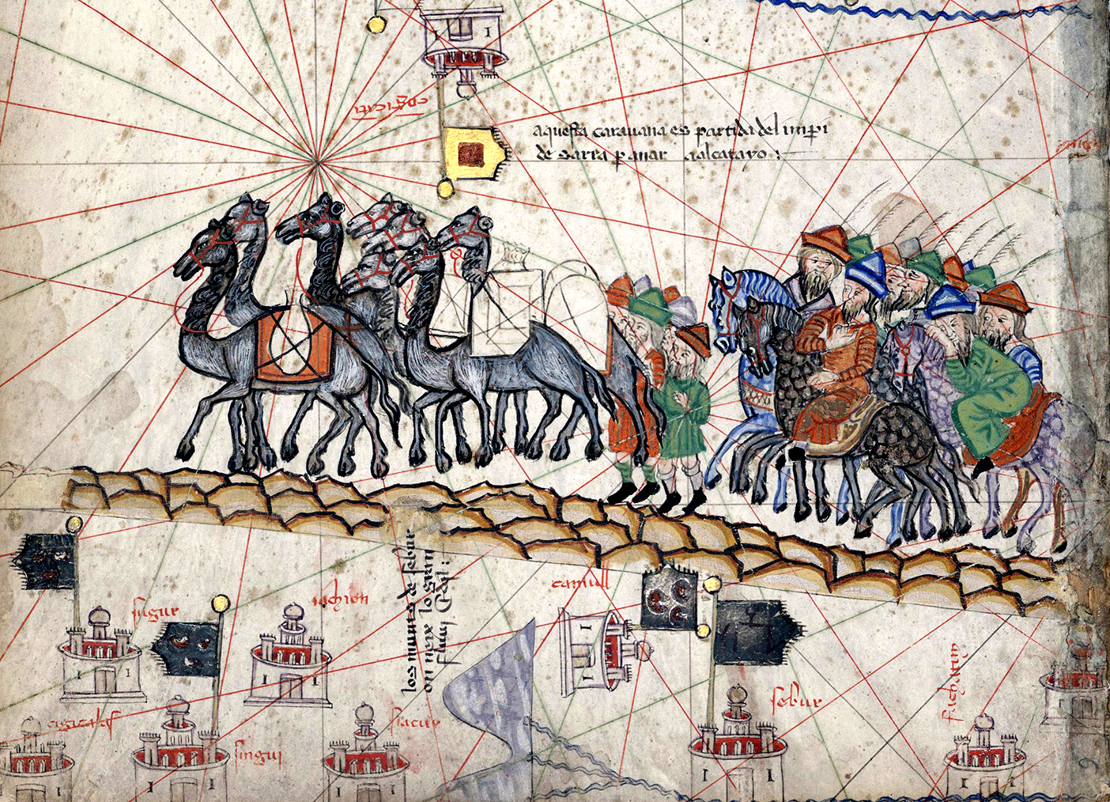
A Merchant Caravan on the Silk Road
Merchant caravan on the Silk Road. Detail, Catalan Atlas, 1375 (public domain).
© More Lessons Less Planning | morelessonslessplanning.com
Notes:
A real public-domain illustration of a merchant caravan traveling the Silk Road, a detail from the Catalan Atlas of 1375. Use it purely as a reference image to make the previous slide concrete: caravans of merchants like this one carried goods across Eurasia - and, with them, ideas and religions. Describe it academically as a period map illustration; students are not asked to decode the image as evidence. Image: detail from the Catalan Atlas, 1375, public domain (via Wikimedia Commons).

Slide 6
Buddhism Travels East
From India into China
Dunhuang and the Mogao Caves
Buddhism began in India and spread east along the Silk Road.
Monks and missionaries traveled with the caravans, teaching as they went.
A missionary travels to teach and spread their religion and win believers.
Dunhuang was an oasis city on the Silk Road in western China.
Its Mogao Caves preserved Buddhist art, statues, and thousands of texts.
It shows Buddhism taking root far from where it began.
Key Concept: BUDDHISM spread from India into China along the Silk Road; DUNHUANG and its Mogao Caves show where MISSIONARIES helped it take root.
© More Lessons Less Planning | morelessonslessplanning.com
Notes:
The clearest example of a religion carried by the Silk Road is Buddhism. Buddhism began in India and spread eastward along the routes from about the 1st century CE, carried by monks and missionaries who traveled with the caravans, teaching and building monasteries along the way. A missionary is a person who travels to new places to teach and spread their religion and win new believers. One vivid record is Dunhuang, an oasis city on the Silk Road in western China, home to the Mogao Caves, where Buddhism took root and its art, statues, and thousands of texts were preserved. Dunhuang shows Buddhism taking root far from where it began - a religion that traveled hundreds of years and thousands of miles along the trade routes. Describe this academically, as an example of religious transmission.

Slide 7
Islam Spreads Along the Routes
Islam begins and spreads
Islam began in Arabia in the 7th century CE and spread east along the Silk Road and the sea routes.
✔
Carried by merchants
Muslim merchants and travelers - not armies alone - carried the faith into Central Asia and western China.
✔
Faith and trade together
Trading cities became centers of Muslim life; Islam grew across Central Asia through this exchange.
✔
Key Concept: After the 7th century, Muslim MERCHANTS carried Islam east along the Silk Road and by sea toward India.
© More Lessons Less Planning | morelessonslessplanning.com
Notes:
A second faith carried by the routes is Islam. Islam began in Arabia in the 7th century CE and soon spread along the Silk Road and the sea routes. Muslim merchants and travelers - not armies alone - carried the faith east into Central Asia and western China, and along the maritime routes toward India and Southeast Asia. Trading cities along the routes became centers of Muslim life, learning, and law. As with Buddhism, this shows religious transmission at work: ordinary traders moving along trade routes carried their religion into new lands, where it took root and grew. Over centuries, Islam became a major faith across much of Central Asia through this exchange. Describe this neutrally, as a historical process of spread through trade.

Slide 8
Nestorian Christianity Reaches Tang China
The Church of the East
The Nestorian Stele (781 CE)
Nestorian Christianity is the Church of the East, a branch of Christianity.
It spread east along the Silk Road out of Persia and Central Asia.
It reached Tang China, where it was known and tolerated for a time.
A stone monument from 781 CE at Chang'an (Xi'an) records Christians in China.
It is written in Chinese and Syriac and describes the Church of the East there.
Manichaeism and Zoroastrianism also traveled these routes.
Key Concept: NESTORIAN CHRISTIANITY, the Church of the East, reached Tang China (Nestorian Stele, 781 CE).
© More Lessons Less Planning | morelessonslessplanning.com
Notes:
A third faith carried east was a branch of Christianity. Nestorian Christianity is the name often used for the Church of the East, a branch of Christianity distinct from the Roman Catholic and Orthodox churches; be careful not to conflate them. It spread eastward along the Silk Road out of Persia and Central Asia and reached Tang China, where it was known and tolerated for a time. The clearest evidence is the Nestorian Stele, a stone monument set up in 781 CE at Chang'an (modern Xi'an), written in Chinese and Syriac, that records a Christian community and the Church of the East in China. Other faiths traveled the routes too - Manichaeism and Zoroastrianism among them. All of this shows the same pattern: religions moving along trade routes into new lands. Present it academically, naming the Church of the East correctly.

Slide 9
Cities of Many Faiths
Faiths side by side
In many Silk Road cities, Buddhists, Muslims, and Christians lived and traded side by side.
✔
Syncretism
Syncretism: the blending of different religions or cultures into new local forms as they meet along the routes.
✔
Exchange, not sameness
Living side by side and blending some forms did NOT make the religions the same.
✔
Key Concept: Silk Road cities held many faiths side by side, and SYNCRETISM blended some forms - but the religions stayed distinct.
© More Lessons Less Planning | morelessonslessplanning.com
Notes:
Bring the threads together. Because the routes carried so many faiths, many Silk Road cities became places of great religious diversity, where Buddhists, Muslims, Christians, and others lived and traded side by side, each keeping its own temples, mosques, and churches. Where religions meet, syncretism can occur - the blending of elements from different religions or cultures into new local forms - and we see it in Silk Road art and practice. Make the honest academic point clearly: living side by side and blending some forms did NOT make the religions the same. Each tradition kept its own distinct beliefs; the Silk Road produced exchange and coexistence, not one merged religion. This is the synthesis of the whole unit: separate faiths, meeting and moving through trade.

Slide 10
A Traveler's Account: Marco Polo
Who was Marco Polo?
Reading it as a primary source
Marco Polo was a late-13th-century Venetian traveler across Asia.
His account describes cities of Buddhists, Muslims, and Christians together.
He dictated the book to a writer, Rustichello da Pisa, around 1298.
His account is a primary source - a firsthand traveler's report.
But he was an outside European Christian observer, not an insider.
He described the diversity; he did NOT create it.
Key Concept: MARCO POLO, a Venetian traveler, described Silk Road diversity as an outside observer - a primary source.
© More Lessons Less Planning | morelessonslessplanning.com
Notes:
To see Silk Road diversity through a traveler's eyes, we turn to Marco Polo. Marco Polo was a late-13th-century Venetian traveler who journeyed across much of Asia along the Silk Road and whose account describes cities where Buddhists, Muslims, and Christians lived and traded side by side. His book is a primary source - a firsthand traveler's report - but note two honest limits for a historian. First, he was an OUTSIDE European Christian observer, not an insider to these religions; he calls Muslims 'Saracens' and Buddhists 'idolaters,' the period terms of a medieval Christian, which we translate into the modern academic terms. Second, he dictated the book to a writer, Rustichello da Pisa, around 1298, and he described the religious diversity of the routes - he did not create it. The transmission of Buddhism, Islam, and Nestorian Christianity along the Silk Road long predates Polo. So we read his account as valuable but partial evidence, from one outside witness.

Slide 11
Studying Religious Exchange Academically
Describe, don't endorse
We study how religions spread as a historical and cultural process, never telling anyone what to believe.
✔
Compare fairly, don't rank
We compare how Buddhism, Islam, and Christianity each traveled - never ranking one faith above another.
✔
Read sources carefully
We treat an outsider's account like Marco Polo's as useful but partial evidence, not the whole picture.
✔
Key Concept: We study Silk Road religious EXCHANGE academically - describing how faiths spread and never ranking belief systems.
© More Lessons Less Planning | morelessonslessplanning.com
Notes:
Because this is a unit on world religions and belief systems, it helps to name how we study the Silk Road's religious exchange. First, we describe rather than endorse: we study how religions spread as a historical and cultural process, explaining what happened and never telling anyone what to believe. Second, we compare fairly rather than rank: we set the spread of Buddhism, Islam, and Christianity side by side to understand each one, noticing both the shared mechanism of exchange and the real differences among the faiths, and we never rank one religion above another. Third, we read sources carefully: an account like Marco Polo's is useful evidence of what one outside traveler saw, but it is partial, not a complete picture of the whole past. Holding to these habits keeps our study of religious exchange accurate, respectful, and academic.

Slide 12
Key Takeaways
The Silk Road carried religions as well as goods across Eurasia.
★
Merchants, monks, and missionaries spread faiths through cultural diffusion.
★
Buddhism, Islam, and Christianity each traveled the routes into new lands.
★
Marco Polo's account is an outsider's primary source on Silk Road diversity.
★
© More Lessons Less Planning | morelessonslessplanning.com
Notes:
Let's recap what you now know about religion on the Silk Road, described academically. First, the setting: the Silk Road was a network of trade routes that carried religions as well as goods across Eurasia. Second, the mechanism: merchants, monks, and missionaries spread faiths through cultural diffusion and religious transmission, aided by caravanserai stops. Third, the three faiths: Buddhism traveled from India into China (seen at Dunhuang), Islam spread along the routes after the 7th century, and Nestorian Christianity - the Church of the East - reached Tang China, recorded on the Nestorian Stele of 781 CE. Fourth, the evidence: Marco Polo's account lets us see Silk Road diversity through a traveler's eyes, read carefully as an outsider's primary source. Throughout, we described religious exchange fairly, as a historical process, and never ranked one tradition against another.

