Slide 1
Reformation Spreads
How the Reformation splintered into national churches - with England as the case study.
© More Lessons Less Planning | morelessonslessplanning.com
Notes:
Opening slide. This lesson examines, as HISTORY, how the Protestant Reformation did not stay in Germany but spread across Europe and split western Christianity into many competing national churches. England is the case study: students trace how King Henry VIII broke the English church from Rome and made it a national church under the crown. Keep the treatment academic and comparative: we analyze the split between Catholic and Protestant churches, and Henry's motives, as historical questions - never as matters of personal faith.

Slide 2
Learning Targets
Explain how the Reformation spread and split into national churches.
★
Explain why Henry VIII broke with Rome - politically, not over doctrine.
★
Explain what the Act of Supremacy (1534) did, and what it did NOT do.
★
Analyze the Act of Supremacy and trace how England became a national church.
★
© More Lessons Less Planning | morelessonslessplanning.com
Notes:
Learning targets. Target 1 traces how the Reformation spread beyond Germany and split western Christianity into competing national churches - Lutheran, Reformed/Calvinist, and Anglican - alongside the Catholic Church. Target 2 uses England as a case study and stresses that Henry VIII's break with Rome was primarily political and dynastic, not a doctrinal protest like Luther's. Target 3 explains what the Act of Supremacy (1534) did (royal control of the church) and, honestly, what it did not do (it did not instantly make England Protestant in doctrine). Target 4 practices sourcing on the Act itself and traces how England became a national church, with Protestant doctrine developing later.

Slide 3
The Reformation Spreads Beyond Germany
The REFORMATION began with Martin Luther's protest in Germany in 1517.
It did not stay there - the movement spread across Europe within decades.
The Reformation was the movement to reform the Church, splitting Christianity.
Reformers like John Calvin built new churches beyond the German lands.
By the mid-1500s, western Europe no longer had a single united Church.
Key Concept: The REFORMATION - the movement to reform the Church - spread far beyond Germany and split western Christianity into competing churches.
© More Lessons Less Planning | morelessonslessplanning.com
Notes:
Set the stage. The REFORMATION - the sixteenth-century movement to reform Christian belief and practice - began with Martin Luther's protest over indulgences in Germany in 1517 (the subject of the previous lesson). Stress to students that it did not remain a German story. Within a few decades, reforming ideas spread across Europe: reformers such as John Calvin in Switzerland built new churches, and rulers and reformers in many lands broke from the authority of the Pope in Rome. By the mid-1500s, the religious unity of western Christianity - which had lasted for centuries - was broken, and Europe was dividing into rival churches. Present this as historical change, neutrally.

Slide 4
National Churches Across Europe
What a national church is
A NATIONAL church is organized under a state or ruler rather than under the Pope in Rome.
✔
The Protestant branches
Lutheran (Germany, Scandinavia), Reformed/Calvinist (Switzerland, Scotland), and Anglican (England).
✔
The Catholic Church remained
The Roman Catholic Church, led by the Pope, stayed strong in Spain, Italy, and France.
✔
Key Concept: A NATIONAL church answers to its own ruler or state, not the Pope - producing Lutheran, Reformed, and Anglican churches.
© More Lessons Less Planning | morelessonslessplanning.com
Notes:
Explain the key concept of this lesson. As the Reformation spread, western Christianity fragmented into what historians call NATIONAL churches - churches organized under the authority of a particular state or ruler rather than under the Pope in Rome. Lay out the map for students, historically and neutrally: Lutheran churches took hold in many German states and in Scandinavia; Reformed or Calvinist churches formed in Switzerland, Scotland, and the Dutch Republic; and in England the Anglican Church (the Church of England) emerged. Meanwhile the Roman Catholic Church, still led by the Pope, remained strong in Spain, Italy, France, and much of central Europe. The big point: religion increasingly became tied to states and rulers. England is the case study we will follow.

Slide 5
England: A Case Study in Building a National Church
Why study England
What made it different
England shows HOW a ruler could nationalize a church.
The break was led by the king, not by a monk or theologian.
It was primarily POLITICAL and DYNASTIC, about a marriage and an heir.
It was not, at first, a doctrinal protest like Luther's.
Key Concept: England is a CASE STUDY for how a ruler nationalized a church - its break was primarily POLITICAL and DYNASTIC.
© More Lessons Less Planning | morelessonslessplanning.com
Notes:
Frame England as the case study, honestly. Explain to students why we zoom in on England: it is a clear example of HOW a ruler could take control of a church and make it national. Stress a crucial distinction up front. Luther's protest in Germany began over doctrine - the sale of indulgences and salvation by faith. England's break, by contrast, was led by its KING, Henry VIII, and was primarily POLITICAL and DYNASTIC: it grew out of the king's marriage problems and his need for a male heir, not out of a theological dispute about Catholic teaching. This distinction is the honesty anchor for the whole lesson - England did not break with Rome because the king disagreed with Catholic theology.

Slide 6
Who Was Henry VIII?
Henry VIII
The king of England (1491-1547), who ruled from 1509 and later broke the English church from Rome.
A devout Catholic king
Early in his reign Henry was a loyal Catholic who defended the Church against Luther's ideas.
Defender of the Faith
In 1521 the Pope gave Henry this title for writing a book AGAINST Martin Luther.
Key Concept: HENRY VIII (1491-1547) began as a devout Catholic - the Pope named him 'Defender of the Faith' in 1521 for writing against Luther.
© More Lessons Less Planning | morelessonslessplanning.com
Notes:
Introduce the king, factually - and protect the honesty anchor. HENRY VIII (1491-1547) became king of England in 1509. Crucially for this lesson, he began his reign as a devout and loyal Catholic. In 1521 - the very years Luther was being condemned - the Pope awarded Henry the title 'Defender of the Faith' for writing (or sponsoring) a book DEFENDING Catholic teaching AGAINST Martin Luther. Make sure students grasp this: Henry was not an early Protestant or a critic of Catholic doctrine. When he later broke with Rome, it was not because he had come to disagree with Catholic theology. The next slide shows a portrait of Henry painted by the leading court artist of his day.

Slide 7
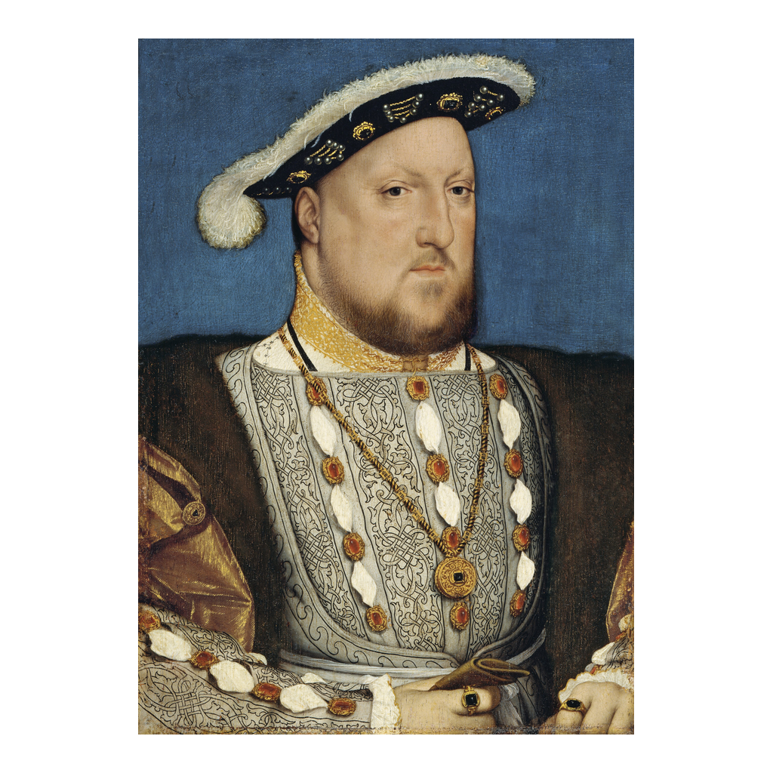
A Portrait of Henry VIII
Portrait of King Henry VIII by Hans Holbein the Younger (c. 1537).
© More Lessons Less Planning | morelessonslessplanning.com
Notes:
This is a portrait of King Henry VIII attributed to Hans Holbein the Younger, painted around 1537. Holbein was a leading court painter in Tudor England, so this is an image made during Henry's own lifetime that helped shape how the powerful king wanted to be seen. Use it simply to put a human face to the ruler students are studying, and note the display of wealth and authority in the rich costume and jewels. Note honestly that it is a painting, not a photograph. It is a real 16th-century painting in the public domain, not a modern illustration.
Reference labels (point to these chart features when teaching): The king of England; Painted c. 1537

Slide 8
The King's 'Great Matter'
Henry's first marriage
Henry was married to CATHERINE OF ARAGON, but they had no surviving son to inherit the throne.
✔
The woman he wished to marry
Henry wanted to marry ANNE BOLEYN, hoping she would give him the male heir he needed.
✔
What Henry sought
Henry sought an ANNULMENT - an official declaration that his marriage was never valid - so he could remarry.
✔
Key Concept: Henry's 'great matter' was seeking an ANNULMENT of his marriage to CATHERINE OF ARAGON so he could marry ANNE BOLEYN.
© More Lessons Less Planning | morelessonslessplanning.com
Notes:
Explain the political and dynastic cause, neutrally. Henry VIII was married to CATHERINE OF ARAGON, a Spanish princess, but their marriage had produced no surviving son, and Henry was desperate for a male heir to secure the Tudor line. Henry wished to marry ANNE BOLEYN, and he came to argue that his marriage to Catherine had never been valid in the first place. What he sought from the Church was an ANNULMENT - an official declaration that a marriage was never truly valid (different from a divorce, which ends a valid marriage). Emphasize the honesty anchor: this was a DYNASTIC and POLITICAL problem - about a marriage, a queen, and an heir - not a dispute over Catholic doctrine. Contemporaries called it 'the king's great matter.'

Slide 9
The Pope Refuses
Henry asked POPE CLEMENT VII to annul his marriage to Catherine.
The Pope REFUSED to grant the annulment.
Catherine's nephew was Emperor Charles V, whose troops controlled Rome.
The Pope was politically trapped and could not risk angering Charles V.
The refusal pushed Henry toward breaking with ROME entirely.
Key Concept: POPE CLEMENT VII REFUSED the annulment - partly because Emperor Charles V controlled Rome - pushing Henry to break with Rome.
© More Lessons Less Planning | morelessonslessplanning.com
Notes:
Explain why the annulment failed, historically. Henry asked POPE CLEMENT VII to declare his marriage to Catherine of Aragon invalid. The Pope REFUSED. Explain the crucial political reason, neutrally: Catherine of Aragon was the aunt of Emperor Charles V, the most powerful ruler in Europe, whose armies had recently sacked and effectively controlled Rome. Granting Henry's annulment would have been an insult to Charles V, and the Pope was in no position to risk it. So the refusal was itself tangled up in European politics, not only in Church doctrine. Stuck, and unwilling to give up Anne Boleyn or the hope of an heir, Henry moved toward taking control of the English church himself - breaking with ROME. Keep the framing analytical.

Slide 10
The Act of Supremacy (1534)
In 1534 the English Parliament passed the ACT OF SUPREMACY.
It declared the king 'the only supreme head in earth of the Church of England.'
This gave Henry the title of SUPREME HEAD over the church.
It created the CHURCH OF ENGLAND, independent of the Pope in Rome.
Royal authority now replaced the POPE's authority over the English church.
Key Concept: The 1534 ACT OF SUPREMACY made the king SUPREME HEAD of the CHURCH OF ENGLAND, independent of the Pope in Rome.
© More Lessons Less Planning | morelessonslessplanning.com
Notes:
Explain the decisive act, precisely. In 1534, the English Parliament passed the ACT OF SUPREMACY. Read the key phrase to students slowly: it declared that the king was to be 'the only supreme head in earth of the Church of England.' Unpack what that meant. It gave Henry the title SUPREME HEAD over the church in England, and it created the CHURCH OF ENGLAND (the Anglican Church) as a national church independent of the Pope in Rome. From now on, the highest authority over the English church was the king and Parliament, not the Pope. Stress that this is the LEGAL heart of England's break with Rome, and that it was accomplished through an act of Parliament - a political and legal instrument - not through a theological reform of Catholic doctrine.

Slide 11
What the Act Did - and Did NOT Do
What the Act DID
What it did NOT do
Made the king head of the English church.
Made the church INDEPENDENT of the Pope - a national church under the crown.
It did NOT instantly change the church's DOCTRINE or beliefs.
Henry kept largely CATHOLIC teaching and worship after the break.
Key Concept: The Act made the church INDEPENDENT of the Pope under royal authority - but it did NOT make England Protestant overnight.
© More Lessons Less Planning | morelessonslessplanning.com
Notes:
This is the single most important honesty slide in the lesson. Be very clear with students about the difference between AUTHORITY and DOCTRINE. What the Act of Supremacy DID: it made the king the head of the English church and made that church independent of the Pope - a national church under the authority of the crown. What the Act did NOT do: it did not instantly change what the church believed or how it worshipped. Under Henry, the Church of England kept largely CATHOLIC doctrine, ceremonies, and practices; the Latin Mass continued, and Henry still saw himself as a Catholic - just one no longer under the Pope. The common shorthand that 'England became Protestant in 1534' is a myth. The 1534 break was about who was in charge (royal authority instead of papal authority), not yet about a change in theology. Protestant doctrine in England came later.

Slide 12
England After Henry: Protestant Doctrine Comes Later
England's Protestant DOCTRINE developed AFTER Henry VIII's break, not in 1534.
Under Henry's young son EDWARD VI, the church became more Protestant.
Under Queen ELIZABETH I, a lasting Protestant settlement took shape.
That settlement gave the Church of England its enduring Anglican identity.
So the shift to Protestant belief was gradual and came after the 1534 break.
Key Concept: England's Protestant doctrine developed LATER - under EDWARD VI and then ELIZABETH I - not from the 1534 Act of Supremacy itself.
© More Lessons Less Planning | morelessonslessplanning.com
Notes:
Trace the honest timeline so students do not collapse it into 1534. England's shift toward Protestant DOCTRINE came AFTER Henry's break, and it was gradual. Under Henry's young son EDWARD VI (reigned 1547-1553), reformers moved the Church of England in a clearly Protestant direction in its beliefs and worship. After a Catholic reign under Mary I, it was under Queen ELIZABETH I (reigned 1558-1603) that a lasting Protestant settlement took shape, giving the Church of England its enduring Anglican character. The takeaway for students: the 1534 Act of Supremacy created a national church under royal control, but the change to Protestant belief unfolded over the following decades under later monarchs - not overnight. Keep the tone historical and neutral about the competing beliefs.

Slide 13
The Reformation's Fragmentation
By the mid-1500s, western Christianity was permanently SPLIT.
Multiple churches now existed: Lutheran, Reformed, Anglican, and Catholic.
Many churches were tied to a particular ruler or STATE.
England was one example of this larger, continent-wide fragmentation.
The religious map of Europe was reshaped for centuries.
Key Concept: By the mid-1500s the Reformation had permanently SPLIT western Christianity into rival churches tied to rulers or STATES.
© More Lessons Less Planning | morelessonslessplanning.com
Notes:
Pull back to the big picture. By the middle of the sixteenth century, the Reformation had permanently SPLIT western Christianity. Where there had once been a single Church under the Pope, there were now several: Lutheran, Reformed/Calvinist, Anglican, and the Roman Catholic Church. Emphasize the pattern students should carry away: many of these churches were tied to a particular ruler or STATE - religion and political power had become deeply linked. England, which we studied closely, was just one example of a much larger fragmentation happening across Europe. This division reshaped European religion, politics, and warfare for centuries. Keep the framing historical and even-handed among the competing churches.

Slide 14
Rebel or Politician? An Honest View
Henry's real motives
How historians analyze it
His break was primarily POLITICAL and dynastic - a marriage and an heir.
It was not a theological protest against Catholic doctrine like Luther's.
Weigh the causes, the ACT (Act of Supremacy 1534), and the consequences.
Avoid the myth that Henry converted England to Protestantism overnight.
Key Concept: Henry's break was primarily POLITICAL, not doctrinal; historians weigh the causes, the ACT of Supremacy, and the consequences.
© More Lessons Less Planning | morelessonslessplanning.com
Notes:
Model the honest, academic verdict. It is tempting to tell England's story as either a brave rebel breaking free or a villain wrecking the Church, but historians are more careful. Explain to students that Henry's break was primarily POLITICAL and dynastic - it grew out of his marriage to Catherine, his desire to marry Anne Boleyn, his need for a male heir, and the Pope's politically driven refusal. It was NOT, at the start, a theological protest against Catholic doctrine the way Luther's was. Teach students to analyze it as history: weigh the causes (the annulment crisis, the Pope's refusal, the king's ambition), the ACT itself (the Act of Supremacy of 1534), and the consequences (a national church under the crown, with Protestant doctrine developing later). Warn them off two myths at once: that Henry acted out of Protestant conviction, and that England became doctrinally Protestant overnight. Remind them sincere people stood on all sides.

Slide 15
How Do We Know? Reading the Act Critically
Our primary source is an excerpt of the ACT OF SUPREMACY of 1534.
We read it from a public-domain 1896 scholarly EDITION (Gee and Hardy).
That edition is public domain because of its age.
The Act is a legal STATUTE - it shows what the law declared.
It does not by itself show how ordinary English people felt about the change.
Tip: The Act of Supremacy is a legal STATUTE - read the excerpt critically for what the LAW declared, not for how ordinary people felt about it.
© More Lessons Less Planning | morelessonslessplanning.com
Notes:
Set up the Primary Source Spotlight and teach how to read it. Our primary source is an excerpt of the ACT OF SUPREMACY of 1534, the statute by which Parliament made the king head of the Church of England. Students read it from a public-domain scholarly EDITION - Documents Illustrative of English Church History, edited by Henry Gee and William John Hardy (London: Macmillan, 1896) - which is public domain because of its age; the wording has been lightly modernized for readability. Teach students what KIND of source this is: it is a legal STATUTE, the official text of a law. That makes it excellent, direct evidence of what the law DECLARED - who was now in charge of the English church - but it does not, by itself, tell us how ordinary English people felt about the change, whether they obeyed happily or resented it. A careful historian reads the law for what it establishes and looks elsewhere for how people experienced it.

Slide 16
Key Takeaways
The REFORMATION split western Christianity into competing NATIONAL churches.
★
England is the case study: HENRY VIII broke the church from Rome.
★
His break was primarily POLITICAL - an ANNULMENT refused by POPE CLEMENT VII.
★
The 1534 ACT OF SUPREMACY made the king SUPREME HEAD of the CHURCH OF ENGLAND.
★
It did NOT make England Protestant overnight - that doctrine came later.
★
Read the Act critically as a legal statute - what the law declared.
★
© More Lessons Less Planning | morelessonslessplanning.com
Notes:
Close the loop and hold the honesty frames. If students remember a few things, make them these: the REFORMATION spread beyond Germany and split western Christianity into competing NATIONAL churches - Lutheran, Reformed/Calvinist, Anglican, and Catholic. England is our case study for how a ruler nationalized a church: HENRY VIII, who began as a devout Catholic, broke the English church from Rome. His break was primarily POLITICAL and dynastic - it grew from his failed effort to get an ANNULMENT of his marriage to Catherine of Aragon, refused by POPE CLEMENT VII. The 1534 ACT OF SUPREMACY made the king the SUPREME HEAD of the CHURCH OF ENGLAND, independent of the Pope. Stress the honesty anchor: this did NOT make England doctrinally Protestant overnight; that developed later under Edward VI and Elizabeth I. And we read the Act critically as a legal statute - evidence of what the law declared, not of how ordinary people felt.

