Slide 1
Recession Compared: 2008 vs 2020 vs 2024
Three recent U.S. downturns - three different causes, three different responses, three different recoveries. What each one taught us about the next.
© More Lessons Less Planning | morelessonslessplanning.com
Notes:
Open with a hook. In the last 18 years the U.S. has lived through THREE famous downturns: the 2008 Great Recession (housing-driven, deepest since the Great Depression), the 2020 COVID recession (virus-driven, shortest on record), and the 2024 soft-landing scare (the Sahm Rule briefly triggered but the NBER did not call a recession). Each was caused by something different. Each was met with a different policy response. Each recovered differently. Today's lesson is the side-by-side comparison.

Slide 2
Learning Targets
Compare the 2008, 2020, and 2024 downturns on causes, depth, and recovery
★
Identify what each downturn taught policymakers about the next response
★
Evaluate which downturn response worked best given the cause
★
© More Lessons Less Planning | morelessonslessplanning.com
Notes:
Read each target aloud. Connect target 1 to slides 3-7 (side-by-side comparison + GDP overlay chart). Connect target 2 to slides 8-12 (policy responses, labor market, lessons learned). Connect target 3 to slides 13-14 (takeaways and key wrap-up).

Slide 3
Three Recent Downturns at a Glance
Downturn | Trigger | NBER Call?
2008 Great Recession | Housing market collapse + global financial crisis | Yes (Dec 2007 - June 2009, 18 months)
2020 COVID Recession | Pandemic shutdowns (lockdowns, business closures) | Yes (Feb 2020 - April 2020, 2 months)
2024 Mini-shake | Post-pandemic Fed tightening + cooling labor market | No (soft-landing scare; NBER did not call)
Key Concept: Three downturns, three causes, three NBER outcomes. 2008 = financial; 2020 = pandemic; 2024 = soft-landing scare (no NBER call).
© More Lessons Less Planning | morelessonslessplanning.com
Notes:
Introduce the three downturns side by side. The 2008 Great Recession lasted 18 months (December 2007 - June 2009) and was the deepest since the Great Depression. The 2020 COVID Recession lasted just 2 months (February - April 2020) - the shortest on record. The 2024 mini-shake was NOT a true recession - the NBER did not call one - but the Sahm Rule (a simple labor-market recession trigger) briefly fired in summer 2024 when unemployment ticked up. The economy then stabilized; jobs kept growing; the NBER call never came. This is the lesson's central frame: same country, very different downturns, very different outcomes.

Slide 4
2008: Housing-Driven, Slow Recovery
The Cause
The Recovery
Housing bubble: U.S. home prices rose 60% from 2000-2006
Subprime mortgages: high-risk loans bundled into mortgage-backed securities
When prices fell, banks holding MBS were insolvent
Lehman Brothers bankruptcy (Sept 2008) was the panic moment
NBER dates: December 2007 - June 2009 (18 months)
Real GDP fell about 4% from peak
Unemployment peaked at 10.0% (October 2009)
L-shaped: it took until 2014 for jobs to fully recover
Big Idea: 2008 was a FINANCIAL crisis - banks froze, credit dried up, and recovery was slow because the financial system had to be rebuilt.
© More Lessons Less Planning | morelessonslessplanning.com
Notes:
Walk through the 2008 case. The cause was a housing bubble combined with risky financial engineering. U.S. home prices rose 60% from 2000 to 2006 (a clear bubble). Banks made millions of SUBPRIME mortgages (high-risk loans to borrowers who could not afford them) and bundled them into MORTGAGE-BACKED SECURITIES (MBS) - bonds backed by pools of home loans. When home prices fell starting in 2006-2007, the MBS values collapsed, and banks holding trillions of dollars in MBS suddenly looked insolvent. The PANIC MOMENT was September 15, 2008, when Lehman Brothers (the 4th largest U.S. investment bank) filed the largest bankruptcy in U.S. history. Credit markets froze. The recovery was slow because the financial system itself had to be repaired. Real GDP fell about 4% peak-to-trough. Unemployment peaked at 10.0% in October 2009 (well after the recession ended in June). It took until 2014 - five years - for total nonfarm payrolls to recover to pre-recession levels. This is the textbook L-SHAPED recovery: sharp fall, long flat bottom, slow climb.

Slide 5
2020: Virus-Driven, Sharp V-Shape
The Cause
The Recovery
March 2020: U.S. states ordered lockdowns to slow COVID-19
Restaurants, retail, travel shut down almost overnight
22 million jobs lost in April 2020 (one month)
Real GDP fell about 9% in Q2 (peak-to-trough)
NBER dates: February 2020 - April 2020 (2 months - shortest ever)
Unemployment peaked at 14.7% (April 2020)
Real GDP recovered to its prior peak by Q2 2021
V-shaped: sharp fall, sharp rebound
Big Idea: 2020 was a PANDEMIC shock - the economy was deliberately frozen, then thawed. The financial system was NOT broken, so recovery was fast.
© More Lessons Less Planning | morelessonslessplanning.com
Notes:
Walk through the 2020 case. The cause was a deliberate, virus-driven economic shutdown. In March 2020, U.S. states ordered lockdowns to slow the spread of COVID-19. Restaurants, retail, travel, and entertainment closed almost overnight. The U.S. lost about 22 million jobs in April 2020 alone - the largest single-month job loss in history. Real GDP fell about 9% peak to trough (Q2 2020). The unemployment rate peaked at 14.7% in April 2020 - the highest since the Great Depression. But the recovery was historically fast. Vaccines arrived in late 2020 / early 2021. Massive fiscal stimulus (CARES Act + PPP + ARP) kept household incomes from collapsing. The financial system was NOT broken (unlike 2008), so credit kept flowing once the economy reopened. Real GDP recovered to its prior peak by Q2 2021. NBER dated the recession from February 2020 to April 2020 - just TWO MONTHS, the shortest on record. This is the textbook V-SHAPED recovery: sharp fall, sharp rebound.

Slide 6
2024: Soft Landing or Mini-Recession?
The setup
Fed raised rates from 0% to 5.25% in 2022-2023 to fight 9% inflation.
The 2024 scare
Summer 2024: payroll growth slowed; unemployment ticked from 3.7% to 4.3%; the Sahm Rule briefly fired.
What the Sahm Rule is
Fires when the 3-month average unemployment rate rises 0.5 points above its 12-month low.
What actually happened
The Fed began cutting rates September 2024; jobs stabilized; NBER did NOT call a recession.
The label
A SOFT LANDING - slowing inflation without triggering a recession; the rare good outcome.
Key Concept: 2024 was a soft-landing scare - the Sahm Rule fired, but the NBER did NOT call a recession.
© More Lessons Less Planning | morelessonslessplanning.com
Notes:
Walk through the 2024 case. The setup: in 2022-2023, the Fed raised interest rates from near 0% to 5.25% (the most aggressive hiking cycle in decades) to fight 9% inflation. The big question was whether the Fed would cause a HARD LANDING (a recession) or pull off a SOFT LANDING (slow inflation without a recession). In summer 2024, the scare arrived. Payroll growth slowed sharply (the July jobs report was a shock). The unemployment rate ticked from 3.7% earlier in the year up to 4.3% in July 2024. The SAHM RULE - a simple labor-market trigger created by economist Claudia Sahm that fires when the 3-month average unemployment rate rises 0.5 points above its 12-month low - briefly triggered. Recession headlines returned. But the Fed cut rates starting September 2024 (a 50-basis-point cut), inflation kept easing, jobs kept growing (slower but positive), and the unemployment rate stabilized. The NBER did NOT call a recession. By early 2026, economists generally agree the U.S. achieved a SOFT LANDING - the rare and difficult outcome the Fed had been aiming for. NOTE: The Sahm Rule's 2024 false positive raised questions about whether the rule still works post-pandemic.

Slide 7
Comparing the Depth: Real GDP Across All Three
How to read the chart
Each line shows real GDP indexed to 100 at the pre-recession peak; lower = bigger drop.
2008 (red)
Fell to about 96 (a 4% drop); bottomed mid-2009; took years to climb back.
2020 (blue)
Fell to about 91 (a 9% drop) but rocketed back to 100 within 5 quarters - the V.
2024 (green)
Barely a visible dip - real GDP stayed positive (the soft-landing case).
Big picture
Depth: 2020 (9%) > 2008 (4%) > 2024 (negligible). Recovery speed: 2020 fast > 2008 slow.
Big Idea: 2020 was DEEPER but SHORTER; 2008 SHALLOWER but LONGER; 2024 barely registered.
© More Lessons Less Planning | morelessonslessplanning.com
Notes:
Frame the GDP overlay. Each line on the chart shows real GDP as an index, with the value set to 100 at each downturn's pre-recession peak. So when a line drops to 95, real GDP fell 5% from peak. This lets you compare DEPTH directly across three episodes. The 2008 line falls to about 96 (a 4% drop) over 6 quarters and takes years to climb back. The 2020 line plunges to about 91 (a 9% drop) in a single quarter but rockets back to 100 within 5 quarters - the V. The 2024 line stays near 100 throughout - barely any visible dip - because the U.S. avoided a recession that year. This visual will be used by students in Activity Part 4 to read off the chart and compare the depth of each downturn.

Slide 8
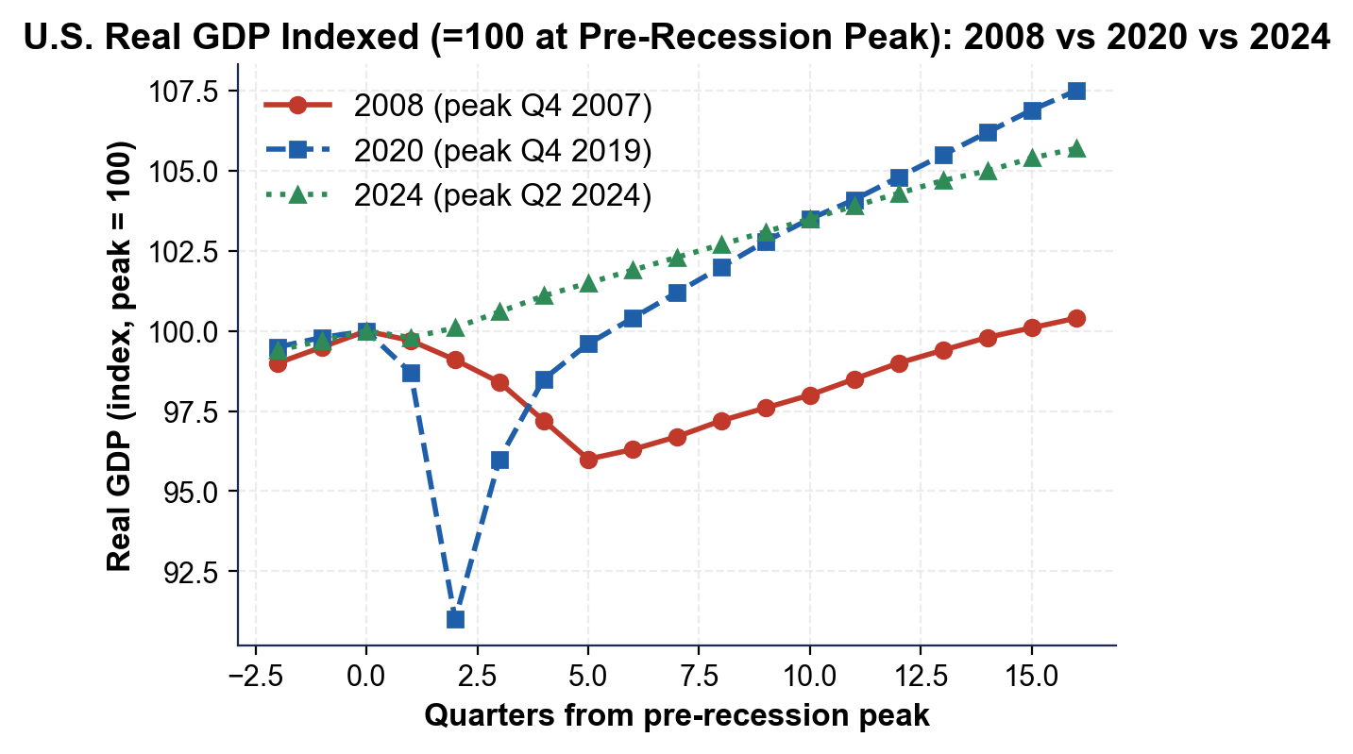
Real GDP Indexed: 2008 vs 2020 vs 2024
Note: Lower = bigger drop from peak. 2020 deepest; 2024 barely dipped.
© More Lessons Less Planning | morelessonslessplanning.com
Notes:
Read the chart. Three lines, each indexed to 100 at the pre-recession peak. The 2008 line drops gradually to about 96 over 6 quarters and stays low for years before climbing back. The 2020 line plunges to about 91 in a single quarter then rockets back to 100 by Q2 2021. The 2024 line barely moves from 100 - real GDP grew throughout the year. Students use this exact chart in Activity Part 4 Question 1 to identify which downturn was deepest (2020), which had the slowest recovery (2008), and to read approximate values directly from the chart.
Reference labels (point to these chart features when teaching): Peak = 100; 2020 drop deepest

Slide 9
Policy Responses Compared
Downturn | Fiscal Response | Monetary Response
2008 | TARP 700 + ARRA 831 (billions); 1.5 trillion total | Fed cut to 0; QE1, QE2, QE3 (large-scale bond buying)
2020 | CARES 2.2 trillion + ARP 1.9 trillion; 4 trillion total | Fed cut to 0 in days; emergency lending; unlimited QE
2024 | No major emergency stimulus (the scare faded) | Fed CUT rates 50 bps in Sept 2024 (preemptive)
Key Concept: 2020 fiscal response was BIGGER and FASTER than 2008 - this is one reason the 2020 recovery was faster.
© More Lessons Less Planning | morelessonslessplanning.com
Notes:
Compare the policy responses. In 2008 the FISCAL response (Congress + President) totaled about 1.5T: TARP (700B, Bush, October 2008) bailed out banks and the auto industry; ARRA (831B, Obama, February 2009) was the recovery package. The MONETARY response (Fed): cut the federal funds rate to 0% by December 2008 and ran three rounds of QUANTITATIVE EASING (buying long-term bonds to push down long rates) - QE1, QE2, QE3 - through 2014. In 2020 the response was MUCH bigger and faster. CARES Act (2.2T, March 2020) and the American Rescue Plan (1.9T, March 2021) totaled about 4T in fiscal stimulus - the largest in history. The Fed cut to 0% in DAYS (March 15, 2020), launched emergency lending facilities, and bought trillions in Treasuries and MBS. In 2024 the scare faded before major fiscal action; the Fed simply cut rates 50bps in September 2024 - a preemptive pivot that stopped the slowdown. The lesson: SPEED MATTERS. The 2020 response was bigger AND faster, which is one reason the 2020 recovery was a sharp V instead of a slow L.

Slide 10
Unemployment Compared
How to read the chart
U.S. unemployment rate per downturn. Higher = more pain; watch recovery speed.
2008 peak
10.0% (Oct 2009); stayed above 6% until 2014 - 5 years high
2020 peak
14.7% (Apr 2020), highest since the Depression; below 6% by mid-2021
2024 peak
4.3% (Jul 2024) then back to 4.1-4.2% - a ripple, not a recession
Big picture
2020 peak HIGHER than 2008, but recovery MUCH faster (system wasn't broken)
Big Idea: 2020 unemployment peak (14.7%) was higher than 2008 (10.0%), but jobs recovered in 18 months vs 5+ years.
© More Lessons Less Planning | morelessonslessplanning.com
Notes:
Frame the unemployment overlay. Each line shows the U.S. unemployment rate during one downturn, plotted by months since the downturn started. The 2008 line rose from 5% to 10% over 18 months and stayed above 8% for THREE YEARS - the slow recovery that defined the Obama-era debate. The 2020 line spiked from 3.5% to 14.7% in a single month - the highest since the Great Depression - but plunged back to 6% by mid-2021 and to under 4% by early 2022 - a historic V. The 2024 line barely moved: from 3.7% up to 4.3% in July 2024 then back to 4.1% by year-end - a ripple, not a recession peak. Students will use this chart in Activity Part 4 Question 2 to read off the three peaks and compare how fast each fell back.

Slide 11
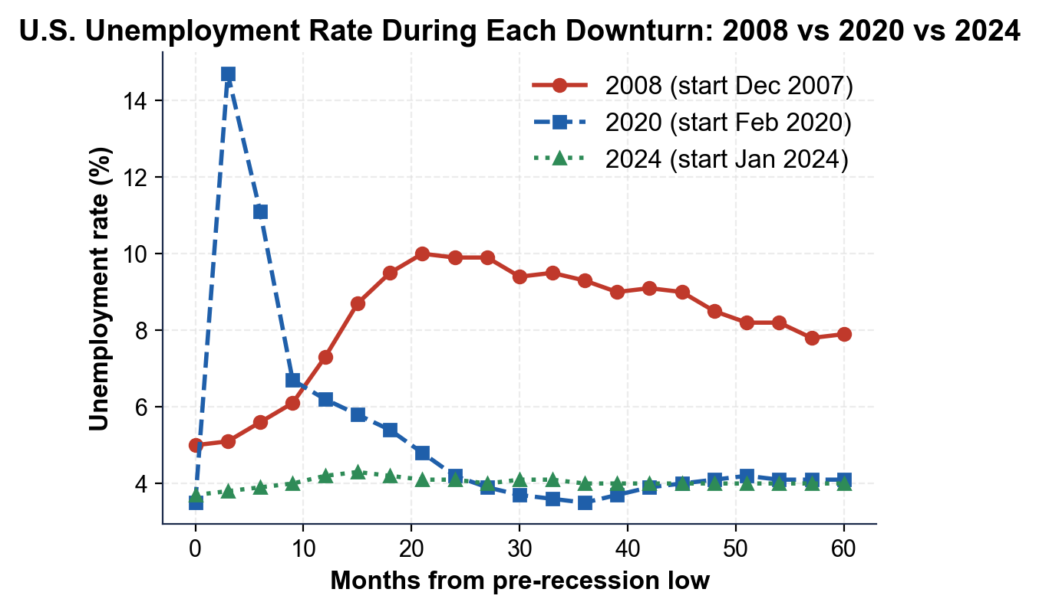
Unemployment Rate: 2008 vs 2020 vs 2024
Note: Higher = more pain. 2020 highest peak; 2024 a small ripple.
© More Lessons Less Planning | morelessonslessplanning.com
Notes:
Read the unemployment chart. Three lines, each plotting the U.S. unemployment rate over the months around each downturn. The 2008 line rises gradually from 5% to a peak of 10.0% in October 2009, then falls slowly. The 2020 line spikes from 3.5% to 14.7% in a single month, then falls dramatically - back below 6% by mid-2021. The 2024 line is barely visible - it ticks up from 3.7% to 4.3% in July 2024 and back down to 4.1% by year-end. Students use this chart in Activity Part 4 Q2 to read off the peaks and compare how fast each line falls back to pre-recession levels.
Reference labels (point to these chart features when teaching): 2020 peak 14.7%; 2008 peak 10.0%

Slide 12
Labor Market Recovery Compared
Job Recovery Speed
Why the Difference
2008: 8.7 million jobs lost; took 6+ years to fully recover (2014)
2020: 22 million jobs lost in April 2020; recovered by June 2022
2024: No net job loss - growth slowed but never went negative
Speed: 2020 > 2008 > 2024 (no recovery needed)
2008: financial system broken; banks could not lend
2020: pandemic shock; financial system intact; massive aid
2024: Fed pivoted fast; no large layoffs hit
Lesson: speed and size of policy response matter
Tip: 2020 recovery was faster than 2008 even though 2020 was DEEPER - intact financial system + bigger faster aid.
© More Lessons Less Planning | morelessonslessplanning.com
Notes:
Drill the labor market recovery comparison. The 2008 case: the U.S. lost 8.7 million jobs from peak in early 2008 through trough in February 2010. Nonfarm payrolls did not return to the pre-recession peak until May 2014 - more than SIX YEARS. The 2020 case: 22 million jobs were lost in April 2020 alone - far more than 2008 in absolute terms. But the recovery was fast: by June 2022, total payrolls had returned to the pre-pandemic peak - about TWO YEARS from the bottom. The 2024 case: no net job loss; job growth slowed sharply mid-year, but the U.S. continued adding jobs every month. Why the difference? In 2008 the financial system was broken - banks could not lend even when there was demand. In 2020 the financial system was intact and the fiscal response (CARES + ARP) was about 2.5 times the size of the 2008 response. In 2024 the Fed pivoted quickly (rate cut in September) before large layoffs hit. The big lesson: speed and size of policy response, plus whether the financial system itself is broken, determine recovery shape.

Slide 13
Stock Market Drawdowns Compared
How to read the chart
Each line is the S&P 500 indexed to 100 at the pre-recession peak
2008 (red)
S&P 500 fell about 57% from peak (October 2007) to trough (March 2009)
2020 (blue)
S&P 500 fell about 34% from peak (Feb 2020) to trough (March 2020) - then hit new highs by Aug 2020
2024 (green)
S&P 500 dipped about 8% during the August 2024 scare then hit new highs by year-end
Big picture
Depth: 2008 > 2020 > 2024. Recovery speed: 2024 > 2020 > 2008
Key Concept: The stock market often falls SHARPLY in a recession - and recovers BEFORE the broader economy.
© More Lessons Less Planning | morelessonslessplanning.com
Notes:
Frame the stock market overlay. Each line shows the S&P 500 stock index during one downturn, indexed to 100 at the pre-recession peak. The 2008 line drops to about 43 (a 57% drop from peak) - the deepest stock-market crash since the Great Depression. The 2020 line drops to about 66 (a 34% drop) - then rockets back and hits new all-time highs by August 2020. The 2024 line dips to about 92 in early August 2024 then climbs to new highs by year-end. Note: the stock market is FORWARD-LOOKING - it tends to fall BEFORE the recession is officially called and recover BEFORE the broader economy does. Students use this chart in Activity Part 4 Q3 to read approximate drawdowns and rank the three downturns by stock-market depth.

Slide 14
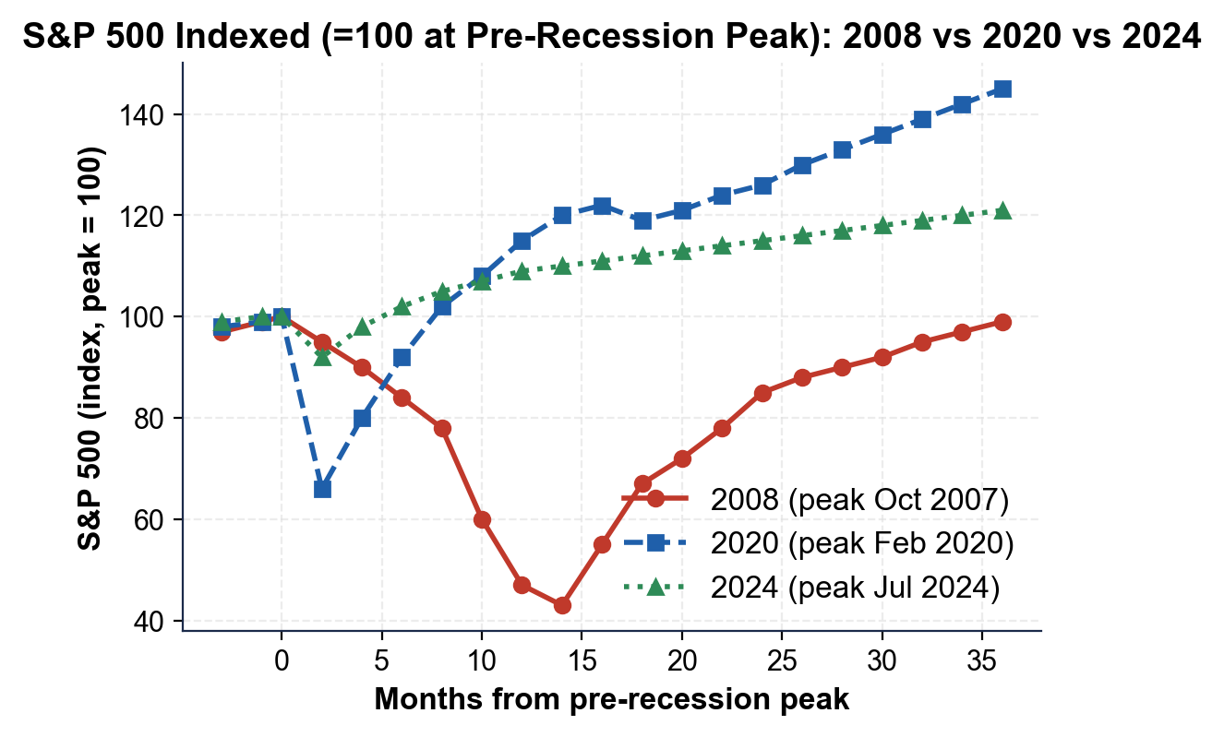
S&P 500 Indexed: 2008 vs 2020 vs 2024
Note: Lower = deeper drawdown. 2008 deepest at -57%; 2024 a small dip.
© More Lessons Less Planning | morelessonslessplanning.com
Notes:
Read the stock market chart. The 2008 line falls to about 43 (a 57% drop from peak). The 2020 line falls to about 66 (a 34% drop) - briefly - then climbs back. The 2024 line dips to about 92 (an 8% drop) and recovers in months. Students use this chart in Activity Part 4 Q3 to compare depth and Q4 to explain why stocks often fall FIRST and recover FIRST.
Reference labels (point to these chart features when teaching): Peak = 100; 2008 drop deepest

Slide 15
What Each Downturn Taught Policymakers
Downturn | Key Lesson
2008 | Stress-test the banks; act faster on financial crises (led to Dodd-Frank, 2010)
2020 | Speed and size of aid matter; CARES proved a fast, massive response can shorten a recession
2024 | Watch the Sahm Rule but do not panic on one bad jobs report; soft landings are possible
Big Idea: Each downturn left a playbook. 2008 = regulate the banks. 2020 = act fast and big. 2024 = stay vigilant.
© More Lessons Less Planning | morelessonslessplanning.com
Notes:
Synthesize the lessons. 2008 taught policymakers to STRESS-TEST THE BANKS - the Dodd-Frank Act of 2010 required regulators to run hypothetical recession scenarios on the big banks every year. The Consumer Financial Protection Bureau (CFPB) was created. Capital requirements were raised. The financial system that emerged from 2008 was much more resilient - this is why 2020, despite being a much sharper shock, did not produce a 2008-style banking crisis. 2020 taught policymakers that SPEED AND SIZE OF AID MATTER. The CARES Act passed Congress in less than two weeks - faster than any prior emergency response. The 4T total response was huge relative to GDP. The result: the shortest recession on record and a fast recovery. 2024 added a different lesson: WATCH THE SAHM RULE but do not panic on a single jobs report. The Sahm Rule fired but the recession never came - the Fed's preemptive cut, combined with continued consumer spending, prevented the slide. Soft landings ARE possible, even after the most aggressive Fed tightening in decades.

Slide 16
Key Takeaways
2008 = housing-driven, deep, slow L-shape (financial system broken)
★
2020 = virus-driven, deepest single-quarter drop, sharp V (system intact)
★
2024 = soft-landing scare; Sahm Rule fired but NBER did not call a recession
★
Policy lesson: speed + size of aid + financial-system health shape recovery
★
Different causes need different responses - one-size-fits-all does NOT work
★
© More Lessons Less Planning | morelessonslessplanning.com
Notes:
Wrap up. Connect each takeaway to a learning target. Targets 1+2: takeaways 1, 2, 3 (cause-depth-recovery comparison). Target 3: takeaways 4, 5 (lessons learned, response evaluation). Tell students Activity Part 5 asks them to write a recommendation memo: a NEW downturn is brewing. They will need to choose a 2008-style, 2020-style, or 2024-style response based on the cause they identify.

