Slide 1
Real vs Nominal GDP: Why It Matters
Why headline GDP numbers lie about growth - and how the GDP deflator strips out inflation to reveal true economic growth
© More Lessons Less Planning | morelessonslessplanning.com
Notes:
Open with a hook. Tell students: 'In 1980, U.S. GDP was about $2.9 trillion. In 2026, it is about $28 trillion - roughly 10 TIMES larger. Did the U.S. economy really grow 10x in 46 years? Did the average American become 10x richer?' Most students will say yes. The actual answer: NO. Nominal GDP grew 10x, but most of that growth was INFLATION (prices rising), not real production. Real GDP (inflation-adjusted) grew about 3x. Today's lesson teaches the SINGLE MOST IMPORTANT distinction in macro: nominal versus real. Without it, every headline about GDP, wages, or income is misleading. The formula: real GDP = (nominal GDP / GDP deflator) x 100. Students will compute real GDP for three real scenarios in the activity.

Slide 2
Learning Targets
Distinguish real GDP from nominal GDP
★
Calculate real GDP using a price deflator
★
Apply the distinction to compare GDP across years correctly
★
© More Lessons Less Planning | morelessonslessplanning.com
Notes:
Read each target aloud. Connect target 1 to slides 3-5 (the nominal problem + the deflator). Connect target 2 to slides 6-7 (the formula and practice). Connect target 3 to slides 8-11 (news headlines, FRED data, and the long-run charts). Tell students this is the most important math in macro - every Federal Reserve press release, every income comparison across decades, every 'is the economy growing' question depends on knowing the difference between real and nominal.

Slide 3
The Nominal GDP Problem
Nominal GDP
The Problem
Measured in THIS YEAR'S prices
Rises with output AND with inflation
1980 U.S. GDP: ~$2.9 trillion
2026 U.S. GDP: ~$28 trillion
Headline says GDP grew 10x since 1980
But most of that is rising PRICES, not output
Inflation alone roughly tripled prices
Real growth was only about 3x, not 10x
Key Concept: Nominal GDP mixes REAL OUTPUT GROWTH with INFLATION. The headline 10x growth hides the truth.
© More Lessons Less Planning | morelessonslessplanning.com
Notes:
Set up the problem. Nominal GDP is measured in CURRENT-YEAR PRICES - the dollar values reported in each year's press release. The catch: prices rise over time (inflation), so a dollar in 1980 buys far more than a dollar in 2026. When U.S. nominal GDP rose from $2.9T in 1980 to $28T in 2026 (a 10x increase), only part of that was MORE STUFF being produced. The rest was the same stuff costing more. A 1980 dollar is worth about $3.85 in 2026 prices (prices roughly tripled). So 'real' growth - the true increase in goods and services produced - was only about 3x, not 10x. Without correcting for inflation, every long-run GDP comparison is misleading. Real GDP per capita (inflation-adjusted, divided by population) grew about 2x in the same period - meaningful but not the dramatic 10x story headlines suggest. This is the central problem the rest of the lesson solves.

Slide 4
Inflation Distorts Year-to-Year Comparisons
Year | Nominal GDP | Approx Price Level | Real Growth?
2020 | $21.4 trillion | Index = 113 | (base)
2021 | $23.6 trillion | Index = 119 | Nominal up 10%, prices up 5%
2022 | $25.7 trillion | Index = 128 | Nominal up 9%, prices up 8%
2023 | $26.0 trillion | Index = 132 | Nominal up 1%, prices up 3%
Tip: Headlines often report NOMINAL growth. Real growth strips out the price change. Always ask: 'In whose prices?'
© More Lessons Less Planning | morelessonslessplanning.com
Notes:
Walk through the table. From 2020 to 2021 nominal GDP rose 10% (from $21.4T to $23.6T) - sounds like a strong year. But the price index (GDP deflator) rose 5% in that same year. So roughly half of the nominal growth was just inflation; real growth was about 5%. From 2022 to 2023 nominal GDP barely grew (1% from $25.7T to $26.0T), but the price index rose 3%. That means REAL GDP actually FELL slightly - a near-recession that the nominal number hides. The headline always reports the bigger nominal number. The real number is what matters for whether the economy actually grew. Students should leave this slide knowing: when someone says 'GDP grew X%', the first question is 'real or nominal?' This is the practical payoff of today's lesson.

Slide 5
The GDP Deflator
What it is
A price index that compares current-year prices to a BASE YEAR (BEA uses 2017 as the current base)
Base-year value
Deflator = 100 in the base year (2017); higher values mean prices rose since then
Example
Deflator = 120 means overall prices are 20% higher than the base year
What it measures
Overall price level for EVERYTHING in GDP - consumer goods, capital goods, exports, government purchases
Why it matters
Divide nominal GDP by the deflator (and multiply by 100) to strip out inflation and get REAL GDP
Key Concept: The GDP deflator = price level of everything in GDP, indexed to 100 in the base year. Higher deflator = more inflation since base.
© More Lessons Less Planning | morelessonslessplanning.com
Notes:
Introduce the GDP deflator. It is a PRICE INDEX - a single number summarizing the overall price level relative to a chosen base year. The BEA currently uses 2017 as the base year (this updates periodically). In the base year, the deflator = 100 by definition. If the deflator in 2026 is 130, that means overall prices in 2026 are 30% higher than they were in 2017. The deflator covers EVERYTHING in GDP - not just what consumers buy. That distinguishes it from CPI (Consumer Price Index), which is based on a fixed basket of consumer goods. The deflator is broader and updates its weights more often (chain-weighted), so it differs slightly from CPI year by year. Both are price indexes, both are anchored to 100 in their base year. The deflator is the official tool for converting nominal to real GDP. Students do not need to compute the deflator - they will be given deflator values in the activity. They need to know what it MEANS and how to USE it in the formula.

Slide 6
The Real GDP Formula
Formula
Real GDP = (Nominal GDP / GDP Deflator) x 100
What it does
Divides the inflation out of nominal GDP, leaving only real output growth
Units
Real GDP is in BASE-YEAR DOLLARS (constant dollars), not current dollars
Base-year check
In the base year (deflator = 100), real GDP = nominal GDP exactly
Working example
Nominal 28T / deflator 130 x 100 = real 21.5T (in 2017 dollars)
Big Idea: Real GDP = (Nominal GDP / Deflator) x 100. Memorize the formula. The x 100 keeps units in dollars.
© More Lessons Less Planning | morelessonslessplanning.com
Notes:
The most important formula of the lesson: Real GDP = (Nominal GDP / GDP Deflator) x 100. Walk through it slowly. Step 1: Take the nominal GDP number for the year (e.g., $28T for 2026). Step 2: Divide by that year's GDP deflator (e.g., 130). Step 3: Multiply by 100. The x 100 is essential - without it, you would get $0.215T which is wrong by a factor of 100. The deflator is an INDEX (centered at 100), so you have to scale back up. The result is in BASE-YEAR DOLLARS. If the base year is 2017, then real GDP is in '2017 dollars' - what the output would have cost at 2017 prices. In the base year itself, deflator = 100, so the formula gives Real GDP = Nominal GDP exactly. Students will do this calculation three times in the activity (1990, 2010, 2026 U.S. data) and verify the year that real and nominal coincide (the base year).

Slide 7
Practice: Convert Nominal to Real GDP
Year | Nominal GDP | Deflator (2017 = 100) | Real GDP (2017 dollars)
1990 | $6.0 trillion | 55 | ($6.0 / 55) x 100 = $10.9 trillion
2000 | $10.3 trillion | 73 | ($10.3 / 73) x 100 = $14.1 trillion
2017 | $19.5 trillion | 100 | ($19.5 / 100) x 100 = $19.5 trillion (base year)
2026 | $28.0 trillion | 130 | ($28.0 / 130) x 100 = $21.5 trillion
Did You Know? Real GDP in 2026 ($21.5T in 2017 dollars) is only about 2x larger than 1990 real GDP ($10.9T) - not 5x like nominal.
© More Lessons Less Planning | morelessonslessplanning.com
Notes:
Work the table out loud. Each row applies Real GDP = (Nominal / Deflator) x 100. 1990: ($6.0 / 55) x 100 = $10.9T in 2017 dollars. This number is LARGER than the $6.0T nominal because 1990 prices were lower than 2017 prices - the same goods would have cost more in 2017 dollars. 2017 is the base year so deflator = 100 and real GDP = nominal exactly. 2026: ($28.0 / 130) x 100 = $21.5T in 2017 dollars. This is SMALLER than the $28T nominal because 2026 prices are higher than 2017 prices. Compare REAL GDP across years: 1990 real GDP = $10.9T, 2026 real GDP = $21.5T - true growth factor is about 2x, NOT the 5x you would get from comparing nominal 1990 ($6T) to nominal 2026 ($28T). This is the headline-vs-reality contrast. Students will redo this calculation themselves in the activity Part 3.

Slide 8
Why News Headlines Confuse These
Headline Traps
What to Ask
'GDP at all-time high!' - usually nominal
'Wages up 5% this year!' - usually nominal
'Stock market record!' - usually nominal
Real growth often half (or less) the nominal number
Real or nominal? (Always ask)
Inflation rate that year?
Real growth = nominal - inflation
Real wage = wage / price index
Tip: When a headline cites a percentage growth without saying 'real', assume it is NOMINAL and subtract inflation to get the true picture.
© More Lessons Less Planning | morelessonslessplanning.com
Notes:
Apply the lesson to real life. News reporters often quote NOMINAL numbers because they sound bigger. 'GDP at all-time high!' is true every year because of inflation alone. 'The Dow hit a record!' - also true repeatedly because of inflation. 'Wages up 5%!' usually means nominal wages; if inflation was 4%, real wages only rose 1%. The skill students should leave with: when they see any growth percentage in financial news, ASK 'real or nominal?' A quick rule of thumb: real growth = nominal growth - inflation. If GDP grew 6% nominal and inflation was 3%, real growth was about 3%. (For small numbers, this approximation is close enough; for larger numbers use the formula.) This skill applies far beyond economics class - it is how to read any financial news intelligently.

Slide 9
Reading FRED Data Correctly
FRED (Federal Reserve Economic Data)
Free public database at fred.stlouisfed.org with thousands of macro time series
GDP series codes
GDP = nominal U.S. GDP; GDPC1 = real U.S. GDP (chain-weighted, 2017 dollars)
Choose the right series
For long-run growth, ALWAYS use GDPC1 (real). For point-in-time size, GDP (nominal) is fine.
Per capita series
GDPCA / population gives real GDP per capita - the standard living-standard measure
Common error
Comparing nominal GDP across decades and concluding the economy grew 10 times. It did not.
Key Concept: On FRED, GDPC1 = REAL GDP (correct for long-run comparisons). GDP = nominal GDP. Pick the right one.
© More Lessons Less Planning | morelessonslessplanning.com
Notes:
Teach students the practical tool. FRED (Federal Reserve Economic Data) is a free public database run by the St. Louis Fed - any student can pull historical GDP, inflation, unemployment, and thousands of other series for free. The catch: FRED has TWO main GDP series. GDP = nominal U.S. GDP (current dollars). GDPC1 = real U.S. GDP (chain-weighted, expressed in 2017 dollars). For long-run comparisons (1980 vs 2026), ALWAYS use GDPC1 (real). For point-in-time size ('how big is the U.S. economy today?'), nominal is fine. The most common mistake students and journalists make is downloading GDP, comparing 1980 to 2026, and concluding the economy grew 10x. It did not - in REAL terms it grew about 3x. The activity Part 4 will reference these chart-reading skills.

Slide 10
Real vs Nominal U.S. GDP 1990-2026
Nominal GDP
Real GDP
1990: ~$6.0 trillion
2026: ~$28 trillion
Growth factor: about 4.7 times since 1990
Includes inflation
1990: ~$10.9 trillion (2017 dollars)
2026: ~$21.5 trillion (2017 dollars)
Growth factor: about 2.0 times since 1990
True output growth
Big Idea: The lines CROSS at the 2017 base year. The GAP between them IS the inflation since the base year.
© More Lessons Less Planning | morelessonslessplanning.com
Notes:
Setup for the real-vs-nominal chart on the next slide. Two lines: nominal GDP (in each year's prices, growing roughly 4.7x from 1990 to 2026) and real GDP (in 2017 base-year dollars, growing about 2.0x in the same period). The two lines CROSS in 2017 - the base year, where deflator = 100 and real = nominal by definition. Before 2017, nominal is BELOW real (1990 prices were lower than 2017 prices, so the same output was a smaller number in nominal). After 2017, nominal is ABOVE real (post-2017 prices are higher, so nominal grows faster than real). The widening GAP between the two lines IS THE INFLATION since the base year. Students will read approximate values for 1990, 2017, and 2026 directly off the chart in the activity Part 4.

Slide 11
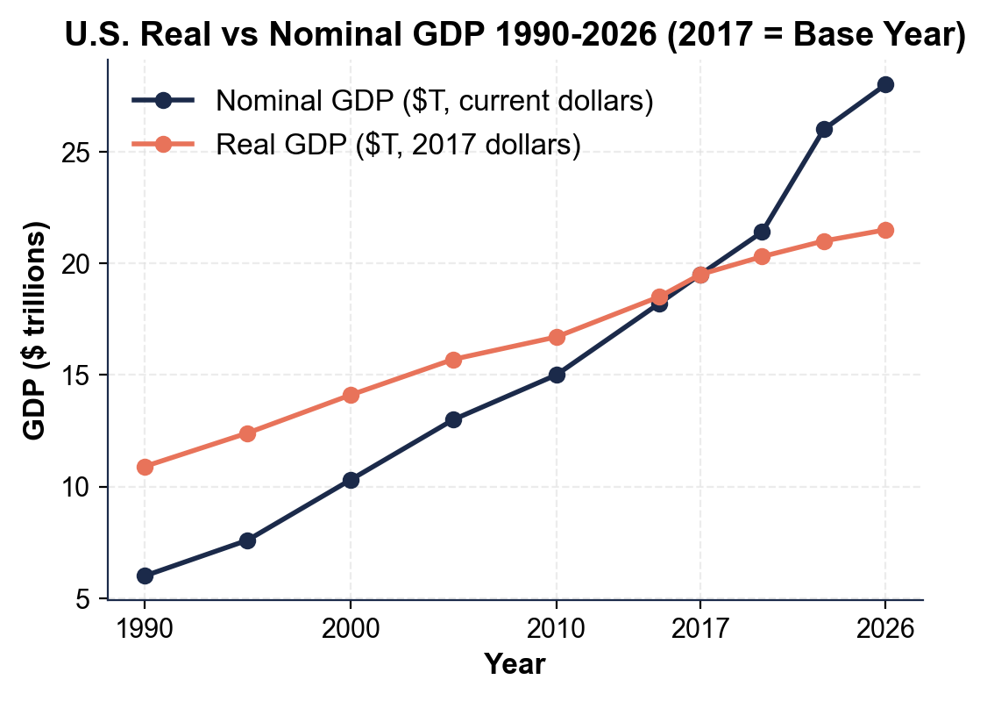
U.S. Real vs Nominal GDP 1990-2026
Note: Lines cross in 2017 (base year). The gap after 2017 IS the inflation.
© More Lessons Less Planning | morelessonslessplanning.com
Notes:
Read the chart. Two lines: nominal GDP (rising from ~$6T in 1990 to ~$28T in 2026) and real GDP (rising from ~$10.9T in 1990 to ~$21.5T in 2026, both in 2017 dollars). The two lines cross at 2017 (the base year, deflator = 100, real = nominal). Before 2017 the real line is ABOVE the nominal line; after 2017 the real line is BELOW the nominal line. The widening gap after 2017 is the inflation that has occurred since the base year. Activity Part 4 will have students extract approximate values from this chart.
Reference labels (point to these chart features when teaching): Cross: 2017; Gap = inflation

Slide 12
GDP Deflator vs CPI (Two Price Indexes)
GDP Deflator
Covers ALL goods in GDP (consumer + capital + government + exports); chain-weighted; 2017 base
CPI (Consumer Price Index)
Covers a FIXED BASKET of consumer goods; updated less often; widely used for cost-of-living and Social Security
Both anchored at 100
Both indexes equal 100 in their base year and rise with inflation
Which is bigger?
CPI usually slightly higher than deflator (consumer prices have risen a bit faster than overall GDP prices)
When to use each
Use the deflator to convert nominal GDP to real GDP. Use CPI for wages, Social Security COLA, and inflation rates
Tip: Deflator = price level of EVERYTHING in GDP. CPI = price level of a CONSUMER BASKET. Use the deflator for GDP math.
© More Lessons Less Planning | morelessonslessplanning.com
Notes:
Set up the second chart. Both the GDP deflator and the CPI are price indexes - single numbers summarizing the overall price level relative to a base year. Both equal 100 in 2017. By 2026, the GDP deflator is about 130 and the CPI is about 135 - both indicating roughly 30% inflation since 2017, with CPI slightly higher. Why the difference? CPI uses a FIXED BASKET of consumer goods only; it does not include things like government purchases, exports, or business equipment. CPI is also updated less often, so it can lag the modern chain-weighted deflator. Practical takeaway: for GDP calculations USE THE DEFLATOR. For wages, salaries, and the cost-of-living adjustments that affect Social Security checks, USE CPI. Students will see both lines tracking closely on the chart but with CPI slightly above by 2026.

Slide 13
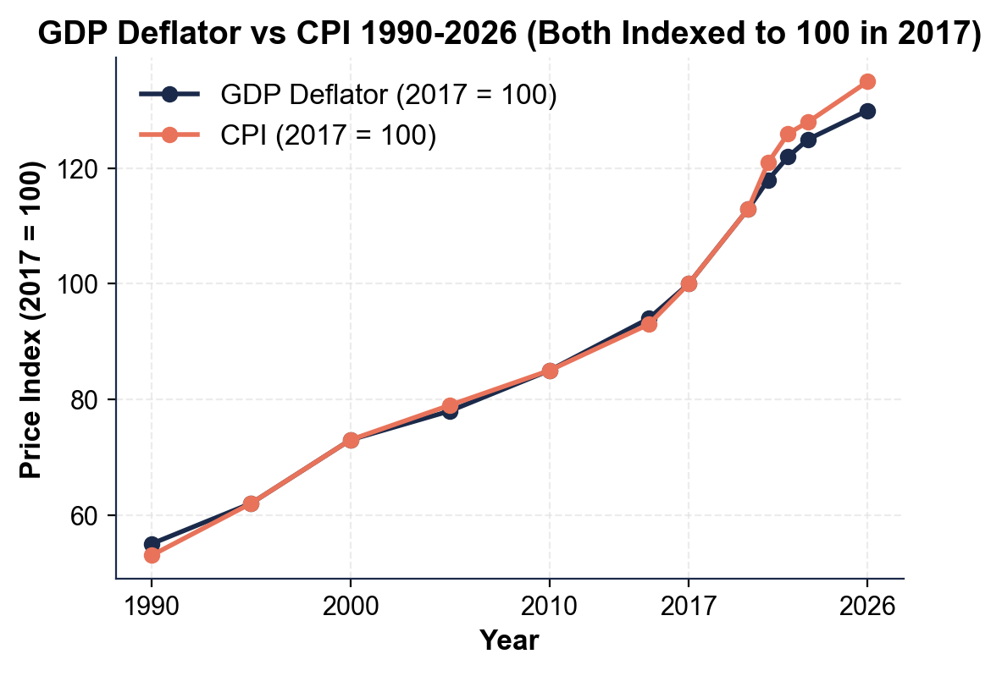
GDP Deflator vs CPI 1990-2026 (Both 2017 = 100)
Note: Both indexes track inflation. CPI slightly higher by 2026.
© More Lessons Less Planning | morelessonslessplanning.com
Notes:
Read the chart. Two lines: GDP deflator (rising from about 55 in 1990 to about 130 in 2026) and CPI (rising from about 53 in 1990 to about 135 in 2026). Both anchored at 100 in 2017 (the base year). The clearest acceleration on the chart is the 2021-2022 post-COVID inflation surge - both lines climb sharply between 2020 and 2022 before flattening. The 2008 oil-price spike is an earlier inflation episode the lesson discusses, but it is far less visible at this annual scale. CPI is slightly higher than the deflator by 2026 because consumer prices have risen a bit faster than overall GDP prices. Both indexes measure inflation; the deflator is used for GDP math, CPI is used for wages and cost-of-living.
Reference labels (point to these chart features when teaching): Both = 100 in 2017; 2026: CPI ~135, Def ~130

Slide 14
Key Takeaways
NOMINAL = current-year prices; REAL = base-year prices (inflation removed)
★
Real GDP = (Nominal GDP / Deflator) x 100 (memorize this formula)
★
Deflator = 100 in the base year (2017); higher = more inflation since
★
For long-run growth comparisons, ALWAYS use REAL GDP (not nominal)
★
U.S. real GDP grew ~3x since 1980; nominal grew 10x - the gap is inflation
★
© More Lessons Less Planning | morelessonslessplanning.com
Notes:
Read each takeaway aloud. Connect to learning targets. Target 1 (distinguish): takeaways 1, 3, 5 - nominal vs real, the deflator, and the long-run comparison. Target 2 (calculate): takeaway 2 - the formula. Target 3 (apply): takeaway 4 - use real for any long-run comparison. The activity Part 5 policy memo will require students to apply the distinction to a real example (e.g., wage growth claims, a presidential record, or a comparison across decades).

