Slide 1
Railroads and the Transportation Revolution
How the steam railroad shrank distance, sped up daily life, and forced the whole country onto a single clock.
© More Lessons Less Planning | morelessonslessplanning.com
Notes:
Opening slide. In one generation, the steam railroad changed how far people could travel, how fast goods could move, and even how a country kept time. This is the Transportation Revolution.

Slide 2
Learning Targets
Explain how the railroad changed the speed and cost of travel.
★
Describe the Liverpool & Manchester Railway, Stephenson, and the Rocket.
★
Explain how railroads reshaped daily life, trade, and time.
★
Identify who benefited from the railroad and who was displaced.
★
© More Lessons Less Planning | morelessonslessplanning.com
Notes:
Read the four learning targets. Today follows one machine, the steam locomotive, from a single test track to a change that reached every part of daily life.

Slide 3
Before the Railroad
Before railroads, goods moved only as fast as a horse could walk.
People traveled by foot, horse and cart, canal boat, or stagecoach.
A 30-mile trip could take a full day and depended on the weather.
The TRANSPORTATION REVOLUTION was this change, driven by the steam railroad.
Key Concept: The TRANSPORTATION REVOLUTION was the dramatic change in how people and goods moved, driven above all by the steam railroad.
© More Lessons Less Planning | morelessonslessplanning.com
Notes:
Before the railroad, people and goods moved by foot, by horse and cart, by canal boat, or by stagecoach. Travel was slow, expensive, and depended on the weather - a trip of 30 miles could take a full day. The dramatic change that followed is called the TRANSPORTATION REVOLUTION: a new way of moving people and goods, driven above all by the steam railroad. Most goods still traveled only as fast as a horse could walk.

Slide 4
The Steam Locomotive
Steam locomotive
A railway engine powered by a steam boiler that pulls wagons and carriages along iron rails.
✔
Burns coal
It burns coal to boil water; the steam pushes pistons that turn the wheels.
✔
Iron rails
Runs on iron rails, like the ones already used in mines with horse-drawn wagons.
✔
Machine, not animal
A machine, not an animal, now did the pulling - tirelessly and far faster.
✔
Key Concept: A STEAM LOCOMOTIVE burns coal to boil water, and the steam pushes pistons that turn the wheels along iron rails.
© More Lessons Less Planning | morelessonslessplanning.com
Notes:
A STEAM LOCOMOTIVE is a railway engine powered by a steam boiler that pulls wagons and carriages along iron rails. It burns coal to boil water; the steam pushes pistons that turn the wheels. Early mines already used iron rails and horse-drawn wagons, but putting a steam engine on those rails meant a machine, not an animal, could now do the pulling - tirelessly, and far faster.

Slide 5
The Liverpool & Manchester Railway (1830)
The LIVERPOOL AND MANCHESTER RAILWAY opened in 1830.
It was the first railway to link two cities using only steam locomotives.
It joined the busy port of Liverpool with the factory city of Manchester.
Next: a real 1831 print of the railway's opening day.
Key Concept: The LIVERPOOL AND MANCHESTER RAILWAY (1830) was the first railway to link two major cities using only steam locomotives.
© More Lessons Less Planning | morelessonslessplanning.com
Notes:
The LIVERPOOL AND MANCHESTER RAILWAY opened in 1830. It was the first railway to link two major cities using only steam locomotives - no horses. It joined the busy port of Liverpool with the manufacturing city of Manchester, carrying both passengers and freight on a timetable. Its opening day was a national event, though it also brought the first widely reported railway death when a Member of Parliament was struck by a locomotive.

Slide 6
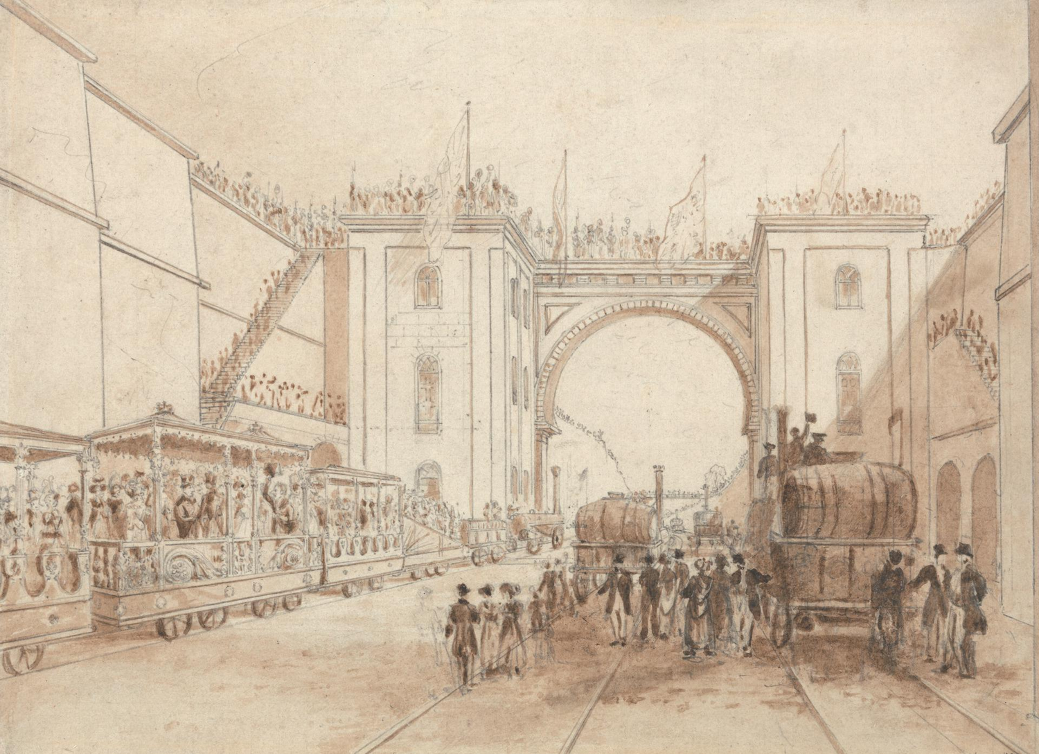
Opening of the Liverpool & Manchester Railway, 1830
Isaac Shaw's 1831 print of the Liverpool & Manchester Railway's opening.
© More Lessons Less Planning | morelessonslessplanning.com
Notes:
This is Isaac Shaw's 1831 print of trains running on the newly opened Liverpool & Manchester Railway. Use it as a reference image to picture what the first inter-city steam railway looked like, not as evidence for any single graded claim.
Reference labels (point to these chart features when teaching): Steam trains on the line; Crowds, opening day 1830

Slide 7
George Stephenson and the Rocket
George Stephenson
The engineer called the Father of Railways, who engineered the Liverpool & Manchester line.
The Rocket
The steam locomotive Stephenson completed in 1829, built with his son Robert.
The Rainhill Trials
A public 1829 contest to choose engines; the Rocket won by reaching about 30 miles per hour.
A design pattern
The Rocket's design became the pattern that later locomotives followed.
Key Concept: Engineer GEORGE STEPHENSON built THE ROCKET, the 1829 locomotive that won the Rainhill Trials and set the pattern for future engines.
© More Lessons Less Planning | morelessonslessplanning.com
Notes:
GEORGE STEPHENSON is called the Father of Railways. He engineered the Liverpool & Manchester line and, with his son Robert, built THE ROCKET - a steam locomotive completed in 1829. At the Rainhill Trials, a public contest to choose engines for the new railway, the Rocket won by reaching about 30 miles per hour. Its design became the pattern that later locomotives followed.

Slide 8
A New Sense of Speed
Before railroads, no one moved faster than a galloping horse.
Passengers described riding at thirty-five miles an hour as flying.
Distances seemed to shrink: a day's journey now took about an hour.
Next: Turner's 1844 painting of a train rushing through rain and mist.
Key Concept: Railroads gave people a new SENSE OF SPEED - travel that once took a day now took an hour, and it felt like flying.
© More Lessons Less Planning | morelessonslessplanning.com
Notes:
Before railroads, no one had ever moved faster than a galloping horse. Riding a train at thirty-five miles an hour was a brand-new human experience - passengers described it as flying. Distances seemed to shrink: a journey that once took a whole day could now take about an hour. Artists tried to capture this new feeling of motion. The next slide shows J.M.W. Turner's famous 1844 painting of a train rushing through rain and mist.

Slide 9
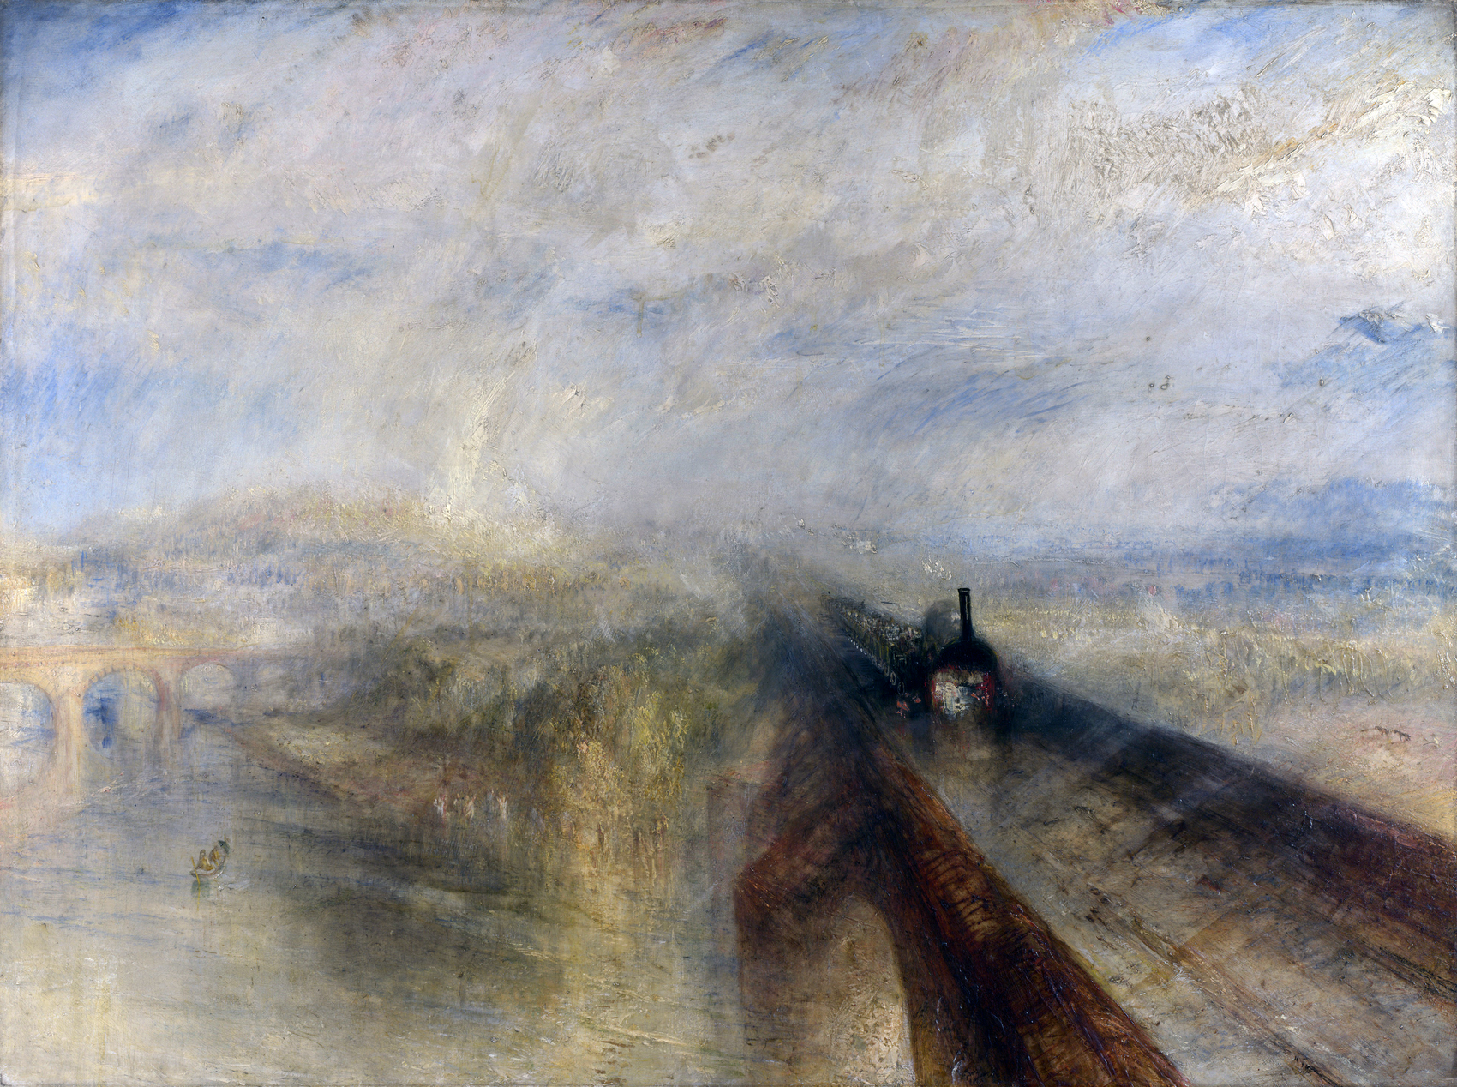
Rain, Steam, and Speed (Turner, 1844)
J.M.W. Turner, Rain, Steam, and Speed - The Great Western Railway (1844).
© More Lessons Less Planning | morelessonslessplanning.com
Notes:
This is J.M.W. Turner's 1844 painting Rain, Steam, and Speed - The Great Western Railway. Use it as a reference image to feel how railway speed struck people at the time - the locomotive and the landscape blur together in rain and mist - not as evidence for any single graded claim.
Reference labels (point to these chart features when teaching): Locomotive rushing forward; Rain and mist blur the scene

Slide 10
The Railway Network Spreads
Railway mania
After the Liverpool & Manchester line's success, investors rushed to fund new lines in a frenzy called railway mania.
✔
Thousands of miles
Within about twenty years, thousands of miles of track connected Britain's cities.
✔
Railway network
The result was a railway network - a web of connected rail lines.
✔
Around the world
The same pattern spread across Europe, the United States, and colonies such as India.
✔
Key Concept: A RAILWAY NETWORK is the growing web of connected rail lines that spread across Britain and then the whole world.
© More Lessons Less Planning | morelessonslessplanning.com
Notes:
After the success of the Liverpool & Manchester line, railway building exploded. Investors rushed to fund new lines in a frenzy called railway mania. Within about twenty years, thousands of miles of track connected Britain's cities into a RAILWAY NETWORK - a web of connected rail lines. The same pattern soon spread across Europe, the United States, and to colonies such as India.

Slide 11
Railroads Set the Clock
Local time
Before railroads, each town set its own clock by the sun, so noon differed from place to place.
A strict timetable
Trains ran on a strict timetable, and mismatched clocks caused confusion and crashes.
Railway time
A single, standardized clock time used everywhere on the network.
National standard time
Railway time slowly became the national standard time we still use today.
Key Concept: To keep trains on schedule, railways adopted RAILWAY TIME - one standardized clock time for every town, replacing dozens of local times.
© More Lessons Less Planning | morelessonslessplanning.com
Notes:
Before railroads, each town set its own clock by the sun, so noon in one town might be several minutes different from noon in the next. That was fine when travel was slow - but trains ran on a strict timetable, and mismatched clocks caused confusion and crashes. So railways adopted RAILWAY TIME: a single, standardized clock time used everywhere on the network. This railway time slowly became the national standard time we still use today.

Slide 12
New Ways of Living
The commuter
A commuter travels a longer distance between home and work, riding the train from a suburb into the city.
✔
Suburbs grow
People could live in a suburb and ride the train into the city each day.
✔
Faster everything
Fresh food, mail, and newspapers reached distant towns in hours instead of days.
✔
Trips for fun
Ordinary families could take cheap excursion trips to the seaside for the first time.
✔
Key Concept: Fast, cheap rail travel created the COMMUTER and changed daily life - where people lived, what they ate, and where they traveled for fun.
© More Lessons Less Planning | morelessonslessplanning.com
Notes:
Cheap, fast rail travel changed everyday life. A COMMUTER - a person who travels a longer distance between home and work - could now live in a suburb and ride the train into the city. Fresh food, mail, and newspapers reached distant towns in hours instead of days. Ordinary families could take cheap excursion trips to the seaside for the first time. Railroads knitted separate local markets into one national market.

Slide 13
Winners and Losers
Railroads sped up INDUSTRIALIZATION by moving coal, iron, and goods cheaply.
They made fortunes for investors, merchants, and towns on the line.
But they caused DISPLACEMENT: stagecoach and canal trades lost business.
Towns the railroad bypassed often declined.
Key Concept: Railroads sped up INDUSTRIALIZATION and made fortunes, but also caused DISPLACEMENT - pushing aside older trades and bypassed towns.
© More Lessons Less Planning | morelessonslessplanning.com
Notes:
Railroads created winners and losers. They sped up INDUSTRIALIZATION - the shift to machine- and factory-based production - by moving coal, iron, and finished goods cheaply, and they made fortunes for investors, merchants, and towns on the line. But they also caused DISPLACEMENT: the pushing aside of older jobs and communities. Stagecoach drivers, coaching inns, and canal companies lost their business, and towns the railroad bypassed declined.

Slide 14
Reference Guide: The Railroad Arrives
Transportation Revolution
The dramatic 19th-century change in how people and goods moved, driven above all by the steam railroad.
Steam locomotive
A railway engine powered by a steam boiler that pulls wagons and carriages along iron rails.
Liverpool and Manchester Railway
The first railway to link two major cities using only steam locomotives, opened in 1830.
George Stephenson
The engineer called the Father of Railways, who built the Rocket and engineered the Liverpool & Manchester line.
The Rocket
Stephenson's 1829 locomotive that won the Rainhill Trials and set the design pattern for later engines.
Key Concept: A new machine (the steam locomotive), a first line (Liverpool & Manchester), and engineer Stephenson began the Transportation Revolution.
© More Lessons Less Planning | morelessonslessplanning.com
Notes:
Review slide with five exact definitions: Transportation Revolution, Steam locomotive, Liverpool and Manchester Railway, George Stephenson, and The Rocket.

Slide 15
Reference Guide: A Changed World
Railway network
The growing web of connected rail lines that spread across Britain and the world.
Railway time
A single standardized clock time so train schedules matched from town to town.
Commuter
A person who travels a longer distance between home and work by fast rail.
Displacement
The pushing aside of older jobs and communities as railroads took over.
Industrialization
The shift to machine- and factory-based production, which railroads sped up.
Key Concept: The railroad network, railway time, the commuter, displacement, and industrialization show how deeply the railroad reshaped daily life.
© More Lessons Less Planning | morelessonslessplanning.com
Notes:
Review slide with five exact definitions: Railway network, Railway time, Commuter, Displacement, and Industrialization.

Slide 16
Key Takeaways
The steam locomotive let a machine, not a horse, haul goods and people fast.
★
The Liverpool & Manchester Railway (1830) and the Rocket began the rail age.
★
Railroads shrank distance, sped daily life, and even standardized time.
★
Railroads made fortunes but also displaced older trades and bypassed towns.
★
© More Lessons Less Planning | morelessonslessplanning.com
Notes:
Recap the four takeaways. The big idea: one machine, the steam locomotive, set off a chain of changes that reshaped travel, trade, time, and daily life.

