Slide 1
Public Goods: Roads, Schools & Free Riders
What makes a good 'public,' why markets underprovide them, and how to classify 15 everyday goods using the rivalry-excludability matrix.
© More Lessons Less Planning | morelessonslessplanning.com
Notes:
Open with the question: 'Why does the government pay for the military, roads, and public schools - but not for your groceries, clothes, or cell phone?' Most students will say 'because everyone needs them.' That is partly right but not precise enough. Today's lesson teaches the two-test economic definition of a PUBLIC GOOD (non-excludable AND non-rivalrous), the free rider problem that makes markets underprovide them, and the four-quadrant matrix (private, club, common, public) that classifies any real good. By the end students should be able to pick up any item and assign it to one of the four quadrants using the two-test rule.

Slide 2
Learning Targets
Identify the 2 traits of public goods (non-excludable, non-rivalrous)
★
Explain the free rider problem and why markets underprovide public goods
★
Classify real goods using the rivalry-excludability matrix
★
© More Lessons Less Planning | morelessonslessplanning.com
Notes:
Read each target aloud. Target 1 maps to slides 3-5 (the two tests). Target 2 maps to slides 8-10 (free riders + underprovision math). Target 3 maps to slides 6-7 and the activity (15-good sort). The practical capstone is the Activity Part 3 scenario cards where students place 15 real goods into the right quadrant using the two-test rule.

Slide 3
What Makes a Good 'Public'?
The Two-Test Rule
Textbook Examples
Test 1: Non-excludable - cannot keep non-payers OUT
Test 2: Non-rivalrous - one person does not use it UP
BOTH must be true for a true public good
Almost no real good is 100 percent both
National defense - protects all residents
Lighthouses - every passing ship benefits
Fireworks displays - everyone within sight sees
Basic research - any scientist can use a formula
Key Concept: A public good must pass BOTH tests - non-excludable AND non-rivalrous. One out of two is not enough.
© More Lessons Less Planning | morelessonslessplanning.com
Notes:
Introduce the economic definition of a PUBLIC GOOD. In economics 'public' does not mean 'used by the public' or 'owned by the government' - it has a specific TECHNICAL meaning. A PUBLIC GOOD must pass two tests at the same time: (1) it must be NON-EXCLUDABLE, meaning the provider cannot keep non-payers from using it; and (2) it must be NON-RIVALROUS, meaning one person's use does not reduce what is left for others. The four textbook examples are NATIONAL DEFENSE (protects every U.S. resident whether they pay taxes or not, and one person being protected does not reduce protection for others), LIGHTHOUSES (every passing ship benefits, and one ship seeing the light does not dim it for others), FIREWORKS DISPLAYS (everyone in sight watches, and one viewer does not use up the show), and BASIC RESEARCH (once a formula is published, everyone can use it, and one scientist using it does not consume it). Almost no real good is 100 percent public on both dimensions - which is why the matrix has four quadrants, not two.

Slide 4
Test 1: Non-Excludable (Cannot Keep People OUT)
What it means
The provider CANNOT keep non-payers from using the good once it is provided
Quick test
Ask: 'Can I charge a fee at the door?' If NO, the good is non-excludable
Yes examples (excludable)
Groceries, Netflix, toll roads, movie tickets, gym memberships
No examples (non-excludable)
National defense, streetlights, clean air, lighthouse signals, fireworks
Why it matters
If you cannot exclude non-payers, voluntary payment collapses - the FREE RIDER setup
Tip: 'Excludable' is about CONTROL of access, not popularity.
© More Lessons Less Planning | morelessonslessplanning.com
Notes:
Drill the first test. NON-EXCLUDABLE means the provider CANNOT keep non-payers from using the good once it is provided. The quick test: 'Can I charge a fee at the door?' If YES (groceries, Netflix, gym), the good is EXCLUDABLE. If NO (national defense, streetlights, clean air, lighthouses, fireworks), the good is NON-EXCLUDABLE. The key insight is that excludability is about CONTROL OF ACCESS, not popularity. Streetlights are extremely popular and used by everyone - but you cannot block someone walking past from benefiting. The same is true of national defense: the military protects every U.S. resident whether or not they pay taxes. Once you cannot exclude non-payers, voluntary payment for the good collapses - this is the free-rider setup that we will work through on slides 8-10.

Slide 5
Test 2: Non-Rivalrous (Does Not Use It UP)
What it means
One person's use does NOT reduce what is available for others
Quick test
Ask: 'If one more person uses it, does anyone get less?' If NO, it is non-rivalrous
Yes examples (rivalrous)
A sandwich, gasoline, a parking spot, a fish, a seat on a plane
No examples (non-rivalrous)
A radio broadcast, a lighthouse beam, national defense, a formula, fireworks
Within capacity
Non-rivalrous up to a capacity limit: a theater until seats fill, a road until traffic jams
Big Idea: Rivalry is about CONSUMPTION. If your use SUBTRACTS from mine, it is rivalrous.
© More Lessons Less Planning | morelessonslessplanning.com
Notes:
Drill the second test. NON-RIVALROUS means one person's use does NOT reduce what is left for others. The quick test: 'If one more person uses it, does anyone else get less?' If YES (a sandwich, a fish, a parking spot, gasoline), the good is RIVALROUS. If NO (a radio broadcast, a lighthouse beam, a formula, fireworks), the good is NON-RIVALROUS. The key concept: rivalry is about CONSUMPTION - whether your use subtracts from mine. Many real-world goods are non-rivalrous WITHIN CAPACITY: a movie theater is non-rivalrous until the seats fill; an interstate highway is non-rivalrous until traffic jams; Netflix is non-rivalrous until server load matters. This is why pure 'public goods' are rare and why the four-quadrant matrix includes the CLUB goods quadrant (excludable but non-rivalrous within capacity - think Netflix, gyms, satellite TV).

Slide 6
The Four-Quadrant Matrix
Two Axes, Four Boxes
How to Use It
Excludable + Rivalrous = PRIVATE (groceries, clothes)
Excludable + Non-rivalrous = CLUB (Netflix, gyms)
Non-excludable + Rivalrous = COMMON (ocean fish, streets)
Non-excludable + Non-rivalrous = PUBLIC (defense, lighthouses)
Run Test 1: Is it excludable?
Run Test 2: Is it rivalrous?
The two answers pick the quadrant
Almost any real good fits one of four boxes
Tip: Run BOTH tests in order. The two yes/no answers give you the quadrant in 5 seconds.
© More Lessons Less Planning | morelessonslessplanning.com
Notes:
Introduce the four-quadrant matrix. The two-test rule produces four possible combinations. PRIVATE GOODS are EXCLUDABLE and RIVALROUS - the everyday market goods (groceries, clothes, haircuts, gasoline). CLUB GOODS are EXCLUDABLE but NON-RIVALROUS - they charge a fee but one user does not deplete the good (Netflix, gyms, cable TV, toll roads). COMMON GOODS are NON-EXCLUDABLE but RIVALROUS - open access, but use depletes the supply (ocean fish stocks, public groundwater, congested city streets, public parking). PUBLIC GOODS are NON-EXCLUDABLE and NON-RIVALROUS - the textbook public goods (national defense, lighthouses, fireworks, basic research). The two-test rule is the only thing students need to memorize - it tells them which quadrant any good lives in. Students should leave knowing: run Test 1, run Test 2, the two answers pick the quadrant.

Slide 7
Public Goods: The Textbook Cases
National defense
Non-excludable and non-rivalrous; protects every U.S. resident. About $850 billion/year.
Lighthouses
The classic 1700s case. Every passing ship sees the light; one ship does not dim it.
Fireworks displays
Once launched, everyone within sight watches; one viewer does not use up the show.
Basic research
Once published, every scientist can use a discovery. Federal R&D ~$200B/year (NSF, NIH, DOE).
Clean air and law enforcement
Air quality rules and police patrols protect everyone in a region.
Big Idea: All five pass BOTH tests cleanly.
© More Lessons Less Planning | morelessonslessplanning.com
Notes:
Walk through the five textbook public goods. NATIONAL DEFENSE is the cleanest example: the U.S. military protects every U.S. resident, and one person being protected does not reduce protection for others. About $850 billion per year. LIGHTHOUSES are the original textbook case from 1700s Britain - economics textbooks have used them for 200 years. FIREWORKS DISPLAYS are the simplest example for high-school students - once the city launches the show, everyone in sight watches whether or not they paid. BASIC RESEARCH (funded by NSF, NIH, DOE) is the public good that powers technology growth - once a formula is published, every scientist worldwide can use it. CLEAN AIR and LAW ENFORCEMENT are area-wide public goods: pollution rules and police patrols benefit everyone in a region, not just the people who paid. All five pass both tests cleanly - which is why they are the textbook public goods.

Slide 8
The Free Rider Problem
Who is a Free Rider?
Why Voluntary Payment Fails
A person who BENEFITS without paying
Possible BECAUSE the good is non-excludable
Every neighbor benefits from streetlights
Every U.S. resident benefits from defense
Each person thinks: 'I will get it anyway'
Each person waits for someone ELSE to pay
Everyone waits at once
Voluntary contributions = far below efficient level
Key Concept: The free-rider problem is why markets UNDERPROVIDE public goods - voluntary payment collapses when you cannot exclude.
© More Lessons Less Planning | morelessonslessplanning.com
Notes:
Introduce the FREE RIDER PROBLEM. A FREE RIDER is a person who benefits from a public good WITHOUT paying for it. The free-rider problem exists BECAUSE the good is non-excludable - you cannot kick non-payers out. Examples: every neighbor benefits from a streetlight even if only one neighbor paid for it; every U.S. resident benefits from national defense whether or not they pay taxes. The mechanism: each person thinks 'I will get the benefit anyway, so why pay?' Each person waits for someone else to pay. EVERYONE waits at once. Voluntary contributions collect far less than what the good is worth in total - the market UNDERPROVIDES the good. This is why the free-rider problem is the central economic justification for government provision of public goods. Without compulsory taxes, the math does not work.

Slide 9
Free-Rider Math: The Underprovision Gap
The Numbers
The Fix
1,000 people each value defense at $50/year
Total value = $50,000
Voluntary collections only $5,000-15,000
Result: defense is UNDERFUNDED
Government taxes everyone $50
Collects the full $50,000
Provides defense at the efficient level
Solves free-rider problem with COMPULSION
Big Idea: The gap between $50,000 (full value) and $10,000 (voluntary) is the UNDERPROVISION GAP. Taxes close it.
© More Lessons Less Planning | morelessonslessplanning.com
Notes:
Walk through the underprovision math. Imagine 1,000 residents each value national defense at $50 per year. Total social value = $50,000 per year. If we tried to fund defense by passing a hat, each resident thinks 'someone else will pay - I will get it anyway.' Voluntary contributions typically come in at $5,000-$15,000 - far below the full $50,000 of value. Result: defense is UNDERFUNDED relative to what people actually want. The gap between $50,000 (what defense is worth in total) and $10,000 (what voluntary contributions collect) is the UNDERPROVISION GAP. The government fix is compulsory taxation: the U.S. taxes all residents and collects the full $50,000. Every resident pays $50; everyone gets defense at the efficient level. Compulsion solves the free-rider problem in a way voluntary contributions never can. This is the economic justification for tax-funded provision of public goods.

Slide 10
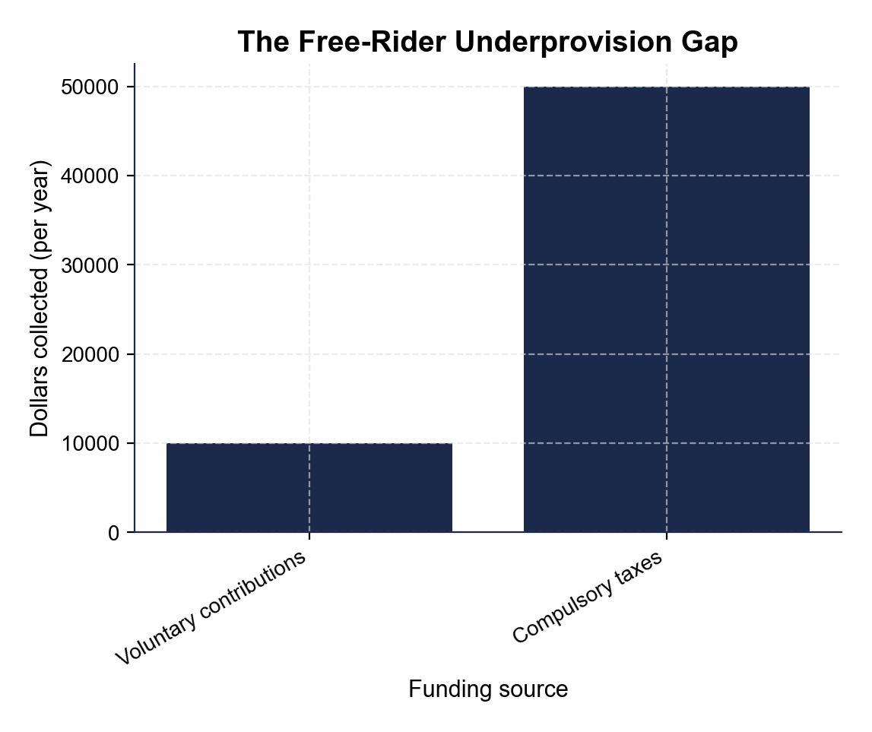
The Underprovision Gap (Voluntary vs Efficient)
Note: Tall bar = $50K efficient level; short bar = $10K voluntary contributions.
© More Lessons Less Planning | morelessonslessplanning.com
Notes:
Display the bar chart. The TALL bar is what people would pay in total ($50,000); the SHORT bar is what voluntary contributions actually collect (~$10,000). The gap is the UNDERPROVISION GAP. Have students identify which bar is which and explain in their own words why the voluntary bar is so much shorter.
Reference labels (point to these chart features when teaching): Voluntary; Efficient

Slide 11
Why Government Provides Public Goods
Market failure
Private markets UNDERPROVIDE public goods; the free-rider problem makes voluntary payment collapse.
Policy fix
Government provides the good and pays with COMPULSORY taxes - the free-rider problem disappears.
U.S. examples
National defense ($850B/yr), public schools ($800B/yr), interstates, basic research ($200B/yr).
Trade-off
Government provision requires taxation; politics decides the amount, not always the efficient level.
Alternative fixes
Private charity, user fees, excludability tweaks (pay-to-enter parks), social pressure.
Tip: Government provision is the standard fix - charity and user fees also work for borderline cases.
© More Lessons Less Planning | morelessonslessplanning.com
Notes:
Explain why government provision is the standard answer. The market failure: private markets UNDERPROVIDE public goods because voluntary payment collapses under free-rider behavior. The policy fix: government provides the good and pays for it with COMPULSORY taxes. Real examples in U.S. dollar terms: NATIONAL DEFENSE about $850 billion per year (federal taxes), PUBLIC SCHOOLS about $800 billion per year (mostly local property taxes), INTERSTATE HIGHWAYS about $60+ billion per year (federal gas tax + general revenue), BASIC RESEARCH about $200 billion per year (NSF, NIH, DOE federal grants). Trade-off: government provision requires taxation (which has its own costs) and politics decides the amount - not always the efficient amount. Alternative fixes that work for borderline cases: private charity (limited capacity), club-good design (charge a user fee), make the good excludable (turn parks into pay-to-enter), and social pressure (peer enforcement, e.g., NPR pledge drives use guilt to convert listeners into payers). Government provision is the standard fix, but it is not the only one.

Slide 12
Tricky Cases: Roads, Schools, Parks
Roads
Depends. Empty interstate = PUBLIC. Congested city street = COMMON. Toll road = CLUB.
Public schools
Near-public but not pure: non-rivalrous within capacity, partly EXCLUDABLE (residency limits).
City parks
Usually PUBLIC for everyday use but COMMON when packed (rivalrous for picnic spots).
Fishing in the ocean
COMMON. Non-excludable but RIVALROUS (one fish caught = one less). Tragedy of the commons.
Netflix
CLUB. Excludable (login required) and non-rivalrous within capacity.
Big Idea: Real goods shift quadrants by CONTEXT and POLICY (toll vs free).
© More Lessons Less Planning | morelessonslessplanning.com
Notes:
Drill the tricky cases. ROADS: depends on context. An empty interstate is PUBLIC (non-excludable and non-rivalrous). A congested city street is COMMON (non-excludable but rivalrous - your car slows mine). A toll road is CLUB (excludable through the toll booth and non-rivalrous within capacity). Same road, different policy, different quadrant. PUBLIC SCHOOLS: near-public but not pure. They are non-rivalrous within capacity (one student does not consume the teacher) but partly EXCLUDABLE (residency requirements, capacity limits, no out-of-district students). CITY PARKS: usually PUBLIC for everyday use (non-excludable, non-rivalrous on a normal day) but COMMON when packed (rivalrous when picnic spots fill). FISHING IN THE OCEAN: classic COMMON good - open access but each fish caught reduces the stock. Subject to the tragedy of the commons. NETFLIX: CLUB - excludable through login and non-rivalrous within capacity. The big idea: real goods often shift quadrants depending on CONTEXT (empty vs jammed) and POLICY (toll vs free).

Slide 13
Sort 15 Goods Into the Four Quadrants
Method
Today's Goods
Run Test 1: Excludable?
Run Test 2: Rivalrous?
Two answers - one quadrant
Note any 'depends on context' goods
Defense, lighthouse, fireworks, basic research, clean air
Sandwich, haircut, gasoline, sneakers, plane seat
Ocean fish, congested city street, public groundwater
Netflix, gym membership
Tip: Some goods shift quadrants by context. Note WHICH quadrant the good lives in MOST OF THE TIME.
© More Lessons Less Planning | morelessonslessplanning.com
Notes:
Set up the activity. Students will sort 15 real goods into the four quadrants. The method: run Test 1 (excludable?), then run Test 2 (rivalrous?), then the two answers pick the quadrant. Today's 15 goods: defense, lighthouse, fireworks, basic research, clean air (PUBLIC); sandwich, haircut, gasoline, sneakers, plane seat (PRIVATE); ocean fish, congested city street, public groundwater (COMMON); Netflix, gym membership (CLUB). Some goods shift quadrants depending on context (e.g., a road can be PUBLIC, COMMON, or CLUB depending on traffic and toll policy). Students should note WHICH quadrant the good lives in MOST OF THE TIME. The activity gives them 15 cards organized into the four quadrants (5 + 5 + 3 + 2). After the sort, students complete a Reference Guide of vocabulary and write a final policy brief recommending whether four borderline goods (a city park, a community Wi-Fi mesh, a basic-research subsidy, and a 5G tower network) should be funded publicly or left to the market.

Slide 14
Key Takeaways
The Big Five
What You Should Be Able to Do
Public goods pass BOTH tests
Non-excludable: cannot keep people OUT
Non-rivalrous: does not use it UP
Free riders break voluntary payment
Markets underprovide - government fixes with taxes
Apply the two tests to ANY good in 10 seconds
Name the four quadrants and their examples
Explain why defense is tax-funded but groceries are not
Tell the free-rider story in two sentences
Big Idea: PUBLIC = non-excludable AND non-rivalrous. Free riders break voluntary payment. Taxes solve it.
© More Lessons Less Planning | morelessonslessplanning.com
Notes:
Wrap up with the lesson takeaways. The five anchor points: (1) public goods pass BOTH tests; (2) non-excludable means you cannot keep people OUT; (3) non-rivalrous means one person does not use it UP; (4) free riders break voluntary payment when goods are non-excludable; (5) markets underprovide - government provision with compulsory taxes is the standard fix. Skills students should leave with: apply the two tests to any good in 10 seconds; name the four quadrants and their examples; explain why defense is tax-funded but groceries are not; tell the free-rider story in two sentences. The clinching test: if you can explain why the city pays for fireworks but you pay for your own sandwich, you have it.

