Slide 1
Prince Henry the Navigator
How Prince Henry organized Portugal's ocean voyages and what Zurara's 1453 chronicle reveals about why
© More Lessons Less Planning | morelessonslessplanning.com
Notes:
Open with the lesson question: why did Prince Henry organize exploration past Cape Bojador, and what do Zurara's five reasons reveal? Note that 'the Navigator' is a nickname coined centuries later; Henry organized and funded voyages but did not sail them himself.

Slide 2
Learning Targets
Explain how Henry organized and funded exploration
★
Explain why 'the Navigator' is a later nickname
★
Question the myth of a formal school at Sagres
★
Analyze Zurara's 1453 chronicle as a patron's account
★
Use the trade and strategic reasons for exploring
★
© More Lessons Less Planning | morelessonslessplanning.com
Notes:
The five targets keep the lesson centered on the approved record: Henry's organizing role, the later nickname, the Sagres question, Zurara's admiring chronicle, and the trade and strategic reasons from the excerpt.

Slide 3
Who Was Prince Henry?
Prince Henry was born in 1394.
As an Infante, he was a Portuguese prince.
He organized and funded ocean voyages.
He did not sail the voyages himself.
Portuguese captains and mariners did the sailing.
Key Concept: Henry organized and funded exploration; 'the Navigator' is a nickname coined centuries later.
© More Lessons Less Planning | morelessonslessplanning.com
Notes:
Prince Henry was born in 1394 (F1). He was an Infante, a Portuguese prince. He organized and funded voyages and gathered experts, but captains and mariners did the actual sailing. 'The Navigator' is a nickname coined centuries later.

Slide 4
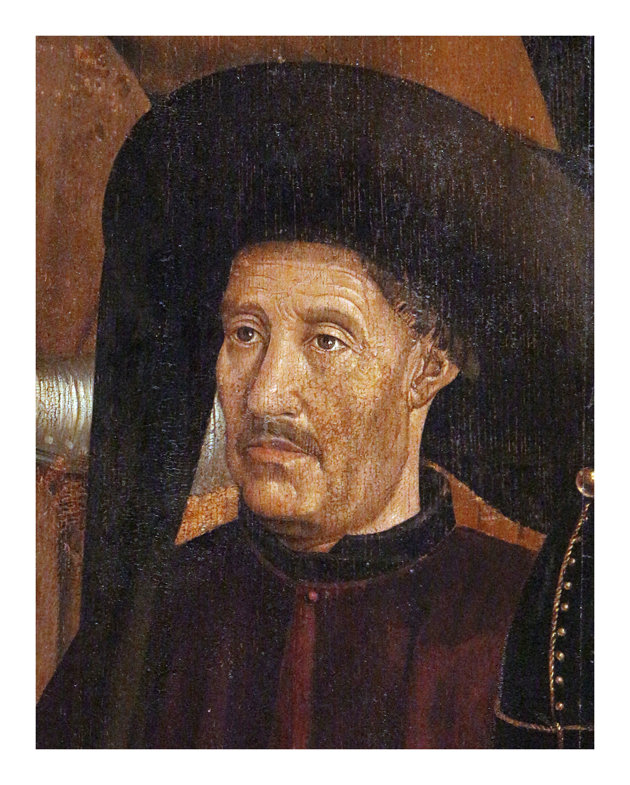
Prince Henry, Saint Vincent Panels (c. 1470)
Prince Henry, Saint Vincent Panels (c. 1470), Lisbon
© More Lessons Less Planning | morelessonslessplanning.com
Notes:
This is a period portrait of Prince Henry from the Saint Vincent Panels (c. 1470), held by the Museu Nacional de Arte Antiga in Lisbon. Use it as a historical reference image, not as evidence for claims beyond the approved record.

Slide 5
Organizing Exploration - the Sagres Question
What the Record Supports
The Sagres Legend
Henry organized systematic exploration
He funded voyages and each expedition
He gathered experts and mariners
A popular legend claims a formal school
No period source documents that school
Treat it as a later legend, not fact
Warning: No period source documents a formal navigation school at Sagres; 'Henry's school' is a later legend.
© More Lessons Less Planning | morelessonslessplanning.com
Notes:
The approved misconception correction is binding. Henry organized systematic exploration, funded voyages, and gathered experts. No period source documents a formal school at Sagres; treat 'Henry's school' as a later legend, not a documented fact.

Slide 6
Cape Bojador: The Feared Barrier
Cape Bojador was a West African cape.
Sailors feared it as the point of no return.
Beyond it lay waters Europeans had not charted.
Rounding it was the first great obstacle.
Henry's captains attempted it again and again.
Key Concept: Cape Bojador was feared as the point of no return, the first barrier to Atlantic exploration.
© More Lessons Less Planning | morelessonslessplanning.com
Notes:
Cape Bojador was a West African cape sailors feared as the point of no return. Beyond it lay waters Europeans had not charted, so rounding it was the first great obstacle for Henry's captains.

Slide 7
Gil Eannes Rounds the Cape (1434)
1434
Squire
Gil Eannes rounded Cape Bojador
Gil Eannes served Prince Henry
Who: Gil Eannes was Henry's squire.
How: He succeeded only after repeated failures.
Credit: Captains and mariners, not Henry, did the sailing.
Remember: Henry's captains did the sailing; his squire Gil Eannes rounded Cape Bojador in 1434.
© More Lessons Less Planning | morelessonslessplanning.com
Notes:
Henry's squire Gil Eannes rounded the feared Cape Bojador in 1434 after repeated failures (F2). This credits the actual sailing to Henry's captains and mariners, not to Henry himself.

Slide 8
Zurara's Chronicle of Guinea (1453)
The Source
The Purpose
Gomes Eannes de Zurara wrote it
Finished in 1453
A chronicle, a record in time order
Henry was Zurara's patron
It praises Henry admiringly
Read it as court praise, not neutral
Key Concept: A chronicle is an official written record in time order; Zurara's praises his patron, Prince Henry.
© More Lessons Less Planning | morelessonslessplanning.com
Notes:
Gomes Eannes de Zurara wrote the Chronicle of Guinea and finished it in 1453, during Henry's lifetime (F6). A chronicle is an official written record of events in time order. Henry was Zurara's patron, so the chronicle praises him admiringly; read it as court praise, not a neutral modern report.

Slide 9
Henry's Five Reasons (Zurara's List)
First
Fourth & Fifth
Second & Third
Know the land beyond Cape Bojador
Curiosity about the unknown
Zurara's opening reason
No Christian ally in thirty-one years
Fighting the Moors that whole time
Spread the Christian faith and save souls
Trade: havens and merchandise
Strategy: scout the Moors' power
Read in the Primary Source Spotlight
Did You Know: Zurara frames all five reasons as praise for his patron, Prince Henry.
© More Lessons Less Planning | morelessonslessplanning.com
Notes:
Zurara lists five reasons Henry pushed past Cape Bojador. The first was Henry's wish to know the land beyond Cape Bojador (F3). The fourth: in thirty-one years fighting the Moors he had found no Christian ally (F4). The fifth was religious: to spread the Christian faith and save souls (F5). The second and third reasons appear in the Primary Source Spotlight.

Slide 10
Reason Two: Trade and Profit
New havens could let ships sail without peril.
A haven is a safe harbor for ships.
Merchandise means goods for buying and selling.
No other known people traded there.
That trade promised great profit for Portugal.
Remember: Reason two is economic - new havens and merchandise promised profit for Portugal.
© More Lessons Less Planning | morelessonslessplanning.com
Notes:
Zurara's second reason is economic: if Christian populations or safe havens were found, ships could sail there and bring back many kinds of merchandise. Because no other known people traded there, the goods would find a ready market and bring great profit.

Slide 11
Reason Three: Scouting the Moors' Power
The Moors were Muslims of North Africa and Spain.
Their power in Africa was greater than commonly supposed.
A wise ruler wants to know his enemy's strength.
Henry sought to learn how far that power reached.
Reason three is strategic, not economic.
Key Concept: Reason three is strategic - Henry wanted to measure the true power of the Moors.
© More Lessons Less Planning | morelessonslessplanning.com
Notes:
Zurara's third reason is strategic: the power of the Moors in Africa was said to be far greater than commonly supposed. Because every wise ruler wants to know the strength of his enemy, Henry worked to discover how far Moorish power extended.

Slide 12
Reference Guide: People and Purpose Terms
chronicle
An official written record of events in time order.
Infante
A Portuguese prince; Henry's title.
patron
Someone who funds and supports another's work.
expedition
A journey organized for a purpose.
Cape Bojador
West African cape sailors feared as the point of no return.
Tip: These terms decode who Henry was, what he organized, and the barrier he pushed past.
© More Lessons Less Planning | morelessonslessplanning.com
Notes:
Review the five record-defined terms exactly: chronicle, Infante, patron, expedition, and Cape Bojador.

Slide 13
Reference Guide: Sea and Trade Terms
Moors
European name for Muslims of North Africa and Spain.
merchandise
Goods for buying and selling.
haven
A safe harbor for ships.
mariner
A sailor.
squire
A young nobleman serving a lord.
Tip: Use these terms to read the trade and strategic reasons in Zurara's chronicle.
© More Lessons Less Planning | morelessonslessplanning.com
Notes:
Review the five record-defined terms exactly: Moors, merchandise, haven, mariner, and squire.

Slide 14
Reading a Patron's Chronicle
Say
Henry organized and funded exploration; his captains sailed.
✔
Do not say
Henry personally captained voyages or ran a proven Sagres school.
✔
Say
Zurara wrote to honor Henry, his patron.
✔
Say
The five reasons mix faith, trade, and strategy.
✔
Read carefully
The chronicle praises Henry; it is not a neutral account.
✔
Warning: A patron's chronicle reveals its court's motives and its bias at the same time.
© More Lessons Less Planning | morelessonslessplanning.com
Notes:
Apply the misconception and wording constraints exactly. Henry organized and funded exploration while captains sailed. Zurara wrote to honor his patron, Henry, so his five reasons read as admiring praise. Strong claims separate what the chronicle shows from what it assumes.

Slide 15
Key Takeaways
Prince Henry organized and funded exploration; his captains did the sailing.
★
'The Navigator' is a nickname coined centuries after Henry's life.
★
No period source documents a formal navigation school at Sagres.
★
Gil Eannes rounded the feared Cape Bojador in 1434.
★
Zurara's 1453 chronicle praises Henry and lists his five reasons for exploring.
★
© More Lessons Less Planning | morelessonslessplanning.com
Notes:
Close with the essential question. Read Zurara's chronicle as a patron's praise and support each claim with a record-backed detail.

