Slide 1
Pompeii: Frozen in Time
Use an eyewitness account and the buried ruins to reconstruct the eruption of Mount Vesuvius and daily life in a Roman town.
© More Lessons Less Planning | morelessonslessplanning.com
Notes:
Opening slide. In 79 CE Mount Vesuvius erupted and buried the Roman town of Pompeii under ash and pumice, freezing a moment of Roman daily life in place. Students will use a primary source (Pliny the Younger's eyewitness letters) plus archaeology to reconstruct what happened.

Slide 2
Learning Targets
Sequence the 79 CE eruption of Vesuvius from an eyewitness account.
★
Explain how ash and pumice preserved Pompeii for archaeologists.
★
Combine an eyewitness primary source with archaeology.
★
Describe Roman daily life from the evidence at Pompeii.
★
© More Lessons Less Planning | morelessonslessplanning.com
Notes:
Read the four learning targets. Today combines a science story (a volcano) with a history skill (using primary sources and archaeology together).

Slide 3
Buried and Frozen in Time
Pompeii
A Roman town buried and preserved by the eruption of Mount Vesuvius in 79 CE.
Primary source
A record of an event made by someone who witnessed it, like Pliny's letters.
Key Concept: POMPEII was a Roman town buried and preserved by the eruption of Mount Vesuvius in 79 CE.
© More Lessons Less Planning | morelessonslessplanning.com
Notes:
POMPEII was a busy Roman town near the Bay of Naples with about 12,000 people, shops, homes, and a forum. In 79 CE it was buried by a volcanic eruption and lost for centuries. Because it was sealed so fast, Pompeii froze a moment of Roman daily life in place. A PRIMARY SOURCE is a record of an event made by someone who witnessed or lived through it, like Pliny's letters - one of the tools we use to reconstruct Pompeii.

Slide 4
Mount Vesuvius Erupts
Vesuvius
The volcano near the Bay of Naples that erupted in 79 CE.
✔
Eruption
The violent release of ash, gas, and rock from a volcano.
✔
Pyroclastic surge
A fast current of hot gas, ash, and rock that killed many people.
✔
Key Concept: An ERUPTION is the violent release of ash, gas, and rock from a volcano like VESUVIUS.
© More Lessons Less Planning | morelessonslessplanning.com
Notes:
VESUVIUS is the volcano near the Bay of Naples that erupted in 79 CE. An ERUPTION is the violent release of ash, gas, and rock from a volcano. Vesuvius shot a column of ash miles into the sky, then later sent down a PYROCLASTIC SURGE - a fast-moving current of hot gas, ash, and volcanic rock - that killed many people at Pompeii in moments.

Slide 5
How a Town Was Preserved
Ash
Fine volcanic particles that fell for hours and buried and preserved the town.
Pumice
Light, porous volcanic rock that rained down on Pompeii during the eruption.
Key Concept: ASH and PUMICE rained down for hours, sealing Pompeii and preserving it almost as it was.
© More Lessons Less Planning | morelessonslessplanning.com
Notes:
For hours, PUMICE - light, porous volcanic rock - rained down, followed by deep ASH, the fine volcanic particles that buried and preserved the town. The ASH and PUMICE piled many feet deep, sealing homes, food, and even loaves of bread in ovens. Because Pompeii was covered so fast, it was preserved almost exactly as it was on that single day.

Slide 6
The Plaster Casts
Plaster cast
Plaster poured into the hollow an ash-buried body left behind after it decayed.
✔
Why it matters
A cast shows a victim's real shape and final position in the ash.
✔
Key Concept: A PLASTER CAST is made by pouring plaster into the hollow an ash-buried body left behind.
© More Lessons Less Planning | morelessonslessplanning.com
Notes:
When victims were buried in ash, their bodies later decayed and left hollow spaces shaped exactly like them. Archaeologists made a PLASTER CAST by pouring plaster into that hollow left in the ash - producing the haunting figures of victims in their final moments. The next slide shows the casts.

Slide 7
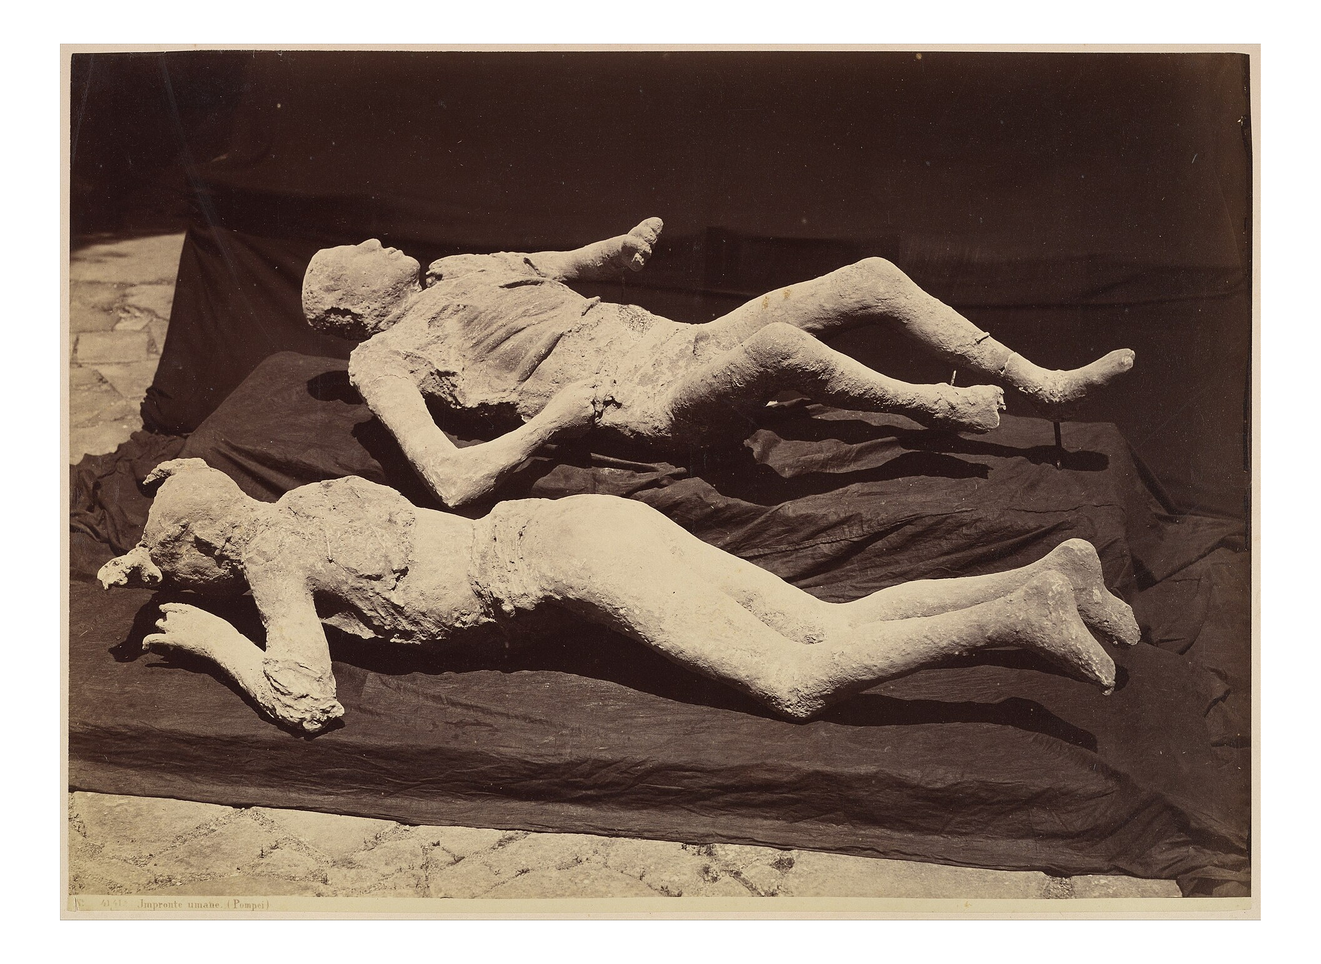
Plaster Casts of Pompeii's Victims
A plaster cast shows a victim's shape and final position in the ash.
© More Lessons Less Planning | morelessonslessplanning.com
Notes:
Real public-domain photograph of plaster casts at the Pompeii archaeological site. Give students a quiet moment to observe the human shape and position before discussing what it reveals about the eruption's final moments.
Reference labels (point to these chart features when teaching): Body-shaped hollow; Final resting position

Slide 8
An Eyewitness: Pliny the Younger
Pliny the Younger
An eyewitness who watched the eruption and later wrote about it in letters.
Primary source
A firsthand record of an event made by someone who witnessed or lived through it.
Key Concept: A PRIMARY SOURCE is a record made by a witness; Pliny's letters are an eyewitness account.
© More Lessons Less Planning | morelessonslessplanning.com
Notes:
Pliny the Younger watched the eruption as a teenager from Misenum, across the Bay of Naples, and later described it in letters to the historian Tacitus. His letters are a PRIMARY SOURCE - a record of an event made by someone who witnessed or lived through it. His uncle, Pliny the Elder, died leading a rescue by boat. Pliny's eyewitness account gives the timing and sequence of the eruption that ruins alone cannot show.

Slide 9
Digging Up the Past
Archaeologist
A scientist who studies the past by excavating and analyzing physical remains.
✔
Excavation
The careful digging and uncovering of a buried site so it can be studied.
✔
Key Concept: An ARCHAEOLOGIST studies the past through EXCAVATION - carefully uncovering a buried site.
© More Lessons Less Planning | morelessonslessplanning.com
Notes:
An ARCHAEOLOGIST is a scientist who studies the past by excavating and analyzing physical remains. EXCAVATION is the careful digging and uncovering of a buried site so it can be studied. At Pompeii, archaeologists slowly uncovered streets, houses, shops, paintings, and even graffiti - physical evidence of how Romans really lived.

Slide 10
Vesuvius Over the Ruins
The excavated ruins of Pompeii sit at the foot of Mount Vesuvius.
Vesuvius is still an active volcano today.
The next slide shows the volcano rising behind the ancient streets.
Key Concept: Vesuvius still looms over the excavated ruins, showing how close the town sat to the volcano.
© More Lessons Less Planning | morelessonslessplanning.com
Notes:
Today the excavated ruins of Pompeii sit in the shadow of Mount Vesuvius, which is still an active volcano. The next slide shows Vesuvius rising behind the uncovered streets and columns - a reminder of how close the Roman town stood to the danger.

Slide 11
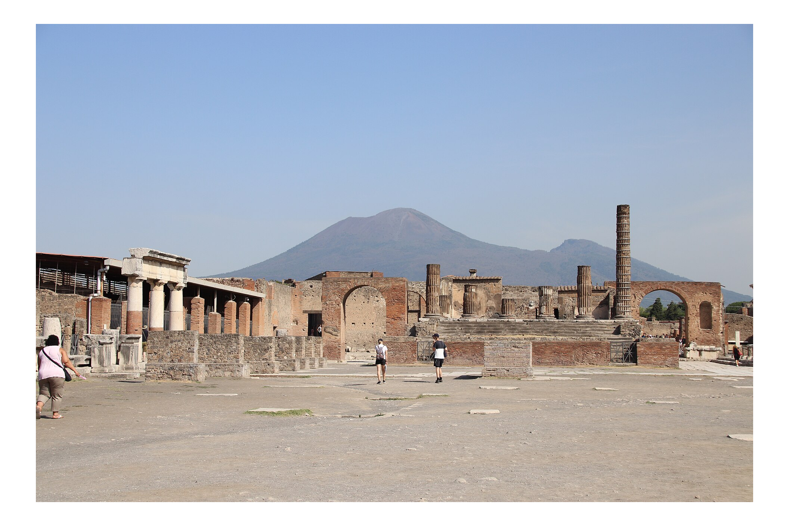
Mount Vesuvius Behind the Ruins of Pompeii
The excavated streets of Pompeii sit directly below Mount Vesuvius.
© More Lessons Less Planning | morelessonslessplanning.com
Notes:
Real public-domain photograph of Mount Vesuvius rising behind the excavated ruins of Pompeii. Point out the columns and streets in the foreground and the volcano behind.
Reference labels (point to these chart features when teaching): Mount Vesuvius; Excavated ruins

Slide 12
Daily Life in a Roman Town
Bakeries were found with bread still in the ovens.
Shops and bars with stone counters lined the streets.
Homes had painted walls, courtyards, and mosaics.
A central forum held markets, temples, and government.
Key Concept: The ruins reveal ordinary Roman life - shops, homes, streets, bakeries, and a forum.
© More Lessons Less Planning | morelessonslessplanning.com
Notes:
Because Pompeii was frozen in a single day, the EXCAVATION reveals ordinary Roman life in detail: bakeries with bread still in the ovens, shops and bars with counters, painted homes, stepping-stones across streets, public baths, and a central forum for markets and government. Everyday objects and graffiti show what regular Romans ate, bought, and cared about.

Slide 13
Reconstructing Pompeii
Eyewitness account
Pliny's letters give the eruption's timing and sequence.
Archaeology
The casts, ruins, and ash layers show what happened to the town.
Key Concept: Historians combine Pliny's eyewitness PRIMARY SOURCE with ARCHAEOLOGY to reconstruct Pompeii.
© More Lessons Less Planning | morelessonslessplanning.com
Notes:
To reconstruct what happened, historians combine two kinds of evidence: Pliny's eyewitness PRIMARY SOURCE, which gives the timing and sequence of the ERUPTION, and ARCHAEOLOGY - the ruins, ash layers, and plaster casts - which shows what happened to the town and its people. Pliny's falling ash matches the deep ash layers archaeologists dig up. Neither source alone is enough; together they give the fullest picture.

Slide 14
Key Takeaways
In 79 CE Vesuvius erupted and buried the Roman town of Pompeii.
★
Pliny the Younger's letters are an eyewitness primary source.
★
Ash and pumice preserved Pompeii; plaster casts reveal victims.
★
Historians reconstruct Pompeii: eyewitness account + archaeology.
★
© More Lessons Less Planning | morelessonslessplanning.com
Notes:
Recap the four takeaways. The big skill: an eyewitness primary source plus archaeology together reconstruct the past.

