Slide 1
Pilgrimage Across World Religions
An academic, comparative look at how believers in different religions travel to sacred places - and what their journeys share.
© More Lessons Less Planning | morelessonslessplanning.com
Notes:
Opening slide. This lesson studies pilgrimage academically and comparatively - as a shared human and religious practice, not as devotion. Students learn what pilgrimage is (a journey to a sacred place undertaken for religious reasons), why believers undertake it, and the four features pilgrimages share across traditions: a sacred destination, ritual acts, community, and transformation. The lesson anchors the comparison in two examples: the Muslim Hajj to Mecca and Buddhist pilgrimage to Bodh Gaya. Set a neutral, scholarly tone from the first minute: we describe each tradition fairly, as a historical and cultural phenomenon, and we never endorse or rank belief systems. Note the honest limit of the comparison - shared features do NOT mean the religions are the same or worship the same way.

Slide 2
Learning Targets
Explain what pilgrimage is and why believers undertake it.
★
Name the four features pilgrimages share across religions.
★
Compare the Hajj to Mecca with Buddhist pilgrimage to Bodh Gaya.
★
Read Ibn Battuta's account of the Hajj as a primary source.
★
© More Lessons Less Planning | morelessonslessplanning.com
Notes:
Read the four learning targets. Today pairs a concept - pilgrimage as a shared human practice - with two concrete examples, the Muslim Hajj and Buddhist pilgrimage to Bodh Gaya. Keep the neutral, comparative stance in mind throughout: our goal is to describe each tradition accurately and to notice both what the journeys share and how their beliefs differ, not to decide which is right. Pay special attention to the four shared features - a sacred destination, ritual acts, community, and transformation - because you will use them to compare the two traditions and to analyze the primary source.

Slide 3
What Is Pilgrimage?
A journey to a sacred place
Why believers go
Pilgrimage is a journey to a sacred place undertaken for religious reasons.
The goal is a sacred destination - a holy place worth traveling far to reach.
It is found across many world religions, not just one.
To grow closer to the sacred or fulfill a religious duty.
To seek forgiveness, blessing, or answered prayer.
To hope for transformation - to return home changed.
Key Concept: PILGRIMAGE is a journey to a sacred place undertaken for religious reasons - a practice shared across world religions.
© More Lessons Less Planning | morelessonslessplanning.com
Notes:
Start with the core idea. Pilgrimage is a journey to a sacred place undertaken for religious reasons; the destination is a sacred place - a holy site worth traveling far to reach. Believers undertake pilgrimage for several reasons: to grow closer to the sacred, to fulfill a religious duty, to seek forgiveness or blessing, or in the hope of transformation - returning home changed. The important academic point is that pilgrimage is not unique to one religion: many world religions have sacred destinations and journeys to them. Present this neutrally as a shared human and religious practice.

Slide 4
The Shared Pattern: Four Common Features
Sacred destination + Ritual
A sacred destination is the holy place that is the goal. Ritual means religious actions done in a fixed, repeated way.
✔
Community
Community is the shared belonging pilgrims feel when many believers gather and perform the same rituals as one people.
✔
Transformation
Transformation is the inner change or spiritual renewal a pilgrim hopes to gain; many return home feeling changed.
✔
Key Concept: Across religions, pilgrimages share four features - a sacred destination, RITUAL, COMMUNITY, and TRANSFORMATION.
© More Lessons Less Planning | morelessonslessplanning.com
Notes:
Even though religions differ, their pilgrimages tend to share four features, and naming them lets us compare fairly. First, a sacred destination - a holy place that is the goal of the journey. Second, ritual - a set of religious actions performed in a fixed, repeated way that gives the pilgrimage its shape and shared meaning. Third, community - the sense of shared belonging pilgrims feel when large numbers of believers gather together and perform the same rituals as one people. Fourth, transformation - the inner change or spiritual renewal a pilgrim hopes to gain from the journey; many return home feeling changed. Stress the honest limit: sharing these features does NOT mean the religions are the same or worship the same way - it means the human pattern of the journey is similar.

Slide 5
The Hajj: Pilgrimage in Islam
The Hajj
Mecca, the destination
The Hajj is the pilgrimage to Mecca and one of the Five Pillars of Islam.
Every able Muslim is expected to make it at least once in a lifetime.
It draws millions of pilgrims from around the world each year.
Mecca is the holiest city of Islam, in present-day Saudi Arabia.
It is the birthplace of Muhammad and the destination of the Hajj.
At its heart stands the Great Mosque and the Kaaba.
Key Concept: The HAJJ is the pilgrimage to MECCA, one of the Five Pillars of Islam, expected once of every able Muslim.
© More Lessons Less Planning | morelessonslessplanning.com
Notes:
The clearest example of a pilgrimage is the Hajj. The Hajj is the pilgrimage to Mecca that is one of the Five Pillars of Islam - the five core practices of the faith - and every able Muslim is expected to make it at least once in a lifetime, if they are physically and financially able. Its destination is Mecca, the holiest city of Islam, in present-day Saudi Arabia; Mecca is the birthplace of Muhammad and the destination of the Hajj. At the heart of Mecca stands the Great Mosque, and at its center the Kaaba. Describe all of this academically, as a description of Islamic practice; we do not depict the Prophet Muhammad, and we describe Mecca respectfully as a place.

Slide 6
Rituals of the Hajj
Ihram
Pilgrims enter ihram, a state of ritual purity marked by two plain white garments, so that rich and poor pilgrims appear equal.
✔
Circling the Kaaba (circumambulation)
Pilgrims perform circumambulation - walking seven times around the Kaaba, the cube-shaped structure at the center of the Great Mosque in Mecca.
✔
Safa and Marwa
Pilgrims walk seven times between the hills of Safa and Marwa, one of several fixed rituals of the Hajj.
✔
Key Concept: Hajj rituals include IHRAM (plain white garments), CIRCUMAMBULATION of the KAABA, and walking between Safa and Marwa.
© More Lessons Less Planning | morelessonslessplanning.com
Notes:
The Hajj is made up of fixed rituals performed in order. First, pilgrims enter ihram, a state of ritual purity marked by wearing two plain white garments; the plain dress means rich and poor pilgrims appear equal before God. Then pilgrims perform circumambulation - the ritual act of walking around a sacred object or place - walking seven times around the Kaaba, the cube-shaped stone structure at the center of the Great Mosque in Mecca that Muslims worldwide face in prayer. Pilgrims also walk seven times between the two hills of Safa and Marwa. These are examples of ritual: religious actions performed in a fixed, repeated way that give the pilgrimage its shape and shared meaning. Describe the rituals accurately and neutrally.

Slide 7
Buddhist Pilgrimage: The Four Sacred Sites
Buddhist pilgrimage
Bodh Gaya
Buddhists honor four sites tied to the Buddha's life.
Lumbini marks his birth; Bodh Gaya, his enlightenment.
Sarnath marks his first teaching; Kushinagar, his death.
Bodh Gaya is the site in India where the Buddha attained enlightenment.
It is marked today by the Mahabodhi Temple and a descendant of the Bodhi tree.
Pilgrims meditate, circle the shrine, and make offerings there.
Key Concept: BODH GAYA - where the Buddha attained enlightenment, marked by the Mahabodhi Temple - is the most important Buddhist pilgrimage site.
© More Lessons Less Planning | morelessonslessplanning.com
Notes:
Buddhism has its own tradition of pilgrimage. Buddhists travel to places connected with the life of the Buddha; four sites are especially sacred: Lumbini (his birth), Bodh Gaya (his enlightenment), Sarnath (his first teaching), and Kushinagar (his death). The most important is Bodh Gaya, the site in India where the Buddha attained enlightenment, marked today by the Mahabodhi Temple and a descendant of the Bodhi tree under which he is said to have sat. At Bodh Gaya, pilgrims meditate, walk around the shrine and the sacred tree, and make offerings. Notice the shared features again - a sacred destination, ritual, community, and the hope of transformation - but keep the traditions distinct: Buddhists honor the place of the Buddha's enlightenment, not the worship of a creator God. On the next slide you will see a photograph of the Mahabodhi Temple.

Slide 8
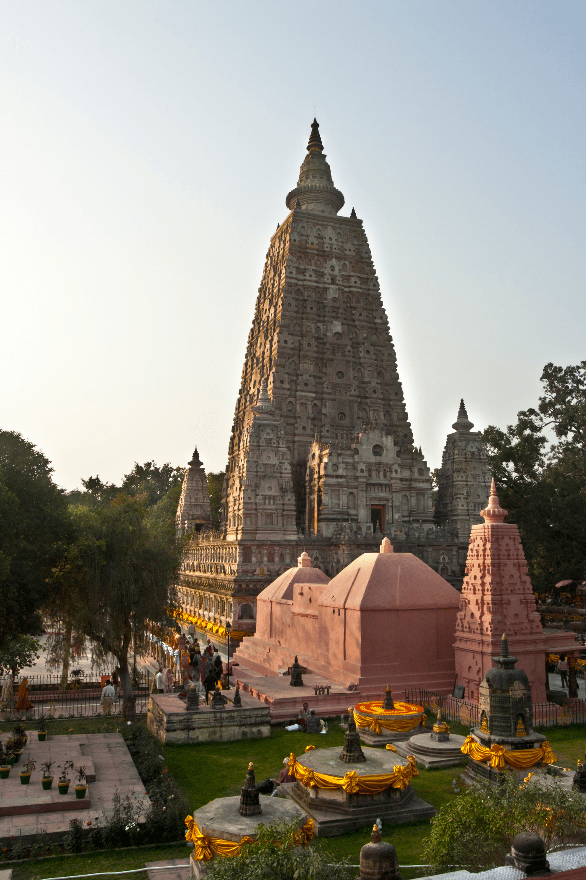
The Mahabodhi Temple at Bodh Gaya
Mahabodhi Temple, Bodh Gaya. Credit: Jakub Michankow, CC BY 2.0.
© More Lessons Less Planning | morelessonslessplanning.com
Notes:
A real Creative-Commons photograph of the exterior of the Mahabodhi Temple at Bodh Gaya, India - the temple that marks the place where the Buddha is said to have attained enlightenment, and one of the most important pilgrimage destinations in Buddhism. Use it purely as a reference image to make the previous slide concrete: this is what a major Buddhist pilgrimage site looks like. Describe it respectfully and academically as a real place; students are not asked to decode the image as evidence. Image credit: photograph by Jakub Michankow, licensed CC BY 2.0 via Wikimedia Commons (File:Exterior_view_of_the_Mahabodhi_Temple.jpg); attribution required.

Slide 9
Comparing the Hajj and Buddhist Pilgrimage
The same human pattern
Both share a sacred destination (Mecca; Bodh Gaya), ritual acts, a community of pilgrims, and the hope of transformation.
✔
Different beliefs
The Hajj worships the one God of Islam; Bodh Gaya honors the Buddha's enlightenment, with no worship of a creator God.
✔
Why this matters
We compare the shared pattern fairly, keep each tradition's beliefs distinct, and never rank them.
✔
Key Concept: The Hajj and Buddhist pilgrimage share the same human FEATURES, but their beliefs stay distinct - similar pattern, different faiths.
© More Lessons Less Planning | morelessonslessplanning.com
Notes:
Now compare the two examples directly. Both the Hajj and a Buddhist journey to Bodh Gaya follow the same human pattern of pilgrimage: a believer travels to a sacred destination (Mecca for the Muslim pilgrim, Bodh Gaya for the Buddhist), performs rituals there (circling the Kaaba; meditating and circling the shrine or Bodhi tree), joins a community of fellow pilgrims, and hopes to be transformed. But their beliefs are not the same, and this is the crucial academic point: the Hajj is an act of worship of the one God of Islam at the place tied to Muhammad, while pilgrimage to Bodh Gaya honors the place of the Buddha's enlightenment and does not involve the worship of a creator God. So the pilgrimages share the same human features - a sacred destination, ritual, community, and transformation - even though the religions remain distinct. We compare them to understand each fairly, never to rank them.

Slide 10
A Pilgrim's Own Words: Ibn Battuta
Who was Ibn Battuta?
Reading it as a primary source
Ibn Battuta was a 14th-century Moroccan Muslim traveler and scholar.
He journeyed across much of the medieval world and performed the Hajj.
His travel book is called the Rihla ('The Journey').
His account of the Hajj is a primary source - a firsthand description.
But he dictated it around 1355, years after his travels, from memory.
So we read it as a remembered travelogue, checked against other sources.
Key Concept: IBN BATTUTA, a 14th-century Muslim traveler, left a firsthand account of the Hajj - a primary source we read carefully.
© More Lessons Less Planning | morelessonslessplanning.com
Notes:
To see the Hajj through a pilgrim's own eyes, we turn to Ibn Battuta. Ibn Battuta was a 14th-century Moroccan Muslim traveler and scholar who journeyed across much of the medieval world - North Africa, the Middle East, and beyond - and who performed the Hajj himself. His travel book is called the Rihla, meaning 'The Journey.' His description of arriving at Mecca and performing the Hajj is a primary source: a firsthand account by someone who was there. But note the honest limit for a historian: Ibn Battuta dictated the Rihla around 1355, years after his pilgrimage (which he made in the 1320s), recalling it from memory rather than writing a diary at Mecca, and a scribe wrote it down. So we treat it as strong evidence of what the Hajj meant to a medieval Muslim pilgrim, while reading it carefully and checking it against other sources. In the activity you will read part of his account.

Slide 11
Studying Pilgrimage Academically
Describe, don't endorse
We study pilgrimage as a historical and cultural practice, never telling anyone what to believe.
✔
Compare fairly, don't rank
We compare the Hajj and Buddhist pilgrimage to understand each - never ranking one above another.
✔
Read sources carefully
We treat Ibn Battuta's account as evidence, not a complete picture of the whole past.
✔
Key Concept: We study pilgrimage as a historical and cultural PRACTICE - describing each tradition fairly and never ranking belief systems.
© More Lessons Less Planning | morelessonslessplanning.com
Notes:
Because this is a unit on world religions and belief systems, it helps to name how we study pilgrimage. First, we describe rather than endorse: we study pilgrimage as a historical and cultural practice, explaining what each tradition does and means, and never telling anyone what to believe. Second, we compare fairly rather than rank: we set the Hajj beside Buddhist pilgrimage to understand each one, noticing both the shared features and the real differences, and we never rank one religion above another. Third, we read sources carefully: an account like Ibn Battuta's is valuable evidence of what pilgrimage meant to one medieval pilgrim, but it is not a complete picture of the whole past. Holding to these habits keeps our study accurate, respectful, and academic.

Slide 12
Key Takeaways
Pilgrimage is a journey to a sacred place undertaken for religious reasons.
★
Four shared features: a sacred destination, ritual, community, transformation.
★
Hajj and Buddhist pilgrimage share the pattern, but their beliefs differ.
★
Ibn Battuta's account is a primary source on the Hajj.
★
© More Lessons Less Planning | morelessonslessplanning.com
Notes:
Let's recap what you now know about pilgrimage, described academically. First, the core idea: pilgrimage is a journey to a sacred place undertaken for religious reasons, a practice found across many world religions. Second, the shared pattern: pilgrimages tend to share four features - a sacred destination, ritual, community, and transformation. Third, the comparison: the Muslim Hajj to Mecca (with rituals like ihram and circling the Kaaba) and Buddhist pilgrimage to Bodh Gaya (the place of the Buddha's enlightenment) follow the same human pattern, but their beliefs remain distinct - similar journeys, different faiths. Fourth, the evidence: Ibn Battuta's account lets us see the Hajj through a pilgrim's own eyes, read carefully as a primary source. Throughout, we described each tradition fairly, as a historical and cultural phenomenon, and never ranked one against another.

