Slide 1
Perfect Competition: The Theoretical Ideal
The four conditions, why no real market meets them, and why wheat comes closest.
© More Lessons Less Planning | morelessonslessplanning.com
Notes:
Open with the punchline: perfect competition is the theoretical benchmark every other market structure in Unit 3 is measured against. It is rarely seen in pure form. Wheat is the cleanest real-world example. By the end of class, students should be able to list the four conditions and explain why monopoly, oligopoly, and monopolistic competition each fail one or more of them.

Slide 2
Learning Targets
List the four conditions of perfect competition and rate a real market on each
★
Distinguish the MARKET chart from the FIRM's horizontal demand curve
★
Explain why free entry and exit drives long-run economic profit to ZERO
★
© More Lessons Less Planning | morelessonslessplanning.com
Notes:
Read the three targets aloud. Target 1 is the diagnostic - given any market, can students name which condition is failing? Target 2 is the technical core - the difference between the market chart and the firm chart is the source of half the confusion about perfect competition. Target 3 is the headline prediction - long-run zero economic profit.

Slide 3
Why Study Perfect Competition?
The Theoretical Benchmark
Real-World Closest Match
Rarely seen in pure form in the real world
Used to MEASURE every other market structure
Sets the standard for consumer-friendly outcomes
The starting point for Unit 3
U.S. WHEAT - tens of thousands of farms
Other commodity grains (corn, soybeans, rice)
Foreign currency exchange (major pairs)
Heavily traded stocks of large companies
Big Idea: Perfect competition is a benchmark - we use it to see what monopoly, oligopoly, and monopolistic competition are MISSING.
© More Lessons Less Planning | morelessonslessplanning.com
Notes:
Frame the unit. Perfect competition is the comparison standard. Wheat is the closest real-world fit and the running example for this toolkit.

Slide 4
The Four Conditions of Perfect Competition
1. Many sellers
Enough independent producers that no single firm's output changes the market price (e.g., tens of thousands of wheat farms)
2. Identical product
Every unit is interchangeable with every other unit; buyers do not care which seller they buy from
3. Free entry and exit
New firms can join the market without significant legal, financial, or technological barriers; failing firms can leave at low cost
4. Perfect information
All buyers and sellers know all prices, product qualities, and production costs; no one has an information advantage
Remember: M-I-F-P (Many sellers, Identical product, Free entry, Perfect information). All FOUR must hold for perfect competition.
© More Lessons Less Planning | morelessonslessplanning.com
Notes:
Walk all four conditions briskly. Each gets its own deeper-dive slide next. The mnemonic M-I-F-P keeps students from forgetting one.

Slide 5
Condition 1: Many Sellers
ENOUGH sellers that no single firm's output moves the market price
Each firm is TINY relative to the market
Wheat: ~100,000+ U.S. farms producing the same commodity
Failure example: smartphone market has only 5 major sellers
Failure example: U.S. soft drinks has 2 dominant firms (Coke, Pepsi)
Try this: If ONE firm cut output by 50%, would the market price change? In perfect competition, NO. In monopoly, YES.
© More Lessons Less Planning | morelessonslessplanning.com
Notes:
The 'many sellers' condition is really about market-share concentration. The Herfindahl-Hirschman index in IO economics formalizes this. Don't go there with HS students - just emphasize that no single firm can move the price.

Slide 6
Condition 2: Identical (Homogeneous) Product
Homogeneous Product Examples
Differentiated Product (FAILS)
WHEAT - graded commodity grain, one bushel = another
GOLD - one standardized ounce of 24K = another
CURRENCY - one euro = another euro
STANDARDIZED stock shares - one Apple share = another
Buyers do NOT care which seller they buy from
iPHONE vs PIXEL - buyers care
STARBUCKS vs LOCAL CAFE - buyers care
TESLA vs FORD - buyers care
Any branded retail - by design, differentiated
Try this: Can you SUBSTITUTE one seller's product for another with NO difference to the buyer? Wheat = yes. iPhone = no.
© More Lessons Less Planning | morelessonslessplanning.com
Notes:
The identical-product condition is what makes commodity markets the closest real-world match. Anything branded automatically fails this. Most retail markets fail because branding is everywhere.

Slide 7
Condition 3: Free Entry and Exit
Free Entry/Exit Examples
Blocked Entry (FAILS)
WHEAT FARMING - rent land, buy seed, plant
FOOD TRUCKS - $20-50k startup, 1-2 month launch
FREELANCE WRITING - laptop + internet, week one
PATENTED PHARMACEUTICAL - 20-year patent
AIRLINES - massive capital + slot allocation
ELECTRIC UTILITY - government franchise monopoly
Big Tech - network-effect entry barrier
Big idea: Free entry erodes profits from ABOVE. Free exit relieves losses from BELOW. Together they drive long-run profit to ZERO.
© More Lessons Less Planning | morelessonslessplanning.com
Notes:
Free entry/exit is the condition that drives the long-run zero-economic-profit prediction. Without it, profits can persist indefinitely (as in monopoly). With it, profits attract new firms until they are competed away.

Slide 8
Condition 4: Perfect Information
ALL prices KNOWN to all buyers and sellers
ALL product qualities KNOWN - no hidden defects
ALL production costs KNOWN - no information advantage
Wheat - USDA NASS publishes prices weekly; futures markets
Failure: used cars (hidden defects, information asymmetry)
Key point: Perfect information means NO ONE can exploit an information advantage to charge a higher price or buy below market.
© More Lessons Less Planning | morelessonslessplanning.com
Notes:
Perfect information is the condition that fails most often in real life. Even commodity markets have small failures (a farmer might know more about local wheat quality than a buyer). The used-car market is the classic asymmetric-information failure (Akerlof's Lemons paper).

Slide 9
The Market Chart Sets the Price
What the Market Chart Shows
What That Means for One Farm
Supply = ALL wheat farms together
Demand = ALL wheat buyers together
They cross at the equilibrium PRICE
On the next chart: $7/bushel, quantity 50
The market sets the price - no single farm does
Your farm accepts whatever price the market gives
If a farm asks for $7.01, buyers go elsewhere
If a farm asks for $6.99, it leaves money on the table
Key Concept: The MARKET chart sets the price. The INDIVIDUAL FARM accepts whatever price the market gives.
© More Lessons Less Planning | morelessonslessplanning.com
Notes:
Set up the market chart on the next slide BEFORE flipping. Students need to know what they are looking at: this is the WHOLE market, not one farm.

Slide 10
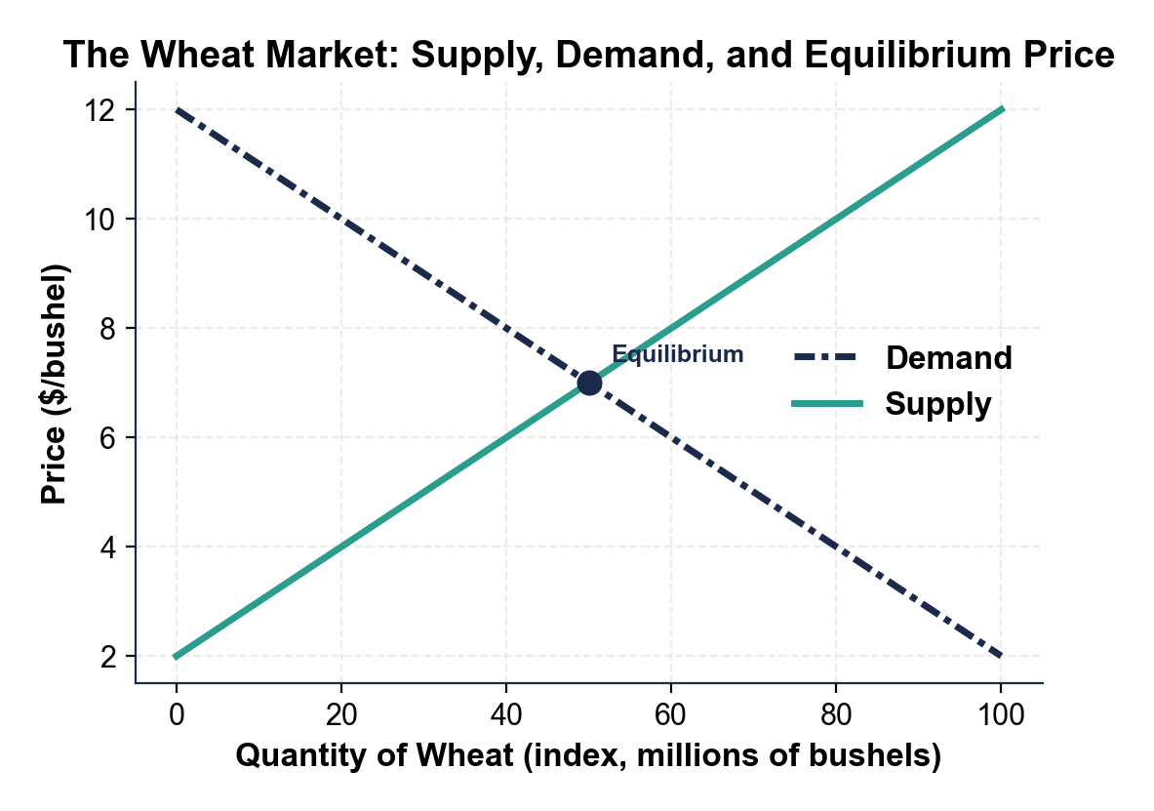
Wheat Market Equilibrium
Wheat market equilibrium: quantity 50 at price $7/bushel.
© More Lessons Less Planning | morelessonslessplanning.com
Notes:
Point to the equilibrium dot. Have students name the price ($7) and the quantity (50) directly off the chart. This is the MARKET-level result that the individual farm must accept.
Reference labels (point to these chart features when teaching): Equilibrium ($7, qty 50)

Slide 11
The Individual Farm Faces a HORIZONTAL Demand Curve
Why Horizontal?
The Technical Name
A single wheat farm is TOO SMALL to move the price
Whatever it sells, the price stays at $7/bushel
The firm's demand curve is HORIZONTAL at $7
This shape is called PERFECTLY ELASTIC demand
It is the SIGNATURE of a price-taker firm
ONLY perfect competition has this shape
Monopoly, oligopoly, MC all face downward slopes
Big Idea: Horizontal demand at the market price = the firm is a PRICE-TAKER. Only perfect competition has this shape.
© More Lessons Less Planning | morelessonslessplanning.com
Notes:
This is the most counterintuitive slide in the deck. Students expect every demand curve to slope down. The individual firm's demand curve in PC is the exception - perfectly flat at the market price. Cue the chart on the next slide.

Slide 12
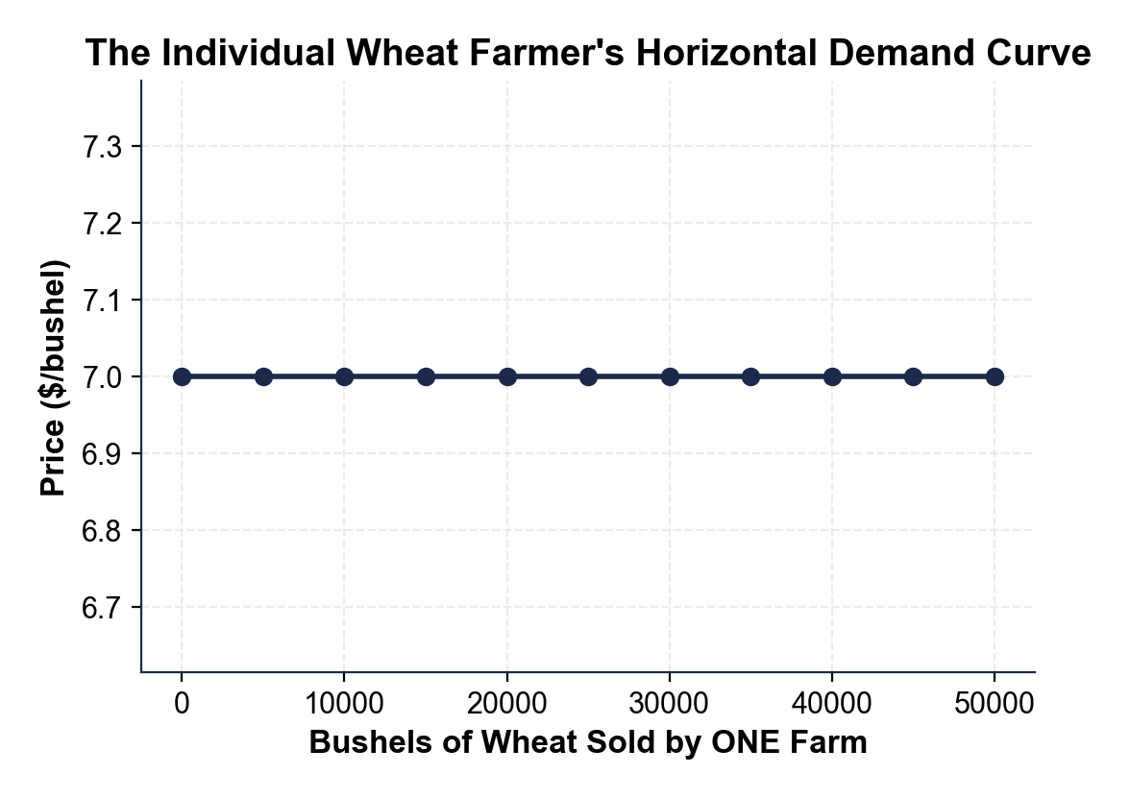
The Individual Wheat Farm: Horizontal Demand at $7
Horizontal demand at $7/bushel - price-taker signature.
© More Lessons Less Planning | morelessonslessplanning.com
Notes:
Have students point to the horizontal line. Trace it from left (0 bushels) to right (50,000 bushels). The price never changes. This is what a price-taker faces.
Reference labels (point to these chart features when teaching): $7/bushel (price-taker line)

Slide 13
Real Wheat Prices Since 2010
Real U.S. wheat prices 2010-2024 (USDA NASS data)
2016 LOW: $3.89/bushel - oversupply year
2022 PEAK: $8.83/bushel - Ukraine war disrupted supply
2.27x swing from low to peak in 6 years
No individual farmer caused or stopped any of these moves
Real talk: A price-taker farmer cannot smooth this chart. Only the WHOLE market can.
© More Lessons Less Planning | morelessonslessplanning.com
Notes:
Set up the wheat-price-history chart. The point of this chart is to show the volatility that a price-taker just has to accept. No single farm caused the 2016 low or the 2022 peak; no single farm could have stopped either.

Slide 14
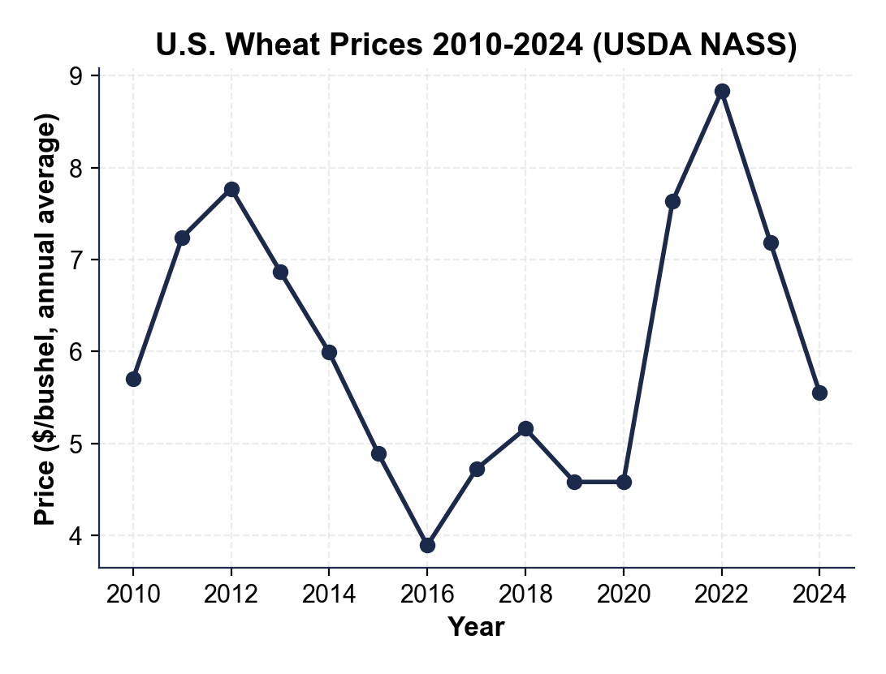
U.S. Wheat Prices 2010-2024
2016 low $3.89 to 2022 peak $8.83 - 2.27x swing.
© More Lessons Less Planning | morelessonslessplanning.com
Notes:
Have students point to the 2016 low and the 2022 peak. The visual gap between the lowest and highest years IS the price-taker reality. No individual farm caused or stopped these moves.
Reference labels (point to these chart features when teaching): 2016 low $3.89; 2022 peak $8.83

Slide 15
Long-Run Zero Economic Profit
Why Zero?
Zero ECONOMIC, Not Zero ACCOUNTING
Profits attract ENTRY - new firms join
More firms = more supply = LOWER price
Lower price erodes the profit margin
Losses cause EXIT - firms leave
Fewer firms = less supply = HIGHER price
Higher price relieves the loss
Owners still earn a NORMAL market return
Economic profit subtracts opportunity cost too
ACCOUNTING profit can still be positive
It just equals what the owner would earn elsewhere
Important: Long-run zero ECONOMIC profit does NOT mean owners earn zero. They earn NORMAL profit - the opportunity-cost return.
© More Lessons Less Planning | morelessonslessplanning.com
Notes:
This is the headline prediction of perfect competition. Most students panic because they hear 'zero profit'. Reassure them: it is zero ECONOMIC profit, which still pays a normal market return.

Slide 16
Market Structure Terms
Perfect competition
A theoretical market structure meeting all four conditions: many sellers, identical product, free entry and exit, perfect information.
Commodity
A standardized, undifferentiated good (wheat, corn, copper, oil, gold) - the cleanest real-world fit for perfect competition.
Market structure
The classification by degree of product differentiation, height of entry barriers, number of sellers, and amount of price-setting power firms have.
Note: Perfect competition is the BENCHMARK in Unit 3 - the rest of the unit shows what happens when conditions fail.
© More Lessons Less Planning | morelessonslessplanning.com
Notes:
Walk the five market-structure terms. Students should be able to define perfect competition, commodity, market structure, homogeneous product, and free entry/exit from this slide alone.

Slide 17
Cost and Profit Terms
Price-taker
A seller with no power to set the price - must accept whatever the market gives; signature is a horizontal demand curve at the market price.
Economic profit
Total revenue minus ALL costs including opportunity cost of the owner's capital and labor; distinct from accounting profit.
Long-run zero profit
The prediction that in a perfectly competitive market, free entry erodes profits and free exit relieves losses; equilibrium has zero economic profit.
Note: These five terms also appear in Activity Part 2 and on the Quiz - finish the Reference Guide vocabulary here.
© More Lessons Less Planning | morelessonslessplanning.com
Notes:
Walk the five cost / profit / price terms. Drill the distinction between economic profit (opportunity-cost-aware) and accounting profit (cash in vs cash out). This is where students get tripped up most often.

Slide 18
Key Takeaways
Perfect competition = M-I-F-P (Many, Identical, Free entry, Perfect info)
It is a THEORETICAL BENCHMARK - wheat is the closest real-world fit
MARKET chart sets the price; INDIVIDUAL FIRM faces a HORIZONTAL demand curve
Individual firm is a PRICE-TAKER - cannot set price, only choose quantity
Long-run prediction: free entry/exit drives ECONOMIC profit to ZERO
Takeaway: Perfect competition is the consumer-friendly benchmark. The rest of Unit 3 shows what happens when ONE of the four conditions fails.
© More Lessons Less Planning | morelessonslessplanning.com
Notes:
Cycle through the five takeaways quickly. Each maps to one part of the activity: four conditions (Part 1), reference vocabulary (Part 2), chart reading (Part 3), real-market diagnosis (Part 4), seasonal-planting memo (Part 5).

