Slide 1
Penelope and the Women of the Odyssey
The cunning Penelope, the sorceress Circe, the goddess Athena - and what the real lives of Greek women were actually like.
© More Lessons Less Planning | morelessonslessplanning.com
Notes:
Open with the contrast at the heart of the lesson. The Odyssey is full of unforgettable, powerful women: Penelope, who outwits a house full of suitors; Circe, a sorceress who turns men into pigs; Athena, a goddess who steers the whole story; Calypso and Nausicaa besides. It would be easy to conclude that ancient Greek women must have been powerful and free. Set the honest frame at once: these women are CHARACTERS in a poem - literary creations - not documentary evidence of how real Greek women lived. This lesson does two things at once. It appreciates how vivid and clever these fictional women are (especially Penelope's cunning, or metis). And it tells the truth about the restricted lives of real classical Athenian women, who lived under a male guardian and were largely confined to the household. Holding both ideas at once - a great story AND the real history behind it - is the whole point.

Slide 2
Learning Targets
The women of the Odyssey: Penelope's metis, Circe, Athena, and the shroud trick
★
The real, restricted lives of Athenian women: the kyrios and the oikos
★
Myth vs. history: the women are literary, not real evidence - plus Sparta
★
© More Lessons Less Planning | morelessonslessplanning.com
Notes:
Read each target aloud. Target 1 maps to slides 3-7 (the myth-vs-history frame, Penelope's metis and the shroud trick, Circe and Calypso, and Athena). Target 2 maps to slides 8-9 (real Athenian women under the kyrios and confined to the oikos, and the central role of weaving). Target 3 maps to slides 10-11 (the Spartan nuance and the honest myth-vs-history verdict). Stress the load-bearing honesty ideas: the epic's women are literary constructs, not proof of how real women lived; real Athenian women were restricted (but not chattel); and Spartan women were comparatively freer than Athenian women.

Slide 3
The Women of the Odyssey: Characters, Not Documentary
A Cast of Powerful Women
But They Are Literary Constructs
PENELOPE outwits the suitors; CIRCE is a sorceress; ATHENA is a goddess
CALYPSO and NAUSICAA - a goddess-nymph and a princess - fill out the cast
On the page these women are clever, magical, and powerful
MYTH is a story that reveals a culture's values - not a record of real life
The poem's women are CHARACTERS, not proof of how real Greek women lived
The honest question: what do these characters REVEAL, not 'were they real?'
Key Concept: The Odyssey's women are characters in a MYTH - they reveal Greek values, NOT how real Greek women actually lived.
© More Lessons Less Planning | morelessonslessplanning.com
Notes:
Establish the central myth-vs-history frame before meeting any single woman. Name the cast: PENELOPE, who outwits a house full of suitors; CIRCE, a sorceress who turns men into swine; ATHENA, the goddess who guides the whole plot; and CALYPSO AND NAUSICAA besides - a goddess-nymph who holds Odysseus on her island and a young princess who helps him. On the page these women are clever, magical, and remarkably powerful. Now make the load-bearing honest move: the Odyssey is MYTH - a traditional story that reveals a culture's values and imagination - not a documentary record of real life. So these women are literary CONSTRUCTS, characters an oral poet shaped, and their power is NOT evidence that real Greek women were powerful or free. Warn students against the tempting but false leap: 'the Odyssey has strong women, therefore Greek women were strong.' The honest question is never 'were they real?' It is 'what do these characters reveal about what the Greeks valued and imagined?' - and, separately, 'what were real Greek women's lives actually like?' The rest of the lesson answers both.

Slide 4
Penelope's Metis: The Shroud Trick
Cunning, Not Just Patience
The Shroud Trick
PENELOPE is Odysseus's wife, besieged by suitors who want his kingdom
METIS is cunning intelligence - cleverness and forethought - her defining trait
She shares this prized quality with Odysseus himself; she is his equal in wits
She vows to choose a suitor once she finishes weaving a SHROUD for Laertes
By day she weaves at the LOOM; by night she secretly unravels the day's work
The ruse holds the suitors off for years - until a maid finally betrays her
Key Concept: Penelope's SHROUD trick - weave by day at the LOOM, unravel by night - is pure METIS (cunning), the quality prized in Odysseus.
© More Lessons Less Planning | morelessonslessplanning.com
Notes:
This is the heart of Penelope's character, and the correction of a common misreading. PENELOPE is Odysseus's wife, left to run Ithaca while a crowd of SUITORS pressures her to remarry and seize the kingdom. Students often remember her only as the 'faithful wife who waits' - patient and passive. Correct this firmly: Penelope's defining trait is METIS, cunning intelligence - the same cleverness and forethought that defines Odysseus. She is his equal in wits. The proof is the famous SHROUD trick. Penelope announces she will choose one of the suitors as soon as she finishes weaving a fine burial SHROUD for Odysseus's old father, Laertes - a duty no one can decently refuse. So every day she works at her LOOM in full view; but every night, by torchlight, she secretly unravels the very cloth she wove that day. The shroud is never finished, and the suitors are held off for about three years - until one of her maids reveals the secret and she is caught in the act. Stress the point: this is not patience, it is a brilliant plan. Penelope buys years of time with a clever, deniable trick - metis, the poem's most prized quality, in a woman. The next slide shows a real ancient Greek vase of women weaving at the loom - the real textile work that stands behind Penelope's story.

Slide 5
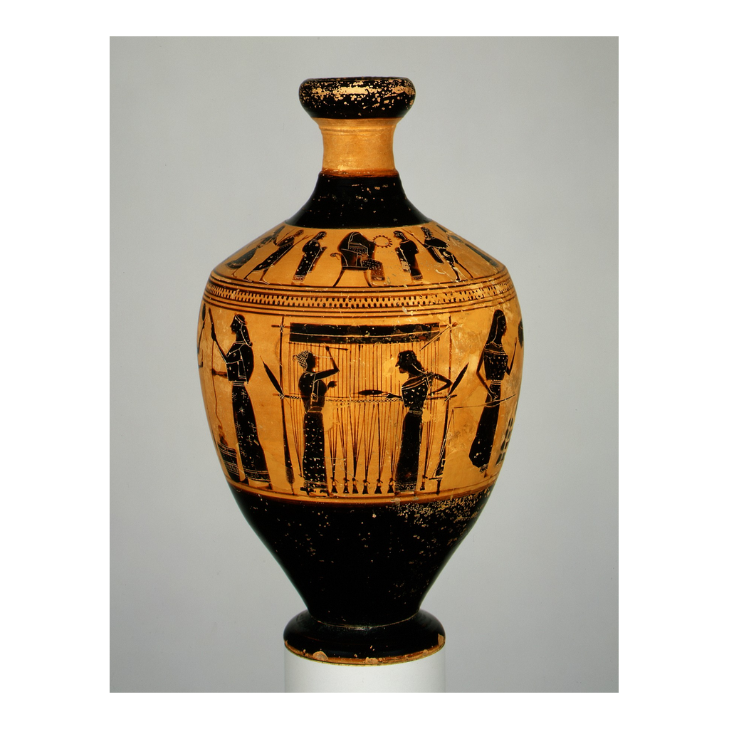
An Ancient Vase: Greek Women at the Loom
Ancient Greek women weaving at an upright loom (Attic lekythos, ca. 550-530 BCE)
© More Lessons Less Planning | morelessonslessplanning.com
Notes:
This is a real ancient Greek vase - an Attic black-figure lekythos (a small oil flask) attributed to the Amasis Painter, made around 550-530 BCE and now in the Metropolitan Museum of Art. Its band of figures shows real, everyday women's work: women weigh raw wool, spin it into yarn, and - at the center - two women weave cloth on a tall upright (warp-weighted) LOOM. Have students find the loom with its vertical threads and the women working the wool around it. Connect it to the previous slide honestly: this vase does NOT show Penelope - it shows ordinary Greek women doing the real textile labor that stood behind her fictional shroud trick. That is the whole point of the image: Penelope's cleverness is a story, but the loom she sits at is drawn straight from the real, restricted lives of Greek women, whose central respectable work was weaving. Keep the honest caption in view: this is genuine ancient Greek ART, and it pictures real women's work, not a scene from the myth. The fact that weaving is painted so proudly onto Greek pottery shows how central it was to a woman's expected role.
Reference labels (point to these chart features when teaching): women at the upright loom; women working wool

Slide 6
Circe and Calypso: The Poem's Supernatural Women
Circe
CIRCE is a divine sorceress - not a mortal woman - who lives on her own island and turns Odysseus's men into swine with her magic.
Calypso
Calypso is a goddess-nymph who holds Odysseus on her island for years; like Circe, she is a supernatural being, not an ordinary Greek woman.
Powerful, but not mortal
These women command magic, islands, and even gods' attention - powers no real Greek woman had. They are fantasy, not evidence about real life.
Keep the categories clear
The lesson keeps three groups distinct: the poem's goddesses and sorceresses, its mortal characters, and the real women of history.
Key Concept: CIRCE is a divine SORCERESS and Calypso a goddess-nymph - supernatural figures with powers no real woman had: fantasy, not history.
© More Lessons Less Planning | morelessonslessplanning.com
Notes:
Handle the poem's most magical women, and use them to sharpen the myth-vs-history distinction. CIRCE is a divine SORCERESS - a goddess with magic, not a mortal woman - who lives alone on the island of Aeaea and famously turns Odysseus's crew into pigs before becoming his helper. Calypso is a goddess-nymph who keeps Odysseus on her island of Ogygia for years, even offering him immortality. Make the analytical point clearly: these women command magic, rule their own islands, and hold heroes and gods' attention - powers that NO real Greek woman, however wealthy or clever, ever had. That is precisely why they are useful for teaching the myth-vs-history move: nobody is tempted to think a real woman turned sailors into pigs, so Circe makes it obvious that the Odyssey's women belong to the world of FANTASY and story, not the historical record. Teach students to keep three categories clearly separate: (1) the poem's goddesses and sorceresses (Circe, Calypso, Athena), (2) the poem's mortal human characters (Penelope, Nausicaa), and (3) the real women of ancient Greek history. Blurring these three is the mistake the whole lesson is designed to prevent. Note we analyze these myths academically - we study what the Greeks imagined and valued, we do not endorse the religion.

Slide 7
Athena: Goddess of Strategic Wisdom
The Goddess Behind the Plot
A Divine Figure, Not a Woman
ATHENA is the goddess of strategic wisdom, craft, and skilled warfare
She protects and guides Odysseus and his son Telemachus throughout the poem
She embodies METIS - clever planning - at the level of a god
Athena is a goddess - her power says nothing about mortal women's lives
The Greeks admired the strategic wisdom (metis) she and Penelope both show
Analyze the myth academically: study what the Greeks valued, don't endorse it
Key Concept: ATHENA is the GODDESS of strategic wisdom who steers the plot - a divine figure whose power is not evidence about real mortal women.
© More Lessons Less Planning | morelessonslessplanning.com
Notes:
Introduce the most powerful woman in the poem - who is not a woman at all, but a goddess. ATHENA is the Greek goddess of strategic wisdom, craft, and skilled warfare. In the Odyssey she is the hidden hand behind the plot: she pleads Odysseus's case among the gods, disguises and protects him, and guides his son Telemachus on his own journey. She embodies METIS - clever, strategic planning - at a divine level, which is why she and the cunning Penelope (and Odysseus) form a kind of trio of intelligence in the poem. Make the honesty point again, because Athena is where students are most likely to slip: Athena is a GODDESS. Her enormous power and authority say nothing about the lives of real mortal Greek women. What Athena reveals is what the Greeks VALUED - they prized strategic wisdom so highly that they made it a goddess and gave her a central role. Remind students of the academic stance the unit takes toward Greek religion: we analyze these gods and myths to understand Greek culture and values; we are not endorsing the religion or treating the gods as real. Athena is a window into the Greek mind, not a role model drawn from real Athenian streets.

Slide 8
Real Greek Women: The Kyrios and the Oikos
The kyrios
A classical Athenian woman lived under a KYRIOS - a male guardian (father, then husband) - who controlled major legal and property decisions on her behalf.
The oikos
Respectable women were largely confined to the OIKOS, the household; managing the home and its work was the center of a woman's expected life.
Limited legal standing
Women had sharply limited property and legal standing and did not hold citizenship rights in the political sense - they could not vote or serve in the assembly.
Restricted, not enslaved
This is restriction, not chattel: free Athenian women were respected wives and mothers with real roles - just far less independence than the poem's heroines.
Big Idea: A real Athenian woman lived under a male guardian (KYRIOS) in the household (OIKOS), with limited legal rights - restricted, not enslaved.
© More Lessons Less Planning | morelessonslessplanning.com
Notes:
Now turn from the poem to the real history, and be careful and precise. For a classical ATHENIAN woman (Athens is our best-documented case), life was legally restricted in ways that differ sharply from the poem's powerful heroines. First, a woman lived her whole life under a KYRIOS - a male guardian. As a girl this was her father; after marriage it became her husband. The kyrios controlled major legal and property decisions on her behalf; a woman generally could not make large contracts or transactions on her own. Second, respectable women were largely confined to the OIKOS - the household. Managing the home, its stores, its slaves, and above all its textile work was the center of a woman's expected life; the public spaces of the city were mainly male. Third, women had sharply limited property and legal standing and did not hold citizenship rights in the political sense - they could not vote, hold office, or sit in the assembly. Now the crucial guardrail, so students do not overstate it: this is RESTRICTION, not slavery. Do NOT say Athenian women 'owned nothing' or 'were slaves.' Free citizen women were respected wives and mothers with genuine authority inside the household and an essential role in religion and the family - they simply had far less independence and public power than Penelope, Circe, or Athena. Keep it factual and non-anachronistic.

Slide 9
Weaving: The Center of Women's Respectable Labor
Why the Loom Matters
This Is Why Penelope's Trick Works
WEAVING and textile work were the central, respectable labor of Greek women
A good wife's virtue was measured in part by her skill and diligence at the loom
Cloth was valuable - women's weaving clothed and enriched the whole household
Penelope weaving a shroud is doing exactly what a good wife was expected to do
No suitor can decently object to finishing a burial cloth for Laertes
The loom links the myth to a real, everyday truth about women's lives
Big Idea: WEAVING was the central respectable labor of Greek women - which is why Penelope's loom and her shroud trick feel so believable.
© More Lessons Less Planning | morelessonslessplanning.com
Notes:
Connect the real history back to the poem through the single most important detail: the loom. Explain that WEAVING and textile work were the central, respectable labor of Greek women, rich and poor alike. Turning raw wool into thread and cloth was constant, skilled, valuable work, and a good wife's virtue was measured in part by her diligence and skill at the loom. Cloth was genuinely valuable - women's weaving clothed the household and could be traded or stored as wealth. This is the real, everyday truth that makes Penelope's story land. When Penelope sits at her LOOM weaving a shroud, she is doing exactly what every Greek audience knew a virtuous wife was supposed to do - which is why the trick is so brilliant: no suitor can decently tell her to STOP weaving a burial cloth for her husband's aged father. The shroud trick works precisely because it hides inside a woman's ordinary, expected, respectable labor. So the loom is the hinge of the whole lesson: it is where the myth (Penelope's cunning) and the history (real women's central role as weavers) meet. Penelope's cleverness is fictional and extraordinary; the loom she sits at is drawn from real life.

Slide 10
Athens vs. Sparta: A Regional Nuance
Not one 'Greece'
Ancient Greece was many separate city-states with different customs; women's lives were not the same everywhere in the Greek world.
Spartan women
SPARTAN WOMEN had comparatively more freedom than Athenian women: they could own and control property and took part in physical education and athletics.
Why the difference
Sparta's warrior society kept men away at war, so women managed estates and were raised to be strong mothers of soldiers - a different role, still not equal to men.
Handle it academically
This is a real, documented compare/contrast, not a 'girl power' myth. Spartan women were freer than Athenian women, but Sparta was still a male-ruled society.
Big Idea: Women's lives varied by city-state. SPARTAN WOMEN were freer than Athenian women - they could own property and did physical education.
© More Lessons Less Planning | morelessonslessplanning.com
Notes:
Add the honest regional nuance so students do not walk away thinking every Greek woman lived the same restricted Athenian life. Stress first that ancient Greece was NOT one country - it was hundreds of separate city-states with their own laws and customs, so women's lives varied from place to place. The most important contrast is Athens versus Sparta. SPARTAN WOMEN had comparatively more freedom than Athenian women: notably, they could own and control property (by some estimates Spartan women eventually controlled a large share of Spartan land), and unlike secluded Athenian girls they took part in physical education, exercise, and athletic competition. Explain the reason academically: Sparta was a militarized society where men were often away at war or in barracks, so women ran the family estates, and the state wanted strong, healthy women to be the mothers of strong soldiers. Keep two guardrails up. First, this is a real, documented historical contrast, not a modern 'girl power' story - handle it as academic compare/contrast. Second, do not overstate it: Spartan women were freer than Athenian women, but Sparta was still a male-ruled warrior state, and Spartan women did not have political equality with men. The takeaway is precise: 'real Greek women's lives varied, and Spartan women were comparatively freer than the restricted women of Athens.'

Slide 11
Myth, Not History: How to Read the Women
What We CAN Say
What We Must NOT Say
Penelope's shroud trick shows METIS - cunning intelligence, her defining trait
The poem's women reveal what the Greeks VALUED (cleverness, loyalty, the home)
Weaving really was central to real women's lives - a detail drawn from history
NOT that the Odyssey 'proves' real Greek women were powerful or free
Real Athenian women were restricted (kyrios, oikos) - Spartan women were freer
Read the women as MYTH that reveals values, not as a documentary of real lives
Big Idea: Be confident what the women REVEAL - Greek values and metis - and honest that they are characters, NOT proof of how real women lived.
© More Lessons Less Planning | morelessonslessplanning.com
Notes:
Pull the whole lesson together with the honest-reader move. State clearly what we CAN say. Penelope's shroud trick shows METIS - cunning intelligence - and she is Odysseus's equal in cleverness; the poem's women (Penelope, Circe, Athena) reveal what the Greeks VALUED, above all strategic wisdom, loyalty, and the running of the household; and one real detail is drawn straight from history - weaving genuinely was the central labor of real Greek women, which is why the loom feels so true. Then state just as clearly what we must NOT say. We must NOT say the Odyssey 'proves' that real Greek women were powerful or free - the women are literary CHARACTERS, not documentary evidence. The real classical Athenian woman lived under a male guardian (the kyrios) and was largely confined to the household (the oikos), with limited legal standing - though we honestly add that Spartan women were comparatively freer. The honest verdict holds two things at once: the Odyssey's women are vivid MYTH that reveals Greek values and imagination, AND the real lives of Greek women were more restricted (and more varied by city-state) than any single character suggests. Teaching students to admire Penelope's cleverness while telling the truth about real women's history is the whole goal of the lesson.

Slide 12
Key Takeaways
PENELOPE's shroud trick is METIS - cunning intelligence, not just patience
★
CIRCE (sorceress) and ATHENA (goddess) are supernatural - not real mortal women
★
Athenian women lived under a KYRIOS, in the OIKOS - restricted, not enslaved
★
The women are MYTH revealing Greek values, NOT proof real women were free
★
© More Lessons Less Planning | morelessonslessplanning.com
Notes:
Close the lesson. Review the four takeaways aloud. Students should be able to (a) explain that PENELOPE's shroud trick - weaving by day, unraveling by night - shows her METIS (cunning intelligence), the same prized quality as Odysseus, not mere patience; (b) explain that CIRCE is a divine sorceress and ATHENA a goddess - supernatural characters whose power is not evidence about real mortal women; (c) describe the real, restricted lives of classical Athenian women, who lived under a male guardian (the KYRIOS) and were largely confined to the household (the OIKOS), with limited legal standing - restricted, but not enslaved; and (d) explain the central myth-vs-history move: the Odyssey's women are MYTH that reveals Greek values, NOT documentary proof that real Greek women were powerful or free, while honestly noting that Spartan women were comparatively freer than Athenian women. The Primary Source Spotlight asks them to read a retelling of Penelope's shroud trick, based on Samuel Butler's 1900 translation (Book II), and connect it to everything above.

