Slide 1
Pearl Harbor
The Morning America Entered World War II
© More Lessons Less Planning | morelessonslessplanning.com
Notes:
Ask students what they already know about Pearl Harbor. Most will name the date and the ships; the lesson adds the reasons behind the attack and what it did to American politics.

Slide 2
Learning Targets
Explain why Japan attacked the American naval base at Pearl Harbor.
★
Describe what happened at Pearl Harbor on December 7, 1941.
★
Summarize the human and material cost of the attack.
★
Explain how the attack ended the American debate over isolationism.
★
Use Roosevelt's December 8, 1941 address as evidence about U.S. entry.
★
© More Lessons Less Planning | morelessonslessplanning.com
Notes:
Point out that targets four and five are about American politics. Half this lesson happens in Washington, not in Hawaii.

Slide 3
Two Empires in the Pacific
Japan needed oil, rubber, and metal it did not have at home.
From 1937 Japan fought a long, costly war in China.
In July 1941 Japan occupied southern French Indochina.
The United States answered by cutting off oil sales to Japan.
Japan imported about 80 percent of its oil from America.
Key Concept: Japan had to choose between leaving China and finding oil somewhere else.
© More Lessons Less Planning | morelessonslessplanning.com
Notes:
The oil embargo is the hinge of the whole lesson. Japan read it as a deadline, not as a warning.

Slide 4
The Road to War in Three Words
Oil Embargo
The 1941 American cutoff of oil sales to Japan, which bought most of its oil from America
Tripartite Pact
The September 1940 treaty binding Germany, Italy, and Japan into the Axis alliance
Axis Powers
Germany, Italy, Japan, and the nations allied with them against the Allies
Note: Japan signed the Tripartite Pact in September 1940, more than a year before Pearl Harbor.
© More Lessons Less Planning | morelessonslessplanning.com
Notes:
These three words explain why one attack in Hawaii pulled the United States into a war in Europe as well.

Slide 5
Japan's Gamble
What Japan Wanted
What Japan Risked
Oil and rubber from Southeast Asia
A free hand in the war in China
Time to build a defensive ring
An American fleet too damaged to interfere
War with a far larger industrial power
An America united by a surprise attack
Missing the American aircraft carriers
A long war it could not hope to win
Did You Know: Admiral Yamamoto planned the attack and doubted Japan could win a long war.
© More Lessons Less Planning | morelessonslessplanning.com
Notes:
Yamamoto is the honest voice here. He designed the attack and still told his government that Japan could run wild for six months and no longer.

Slide 6
The Target: Pearl Harbor
The Base
Battleship Row
Why Surprise
Home of the American Pacific Fleet.
On the island of Oahu, Hawaii.
Nearly 4,000 miles from Japan.
Seven battleships moored side by side.
An eighth sat in dry dock nearby.
Planes parked in rows against sabotage.
Six carriers sailed nearly 4,000 miles.
They kept total radio silence.
No declaration of war came first.
Fact: The Japanese strike force sailed on November 26, 1941, eleven days before the attack.
© More Lessons Less Planning | morelessonslessplanning.com
Notes:
The third card is the one students argue about. The aircraft were bunched together to guard against sabotage on the ground, which made them perfect targets from the air.

Slide 7
110 Minutes: The Attack Unfolds
7:55 a.m.
The first wave of 183 aircraft struck the airfields and Battleship Row
✔
8:10 a.m.
A bomb set off the forward magazine of the USS Arizona and the ship was lost
✔
8:54 a.m.
The second wave of 170 aircraft attacked through heavy anti-aircraft fire
✔
9:45 a.m.
The last aircraft turned for their carriers and no third wave was sent
✔
Note: The whole attack lasted about 110 minutes, from 7:55 to 9:45 in the morning.
© More Lessons Less Planning | morelessonslessplanning.com
Notes:
The next slide is the photograph of the Arizona burning. Do not rush past it; give the class thirty silent seconds with it.

Slide 8
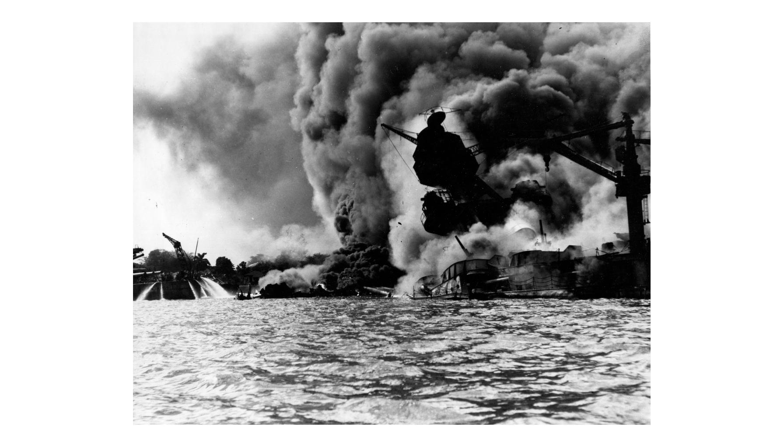
USS Arizona Burning, December 7, 1941
Note: U.S. Navy photo.
© More Lessons Less Planning | morelessonslessplanning.com
Notes:
Give the class thirty seconds of silence with the photograph before anyone speaks. Say plainly that 1,177 men died on this ship and that most of them are still aboard her.
Reference labels (point to these chart features when teaching): Forward magazine hit; Harbor still burning

Slide 9
The Cost of the Attack
Measure | Figure | Notes
Americans killed | 2,403 | Including 68 civilians
Americans wounded | 1,178 | Service members and civilians
Killed on the USS Arizona | 1,177 | Almost half of all American deaths
American ships sunk or damaged | 21 | All eight battleships present were hit
American aircraft destroyed | 188 | Most were caught on the ground
Japanese aircraft lost | 29 | Out of the 353 that attacked
Key Concept: Almost half of all American deaths came from one ship, the USS Arizona.
© More Lessons Less Planning | morelessonslessplanning.com
Notes:
Students use this exact table again in Activity Part 3. Do not solve the arithmetic for them here; just make sure they can read the rows.

Slide 10
The Attack in Four Words
Pearl Harbor
The United States Navy base on Oahu, Hawaii, attacked by Japan on December 7, 1941
Battleship Row
The line of moorings beside Ford Island where seven American battleships lay side by side
USS Arizona
The battleship destroyed when a bomb set off her forward magazine, killing 1,177 of her crew
Aircraft Carrier
A warship that launches and lands aircraft at sea; the three American carriers were away
Remember: All three American carriers were away from Pearl Harbor and survived.
© More Lessons Less Planning | morelessonslessplanning.com
Notes:
The last row is the one that decides the Pacific war. Japan sank battleships and missed the ships that mattered.

Slide 11
What the Japanese Missed
All three American carriers were away from Pearl Harbor.
The fuel tank farm held 4.5 million barrels and was untouched.
The submarine base and its torpedoes were never attacked.
The repair yards raised and rebuilt most of the damaged ships.
No third wave was sent to finish the job.
Did You Know: Of the 21 ships hit, all but three returned to service during the war.
© More Lessons Less Planning | morelessonslessplanning.com
Notes:
Admiral Nimitz later said that losing the fuel would have set the Pacific war back two years. The tanks sat in the open and were never hit.

Slide 12
America Before and After
Before December 7
After December 7
Most Americans wanted to stay out of the war
The America First Committee had 800,000 members
The House renewed the draft by 203 to 202
Aid to Britain, but no American army
Isolationism collapsed in a single morning
Recruiting offices filled the following day
Congress voted for war with one dissent
A war in the Pacific and in Europe at once
Fact: The America First Committee shut itself down within four days of the attack.
© More Lessons Less Planning | morelessonslessplanning.com
Notes:
The draft renewal vote is the number to sit on. In August 1941 the country nearly disbanded its own army; four months later it was unanimous for war.

Slide 13
The Day of Infamy Address
Roosevelt spoke to Congress at midday on December 8, 1941.
The address ran barely seven minutes from start to finish.
About 81 percent of American homes listened on the radio.
He asked Congress to declare that a state of war existed.
He did not blame the commanders at Pearl Harbor.
Did You Know: Roosevelt crossed out world history on his draft and wrote infamy by hand.
© More Lessons Less Planning | morelessonslessplanning.com
Notes:
Students read five passages from this address in Activity Part 4. Flag that now so the Activity feels like a continuation, not a new task.

Slide 14
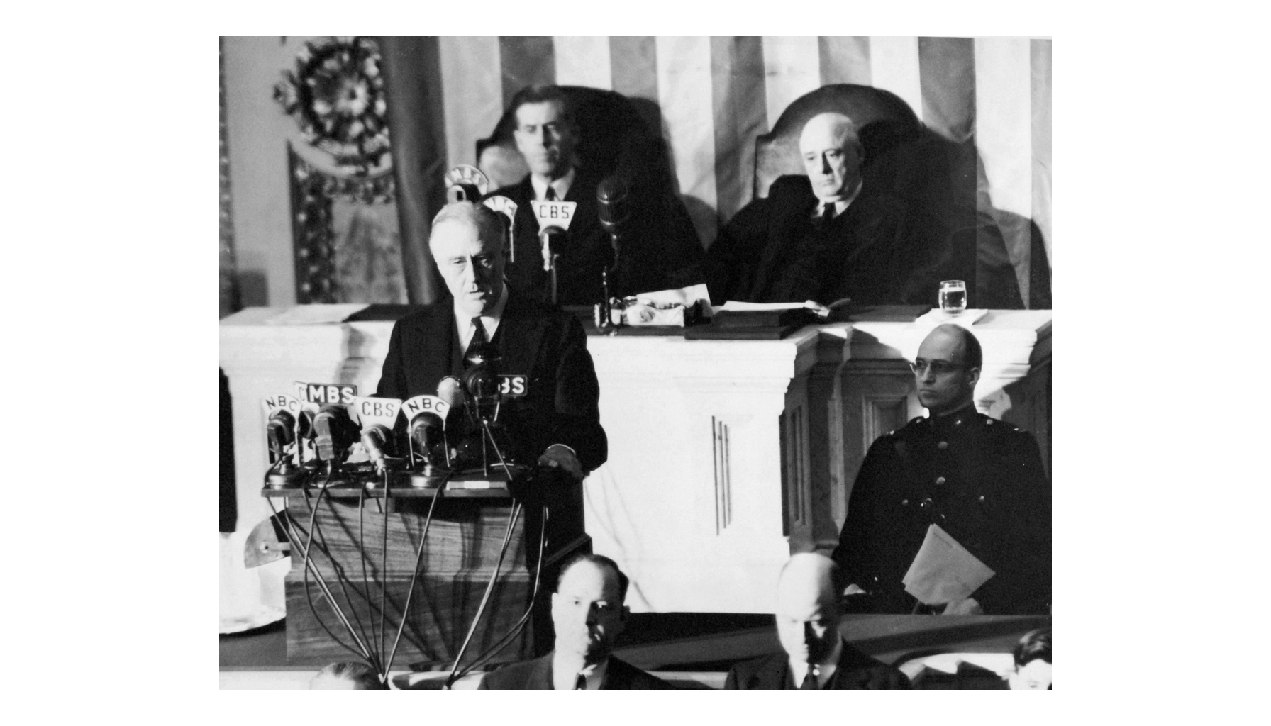
Roosevelt Asks Congress for War, December 8, 1941
Note: December 8, 1941.
© More Lessons Less Planning | morelessonslessplanning.com
Notes:
Point out that the room is full. It is called a joint session because the Senate and the House are meeting together in the House chamber; the Cabinet and the Supreme Court attended as well.
Reference labels (point to these chart features when teaching): Joint session of Congress; Reading from the address

Slide 15
The Vote for War
Vote or event | Date | Result
Senate votes on war with Japan | December 8, 1941 | 82 to 0 in favor
House votes on war with Japan | December 8, 1941 | 388 to 1 in favor
Roosevelt signs the declaration | December 8, 1941 | The United States is at war
Germany and Italy declare war | December 11, 1941 | Congress replies the same day
Note: The single no vote was Jeannette Rankin of Montana, who also voted against war in 1917.
© More Lessons Less Planning | morelessonslessplanning.com
Notes:
Rankin is worth ninety seconds. She was the first woman elected to Congress and the only member to vote against both world wars.

Slide 16
The American Answer in Three Words
Isolationism
The belief that the United States should stay out of wars fought outside the Americas
Day of Infamy
The name given to Roosevelt's December 8, 1941 address asking Congress to declare war on Japan
Declaration of War
A formal vote by Congress putting the country at war, taken on December 8, 1941
Key Concept: One attack turned the strongest argument in American politics into a dead letter.
© More Lessons Less Planning | morelessonslessplanning.com
Notes:
Isolationism did not lose an argument on December 7. It stopped being an argument at all.

Slide 17
A Country at War
Enlist and draft
More than 16 million Americans served in uniform during the war
✔
Build the weapons
Car plants and shipyards switched to tanks, aircraft, and cargo ships
✔
Ration and save
Sugar, coffee, gasoline, and rubber were rationed at home
✔
Fight two wars at once
American forces fought Japan in the Pacific and Germany in Europe
✔
Fact: American factories built about 300,000 military aircraft between 1941 and 1945.
© More Lessons Less Planning | morelessonslessplanning.com
Notes:
This slide is the bridge to the rest of Unit 13. Every later lesson depends on the production figures that start here.

Slide 18
Roosevelt Names the Day
Yesterday, December 7, 1941 — a date which will live in infamy — the United States of America was suddenly and deliberately attacked by naval and air forces of the Empire of Japan.
— Franklin D. Roosevelt, address to Congress, December 8, 1941
Roosevelt asked Congress to declare that a state of war already existed with Japan.
Remember: You will read a longer passage from this same address in Activity Part 4.
© More Lessons Less Planning | morelessonslessplanning.com
Notes:
Read the line aloud twice, once flat and once as a broadcast. The rhythm of the sentence is doing as much work as the facts in it.

Slide 19
Why December 7 Changed the War
The United States entered a war it had watched for two years.
Britain gained the ally it had needed since 1940.
The Pacific war would be fought by carriers, not battleships.
American factories became the arsenal of the Allies.
Many historians argue Japan won the morning and lost the war.
Big Idea: The attack united America faster than any argument ever could.
© More Lessons Less Planning | morelessonslessplanning.com
Notes:
Churchill wrote that on the night of December 7 he went to bed and slept the sleep of the saved. That is the sentence to leave students with.

Slide 20
Key Takeaways
Japan attacked to destroy the American fleet and seize oil in the south.
★
The attack killed 2,403 Americans and sank or damaged 21 ships.
★
Many historians say the surviving carriers, fuel, and yards won the war.
★
Roosevelt's December 8 address ended the argument over staying neutral.
★
Germany declared war on December 11, making it one global war.
★
© More Lessons Less Planning | morelessonslessplanning.com
Notes:
Ask students which takeaway they would defend in Activity Part 5. Their verdict paragraph is easier once they have picked a side out loud.

