Slide 1
Payday Loans: The 400% APR Trap
A payday loan looks cheap: borrow $300, pay back $345 in two weeks - just a $45 FEE. But that $45 fee on a 14-day loan is really about a 391% APR - far higher than a credit card (about 24%) or a personal loan (about 11%). Marcus Bell takes a $300 payday loan and cannot repay it on payday, so he ROLLS IT OVER, paying $45 again and again while the $300 never shrinks. This lesson shows how payday loans work, how to convert a flat fee to an APR, why the rollover DEBT CYCLE traps borrowers, and what safer alternatives exist.
© More Lessons Less Planning | morelessonslessplanning.com
Notes:
Open with the hook that makes this lesson matter for at-risk students: a payday loan is marketed as a small, fast fix - borrow $300, pay it back on your next payday with 'just a $45 fee.' The trap is that the fee is quoted as a flat dollar amount, not an interest rate, so borrowers never see the true cost. Students follow Marcus Bell, who borrows $300 and is charged a $45 fee for a 14-day term, owing $345 on payday. When Marcus cannot repay the $345 in two weeks, he ROLLS OVER the loan - pays another $45 fee to push the due date out - and the $300 principal never goes down. The insight students must leave with: that $45 fee converts to about a 391% APR (the '400% APR trap'), roughly 16 times a credit card's rate and 36 times a personal loan's, and the rollover DEBT CYCLE can make a $300 loan cost hundreds in fees while you still owe the original $300. Over this lesson students learn how payday loans (and title loans) work, the foundational APR formula that converts a flat fee to a yearly rate, the rollover cycle, and safer alternatives. As the sixth toolkit of Unit 5, this builds on what a loan is (TK41), how interest and APR work (TK42), auto loans (TK43), and mortgages (TK45), turning the spotlight on the most predatory loan most people will ever be offered.

Slide 2
Learning Targets
Define payday loan, title loan, APR, flat fee, and the debt cycle
★
Convert a payday loan's flat fee to an APR: (Fee / Loan) x (365 / days) x 100
★
Read a bar chart comparing a payday loan's APR to other loans
★
Explain how the rollover debt cycle traps borrowers and name safer alternatives
★
© More Lessons Less Planning | morelessonslessplanning.com
Notes:
Read the four targets aloud. Tell students the lesson follows Marcus Bell, who takes a $300 payday loan with a $45 fee for a 14-day term. Target 1 is the vocabulary: a PAYDAY LOAN is a small short-term loan due on your next payday; a TITLE LOAN uses your car as collateral; APR is the true yearly cost as a percent; a FLAT FEE is a single dollar charge that hides the real cost; the DEBT CYCLE is the trap of rolling the loan over again and again. Target 2 is the foundational calculation: converting a flat fee to an APR with APR = (Fee / Loan) x (365 / days) x 100, so students can compare a payday loan to any other loan. Target 3 is reading a bar chart that puts the payday loan's APR (about 391%) next to a credit card (about 24%) and a personal loan (about 11%). Target 4 is the understanding that protects them: the rollover DEBT CYCLE keeps the principal from ever shrinking while fees pile up, and there are cheaper alternatives. The APR formula is treated as a labeled foundational model students apply throughout.

Slide 3
The 400% APR Trap
It looks cheap
It is really ~391% APR
Marcus borrows $300 and owes $345 in 14 days - 'just a $45 FEE'
The store quotes a FLAT FEE in dollars, never an interest rate
$45 on $300 for two weeks 'feels' small and fast
So borrowers sign without knowing the true yearly cost
Convert the fee to a yearly rate (APR) to see the real cost
Marcus's $45 fee on $300 for 14 days = about a 391% APR
That is about 16x a credit card (~24%) and 36x a personal loan (~11%)
The 'small fee' is one of the most expensive loans you can take
Key Concept: A payday FLAT FEE hides the cost. Marcus's $45 fee on a $300, 14-day loan is really about a 391% APR - the 400% APR trap.
© More Lessons Less Planning | morelessonslessplanning.com
Notes:
Frame the whole lesson with the central trap. A payday loan is sold as cheap and simple: Marcus Bell borrows $300 and agrees to pay back $345 on his next payday - 'just a $45 fee.' The store quotes the cost as a FLAT FEE in dollars, never as an interest rate, so the loan feels small and fast. The trap is that $45 on a $300 loan for only 14 days, when you convert it to a yearly rate, is about a 391% APR - the '400% APR trap.' Make the comparison concrete: a typical credit card is about 24% APR and a typical personal loan is about 11% APR, so Marcus's payday loan is roughly 16 times a credit card's rate and 36 times a personal loan's rate. The reason borrowers fall for it is exactly that the fee is quoted in dollars, not as an APR - the next slides teach how to convert a flat fee to an APR so students can see (and compare) the true cost. The following slide shows the comparison as a bar chart: the payday bar towers over the credit-card and personal-loan bars.

Slide 4
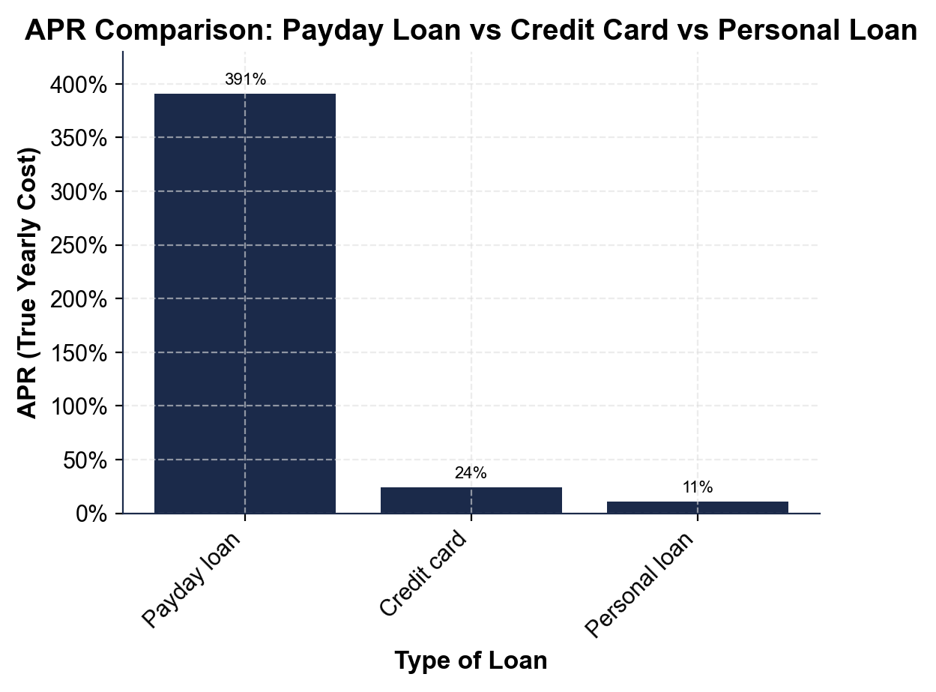
APR Comparison: Payday Loan vs Credit Card vs Personal Loan
The payday loan's APR towers over a credit card and a personal loan.
© More Lessons Less Planning | morelessonslessplanning.com
Notes:
Have students read the bar chart. The x-axis lists three borrowing options - payday loan, credit card, and personal loan - and the y-axis is the APR (the true yearly cost as a percent). The payday-loan bar is about 391% (Marcus's $300 / $45 / 14-day loan), the credit-card bar is about 24%, and the personal-loan bar is about 11%. The picture makes the lesson obvious: the payday bar TOWERS over the other two - it is roughly 16 times the height of the credit-card bar and 36 times the personal-loan bar. The credit-card and personal-loan APRs are typical/representative rates (labeled approximate); the payday APR is the verified 391% students will calculate themselves later in the lesson. This is the chart Activity Part 3 reads. Point out that all three are ways to borrow money - the only difference the chart shows is how much each one really costs per year.
Reference labels (point to these chart features when teaching): Payday ~391%; Card ~24%, Personal ~11%

Slide 5
How Payday Loans Work
Small amount, short term, car collateral
A PAYDAY LOAN is a small loan ($100-$500) due on your next payday (about 14 days); a TITLE LOAN uses your car as COLLATERAL
✔
You pay a flat fee, not a rate
The lender charges a FLAT FEE in dollars (Marcus: $45 on a $300 loan) instead of quoting an interest rate, so the cost looks small
✔
You owe it all at once
The whole amount is due on payday: Marcus owes $300 + $45 = $345 in 14 days, not small monthly payments like other loans
✔
Easy to get, hard to repay
No credit check makes it easy to get, but repaying $345 out of one paycheck is hard - which is what leads to rolling the loan over
✔
Key Concept: COLLATERAL is an asset, such as a car, pledged to secure a loan; the lender can take it if you do not repay - a title loan's risk.
© More Lessons Less Planning | morelessonslessplanning.com
Notes:
Teach the mechanics so the rest of the lesson makes sense. A PAYDAY LOAN is a small loan, often $100 to $500, due in full on your next payday - usually about 14 days away. A TITLE LOAN is the close cousin: same idea, but it uses your car as COLLATERAL - an asset pledged to secure a loan - so if you cannot repay, the lender can take your car. Instead of an interest rate, the lender charges a FLAT FEE in dollars: Marcus borrows $300 and is charged a $45 fee, so he owes $300 + $45 = $345. The whole $345 is due at once on payday - there are no small monthly payments like an auto loan or mortgage. Payday lenders usually do no credit check and hand over cash fast, which is why people in a tight spot use them. But that is also the trap: repaying the entire $345 out of a single paycheck is hard, and when a borrower cannot, they roll the loan over (taught two slides from now). Stress the two things that make payday loans different from the loans in earlier toolkits: the cost is a flat fee, not a quoted rate, and the whole balance is due at once on a very short term.

Slide 6
The Flat-Fee Disguise
Why the fee fools people
See it as a yearly rate
A FLAT FEE is a fixed dollar charge for the loan, not a percentage
It is a fixed charge, not a percentage of the loan amount you borrow
$45 on $300 is a 15% FLAT FEE - just for 14 days, not a year
The fee hides the true yearly cost until you convert it to an APR
To compare loans fairly, convert the fee to an APR (a yearly rate)
The same 15% charged every 14 days, all year, is a huge yearly cost
15% x 26 periods is about 391% per year - not 15%
Always ask for the APR, not just the dollar fee
Key Concept: A FLAT FEE is a fixed dollar charge, not a percentage of the loan. Marcus's $45 on $300 is a 15% fee for 14 days - about a 391% APR.
© More Lessons Less Planning | morelessonslessplanning.com
Notes:
Expose the disguise that makes payday loans work. The lender quotes the cost as a FLAT FEE in dollars - $45 - which hides two things. First, as a rate, $45 on a $300 loan is a 15% fee (45 / 300 = 0.15 = 15%). Second, and this is the key, that 15% is only for the 14-day term, NOT for a year. Fifteen percent 'sounds' like an ordinary interest rate, but a normal APR is for a whole year, while this 15% is charged for just two weeks. To compare a payday loan fairly with a credit card or a personal loan, you have to put it on the same yearly footing - convert it to an APR. The bridge students need: there are about 26 fourteen-day periods in a year (365 / 14 = 26.07). If you were charged that same 15% fee every 14 days all year long, the yearly cost is roughly 15% x 26, which is about 391% - not 15%. That is why the flat fee is a disguise: the small dollar amount and the 'only 15%' both hide a triple-digit APR. The rule students should take away: never judge a short-term loan by its dollar fee - always convert it to an APR, which the next slide does step by step.

Slide 7
Converting the Fee to APR
The foundational APR formula
APR = (Fee / Loan Amount) x (365 / Loan Term in days) x 100. The Fee/Loan part is the flat fee rate; the 365/days part scales it to a full year
Step 1 - flat fee rate
Fee / Loan = $45 / $300 = 0.15 (a 15% fee for the 14-day term)
Step 2 - scale to a year
365 / Loan Term in days = 365 / 14 = 26.07 (about 26 fourteen-day periods in a year)
Step 3 - multiply and convert
APR = 0.15 x 26.07 x 100 = about 391% - Marcus's '$45 fee' is really a 391% APR loan
Key Concept (FOUNDATIONAL MODEL): APR = (Fee / Loan) x (365 / days) x 100. For Marcus: 0.15 x 26.07 x 100 = about 391% APR.
© More Lessons Less Planning | morelessonslessplanning.com
Notes:
This is the calculation slide and the heart of the lesson. Teach the foundational model explicitly: to convert any short-term flat fee into a yearly rate, APR = (Fee / Loan Amount) x (365 / Loan Term in days) x 100. Explain each factor. The first factor, Fee / Loan Amount, is the FLAT FEE RATE - what fraction of the loan the fee is for this one term. The second factor, 365 / Loan Term in days, scales that single-term rate up to a full year by counting how many such terms fit in 365 days. Multiplying by 100 turns the decimal into a percent. Now walk Marcus's loan step by step. Step 1, the flat fee rate: Fee / Loan = $45 / $300 = 0.15, a 15% fee for the 14-day term. Step 2, scale to a year: 365 / 14 = 26.07, meaning about 26 fourteen-day periods fit in a year. Step 3, multiply and convert: APR = 0.15 x 26.07 x 100 = about 391%. So Marcus's '$45 fee on $300' is really a 391% APR loan. Stress the pattern students must carry into the Activity: a shorter term (smaller number of days) makes 365/days bigger, which pushes the APR even higher for the same fee rate - so the very short payday term is part of what makes the APR so brutal. Treat the formula as a labeled foundational model, like the simple-interest and monthly-payment models from earlier toolkits.

Slide 8
The Rollover Debt Cycle
Marcus cannot repay $345
On payday Marcus owes the whole $345 at once, but he cannot spare it - so the lender offers to ROLL OVER the loan
A rollover buys time, not progress
A ROLLOVER means extending the payday loan by paying a new $45 fee, which restarts the loan and adds more cost while the $300 PRINCIPAL does not shrink
The fees pile up
The PRINCIPAL is the amount you originally borrow ($300); when the loan is rolled over the principal does not shrink while fees pile up - $225 after 5 rollovers
This is the debt cycle
The DEBT CYCLE is being stuck paying fee after fee while the loan never shrinks - $225 in fees on a $300 loan that is still fully owed
Key Concept: A ROLLOVER pays a new $45 fee, but the $300 PRINCIPAL never shrinks - 5 rollovers cost $225 in fees, still owing $300.
© More Lessons Less Planning | morelessonslessplanning.com
Notes:
Teach the mechanism that turns a one-time loan into a trap. On payday, Marcus owes the entire $345 at once, but if he pays it he will be short again - and often he simply cannot spare $345 out of one paycheck. So the lender offers a ROLLOVER: pay just the $45 fee again to extend the due date by another 14 days. The crucial point students must see: a rollover buys TIME, not PROGRESS. The $45 fee keeps the loan open, but the $300 PRINCIPAL does not go down at all - Marcus still owes the full $300 after paying the fee. Walk the cycle as a running total. After rollover 1, Marcus has paid $45 in rollover fees and still owes $300. After rollover 2, $90 in fees, still owes $300. Keep going: rollover 3 is $135, rollover 4 is $180, and rollover 5 is $225 in rollover fees - and he STILL owes the original $300. So a $300 loan has now cost $225 in fees (or $270 counting the first $45 fee) with zero progress on the balance. That is the DEBT CYCLE: stuck paying fee after fee while the loan never shrinks. This is why payday loans are so dangerous - the high APR is not just a number; the rollover structure makes it very easy to pay far more in fees than you ever borrowed and still owe the whole thing. Use the small rollover table on the slide so students can SEE the fees climb while the $300 stays flat.

Slide 9
Alternatives to Payday Loans
Credit-union small-dollar loan
Many credit unions offer small short-term loans at a capped APR (often 28% or less) - dramatically cheaper than a payday loan's ~391%
✔
Ask for a payment plan
Call the biller (utility, medical, rent) and ask for a payment plan or an extension; many will work with you for little or no fee
✔
Paycheck advance from an employer
Some employers or apps let you draw earned pay early for a small or no fee instead of borrowing at a high APR
✔
Build a small emergency fund
Even $300-$500 saved means you never need a payday loan; the best fix is to avoid the emergency borrow in the first place
✔
Key Concept: Cheaper than a payday loan: a credit-union small-dollar loan (often 28% or less), a payment plan, or an emergency fund.
© More Lessons Less Planning | morelessonslessplanning.com
Notes:
Give students real, doable alternatives so the lesson ends with a way out, not just a warning. First, a credit-union small-dollar loan: many credit unions offer small, short-term loans with a capped APR - often 28% or less - which is dramatically cheaper than a payday loan's ~391%, and they report to credit bureaus so they can build credit. Second, ask for a payment plan or extension: if the cash crunch is a bill (a utility, a medical bill, rent), calling the biller and asking for a payment plan is often free or low-cost and avoids borrowing at all. Third, a paycheck advance: some employers, and some apps, let workers draw pay they have already earned a little early for a small fee or none - far cheaper than a payday loan. Fourth, and best of all, a small emergency fund: even $300 to $500 saved means a flat tire or a surprise bill never forces a high-APR loan. Tie it back to the unit: the whole reason to understand APR and the debt cycle is so that, when money is tight, students reach for one of these instead of the payday store. Emphasize that needing money fast is real and common - the goal is not to shame anyone, but to make sure they know the cheaper options exist before they sign a 391% loan.

Slide 10
Calculate the APR of a Payday Loan
Steps to find the APR
Worked: borrow $400, $60 fee, 10-day term
Step 1: flat fee rate = Fee / Loan Amount (as a decimal)
Step 2: period factor = 365 / Loan Term in days
Step 3: APR = Step 1 x Step 2 x 100 (a percent)
Shorter term (fewer days) = bigger 365/days = higher APR
Flat fee rate = $60 / $400 = 0.15 (a 15% fee)
Period factor = 365 / 10 = 36.5
APR = 0.15 x 36.5 x 100 = about 548%
Same 15% fee, shorter term -> even higher APR than Marcus's 391%
Key Concept: APR = (Fee / Loan) x (365 / days) x 100. A $60 fee on $400 for 10 days = 0.15 x 36.5 x 100 = about 548% - worse than Marcus's loan.
© More Lessons Less Planning | morelessonslessplanning.com
Notes:
Give students a clean, repeatable procedure and a fresh worked example they will mirror in the Activity. Lay out the foundational model once more as steps: Step 1, find the flat fee rate by dividing the Fee by the Loan Amount (keep it as a decimal); Step 2, find the period factor by dividing 365 by the Loan Term in days; Step 3, multiply Step 1 by Step 2 by 100 to get the APR as a percent. Then work a brand-new loan so students see the steps on different numbers - a borrower takes $400 with a $60 fee for a 10-day term. Step 1: flat fee rate = $60 / $400 = 0.15 (a 15% fee, the same rate as Marcus). Step 2: period factor = 365 / 10 = 36.5 (ten-day periods in a year). Step 3: APR = 0.15 x 36.5 x 100 = about 548%. Drive home the pattern: the fee rate is the SAME 15% as Marcus's loan, but because the term is shorter (10 days instead of 14), the period factor is bigger (36.5 instead of 26.07), so the APR is even higher - about 548% versus 391%. The shorter the term, the worse the APR for the same fee rate. This is exactly the calculate-the-APR task students do for Marcus's loan and other loans in Part 4. Remind them: always convert the flat fee to an APR before deciding.

Slide 11
Key Takeaways
A PAYDAY LOAN is a small, short-term loan due on payday for a FLAT FEE
★
Convert the fee to a rate: APR = (Fee / Loan) x (365 / days) x 100
★
Marcus's $45 fee on a $300, 14-day loan is really about a 391% APR
★
A ROLLOVER pays a new fee but the principal never shrinks - the DEBT CYCLE
★
Cheaper options exist: credit-union loans, payment plans, an emergency fund
★
© More Lessons Less Planning | morelessonslessplanning.com
Notes:
Read each takeaway and connect it to the learning targets. T1 (define) -> a PAYDAY LOAN is a small, short-term loan due in full on your next payday for a FLAT FEE in dollars (a TITLE LOAN is the same but backed by your car); the cost is quoted as a dollar fee, which hides the true rate. T2 (calculate) -> to see the real cost, convert the flat fee to a yearly rate with the foundational model APR = (Fee / Loan) x (365 / days) x 100; the first factor is the flat fee rate, the second scales it to a year. T2/T3 (the result) -> Marcus's $45 fee on a $300 loan for 14 days is about a 391% APR, roughly 16x a credit card (~24%) and 36x a personal loan (~11%) - the bar chart makes the gap visible. T4 (the trap) -> a ROLLOVER pays a new $45 fee to extend the due date, but the $300 PRINCIPAL never shrinks, so the fees pile up ($225 after 5 rollovers, still owing $300) - that is the DEBT CYCLE. T4 (the way out) -> cheaper alternatives exist: a credit-union small-dollar loan (often 28% or less), a payment plan from the biller, an employer paycheck advance, or a small emergency fund. The spine of the lesson: a payday loan's small fee disguises a triple-digit APR, and the rollover structure traps borrowers - so always convert the fee to an APR and reach for a cheaper option first. As the sixth toolkit of Unit 5, this builds on what a loan is (TK41), interest and APR (TK42), auto loans (TK43), and mortgages (TK45), focusing on the most predatory loan students are likely to be offered.

