Slide 1
Pandemic Economics: COVID's Lasting Impact
How a Pandemic Reshaped the Global Economy in 5 Years - and the 1929 and 2008 Lessons That Drove the Response
© More Lessons Less Planning | morelessonslessplanning.com
Notes:
Open by asking students what they remember about March 2020. Most will remember school closing, family events canceled, parents working from home. Tell them: the pandemic also caused the sharpest single-quarter GDP collapse in modern records (-9.1% in Q2 2020), the largest stimulus response in U.S. history (over $5 trillion = 25% of one year of GDP), and the highest inflation since 1981. This is the CAPSTONE of Unit 10 - it pulls together every concept: recession measurement, monetary policy, fiscal stimulus, supply and demand, inflation, unemployment, externalities. The 1929 (TK 99) and 2008 (TK 91) playbooks were applied here in real time.

Slide 2
Learning Targets
Trace the COVID economic impact 2020-2024
★
Identify lasting changes (remote work, supply chains, inflation)
★
Evaluate the policy response across the cycle
★
© More Lessons Less Planning | morelessonslessplanning.com
Notes:
Read each target aloud. Tell students they will leave able to explain why the COVID recession was so short (the fastest recession-to-recovery cycle in U.S. history), name the four lasting changes (remote work, supply-chain reshoring, inflation surge, Fed rate hikes), and evaluate the policy response by comparing it to the 1929 and 2008 playbooks.

Slide 3
March 2020: The Sharpest Recession Ever
March 2020
Lockdowns begin - non-essential business shut nationwide
✔
Q2 2020
Real GDP fell 9.1% - sharpest quarterly drop in modern records
✔
April 2020
Unemployment hit 14.7% - highest since the Great Depression
✔
Initial claims
6.9 million in one week - 24x the pre-pandemic peak
✔
NBER duration
Just 2 months - the shortest recession in NBER history
✔
Big Idea: The pandemic recession was unique - sharpest, fastest, and shortest. The depth was historic; the duration was not.
© More Lessons Less Planning | morelessonslessplanning.com
Notes:
Walk the timeline. March 2020 lockdowns triggered an instant recession. GDP fell 9.1% in Q2 2020 - the sharpest single-quarter drop in modern records. Unemployment shot to 14.7% in April 2020 - the highest since the Great Depression (cross-link TK 99 and TK 73). Initial unemployment claims hit 6.9 million in one week - 24x the pre-pandemic peak. But the NBER (National Bureau of Economic Research) called the recession over in just 2 months - the shortest in their history. The recession was historic in DEPTH, not in DURATION. Key term - Lockdown: Government-mandated stay-at-home orders that began in mid-March 2020; closed non-essential businesses, schools, and travel and triggered the sharpest quarterly GDP drop in modern records. Key term - COVID-19 recession: The two-quarter U.S. recession of Q1-Q2 2020; the sharpest single-quarter GDP contraction in modern records and the shortest NBER recession in history at just 2 months.

Slide 4
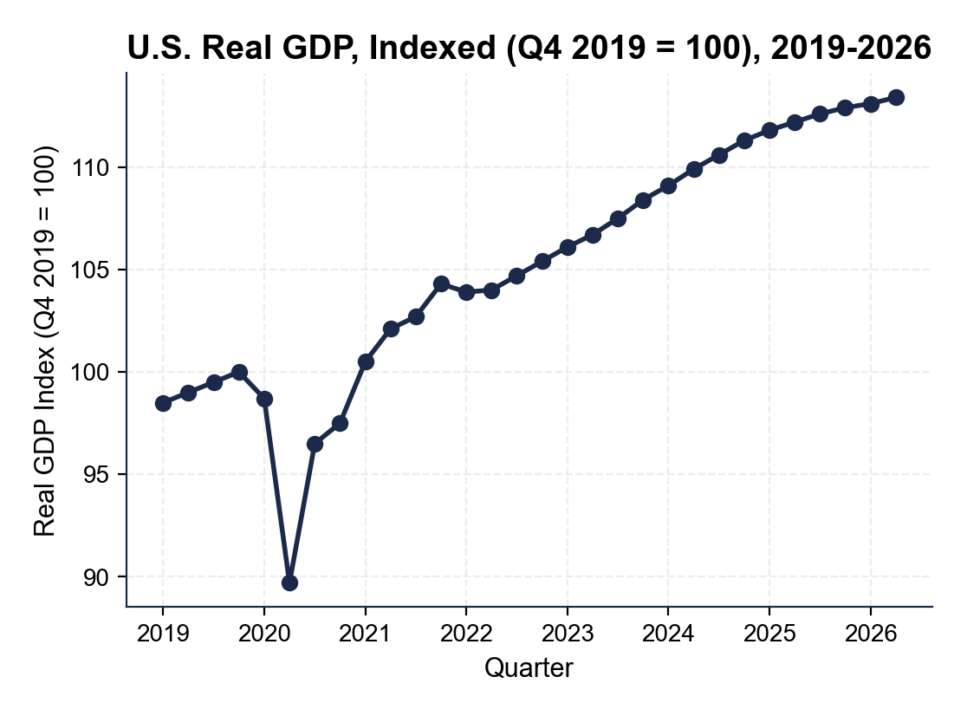
U.S. Real GDP: 2019-2026 (Indexed Q4 2019 = 100)
Note: GDP fell 9.1% to 89.7 in Q2 2020; recovered Q1 2021.
© More Lessons Less Planning | morelessonslessplanning.com
Notes:
Have students point to Q4 2019 (index 100), Q2 2020 (index 89.7 - the trough), and Q1 2021 (index 100.5 - recovery). Walk the curve: nearly flat through 2019, sharp dip in Q1 2020, collapse to 89.7 in Q2 2020, then a steep V-shape recovery through Q3-Q4 2020 and into Q1 2021. By 2026 the index reaches about 113 - meaning the U.S. economy is about 13% larger than it was right before COVID.
Reference labels (point to these chart features when teaching): Q2 2020 trough: 89.7; Q1 2021 recovery: 100.5

Slide 5
The Unprecedented Stimulus Response
Fiscal: Over $5 Trillion in 12 Months
Monetary: Zero Rates + QE
CARES Act 2020 - $2.2 trillion
December 2020 deal - $900 billion
American Rescue Plan 2021 - $1.9 trillion
Paycheck Protection Program (PPP) - $800B
Fed cut rates to 0-0.25% in March 2020
Fed balance sheet $4.2T to 9 trillion via QE
Direct corporate-bond purchases (a first)
Same playbook as 2008 - much faster
Real Talk: Total stimulus was about 25% of one year of 2020 GDP - bigger than the New Deal as a share of GDP and 5x larger than 2008 TARP.
© More Lessons Less Planning | morelessonslessplanning.com
Notes:
Walk through both columns. FISCAL: total stimulus across CARES Act ($2.2T March 2020), December 2020 deal ($900B), and ARP ($1.9T March 2021) reached over $5T - about 25% of one year of 2020 GDP. PPP loans alone added $800B. MONETARY: the Fed cut rates from 1.5% to 0-0.25% in two weeks (faster than 2008), launched unlimited QE, and bought corporate bonds for the first time ever. Cross-link TK 99: New Deal was about 50% of one year of 1939 GDP spread over 6 years. Cross-link TK 91: TARP 2008 was about 5% of 2008 GDP. The COVID response was the LARGEST counter-cyclical stimulus in U.S. history as a share of GDP. Key term - Quantitative easing (QE): Large-scale Federal Reserve purchases of Treasury and mortgage bonds; expanded the Fed balance sheet from $4.2 trillion to about $9 trillion between 2020 and 2022. Key term - CARES Act: The $2.2 trillion stimulus law signed in March 2020; included $1,200 checks, expanded unemployment, and Paycheck Protection Program (PPP) loans for small businesses. Key term - American Rescue Plan (ARP): The $1.9 trillion stimulus law signed in March 2021; included $1,400 checks and the expanded Child Tax Credit and took total pandemic stimulus over $5 trillion.

Slide 6
The 2021 Recovery Rocket
Q1 2021
Real GDP regained pre-pandemic level (index 100.5) - just 9 months after the trough
Unemployment
Fell from 14.7% (Apr 2020) to 3.9% (Dec 2021) - the fastest labor market recovery on record
Stock market
S&P 500 gained 27% in 2021 alone after Q1 2020 crash and rapid 2020 rebound
Vaccine rollout
First doses December 2020; broad availability April 2021 reopened the service economy
Pent-up demand
Stimulus + savings + reopening drove consumption back above pre-pandemic trend
Big Idea: The fastest recession-to-recovery cycle in U.S. history. Vaccines reopened services; stimulus put money in pockets; demand surged.
© More Lessons Less Planning | morelessonslessplanning.com
Notes:
The 2020-2021 cycle was unprecedented in speed. Q1 2021 GDP regained the pre-pandemic level - just 9 months from trough. Unemployment fell from 14.7% (April 2020) to 3.9% (December 2021) - the fastest labor recovery on record. Compare to 2008-2010: GDP took 4 years to recover; unemployment took 7+ years (TK 91). Compare to 1929-1939: GDP took 7 years and unemployment never recovered until WWII (TK 99). The combination of vaccine availability (April 2021), $5T+ in stimulus, and pent-up consumer demand created a recovery rocket. The downside was inflation - covered next slide.

Slide 7
Supply Chain Crisis 2021-2022
March 2021 Suez Canal block - Ever Given grounded for 6 days
Port of LA backlog peaked at 109 ships waiting in October 2021
Semiconductor shortage cut auto production by 7.7M vehicles in 2021
Container shipping rates spiked 5-10x above pre-pandemic
GSCPI hit +4.3 standard deviations - the all-time peak
Key Concept: A demand-stimulated economy hit a supply-constrained world. The mismatch produced inflation.
© More Lessons Less Planning | morelessonslessplanning.com
Notes:
The 2021-2022 supply chain crisis was a once-in-a-generation event. Specific shocks: the Ever Given grounded in the Suez Canal for 6 days in March 2021, blocking 12% of global trade; Port of LA had 109 ships waiting at peak in October 2021 (vs typical 0-1); semiconductor shortage cut auto production by 7.7 million vehicles in 2021; shipping container rates from China to the U.S. West Coast spiked from about $1,500 (pre-pandemic) to $20,000+ at peak. The NY Fed Global Supply Chain Pressure Index (GSCPI) hit +4.3 standard deviations - more than 4x any prior reading in the series. Stimulus put money into consumer pockets just as supply chains broke. The mismatch produced inflation - the next slide.

Slide 8
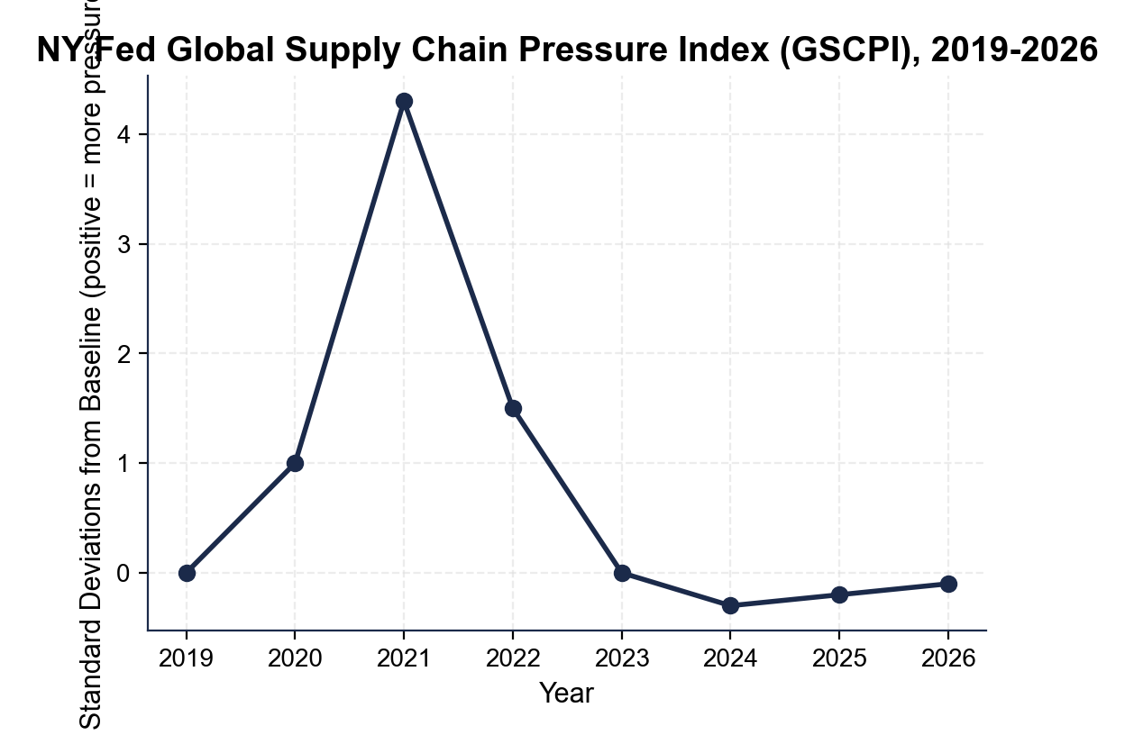
Global Supply Chain Pressure Index: 2019-2026
Note: GSCPI peaked at +4.3 in 2021 - all-time high.
© More Lessons Less Planning | morelessonslessplanning.com
Notes:
Have students point to 2019 (near 0), 2021 (peak at +4.3), and 2023 (back near 0). Walk the curve: flat through 2019, modest rise in 2020 to +1.0, dramatic spike to +4.3 in late 2021, decline through 2022 to +1.5 by year-end, near zero by 2023, and slightly below zero through 2024-2026. The 2021 peak is more than 4x larger than any prior reading. The chart visualizes why pandemic inflation was supply-driven: when supply chains broke this severely, prices had to rise.
Reference labels (point to these chart features when teaching): 2019: 0.0; 2021 peak: +4.3

Slide 9
The Inflation Surge 2021-2024
June 2022 peak
CPI hit 9.1% YoY - the highest inflation since November 1981
Three drivers
Supply chain shock + stimulus demand + energy prices (Russia/Ukraine 2022)
Fed response
Funds rate raised from 0-0.25% to 5.25-5.50% by July 2023 - fastest cycle since 1980-81
'Transitory' framing failed
Fed dropped the term in November 2021 and pivoted to aggressive hiking
By end-2024
CPI back near 2.5%; soft landing achieved without recession
Important: The Fed's transitory call in 2021 was the biggest forecasting error of the cycle - it cost about 6 months of late hiking.
© More Lessons Less Planning | morelessonslessplanning.com
Notes:
CPI inflation peaked at 9.1% YoY in June 2022 - the highest since November 1981. Three drivers: supply chain shock (GSCPI peak), stimulus-driven demand surge, and energy prices (Russia invaded Ukraine February 2022, oil spiked above $120/barrel). Fed initially called inflation TRANSITORY in 2021; dropped the term in November 2021 and pivoted to the most aggressive hiking cycle since the 1980s - funds rate from 0-0.25% to 5.25-5.50% in 16 months. Cross-link TK 76 (Fed) and TK 91 (2008 vs 2020 monetary cycles). By end-2024, CPI was back near 2.5% (Fed target 2%). Most economists predicted recession from 2022 hikes - it never came. SOFT LANDING achieved. Key term - CPI inflation: Year-over-year change in the Consumer Price Index; peaked at 9.1% in June 2022, the highest reading since 1981, and drove the Fed's rate-hike cycle. Key term - Federal funds rate: The interest rate banks charge each other for overnight lending; the Fed raised it from 0-0.25% to 5.25-5.50% between March 2022 and July 2023, the fastest hiking cycle in 40 years. Key term - Transitory inflation: The Federal Reserve's 2021 framing that the inflation surge would be temporary as supply chains normalized; the Fed dropped the term in November 2021 as prices kept rising.

Slide 10
Remote Work as Permanent Shift
What Changed
Why It Stuck
Pre-pandemic remote share: about 5%
April 2020 peak: about 60%
Settled by 2024: about 30% hybrid
Office workers most affected
Workers prefer hybrid (90%+ in surveys)
Productivity stayed flat or improved
Companies cut commercial real estate
Geographic flexibility for hiring
Big Idea: Remote work survived the return-to-office push. The 25 percentage-point step-change is the largest workforce shift in any modern decade.
© More Lessons Less Planning | morelessonslessplanning.com
Notes:
Remote work was about 5% pre-pandemic. April 2020 peak: about 60% (lockdowns). Settled by 2024 at about 30% hybrid - a 25 percentage-point step change from baseline. Why it stuck: 90%+ of office workers prefer hybrid in surveys; productivity studies generally show flat-to-positive effects; companies cut commercial real estate (NYC, SF vacancy >20% by 2024); geographic flexibility for hiring (you can hire in lower-cost cities). The return-to-office push 2022-2024 was real but never reversed the step-change. Compare to historical workforce shifts: agriculture-to-manufacturing (50 years), manufacturing-to-services (40 years). Remote work happened in 5 years. Key term - Remote work: Performing job duties from home rather than the employer location; it surged during the 2020 lockdowns and settled into a permanent hybrid pattern that reshaped offices and commercial real estate by 2024.

Slide 11
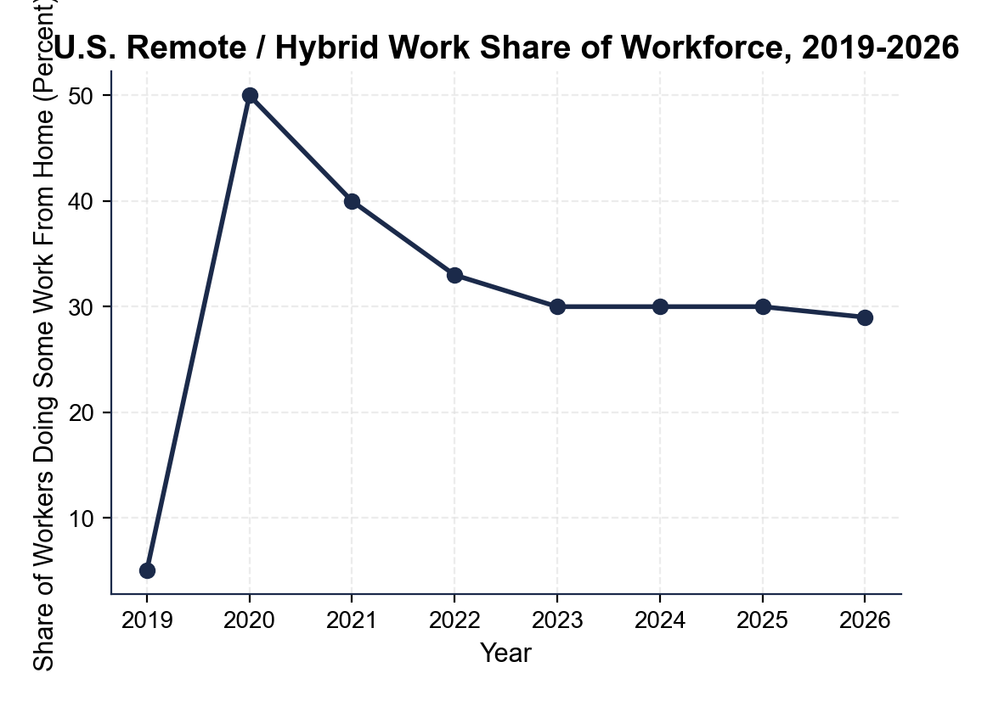
Remote / Hybrid Work Share: 2019-2026
Note: Remote share: 5% to 30% hybrid - a permanent 25-pt shift.
© More Lessons Less Planning | morelessonslessplanning.com
Notes:
Have students point to 2019 (5%), 2020 (50% annual), and 2024 (30% settled). Walk the curve: flat at 5% in 2019, sharp jump to 50% annual average in 2020 (60% peak in April), gradual decline through 2021 and 2022, settle near 30% by 2023-2024, hold steady through 2026. The chart shows the step change is permanent. Compare to other workforce shifts: women in the labor force rose from 33% in 1948 to 60% in 2000 (52 years for a 27-percentage-point change). Remote work hit a 25-percentage-point change in less than 5 years.
Reference labels (point to these chart features when teaching): 2019: 5%; 2024 settled: 30%

Slide 12
Takeaways and What's Still Changing
Stimulus size matters
$5T+ kept the recession to 2 months - the 1929 and 2008 playbooks worked at scale
Supply matters too
Demand stimulus into broken supply chains caused the worst inflation since 1981
Soft landing achieved
Fed hikes 2022-2023 cooled inflation without triggering recession - rare in U.S. history
Reshoring is here
CHIPS Act ($52B) and IRA ($370B) shift U.S. industrial policy (cross-link TK 95)
Remote work is permanent
30% hybrid share is the new baseline; commercial real estate still adjusting
Big Idea: The pandemic accelerated changes that were already underway - and locked them in. The economy of 2026 is structurally different from 2019.
© More Lessons Less Planning | morelessonslessplanning.com
Notes:
Walk through each takeaway. STIMULUS SIZE: the response worked - 2 months of recession instead of years. SUPPLY MATTERS: demand-side stimulus alone is not enough when supply chains break. SOFT LANDING: the Fed's 2022-2023 hiking cycle is a major Fed policy success - hiked 525 basis points without causing recession. RESHORING: CHIPS Act ($280B total, $52B chip subsidies) and IRA ($370B climate, cross-link TK 95) reflect a new industrial-policy posture. REMOTE WORK: 30% hybrid share is permanent. The economy of 2026 is structurally different from 2019. Key term - Inflation Reduction Act (IRA): The $370 billion 2022 climate and clean-energy law; part of the post-pandemic reshoring push alongside the CHIPS Act, and also let Medicare negotiate drug prices.

Slide 13
Key Takeaways
GDP fell 9.1% in Q2 2020 (sharpest ever) and recovered by Q1 2021
★
Total stimulus exceeded $5 trillion (~25% of GDP) - largest in U.S. history
★
Inflation peaked at 9.1% in June 2022 - highest since November 1981
★
Fed funds rose 0% to 5.25-5.50% in 16 months - fastest cycle since 1980-81
★
Remote work settled at 30% hybrid - a permanent 25 percentage-point shift
★
© More Lessons Less Planning | morelessonslessplanning.com
Notes:
Read each takeaway. Connect back to the learning targets. Capstone synthesis: the pandemic recession applied the 1929 (TK 99) and 2008 (TK 91) playbooks at unprecedented speed and scale. The 1929 lesson - counter-cyclical stimulus and lender-of-last-resort - was applied within weeks. The 2008 lesson - aggressive fiscal AND monetary - was applied at 5x the scale. The new lesson from 2020-2024: supply matters too. Demand-side stimulus into broken supply chains caused inflation. The CHIPS Act and IRA are the forward-looking reshoring response. End by connecting to the activity briefing memo - students will be Dr. Vasquez at the CEA preparing the 5-year retrospective.

