Slide 1
Outsourcing: Jobs, Costs & Consequences
Four waves of outsourcing - manufacturing, customer service, software, AI - and what they cost American workers
© More Lessons Less Planning | morelessonslessplanning.com
Notes:
Open with the four waves. Most students associate 'outsourcing' with 1990s-2000s manufacturing - the closed steel mill, the empty factory. That was Wave 1. Three more waves followed: customer service to India and the Philippines (Wave 2, 2000s), software development (Wave 3, 2010s), and now AI replacing knowledge work (Wave 4, 2020s). Today we trace each wave, count the jobs, and look at what's coming next. By the end of class students should be able to explain (1) why companies outsource (labor arbitrage), (2) which wave hit which workers, and (3) how AI is the next wave - and the first one that doesn't require a foreign country at all.

Slide 2
Learning Targets
Define OUTSOURCING and trace its FOUR WAVES
★
Identify each wave's JOB IMPACT on U.S. workers
★
Evaluate the AI wave: consumer gains vs displacement
★
© More Lessons Less Planning | morelessonslessplanning.com
Notes:
Read each target aloud. Connect target 1 to the four definition slides and the timeline chart; target 2 to the costs-to-U.S.-workers slide and the bar chart; target 3 to the consumer-benefits slide and the activity policy recommendation. Tell students: today's lesson is the closing toolkit of Unit 9 (International Trade). Tariffs, NAFTA, trade deficits, sanctions, and currency exchange were all about goods crossing borders. Outsourcing is about JOBS crossing borders - and the AI wave is about jobs being eliminated entirely without crossing any border at all.

Slide 3
What Is Outsourcing?
Definition
Why Companies Do It
Moving work a company used to do IN-HOUSE to OUTSIDE workers
OFFSHORING = outsourcing to another COUNTRY
ONSHORING / RESHORING = bringing the work back
Driven by LABOR ARBITRAGE - cheaper wages abroad
U.S. wages are higher than in India, Philippines, China
Same work, lower cost = bigger profit
Consumers get LOWER prices on goods and services
U.S. workers lose jobs in the affected sector
Key Concept: OFFSHORING moves the work abroad. The driver is LABOR ARBITRAGE - paying less for the same work.
© More Lessons Less Planning | morelessonslessplanning.com
Notes:
Anchor the definition. OUTSOURCING is when a company moves work it used to do in-house to outside workers or contractors. OFFSHORING is the specific case where the outside workers are in another country. ONSHORING (or RESHORING) is bringing work back to the home country. The economic driver is LABOR ARBITRAGE - paying $5,000/year for a Filipino call-center worker instead of $35,000/year for a U.S. one. The same work, much cheaper. The consumer wins (cheaper goods, cheaper services), the company wins (higher profit), but U.S. workers in the affected sector lose their jobs. This trade-off is the central theme of today's lesson and the Unit 9 closer.

Slide 4
Wave 1: Manufacturing to Asia (1980s-2000s)
1980s-1990s - Light manufacturing leaves first
Textiles, apparel, footwear to Asia; NAFTA shifts autos and electronics to Mexico
✔
2001 - China joins the WTO (CHINA SHOCK begins)
Tariffs on Chinese goods drop sharply; manufacturing offshoring to China accelerates
✔
2001-2010 - ~2.4 MILLION total U.S. jobs lost
China-shock decade: manufacturing plus local-labor-market spillover (Autor/Dorn/Hanson)
✔
Result: jobs fell 17M to <12M
Rust Belt cities (Cleveland, Detroit, Pittsburgh) hardest hit; many never recovered
✔
Big Idea: Wave 1 hit hardest. The 2001 CHINA SHOCK alone cost ~2.4 million total U.S. jobs (mfg plus spillover), 2001-2010.
© More Lessons Less Planning | morelessonslessplanning.com
Notes:
Wave 1 was manufacturing offshoring, the largest wave by job count. It started in the 1980s with low-skill labor-intensive goods (apparel, footwear, textiles) moving to Mexico and then to Asia. NAFTA (1994) accelerated the shift to Mexico for autos and electronics. The 2001 China shock - when China joined the WTO and tariffs dropped sharply - was the inflection point. The MIT economist David Autor's landmark research estimated 2.4 million TOTAL U.S. jobs (manufacturing plus local-labor-market spillover) lost to the China shock in the decade after WTO accession (Autor/Dorn/Hanson). U.S. manufacturing employment fell from about 17 million in 2000 to under 12 million by 2010. The Rust Belt cities (Cleveland, Detroit, Pittsburgh, Buffalo) saw the steepest declines. Many of those jobs never came back - the factories were torn down or repurposed. Today, U.S. manufacturing employment is around 12.8 million, still well below the 2000 peak.

Slide 5
Wave 2: Customer Service to India and the Philippines (2000s)
Early 2000s - call centers offshore
Customer service, tech support, billing, and back-office work shift to India and the Philippines
Why these two countries
Both have large English-speaking workforces; Philippines especially neutral accent; India strong technical skills
The wage gap
U.S. call-center pay: ~$35,000; Filipino pay: ~$5,000—a seven-to-one labor gap.
Companies that offshored
Dell, AT&T, American Express, Citibank, IBM - calls in the 2000s-2010s often went to Manila or Bangalore
Industry name - BPO
Business Process Outsourcing. Philippines BPO employs ~1.3 million; India BPO employs ~4.5 million
Tip: Wave 2 moved SERVICES not goods. A 7-to-1 wage gap made call centers irresistible to U.S. companies.
© More Lessons Less Planning | morelessonslessplanning.com
Notes:
Wave 2 was services, primarily call centers and back-office work, moving to India and the Philippines in the 2000s. The driver was the same as Wave 1 - labor arbitrage - but now applied to white-collar service work instead of factory work. A U.S. call-center worker earned about $35,000/year; a Filipino call-center worker earned about $5,000/year. That 7-to-1 wage gap made offshoring irresistible. The Philippines became the global capital of call-center work because Filipinos speak nearly accent-neutral American English (a legacy of U.S. colonial-era education). India dominated technical support and back-office processing (Bangalore especially). The industry got a name - BPO (Business Process Outsourcing) - and grew into millions of jobs. When you called Dell tech support in 2008 or AT&T billing in 2012, you were almost certainly talking to Manila or Bangalore. The U.S. lost an estimated 500,000-1.5 million customer-service and back-office jobs to this wave.

Slide 6
Wave 3: Software Development to India and Eastern Europe (2010s)
Aspect | Detail | Why it matters
When and where | 2010s; Bangalore, Hyderabad, Krakow, Kyiv, Bucharest | Engineering work is digital - crosses borders instantly
Talent pipeline | Indian engineering universities: ~1.5M grads/year | Massive supply of trained engineers at low cost
The wage gap | U.S. dev ~$120k vs Indian dev ~$15k = 8-to-1 | Same labor arbitrage logic as Wave 2, but on higher-paid work
What moved offshore | Routine coding, QA testing, IT support, mobile apps | Rule-based, predictable tasks travel best
What stayed in the U.S. | Senior architecture, AI/ML research, customer-facing work | Judgment-heavy and on-site work stays
Did You Know? Bangalore is now the world's second-largest tech hub by employment - bigger than Silicon Valley by headcount.
© More Lessons Less Planning | morelessonslessplanning.com
Notes:
Wave 3 was software and IT, moving to India (Bangalore, Hyderabad) and Eastern Europe (Poland, Ukraine, Romania) in the 2010s. The economic logic was identical to Wave 2 - labor arbitrage on cognitive work - but now applied to a much higher-paid profession. A U.S. software engineer earned about $120,000/year; an Indian software engineer of comparable skill earned about $15,000/year. That 8-to-1 wage gap drew Microsoft, IBM, Oracle, Google, and almost every major U.S. tech firm to open large offshore offices. Bangalore is now the world's second-largest tech hub by employment, bigger than Silicon Valley by headcount. What got offshored: routine coding, QA testing, IT support, maintenance of legacy systems. What stayed: senior architecture, product design, cutting-edge AI/ML research, on-site customer-facing work. The U.S. tech sector kept growing in absolute terms during Wave 3 - but the GROWTH disproportionately happened offshore. About 300,000-500,000 U.S. tech jobs are estimated to have been displaced.

Slide 7
Wave 4: AI-Driven Knowledge Work (2020s)
2022 - Generative AI arrives
What is getting AI-replaced
Estimated U.S. impact
ChatGPT launched Nov 2022
GitHub Copilot, Claude, Midjourney follow
AI now does jobs humans used to do
First wave that needs no foreign country
Paralegal research and basic legal work
Copywriting and basic journalism
Customer-support chat (first level)
Basic coding, transcription, translation
Goldman Sachs (2023): ~300M jobs exposed globally
About 6-7% of U.S. workers could be displaced by 2030
Exposure reaches high-skill as well as lower-skill work
Big Idea: Unlike earlier waves, AI can eliminate work without moving it abroad.
© More Lessons Less Planning | morelessonslessplanning.com
Notes:
Wave 4 is fundamentally different from the first three. Waves 1, 2, and 3 all moved work to a cheaper foreign country - manufacturing to China, call centers to the Philippines, software to India. Wave 4 doesn't require any foreign country at all. AI - generative AI specifically, starting with ChatGPT in November 2022 - eliminates the work itself. A copywriter who used to bill $80/hour for ad copy is now competing with ChatGPT, which produces draft copy for cents per query. A junior software developer doing routine coding is competing with GitHub Copilot, which generates code from natural-language prompts. A paralegal doing legal research is competing with Claude or specialized legal AI. The Goldman Sachs Global Economics report (March 26, 2023) estimated ~300 million jobs globally exposed to AI automation and projected up to 7% of the U.S. workforce displaced over 10 years; the lesson uses ~6-7% by 2030 as the derived figure. Unlike Waves 1-3, this wave hits HIGH-skill knowledge workers as much as or MORE than low-skill workers (Goldman Sachs and follow-on research find white-collar exposure is higher). The lesson's central question: what comes next for displaced workers?

Slide 8
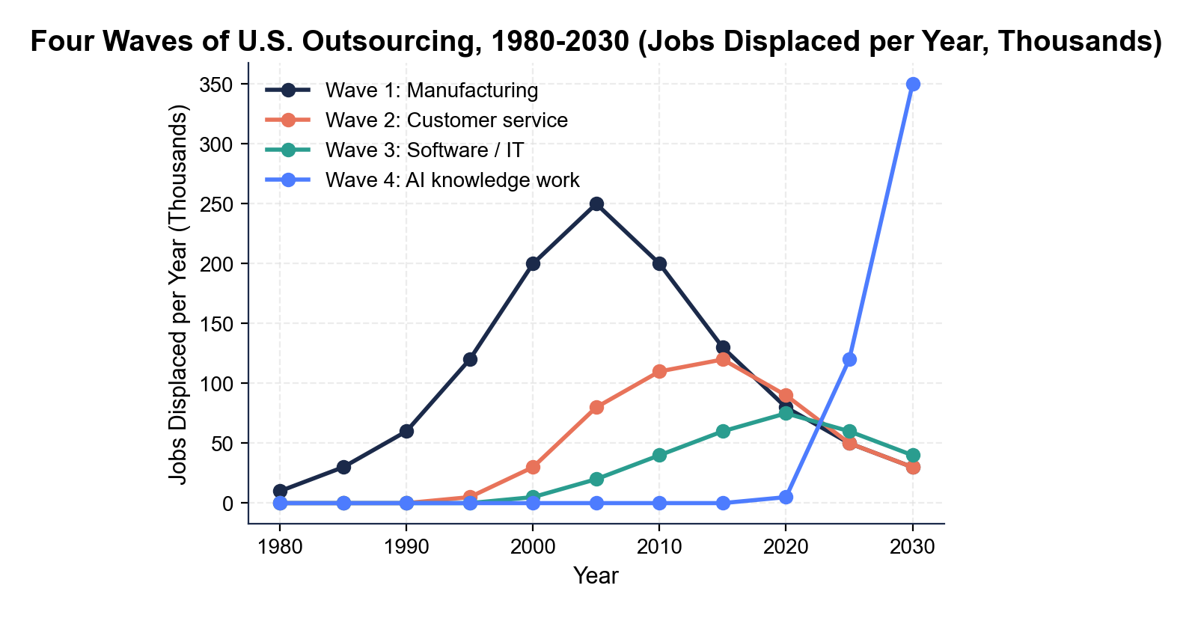
Four Waves of Outsourcing Over Time
Note: Each wave peaks ~10-15 years apart; AI rises steepest.
© More Lessons Less Planning | morelessonslessplanning.com
Notes:
Read the chart left to right. Wave 1 (manufacturing, navy line) rises from 1980, peaks around 2005 in the wake of the China shock, then declines as most movable factory work has already left. Wave 2 (customer service, coral line) rises from 2000, peaks around 2015 when the Philippines BPO industry hits its full size. Wave 3 (software, teal line) rises from 2010, peaks around 2020 (accept 2020-2023 from chart). Wave 4 (AI-driven knowledge work, solid blue line) rises sharply from 2022 onward - the steepest curve on the chart - with no peak yet visible. The chart's takeaway: outsourcing is not a one-time event but a recurring economic force. Each wave hits a different category of workers; the wave never really ends, it just moves to the next category.
Reference labels (point to these chart features when teaching): Wave 1 peak: ~2005; Wave 4 rising: 2022 onward

Slide 9
The Costs to U.S. Workers
Manufacturing job losses (Wave 1)
Manufacturing employment fell from 17M (2000) to ~12M (2010); the China shock cost ~2.4M total U.S. jobs
Service job displacement (Wave 2)
~500,000 to 1.5 million U.S. call-center and back-office jobs moved offshore in the 2000s
Software job displacement (Wave 3)
~300,000 to 500,000 U.S. routine-coding and IT-support jobs moved to India and Eastern Europe
AI displacement (Wave 4, projected)
Goldman Sachs: ~300M jobs globally exposed; ~6-7% of U.S. workforce displaced by 2030
Wage stagnation in displaced regions
Rust Belt wages fell 10-20% vs the national average (2000-2015); many never recovered
Tip: Outsourcing's job costs are CONCENTRATED in specific regions and worker categories - even when the national economy grows.
© More Lessons Less Planning | morelessonslessplanning.com
Notes:
The job costs of outsourcing are CONCENTRATED, not distributed evenly. Wave 1 hit manufacturing communities hardest - the Rust Belt cities where steel mills, auto plants, and electronics factories closed. David Autor's research found that workers displaced by the China shock often never recovered comparable pay; they took lower-paid service jobs, went on disability, or left the workforce entirely. Wave 2 hit call-center workers in mid-sized U.S. cities (Omaha, Tampa, San Antonio) where BPO companies had built large U.S. operations before offshoring. Wave 3 hit junior software developers and IT support workers, often in mid-tier tech markets. Wave 4 is hitting knowledge workers across U.S. metros - paralegals in New York, copywriters in Los Angeles, customer-support agents everywhere. The total displaced is in the millions. Wage stagnation followed: Rust Belt cities saw wages fall 10-20% relative to the national average from 2000-2015. The lesson teaches the trade-off: consumers won, but workers in the affected sectors paid the cost.

Slide 10
The Consumer Benefits
Cheaper goods (Wave 1)
Clothing, electronics, furniture, toys, appliances all got dramatically cheaper
Real-world example
A flat-screen TV that cost $5,000 in 2000 costs ~$300 in 2024 - mostly offshored manufacturing
Cheaper services (Wave 2)
24/7 customer support became standard - companies could staff support lines around the clock
Cheaper software (Wave 3)
Apps and SaaS are cheaper - developers cost 1/8 as much in Bangalore as San Francisco
AI productivity gains (Wave 4)
AI tools let one worker do the job of 3-5; products get cheaper, faster, more abundant
Big Idea: Every wave made goods CHEAPER. Gains spread across ~330M consumers; costs hit fewer workers hard.
© More Lessons Less Planning | morelessonslessplanning.com
Notes:
Outsourcing made consumer goods and services cheaper - that's the other side of the trade-off. A flat-screen TV that cost $5,000 in 2000 costs about $300 in 2024 - most of that price drop is offshored manufacturing in Asia. Cars, clothing, electronics, furniture, toys all dropped in real price between 2000 and 2020. Wave 2 gave consumers 24/7 customer support that companies couldn't have afforded at U.S. wages. Wave 3 made software cheaper - apps you use daily (banking, streaming, social media) are partially built in Bangalore. Wave 4 is making AI-augmented services dramatically cheaper - one writer with ChatGPT can produce what a team of three used to produce. The consumer benefits are spread across all ~330 million U.S. consumers. The job costs are concentrated on a smaller number of displaced workers in specific sectors. This is the central economic trade-off of outsourcing: many people gain a little, fewer people lose a lot. Whether the gain outweighs the loss is the policy debate.

Slide 11
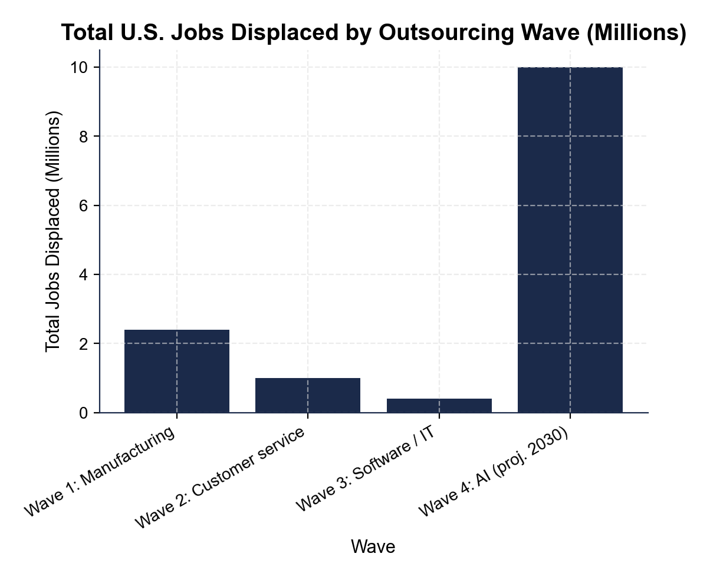
U.S. Jobs Outsourced by Wave
Note: Manufacturing is biggest so far; AI projected largest.
© More Lessons Less Planning | morelessonslessplanning.com
Notes:
Read the bar chart left to right. Wave 1 (manufacturing) is the tallest bar at about 2.4 million U.S. jobs displaced (Autor/Dorn/Hanson China-shock estimate, total U.S. employment effect, 2001-2010). Wave 2 (customer service) is shorter at about 1 million jobs - the midpoint of the 500K-1.5M range. Wave 3 (software/IT) is about 400,000 jobs - the midpoint of the 300K-500K range. Wave 4 (AI-displaced knowledge work, projected) is shown at about 10 million by 2030 - a DERIVED projection from Goldman Sachs Global Economics report (March 26, 2023; "up to 7%% over 10 years" framing applied to the U.S. labor force); NOT a Goldman direct quote - the largest projected wave, though uncertain. The chart's lesson: manufacturing was the biggest in absolute terms, but AI is projected to dwarf the earlier waves IF the projections hold. Students should read the chart to identify which wave is biggest, which is smallest, and where the projections suggest the future is going.
Reference labels (point to these chart features when teaching): Wave 1: ~2.4M total U.S. jobs; Wave 4: ~10M (projected)

Slide 12
Where the Next Wave Goes
Jobs AI Will Likely Replace
Jobs AI Will Likely NOT Replace
Routine writing - copywriting, basic journalism, summaries
Routine coding - boilerplate, simple websites, scripts
Customer support chat - first-level inquiries
Paralegal research, basic translation, transcription
Non-routine PHYSICAL work - plumbers, electricians, nurses
In-person services - childcare, elder care, dental hygienists
Senior creative + strategic work - architects, executives
Skilled trades requiring on-site judgment
Key Concept: ROUTINE tasks (rule-based) go offshore or to AI. NON-ROUTINE tasks (judgment, in-person, physical) stay.
© More Lessons Less Planning | morelessonslessplanning.com
Notes:
The pattern across all four waves is ROUTINE versus NON-ROUTINE. ROUTINE tasks are rule-based, predictable, and can be specified step-by-step. Routine factory work went to China in Wave 1. Routine customer-service scripts went to the Philippines in Wave 2. Routine coding went to India in Wave 3. Routine writing, drawing, summarizing, and coding are now going to AI in Wave 4. NON-ROUTINE tasks - those requiring judgment, in-person presence, or physical dexterity - have stayed in the U.S. across all four waves. A plumber still has to physically be at a leaking pipe. A nurse still has to be at the patient's bedside. A senior architect still has to make judgment calls a junior architect cannot. The lesson's takeaway for students entering the workforce: pick non-routine work, or pick the wave (AI-augmented worker, not AI-replaced worker). The activity Part 5 will ask students to write a memo recommending a career strategy in light of all four waves. In short: a ROUTINE TASK follows clear rules and can be done step-by-step, so it is easiest to outsource or automate, while a NON-ROUTINE TASK requires judgment, creativity, or in-person presence and is hardest to outsource.

Slide 13
Key Takeaways
FOUR WAVES of outsourcing: manufacturing, service, software, AI
★
Each wave is driven by LABOR ARBITRAGE - paying less for the same work
★
Wave 1 cost ~2.4M total U.S. jobs (mfg + spillover) to the 2001-2010 China shock
★
Gains spread to 330M consumers; costs hit displaced workers hard
★
Wave 4 (AI) is the first wave with NO foreign country needed
★
© More Lessons Less Planning | morelessonslessplanning.com
Notes:
Read each takeaway. Connect back to learning targets. Target 1 (define + trace four waves): takeaways 1-2 establish the four waves and the labor arbitrage driver. Target 2 (job impacts): takeaway 3 quantifies Wave 1's hit on manufacturing. Target 3 (consumer benefits vs displacement): takeaway 4 names the trade-off, takeaway 5 names the new feature of Wave 4. The activity Part 5 policy memo will ask students to weigh the trade-off explicitly and recommend a strategy for displaced workers.

