Slide 1
Origins of the Cold War
From Allies to Adversaries: Yalta to the Warsaw Pact, 1945-1955
© More Lessons Less Planning | morelessonslessplanning.com
Notes:
Open with the puzzle the whole lesson answers: the United States and the Soviet Union won a world war on the same side, and within four years they were arming against each other.

Slide 2
Learning Targets
Explain why the U.S.-Soviet wartime alliance broke apart after 1945.
★
Describe how the Soviet Union built a bloc of satellite states.
★
Define containment and explain the strategy behind it.
★
Explain what the Truman Doctrine promised and what triggered it.
★
Explain how the Marshall Plan used economic aid as a Cold War tool.
★
Describe how Berlin, NATO, and the Warsaw Pact split Europe in two.
★
© More Lessons Less Planning | morelessonslessplanning.com
Notes:
Point at target one and tell students the whole lesson is an answer to that single question: why did the alliance break?

Slide 3
Allies of Convenience
The U.S., Britain, and the Soviet Union fought Nazi Germany together.
They shared one goal: defeating Hitler, not building a shared future.
The United States was a capitalist democracy.
The Soviet Union was a communist dictatorship under Joseph Stalin.
Once Germany fell in 1945, the common enemy that held them together was gone.
Key Concept: The alliance was built on a shared enemy, not on shared values.
© More Lessons Less Planning | morelessonslessplanning.com
Notes:
Do not let students assume the alliance was warm. It was a working arrangement between governments that distrusted each other before, during, and after the war.

Slide 4
Yalta, February 1945: Promises Made
Who met
Roosevelt, Churchill, and Stalin, in Soviet Crimea
✔
Germany
Agreed to divide defeated Germany into occupation zones
✔
Eastern Europe
Stalin promised free elections in the liberated countries
✔
New organization
Agreed to create the United Nations
✔
Note: Yalta produced promises, not enforcement. Nothing bound Stalin to keep them.
© More Lessons Less Planning | morelessonslessplanning.com
Notes:
The key detail is the gap between what was agreed and what could be enforced. The Red Army was already standing in the countries whose elections were being promised.

Slide 5
Potsdam, July 1945: Promises Broken
Roosevelt had died in April; Truman took his place at the table.
Churchill was voted out mid-conference and replaced by Attlee.
Soviet troops already occupied most of Eastern Europe.
Stalin refused to allow genuinely free elections in Poland.
Truman left Potsdam convinced Stalin could not be trusted.
Did You Know? Truman learned the atomic bomb test had worked while he was at Potsdam.
© More Lessons Less Planning | morelessonslessplanning.com
Notes:
Five months separate Yalta from Potsdam, and in those five months two of the three leaders changed and the promise about free elections quietly died.

Slide 6
Words to Know: From Alliance to Rivalry
Cold War
The postwar rivalry between the United States and the Soviet Union, fought through aid, alliances, and proxy wars
Iron Curtain
The dividing line between Soviet-controlled Eastern Europe and the democratic West, named by Churchill in 1946
Containment
The U.S. strategy of stopping communism from spreading beyond where it already existed, rather than rolling it back
Satellite State
An Eastern European country that kept its own name and borders but whose government answered to Moscow
Remember: You will use all four of these words again in the Activity packet.
© More Lessons Less Planning | morelessonslessplanning.com
Notes:
Read each definition aloud once and move on. Containment is the one to slow down on; the whole second half of the deck is an illustration of it.

Slide 7
The Iron Curtain Falls Across Eastern Europe
Poland, Hungary, Romania, Bulgaria, and Albania fell under Soviet control.
Each kept its own name and flag but answered to Moscow.
Communists took power through rigged votes, arrests, and pressure.
Czechoslovakia was the last to fall, in a coup in February 1948.
Churchill gave the Iron Curtain its name in a 1946 speech.
Warning: A satellite state was not annexed. It was controlled from a distance.
© More Lessons Less Planning | morelessonslessplanning.com
Notes:
Stress the mechanism, not just the outcome. Most of these takeovers came from inside rather than by invasion, and in most cases the Red Army was present - but not everywhere. Soviet troops were never in Albania, whose communists won power through the wartime partisan movement, and they had withdrawn from Czechoslovakia in December 1945, more than two years before the February 1948 coup.

Slide 8
Greece and Turkey in Crisis, 1947
Greece
Civil war between the government and communist-led rebels
✔
Turkey
Soviet pressure for a share of control over the straits
✔
Britain
Broke, and told Washington it could no longer pay for either
✔
The question
Would the United States step into Britain's place?
✔
Key Concept: Britain's withdrawal forced the United States to decide how far it would go.
© More Lessons Less Planning | morelessonslessplanning.com
Notes:
This slide is the setup for the Truman Doctrine. Students need the crisis before they can judge the response.

Slide 9
The Truman Doctrine, March 12, 1947
Truman went before a joint session of Congress to ask for aid.
He said the U.S. must support free peoples resisting attempted subjugation.
He framed the world as a choice between two ways of life.
Congress approved the aid for Greece and Turkey.
The speech set the pattern for U.S. Cold War policy for decades.
Key Concept: Aid to two countries became a promise to the whole world.
© More Lessons Less Planning | morelessonslessplanning.com
Notes:
The critical move is the jump from a specific request to a universal principle. Truman asked for money for two countries and justified it with a rule that could apply anywhere.

Slide 10
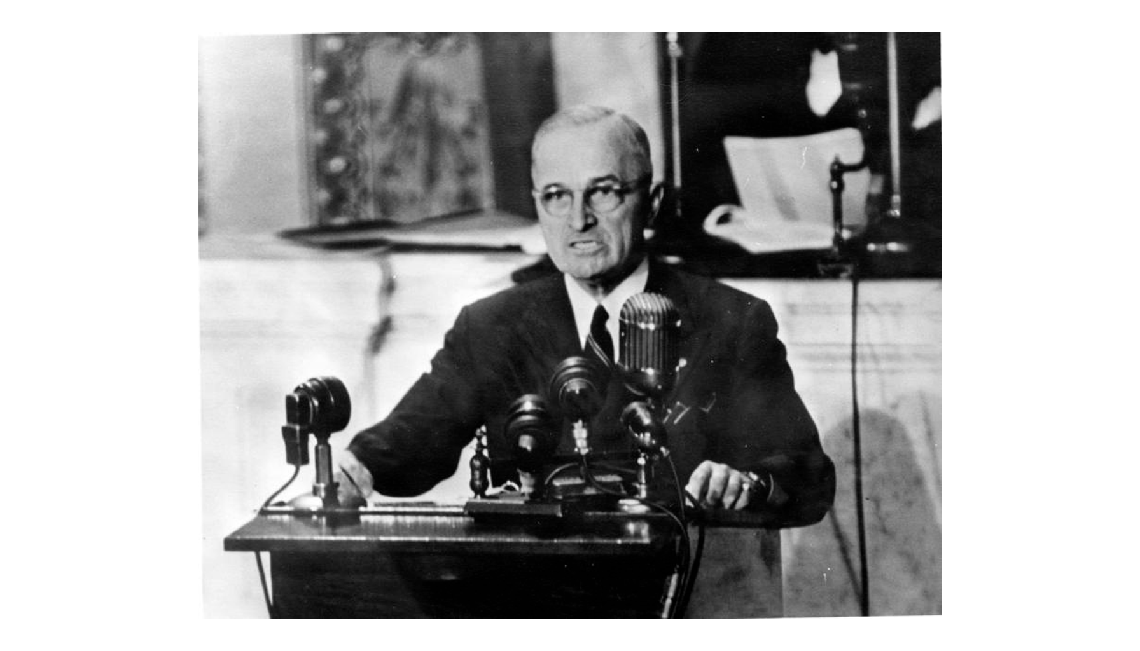
Truman Addresses Congress, March 12, 1947
Note: U.S. gov. photo.
© More Lessons Less Planning | morelessonslessplanning.com
Notes:
Give the class a few silent seconds with the photograph. Then point out the wall of microphones: this request was aimed past Congress at the country listening on the radio.
Reference labels (point to these chart features when teaching): Truman at the rostrum; Bank of radio microphones

Slide 11
Words to Know: The American Response
Truman Doctrine
Truman's March 12, 1947 pledge that the United States would support free peoples resisting attempted subjugation
Marshall Plan
The U.S. aid program, announced in June 1947, that rebuilt Western Europe's economies so communism would not take hold
Berlin Blockade
The Soviet cutoff of every road, rail, and canal route into West Berlin, meant to force the Western powers out
Note: These three terms are the American answer to the problem in the last four slides.
© More Lessons Less Planning | morelessonslessplanning.com
Notes:
Read each definition aloud once. All three of these are containment in practice; the next slides show each one working.

Slide 12
Containment: The Strategy Behind the Doctrine
Where the Idea Came From
What Containment Meant
Diplomat George Kennan warned Washington in 1946.
He argued Soviet expansion could be blocked.
His 1947 article named the strategy publicly.
Stop communism spreading past where it exists.
Use aid and alliances before using armies.
Accept the Soviet bloc; do not roll it back.
Note: Containment was a limit as much as a commitment. Hold the line, do not invade.
© More Lessons Less Planning | morelessonslessplanning.com
Notes:
Students often assume the U.S. goal was to destroy communism. It was not, at least not by force. Containment is a strategy of patience.

Slide 13
The Marshall Plan, 1948-1952
$13.3 billion
16
U.S. aid sent to Western Europe
Countries that received the aid
Announced by: Secretary of State George Marshall, June 1947
Goal: Rebuild economies so communism would not take hold
Soviet answer: Stalin forced the Eastern bloc to refuse the aid
Did You Know? The Soviet Union was invited to join the Marshall Plan and turned it down.
© More Lessons Less Planning | morelessonslessplanning.com
Notes:
The Soviet refusal is the point worth dwelling on. The offer was open to them, and rejecting it hardened the split that the plan is often blamed for creating.

Slide 14
Germany Splits, Berlin Is Trapped
Germany was still divided into four occupation zones after the war.
Berlin sat deep inside the Soviet zone but was split four ways too.
In 1948 the Western powers merged their zones and issued a new currency.
Stalin saw a rebuilt western Germany as a direct threat.
He cut off every road, rail, and canal route into West Berlin.
Key Concept: Berlin was the one place where the two blocs touched face to face.
© More Lessons Less Planning | morelessonslessplanning.com
Notes:
Make sure students can picture the geography: West Berlin was an island of Western occupation more than a hundred miles inside Soviet-controlled territory.

Slide 15
The Berlin Airlift
277,569
2.3 million
Flights into the blockaded city
Tons of cargo delivered by air
Blockade: June 24, 1948 to May 12, 1949
Cargo: Food, coal, and medicine flown in around the clock
Why not force: Driving a convoy through risked starting a shooting war
Fun Fact: Some pilots dropped candy on small handmade parachutes for children below.
© More Lessons Less Planning | morelessonslessplanning.com
Notes:
This is containment working exactly as designed: the West held the line without firing a shot, and the Soviets ended the crisis themselves.

Slide 16
Words to Know: Two Armed Camps
Berlin Airlift
The Western operation that supplied West Berlin entirely by air rather than abandon the city or fight through
NATO
The North Atlantic Treaty Organization, the 1949 alliance in which an attack on one member is an attack on all
Warsaw Pact
The 1955 alliance of the Soviet Union and its satellite states, formed after West Germany joined NATO
Remember: These last three terms complete the ten-term Reference Guide in your Activity.
© More Lessons Less Planning | morelessonslessplanning.com
Notes:
Read each definition aloud once. NATO and the Warsaw Pact are the permanent structures the crisis left behind.

Slide 17
NATO and the Warsaw Pact
NATO, 1949
Twelve Western nations pledge that an attack on one is an attack on all
✔
Why it mattered
The U.S. joined a peacetime military alliance for the first time
✔
Warsaw Pact, 1955
The USSR and its satellites answer with an alliance of their own
✔
The trigger
West Germany was admitted to NATO in May 1955
✔
Note: Each side built its alliance because the other side already had one.
© More Lessons Less Planning | morelessonslessplanning.com
Notes:
Point at the six-year gap. NATO came first, in 1949; the Warsaw Pact followed in 1955, and the immediate trigger was West Germany joining NATO.

Slide 18
Two Blocs, One Divided Europe
Feature | Western Bloc | Soviet Bloc
Leading power | United States | Soviet Union
Economy | Capitalism and private business | State-run communism
Government | Elections with rival parties | One-party rule
Aid program | Marshall Plan, 1948 | Comecon, 1949
Military alliance | NATO, 1949 | Warsaw Pact, 1955
Key Concept: By 1955 almost every European country sat on one side of this table or the other.
© More Lessons Less Planning | morelessonslessplanning.com
Notes:
This table is the summary students rebuild themselves in Activity Part 3, so read it across the rows rather than down the columns.

Slide 19
Why the Alliance Broke
Each side read the other's defensive moves as aggression.
The Soviets wanted a buffer zone after two invasions from the west.
Americans saw that buffer zone as the conquest of free nations.
Neither side wanted another shooting war so soon after 1945.
So the fight moved to aid, alliances, propaganda, and proxy conflicts.
Remember: A cold war is still a war. It just uses different weapons.
© More Lessons Less Planning | morelessonslessplanning.com
Notes:
End on the interpretive question rather than a verdict. Students argue it themselves in Activity Part 5, so do not hand them your answer here.

Slide 20
Key Takeaways
The alliance held together because of a shared enemy, and ended with it.
★
Yalta promised free elections; Eastern Europe got satellite states.
★
Containment meant stopping communism, not rolling it back by force.
★
The Truman Doctrine and Marshall Plan turned containment into policy.
★
Berlin, NATO, and the Warsaw Pact left Europe in two armed blocs.
★
© More Lessons Less Planning | morelessonslessplanning.com
Notes:
Close by returning to the opening puzzle: allies in 1945, adversaries by 1949, two armed camps by 1955.

