Slide 1
Oligopoly: When a Few Dominate
A few firms, a lot of coordination - why oligopoly prices stay sticky and why it matters.
© More Lessons Less Planning | morelessonslessplanning.com
Notes:
Open with the Unit 3 spectrum. TK 21 (Perfect Competition) was many sellers, identical product, price-takers. TK 22 (Monopoly) was one seller, no substitutes, price-maker. Today is the MIDDLE GROUND: a small handful of firms that ARE interdependent - each firm's choices depend on what rivals will do. The real wireless carrier example will run through the entire lesson.

Slide 2
Learning Targets
Define OLIGOPOLY using its four features and the four-firm concentration ratio
★
Apply game theory - read a prisoner's dilemma payoff matrix and find Nash
★
Read a KINKED DEMAND CURVE and explain why oligopoly prices stay sticky
★
© More Lessons Less Planning | morelessonslessplanning.com
Notes:
Read the three targets aloud. Target 1 is the structural definition. Target 2 is the technical core. Target 3 is the pricing implication.

Slide 3
The Unit 3 Spectrum: Where Does Oligopoly Sit?
From PC to Monopoly
Real U.S. Oligopolies (Live Today)
PC (TK 21): MANY sellers, identical product, free entry
Monopolistic Comp: many sellers, differentiated product
OLIGOPOLY (TK 23): FEW sellers, high barriers, interdependent
Monopoly (TK 22): ONE seller, no substitutes, total power
Wireless carriers - Verizon, AT&T, T-Mobile (96% market share)
Commercial airlines - American, Delta, United, Southwest
Soft drinks - Coca-Cola, PepsiCo, Keurig Dr Pepper
Athletic footwear - Nike, Adidas, Skechers, Puma
Big Idea: Oligopoly is the most COMMON real market structure for big U.S. consumer industries - the middle ground between PC and monopoly.
© More Lessons Less Planning | morelessonslessplanning.com
Notes:
Place oligopoly on the spectrum. Use the real industry list to ground the model. Wireless carriers and airlines will be the two running examples.

Slide 4
The Four Defining Features of Oligopoly
1. Few sellers
A SMALL number of large firms (typically 4-10) dominate the market; measured by the four-firm concentration ratio (CR4 > 40% suggests oligopoly)
2. High barriers to entry
Enormous capital requirements, brand recognition, government regulation, network effects, or patents block new firms - the same barrier types as monopoly
3. Interdependence
Each firm's pricing/output decisions depend on what rivals will do; this is the NEW feature unique to oligopoly - game theory applies
4. Differentiated OR homogeneous products
Some oligopolies sell differentiated products (cars, smartphones, soft drinks); others sell nearly identical products (steel, oil, gasoline) - both still oligopoly
Key Concept: Unlike monopoly, oligopoly has MULTIPLE firms that must GUESS what rivals will do. That is why GAME THEORY applies.
© More Lessons Less Planning | morelessonslessplanning.com
Notes:
Walk all four features. Feature 3 (interdependence) is the new idea - the others overlap with monopoly. Drill that interdependence is what makes game theory necessary.

Slide 5
Feature 1: Few Sellers (and How We Measure It)
The CR4 Threshold Rules
U.S. Industry CR4 (2024 estimates)
CR4 < 40% = competitive
CR4 40-60% = oligopoly tendencies
CR4 > 60% = clear oligopoly
CR4 > 90% = near-monopoly
Wireless carriers - 96% (Verizon, AT&T, T-Mobile, US Cellular)
Commercial airlines - 80% (American, Delta, United, Southwest)
Soft drinks - 73% (Coca-Cola, PepsiCo, Keurig Dr Pepper)
Restaurants - 10% (no oligopoly - too fragmented)
Try this: List 3 wireless carriers, 3 airlines, 3 soft drink companies - easy. Now try restaurants - much harder. That difficulty IS the CR4.
© More Lessons Less Planning | morelessonslessplanning.com
Notes:
Feature 1 is measured by concentration ratio. CR4 > 60% is the standard oligopoly threshold. Walk all six industries on the chart upcoming.

Slide 6
Feature 2: High Barriers to Entry
CAPITAL barrier
Wireless carrier needs spectrum licenses + nationwide cell tower network = $20-100B startup cost. Airlines need fleet + gate slots + maintenance.
BRAND barrier
Coca-Cola and Pepsi spent 100+ years building brand recognition; new soft drink entrant must beat established brand loyalty
REGULATORY barrier
Wireless carriers need FCC spectrum license; airlines need FAA certification + airport gate slots; banks need state and federal charters
NETWORK / SCALE barrier
Existing carrier has nationwide coverage + millions of subscribers paying for the network; new entrant cannot match cost-per-subscriber
Big Idea: Same barrier types as monopoly - but oligopolies share the protected market among 3-5 firms, not just one.
© More Lessons Less Planning | morelessonslessplanning.com
Notes:
Walk all four barrier types. Wireless and airlines have ALL FOUR stacked.

Slide 7
Feature 3: Interdependence (The New Idea)
What Interdependence Means
Why It's Unique to Oligopoly
Each firm's profit depends on rivals' choices
Firms must constantly GUESS rival behavior
When Verizon raises prices, AT&T MUST decide: match or not?
Game theory is the tool for analyzing this
PC: thousands of sellers - no one watches rivals (they don't matter)
Monopoly: no rivals to watch
OLIGOPOLY: 3-5 rivals - watching them is EVERYTHING
Monopolistic competition: too many rivals to track
Real talk: This is why oligopoly is the most ANALYTICALLY INTERESTING market structure. It is also the most realistic for big U.S.
© More Lessons Less Planning | morelessonslessplanning.com
Notes:
Interdependence is the NEW concept. Drill it. This is what makes oligopoly fundamentally different from the prior structures students learned.

Slide 8
Feature 4: Differentiated OR Homogeneous Products
Differentiated Oligopoly
Homogeneous Oligopoly
Cars - Toyota, Ford, GM, Honda (different brands, features)
Smartphones - Apple iOS vs Samsung Android
Soft drinks - Coke vs Pepsi (taste, branding)
Athletic footwear - Nike vs Adidas (style, technology)
Oil refining - gasoline is gasoline at any pump
Steel - one ton of structural steel = another
Cement - construction-grade is construction-grade
Coach airline seats - functionally interchangeable
Key Concept: Both differentiated AND homogeneous markets can be oligopolies. Product type affects HOW firms compete (brand vs price).
© More Lessons Less Planning | morelessonslessplanning.com
Notes:
Feature 4 is the product-type axis. Differentiated oligopolies compete on brand AND price. Homogeneous oligopolies compete almost entirely on price - which makes the temptation to collude EVEN STRONGER.

Slide 9
Concentration Ratio - Where Do U.S. Industries Sit?
FOUR-FIRM CONCENTRATION RATIO (CR4) = % of sales held by top 4 firms
Computed as: (firm1 + firm2 + firm3 + firm4) / total industry sales
CR4 > 60% = clear oligopoly; CR4 > 90% = near-monopoly territory
On the next chart - SIX U.S. industries plotted with the 60% threshold line
Wireless is the most concentrated; restaurants are the LEAST
Watch out: CR4 = 96% does NOT mean four firms own 96%. It means the FOUR LARGEST firms combined hold that share. Smaller firms make up the rest.
© More Lessons Less Planning | morelessonslessplanning.com
Notes:
Set up the CR4 chart on the next slide. Pre-load the numbers (wireless 96%, airlines 80%, soft drinks 73%, athletic footwear 64%, banking 45%, restaurants 10%) so students can verify on the chart.

Slide 10
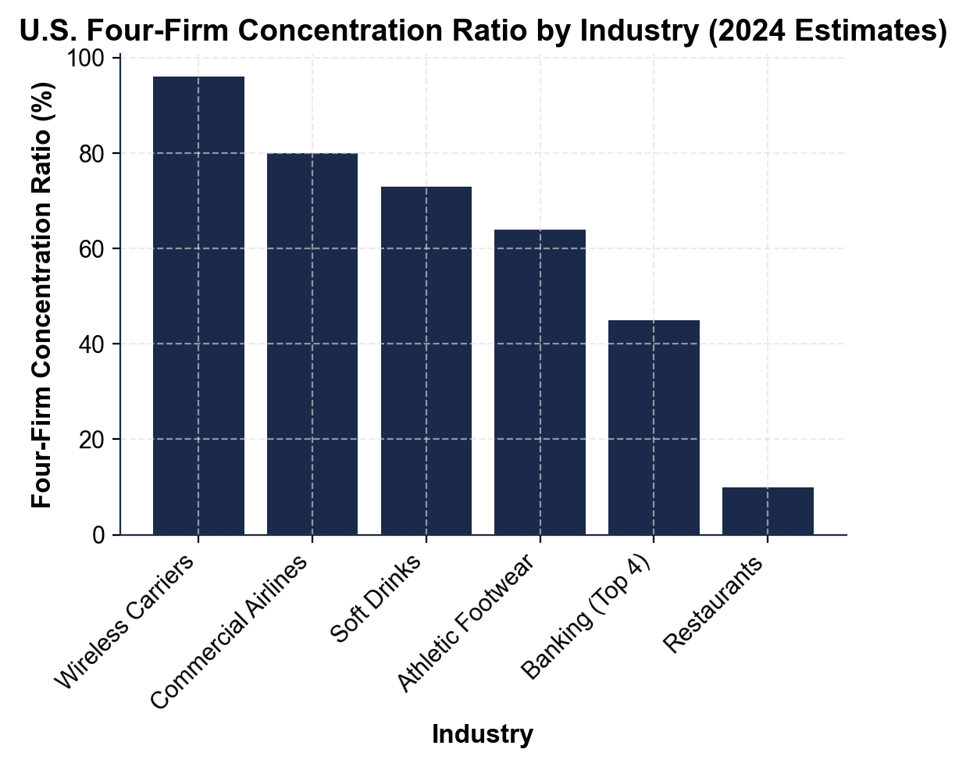
Four-Firm Concentration Ratio Across U.S. Industries
CR4 for six U.S. industries; 60% horizontal line is the oligopoly threshold.
© More Lessons Less Planning | morelessonslessplanning.com
Notes:
Point to each bar. Read the percent off the chart. Five of six industries cross 60%. Restaurants are the lone non-oligopoly.
Reference labels (point to these chart features when teaching): Wireless: CR4 = 96%; Restaurants: CR4 = 10%

Slide 11
Game Theory and the Prisoner's Dilemma
The Game (Two Wireless Carriers)
The Surprise (Next Chart)
Two firms - Carrier A and Carrier B - each pick a strategy
Choice 1: COMPETE (cut prices, fight for share)
Choice 2: COOPERATE (hold prices high, share market)
Four possible OUTCOMES depending on what each picks
Both Cooperate (best for both): $20B each
Both Compete (Nash equilibrium): $10B each
But each firm INDIVIDUALLY does better by competing
Result: mutual defection - WORSE for both than mutual cooperation
Important: Nash equilibrium = neither firm can improve by switching alone. In prisoner's dilemma, that's Both Compete - the WORSE outcome.
© More Lessons Less Planning | morelessonslessplanning.com
Notes:
Set up the prisoner's dilemma chart on the next slide. Drill the four outcomes BEFORE the chart shows them.

Slide 12
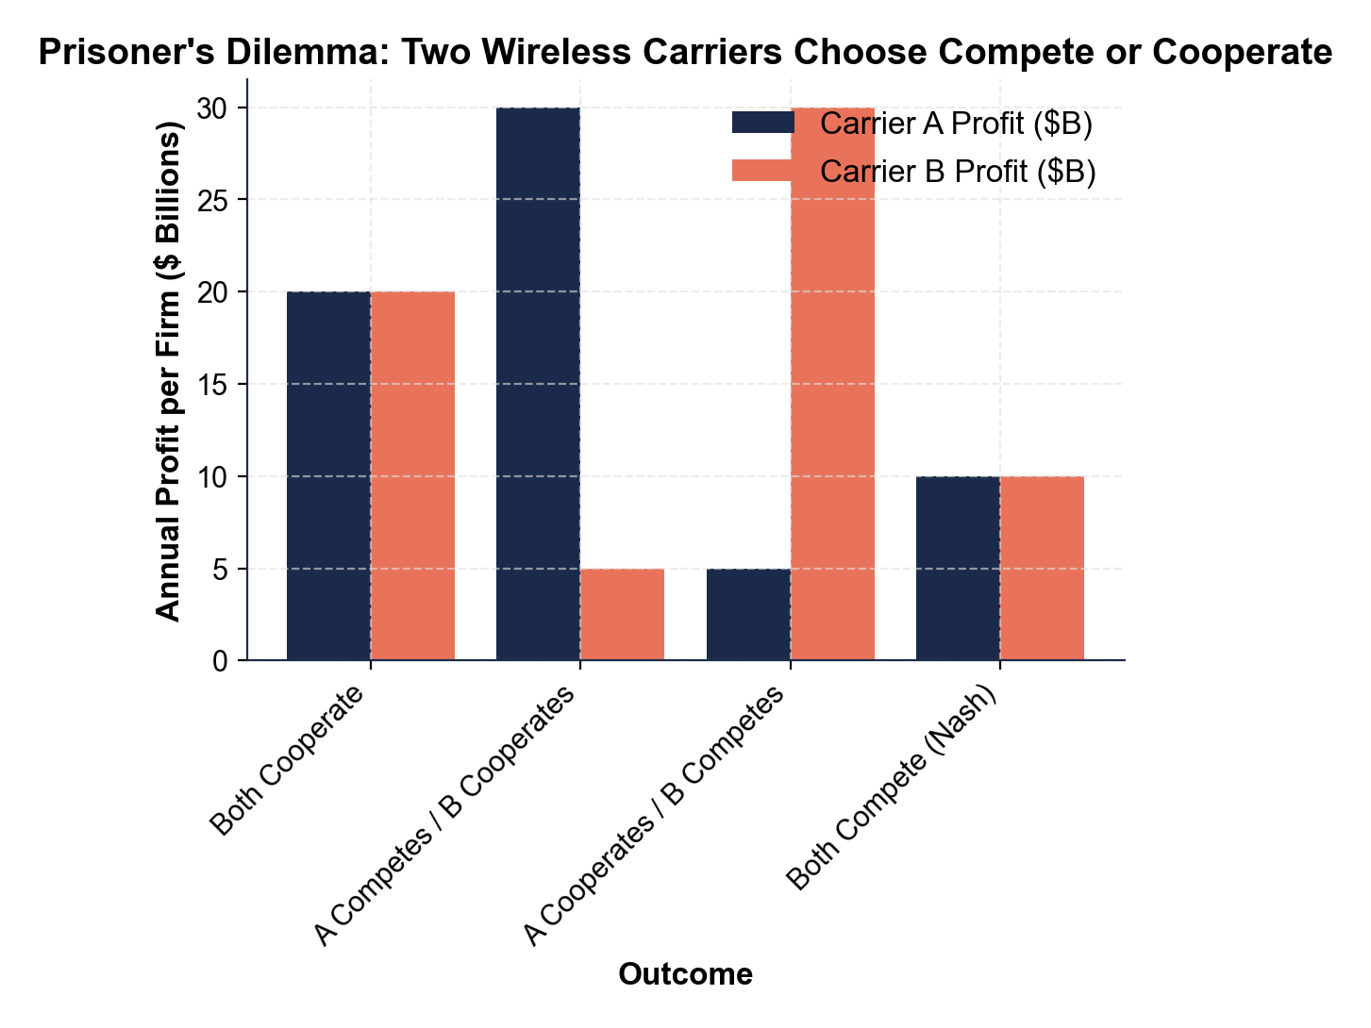
Prisoner's Dilemma Payoff Matrix
Nash: Both Compete $10B each; Both Cooperate $20B is jointly preferred.
© More Lessons Less Planning | morelessonslessplanning.com
Notes:
Point to each pair of bars. Drill the Nash equilibrium (Both Compete). Drill the dominant strategy logic.
Reference labels (point to these chart features when teaching): Nash equilibrium: $10B each; Cooperate ideal: $20B each

Slide 13
Why Oligopoly Prices Stay Sticky - The Kinked Demand Curve
Imagine current market price is $50 - all firms charging the same
If you RAISE price to $54: rivals DO NOT match - you lose 40 customers fast
If you CUT price to $35: rivals DO match - you barely gain 10 customers
Result: profit DROPS in either direction - the bend at $50 is a KINK
Implication: each firm leaves price unchanged - oligopoly prices are STICKY
Big Idea: Kinked demand explains why airline, wireless, and soda prices barely move month-to-month - even though firms could change them.
© More Lessons Less Planning | morelessonslessplanning.com
Notes:
Set up the kinked demand chart on the next slide. The visible bend at (Q=100, P=$50) is the kink. The chart's two slopes encode the asymmetric rival response.

Slide 14
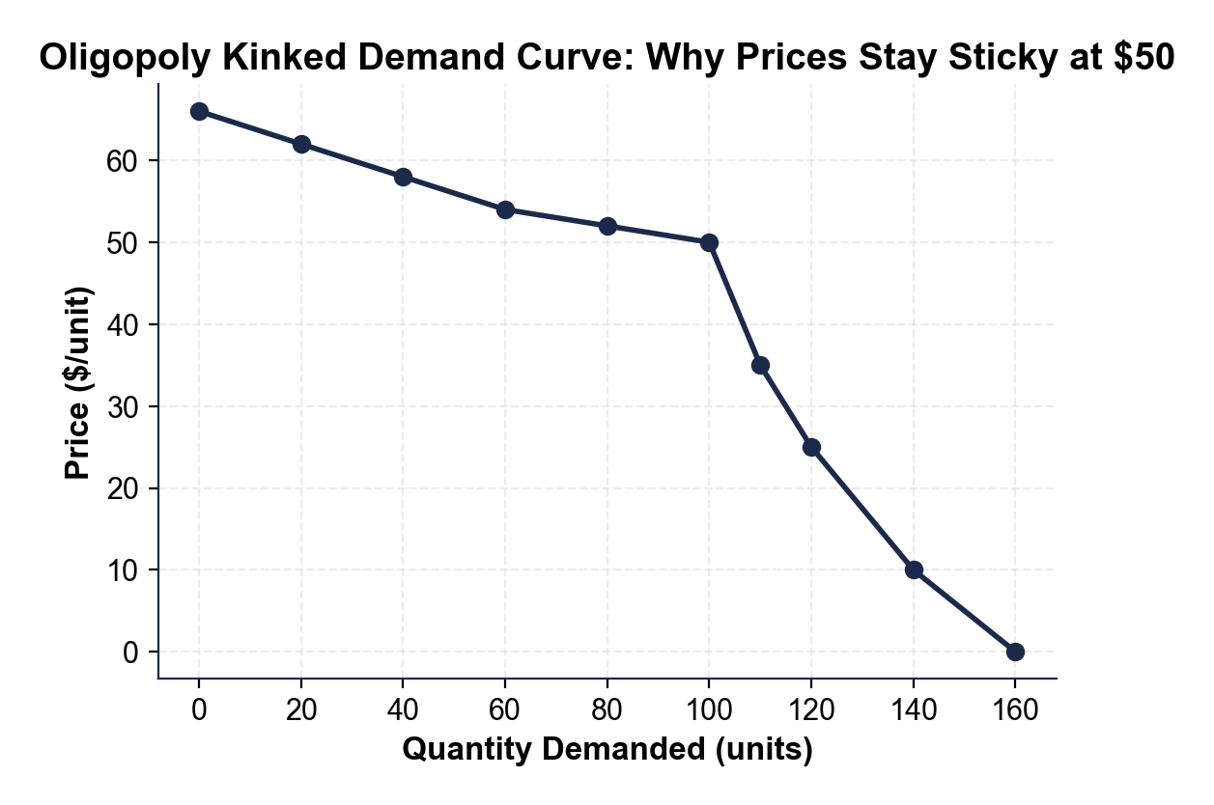
The Kinked Demand Curve
Kink at Q=100, P=$50. Raise to $54 loses 40 units; cut to $35 gains 10.
© More Lessons Less Planning | morelessonslessplanning.com
Notes:
Point to the bend in the demand line at Q=100 P=$50. Trace up to $55, read Q=60 (lost 40 units). Trace down to $40, read Q=110 (gained only 10 units).
Reference labels (point to these chart features when teaching): Above kink: elastic; Below kink: inelastic

Slide 15
Collusion vs Tacit Collusion - The Legal Line
OVERT Collusion (Illegal)
TACIT Collusion (Legal Gray Zone)
Firms EXPLICITLY agree to fix prices, output, or market share
ILLEGAL under Sherman Antitrust Act (1890)
Penalties: corporate fines + executive prison time
Examples: vitamin cartel (1990s), LIBOR rigging (2008)
Firms COORDINATE WITHOUT explicit communication
Price leadership - one firm announces, rivals follow
Parallel pricing - all firms change prices simultaneously
Harder to prosecute - no smoking-gun email
Real talk: Tacit collusion gives the SAME consumer harm as a cartel - but no documentary evidence to prosecute. Hardest oligopoly problem.
© More Lessons Less Planning | morelessonslessplanning.com
Notes:
Drill the legal distinction. Overt collusion is illegal. Tacit collusion is in a gray zone but increasingly prosecuted under modern antitrust doctrine.

Slide 16
Price Leadership in Real U.S. Industries
WIRELESS - the leader
Verizon leads on plan pricing; AT&T and T-Mobile match within days. No documented agreement.
AIRLINES - the test
Carriers float a fare change overnight in a test market. Rivals match in 24-48 hours or it reverses.
STEEL - the announcement
Historically U.S. Steel published price lists; smaller mills matched. 1924 Pittsburgh Plus FTC case.
OIL - the OPEC exception
OPEC member nations meet quarterly to set production quotas. Legal abroad under foreign sovereign immunity.
Note: Price leadership is the most common form of tacit collusion in oligopoly - coordination without talking.
© More Lessons Less Planning | morelessonslessplanning.com
Notes:
Walk the four examples. Each shows price leadership in a different oligopoly industry. The OPEC exception is the only formal cartel allowed - and only because it operates under foreign sovereign immunity.

Slide 17
Antitrust and Oligopoly Enforcement
The Three Big Antitrust Tools
Recent Real Cases
PRICE FIXING prosecutions - Section 1 Sherman Act (1890)
MERGER review - block oligopoly-strengthening deals
MARKET INVESTIGATIONS - FTC studies whole industries
Modern focus: Big Tech, airlines, prescription drugs
T-Mobile/Sprint merger 2020 - approved with conditions
AT&T/Time Warner 2018 - approved, vertically structured
Major airlines - DOJ blocked JetBlue/Spirit 2024
Apple/Google ad markets - active 2024-26 cases
Big Idea: U.S. antitrust mostly focuses on MERGER REVIEW (prevent new oligopolies) and OVERT collusion. Tacit collusion is rarely prosecuted alone.
© More Lessons Less Planning | morelessonslessplanning.com
Notes:
Walk the modern antitrust framework. The three tools (price fixing, merger review, market study) cover most of the FTC and DOJ Antitrust Division workload. Recent cases ground the model.

Slide 18
Market Structure Terms (1 of 3)
Oligopoly
A market dominated by a small number (4-10) of large interdependent firms with high barriers to entry; firms must guess what rivals will do.
Interdependence
Each firm's profit depends on what RIVAL firms choose; the new feature unique to oligopoly that makes game theory necessary.
Four-firm concentration ratio
Percent of total industry sales held by the four largest firms; CR4 > 60% suggests oligopoly; CR4 > 90% is near-monopoly.
Note: These three terms appear in Activity Part 2 and on the Quiz - drill the interdependence definition.
© More Lessons Less Planning | morelessonslessplanning.com
Notes:
Walk the three key oligopoly terms. OLIGOPOLY: a market dominated by a small number of large firms (typically 4-10) where each firm's pricing and output decisions depend on what rivals will do; high barriers to entry; firms are interdependent. INTERDEPENDENCE: the defining feature of oligopoly: each firm's profit depends not just on its own choice but on what RIVAL firms choose; firms must constantly guess rival behavior, which is why game theory applies. FOUR-FIRM CONCENTRATION RATIO: the percent of total industry sales held by the FOUR LARGEST firms; CR4 > 40% suggests oligopoly tendencies, CR4 > 60% strongly suggests oligopoly, CR4 > 90% is near-monopoly.

Slide 19
Market Structure Terms (2 of 3)
Collusion - Rival firms COORDINATE prices or output to act like a single
Tacit collusion - Firms coordinate WITHOUT explicit communication - using price
Kinked demand curve - Model showing why oligopoly prices are STICKY: rivals do
Note: These three terms appear in Activity Part 2 and on the Quiz - drill the difference between overt and tacit collusion.
© More Lessons Less Planning | morelessonslessplanning.com
Notes:
Walk the three more oligopoly terms. COLLUSION: when rival firms COORDINATE prices or output to act like a single monopoly; ILLEGAL when done explicitly under U.S. antitrust law (Sherman Act); the temptation is built into oligopoly's interdependence. TACIT COLLUSION: when firms coordinate prices or output WITHOUT explicit communication - using price signals, public announcements, and price leadership; legally harder to prosecute than overt collusion but produces the same anticompetitive outcome. KINKED DEMAND CURVE: a model showing why oligopoly prices are STICKY: if a firm raises price, rivals do not follow and demand drops sharply; if a firm cuts price, rivals match and the price cut wins few new customers; the result is a kink at the current price and a strong incentive to leave price unchanged.

Slide 20
Market Structure Terms (3 of 3)
Game theory
Branch of economics analyzing strategic decisions where one player's best move depends on what other players choose; prisoner's dilemma is the standard tool.
Price leadership
Tacit collusion where ONE firm announces a price change and rivals follow within days; common in airlines, wireless, steel.
Nash equilibrium
Outcome where NO player can improve by changing strategy unilaterally; in the prisoner's dilemma, mutual defection is the Nash equilibrium.
Cartel
A FORMAL agreement among rival firms to coordinate prices, output, or market shares; illegal in U.S. but legal in OPEC's oil quotas.
Note: These four terms appear in Activity Part 2 and on the Quiz - drill the Nash equilibrium concept.
© More Lessons Less Planning | morelessonslessplanning.com
Notes:
Walk the four final oligopoly terms. GAME THEORY: the branch of economics analyzing strategic decisions where one player's best move depends on what other players choose; the PRISONER'S DILEMMA payoff matrix is the standard tool for analyzing oligopoly pricing. PRICE LEADERSHIP: a form of tacit collusion where ONE firm (the price leader) publicly announces a price change and rivals follow within days; common in airlines, wireless carriers, and steel; mimics cartel coordination without explicit communication. NASH EQUILIBRIUM: an outcome in a strategic game where NO player can improve their payoff by changing their move unilaterally - given what the other players are doing; in the prisoner's dilemma, mutual defection (compete/compete) is the Nash equilibrium even though both firms prefer mutual cooperation. CARTEL: a FORMAL agreement among rival firms to coordinate prices, output, or market shares - illegal in the U.S. (Sherman Act 1890) but legal in some international forums like OPEC's oil quotas.

Slide 21
Key Takeaways
Oligopoly = FEW sellers + HIGH barriers + INTERDEPENDENT firms + diff. or
Concentration is measured by CR4 - > 60% is clear oligopoly territory
Game theory and the prisoner's dilemma explain WHY firms tacitly collude
KINKED DEMAND curve explains why oligopoly prices stay STICKY at the current
U.S. antitrust focuses on merger review + explicit collusion - tacit collusion
Takeaway: Oligopoly is the most COMMON real market structure - and the most interesting. Game theory works because firms are INTERDEPENDENT.
© More Lessons Less Planning | morelessonslessplanning.com
Notes:
Cycle through the five takeaways. Each maps to one part of the activity: four features (Part 1), reference vocabulary (Part 2), chart reading (Part 3), four-market diagnosis (Part 4), policy recommendation memo (Part 5).

