Slide 1
Newgrange: Tomb of the Ancients
A Neolithic passage tomb older than the pyramids - built with astonishing engineering and aligned to the winter sun.
© More Lessons Less Planning | morelessonslessplanning.com
Notes:
Opening slide. Around 3200 BCE, Neolithic farmers in Ireland raised a massive stone mound that has outlasted the pyramids of Giza and Stonehenge. Today students investigate how Newgrange was built, what its carved art might mean, and why its builders aligned it with the sun.

Slide 2
Learning Targets
Explain how Newgrange's construction reflects Neolithic engineering skill.
★
Describe the entrance stone's megalithic art and why its meaning is debated.
★
Explain how Newgrange aligns with the midwinter sunrise.
★
Compare Newgrange's age to other famous ancient monuments.
★
© More Lessons Less Planning | morelessonslessplanning.com
Notes:
Read the four learning targets. Today connects three big ideas: engineering (how it was built), art (what was carved on it), and astronomy (why it points where it points).

Slide 3
Older Than the Pyramids
Neolithic
Relating to the New Stone Age - farming, permanent settlements, and polished stone tools.
Tumulus
A large mound of earth and stone raised over an ancient tomb or grave.
Key Concept: Newgrange is a NEOLITHIC TUMULUS built around 3200 BCE - older than Stonehenge and the Egyptian pyramids.
© More Lessons Less Planning | morelessonslessplanning.com
Notes:
Newgrange was built around 3200 BCE by farmers of the NEOLITHIC period - the New Stone Age, marked by farming, permanent settlements, and polished stone tools. It is a TUMULUS - a large mound of earth and stone raised over an ancient tomb - located in the Boyne Valley in Ireland. That makes Newgrange older than Stonehenge and even older than the Great Pyramid of Giza in Egypt.

Slide 4
Building the Passage Tomb
A passage tomb
A narrow stone passage leads into an inner burial chamber under the mound.
✔
Built from megaliths
Large stones (megaliths) were dragged, shaped, and stacked without metal tools.
✔
A massive undertaking
The mound covers about an acre and contains around 200,000 tonnes of material.
✔
Key Concept: Newgrange is a PASSAGE TOMB built from huge MEGALITHS moved without metal tools or wheels.
© More Lessons Less Planning | morelessonslessplanning.com
Notes:
Newgrange is a PASSAGE TOMB - a Neolithic tomb with a narrow stone passage leading into an inner burial chamber, covered by a huge mound. It was built from MEGALITHS - large stones used to build a prehistoric monument - some weighing several tonnes, dragged from miles away without metal tools, wheels, or draft animals. The mound covers roughly an acre and contains an estimated 200,000 tonnes of stone and earth.

Slide 5
The Great Mound
Kerbstone
One of a ring of large stones set around the mound's base to hold it in place.
Key Concept: A ring of carved KERBSTONES holds the mound's edge in place and marks its boundary.
© More Lessons Less Planning | morelessonslessplanning.com
Notes:
Around the base of the mound sits a ring of large KERBSTONES - stones set edge to edge to hold the mound in place and mark its outer boundary. Ninety-seven kerbstones surround Newgrange, and several are carved with megalithic art. Modern archaeologists reconstructed the mound's outer wall with a facade of bright white quartz stones, based on quartz found scattered at the site during excavation. The next slide shows that facade.

Slide 6
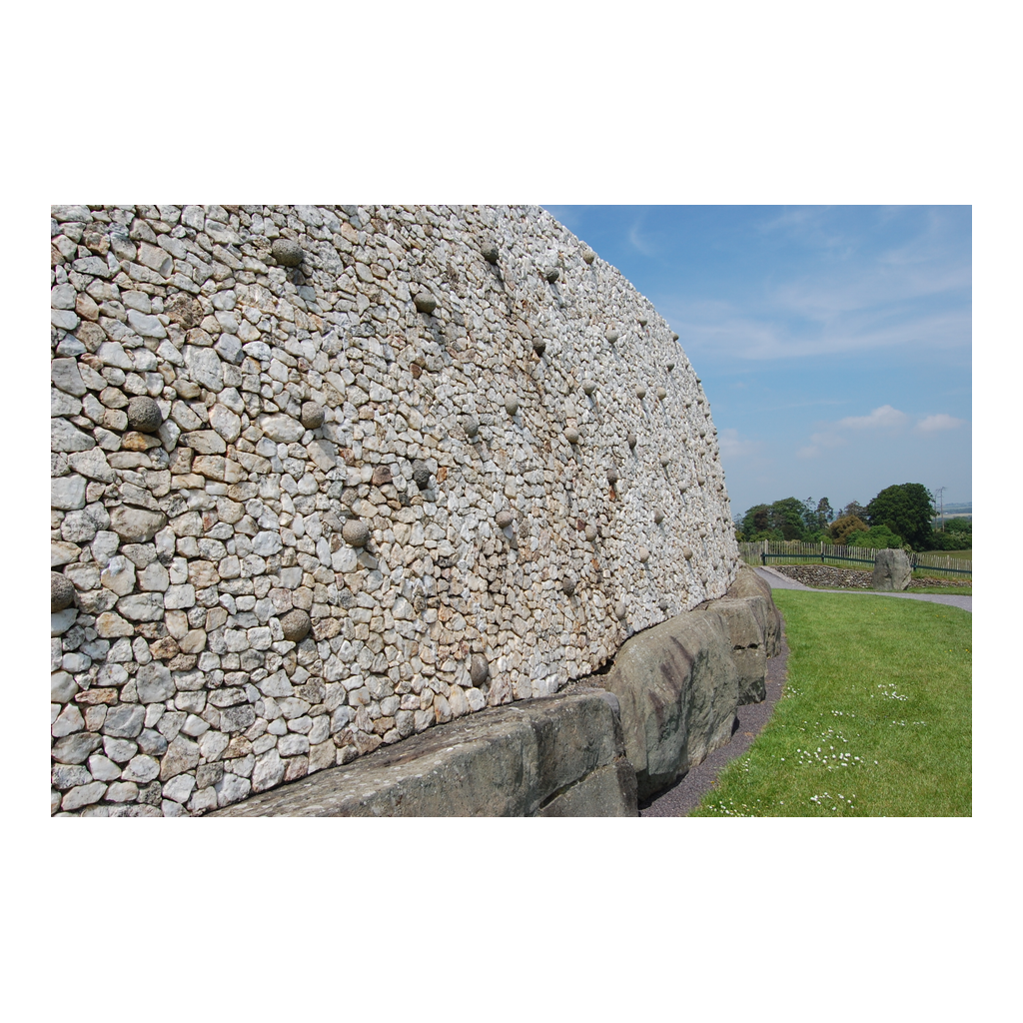
The Reconstructed Facade
The Newgrange mound, with its reconstructed white quartz facade and kerbstones.
© More Lessons Less Planning | morelessonslessplanning.com
Notes:
Public-domain photograph of the Newgrange mound exterior, Bru na Boinne, Ireland. Give students a moment to notice the bright white quartz facade and the ring of kerbstones at the base holding the mound's edge.
Reference labels (point to these chart features when teaching): Quartz facade; Kerbstones at the base

Slide 7
An Engineering Marvel: The Corbelled Roof
No mortar
Flat stones are stacked in rings, each ring set slightly inward, with no mortar at all.
✔
A closed capstone
The rings rise until they meet at the top, closed by a single capstone.
✔
Watertight for 5,000 years
The corbelled roof has kept the inner chamber completely dry for over 5,000 years.
✔
Key Concept: The CORBELLED ROOF stacks stone rings inward with no mortar, and has stayed watertight for 5,000 years.
© More Lessons Less Planning | morelessonslessplanning.com
Notes:
The inner chamber of Newgrange is covered by a CORBELLED ROOF - a roof built by stacking overlapping rings of stone that lean inward until they meet at the top, without any mortar. Each ring of flat stones was set slightly inside the ring below it, narrowing the gap until a single capstone could close it at the top. This dry-stone technique has kept the chamber completely watertight for more than 5,000 years - a remarkable feat of Neolithic engineering.

Slide 8
The Carved Entrance Stone
A huge kerbstone sits directly in front of the passage entrance.
Its entire face is covered with carved spirals, lozenges, and arcs.
Kerbstones around the site are carved with the same spiral art style.
No metal tools existed yet - carvings were pecked into stone by hand.
Key Concept: Newgrange's kerbstones are covered in MEGALITH art, pecked into the stone by hand.
© More Lessons Less Planning | morelessonslessplanning.com
Notes:
Directly in front of the passage sits Newgrange's most famous MEGALITH - the entrance stone, its entire face covered with carved spirals, diamond shapes, and arcs. That same spiral art style appears on other carved kerbstones around the mound, all pecked into the stone by hand using harder stone tools, since metal tools did not yet exist. It is considered one of the finest examples of megalithic art anywhere in Neolithic Europe. The next slide shows an example of this carved spiral art.

Slide 9
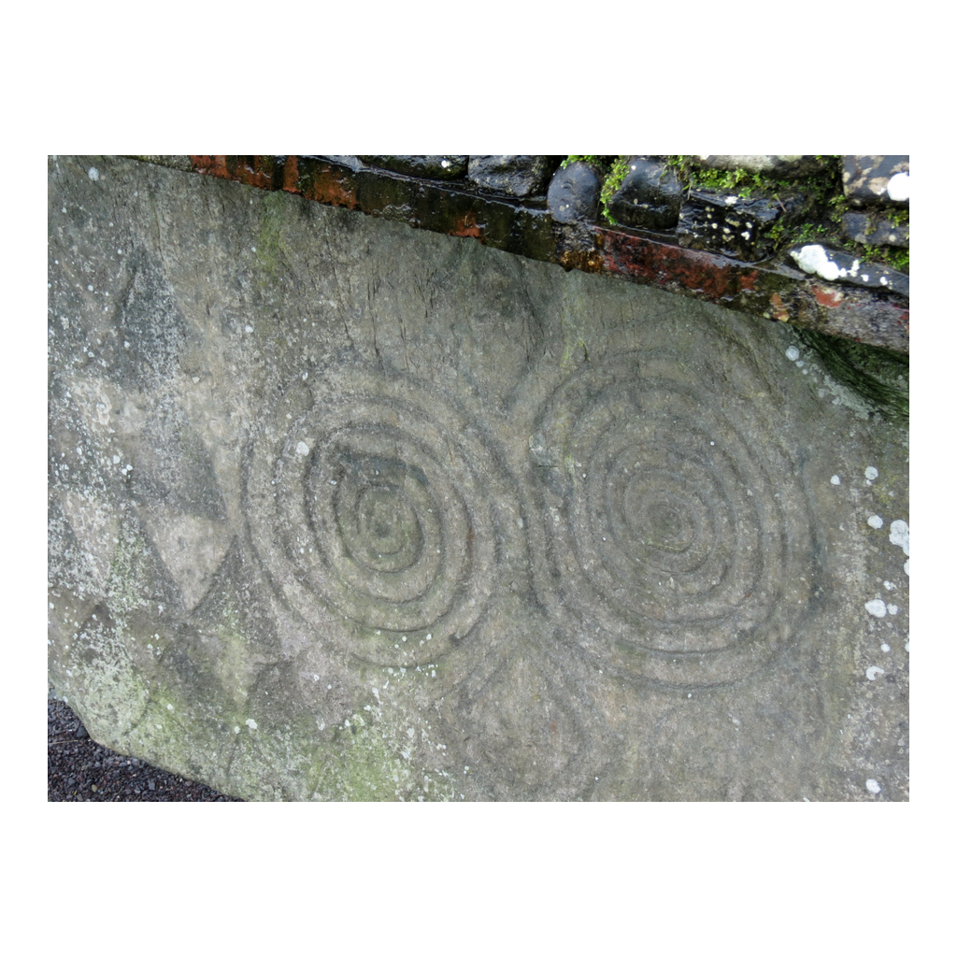
Megalithic Art at Newgrange
A carved kerbstone at Newgrange with connected-spiral megalithic art.
© More Lessons Less Planning | morelessonslessplanning.com
Notes:
Public-domain photograph of a carved kerbstone at Newgrange, showing two connected spiral carvings in the same style as the famous entrance stone. Give students a moment to trace the spiral lines with their eyes and notice how deeply and precisely they are cut into the stone.
Reference labels (point to these chart features when teaching): Carved spiral motifs; Weathered stone surface

Slide 10
What the Spiral Might Mean
Triple spiral (Triskele)
Three connected spirals carved on the entrance stone - meaning still debated.
Key Concept: The TRIPLE SPIRAL is Newgrange's most famous carving - its exact meaning is unknown.
© More Lessons Less Planning | morelessonslessplanning.com
Notes:
The most famous single carving at Newgrange is the TRIPLE SPIRAL, or triskele - a design of three connected spirals cut into the entrance stone. Historians and archaeologists have proposed many ideas about what it might represent - the sun's yearly journey, the three phases of life, or simply decorative art - but no key or written explanation survives from the builders. Its exact meaning remains genuinely debated, and honest historians say so rather than guessing.

Slide 11
Aligned with the Sun
Winter solstice
The shortest day and longest night of the year - sunrise at its most southerly point.
Key Concept: Newgrange's passage points southeast, toward the sunrise on the WINTER SOLSTICE.
© More Lessons Less Planning | morelessonslessplanning.com
Notes:
Newgrange's passage was not built facing just any direction - it points southeast, toward the point on the horizon where the sun rises on the WINTER SOLSTICE, the shortest day and longest night of the year. Even the antiquarian George Coffey noticed in 1912 that the passage leaned toward the southeast, near where the sun rises at the year's shortest days, though he could not fully explain why.

Slide 12
The Roof-Box: A Hidden Window
A small opening
A narrow box-shaped gap sits above the main passage entrance.
✔
A beam of light
For a few mornings around the winter solstice, sunlight enters through it.
✔
Confirmed in 1967
Archaeologist Michael J. O'Kelly documented the light reaching the inner chamber.
✔
Key Concept: The ROOF-BOX lets sunlight reach the inner chamber only at midwinter sunrise - confirmed in 1967.
© More Lessons Less Planning | morelessonslessplanning.com
Notes:
Above the passage entrance is a narrow opening called the ROOF-BOX - a small rectangular gap that lets sunlight reach the inner chamber only at midwinter sunrise. For a few mornings around the winter solstice, a beam of sunlight travels the full sixty feet of the passage and illuminates the back chamber. This remarkable effect was confirmed by archaeologist Michael J. O'Kelly in 1967, decades after Coffey's 1912 survey, and proved the Neolithic builders designed Newgrange with real astronomical precision.

Slide 13
How We Know: Coffey's 1912 Survey
Antiquarian
An early scholar who studied and collected ancient objects before modern archaeology existed.
Key Concept: ANTIQUARIAN George Coffey surveyed Newgrange in 1912, decades before the roof-box was confirmed.
© More Lessons Less Planning | morelessonslessplanning.com
Notes:
How do we know all this? Part of the answer comes from ANTIQUARIANS - early scholars who studied and collected ancient objects and monuments before the modern field of archaeology existed. George Coffey, an Irish antiquarian, surveyed Newgrange in 1912, carefully describing its construction, its carved entrance stone, and its southeast orientation. In the activity you will read Coffey's own words as a primary source, decades before O'Kelly confirmed the roof-box's solstice light in 1967.

Slide 14
Key Takeaways
Newgrange is a Neolithic passage tomb older than Stonehenge and the pyramids.
★
Its corbelled roof has stayed watertight for over 5,000 years, no mortar.
★
The entrance stone's triple spiral is a famous carving with unknown meaning.
★
The roof-box aligns the passage with the midwinter sunrise - real astronomy.
★
© More Lessons Less Planning | morelessonslessplanning.com
Notes:
Recap the four takeaways. The big idea: Newgrange shows that Neolithic people were not simple - they were skilled engineers, artists, and careful observers of the sky, thousands of years before written history.

