Slide 1
New Weapons of War
How technology changed the fighting on the Western Front
© More Lessons Less Planning | morelessonslessplanning.com
Notes:
Set the frame in one sentence: this lesson is about machines and tactics, not about individual battles.

Slide 2
Learning Targets
Explain how machine guns and barbed wire created the trench stalemate
★
Describe what poison gas did and why it never won a lasting breakthrough
★
Explain how tanks were designed to cross trenches and crush wire
★
Describe how aircraft changed what commanders could see
★
Use a 1918 technical article as evidence about new weapons
★
© More Lessons Less Planning | morelessonslessplanning.com
Notes:
Read target 5 aloud - students are often surprised the Activity uses a real magazine article from 1918.

Slide 3
Why 1914 Was Different
Armies in 1914 carried industrial weapons but still used older tactics
Factories mass-produced guns, shells, and barbed wire by the million
Defensive firepower advanced faster than any way to move troops
Stalemate: a deadlock in which neither side can advance or win
Attrition: wearing the enemy down through steady losses, not one breakthrough
The result was four years of trench lines that barely moved
Key Concept: New weapons made defending easier and attacking far more costly.
© More Lessons Less Planning | morelessonslessplanning.com
Notes:
Stress the mismatch: the weapons were new, the tactics were not. That gap is the whole unit.

Slide 4
The Machine Gun Rules the Ground
Machine gun: a rapid-fire weapon firing hundreds of rounds a minute
A heavy machine gun fired roughly 450 to 600 rounds every minute
One crew of four to six men could stop an attacking company
Guns were sited to cross their fire and sweep the ground between them
A water jacket around the barrel kept the gun cool enough to keep firing
Attacking soldiers had to cross open ground into that fire
Key Concept: The machine gun made defending cheap and attacking expensive.
© More Lessons Less Planning | morelessonslessplanning.com
Notes:
Do the arithmetic aloud: six men versus a hundred attackers is the whole problem of 1915-1917.

Slide 5
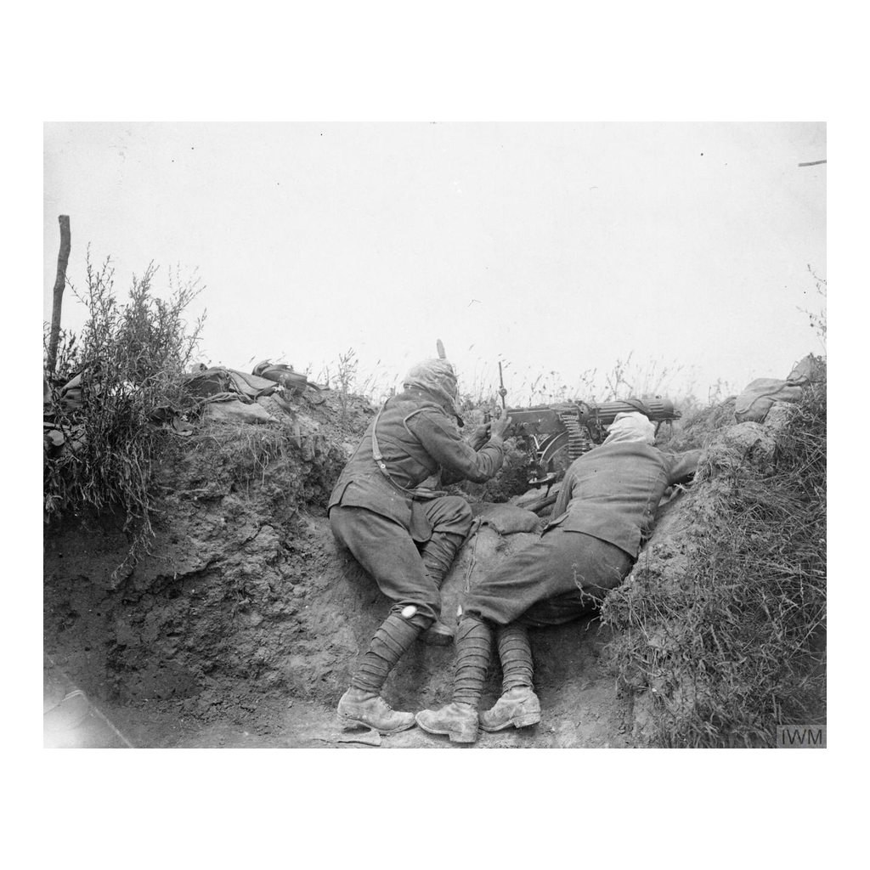
A Machine Gun Crew in Position
A Vickers machine gun crew in a trench position, Somme, 1916
© More Lessons Less Planning | morelessonslessplanning.com
Notes:
Give students ten quiet seconds before you say anything. Someone will notice the gas hoods.

Slide 6
The Rest of the Defensive System
Barbed wire
coiled steel wire strung across No Man's Land to stop and trap attacking infantry
Artillery
the large guns that fired explosive shells and caused most of the war's casualties
Creeping barrage
a wall of shellfire that moved forward just ahead of the advancing infantry
Beaten zone
the strip of ground a machine gun could sweep with fire from one position
Note: Wire, artillery, and the machine gun worked as one system, not as separate weapons.
© More Lessons Less Planning | morelessonslessplanning.com
Notes:
The key move: wire does not kill anyone. It holds attackers still so the machine gun can.

Slide 7
Poison Gas Enters the War
Poison gas: chemical weapons released to injure, blind, or kill soldiers
Germany's chlorine attack at Ypres in April 1915 was the first at scale
Phosgene came next: harder to see, with symptoms that appeared hours later
Mustard gas arrived in 1917 and blistered skin, eyes, and lungs
Mustard gas soaked into soil and clothing and stayed dangerous for days
Both sides used gas for the rest of the war
Note: Gas was meant to force soldiers out of trenches that shells could not reach.
© More Lessons Less Planning | morelessonslessplanning.com
Notes:
Keep this clinical. The tactical logic - gas flows into places shells cannot reach - is the teaching point.

Slide 8
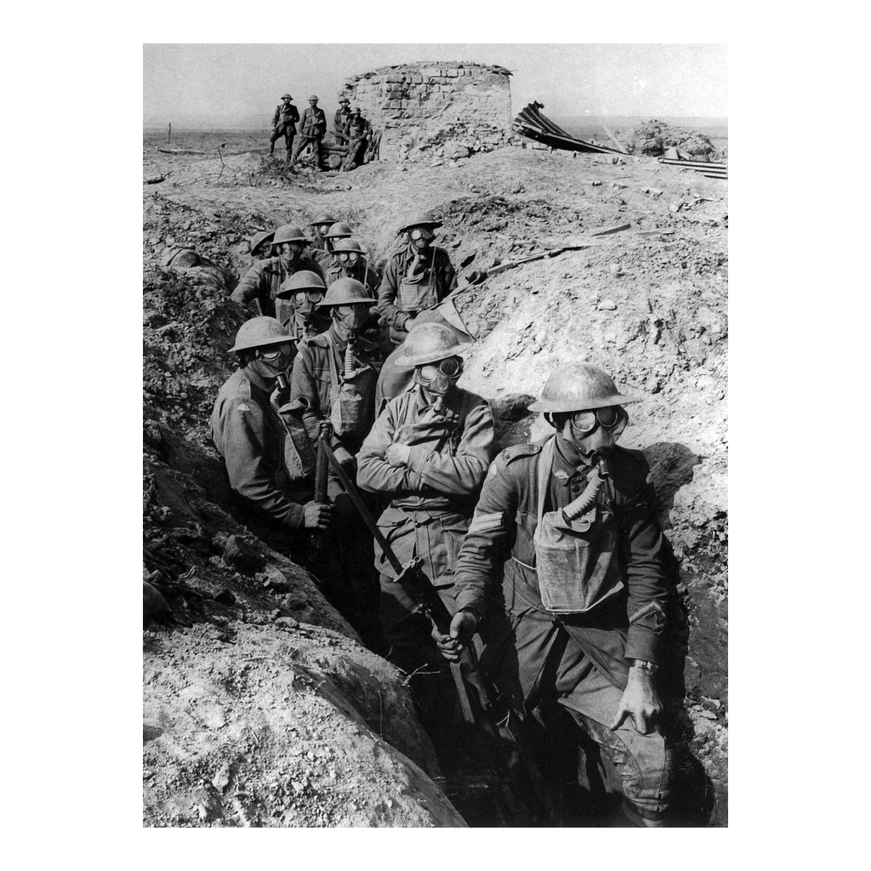
The Equipment That Answered Gas
Australian infantry in Small Box Respirators, Ypres, 1917
© More Lessons Less Planning | morelessonslessplanning.com
Notes:
This is a photograph of protective equipment, not of casualties. That choice is deliberate - say so if students ask.

Slide 9
The Answer to Gas Was Equipment and Drill
Gas mask
Protective headgear with a filter that let soldiers keep fighting through a gas attack
✔
Alarms
Sentries banged gongs, rang bells, or swung rattles the moment gas was spotted
✔
Drill
Units drilled until a soldier could get a mask on in seconds, because seconds decided who was hurt
✔
The numbers
Gas caused roughly 1.3 million casualties but about 90,000 deaths across the whole war
✔
The verdict
Gas never won a lasting breakthrough; wind was unreliable and defenders adapted within months
✔
Key Concept: Gas injured far more soldiers than it killed, and it never won a lasting breakthrough.
© More Lessons Less Planning | morelessonslessplanning.com
Notes:
This slide is the corrective. Students arrive thinking gas was the war's biggest killer; the numbers say otherwise.

Slide 10
The Tank: Built to Cross a Trench
Tank: an armored tracked vehicle built to cross trenches and crush barbed wire
British engineers designed it to solve the wire-and-trench problem directly
The name tank was a cover story to hide the project from enemy spies
Tracks spread the weight so it could cross soft, cratered ground
Armor plate stopped rifle and machine-gun bullets
The long rhomboid shape let it climb out of a trench instead of dropping in
Key Concept: The tank was engineered backward from one problem - crossing a trench.
© More Lessons Less Planning | morelessonslessplanning.com
Notes:
Every feature on this slide answers a specific obstacle. Make students name the obstacle for each one.

Slide 11
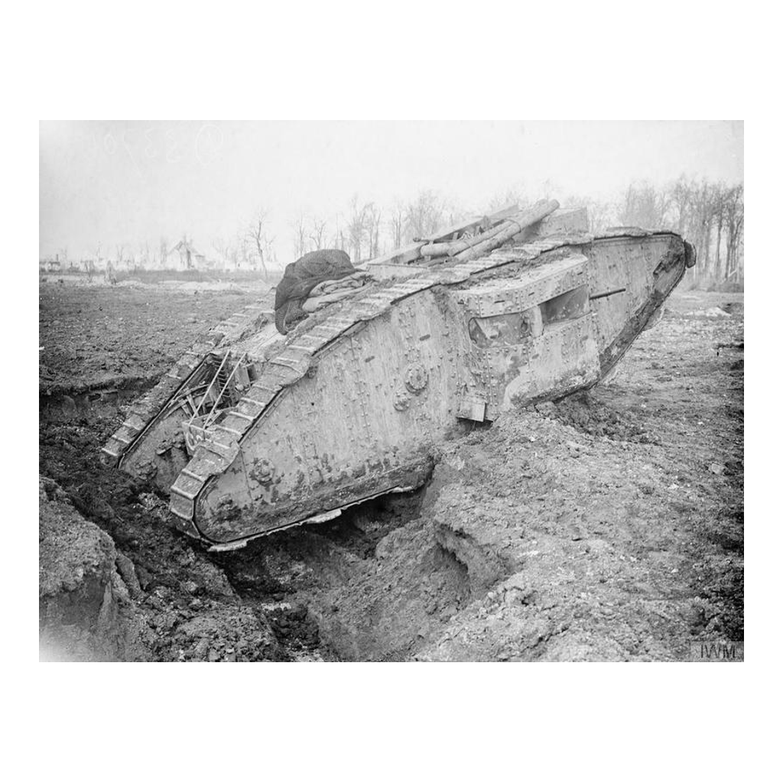
A Tank Crossing a Trench
A British tank climbing out of a trench, Arras, 1917
© More Lessons Less Planning | morelessonslessplanning.com
Notes:
This is the single photograph that makes the previous slide make sense. Let it sit.

Slide 12
What Tanks Could and Could Not Do
What Tanks Could Do
What Tanks Could Not Do
Cross a trench and flatten belts of barbed wire
Shield the infantry walking behind them
At Cambrai in November 1917, about 476 attacked together
At Amiens in August 1918, they helped break the line
Move fast - a Mark I made about 4 miles per hour
Stay running - many broke down or ditched
At Flers-Courcelette, September 1916, 49 tanks were sent
Only 32 reached the start line; about 9 kept up
Did You Know: Early tank crews worked in heat, engine fumes, and noise bad enough to make men pass out.
© More Lessons Less Planning | morelessonslessplanning.com
Notes:
The honest version: the first tanks mostly failed. Cambrai is where mass use finally worked.

Slide 13
Planes: Eyes Above the Trenches
Reconnaissance: scouting flights that mapped trenches and directed the guns
Observers photographed whole trench systems from the air
Fighters appeared mainly to stop the other side's reconnaissance
Dogfight: an aerial battle between fighter planes over the Western Front
Synchronized machine guns let a pilot fire straight through the propeller
By 1918 aircraft also bombed targets and attacked troops on the ground
Key Concept: Aircraft mattered most for what they let commanders see.
© More Lessons Less Planning | morelessonslessplanning.com
Notes:
Students expect dogfights. The real story is the camera, not the guns.

Slide 14
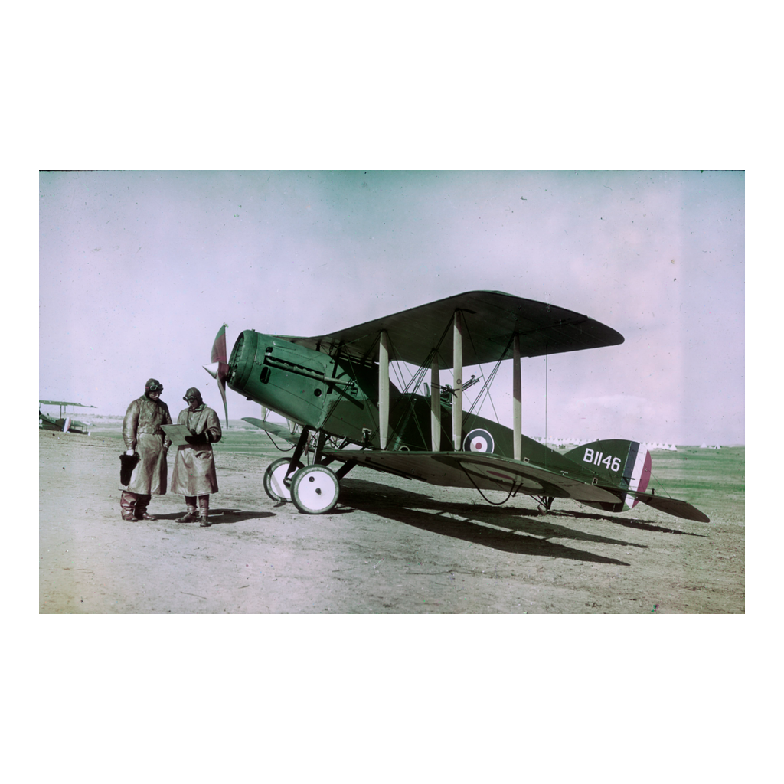
A Two-Seat Observation Aircraft
A two-seat Bristol Fighter with its pilot and observer, 1918
© More Lessons Less Planning | morelessonslessplanning.com
Notes:
Genuine 1918 colour - a Paget plate by Frank Hurley, not a modern colourization. Worth saying out loud.

Slide 15
What Actually Caused the Casualties
Cause of Wound | Approximate Share | What It Tells You
Artillery shells and shrapnel | About 60% | The biggest danger was the gun you never saw
Rifle and machine-gun bullets | About 35% | Most of the rest came from small arms fire
Poison gas | About 2-3% | Gas injured far more soldiers than it killed
Bayonets | Well under 1% | Hand-to-hand fighting was rare, not typical
Note: About 21 million soldiers were wounded in WWI; these are approximate shares, and grenade wounds group with shell.
© More Lessons Less Planning | morelessonslessplanning.com
Notes:
This table quietly corrects three student misconceptions at once: gas, bayonets, and what artillery actually did.

Slide 16
Which Weapon Broke the Stalemate?
Created It: Guns and Wire
Did Not Break It: Poison Gas
Helped End It: Tanks, Planes
Defense got cheap; attack got expensive
A few gunners could stop hundreds
Wire funneled attackers into the guns
Success depended on wind and weather
Masks and drill cancelled its effect
It frightened more than it killed
Tanks crossed trenches and crushed wire
Planes spotted targets and guided the guns
By 1918 they attacked as one force
Key Concept: No single weapon broke the stalemate - combining them did.
© More Lessons Less Planning | morelessonslessplanning.com
Notes:
This is the synthesis slide and the answer to the essential question. Do not rush it.

Slide 17
What Engineers Wrote in 1918
Tanks alone cannot achieve a victory. The infantry must accompany the tanks [...] Once more, success rests on perfect teamwork.
— Scientific American, November 2, 1918
You will read a longer piece of this article in the Activity. It was printed while the war was still being fought, nine days before the fighting stopped.
Did You Know: Scientific American called the early tank a land battleship.
© More Lessons Less Planning | morelessonslessplanning.com
Notes:
Students are often startled that a 1918 magazine already understood combined arms. That surprise is the hook.

Slide 18
Reading a Wartime Technical Article
Who wrote it, and when?
Sourcing comes first - answer who, when, and why before deciding what a source proves
✔
Was the outcome known?
This article was written while the war was still being fought, so the ending was unknown
✔
What can it show you?
Technical detail about how a machine was built and what it was meant to do
✔
What can it not show you?
Wartime censors and military secrecy kept some facts out of print
✔
How do you use it?
Pair it with your notes, because one source rarely covers the whole story
✔
Tip: A wartime magazine tells you what people believed at the time, not what historians concluded later.
© More Lessons Less Planning | morelessonslessplanning.com
Notes:
Model the first sourcing question aloud using this slide before students attempt the Activity.

Slide 19
Key Takeaways
Industrial technology gave the defense the advantage and froze the front
★
Machine guns and barbed wire made attacking across open ground deadly
★
Poison gas caused mass casualties but never produced a breakthrough
★
Tanks were engineered to solve one problem: crossing a trench
★
By 1918 tanks, planes, artillery, and infantry attacked as one system
★
© More Lessons Less Planning | morelessonslessplanning.com
Notes:
Return to the essential question and take three competing answers before the Exit Ticket.

