Slide 1
Negotiating Big Purchases: Getting a Better Deal
Learn why the sticker price is only a starting point, and how research, a walk-away price, and good timing can talk the price of a big purchase down.
© More Lessons Less Planning | morelessonslessplanning.com
Notes:
This is the 'the price on the tag is not the price you have to pay' lesson of Unit 9. Big purchases - a used car, furniture, a mattress - almost always have room to negotiate, but most first-time buyers pay the sticker price because no one taught them how to ask for a better deal. Today students learn the moves: do your research, set a walk-away price, time the purchase, and use a simple script to negotiate. Students will leave able to calculate how much a real buyer - Tyler Brooks, buying his first used car - saved by negotiating and decide whether a deal is worth taking.

Slide 2
Learning Targets
Explain why the sticker price is a starting point and what is negotiable
★
Calculate the savings on a negotiated purchase (savings model)
★
Turn savings into a percent off (percent-off model)
★
Set a walk-away price and use research, timing, and a chart to judge a deal
★
© More Lessons Less Planning | morelessonslessplanning.com
Notes:
Read the four targets and connect them to the arc of the lesson. Target 1 is the why: explain why the sticker price is only a starting point and what makes a big purchase negotiable. Target 2 is the first math skill: calculate the savings on a negotiated purchase using SAVINGS = STICKER - NEGOTIATED. Target 3 is the second math skill: turn those savings into a percent off using PERCENT OFF = SAVINGS / STICKER. Target 4 is the judgment: set a walk-away price and use research, timing, and a bar chart of average savings to decide whether a deal is a good one. By the end, students can negotiate a big purchase and prove how much they saved.

Slide 3
Getting a Better Deal
Negotiation
NEGOTIATION is working out a lower price by talking, offering, and countering with a seller
Sticker price
The STICKER PRICE is the seller's first asking price, before any negotiation
Negotiated price
The NEGOTIATED PRICE is the final price you and the seller agree on after negotiating
Meet Tyler
Tyler Brooks is buying his first car; his coach Rosa Delgado shows him the sticker price can come down
Key Concept: The STICKER PRICE is a starting point; NEGOTIATION turns it into a lower NEGOTIATED PRICE you both agree on.
© More Lessons Less Planning | morelessonslessplanning.com
Notes:
Frame the whole lesson: NEGOTIATION is working out a lower price by talking, offering, and countering with a seller - it is a normal, expected part of buying a big-ticket item. Make the key distinction students will use all lesson: the STICKER PRICE is the seller's first asking price, before any negotiation (the number on the tag), while the NEGOTIATED PRICE is the final price you and the seller agree on after negotiating. The gap between them is what you save. Introduce the persona and the real problem: Tyler Brooks is buying his first used car and assumes the $10,000 sticker price is what he has to pay; his negotiation coach Rosa Delgado is going to show him the sticker price is only a starting point. This sets up the two labeled models that follow. Key terms - Negotiation: working out a lower price. Sticker price: the seller's first asking price. Negotiated price: the final agreed price.

Slide 4
Why Prices Are Negotiable
Sellers build in room
Sticker prices often include markup and wiggle room, so there is space to come down
✔
A sale beats no sale
Sellers usually prefer a slightly lower price to losing the sale, especially on big-ticket items
✔
Some things negotiate more
Cars, furniture, and mattresses have the most room; groceries and most electronics have little
✔
Big purchases, big savings
The bigger the price tag, the more a small percent off is worth in real dollars
✔
Key Concept: Big-ticket items like cars and furniture have built-in room to negotiate; a sale usually beats no sale for the seller.
© More Lessons Less Planning | morelessonslessplanning.com
Notes:
Explain WHY negotiation works so students believe it is worth trying. First, sellers build in room: sticker prices often include markup and wiggle room, so there is space to come down without the seller losing money. Second, a sale beats no sale: a seller usually prefers a slightly lower price to losing the sale entirely, especially on big-ticket items that are hard to move. Third, some things negotiate more than others: cars, furniture, and mattresses have the most room, while groceries and most electronics have thin margins and little room - a fact the bar chart will show later. Fourth, the payoff scales: the bigger the price tag, the more even a small percent off is worth in real dollars, which is why this lesson focuses on BIG purchases. Make the teaching point: you negotiate hardest where there is the most room and the most money at stake. This previews the average-savings-by-category chart.

Slide 5
Do Your Research First
Research
RESEARCH is finding out what a fair price is before you negotiate so you know your target
Target price
Your TARGET PRICE is the price you aim for going in, a bit below fair market, based on research
Know the market
Look up recent sale prices for the same item so the seller cannot bluff you on value
Tyler's homework
Tyler researched his car and set a TARGET PRICE of $8,500, a bit below the fair market value
Key Concept: RESEARCH the fair price first, then set a TARGET PRICE a bit below it so you have room to negotiate up to a fair deal.
© More Lessons Less Planning | morelessonslessplanning.com
Notes:
Teach the step that makes everything else work: RESEARCH. RESEARCH is finding out what a fair price is before you negotiate, so you know your target and cannot be bluffed. Tell students the practical move: look up recent sale prices for the same item (the same car model, year, and mileage; the same couch) so you know what it is really worth. Then introduce the TARGET PRICE: the price you aim for going in, set a bit below fair market value, based on your research - low enough to leave room to negotiate up, but not so low it insults the seller. Work it with the persona: Tyler researched his car's fair market value and set a TARGET PRICE of $8,500, a bit below what similar cars sell for, so his opening offer had room. Make the teaching point: research turns negotiation from guessing into a plan - you know the fair price, your target, and (next slide) the most you will pay. Key terms - Research: finding a fair price before you negotiate. Target price: the price you aim for going in.

Slide 6
Your Savings and Percent Off
The savings model
SAVINGS = STICKER PRICE - NEGOTIATED PRICE - how much you cut off the price
✔
The percent-off model
PERCENT OFF = SAVINGS / STICKER PRICE - your savings as a share of the sticker price
✔
Tyler's savings
Tyler talked $10,000 down to $9,000, so SAVINGS = $10,000 - $9,000 = $1,000
✔
Tyler's percent off
PERCENT OFF = $1,000 / $10,000 = 0.10 = 10% off the sticker price
✔
Key Concept: SAVINGS = STICKER - NEGOTIATED. PERCENT OFF = SAVINGS / STICKER. Tyler saved $1,000, which is 10% off.
© More Lessons Less Planning | morelessonslessplanning.com
Notes:
These are the two central quantitative models - teach them explicitly and put them on the board under clear labels before students calculate with them. THE FIRST LABELED MODEL - SAVINGS = STICKER PRICE - NEGOTIATED PRICE - is simply how much you cut off the price: subtract what you agreed to pay from the seller's first asking price. THE SECOND LABELED MODEL - PERCENT OFF = SAVINGS / STICKER PRICE - turns those dollars into a percent so you can compare deals of different sizes: divide the savings by the sticker price. Work both with the persona: Tyler talked his car from a $10,000 sticker down to a $9,000 negotiated price, so his SAVINGS = $10,000 - $9,000 = $1,000, and his PERCENT OFF = $1,000 / $10,000 = 0.10 = 10% off. Make the teaching point: savings tells you the dollars, percent off tells you how good the deal was relative to the price. Tell students Activity Part 3 asks them to apply both models to Tyler's deal. Key terms - Savings: sticker minus negotiated. Percent off: savings divided by sticker.

Slide 7
The Walk-Away Price
Walk-away price
Your WALK-AWAY PRICE is the highest price you are willing to pay before you walk away
The decision rule
If the negotiated price is at or below your walk-away price, buy; if the seller will not, walk away
Tyler's walk-away
Tyler set a WALK-AWAY PRICE of $9,200; he negotiated $9,000, which is below it, so he buys
The power of walking
Being willing to walk away is what gives you the power to get a better price
Key Concept: Your WALK-AWAY PRICE is the most you will pay. Buy at or below it; walk if the seller will not come down.
© More Lessons Less Planning | morelessonslessplanning.com
Notes:
Teach the single most important idea for not overpaying: the WALK-AWAY PRICE. Your WALK-AWAY PRICE is the highest price you are willing to pay before you walk away from the deal - you set it in advance, based on your research, so emotion in the moment does not push you over it. Teach the decision rule clearly: if the negotiated price is at or below your walk-away price, it is a good deal - buy; if the seller will not come down to your walk-away price, walk away. Work it with the persona: Tyler set a WALK-AWAY PRICE of $9,200 before he started, and he negotiated the car to $9,000, which is below his walk-away, so he buys with confidence. Then make the counter-case to cement the rule: if the seller had refused to go below $9,400 (above Tyler's $9,200 walk-away), Tyler should walk away, even though he wants the car. Make the teaching point: being willing to walk away is exactly what gives you the power to get a better price - a seller who knows you will leave is more likely to come down. Tell students Activity Part 3 and Part 5 use the walk-away rule to decide. Key term - Walk-away price: the highest price you will pay before walking away.

Slide 8
Timing Your Purchase
When you buy matters
TIMING is choosing when to buy - end of month, model-year clearance, or a holiday sale - for a better deal
✔
End of the month or quarter
Salespeople chasing quotas near a deadline are more willing to cut a deal to close a sale
✔
Out with the old models
Last year's cars, phones, and appliances get marked down when new models arrive
✔
Off-season and holidays
Buying out of season or during a big sale event usually means lower prices
✔
Tip: TIMING gets a better deal - buy at end of month, during model-year clearance, or in the off-season when sellers are motivated.
© More Lessons Less Planning | morelessonslessplanning.com
Notes:
Teach the move that costs nothing but patience: TIMING. TIMING is choosing when to buy - end of month, model-year clearance, or a holiday sale - to get a better deal, because the same item costs different amounts depending on when you buy it. Give concrete windows. End of the month or quarter: salespeople chasing sales quotas near a deadline are more willing to cut a deal to close one more sale. Out with the old models: last year's cars, phones, and appliances get marked down when the new models arrive, so buying the outgoing model saves money. Off-season and holidays: buying out of season (a grill in winter, a coat in spring) or during a big sale event usually means lower prices. Make the teaching point: timing stacks with negotiation - if you show up at the right moment AND negotiate, you save the most. Connect back to the persona: Tyler could strengthen his deal by shopping at the end of the month when the dealer wants to hit a quota. Key term - Timing: choosing when to buy to get a better deal.

Slide 9
Negotiation Scripts
Open below your target
Make a polite first offer below your target price so you have room to move up
✔
The counteroffer
A COUNTEROFFER is a new price you offer back after the seller names a price
✔
Use silence and reasons
Name a reason ('similar cars sell for less') and then pause - let the seller respond
✔
Be ready to walk
Politely mention your walk-away: 'I can do $9,000, but not more' - and mean it
✔
Key Concept: Open below your target, trade COUNTEROFFERS with a reason, use silence, and be ready to walk at your walk-away price.
© More Lessons Less Planning | morelessonslessplanning.com
Notes:
Give students actual words to say so negotiation feels doable, not scary. Open below your target: make a polite first offer a bit below your target price so you have room to move up toward a fair deal (if your target is $8,500, you might open at $8,000). Introduce the key term: a COUNTEROFFER is a new price you offer back after the seller names a price - negotiation is a back-and-forth of counteroffers until you meet or someone walks. Teach two techniques: name a reason and then use silence ('similar cars with this mileage sell for less' - then pause and let the seller respond; do not fill the silence), which is more persuasive than just naming a lower number. Finally, be ready to walk: politely mention your walk-away price ('I can do $9,000, but not more') and mean it. Make the teaching point: a script keeps you calm and in control - you are trading counteroffers toward your target, protected by your walk-away price. Tell students the Activity's role-play uses these moves. Key term - Counteroffer: a new price you offer back after the seller names a price.

Slide 10
Average Savings by Category (Chart Intro)
Six bars, six categories
The next chart shows the average dollars saved by negotiating in six categories of big purchase
Used cars save the most
The USED CAR bar is the biggest at about $1,200 - cars have the most room to negotiate
Electronics save the least
The ELECTRONICS bar is the smallest at about $75 - thin margins leave little room
Where to push hardest
The taller the bar, the more your negotiating effort pays off in that category
Key Concept: On the chart, the USED CAR bar is the biggest (about $1,200) and ELECTRONICS the smallest (about $75).
© More Lessons Less Planning | morelessonslessplanning.com
Notes:
Set up the chart by teaching what it will show: the average dollars a buyer saves by negotiating in six categories of big purchase, drawn as BARS, where the taller the bar, the more you typically save. Tell students the chart on the next slide lets them compare where negotiation pays off most. Preview the two things to look for. First, the biggest bar: the USED CAR bar is the tallest at about $1,200 - cars have the most room to negotiate, which is why this lesson uses a car as the main example. Second, the smallest bar: the ELECTRONICS bar is the shortest at about $75 - electronics have thin margins, so there is little room to come down. Make the teaching point: the chart tells you where your negotiating effort pays off most - push hardest where the bars are tall (cars, furniture, jewelry) and do not waste energy where they are short (electronics). Remind students these are average examples, not guarantees. Set up the next slide as the evidence, and tell students Activity Part 4 asks them to read all six bars, name the biggest and smallest, and find the gap between them.

Slide 11
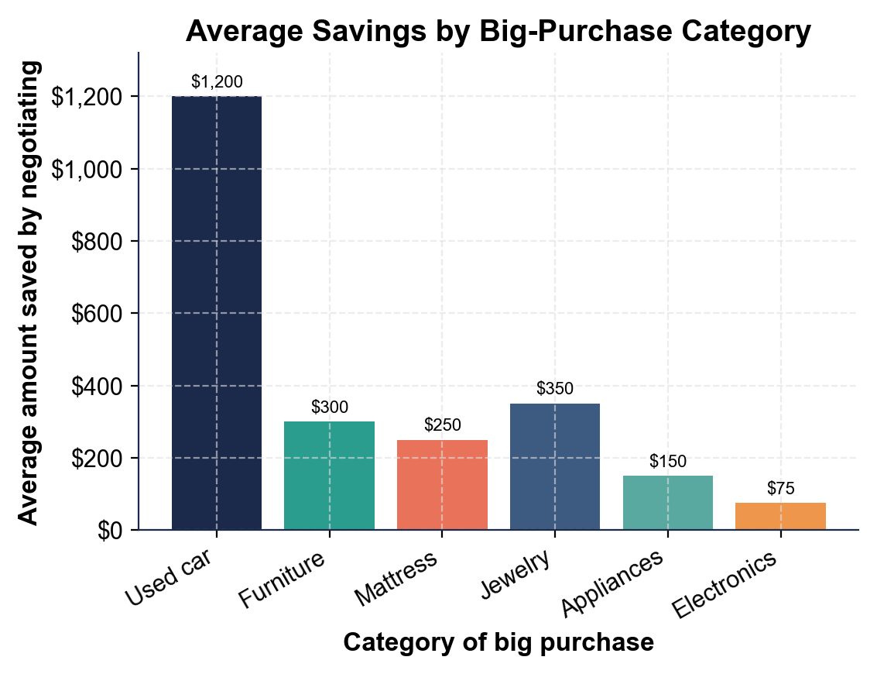
Average Savings by Big-Purchase Category
Used cars save the most when negotiated (~$1,200); electronics the least (~$75).
© More Lessons Less Planning | morelessonslessplanning.com
Notes:
Give students a moment to read the six bars on their own before discussing. The bar chart shows the average amount saved by negotiating in six categories of big purchase: USED CAR at about $1,200 (the tallest bar), JEWELRY at about $350, FURNITURE at about $300, MATTRESS at about $250, APPLIANCES at about $150, and ELECTRONICS at about $75 (the shortest bar). Point out the ranking from tallest to shortest: used car, jewelry, furniture, mattress, appliances, electronics. Work the takeaways live. The used-car bar towers over the rest because cars have the most markup and room to negotiate; electronics is tiny because thin margins leave little room. Note the gap between the biggest and smallest bar: $1,200 - $75 = $1,125, showing negotiation pays off far more on a car than on a gadget. Connect to the persona: Tyler saved $1,000 negotiating his used car, right in line with the roughly $1,200 average for cars. This is the chart Activity Part 4 reads and analyzes; students read all six bars, name the biggest and smallest, and find the gap between them. Remind students these are average examples, not guaranteed savings.
Reference labels (point to these chart features when teaching): Used car biggest: $1,200; Electronics smallest: $75

Slide 12
Run Your Own Negotiation
Step 1 - Research and set prices
RESEARCH the fair price, set a TARGET PRICE below it, and set your WALK-AWAY PRICE - the most you will pay
✔
Step 2 - Open and counter
Open below your target, then trade COUNTEROFFERS with a reason until you reach a price or walk
✔
Step 3 - Do the math
SAVINGS = STICKER - NEGOTIATED, then PERCENT OFF = SAVINGS / STICKER to score your deal
✔
Step 4 - Decide
If the negotiated price is at or below your WALK-AWAY PRICE, buy; if not, walk away
✔
Key Concept: Research and set prices, open and counter, do the savings math, then decide with your walk-away price.
© More Lessons Less Planning | morelessonslessplanning.com
Notes:
Give students the exact repeatable process they use in the Activity capstone to run a real negotiation and score it. Step 1 - RESEARCH AND SET PRICES: research the fair price, set a TARGET PRICE a bit below it, and set your WALK-AWAY PRICE, the most you will pay. Step 2 - OPEN AND COUNTER: open with a polite offer below your target, then trade COUNTEROFFERS, naming a reason each time, until you reach a price or hit your walk-away. Step 3 - DO THE MATH: once you agree on a price, find SAVINGS = STICKER - NEGOTIATED, then PERCENT OFF = SAVINGS / STICKER, so you can score how good the deal was. Step 4 - DECIDE: if the negotiated price is at or below your walk-away price, buy; if the seller will not come down to it, walk away. Walk students through the Activity's Part 5 client, Jordan Price, who talks a $12,000 SUV down to $10,200 (saving $1,800, or 15% off) against a $10,500 walk-away, so Jordan buys. Tell students the Activity's final Part asks them to run exactly these four steps for a new client and decide whether that client got a good deal.

Slide 13
Key Takeaways
The STICKER PRICE is a starting point - big purchases are negotiable
★
SAVINGS = STICKER - NEGOTIATED; Tyler saved $10,000 - $9,000 = $1,000
★
PERCENT OFF = SAVINGS / STICKER; Tyler's $1,000 is 10% off
★
Set a WALK-AWAY PRICE from research: buy at or below it, walk above it
★
Research, timing, and knowing where to push (cars save most) get a better deal
★
© More Lessons Less Planning | morelessonslessplanning.com
Notes:
Read each takeaway and connect it back to the learning targets. T1 (the why) -> the STICKER PRICE is only a starting point, and big purchases like cars and furniture are negotiable. T2 (model 1) -> SAVINGS = STICKER - NEGOTIATED; Tyler saved $10,000 - $9,000 = $1,000. T3 (model 2) -> PERCENT OFF = SAVINGS / STICKER; Tyler's $1,000 is 10% off the sticker. T4 (the judgment) -> set a WALK-AWAY PRICE from your research and use the rule: buy at or below it, walk away above it. T5 (the moves) -> research the fair price, time your purchase when sellers are motivated, and push hardest where the savings are biggest (cars save the most; electronics the least). Close by returning to the opening idea: students can now negotiate a big purchase and prove how much they saved.

