Slide 1
Napoleon's Rise to Power
How a young general exploited revolutionary chaos and a weak Directory to seize control of France
© More Lessons Less Planning | morelessonslessplanning.com
Notes:
Open with the lesson question: how did a revolution that overthrew a king end with one man ruling France? Preview the arc: Napoleon's early military fame, the weak Directory, the Coup of 18 Brumaire in 1799, and his rise to First Consul.

Slide 2
Learning Targets
Explain how Napoleon rose from a young officer to a famous general
★
Describe how the Army of Italy and the Egyptian campaign built his reputation
★
Explain why the weak Directory created an opening for a strong leader
★
Analyze the Coup of 18 Brumaire and how Napoleon became First Consul
★
Evaluate how a revolution against a king ended with one-man rule
★
© More Lessons Less Planning | morelessonslessplanning.com
Notes:
The five targets keep the lesson centered: Napoleon's early rise, his military campaigns, the weakness of the Directory, the Coup of 18 Brumaire, and the big-picture shift from revolution to one-man rule.

Slide 3
The Young General
Napoleon Bonaparte trained as an artillery officer in the French army.
In 1793, he drove British forces out of the port of Toulon and won fame.
In 1795, he crushed a royalist revolt in Paris with cannon fire.
The new Directory government rewarded him with higher command.
By his mid-twenties, Napoleon was one of France's most promising generals.
Key Concept: Napoleon rose fast as a young artillery officer, winning fame at Toulon (1793) and by crushing a royalist revolt in Paris (1795).
© More Lessons Less Planning | morelessonslessplanning.com
Notes:
Napoleon Bonaparte trained as an artillery officer in the French army. In 1793 he drove British forces out of the port of Toulon and won early fame, and in 1795 he crushed a royalist revolt in Paris with cannon fire. The new Directory government rewarded him with higher command, and by his mid-twenties Napoleon was one of France's most promising generals.

Slide 4
Command of the Army of Italy, 1796
In 1796, the Directory gave Napoleon command of the Army of Italy.
His soldiers were ragged, hungry, and often unpaid.
Napoleon issued a proclamation promising glory and the rich plains of Italy.
He built fierce personal loyalty among his troops.
The proclamation shows how Napoleon turned hardship into motivation.
Key Concept: In 1796 Napoleon took command of the ragged, unpaid Army of Italy and used a proclamation promising glory to build personal loyalty.
© More Lessons Less Planning | morelessonslessplanning.com
Notes:
In 1796 the Directory gave Napoleon command of the Army of Italy, whose soldiers were ragged, hungry, and often unpaid. Napoleon issued a proclamation promising them glory and the rich plains of Italy, building fierce personal loyalty among his troops. The proclamation, which students read in the Primary Source Spotlight, shows how Napoleon turned hardship into motivation.

Slide 5
Victories in Italy, 1796-97
Winning in Italy
The Payoff
Napoleon won fast victories at Lodi, Arcole, and Rivoli
He knocked Austria's allies out of the war one by one
The 1797 Treaty of Campo Formio ended the fighting in Italy
France gained land and Napoleon gained enormous fame
His name was now known across France
Key Concept: Napoleon's 1796-97 victories in Italy, ending in the Treaty of Campo Formio, made him a national hero.
© More Lessons Less Planning | morelessonslessplanning.com
Notes:
Napoleon won fast victories at Lodi, Arcole, and Rivoli, knocking Austria's allies out of the war one by one. The 1797 Treaty of Campo Formio ended the fighting in Italy. France gained land and Napoleon gained enormous fame, and his name was now known across France.

Slide 6
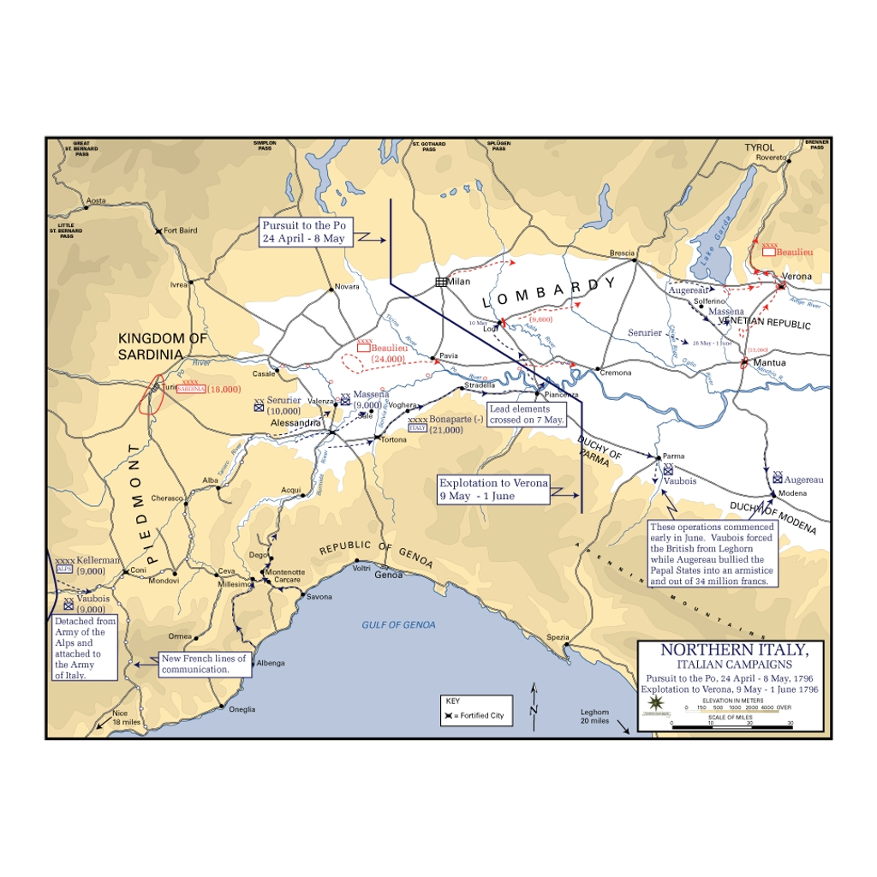
The Italian Campaign, 1796-97
Map of Napoleon's Italian campaign, 1796-97
© More Lessons Less Planning | morelessonslessplanning.com
Notes:
This is a historical map of northern Italy showing the region of Napoleon's 1796-97 campaign. Use it as a geographic reference for where Lodi, Arcole, and Rivoli were fought, not as evidence for any single graded fact.

Slide 7
Building the Legend
Napoleon carefully controlled his own public image.
He sent dramatic bulletins from the front to newspapers in Paris.
Artists painted him as a bold, heroic leader on horseback.
This propaganda made him look larger than life.
A general with fame and a loyal army was a threat to any weak government.
Key Concept: Napoleon used bulletins and heroic paintings as propaganda to build a larger-than-life public image.
© More Lessons Less Planning | morelessonslessplanning.com
Notes:
Napoleon carefully controlled his own public image. He sent dramatic bulletins from the front to newspapers in Paris, and artists painted him as a bold, heroic leader on horseback. This propaganda made him look larger than life. A general with fame and a loyal army was a threat to any weak government - a warning students should keep in mind as the Directory grows weaker.

Slide 8
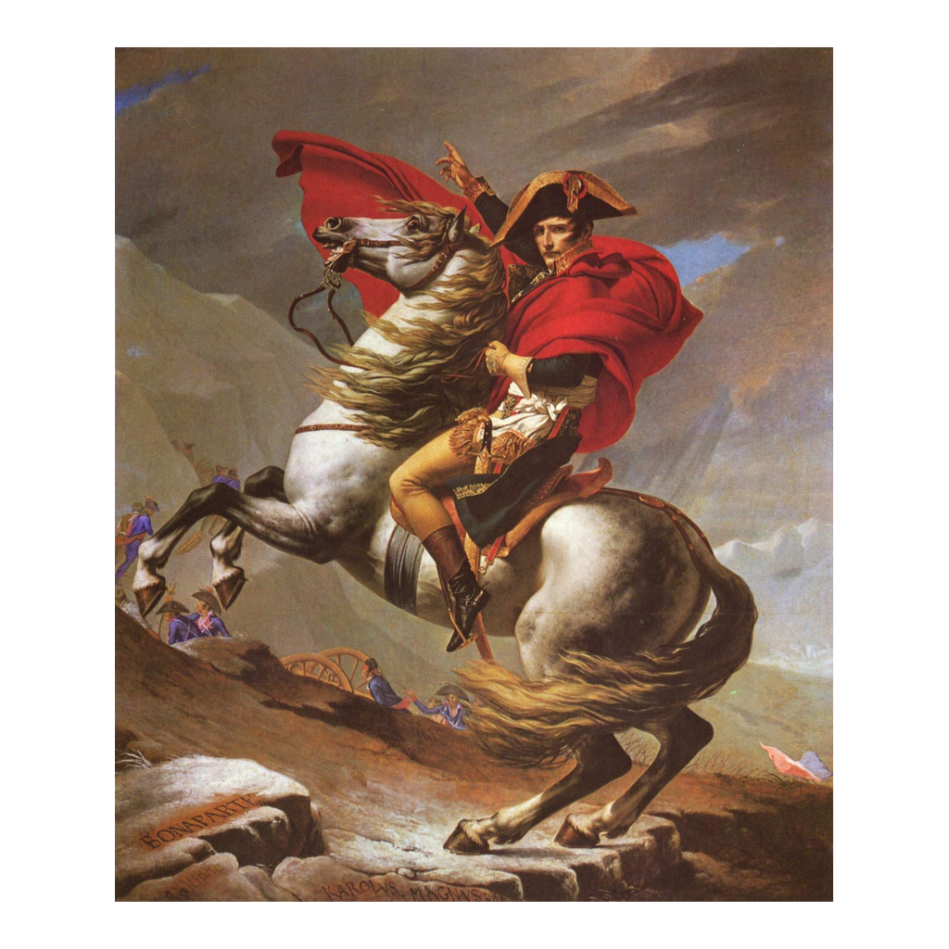
Napoleon Crossing the Alps
David, Napoleon Crossing the Alps (1801) - an idealized propaganda image
© More Lessons Less Planning | morelessonslessplanning.com
Notes:
This is Jacques-Louis David's Napoleon Crossing the Alps (1801), one of the most famous images of Napoleon. It is an idealized propaganda painting: it shows him on a rearing horse in a heroic pose, though in reality the crossing was made on a mule led by a guide. Use it as an example of image-making, not as an accurate record of events.

Slide 9
The Egyptian Campaign, 1798-99
Into Egypt
A Costly Failure
In 1798, Napoleon led an expedition to Egypt
He won the Battle of the Pyramids on land
The British navy destroyed his fleet at the Battle of the Nile
His army was left trapped and far from home
In 1799, Napoleon abandoned his army and sailed back to France
Key Concept: Napoleon's 1798-99 Egyptian campaign failed militarily, yet he escaped blame and returned to France as a famous general.
© More Lessons Less Planning | morelessonslessplanning.com
Notes:
In 1798 Napoleon led an expedition to Egypt and won the Battle of the Pyramids on land. But the British navy destroyed his fleet at the Battle of the Nile, leaving his army trapped and far from home. In 1799 Napoleon abandoned his army and sailed back to France, escaping blame and returning as a still-famous general.

Slide 10
The Weak Directory
The Directory was a five-man executive that ruled France from 1795.
It was widely seen as corrupt and ineffective.
France faced money problems, rising prices, and war weariness.
The Directory survived several coups and street revolts.
Few French people were willing to defend it.
Key Concept: The Directory, France's weak and unpopular five-man government after 1795, left few people willing to defend it.
© More Lessons Less Planning | morelessonslessplanning.com
Notes:
The Directory was a five-man executive that ruled France from 1795. It was widely seen as corrupt and ineffective, and France faced money problems, rising prices, and war weariness. The Directory survived several coups and street revolts, but few French people were willing to defend it - a fatal weakness when a popular general decided to act.

Slide 11
A Country Ready for a Strongman
A Country Exhausted
An Opening for a Strongman
Years of revolution had left France unstable and tired
People feared both a return of the king and new radical terror
Many wanted order and stability more than liberty
A popular general looked like a source of that order
Revolutionary chaos created an opening for one-man rule
Key Concept: War, instability, and fear of both royalists and radicals made many French people want order, creating an opening for a strong leader.
© More Lessons Less Planning | morelessonslessplanning.com
Notes:
Years of revolution had left France unstable and tired, and people feared both a return of the king and a new radical terror. Many wanted order and stability more than liberty, and a popular general looked like a source of that order. Revolutionary chaos created an opening for one-man rule.

Slide 12
The Coup of 18 Brumaire, November 1799
The Coup of 18 Brumaire took place on November 9-10, 1799.
Director Emmanuel Sieyes helped plan the coup and needed a general's support.
Napoleon provided the soldiers who forced out the lawmakers.
The Council of Five Hundred was cleared by troops.
Napoleon outmaneuvered Sieyes to take the leading role himself.
Key Concept: The Coup of 18 Brumaire (Nov. 9-10, 1799) was planned by Sieyes but ran on Napoleon's soldiers, whom he used to take control.
© More Lessons Less Planning | morelessonslessplanning.com
Notes:
The Coup of 18 Brumaire took place on November 9-10, 1799. Director Emmanuel Sieyes helped plan the coup and needed a general's support, and Napoleon provided the soldiers who forced out the lawmakers. The Council of Five Hundred was cleared by troops. Importantly, Napoleon did not act alone: he outmaneuvered Sieyes and the other plotters to take the leading role himself.

Slide 13
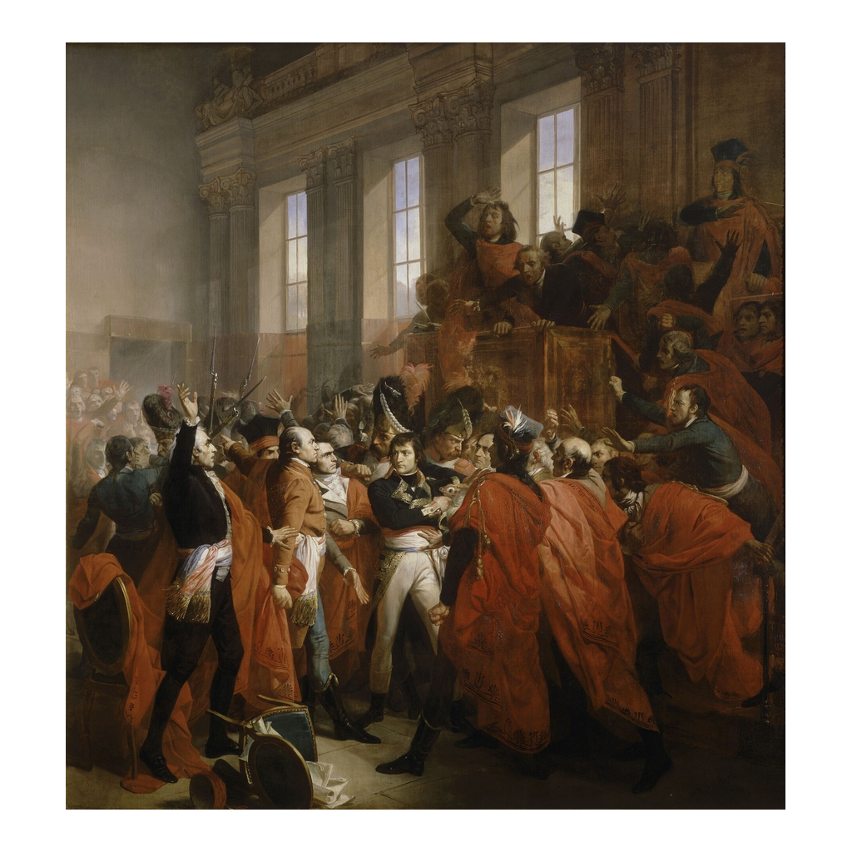
Bonaparte and the Council of Five Hundred
Bouchot, General Bonaparte at the Coup of 18 Brumaire (painted 1840)
© More Lessons Less Planning | morelessonslessplanning.com
Notes:
This is Francois Bouchot's 1840 painting of General Bonaparte confronting the Council of Five Hundred during the Coup of 18 Brumaire. It was painted more than forty years after the event, so it is a dramatic later interpretation, not an eyewitness record. Use it as a reference image for the confrontation, not as proof of exactly what happened.

Slide 14
From Directory to Consulate
The Consulate
First Consul
The coup ended the Directory and created the Consulate
Three consuls now led France on paper
Napoleon became First Consul and held the real power
He was NOT yet emperor - that came later, in 1804
The Constitution of Year VIII concentrated power in his hands
Key Concept: The coup ended the Directory and created the Consulate; Napoleon became First Consul, not yet emperor.
© More Lessons Less Planning | morelessonslessplanning.com
Notes:
The coup ended the Directory and created the Consulate, in which three consuls led France on paper. In reality, Napoleon became First Consul and held the real power. He was not yet emperor - that came later, in 1804. The Constitution of Year VIII concentrated power in his hands while keeping the appearance of a republic.

Slide 15
Consolidating Power as First Consul
As First Consul, Napoleon controlled the army, police, and lawmaking.
He held a plebiscite, a public yes-or-no vote, to approve his rule.
The vote gave his takeover the appearance of popular support.
He restored order, calmed the economy, and made peace for a time.
Napoleon presented one-man rule as the will of the people.
Key Concept: As First Consul, Napoleon used a plebiscite to give his one-man rule the appearance of popular support.
© More Lessons Less Planning | morelessonslessplanning.com
Notes:
As First Consul, Napoleon controlled the army, police, and lawmaking. He held a plebiscite - a public yes-or-no vote - to approve his rule, which gave his takeover the appearance of popular support. He restored order, calmed the economy, and made peace for a time. Napoleon presented one-man rule as the will of the people.

Slide 16
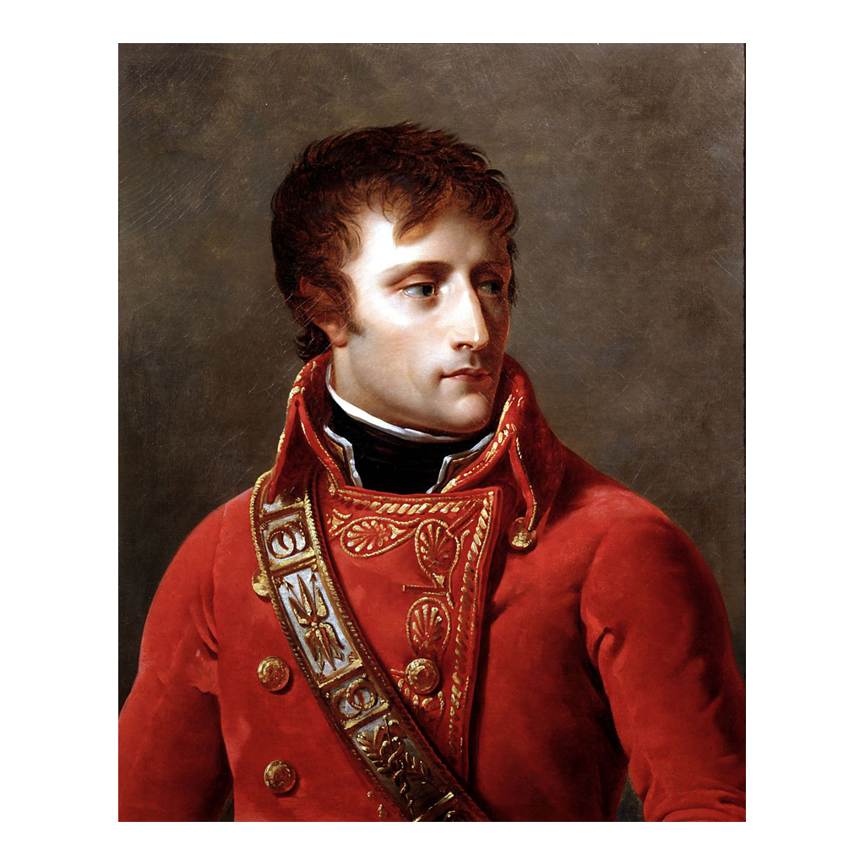
Napoleon as First Consul
Portrait of Napoleon Bonaparte as First Consul (c. 1802-1804)
© More Lessons Less Planning | morelessonslessplanning.com
Notes:
This is an official portrait of Napoleon Bonaparte as First Consul, painted around 1802-1804. Like all official portraits, it was made to project authority and legitimacy. Use it as a reference image for how Napoleon presented himself as head of state, not as proof of any single fact.

Slide 17
From Revolution to Empire
A revolution that overthrew a king had produced a new strongman.
In 1802, a plebiscite made Napoleon Consul for Life.
In 1804, Napoleon crowned himself Emperor of the French.
Revolutionary chaos had opened the door to one-man rule.
The Republic's search for order ended in a new form of autocracy.
Key Concept: A revolution that overthrew a king ended with Napoleon as Consul for Life (1802), then Emperor (1804) - one-man rule.
© More Lessons Less Planning | morelessonslessplanning.com
Notes:
A revolution that overthrew a king had produced a new strongman. In 1802 a plebiscite made Napoleon Consul for Life, and in 1804 he crowned himself Emperor of the French. Revolutionary chaos had opened the door to one-man rule, and the Republic's search for order ended in a new form of autocracy. This is the analytical payoff of the lesson.

Slide 18
Reference Guide: The Rise of a General
Napoleon Bonaparte
The young general who rose during the French Revolution to rule France.
Army of Italy
The French army Napoleon led to victory in northern Italy in 1796-97.
Egyptian Campaign
Napoleon's 1798-99 expedition that failed militarily but built his fame.
Directory
The five-man executive that governed France from 1795 to 1799.
Coup of 18 Brumaire
Napoleon's November 1799 seizure of power that ended the Directory.
Tip: These five terms trace the story from Napoleon's early fame to the coup that ended the Directory.
© More Lessons Less Planning | morelessonslessplanning.com
Notes:
Review the five terms exactly as defined: Napoleon Bonaparte, Army of Italy, Egyptian Campaign, Directory, and Coup of 18 Brumaire. Students use these definitions to complete the Reference Guide in the Activity.

Slide 19
Reference Guide: Seizing Control
Consulate
The government that replaced the Directory after the 1799 coup.
First Consul
The title Napoleon took as head of the Consulate in 1799.
Constitution of Year VIII
The 1799 constitution that made Napoleon First Consul.
Emmanuel Sieyes
The Directory member who helped plan the coup with Napoleon.
plebiscite
A yes-or-no public vote Napoleon used to approve his new government.
Tip: These five terms name the new government, Napoleon's title, and the tools he used to make one-man rule look legitimate.
© More Lessons Less Planning | morelessonslessplanning.com
Notes:
Review the five terms exactly as defined: Consulate, First Consul, Constitution of Year VIII, Emmanuel Sieyes, and plebiscite. Students use these definitions to complete the Reference Guide in the Activity.

Slide 20
Key Takeaways
Napoleon rose fast as a young general, winning fame in Italy in 1796-97.
★
The Egyptian campaign (1798-99) failed but did not ruin his reputation.
★
The weak, unpopular Directory left France ready for a strong leader.
★
In the Coup of 18 Brumaire (Nov. 1799) Napoleon seized power with Sieyes.
★
Napoleon became First Consul, not emperor - that came later, in 1804.
★
© More Lessons Less Planning | morelessonslessplanning.com
Notes:
Close with the essential question. Each takeaway connects Napoleon's military fame, the weakness of the Directory, and the Coup of 18 Brumaire to the big-picture shift from revolution to one-man rule.

