Slide 1
Monsters of the Mediterranean
Sirens, Scylla, and Charybdis - what the Odyssey's monsters reveal about the real fears of ancient Greek sailors.
© More Lessons Less Planning | morelessonslessplanning.com
Notes:
Open with the danger. In Book XII of the Odyssey, Odysseus must sail past three of the most famous monsters in all of literature: the Sirens, whose song lures sailors to their death; Scylla, a six-headed monster of the rock; and Charybdis, a whirlpool that swallows whole ships. Set the honest frame at once: these monsters are MYTHOLOGICAL - they are not real creatures. The whole point of this lesson is what these stories REVEAL - what real ancient Greek sailors actually feared out on a dangerous sea, and how Greek storytellers turned those fears into unforgettable monsters. We will also look at a centuries-old game: trying to pin Odysseus's route onto a real map. That game is fun, but it is speculative and debated - not settled fact.

Slide 2
Learning Targets
The monsters of Book XII: Sirens, Scylla, Charybdis, and Circe's warning
★
What the monsters REVEAL: the real fears of ancient Greek sailors
★
Mapping Odysseus's route: a SPECULATIVE tradition, and myth vs. history
★
© More Lessons Less Planning | morelessonslessplanning.com
Notes:
Read each target aloud. Target 1 maps to slides 3-7 (Circe's warning, the Sirens, Odysseus's wax-and-mast plan, and Scylla and Charybdis). Target 2 maps to slide 8 (reading the monsters as dramatizations of real sailors' fears). Target 3 maps to slides 9-11 (the speculative route-mapping tradition, the myth-not-history frame, and the honest verdict). Stress the load-bearing honesty ideas: the monsters are mythological, not real; and mapping Odysseus's exact route is a debated tradition of attempts, not proven fact.

Slide 3
Circe's Warning: The Road Ahead
Who Is Circe?
The Goal Is Still Home
CIRCE is the enchantress who warns Odysseus how to survive the dangers ahead
In Book XII she tells him about the Sirens, Scylla, and Charybdis
Her warning is knowledge - it lets Odysseus plan before he sails
NOSTOS is the Greek word for the homecoming or return
The whole Odyssey is Odysseus's struggle to reach home on Ithaca
Every monster in Book XII stands between him and that homecoming
Key Concept: The enchantress CIRCE warns Odysseus how to survive the monsters ahead so he can continue his NOSTOS - the long struggle home to Ithaca.
© More Lessons Less Planning | morelessonslessplanning.com
Notes:
Set up the episode. CIRCE is an enchantress on the island of Aeaea; earlier in the Odyssey she was a danger, but by Book XII she has become a helper. Before Odysseus leaves her island, she warns him about the monsters he will meet on the sea ahead: the Sirens, then the twin terrors Scylla and Charybdis. Emphasize that her warning is really KNOWLEDGE - it is the information that lets Odysseus plan ahead instead of blundering into disaster. Remind students of the engine of the whole poem: NOSTOS, the Greek word for the homecoming or return. The entire Odyssey is Odysseus's long struggle to get home to his island of Ithaca, and every monster in Book XII is one more obstacle standing between him and that homecoming.

Slide 4
The Sirens: The Deadly Song
The Sirens
The SIRENS are bird-women whose beautiful song lures passing sailors to steer close and die; they never reach home again.
A field of bones
Circe warns of a great heap of dead men's bones lying all around the Sirens' green meadow - a sign of how many sailors the song kills.
The fear it reveals
The real danger is the temptation to STOP - to be lured off course and abandon the long, hard voyage home.
Not a real animal
The Sirens are mythological: their song promises knowledge and delight, but giving in is a deadly trap.
Key Concept: The SIRENS are bird-women whose song lures sailors to their death - a myth of the temptation to stop and give up the voyage home.
© More Lessons Less Planning | morelessonslessplanning.com
Notes:
Introduce the first monster and, right away, what it reveals. The SIRENS are bird-women who sit in a green meadow and sing so beautifully that any sailor who hears them steers his ship close to listen - and dies there, never reaching home. Circe warns that the ground around them is a heap of rotting bones. Now make the honest, revealing move: the Sirens are not a real animal, and the point is not 'watch out for singing bird-women.' The Sirens dramatize a real and deadly danger for sailors - the TEMPTATION to stop. The song promises knowledge and delight, but giving in means abandoning the long, hard voyage home. Ask students what makes this fear so real: on a difficult journey, the pull to quit, to be distracted, to stop trying, can be as deadly as any storm. That is the human fear the Siren myth captures.

Slide 5
Odysseus's Plan: Wax and the Mast
Surviving by Cunning
A Plan, Not a Fight
METIS is cunning, cleverness, and forethought - planning ahead
Odysseus plugs his crew's ears with WAX so they cannot hear the song
He has himself bound to the MAST so he can listen but not steer to his death
You cannot fight a song - so Odysseus outsmarts it instead
He orders the crew to bind him tighter if he begs to be freed
The next slide shows an ancient vase of this exact scene
Key Concept: Odysseus survives the Sirens by METIS (cunning) - wax in the crew's ears and binding himself to the mast - a plan, not a fight.
© More Lessons Less Planning | morelessonslessplanning.com
Notes:
This is the heart of the Sirens episode: Odysseus does not fight the danger, he outsmarts it. METIS is the Greek word for cunning, cleverness, and forethought - and this plan is pure metis. You cannot fight a song with a sword, so Odysseus makes a plan. He softens a great wheel of WAX and plugs the ears of every crew member so they cannot hear the Sirens at all. Then, because he wants to hear the famous song himself and survive, he orders the men to tie him upright to the MAST - and, crucially, to bind him even tighter if he begs to be set free. When the Sirens sing, Odysseus does beg and struggle, but the bound ropes and the deaf crew keep the ship on course. Stress the pattern that runs through the whole Odyssey: Odysseus survives not by being the strongest but by being the cleverest - planning ahead for a danger he cannot overpower. The next slide shows a real ancient Greek vase of this very scene so students can picture it.

Slide 6
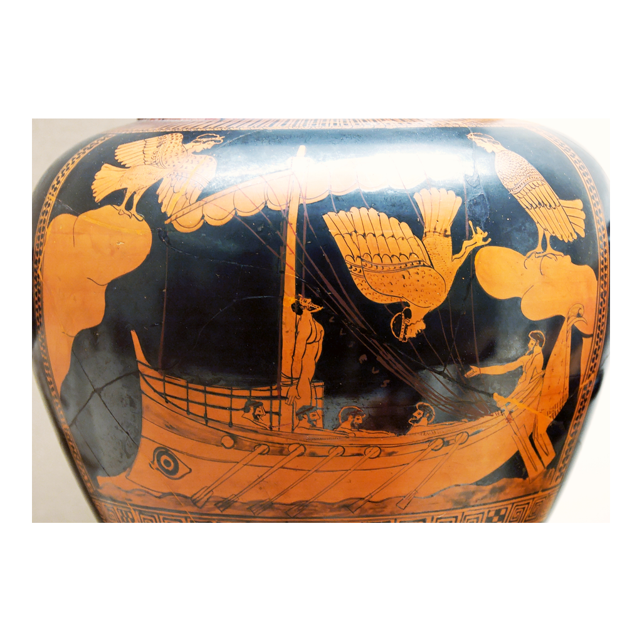
An Ancient Vase: Bound to the Mast
The Siren Vase (British Museum, ca. 480-470 BCE): Odysseus bound to the mast
© More Lessons Less Planning | morelessonslessplanning.com
Notes:
This is a real ancient Greek vase - the famous Siren Vase, an Attic red-figure stamnos painted around 480-470 BCE (now in the British Museum). It shows Odysseus tied to the mast of his ship while the bird-women Sirens fly around him, one of them tumbling down. Have students notice the human figure lashed upright to the mast and the bird-bodied, human-headed Sirens overhead. Connect it to the previous slide: this is metis in action - Odysseus survives the deadly song by a plan (bound to the mast, crew's ears stopped), not by force. Keep the honest caption in view: this is ancient Greek ART depicting a scene from the myth, not a photograph of a real event. Greeks painted this scene onto pottery because the story was beloved and widely known - which is itself evidence of how important the Odyssey was to their culture.
Reference labels (point to these chart features when teaching): Odysseus bound to the mast; the bird-women Sirens

Slide 7
Scylla and Charybdis: The Twin Terrors
Scylla
SCYLLA is a monster of the high rock with six long necks and heads; she snatches a sailor in each mouth from any ship that passes too close.
Charybdis
CHARYBDIS is a whirlpool on the opposite side that three times a day sucks down and vomits up the sea, swallowing any ship caught over it.
A narrow passage
The two monsters guard opposite sides of a narrow strait, so a ship must pass dangerously close to one or the other - there is no safe middle.
The grim choice
Circe tells Odysseus to hug Scylla's side: it is better to lose six men to Scylla than the whole crew to Charybdis - a brutal cost-benefit choice.
Key Concept: SCYLLA (a six-headed rock monster) and CHARYBDIS (a ship-swallowing whirlpool) guard a narrow strait - lose six men or the whole crew.
© More Lessons Less Planning | morelessonslessplanning.com
Notes:
Introduce the twin terrors and the impossible choice between them. SCYLLA is a monster who lives high on a rock; she has six long necks, each ending in a horrible head, and she shoots them all out at once to snatch a sailor in each mouth from any ship passing beneath. On the opposite side, close enough that the two are almost within a bowshot, is CHARYBDIS, a whirlpool that three times a day sucks the sea down into a black funnel and then vomits it back up - swallowing any ship caught over it. Make the geography clear: the two monsters sit on OPPOSITE sides of a narrow strait, so there is no safe middle path. A ship must pass dangerously close to one or the other. Circe gives Odysseus a brutal piece of advice: steer close to Scylla's side and accept that she will grab six men, because it is better to lose six men than to lose the entire crew and ship to Charybdis. This grim cost-benefit choice is one of the most famous dilemmas in literature - the origin of the phrase 'between a rock and a hard place.'

Slide 8
Reading the Monsters: The Real Fears of Sailors
Monsters as Fears in Disguise
Why Tell It This Way?
The monsters are mythological - but they dramatize REAL dangers at sea
The Sirens = the deadly lure to stop and abandon the voyage
Scylla = the terror of a narrow, rocky, ship-wrecking strait
Charybdis = the real hazard of a violent, ship-swallowing whirlpool
A monster is more memorable and vivid than a plain warning
The stories REVEAL what ancient Greek sailors most feared
Big Idea: The monsters are myth, but they REVEAL real sailor fears - the lure to give up (Sirens), a rocky strait (Scylla), a whirlpool (Charybdis).
© More Lessons Less Planning | morelessonslessplanning.com
Notes:
This is the central 'reading' of the lesson, and it deserves real emphasis. Say it plainly: the monsters are MYTHOLOGICAL - they are not real creatures, and we are not claiming a six-headed beast really ate real sailors. But the monsters are not random. Each one dramatizes a genuine danger that ancient Greek sailors actually faced. The Sirens dramatize the deadly temptation to STOP - to be distracted, to give up the exhausting voyage home. Scylla dramatizes the terror of a narrow, rocky strait where a ship can be wrecked and men lost. Charybdis dramatizes the real hazard of a violent whirlpool that can swallow a ship whole. Ask students why tell it with monsters instead of a plain warning? Because a monster is vivid and unforgettable in a world where stories were spoken aloud and passed down by memory - and because fear feels like a monster. The honest, powerful reading is this: the Odyssey's monsters are a window into what real Greek sailors most feared out on a dangerous sea. Reading them this way is both more accurate and more interesting than asking 'were they real?'

Slide 9
Mapping the Journey: A Speculative Tradition
An old temptation
For 2,000 years, readers have tried to pin Odysseus's route onto a real map of the Mediterranean.
The Strait of Messina
The STRAIT OF MESSINA, the narrow passage between Italy and Sicily, is where many writers place Scylla and Charybdis.
Speculative, not proven
This route-mapping is SPECULATIVE - guesswork, not proof. Others argue the geography is deliberately fantastical and unmappable.
An honest verdict
Treat route-mapping as an ongoing debate, never as settled fact that 'Odysseus really sailed here.'
Big Idea: Locating Odysseus's monsters on a real map (like the STRAIT OF MESSINA) is a SPECULATIVE, debated tradition of attempts - not proven fact.
© More Lessons Less Planning | morelessonslessplanning.com
Notes:
Introduce the second big thread of the lesson, and be scrupulously honest about it. For more than two thousand years, readers have found it irresistible to try to pin Odysseus's wanderings onto a real map of the Mediterranean. The most famous example is Scylla and Charybdis: the narrow, dangerous STRAIT OF MESSINA between the toe of Italy and the island of Sicily has a real, violent whirlpool, so many writers - ancient ones like the historians Thucydides and Strabo, and many modern ones - identified that strait with Circe's twin terrors. But here is the load-bearing honesty point: all of this is SPECULATIVE. It is guesswork and interpretation, not proof. Plenty of serious scholars argue the opposite - that the Odyssey's geography is deliberately fantastical, a poet's imagined world that was never meant to match a real map, and that trying to chart it is a mistake. So present route-mapping the honest way: as a long, ongoing TRADITION OF ATTEMPTS and an active DEBATE. We can say 'some writers have argued Scylla and Charybdis are the Strait of Messina.' We must NOT say 'Odysseus really sailed through the Strait of Messina.' The debate itself is the interesting, honest story.

Slide 10
Myth, Not History: How to Read the Monsters
What the Odyssey Is
How to Read It Honestly
The Odyssey is MYTH and literature, not a historical record
It grew out of the ORAL TRADITION - stories performed and passed down aloud
HOMER is the name given to the oral poet(s) behind it, c. 8th century BCE
The monsters are mythological - Scylla and Charybdis were not real creatures
Ask what the story REVEALS, not 'did this really happen?'
Read it for the fears and values of the ancient Greeks
Big Idea: The Odyssey is MYTH and oral literature, not history - the monsters are not real creatures. Read them for what they reveal.
© More Lessons Less Planning | morelessonslessplanning.com
Notes:
Pull the honesty frame together. The Odyssey is MYTH and literature, not a history report. It did not come from a single author sitting down to write a documentary; it grew out of the ORAL TRADITION - stories composed and passed down by spoken performance over centuries before being written down. HOMER is the name traditionally given to the oral poet, or poets, credited with the Odyssey around the 8th century BCE, but we should not claim as fact that one man named Homer wrote it in one specific year. Now the load-bearing point about the monsters: Scylla and Charybdis and the Sirens are MYTHOLOGICAL - they were not real creatures, and a myth-monster did not really eat real sailors. So the honest question is never 'did this really happen?' The honest question is 'what does this story REVEAL?' And the answer is rich: it reveals what ancient Greek sailors feared (a rocky strait, a whirlpool, the lure to give up) and what the Greeks valued (cunning, forethought, the longing for home). Reading the Odyssey as myth that reveals a culture's fears and values is both accurate and far more interesting than treating it as a travel log.

Slide 11
Weighing It: What We Can and Can't Say
What we CAN say
The monsters of Book XII reveal real fears of ancient Greek sailors, and Odysseus survives the Sirens by cunning (metis) - wax and the mast.
What we CAN say
Some writers have argued Scylla and Charybdis are the Strait of Messina; the story of Charybdis likely dramatizes the real hazard of a whirlpool.
What we must NOT say
We must NOT say the Sirens, Scylla, or Charybdis were real creatures, or that Odysseus 'really sailed' a route we can prove on a map.
The honest verdict
Read the monsters as myth that reveals what sailors feared, and treat route-mapping as a debated tradition of attempts - not settled fact.
Big Idea: Be confident what the monsters REVEAL - real sailor fears - and honest that they are myth and route-mapping is debated, not fact.
© More Lessons Less Planning | morelessonslessplanning.com
Notes:
Close by separating what we can say with confidence from what we cannot - the honest-reader move that runs through the whole unit. State clearly what we CAN say: the monsters of Book XII reveal the real fears of ancient Greek sailors (the deadly lure to stop, a rocky strait, a violent whirlpool); Odysseus survives the Sirens by cunning (metis) - the wax and the mast; some ancient and modern writers have argued that Scylla and Charybdis correspond to the Strait of Messina, and the story of Charybdis likely dramatizes the real hazard of a whirlpool. Then state just as clearly what we must NOT say: we cannot say the Sirens, Scylla, or Charybdis were real creatures, and we cannot say Odysseus 'really sailed' a route we can prove on a map. The honest verdict holds two things at once: the monsters are myth that reveals what sailors feared, and the route-mapping is a debated tradition of attempts, not settled fact. Teaching students to read a story for what it reveals, while staying honest about what it is and is not, is the real goal of the lesson.

Slide 12
Key Takeaways
Book XII: the SIRENS, SCYLLA (six heads), and CHARYBDIS (the whirlpool)
★
Odysseus beats the Sirens by METIS - wax in the ears, bound to the mast
★
MYTH that reveals real fears: the lure to quit, a rocky strait, a whirlpool
★
Route-mapping (e.g., STRAIT OF MESSINA) is SPECULATIVE and debated, not fact
★
© More Lessons Less Planning | morelessonslessplanning.com
Notes:
Close the lesson. Review the four takeaways aloud. Students should be able to (a) name the three monsters of Book XII - the Sirens, Scylla, and Charybdis - and describe Circe's warning; (b) explain that Odysseus survives the Sirens by METIS (cunning): wax in the crew's ears and binding himself to the mast; (c) explain that the monsters are MYTHOLOGICAL but REVEAL the real fears of ancient Greek sailors - the deadly lure to stop, a narrow rocky strait, and a violent whirlpool; and (d) explain that trying to map Odysseus's route onto real geography (like the Strait of Messina) is a SPECULATIVE, debated tradition, and that the Odyssey is myth and oral literature that reveals Greek fears and values, not a historical record. The Primary Source Spotlight asks them to read Circe's warning in the Odyssey's own words and connect it to everything above.

