Slide 1
Monopoly: One Seller, All the Power
One seller, no substitutes, sky-high prices - and the deadweight loss the rest of us pay.
© More Lessons Less Planning | morelessonslessplanning.com
Notes:
Open with the contrast: last lesson was Perfect Competition where the individual firm is a price-TAKER and earns zero long-run profit. Today is the opposite extreme - one seller, no substitutes, the firm is a price-MAKER and earns sustained monopoly profit. The deadweight loss IS the cost society pays for letting that monopoly stand.

Slide 2
Learning Targets
Define MONOPOLY using its four features and contrast with Perfect Competition
★
Read the monopoly pricing diagram - find Q where MR=MC, then P on demand
★
Explain DEADWEIGHT LOSS and distinguish REGULATED from UNREGULATED monopolies
★
© More Lessons Less Planning | morelessonslessplanning.com
Notes:
Read the three targets aloud. Target 1 is the structural definition (one seller, no substitutes, high barriers, price-maker). Target 2 is the technical core (the two-step monopoly pricing rule). Target 3 is the welfare cost AND the policy response.

Slide 3
Why Study Monopoly?
The Opposite of Perfect Competition
Real U.S. Monopolies (Live Today)
PC: many sellers - Monopoly: ONE seller
PC: identical product - Monopoly: no substitutes
PC: free entry - Monopoly: HIGH barriers
PC: price-taker - Monopoly: price-MAKER
Local electric utility - one wire network per service area
Patented pharmaceuticals - 20-year legal monopoly
Local cable TV - government franchise per territory
Some Big Tech platforms - network-effect monopolies
Big Idea: Monopoly flips every condition of perfect competition. Understanding both ends of the spectrum lets you place every real market in between.
© More Lessons Less Planning | morelessonslessplanning.com
Notes:
Frame TK 22 as the OPPOSITE of TK 21. Use the side-by-side contrast to set up the diagnostic. Real-world examples ground the model.

Slide 4
The Four Defining Features of Monopoly
1. One seller
Exactly ONE firm supplies the market; no competing producers (the local electric utility, the patent holder of a drug, the only railroad serving a route)
2. No close substitutes
Buyers have no realistic alternative product - insulin for diabetics, the electric grid for power, the patented drug while patent is active
3. High barriers to entry
Legal, financial, or technological obstacles block new firms - patents, government franchises, enormous fixed costs, network effects
4. Price-maker firm
The single firm SETS its own price by choosing how much to produce; opposite of perfect competition's price-takers
Remember: ALL FOUR features must hold for pure monopoly. A market with one seller but easy entry is NOT a monopoly - someone will compete it away.
© More Lessons Less Planning | morelessonslessplanning.com
Notes:
Walk all four features briskly. Each gets its own deeper-dive slide next. Stress that all four must hold - a single seller with easy entry would attract competition and lose its monopoly position.

Slide 5
Feature 1: One Seller
EXACTLY ONE firm supplies the entire market
ELECTRIC UTILITY - one set of wires per service area
PATENTED DRUG - one legal seller for 20 years
CABLE TV - one government-franchised provider per territory
Contrast with PC: tens of thousands of wheat farms = many sellers
Try this: Can you name a SECOND firm that delivers electricity through wires to your house? In most U.S. cities, no. That is feature 1 in action.
© More Lessons Less Planning | morelessonslessplanning.com
Notes:
Feature 1 is the structural definition - one firm controls the market. Most real-world examples are utilities and patent holders. Big Tech firms approach but rarely achieve pure feature 1.

Slide 6
Feature 2: No Close Substitutes
No Close Substitutes (Strong)
Close Substitutes Exist (Weak)
INSULIN for diabetics - no alternative drug
PATENTED DRUG while patent is active
ELECTRIC GRID for refrigeration, AC, lighting
Big Tech platform - users locked in by network
TAXI medallion - Uber and Lyft are substitutes
CABLE TV - streaming is a close substitute
Brand-name CEREAL - private-label is a substitute
Postal service - email is a substitute
Key Concept: 'No close substitutes' means even if price doubles, buyers stay because they cannot switch. Fewer substitutes = more monopoly power.
© More Lessons Less Planning | morelessonslessplanning.com
Notes:
Feature 2 is what gives the monopoly its pricing power. If close substitutes exist, raising the price drives buyers away. Insulin has no real substitute - the monopoly can charge accordingly.

Slide 7
Feature 3: High Barriers to Entry (Four Types)
LEGAL barrier
Patent (20-year monopoly), copyright, government franchise (cable TV territory), licensing (taxi medallion)
TECHNOLOGICAL barrier
Natural monopoly - one set of wires/pipes/rails cheaper than competing networks (electric, water, rail, broadband)
FINANCIAL barrier
Enormous upfront capital - building a steel mill, launching a satellite network, drilling a mine - blocks all but deep-pocketed entrants
NETWORK EFFECT barrier
Each user makes the product more valuable - social networks, payment systems, ride-share platforms - new entrants cannot match the user base
Big Idea: Barriers are what KEEP a monopoly in place. Without barriers, profits attract entry and the monopoly is competed away.
© More Lessons Less Planning | morelessonslessplanning.com
Notes:
Walk all four barrier types. The mnemonic is L-T-F-N (legal, technological, financial, network). Most real monopolies use 2-3 barriers stacked (the electric utility has both a technological and a legal franchise barrier).

Slide 8
Feature 4: Price-Maker Firm
Price-Maker vs Price-Taker
How the Monopoly Picks the Price
PC firm = PRICE-TAKER (horizontal demand)
Monopoly = PRICE-MAKER (downward demand)
Monopoly chooses Q, market gives back P
Demand curve tells the monopoly what P each Q yields
Step 1: Find Q where MR = MC (the profit-max quantity)
Step 2: Trace UP to the demand curve at that Q
That P is the highest the market will pay for Q
Result: P > MC always (monopoly markup)
Important: A monopoly does NOT just 'charge whatever it wants'. It follows the two-step rule: pick Q where MR=MC, read P off the demand curve.
© More Lessons Less Planning | morelessonslessplanning.com
Notes:
Feature 4 sets up the technical core of monopoly pricing. The two-step rule is what students will use on the next chart and again on the activity. Drill it.

Slide 9
Monopoly Pricing: Pick Q where MR = MC
The Three Curves on the Chart
Reading the Chart (Next Slide)
DEMAND - downward-sloping, market demand curve
MARGINAL REVENUE - downward, twice as steep as Demand
MARGINAL COST - upward-sloping, the supply side
MR crosses MC at quantity 30 - that is the monopoly Q
Trace UP from Q=30 to demand - price is $14
Compare to competitive: where MC meets demand at Q=50, P=$10
Monopoly: Q lower, P higher
Watch out: MR is ALWAYS below Demand for a monopoly. That gap is why MR=MC occurs at a LOWER quantity than competitive equilibrium.
© More Lessons Less Planning | morelessonslessplanning.com
Notes:
Set up the monopoly pricing chart on the next slide BEFORE flipping. Drill the three curves and the two-step rule. Pre-load the values (Q=30, P=$14) so students can verify on the chart.

Slide 10
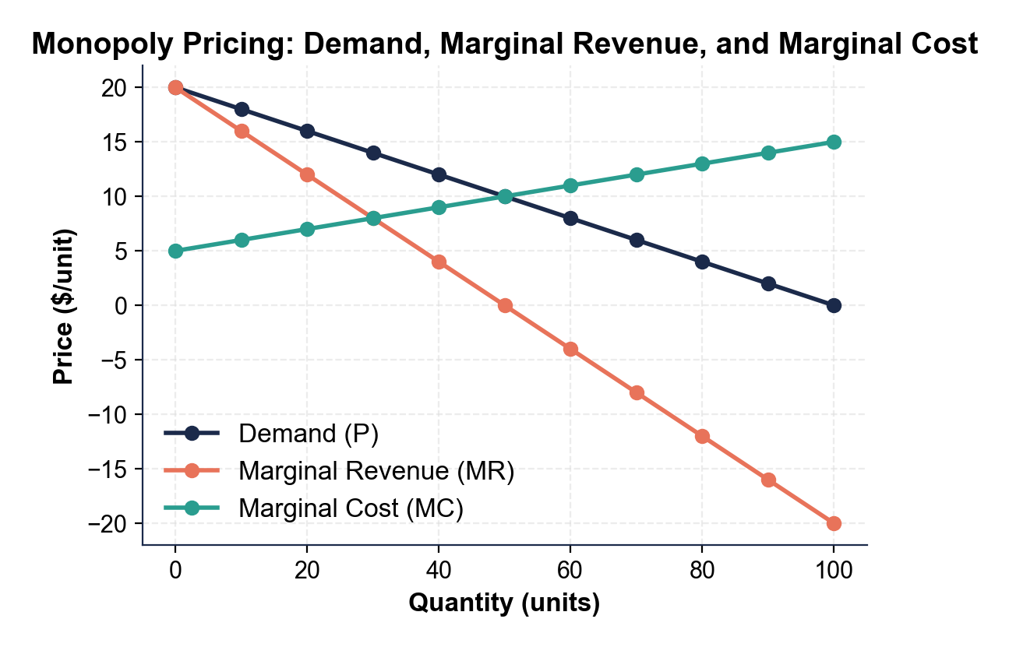
Monopoly Pricing Diagram
MR=MC at Q=30; demand at Q=30 gives P=$14 (monopoly equilibrium).
© More Lessons Less Planning | morelessonslessplanning.com
Notes:
Point to MR=MC at quantity 30. Trace up to demand. Read $14 off the price axis. Compare to where MC meets demand at quantity 50 (price $10).
Reference labels (point to these chart features when teaching): Q=30, P=$14 (monopoly); Q=50, P=$10 (competitive)

Slide 11
Deadweight Loss - The Cost Society Pays
COMPETITIVE equilibrium: Q=50, P=$10 (supply meets demand)
MONOPOLY equilibrium: Q=30, P=$14 (MR=MC, then P on demand)
Monopoly produces 20 FEWER units AND charges $4 MORE per unit
Between Q=30 and Q=50, value > cost - those units never produced
Value that disappears = DEADWEIGHT LOSS (welfare society loses)
Big Idea: Deadweight loss is NOT a transfer (consumer surplus to monopoly is a transfer). It is welfare that DISAPPEARS - no one gets it.
© More Lessons Less Planning | morelessonslessplanning.com
Notes:
Set up the deadweight loss chart on the next slide. Drill the distinction between TRANSFER (consumer surplus to monopoly profit - still exists, different pocket) and DEADWEIGHT LOSS (welfare that vanishes).

Slide 12
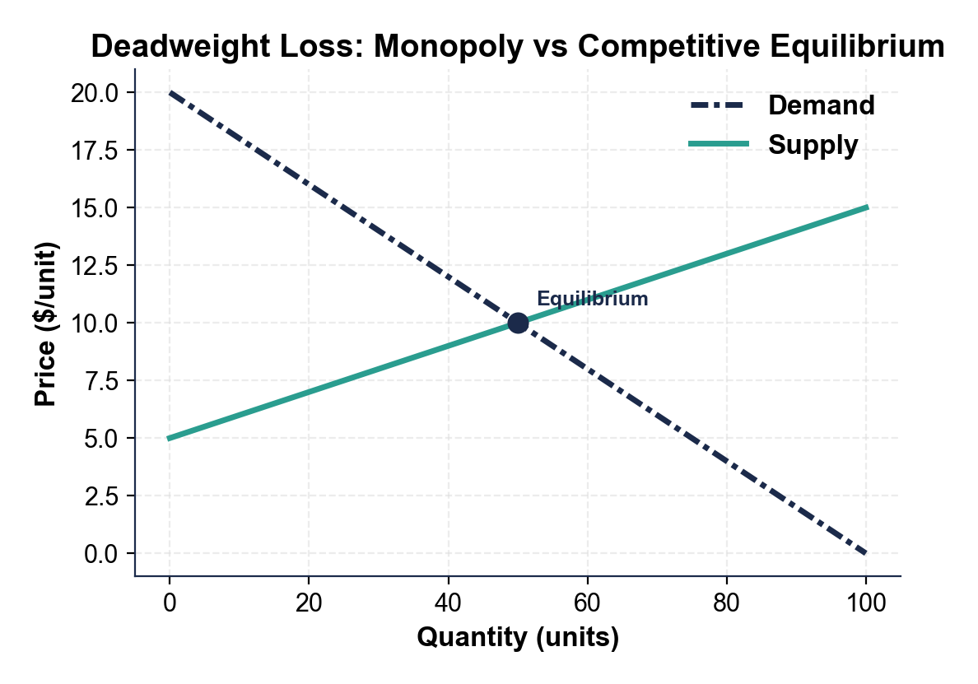
Deadweight Loss: Monopoly vs Competitive
Competitive Q=50 P=$10; Monopoly Q=30 P=$14; triangle between = deadweight loss.
© More Lessons Less Planning | morelessonslessplanning.com
Notes:
Have students point to both equilibria. The competitive equilibrium where supply meets demand. The monopoly equilibrium higher and to the left. The triangle between is the deadweight loss.
Reference labels (point to these chart features when teaching): Competitive (Q=50, P=$10); Monopoly (Q=30, P=$14)

Slide 13
Patented Drugs - The Time-Limited Monopoly
U.S. utility PATENT = 20-year legal monopoly
Brand-name drug under patent has ONE seller (the patent holder)
Patent expires - generic competition allowed - prices crash
On the next chart - brand vs generic prices for 4 common drugs
Roughly 20x price ratio = the dollar value of monopoly power
Real talk: When a patent expires, the same molecule costs 5-10% of what it cost the day before. That gap IS monopoly pricing power.
© More Lessons Less Planning | morelessonslessplanning.com
Notes:
Set up the brand-vs-generic drug chart on the next slide. The point is to put a dollar number on monopoly pricing power. Patents trade 20 years of monopoly profit for public disclosure of the invention.

Slide 14
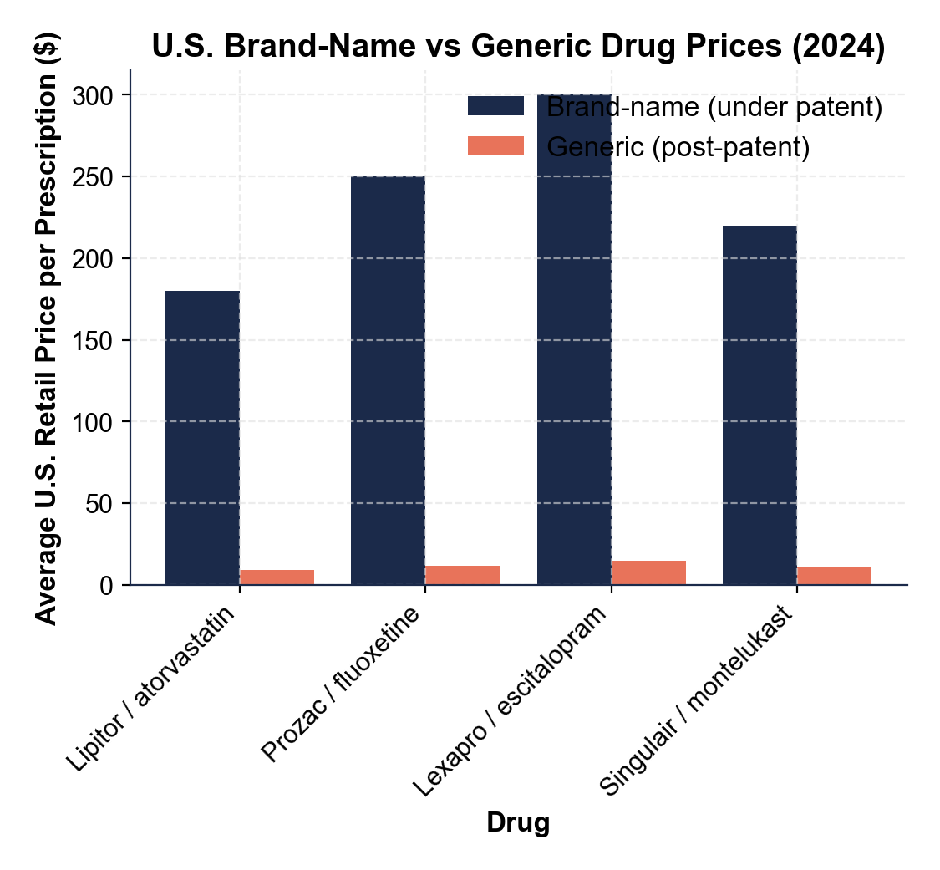
Brand vs Generic Drug Prices
Patent-monopoly brand prices vs post-patent generic prices for four drugs.
© More Lessons Less Planning | morelessonslessplanning.com
Notes:
Have students point to a tall brand bar next to its short generic bar. The visual gap is the dollar value of the patent monopoly. The molecule is the SAME - only the legal status changed.
Reference labels (point to these chart features when teaching): Brand prices $180-$300; Generic prices $9-$15

Slide 15
Regulated Monopoly - How Society Manages It
Public Utility Regulation
Patent Regulation
State PUBLIC UTILITY COMMISSION reviews rates
Caps prices to limit deadweight loss
Requires service to all customers in territory
Trades monopoly profits for stable service
Blocks PRICE DISCRIMINATION across customer classes
PATENT = 20-YEAR limited monopoly granted by USPTO
Trade: monopoly profit in exchange for disclosure
Generic competition required AFTER expiration
Designed to expire so welfare loss is temporary
Big Idea: A REGULATED MONOPOLY does NOT eliminate the monopoly - it limits the deadweight loss. The trade-off: fewer market signals for lower prices.
© More Lessons Less Planning | morelessonslessplanning.com
Notes:
Walk how the U.S. manages two big monopoly types. Utilities are regulated continuously by state commissions. Patents are time-limited monopolies that expire after 20 years.

Slide 16
Unregulated Monopolies - The Antitrust Battleground
Modern Examples
Antitrust Tools
GOOGLE - 90%+ U.S. search share
FACEBOOK / META - dominant social network
AMAZON - online retail platform
Local cable + broadband providers
SHERMAN ACT (1890) - bans monopolization
CLAYTON ACT (1914) - blocks anti-competitive mergers
FTC ACT (1914) - bans unfair methods of competition
Recent: DOJ + 38 states vs Google search (2024)
Real talk: When regulation is not feasible, the U.S. response is to BREAK UP the monopoly (antitrust). Standard Oil 1911. AT&T 1984. Google 2024?
© More Lessons Less Planning | morelessonslessplanning.com
Notes:
Walk the antitrust response to unregulated monopolies. The standard U.S. approach is either to regulate (utilities) or to break up (oil, telecom). Big Tech is the current battleground.

Slide 17
Market Structure Terms (1 of 3)
Monopoly
A market with one seller, no close substitutes, and high barriers to entry; the single firm is a price-maker with significant market power.
Natural monopoly
A market where one firm serves the whole market at lower total cost than two firms could - electric, water, rail; the technological case for one seller.
Market power
A firm's ability to raise price above marginal cost without losing all its customers - zero in perfect competition, highest in pure monopoly.
Note: These terms also appear in Activity Part 2 and on the Quiz - finish the Reference Guide vocabulary here.
© More Lessons Less Planning | morelessonslessplanning.com
Notes:
Walk the three monopoly terms. MONOPOLY: a market structure with ONE seller, no close substitutes for the product, and high barriers preventing new firms from entering; the single firm is a price-maker with significant market power. NATURAL MONOPOLY: a market where one firm can serve the whole market at lower total cost than two or more firms could, usually because of huge fixed infrastructure costs (electric grid, water pipes, rail tracks). MARKET POWER: a firm's ability to raise price above marginal cost without losing all its customers; zero in perfect competition, highest in pure monopoly.

Slide 18
Market Structure Terms (2 of 3)
Deadweight loss
Welfare society loses when monopoly Q falls below competitive Q - units the buyer values more than they cost, never produced.
Regulated monopoly
A monopoly whose prices, output, or service quality are capped by a government agency (PUC, FCC) to prevent unregulated price-gouging.
Price discrimination
When a monopoly charges DIFFERENT prices to different buyers for the same product based on willingness to pay - common in pharma, airlines, software.
Note: These three terms appear in Activity Part 2 and on the Quiz - drill the deadweight loss definition.
© More Lessons Less Planning | morelessonslessplanning.com
Notes:
Walk the three more monopoly terms. DEADWEIGHT LOSS: the total welfare lost to society when a monopoly produces less output than the competitive equilibrium - the consumer plus producer surplus that simply disappears, shown as a triangle on the monopoly diagram. REGULATED MONOPOLY: a monopoly whose prices, output, or service quality are controlled by a government agency (Public Utility Commission, FCC) to prevent the price-gouging an unregulated monopoly would otherwise impose. PRICE DISCRIMINATION: when a monopoly charges DIFFERENT prices to different buyers for the same product based on willingness to pay - common in pharma (different country prices), airlines (advance vs last-minute), and software (student vs business pricing).

Slide 19
Market Structure Terms (3 of 3)
Price-maker
A firm with the power to SET its own price by choosing how much output to sell; opposite of price-taker; signature of monopoly.
Barrier to entry
A legal, financial, or technological obstacle that prevents new firms from joining a market - patents, franchises, fixed costs, network effects.
Marginal revenue
The additional revenue a firm earns from selling ONE more unit; in monopoly MR is always LOWER than price because lowering price drops price on every unit.
Patent
A 20-year legal monopoly granted by the U.S. Patent Office in exchange for public disclosure of the invention.
Note: These three additional terms appear in Activity Part 2 and on the Quiz - drill the price-maker vs marginal revenue distinction.
© More Lessons Less Planning | morelessonslessplanning.com
Notes:
Walk the four final monopoly terms. PRICE-MAKER: a firm with the power to SET its own price by choosing how much output to sell; opposite of price-taker; signature of a monopoly or strong oligopoly. BARRIER TO ENTRY: a legal, financial, or technological obstacle that prevents new firms from joining a market - patents, government franchises, enormous fixed costs, and network effects are common examples. MARGINAL REVENUE: the additional revenue a firm earns from selling ONE more unit of output; in monopoly, MR is always LOWER than the price because lowering price to sell one more unit drops the price on every unit. PATENT: a legal grant from the government giving the patent holder a TIME-LIMITED monopoly (20 years for U.S. utility patents) on a specific invention; the trade-off is monopoly profit in exchange for disclosing the invention publicly.

Slide 20
Key Takeaways
Monopoly = ONE seller + NO substitutes + HIGH barriers + PRICE-MAKER
Two-step pricing rule: pick Q where MR=MC, read P off demand curve
Monopoly produces LESS and charges MORE than competitive equilibrium
DEADWEIGHT LOSS triangle = welfare society loses to monopoly pricing
Two U.S. responses: REGULATE (utilities) or BREAK UP (antitrust)
Takeaway: Monopoly is the opposite of perfect competition. Deadweight loss is the price society pays - regulation and antitrust limit it.
© More Lessons Less Planning | morelessonslessplanning.com
Notes:
Cycle through the five takeaways. Each maps to one part of the activity: four features (Part 1), reference vocabulary (Part 2), chart reading (Part 3), four-market diagnosis (Part 4), regulatory recommendation memo (Part 5).

