Slide 1
Monopolistic Competition: Brand Wars
Many sellers, many brands - how restaurants, sneakers, and coffee shops compete.
© More Lessons Less Planning | morelessonslessplanning.com
Notes:
Open with the Unit 3 spectrum. TK 21 PC - many identical sellers. TK 22 monopoly - one seller. TK 23 oligopoly - few interdependent firms. Today: MANY sellers with DIFFERENTIATED products.

Slide 2
Learning Targets
Define MONOPOLISTIC COMPETITION using its four features
★
Explain PRODUCT DIFFERENTIATION and the four types
★
Analyze ADVERTISING and zero long-run profit
★
© More Lessons Less Planning | morelessonslessplanning.com
Notes:
Read the three targets aloud. Target 1 - structural definition. Target 2 - differentiation as the engine. Target 3 - implications: advertising, brand wars, zero long-run profit, variety vs efficiency.

Slide 3
The Unit 3 Spectrum: Where Does MC Sit?
Unit 3 - The Full Spectrum
Real U.S. MC Industries
PC (TK 21): MANY sellers, IDENTICAL products
MC (TK 24): MANY sellers, DIFFERENTIATED products
OLIGOPOLY (TK 23): FEW interdependent firms
MONOPOLY (TK 22): ONE seller, no substitutes
Restaurants - 750,000+ across the U.S.
Hair salons - 92,000+ nationwide
Clothing brands - thousands of brands and shops
Coffee shops - 38,000+ including independents
Big Idea: MC is the most COMMON real structure - restaurants, salons, coffee shops, clothing, gyms.
© More Lessons Less Planning | morelessonslessplanning.com
Notes:
Place MC on the spectrum BETWEEN perfect competition and oligopoly. Key contrast with PC is product differentiation. Key contrast with oligopoly is the LARGE number of sellers.

Slide 4
The Four Defining Features of MC
1. Many sellers
Hundreds or thousands of firms; each firm acts independently; no interdependence like oligopoly
2. Differentiated products
Each firm sells a product slightly DIFFERENT from rivals - physical, service, location, or brand image; this is the defining new feature
3. Free entry and exit
Low startup costs let new firms enter when profits are positive; firms can exit when losses persist; drives long-run profit to ZERO
4. Some pricing power
Each firm has a DOWNWARD-SLOPING demand curve because its product is unique; can raise price somewhat but close substitutes limit it
Key Concept: The big difference from PC is DIFFERENTIATION. Every restaurant has its own menu - wheat is just wheat.
© More Lessons Less Planning | morelessonslessplanning.com
Notes:
Walk all four features. Feature 2 (differentiation) is the engine - it gives firms a downward-sloping demand curve. Feature 3 (free entry) drives long-run profits to zero.

Slide 5
Feature 1: Many Sellers (How Many is Many?)
The Many-Sellers Test
U.S. MC Industry Counts (2024)
Typically HUNDREDS or THOUSANDS of firms
No single firm affects the market price
Firms do NOT watch each other (unlike oligopoly)
CR4 is usually LOW - often under 30%
Restaurants - 750,000+ (CR4 around 10%)
Hair salons - 92,000+ (CR4 under 5%)
Clothing stores - 130,000+ (CR4 around 20%)
Coffee shops - 38,000+ (Starbucks 42%)
Try this: list 3 wireless carriers (easy). Now list 50 restaurants in your town. That difficulty IS MC.
© More Lessons Less Planning | morelessonslessplanning.com
Notes:
Feature 1 is having MANY sellers - not interdependent like oligopoly. The U.S. industry counts here preview the chart on the next slide.

Slide 6
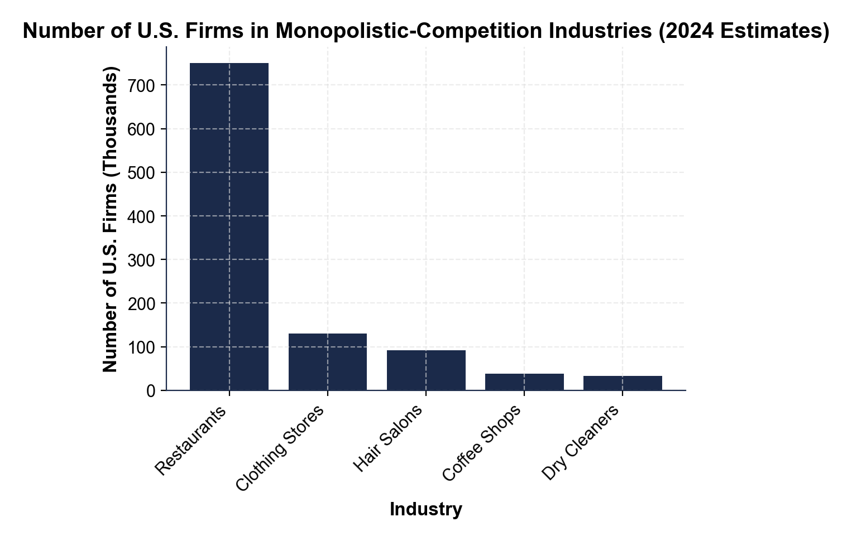
Number of U.S. Firms in MC Industries
Five U.S. MC industries by firm count. Restaurants dominate.
© More Lessons Less Planning | morelessonslessplanning.com
Notes:
Point to each bar. Read the firm count off the chart. All five industries have thousands or hundreds of thousands of firms - the many-sellers feature in action.
Reference labels (point to these chart features when teaching): Restaurants: 750,000+; Hair salons: 92,000+

Slide 7
Feature 2: Differentiated Products (The Engine)
What Differentiation Means
Why It's the NEW Idea Here
Real Pricing Power Examples
Each firm sells a UNIQUE product, not identical to rivals
Real differences (ingredients, design, service)
Perceived differences (brand image, advertising)
PC: wheat is wheat - zero differentiation
Oligopoly: differentiation OPTIONAL (cars vs steel)
MC: differentiation is the ENGINE - every firm uses it
Local burrito spot $14 vs Chipotle $11 - 27% premium
Starbucks latte $5.50 vs Dunkin $3.50
Lululemon leggings $98 vs Champion $25
Real talk: Your favorite burrito spot can charge $14 when Chipotle charges $11 - differentiation gets you that $3.
© More Lessons Less Planning | morelessonslessplanning.com
Notes:
Differentiation is the ENGINE of MC. Without it, the firm collapses back to PC. Differentiation can be real (ingredients) or perceived (brand image).

Slide 8
Feature 3: Free Entry and Exit
Low Barriers to Entry
Why Free Entry Drives Profit to Zero
Restaurant - $50-200K to open
Hair salon - $25-100K for a small salon
Coffee shop - $30-300K for a storefront
Clothing brand - $5-50K online direct-to-consumer
If existing firms earn HIGH profit, new firms ENTER
New entrants take customers from incumbents
Demand for each firm SHIFTS LEFT
Process continues until profit = ZERO
Did You Know: 60% of new U.S. restaurants close in year 1. That high failure rate is FREE EXIT in action.
© More Lessons Less Planning | morelessonslessplanning.com
Notes:
Free entry and exit drives long-run profit to zero. The BIG SURPRISE - successful brands like Starbucks do NOT earn permanent monopoly profits.

Slide 9
Feature 4: Some Pricing Power
DOWNWARD-SLOPING demand
Each firm's product is UNIQUE - it can raise price slightly without losing ALL customers (unlike PC's perfectly flat demand)
Relatively ELASTIC
Many close substitutes exist - if Starbucks raises latte to $8, customers walk to Dunkin or Peet's quickly
Brand premium examples
Starbucks $5.50 latte vs Dunkin $3.50 (60% premium); Lululemon $98 vs Champion $25 (3.9x premium); Apple AirPods $130 vs generic $30
Limited not unlimited
MC pricing power is real but capped by substitutes; far less than monopoly's total pricing power
Note: PC has zero pricing power. Monopoly has total. MC sits between - meaningful but limited.
© More Lessons Less Planning | morelessonslessplanning.com
Notes:
Feature 4 gives MC firms a DOWNWARD-SLOPING demand curve (unlike PC's flat) but RELATIVELY ELASTIC (unlike monopoly's steeper). Brand premiums of 2-4x are common.

Slide 10
The Four Types of Product Differentiation
1. PHYSICAL differentiation
Real differences in ingredients, materials, design, features (grass-fed burger; carbon-plate sneakers; espresso quality)
2. SERVICE differentiation
Differences in customer experience - speed, helpfulness, expertise (Chick-fil-A's 'my pleasure'; salon with online booking)
3. LOCATION differentiation
Convenience or proximity (the only coffee shop in a small town; the food truck near the office park)
4. BRAND IMAGE differentiation
Perceived identity from advertising (Nike = athletic; Apple = premium tech; Patagonia = environmental)
Key Concept: Most real MC firms use a MIX of all four. Starbucks combines all four at once.
© More Lessons Less Planning | morelessonslessplanning.com
Notes:
The four differentiation types are the diagnostic tool students will use throughout the activity. Most real firms use a MIX - rarely just one. Starbucks shows all four.

Slide 11
Non-Price Competition: Why Ads Dominate
Why MC Firms Avoid Price Wars
The Non-Price Tools
Rivals can match price cuts instantly
Price cuts shrink everyone's revenue
Differentiation gives BETTER weapons than price
Advertising builds brand premium price cannot
ADVERTISING - massive ad spend (see next slide)
STORE EXPERIENCE - Apple Store, Lululemon vibe
LOYALTY PROGRAMS - Starbucks Rewards, Sephora
PRODUCT INNOVATION - new menu items, limited drops
Tip: Massive ad spend with little price competition = MC, not oligopoly or monopoly.
© More Lessons Less Planning | morelessonslessplanning.com
Notes:
Non-price competition is the BIG observable behavior of MC firms. They spend heavily on ads instead of cutting prices. The next slide chart makes this visible.

Slide 12
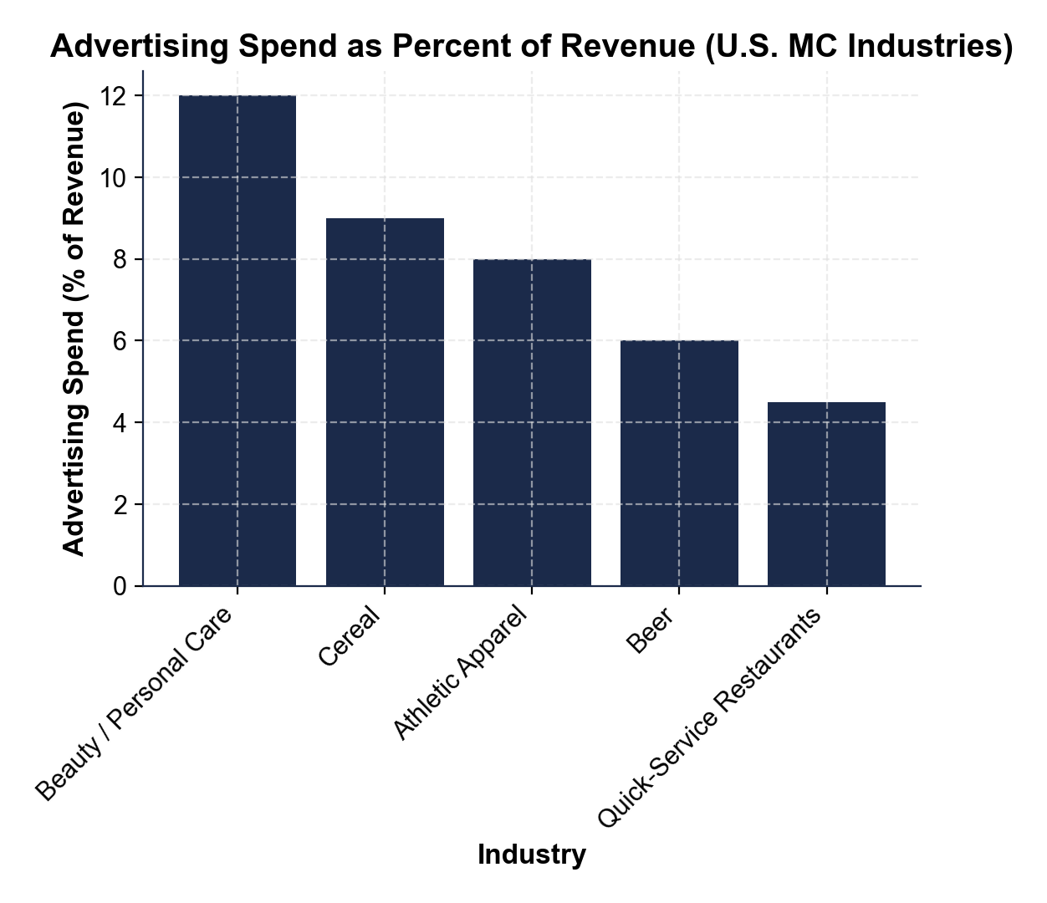
Advertising Spend as % of Revenue (MC)
Five MC industries' ad spend % of revenue. Beauty leads at 12%.
© More Lessons Less Planning | morelessonslessplanning.com
Notes:
Point to each bar. Read the percent off the chart. All five MC industries spend 4-12% of revenue on ads - way above the typical 1-2% industry average.
Reference labels (point to these chart features when teaching): Beauty / personal care: 12%; Fast food: 4.5%

Slide 13
Informative vs Persuasive Advertising
INFORMATIVE Advertising
PERSUASIVE Advertising
Conveys FACTUAL information - price, features
Helps consumers make better choices
Generally considered ECONOMICALLY VALUABLE
Example: pizza ad listing menu prices
Builds BRAND IMAGE / emotional connection
Conveys little factual product information
Economists DEBATE if wasteful or valuable
Example: Nike commercial with Serena winning
Did You Know: a pure informative Super Bowl ad does not exist. Every $7M slot is mostly persuasive brand-building.
© More Lessons Less Planning | morelessonslessplanning.com
Notes:
Informative-vs-persuasive split is the key economic debate around MC advertising. PURE informative ads (price + features only) are rare; most real ads MIX both.

Slide 14
Brand Wars in Real U.S. Industries
Starbucks vs Dunkin
Nike vs Adidas
Chipotle vs Qdoba
Starbucks - premium, espresso focus, third-place vibe
Dunkin - speed, value, working-class identity
Both profitable; different positioning, not price war
Nike - athlete endorsements, basketball, $40B U.S. rev
Adidas - lifestyle and soccer, retro Y2K aesthetic
Each builds brand image; rarely match each other on price
Chipotle - food-with-integrity brand, simpler menu
Qdoba - more topping variety, more regional locations
Differentiated competitors; coexist in most U.S. markets
Real talk: 'Brand wars' is the marketing phrase for MC in action. Each firm builds differentiation.
© More Lessons Less Planning | morelessonslessplanning.com
Notes:
Brand wars is the everyday phrase for MC competition. The three case studies show how differentiated firms coexist without driving each other out of business.

Slide 15
Short-Run vs Long-Run Profit in MC
SHORT-RUN - Positive Profit Possible
LONG-RUN - Zero Economic Profit
Successful MC firm earns HIGH profit briefly
Differentiation + brand loyalty give power
Viral new restaurant - $200K profit year 1
But profit signals attract competitors...
Free entry attracts new firms
Demand for each existing firm shifts LEFT
Profit gets COMPETED AWAY to zero
Firms still earn normal profit but no excess
Big Idea: Even Starbucks earns near zero LONG-RUN economic profit - their accounting profit is mostly normal profit.
© More Lessons Less Planning | morelessonslessplanning.com
Notes:
Short-run vs long-run distinction is the big economic insight of MC. POSITIVE profit is temporary because free entry competes it away. The chart on the next slide visualizes this.

Slide 16
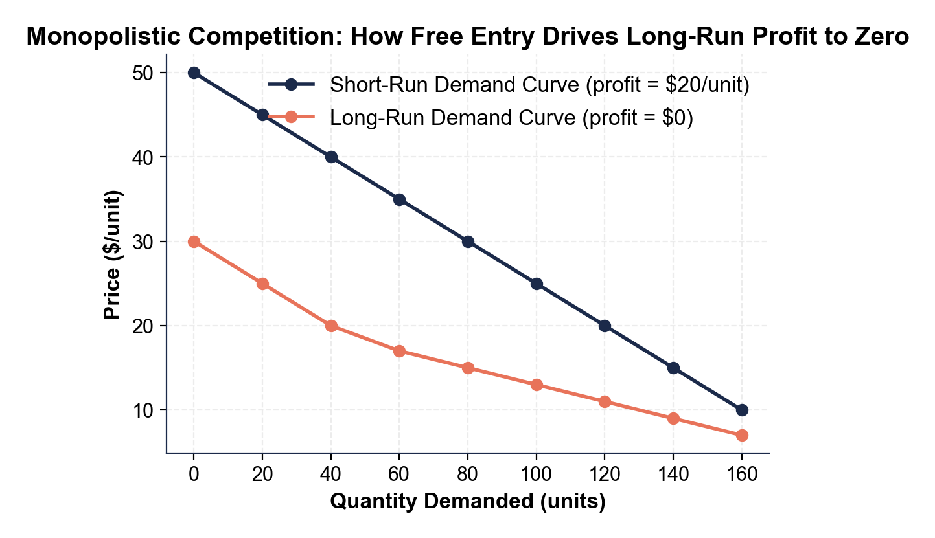
How Free Entry Drives Long-Run Profit to Zero
Demand shifts LEFT as new firms enter; profit drops $20 to $0.
© More Lessons Less Planning | morelessonslessplanning.com
Notes:
Point to each curve. SHORT-RUN demand line is rightward - profit per unit $20 (price above average cost). LONG-RUN line shifts LEFT - price equals average cost - zero profit.
Reference labels (point to these chart features when teaching): Short-run profit: $20; Long-run profit: $0

Slide 17
Excess Capacity and the Variety Tradeoff
EXCESS CAPACITY in MC
The Variety vs Efficiency Tradeoff
Each firm operates BELOW efficient scale
Restaurants have empty tables most weeknights
Hair salons - empty chairs most afternoons
Coffee shops - lulls between rushes
MC is INEFFICIENT - too many firms
BUT - consumers get VARIETY (250 menus, not 1)
Most economists say variety beats efficiency
We choose MC because we want a CHOICE
Key Concept: A perfectly efficient food market would be ONE giant cafeteria. We pick MC because VARIETY matters.
© More Lessons Less Planning | morelessonslessplanning.com
Notes:
Excess capacity is the inefficiency of MC - but it is the COST of variety. Consumers actually PREFER this tradeoff - they would rather have 250 differentiated restaurants than 1 efficient cafeteria.

Slide 18
Market Structure Terms (1 of 2)
MONOPOLISTIC COMPETITION
Market with MANY sellers, DIFFERENTIATED products, free entry/exit, some pricing power
PRODUCT DIFFERENTIATION
Making a product DISTINCT from competitors through real or perceived differences - the engine of MC
BRAND IMAGE
Consumer perception built through advertising; lets firms charge a price premium
NON-PRICE COMPETITION
Competition through ads, location, service, features - NOT price; dominates MC
FREE ENTRY AND EXIT
Low startup costs let new firms enter and exit easily; drives long-run profit to zero
Tip: All five terms tie back to DIFFERENTIATION. Without it, MC collapses to PC.
© More Lessons Less Planning | morelessonslessplanning.com
Notes:
First half of the vocabulary terms (5 of 10). Each is a Part 2 Reference Guide row. They all connect through DIFFERENTIATION as the engine.

Slide 19
Market Structure Terms (2 of 2)
Zero economic profit (long run)
Firms earn only NORMAL profit - just enough to cover opportunity costs; the standard MC long-run outcome
Excess capacity
Firms operate BELOW efficient scale - empty tables, empty chairs; the MC inefficiency
Informative advertising
Advertising that conveys FACTUAL information - price, features, availability, store hours
Persuasive advertising
Advertising designed to BUILD BRAND IMAGE / emotional attachment without factual product information
Variety vs efficiency tradeoff
MC's structural tradeoff - more product variety at slightly higher prices and lower efficiency
Key Concept: MC trades EFFICIENCY for VARIETY. Most consumers prefer this tradeoff.
© More Lessons Less Planning | morelessonslessplanning.com
Notes:
Second half of vocabulary terms (5 more). Consequence-side terms - what HAPPENS in MC equilibrium. Variety vs efficiency tradeoff is the closing insight.

Slide 20
Key Takeaways
MC = MANY sellers + DIFFERENTIATED + FREE entry + power
★
DIFFERENTIATION (physical, service, location, brand) is the engine
★
Non-price competition - advertising, brand wars - dominates
★
Free entry drives LONG-RUN PROFIT TO ZERO even for big brands
★
MC trades efficiency for VARIETY - consumers prefer it
★
© More Lessons Less Planning | morelessonslessplanning.com
Notes:
Five-takeaway closure. Each maps to one lesson section. Even big brands like Starbucks earn zero long-run economic profit - the surprise insight.

