Slide 1
Michelangelo and the Sistine Chapel Ceiling
How a reluctant sculptor turned a chapel ceiling into a masterpiece under a demanding pope - 1508 to 1512.
© More Lessons Less Planning | morelessonslessplanning.com
Notes:
Opening slide. This lesson explores how Michelangelo Buonarroti (1475-1564) painted the Sistine Chapel ceiling between 1508 and 1512 under intense pressure from Pope Julius II. The lesson is honest about several points: Michelangelo considered himself a SCULPTOR and resented the painting commission, even trying to refuse it; the famous story that he painted lying flat on his back is a MYTH - he designed a standing wooden scaffold and painted looking upward; the ceiling (1508-1512) is a SEPARATE work from the Last Judgment altar wall (1536-1541); and he worked with assistants for plaster and labor even though he painted the figures himself. Our primary source is the biography by his fellow artist Giorgio Vasari.

Slide 2
Learning Targets
Explain why Pope Julius II commissioned the ceiling and how patronage shaped it.
★
Define fresco, commission, patron, and scaffold; describe the labor.
★
Describe what Michelangelo painted - honestly, myths and all.
★
Analyze Vasari's biography as a primary source, read critically.
★
© More Lessons Less Planning | morelessonslessplanning.com
Notes:
Learning targets. Target 1 introduces the commission and the role of the patron, Pope Julius II. Target 2 builds the core vocabulary - fresco, commission, patron, scaffold - and the physical labor. Target 3 is a key honesty point: describe the work while correcting the lying-down myth and remembering Michelangelo resented the job and used assistants. Target 4 practices sourcing on Vasari's admiring biography.

Slide 3
Who Was Michelangelo?
MICHELANGELO Buonarroti (1475-1564) was a giant of the RENAISSANCE in Italy.
The RENAISSANCE was a rebirth of art and learning that revived Greece and Rome.
He considered himself a SCULPTOR - an artist who carves figures from stone.
He carved the marble statues David and the Pieta before the ceiling.
He painted the Sistine ceiling reluctantly - it was not the art he loved most.
Key Concept: MICHELANGELO (1475-1564) was a Renaissance genius who considered himself a SCULPTOR first, not a painter.
© More Lessons Less Planning | morelessonslessplanning.com
Notes:
MICHELANGELO Buonarroti (1475-1564) was one of the greatest artists of the RENAISSANCE - the rebirth of art and learning in Europe (about 1350-1600) that revived the study of ancient Greece and Rome. Stress one idea that runs through the whole lesson: Michelangelo thought of himself as a SCULPTOR, an artist who carves figures out of stone, far more than as a painter. Before he ever touched the Sistine ceiling he had already carved two of the most famous marble statues in history, the David and the Pieta. So when the pope ordered him to PAINT a ceiling, he was being pulled away from the art he loved most. That reluctance is the emotional heart of the story students are about to learn.

Slide 4
The Sistine Chapel and Its Patron
Sistine Chapel
The pope's private chapel in the Vatican, whose ceiling Michelangelo painted from 1508 to 1512.
Patron
A wealthy or powerful backer who pays for and directs an artist's work.
Pope Julius II
The strong-willed 'Warrior Pope' who was Michelangelo's patron and pressured him to paint the ceiling.
Key Concept: The SISTINE CHAPEL is the pope's chapel in the Vatican; Michelangelo's PATRON there was POPE JULIUS II.
© More Lessons Less Planning | morelessonslessplanning.com
Notes:
The SISTINE CHAPEL is the pope's private chapel inside the Vatican in Rome - the place where popes are still chosen today. Its ceiling is the surface Michelangelo painted between 1508 and 1512. Explain the key relationship of the whole lesson: the PATRON. A patron is a wealthy or powerful backer who pays for an artist's work and also gets to direct it. Michelangelo's patron for the ceiling was POPE JULIUS II, nicknamed the 'Warrior Pope' because he led armies and had an iron will. Because Julius paid for the work and held enormous power, he could order Michelangelo to take a job the artist did not want - and could push him hard to finish it. Patronage in the Renaissance gave us glorious art, but it also meant artists often served the ambitions of the powerful.

Slide 5
An Unwanted Commission
A commission from the pope
A COMMISSION is a formal, paid order to create art; in 1508 Julius II ordered the ceiling.
✔
Michelangelo tried to refuse
As a SCULPTOR, he resented the painting job and even suggested the pope hire Raphael instead.
✔
The pope would not be moved
Julius II insisted and pressured him, so Michelangelo finally agreed against his own wishes.
✔
Important: A COMMISSION is a paid order to make art. Michelangelo took this one RELUCTANTLY, under pressure from Julius II.
© More Lessons Less Planning | morelessonslessplanning.com
Notes:
This slide sets up the central conflict. A COMMISSION is a formal, paid order to create a work of art. In 1508 Pope Julius II handed Michelangelo the commission to paint the Sistine Chapel ceiling. Here is the honest, human truth students should hold onto: Michelangelo did NOT want this job. As a SCULPTOR, he felt painting a ceiling was not his true art, and according to his fellow artist Vasari he tried to get out of it, even suggesting the pope give the work to the younger painter Raphael instead. But Julius II was headstrong and would not be refused. He insisted, applied pressure, and Michelangelo finally agreed - not happily, but because a powerful patron gave him little choice. Correct any idea that 'the pope asked and Michelangelo gladly said yes.' This was a reluctant artist bending to a demanding patron.

Slide 6
Nine Scenes from Genesis
The ceiling holds about 343 painted figures across a huge curved surface.
Nine central scenes retell stories from GENESIS in the Bible.
They include the Creation, Adam and Eve, and the Flood of Noah.
Around them sit prophets and sibyls who were said to foretell the future.
It is one of the largest and most ambitious paintings ever attempted.
Did You Know? The ceiling has about 343 figures and NINE central scenes from GENESIS - one of the biggest paintings ever made.
© More Lessons Less Planning | morelessonslessplanning.com
Notes:
Help students grasp the sheer scale of what Michelangelo took on. The Sistine ceiling is not a single picture but an enormous painted program covering a huge curved vault, holding roughly 343 human figures. Down the center run NINE main scenes retelling stories from GENESIS, the first book of the Bible - among them the Creation of the world, the creation of Adam and Eve, and the great Flood of Noah. Around those nine scenes Michelangelo painted rows of prophets and sibyls (figures believed to foretell the future), plus dozens of other figures. Emphasize that this was one of the largest and most ambitious paintings ever attempted, and that a single artist drove the whole design - which is exactly why it took years and why the labor was so punishing. The next slide shows one of those nine Genesis scenes - the Fall and Expulsion of Adam and Eve.

Slide 7
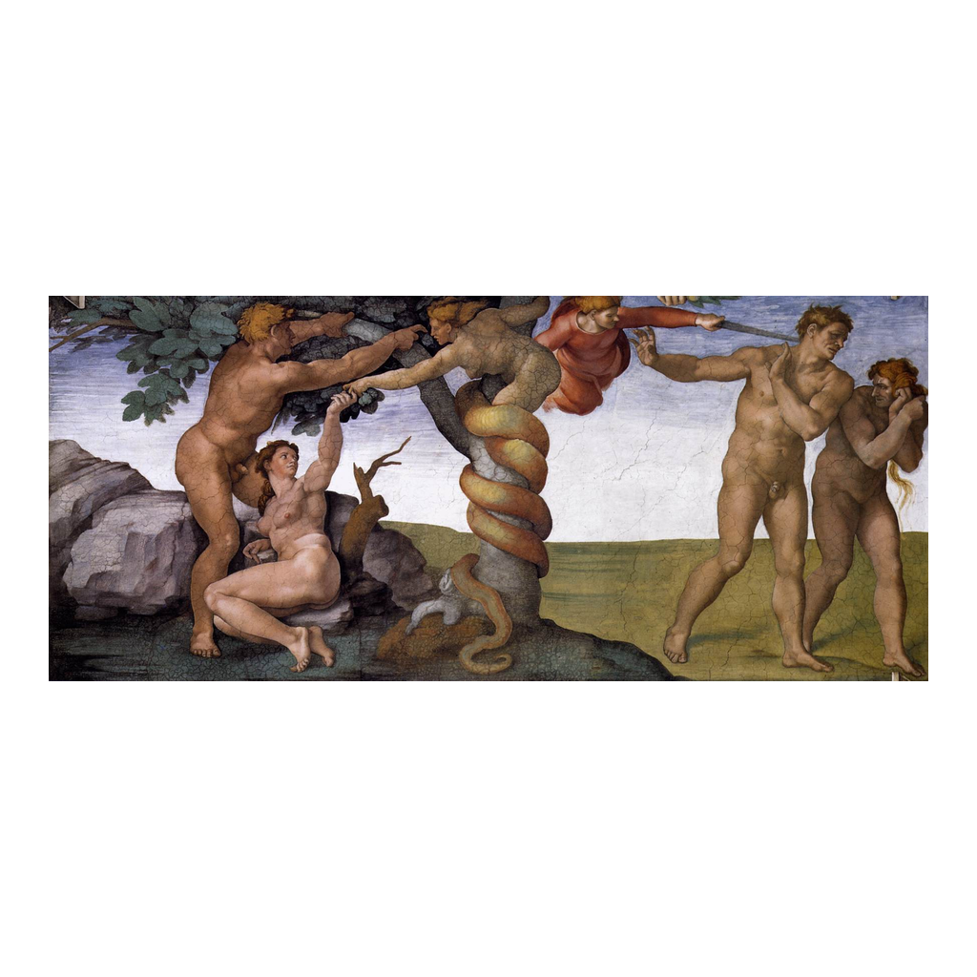
The Fall and Expulsion from Eden
Michelangelo, The Fall and Expulsion from Eden, Sistine ceiling (Vatican).
© More Lessons Less Planning | morelessonslessplanning.com
Notes:
This is one of the nine central Genesis scenes on Michelangelo's Sistine ceiling: The Fall and Expulsion from the Garden of Eden, painted around 1509-1510. On the left, Adam and Eve reach toward the tree where a serpent tempts them; on the right, an angel drives them out of Eden. Use it as a concrete example of the nine Genesis stories the ceiling tells and of Michelangelo's sculptor's eye for the powerful human body. Remind students that the whole ceiling holds about 343 figures across scenes like this one, and that Michelangelo painted all of it in fresco while standing on a scaffold looking upward - not lying on his back.
Reference labels (point to these chart features when teaching): Adam, Eve, and the serpent; One of the nine Genesis scenes

Slide 8
The Creation of Adam
THE CREATION OF ADAM is the most famous scene on the ceiling.
God reaches out from the right to give life to Adam on the left.
Their fingers almost touch - a tiny gap charged with meaning.
It shows Michelangelo's sculptor's eye for the strong human body.
It has become one of the most recognized images in the world.
Key Concept: In THE CREATION OF ADAM, God reaches toward Adam and their fingers nearly touch - the ceiling's most famous scene.
© More Lessons Less Planning | morelessonslessplanning.com
Notes:
This slide focuses on the single most famous part of the ceiling: THE CREATION OF ADAM. In it, God sweeps in from the right, carried by angels, and stretches out his arm to give life to the first man, Adam, who reclines on the left. The unforgettable detail is that their fingers reach toward each other but do NOT quite touch - a tiny gap that seems to hold the very moment life is about to pass from God to man. Point out to students that even in paint, Michelangelo's training as a SCULPTOR shows: Adam's body is powerful and three-dimensional, drawn as if it were carved marble. This one scene has become one of the most recognized images in the entire world, reproduced everywhere. The next slide shows the painting itself.

Slide 9
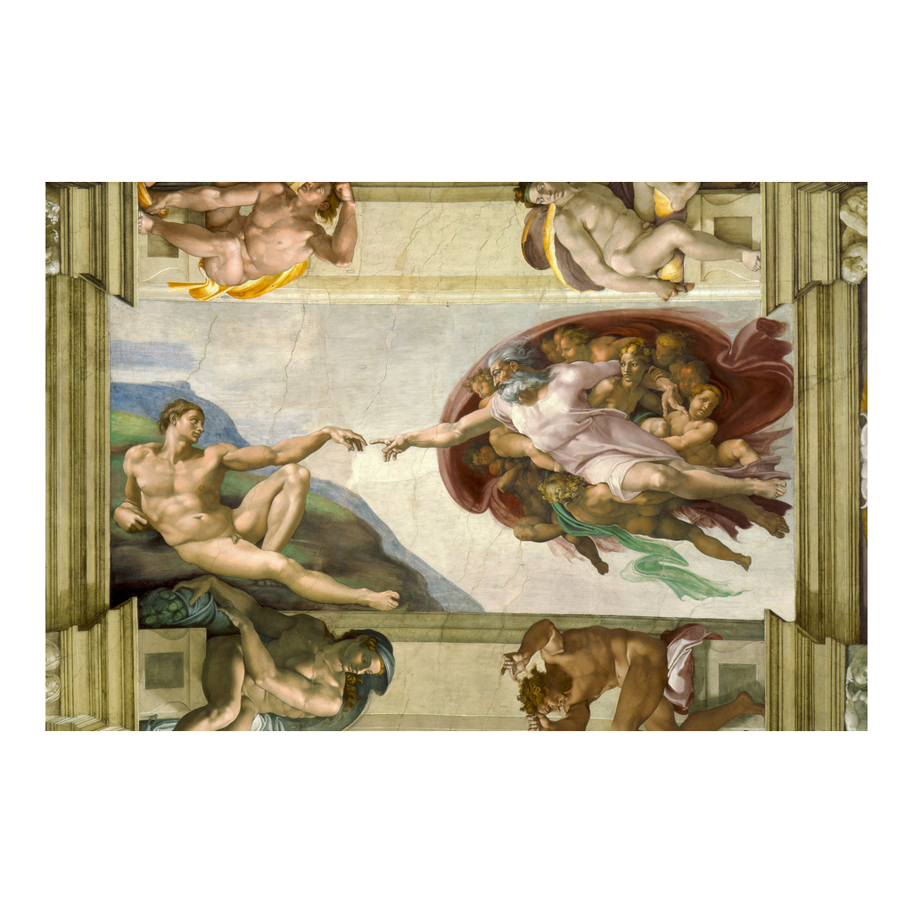
The Creation of Adam - Up Close
Michelangelo, The Creation of Adam, Sistine Chapel ceiling, c. 1512 (Vatican).
© More Lessons Less Planning | morelessonslessplanning.com
Notes:
This is Michelangelo's actual The Creation of Adam, part of the Sistine ceiling finished around 1512. Have students find the two reaching hands at the center - God's outstretched finger on the right, Adam's relaxed hand on the left - and the small gap between them. Point out how solid and sculptural Adam's body looks, the mark of an artist who thought first in marble. Remind students this is a genuine Renaissance fresco, paint soaked into wet plaster on the ceiling itself, not a modern picture. It is the perfect close-up to follow the wide shot of the whole ceiling.
Reference labels (point to these chart features when teaching): God reaches toward Adam; Their fingers nearly touch

Slide 10
Fresco - Painting into Wet Plaster
Fresco
Painting onto fresh, wet plaster so the color soaks in and becomes part of the wall as it dries.
Work fast, or start over
The plaster dries in a day, so the artist must finish each patch before it sets - mistakes mean chipping it out.
He had assistants
Helpers mixed plaster and ground colors, but Michelangelo painted the figures himself - he did not work totally alone.
Key Concept: FRESCO means painting into wet plaster - it dries in a day, so the artist must work fast and cannot easily fix mistakes.
© More Lessons Less Planning | morelessonslessplanning.com
Notes:
Explain the demanding technique. FRESCO means painting directly onto fresh, WET plaster: the artist spreads a patch of wet plaster, then paints into it so the color soaks in and becomes part of the wall as it dries. This is why fresco is so unforgiving - the plaster dries within a day, so the artist has to plan carefully and finish each section before it sets. A mistake usually means chipping the plaster out and starting that patch over. Correct one common myth here: Michelangelo did NOT do every single task alone. He had assistants who mixed plaster, ground pigments, and prepared the surface. What made the ceiling his is that he designed the whole thing and painted the figures himself. So the honest picture is a driven master leading a small team through a brutally difficult technique - not a lone hero doing every chore by himself.

Slide 11
Correcting the Myth - The Standing Scaffold
MYTH: people say Michelangelo painted lying flat on his back.
TRUTH: he designed a wooden SCAFFOLD and painted while standing.
He stood and bent backward, reaching UP toward the ceiling above him.
The scaffold was a raised wooden platform built out high above the floor.
Knowing this changes how we picture the four-year ordeal.
Warning: It is a MYTH that Michelangelo painted lying down. He designed a SCAFFOLD and painted standing, reaching upward.
© More Lessons Less Planning | morelessonslessplanning.com
Notes:
This slide corrects the single most common myth about the Sistine ceiling. Many people - maybe even in your class - believe Michelangelo painted the ceiling lying flat on his back. That is a MYTH. The truth is that he designed a special wooden SCAFFOLD, a raised platform built out from the walls high above the chapel floor, and he painted while STANDING on it, bending backward and reaching UP toward the surface just above his head. It was still agonizing - craning your neck and lifting your arms overhead for hours does terrible things to the back and neck - but it was not the cartoon image of a man reclining comfortably. Make sure students can state the correction in their own words: not lying down, but standing on a scaffold and reaching up. We even have Michelangelo's own words about the strain, on the next slide.

Slide 12
Four Years of Labor
The physical ordeal
In his own words
He worked from 1508 to 1512 - about four years.
Craning upward strained his neck, back, and eyes.
For a time he could read only by holding pages overhead.
Michelangelo wrote a SONNET complaining of the pain.
He joked his beard pointed at the ceiling and his skin stretched.
His own poem is our best evidence for the suffering.
Did You Know? Michelangelo wrote a SONNET about the pain of the work - describing his strained neck and how his skin stretched.
© More Lessons Less Planning | morelessonslessplanning.com
Notes:
This slide gives students the human cost of the ceiling, and a great sourcing moment. Michelangelo worked on the ceiling from 1508 to 1512 - roughly FOUR years. Standing on the scaffold with his head thrown back, craning upward day after day, strained his neck, his back, and his eyes; according to his biographer Vasari, for a while afterward he could read a letter or study a drawing only by holding it up above his head and looking upward. The best evidence of all comes from Michelangelo himself: he wrote a SONNET - a short 14-line poem - complaining about the misery of the job. In it he jokes grimly that his beard points at the ceiling, that his skin stretches and folds, and that he is not in a good place. Point out to students why this matters: his own poem is a firsthand source, closer to the truth than any legend, and it confirms the strain of the standing-and-reaching work - not lying comfortably on his back.

Slide 13
Not the Last Judgment - Two Commissions
The ceiling (1508-1512)
The scenes from Genesis on the vault - the work of this lesson - done for Pope Julius II.
✔
The Last Judgment (1536-1541)
A SEPARATE, later fresco on the altar WALL, painted over 20 years afterward for a different pope.
✔
Do not mix them up
Same chapel, two different jobs, decades apart - the ceiling and the wall are not the same work.
✔
Remember: The CEILING (1508-1512) and the LAST JUDGMENT on the altar WALL (1536-1541) are two SEPARATE works - do not confuse them.
© More Lessons Less Planning | morelessonslessplanning.com
Notes:
Prevent a very common mix-up. There are two famous Michelangelo works in the Sistine Chapel, and they are NOT the same thing. The first is the CEILING, painted from 1508 to 1512 for Pope Julius II - the scenes from Genesis, including The Creation of Adam, that this whole lesson is about. The second is The LAST JUDGMENT, a completely SEPARATE fresco painted more than twenty years LATER, from 1536 to 1541, on the altar WALL at the front of the chapel, for a different pope. It shows the end of the world and the judging of souls. Tell students plainly: same chapel, two different commissions, decades apart. When people talk about 'the Sistine Chapel,' they sometimes blur the ceiling and the wall together - but for this lesson, we mean the CEILING of 1508-1512.

Slide 14
How Do We Know? Vasari's Lives
Much of the story comes from Giorgio VASARI, an artist and writer.
In 1550 he published Lives, biographies of Renaissance artists.
Vasari admired Michelangelo and knew him - he is not a neutral reporter.
His book is a PRIMARY source close to the events, but it praises its hero.
We read it for what it shows and question it where it may exaggerate.
Tip: Giorgio VASARI's 1550 book Lives is our main source - but he ADMIRED Michelangelo, so we read it critically.
© More Lessons Less Planning | morelessonslessplanning.com
Notes:
This sourcing slide sets up the Primary Source Spotlight. So how do we know all these details about the ceiling? A great deal comes from Giorgio VASARI, himself a Renaissance painter and architect, who in 1550 published a famous book usually called Lives (its full title is Lives of the Most Excellent Painters, Sculptors, and Architects). It contains biographies of the great artists of his age, including a long life of Michelangelo. Vasari is a valuable PRIMARY source: he lived in the same period, knew Michelangelo personally, and wrote close to the events. But warn students clearly: Vasari deeply ADMIRED Michelangelo and treated him almost as a god of art, so his book is not neutral reporting - it praises its hero and repeats dramatic stories that flatter him. That does not make it worthless; it makes it a source we must read carefully, trusting it on basic facts like the commission and the physical ordeal, but questioning it where it may exaggerate motives or intrigue.

Slide 15
The Honest Picture
Michelangelo was a SCULPTOR who took the ceiling reluctantly, under pressure.
He painted STANDING on a scaffold, not lying on his back.
He led ASSISTANTS but designed and painted the figures himself.
The ceiling (1508-1512) is separate from the later Last Judgment.
Vasari's admiring biography must be read as evidence, not gospel.
Remember: reluctant sculptor, pressured by his patron, painting STANDING - and Vasari's praise must be read critically.
© More Lessons Less Planning | morelessonslessplanning.com
Notes:
Pull the honesty threads together so students admire the achievement accurately, not as a myth. First, Michelangelo was above all a SCULPTOR who took the ceiling reluctantly, under real pressure from his patron Pope Julius II - not an eager volunteer. Second, he painted while STANDING on a scaffold he designed, bending back and reaching up - NOT lying flat on his back, the myth we corrected. Third, he led a team of ASSISTANTS who handled plaster and pigment, but he designed the whole program and painted the figures himself, so it is truly his masterpiece without being a one-man chore. Fourth, the ceiling of 1508-1512 is a separate work from the later Last Judgment on the altar wall. And fifth, much of the dramatic story comes from Vasari, who admired Michelangelo, so we read his biography as valuable evidence rather than as settled, neutral fact. The real story - a reluctant genius pushed to greatness under pressure - is more human, and more impressive, than the legend.

Slide 16
Key Takeaways
Pope Julius II commissioned the Sistine ceiling (1508-1512).
★
Michelangelo was a SCULPTOR who took the job reluctantly, under pressure.
★
He painted in FRESCO, STANDING on a scaffold - NOT lying on his back.
★
The ceiling shows about 343 figures and nine scenes from Genesis.
★
The ceiling is separate from the later Last Judgment on the altar wall.
★
Our main source, Vasari's admiring biography, must be read critically.
★
© More Lessons Less Planning | morelessonslessplanning.com
Notes:
Close the loop. If students remember one thing, make it this: a reluctant SCULPTOR, Michelangelo, was pressured by his patron Pope Julius II into painting the Sistine Chapel ceiling from 1508 to 1512, and he turned an unwanted COMMISSION into one of the greatest works of art in history. Then hold the honesty frames firmly: he painted in FRESCO while STANDING on a scaffold he designed - NOT lying on his back; the ceiling holds about 343 figures and nine scenes from Genesis, including The Creation of Adam; the ceiling is a separate work from the later Last Judgment on the altar wall; and he led assistants even as he painted the figures himself. Finally, remind them that much of the story reaches us through Vasari's admiring biography, which we read as valuable evidence rather than neutral fact - exactly the source they analyzed in the activity.

