Slide 1
Medici Florence and the Renaissance
How the banking wealth and patronage of the Medici family helped turn Florence into the birthplace of the Renaissance.
© More Lessons Less Planning | morelessonslessplanning.com
Notes:
Opening slide. This lesson traces how Florence - a rich banking and trade city-state - and above all its leading banking family, the Medici, poured wealth into art through PATRONAGE and helped make Florence the birthplace of the Renaissance. The lesson is honest about four things: Medici patronage was a major cause of the Renaissance but not the only one; the patronage was partly self-interested image-making; the classic golden-age story belongs to the 15th-century Medici (Cosimo the Elder and Lorenzo the Magnificent), while the artist Cellini worked for the LATER Duke Cosimo I; and Cellini's own memoir, our primary source, is vivid but boastful.

Slide 2
Learning Targets
Explain how Florence's Medici banking wealth funded a rebirth of art.
★
Define Renaissance, humanism, patronage, and how a commission funds art.
★
Tell the 1400s Medici (Cosimo the Elder, Lorenzo) apart from Duke Cosimo I.
★
Analyze Cellini's Autobiography as vivid but boastful firsthand evidence.
★
© More Lessons Less Planning | morelessonslessplanning.com
Notes:
Learning targets. Target 1 links banking wealth to art. Target 2 builds the core vocabulary of the Renaissance and patronage. Target 3 is a key honesty point: keep the golden-age story on the 15th-century Medici and know that Cellini's patron was the later Duke Cosimo I. Target 4 practices sourcing on a boastful firsthand memoir.

Slide 3
Florence - A City of Wealth
FLORENCE was a wealthy banking and trade city-state in northern ITALY.
Its merchants and bankers earned fortunes in wool, cloth, and money-lending.
Wealthy families competed to display their riches and status in the city.
This concentration of WEALTH gave Florence the means to fund art and learning.
Florence is often called the BIRTHPLACE of the Renaissance.
Big idea: FLORENCE - a rich banking and trade city-state in Italy - had the WEALTH to fund a rebirth of art and learning.
© More Lessons Less Planning | morelessonslessplanning.com
Notes:
FLORENCE was a wealthy banking and trade city-state in northern Italy. Its merchants and bankers earned great fortunes in the wool and cloth trades and in money-lending, and wealthy families competed to display their riches and status. That concentration of WEALTH gave the city the means to fund a burst of art and learning - which is why Florence, more than any other city, is often called the BIRTHPLACE of the Renaissance. Stress the causal link for students: the money came first, from banking and trade, and the art followed.

Slide 4
The Medici - Bankers of Florence
The Medici
The MEDICI were the wealthy BANKING family who dominated Florence for generations.
✔
The richest bank in Europe
Their bank, founded around 1397, grew into the richest in Europe and even handled the Pope's money.
✔
Risen through a guild
The Medici rose to power through a merchant GUILD - an association of merchants or craftsmen that controlled a trade - not through old noble birth.
✔
Key Concept: The MEDICI were Florence's leading BANKING family; their fortune became the engine that funded the city's art.
© More Lessons Less Planning | morelessonslessplanning.com
Notes:
The MEDICI were the wealthy BANKING family who dominated Florence for generations. Their bank, founded around 1397, became the richest in Europe and even handled the Pope's money. Point out that the Medici began as commoners who rose to power through a merchant GUILD - an association of merchants or craftsmen that controlled a particular trade in the city - rather than through old noble birth. Their enormous banking fortune is what made the family the great engine of Florentine art: money earned in banking was spent on artists.

Slide 5
Cosimo de' Medici the Elder
Cosimo the Elder
COSIMO DE' MEDICI THE ELDER (1389-1464) was the 15th-century Medici banker and STATESMAN who made the family the true rulers of Florence.
✔
Ruled from behind the scenes
He ran the Medici bank and quietly controlled the city's government without holding a crown.
✔
The first great patron
He spent a FORTUNE funding artists, architects, and scholars, and founded a great public library.
✔
Key Concept: COSIMO DE' MEDICI THE ELDER (1389-1464) - banker and statesman - was the first great Medici PATRON of Renaissance Florence.
© More Lessons Less Planning | morelessonslessplanning.com
Notes:
COSIMO DE' MEDICI THE ELDER (1389-1464) was the 15th-century Medici banker and STATESMAN who made the family the true rulers of Florence. He ran the Medici bank and quietly controlled the city's government from behind the scenes, without ever holding a crown. Most important for this lesson, he was the family's first great art PATRON: he spent a FORTUNE funding artists, architects, and scholars, and founded a great public library. Note the dates for students - 1389 to 1464, squarely in the 1400s - because a LATER Medici also named Cosimo (Duke Cosimo I) comes up near the end of the lesson, and the two must not be confused. The next slide shows a real Renaissance portrait of Cosimo the Elder.

Slide 6
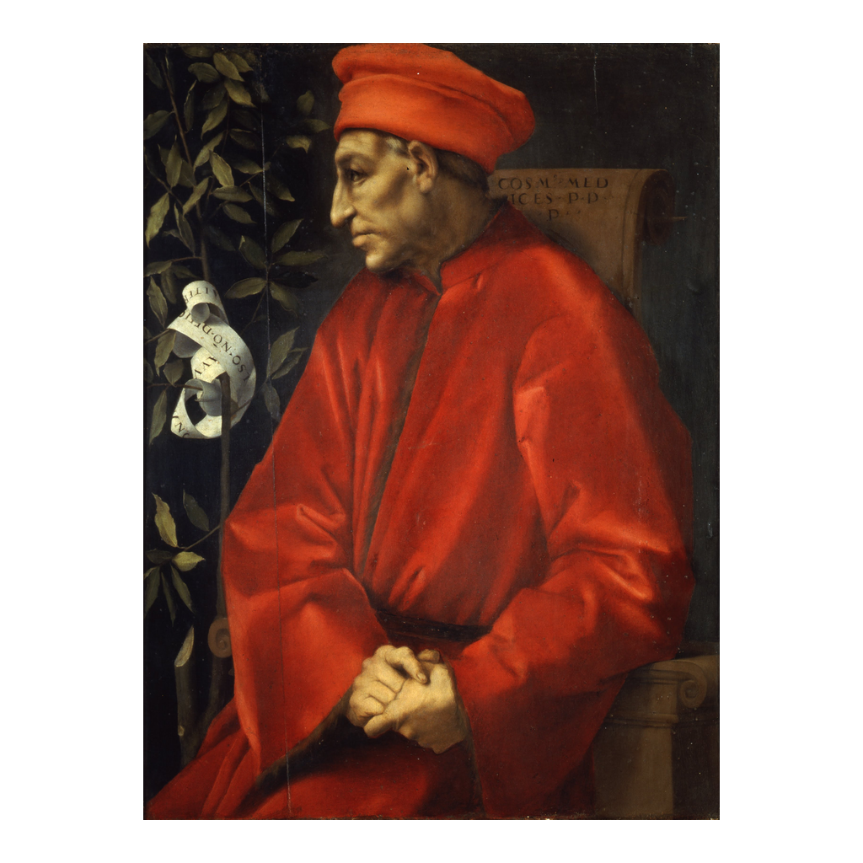
A Medici Portrait
Cosimo de' Medici the Elder, an idealized portrait by Pontormo, c. 1518.
© More Lessons Less Planning | morelessonslessplanning.com
Notes:
A Renaissance portrait of Cosimo de' Medici the Elder by the Florentine painter Jacopo Pontormo, made about 1518-1520. Be honest with students about what this image is and is not: Cosimo the Elder died in 1464, so Pontormo painted this roughly fifty years AFTER Cosimo's death. It is therefore a posthumous, idealized portrait - a later artist's respectful image of a famous ancestor of the ruling Medici - not a life likeness or a photograph of the man. It still teaches us something real: it shows how sixteenth-century Florence chose to REMEMBER and honor the founder of Medici greatness, in the sober red robe of a wise elder statesman. This makes it a good example of how art itself served Medici prestige.
Reference labels (point to these chart features when teaching): Red robe of a Florentine elder; Painted after his death

Slide 7
Lorenzo the Magnificent
LORENZO THE MAGNIFICENT (1449-1492) was the grandson of Cosimo the Elder.
He led Florence at the HEIGHT of its Renaissance golden age.
Lorenzo was a poet and a lavish PATRON of Botticelli and young Michelangelo.
Under Lorenzo, the Medici court became the cultural center of all Italy.
Both Cosimo the Elder and Lorenzo belong to the 1400s golden age.
Key Concept: LORENZO THE MAGNIFICENT (1449-1492), grandson of Cosimo the Elder, led Florence at the HEIGHT of its Renaissance.
© More Lessons Less Planning | morelessonslessplanning.com
Notes:
LORENZO DE' MEDICI (1449-1492), the grandson of Cosimo the Elder, was called 'the MAGNIFICENT.' He led Florence at the HEIGHT of its Renaissance golden age. Lorenzo was himself a poet and a lavish PATRON of artists - he supported painters like Botticelli and hosted the teenage Michelangelo in his household - and under him the Medici court became the cultural center of all Italy. Stress the timeline for students: both Cosimo the Elder (1389-1464) and Lorenzo the Magnificent (1449-1492) belong to the 1400s. This is the century of the classic Florentine Renaissance, the golden age the whole 'birthplace of the Renaissance' story is built on.

Slide 8
What Was the Renaissance?
Renaissance
A 'rebirth' of art and learning in Europe (about 1350-1600) that revived the study of ancient Greece and Rome.
Humanism
A Renaissance movement that studied classical texts and celebrated human potential, reason, and achievement.
Classical revival
Renaissance artists and scholars looked back to ancient Greek and Roman models for inspiration.
Key Concept: The RENAISSANCE was a rebirth of art and learning; HUMANISM revived classical texts and celebrated human potential.
© More Lessons Less Planning | morelessonslessplanning.com
Notes:
The RENAISSANCE means a 'rebirth' of art and learning in Europe, running roughly from 1350 to 1600, that revived the study of ancient Greece and Rome. Its guiding intellectual movement was HUMANISM: the study of classical texts and a new celebration of human potential, reason, and achievement. Help students see the link back to Florence and the Medici: humanist scholars needed patrons to pay for manuscripts and salaries, and artists needed patrons to commission the paintings and statues that revived classical models. Renaissance ideas and Medici money worked together.

Slide 9
Patronage - Banking Wealth Becomes Art
Patronage
PATRONAGE was the financial SUPPORT wealthy families gave to artists and scholars.
✔
Patron
A PATRON was the wealthy BACKER who paid for a work of art and often chose its subject.
✔
Commission
A COMMISSION was a formal ORDER and payment for a specific work - a statue, a painting, or a building.
✔
Key Concept: Through PATRONAGE, a wealthy PATRON paid a COMMISSION so an artist could create - turning banking wealth into art.
© More Lessons Less Planning | morelessonslessplanning.com
Notes:
This is the mechanism at the heart of the lesson. PATRONAGE was the financial SUPPORT that wealthy families like the Medici gave to artists and scholars. The wealthy BACKER who paid was called a PATRON, and the patron often chose the subject of the work. A COMMISSION was the formal ORDER and payment for a specific piece - a statue, a painting, or a building. Put the chain together for students: a Medici patron used banking wealth to give a commission to an artist, who then created a work of Renaissance art. That is exactly how banking money turned into the paintings, sculptures, and buildings we admire today.

Slide 10
Why Florence? Many Causes
Medici PATRONAGE was a MAJOR cause of the Renaissance - but not the ONLY one.
Florence also held surviving CLASSICAL texts that scholars could study.
Its trade wealth created a large class of families who could fund art.
Fierce COMPETITION among city-states and families drove spending on grand art.
Humanist scholarship gave artists new ideas and ancient models to imitate.
Important: Medici money was ONE major driver of the Renaissance - classical texts, trade wealth, competition, and scholarship all mattered too.
© More Lessons Less Planning | morelessonslessplanning.com
Notes:
Now be honest about causation. Medici PATRONAGE was a MAJOR cause of the Florentine Renaissance - but it was NOT the only one. Florence also happened to hold surviving CLASSICAL texts from Greece and Rome that scholars could study; its trade wealth created a whole class of well-off families, not just the Medici, who could fund art; fierce COMPETITION among rival city-states and families pushed everyone to spend on grand public art; and humanist scholarship gave artists new ideas and ancient models to imitate. Teach the reasoning skill: a big historical change like the Renaissance usually has several causes working together, so students should never write that 'Medici money alone caused the Renaissance.'

Slide 11
Patronage Was Not Pure Charity
Prestige
Funding great art brought a family PRESTIGE - it advertised their wealth, taste, and importance.
✔
Piety
Paying for churches and religious art showed devotion and helped ease guilt over money-lending.
✔
Power
Splendid public art helped bankers claim political LEGITIMACY and win the people's loyalty.
✔
Warning: Medici patronage was partly self-interested image-making - a tool for PRESTIGE, piety, and political power, not pure charity.
© More Lessons Less Planning | morelessonslessplanning.com
Notes:
Add one more honest layer. Medici patronage was not pure charity or simple love of beauty - it was partly self-interested image-making. Funding great art brought a family PRESTIGE, advertising its wealth, taste, and importance to all of Florence and beyond. Paying for churches and religious art showed piety and, for a banking family, helped ease the era's guilt over charging interest on loans. And splendid public art helped the Medici, who held no royal title, claim political LEGITIMACY and win the loyalty of the people. So when we admire Medici-funded art, students should remember it was also a deliberate tool of Medici power and reputation.

Slide 12
The Later Medici - Duke Cosimo I
Do NOT confuse the two Cosimos - the golden age belongs to the 1400s Medici.
Cosimo the Elder and LORENZO THE MAGNIFICENT built that 1400s golden age.
The later Duke Cosimo I became the first GRAND Duke of Tuscany in the 1500s.
Duke Cosimo I ruled a CENTURY after Cosimo the Elder - a different age.
Cellini worked for Duke Cosimo I, not the earlier 1400s Medici.
Important: DUKE COSIMO I (r. 1537-1574) is a LATER Medici of the 1500s - NOT Cosimo the Elder. Cellini's patron was Duke Cosimo I.
© More Lessons Less Planning | morelessonslessplanning.com
Notes:
Head off the single most likely confusion in this lesson. Two different Medici were named Cosimo. The classic 'birthplace of the Renaissance' golden age belongs to the 1400s Medici: COSIMO THE ELDER (1389-1464) and his grandson LORENZO THE MAGNIFICENT (1449-1492). But a LATER Medici, DUKE COSIMO I, ruled Florence in the 1500s - he became the first GRAND Duke of Tuscany and reigned from 1537 to 1574, roughly a CENTURY after Cosimo the Elder. He is a different man in a different age. This matters for our primary source: the sculptor Benvenuto Cellini worked for DUKE COSIMO I, not for the earlier 1400s Medici. Keep the golden-age story on Cosimo the Elder and Lorenzo, and remember Cellini's patron was the later Duke Cosimo I.

Slide 13
How Do We Know? Cellini's Memoir
Much of what we know comes from letters, contracts, and MEMOIRS of the time.
The sculptor Benvenuto Cellini wrote a famous AUTOBIOGRAPHY of his own life.
It shows how artists depended on and COMPETED for wealthy patrons.
But Cellini's memoir is BOASTFUL - he praises himself, so it is not neutral.
Historians CROSS-CHECK his stories against contracts and letters.
Tip: Cellini's boastful AUTOBIOGRAPHY is vivid evidence of the patron-artist world - but historians CROSS-CHECK it, because it glorifies its author.
© More Lessons Less Planning | morelessonslessplanning.com
Notes:
This sourcing slide sets up the Primary Source Spotlight. Much of what we know about Renaissance artists and their patrons comes from letters, contracts, and MEMOIRS. One of the most famous is The AUTOBIOGRAPHY of Benvenuto Cellini, a Florentine goldsmith and sculptor who wrote the vivid story of his own life. It is wonderful firsthand evidence of how artists depended on and COMPETED for wealthy patrons. But warn students clearly: Cellini's memoir is deeply BOASTFUL - he constantly praises his own genius, picks fights, and tells thrilling tales - so it is not a neutral or objective record. The right way to use it is exactly how historians do: enjoy its vivid detail, but CROSS-CHECK its claims against contracts, letters, and other accounts, and never take Cellini's word that he was simply the greatest.

Slide 14
Key Takeaways
FLORENCE was a rich banking city-state - the birthplace of the Renaissance.
★
The MEDICI banking family used its fortune to fund art through PATRONAGE.
★
Cosimo the Elder and Lorenzo the Magnificent led the 1400s golden age.
★
Patronage was a MAJOR cause of the Renaissance - but not the only one.
★
Medici patronage was partly self-interested - for prestige, piety, and power.
★
Cellini's boastful memoir needs critical reading; his patron was Duke Cosimo I.
★
© More Lessons Less Planning | morelessonslessplanning.com
Notes:
Close the loop. If students remember one thing, make it the chain: FLORENCE's banking and trade WEALTH, concentrated in the MEDICI family, funded a rebirth of art through PATRONAGE, helping make Florence the birthplace of the Renaissance. Then hold the honesty frames: the golden age belongs to the 1400s Medici (Cosimo the Elder and Lorenzo the Magnificent); patronage was a major but not the only cause of the Renaissance; that patronage was partly self-interested image-making; and Cellini's memoir - written about his patron the LATER Duke Cosimo I - is vivid but boastful evidence that must be read critically.

