Slide 1
Market Equilibrium: Where Supply Meets Demand
Where the two curves cross, the market finds its price.
© More Lessons Less Planning | morelessonslessplanning.com
Notes:
This is the Unit 2 capstone. Remind students they have already learned demand (buyers, TK 11) and supply (producers, TK 12). Today the two stories come together on ONE chart. Open with the everyday version: ever seen a store with way too much unsold stuff (a surplus) or a hot item that sold out instantly (a shortage)? Both happen when the price is wrong - and today we find the price that is exactly right.

Slide 2
Learning Targets
Define MARKET EQUILIBRIUM and find the equilibrium price and quantity
★
Identify a SURPLUS (price too high) and a SHORTAGE (price too low)
★
Explain how a market SELF-CORRECTS back toward equilibrium
★
© More Lessons Less Planning | morelessonslessplanning.com
Notes:
Read the three targets aloud. Target 1 is the core idea - where the curves cross. Target 2 is the two failure modes - surplus and shortage. Target 3 is the punchline - markets fix themselves by moving the price back toward equilibrium.

Slide 3
What Is Market Equilibrium?
The Idea in One Sentence
Why It Matters
Demand = buyers; Supply = producers
Put both curves on ONE chart
They cross at exactly ONE point
That crossing point is EQUILIBRIUM
At equilibrium, quantity demanded = quantity supplied
No unsold goods piling up (no surplus)
Nothing selling out (no shortage)
The market 'clears' - everyone is matched
Key Concept: Market equilibrium is the ONE price where quantity demanded exactly equals quantity supplied - the point where the two curves cross.
© More Lessons Less Planning | morelessonslessplanning.com
Notes:
Define market equilibrium cleanly. It is the single point where the demand curve and the supply curve cross. At that point the amount buyers want equals the amount producers offer, so the market clears - no leftover goods, nothing sold out.

Slide 4
Equilibrium Price and Equilibrium Quantity
EQUILIBRIUM PRICE
The one price where quantity demanded equals quantity supplied; for our pizzas it is $8. Also called the market-clearing price.
EQUILIBRIUM QUANTITY
The amount bought and sold at that price; for our pizzas it is 400 pizzas per week.
QUANTITY DEMANDED
The amount buyers are willing and able to buy at one specific price; you read it off the demand curve.
QUANTITY SUPPLIED
The amount producers are willing and able to offer for sale at one specific price; you read it off the supply curve.
Did You Know: At Bella's the equilibrium price is $8 and the equilibrium quantity is 400 pizzas - that is exactly where the curves cross.
© More Lessons Less Planning | morelessonslessplanning.com
Notes:
Four terms. EQUILIBRIUM PRICE ($8) is read up the vertical axis; EQUILIBRIUM QUANTITY (400 pizzas) is read across the horizontal axis. QUANTITY DEMANDED is the amount buyers buy at one price (read off the demand curve); QUANTITY SUPPLIED is the amount producers offer at one price (read off the supply curve). These numbers reappear on the chart and in the activity.

Slide 5
Putting Demand and Supply on One Chart
How to Read the Chart
What the Next Slide Shows
PRICE is on the vertical (Y) axis
QUANTITY is on the horizontal (X) axis
DEMAND slopes DOWN (the navy dashed line)
SUPPLY slopes UP (the teal solid line)
The two curves cross at ONE point
That point is at $8 and 400 pizzas
Left of it, the demand line is higher
The crossing point is the equilibrium
Tip: Demand slopes DOWN, supply slopes UP. Where they cross is the equilibrium - find that point first on every supply-and-demand chart.
© More Lessons Less Planning | morelessonslessplanning.com
Notes:
Set up the equilibrium chart on the next slide BEFORE flipping. Demand is the navy downward line (from TK 11), supply is the teal upward line (from TK 12). Pre-load the crossing point ($8, 400 pizzas) so students can verify it on the chart. The crossing point is the equilibrium.

Slide 6
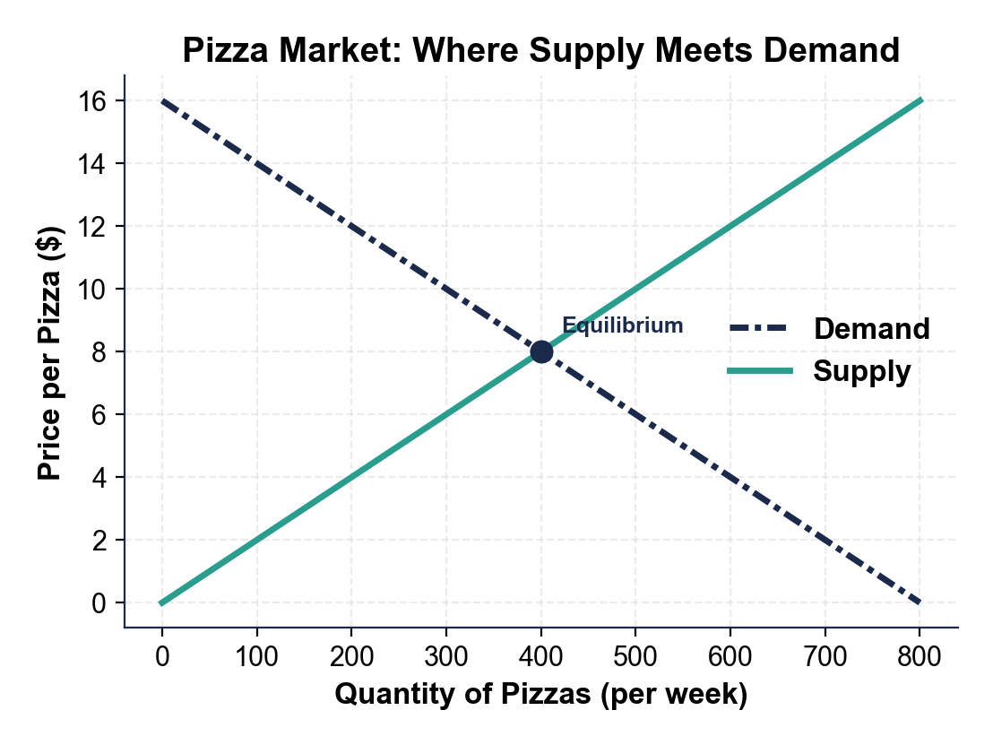
The Pizza Market - Where the Curves Cross
Demand and supply cross at the equilibrium.
© More Lessons Less Planning | morelessonslessplanning.com
Notes:
Point to the single crossing point. Trace up to the price axis ($8) and down to the quantity axis (400 pizzas). At that point the navy demand line and the teal supply line meet - quantity demanded equals quantity supplied. That is the market equilibrium.
Reference labels (point to these chart features when teaching): Equilibrium price = $8; Equilibrium quantity = 400

Slide 7
What Happens at the WRONG Price?
Price Too HIGH
Price Too LOW
Set above equilibrium ($12 instead of $8)
Producers offer a LOT (quantity supplied is high)
Buyers pull back (quantity demanded is low)
Result: a SURPLUS of unsold goods
Set below equilibrium ($4 instead of $8)
Buyers want a LOT (quantity demanded is high)
Producers cut back (quantity supplied is low)
Result: a SHORTAGE - the good sells out
Warning: Only the equilibrium price clears the market. Any other price creates a surplus (too high) or a shortage (too low).
© More Lessons Less Planning | morelessonslessplanning.com
Notes:
Preview the two problems before taking them one at a time. A price ABOVE equilibrium creates a SURPLUS (too much supplied, not enough demanded). A price BELOW equilibrium creates a SHORTAGE (too much demanded, not enough supplied). The next four slides walk each one on a chart.

Slide 8
Surplus - Price Set ABOVE Equilibrium
A SURPLUS happens when the price is ABOVE equilibrium
At $12 (above the $8 equilibrium) producers make a lot
Quantity supplied = 600, but quantity demanded = only 200
Surplus = quantity supplied - quantity demanded = 600 - 200 = 400
On the next slide: a $12 price line and the 400-pizza gap
Note: A surplus is excess supply. Quantity supplied (600) is bigger than quantity demanded (200), so 400 pizzas go unsold.
© More Lessons Less Planning | morelessonslessplanning.com
Notes:
Set up the surplus chart. At a price of $12 (above the $8 equilibrium), read quantity supplied (600) and quantity demanded (200) off the curves. The surplus is the difference: 600 - 200 = 400 unsold pizzas. Pre-load these numbers so students can verify them on the chart.

Slide 9
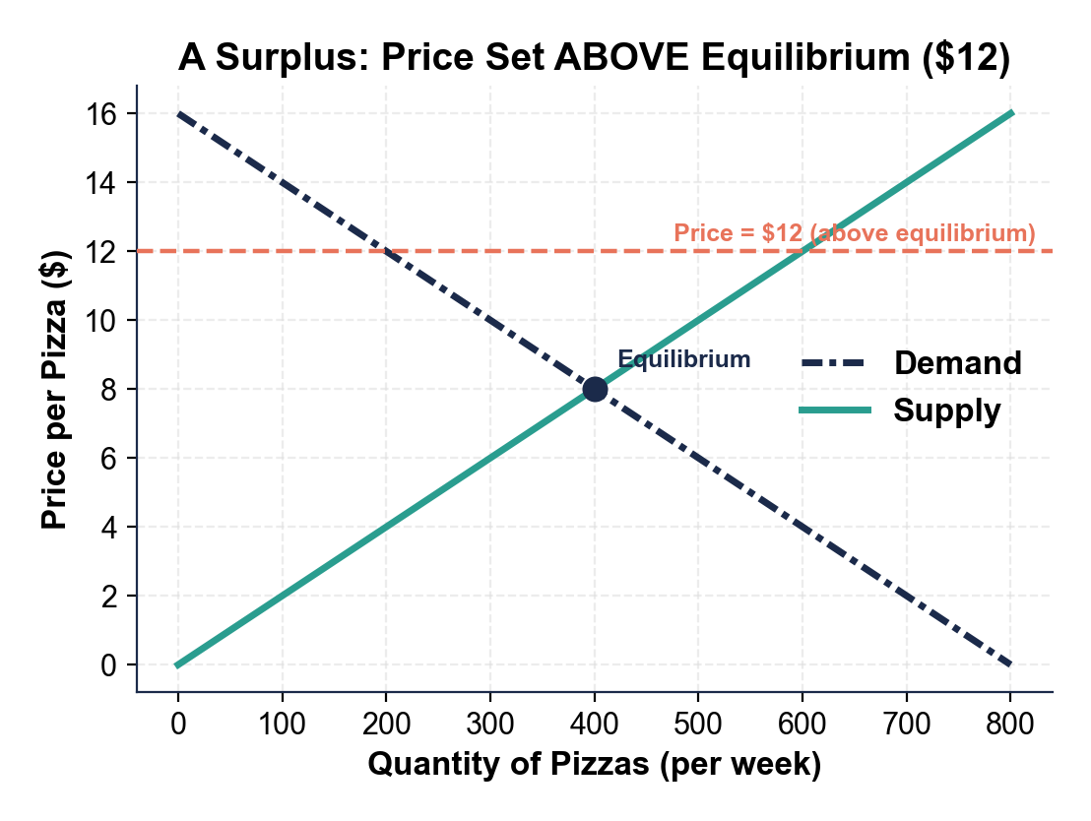
A Surplus at $12 - Too Many Pizzas
At $12, supply (600) beats demand (200).
© More Lessons Less Planning | morelessonslessplanning.com
Notes:
Point to the coral $12 price line. Trace right to the teal supply curve (600 pizzas) and to the navy demand curve (200 pizzas). The horizontal gap between them is the surplus: 600 - 200 = 400 unsold pizzas. The price is too high.
Reference labels (point to these chart features when teaching): Qs = 600 at $12; Qd = 200 at $12

Slide 10
Shortage - Price Set BELOW Equilibrium
A SHORTAGE happens when the price is BELOW equilibrium
At $4 (below the $8 equilibrium) buyers want a lot
Quantity demanded = 600, but quantity supplied = only 200
Shortage = quantity demanded - quantity supplied = 600 - 200 = 400
On the next slide: a $4 price line and the 400-pizza gap
Note: A shortage is excess demand. Quantity demanded (600) beats quantity supplied (200), so the kitchen sells out and buyers go home empty.
© More Lessons Less Planning | morelessonslessplanning.com
Notes:
Set up the shortage chart. At a price of $4 (below the $8 equilibrium), read quantity demanded (600) and quantity supplied (200) off the curves. The shortage is the difference: 600 - 200 = 400 pizzas. Pre-load these numbers so students can verify them on the chart.

Slide 11
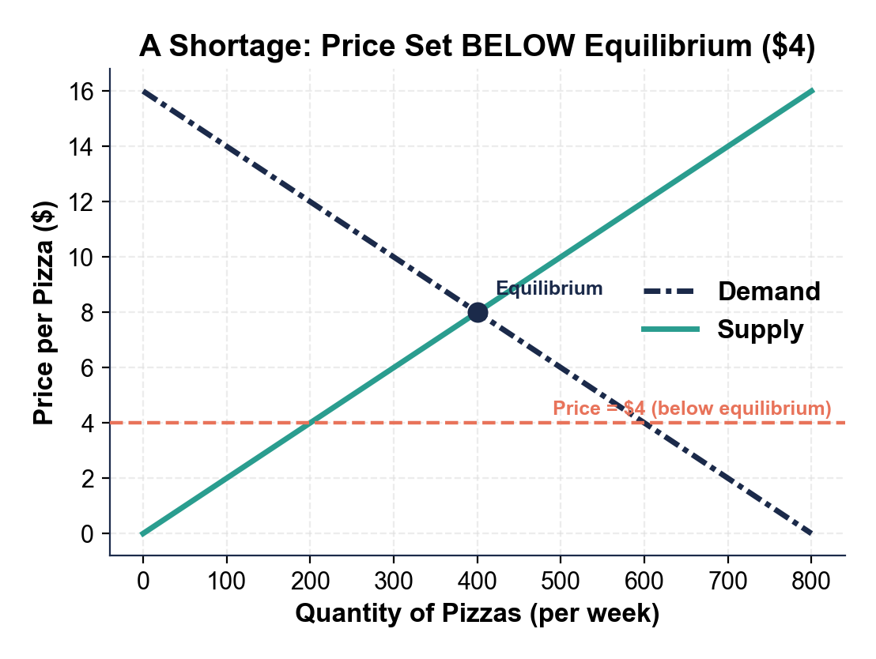
A Shortage at $4 - Sold Out by Lunch
At $4, demand (600) beats supply (200).
© More Lessons Less Planning | morelessonslessplanning.com
Notes:
Point to the coral $4 price line. Trace right to the navy demand curve (600 pizzas) and to the teal supply curve (200 pizzas). The horizontal gap between them is the shortage: 600 - 200 = 400 pizzas. The price is too low and the kitchen sells out.
Reference labels (point to these chart features when teaching): Qd = 600 at $4; Qs = 200 at $4

Slide 12
How a Surplus Self-Corrects - The Price Falls
Step 1 - Unsold goods pile up
At $12 the kitchen made 600 pizzas but sold only 200; 400 go stale on the shelf
✔
Step 2 - Sellers cut the price
To move the extra pizzas, Bella's lowers the price - a surplus pushes the price DOWN
✔
Step 3 - The gap shrinks
As the price falls, quantity demanded rises and quantity supplied falls - they move closer
✔
Step 4 - Back to equilibrium
The price keeps dropping until it reaches $8, where quantity demanded = quantity supplied
✔
Big Idea: A surplus pushes the price DOWN. Sellers cannot move all their goods, so they cut prices until the market clears at equilibrium.
© More Lessons Less Planning | morelessonslessplanning.com
Notes:
The market fixes itself. A surplus means goods are not selling, so sellers lower the price. As the price falls, buyers want more and producers offer less, closing the gap until the price settles at equilibrium ($8). No one has to plan this - the price does it automatically.

Slide 13
How a Shortage Self-Corrects - The Price Rises
Step 1 - The good sells out
At $4 buyers wanted 600 pizzas but the kitchen made only 200; 400 buyers leave empty
✔
Step 2 - Sellers raise the price
With buyers competing for too few pizzas, Bella's raises the price - a shortage pushes the price UP
✔
Step 3 - The gap shrinks
As the price rises, quantity demanded falls and quantity supplied rises - they move closer
✔
Step 4 - Back to equilibrium
The price keeps rising until it reaches $8, where quantity demanded = quantity supplied
✔
Big Idea: A shortage pushes the price UP. Buyers compete for too few goods, so the price rises until the market clears at equilibrium.
© More Lessons Less Planning | morelessonslessplanning.com
Notes:
The mirror of the surplus case. A shortage means buyers are competing for too few goods, so the price rises. As the price climbs, buyers want less and producers offer more, closing the gap until the price settles at equilibrium ($8). The market self-corrects in both directions.

Slide 14
Reading the Pizza Table - Equilibrium, Surplus, Shortage
Price | Quantity Demanded | Quantity Supplied | Diagnosis
$12 | 200 | 600 | Surplus of 400
$8 | 400 | 400 | Equilibrium
$4 | 600 | 200 | Shortage of 400
Did You Know: Only at $8 does quantity demanded (400) equal quantity supplied (400). Above $8 you get a surplus; below $8 you get a shortage.
© More Lessons Less Planning | morelessonslessplanning.com
Notes:
Bring the whole story into one table. At $12, supply (600) beats demand (200) - surplus. At $8 they match at 400 - equilibrium. At $4, demand (600) beats supply (200) - shortage. These exact numbers match all three charts and the activity.

Slide 15
Putting It Together - The Market Finds Its Price
Step 1 - Find the crossing point
Where the demand curve and supply curve cross is the market equilibrium ($8, 400 pizzas)
✔
Step 2 - Check the price
Above equilibrium = surplus (Qs > Qd); below equilibrium = shortage (Qd > Qs)
✔
Step 3 - Predict the correction
A surplus pushes the price down; a shortage pushes the price up - both head toward equilibrium
✔
Step 4 - The market clears
At equilibrium quantity demanded = quantity supplied, so there is no surplus and no shortage
✔
Big Idea: Markets are self-correcting. Whatever the starting price, surpluses and shortages push it back toward the price where supply meets demand.
© More Lessons Less Planning | morelessonslessplanning.com
Notes:
Synthesis slide. Walk the four steps: find the crossing point, check whether the price is above or below it, predict the self-correction, and confirm the market clears at equilibrium. This is the logic students apply on the quiz, the exit ticket, and Activity Parts 3-5.

Slide 16
Market Equilibrium Vocabulary (1 of 3)
Market equilibrium
The single price and quantity where quantity demanded equals quantity supplied; the point where the two curves cross.
Equilibrium price
The one price where quantity demanded equals quantity supplied; no surplus and no shortage. The market-clearing price.
Equilibrium quantity
The amount bought and sold at the equilibrium price, where the demand and supply curves intersect.
Note: Every term on this slide appears in Activity Part 2 (the Reference Guide) and on the Quiz - learn them here.
© More Lessons Less Planning | morelessonslessplanning.com
Notes:
Walk the three terms. MARKET EQUILIBRIUM: where quantity demanded equals quantity supplied, the crossing point. EQUILIBRIUM PRICE: the one price ($8) where they are equal, also called the market-clearing price. EQUILIBRIUM QUANTITY: the amount (400 pizzas) bought and sold at that price.

Slide 17
Market Equilibrium Vocabulary (2 of 3)
1
2
3
Surplus
Shortage
Market-clearing price
Price ABOVE equilibrium: quantity supplied is greater than quantity demanded, so goods go unsold (excess supply).
Price BELOW equilibrium: quantity demanded is greater than quantity supplied, so the good sells out (excess demand).
Another name for the equilibrium price - it 'clears' the market with no surplus and no shortage.
Note: These three terms appear in Activity Part 2 and on the Quiz - surplus means too high, shortage means too low.
© More Lessons Less Planning | morelessonslessplanning.com
Notes:
Walk the three terms. SURPLUS: price above equilibrium, quantity supplied beats quantity demanded, goods go unsold (excess supply). SHORTAGE: price below equilibrium, quantity demanded beats quantity supplied, the good sells out (excess demand). MARKET-CLEARING PRICE: another name for the equilibrium price.

Slide 18
Market Equilibrium Vocabulary (3 of 3)
Excess supply
Another name for a surplus - how much quantity supplied exceeds quantity demanded when the price is too high.
Excess demand
Another name for a shortage - how much quantity demanded exceeds quantity supplied when the price is too low.
Self-correcting market
A market price moves on its own toward equilibrium: a surplus pushes it down, a shortage pushes it up.
Note: These three terms also appear in Activity Part 2 and on the Quiz - drill excess supply, excess demand, and self-correcting.
© More Lessons Less Planning | morelessonslessplanning.com
Notes:
Walk the three terms. EXCESS SUPPLY: another name for a surplus. EXCESS DEMAND: another name for a shortage. SELF-CORRECTING MARKET: the price moves toward equilibrium on its own - a surplus pushes it down, a shortage pushes it up.

Slide 19
Key Takeaways
Market equilibrium is where the demand and supply curves cross
At equilibrium, quantity demanded = quantity supplied (here $8 and 400)
Price ABOVE equilibrium = surplus (too much supplied)
Price BELOW equilibrium = shortage (too much demanded)
Markets self-correct: surplus pushes price down, shortage pushes price up
Takeaway: Wherever the price starts, surpluses and shortages push it back toward the one price where supply meets demand - the market equilibrium.
© More Lessons Less Planning | morelessonslessplanning.com
Notes:
Cycle through the five takeaways. Each maps to one part of the activity: equilibrium (Part 1), reference vocabulary (Part 2), reading the three charts (Part 3), diagnosing prices across scenarios (Part 4), and the pricing-recommendation memo (Part 5).

