Slide 1
Mansa Musa's Pilgrimage to Mecca
How a king's 1324 journey to Mecca broadcast the gold of Mali to the whole world.
© More Lessons Less Planning | morelessonslessplanning.com
Notes:
Opening slide. In 1324 the ruler of the West African empire of Mali, Mansa Musa, set out on the Hajj - the Muslim pilgrimage to the holy city of Mecca. He did not travel quietly. He crossed the Sahara with an enormous caravan and so much gold that, when he stopped in Cairo, his spending and gifts became legendary and even changed the price of gold in Egypt for years. Set the frame from the first minute, in a respectful, academic tone: this is the history of a real and immensely wealthy West African empire, and we describe it accurately. Two honest anchors run through the whole lesson. First, the famous huge numbers for the caravan come from later writers and may be exaggerated, so we treat them as estimates. Second, our fullest account comes from al-Umari, an Arab historian in Cairo who wrote about twelve years after the visit from people who remembered it - a near-contemporary but secondhand source. The payoff: this single journey put Mali, and West Africa's wealth, onto European maps within about fifty years.

Slide 2
Learning Targets
Explain who Mansa Musa was and how Mali grew rich on gold and trade.
★
Describe the 1324 Hajj and the caravan to Cairo - and judge the numbers.
★
Explain how gold in Cairo made gold cheap for years (inflation).
★
Analyze al-Umari's account and how the Hajj put Mali on the map.
★
© More Lessons Less Planning | morelessonslessplanning.com
Notes:
Read the four learning targets. Keep two anchors in mind throughout. First, we treat this as the achievement of a real West African empire, described accurately: Mali grew rich on gold and the trans-Saharan trade, and Mansa Musa's pilgrimage was a genuine act of faith as well as a display of wealth. Second, we read our main source - al-Umari's account of the gold in Cairo - critically, remembering that al-Umari wrote in Cairo about twelve years after the visit from others' reports, and that the famous huge caravan numbers come from later writers and are estimates. Pay special attention to target three (the gold in Cairo causing inflation), because that economic ripple is the memorable hook of the lesson, and to target four (al-Umari and the Catalan Atlas), because that source and that map are what students analyze and explain in the activity.

Slide 3
The Empire of Mali
Richer than Ghana
Gold and Timbuktu
The empire of Mali rose after Ghana in the western Sahel.
Mali grew even richer from gold and the trans-Saharan trade.
Its power stretched across a huge stretch of West Africa.
Mali controlled the goldfields and the trade routes north.
The city of Timbuktu grew famous for trade and learning.
Timbuktu's golden age belongs to Mali, NOT to Ghana.
Key Concept: MALI rose after Ghana in the western Sahel and grew rich on gold and trade; TIMBUKTU flourished under Mali, not Ghana.
© More Lessons Less Planning | morelessonslessplanning.com
Notes:
Start by placing Mansa Musa's kingdom. The empire of MALI rose in the western Sahel of West Africa - the belt of grassland just south of the Sahara - after the earlier empire of Ghana declined, and it grew even larger and richer than Ghana had been. Make the sequence clear and accurate: Ghana came first, then Mali, then later Songhai; do not blur them together. Mali's wealth, like Ghana's, rested on gold and the trans-Saharan trade, but Mali controlled the goldfields and the northern trade routes even more firmly. Under Mali, the city of TIMBUKTU grew into a world-famous center of trade and Islamic learning, with scholars, libraries, and great mosques - and it is important to be accurate here: Timbuktu's golden age belongs to MALI (and later Songhai), not to Ghana. This is the empire that Mansa Musa ruled at its height, and its gold is what makes the rest of the story possible.

Slide 4
Mansa Musa, King of Mali
One of history's richest
A devout Muslim
'Mansa' was Mali's title for its ruler, meaning king.
Mansa Musa ruled Mali at its height, from about 1312.
His control of gold made him one of history's richest people.
Mansa Musa was a devout Muslim ruler of Mali.
His faith led him to make the Hajj to Mecca in 1324.
He built mosques and supported Islamic learning at home.
Key Concept: MANSA MUSA, ruler of Mali, was a devout MUSLIM and, through his control of gold, one of the richest people in history.
© More Lessons Less Planning | morelessonslessplanning.com
Notes:
Now the man at the center of the lesson. 'Mansa' was the Mali title for its ruler - it means something like 'king' or 'emperor' - so 'Mansa Musa' means 'King Musa.' Mansa Musa came to power around 1312 and ruled Mali at the height of its wealth and power. Because he controlled the goldfields and the trade of one of the richest empires on Earth, he is often called one of the wealthiest people in all of human history - some modern writers estimate his wealth as almost impossible to measure. Just as important for this lesson, Mansa Musa was a devout MUSLIM. Islam had reached West Africa through the trans-Saharan trade, and by Mansa Musa's time the rulers of Mali were Muslim. His faith shaped his rule - he built mosques and supported Islamic scholars - and above all it led him, in 1324, to undertake the Hajj, the pilgrimage to Mecca that is a duty for Muslims. Present his faith factually and respectfully: the pilgrimage was a genuine religious act, and it is also the journey that made him famous around the world.

Slide 5
The Hajj: The Pilgrimage to Mecca
A duty of faith
The Hajj is the pilgrimage to Mecca that every able Muslim tries to make at least once.
✔
The destination: Mecca
The Hajj leads to the holy city of Mecca, in Arabia, the center of the Muslim faith.
✔
Mansa Musa's Hajj
In 1324 Mansa Musa set out from Mali on the Hajj, thousands of miles across the Sahara.
✔
Key Concept: The HAJJ is the Muslim pilgrimage to the holy city of MECCA; Mansa Musa made his Hajj in 1324, traveling thousands of miles from Mali.
© More Lessons Less Planning | morelessonslessplanning.com
Notes:
Explain why Mansa Musa made this journey at all, respectfully and factually. The HAJJ is the pilgrimage to Mecca - one of the central duties of Islam, which every Muslim who is able is expected to make at least once in their life. Its destination is MECCA, the holy city in Arabia (in what is now Saudi Arabia) that is the spiritual center of the Muslim faith. For Mansa Musa, making the Hajj was first of all an act of his religion. But because he was the ruler of one of the richest empires on Earth, his pilgrimage was also enormous in scale. In 1324 he set out from Mali toward Mecca - a journey of thousands of miles that would cross the vast Sahara Desert and pass through the great cities of North Africa and Egypt on the way. Keep the tone academic: we are describing a real religious journey and the extraordinary historical event it became, not teaching the beliefs themselves.

Slide 6
The Great Caravan of 1324
A caravan, not a single traveler
Mansa Musa crossed the desert with a huge caravan - a great train of people, camels, and gold.
✔
Loaded with gold
Tradition says thousands of people traveled with him and camels carried heavy loads of gold.
✔
Read the numbers carefully
The famous huge figures come from later writers and may be exaggerated - treat them as estimates.
✔
Key Concept: Mansa Musa crossed the Sahara with a gold-laden CARAVAN; the famous huge numbers come from later writers, so treat them as estimates.
© More Lessons Less Planning | morelessonslessplanning.com
Notes:
Now the scale of the journey - taught with an honesty anchor built right in. Mansa Musa did not travel to Mecca as a lone pilgrim. He crossed the desert with an enormous CARAVAN: a great train of people, animals, and goods moving together. Later Arab writers describe it in astonishing terms - tens of thousands of people, thousands of servants and soldiers, and long lines of camels each carrying heavy loads of gold, plus horses and supplies. These images are memorable, and they capture something true: the caravan was genuinely huge and genuinely loaded with gold. But teach students to read the numbers carefully. The most famous figures (for example, sixty thousand people, or a hundred camels each carrying three hundred pounds of gold) come from LATER writers, often writing well after 1324 and repeating stories, so historians treat them as ESTIMATES that may be exaggerated rather than exact counts. The honest way to say it: the caravan was enormous and gold-laden, and the exact numbers are uncertain. This is a good, concrete lesson in how history works - we can know an event was huge without trusting every number attached to it.

Slide 7
Across the Sahara to Cairo
Crossing the desert
The stop in Cairo
The caravan crossed the vast Sahara Desert by camel.
It followed the trans-Saharan routes north and east.
The journey to Mecca took many months each way.
On the way, the caravan stopped in Cairo, in Egypt.
Cairo was one of the greatest cities of the Islamic world.
It is in Cairo that the story of the gold really begins.
Key Concept: The caravan crossed the vast SAHARA along the trans-Saharan routes and stopped in the great Egyptian city of CAIRO on the way to Mecca.
© More Lessons Less Planning | morelessonslessplanning.com
Notes:
Trace the route, because geography sets up the famous part of the story. From Mali, the pilgrimage had to cross the SAHARA - one of the largest and harshest deserts on Earth - by camel caravan, following the established trans-Saharan routes north and east toward North Africa and Egypt. The whole journey to Mecca and back took many months each way. The key stop for our lesson is CAIRO, the great city on the Nile in Egypt, which at the time was one of the largest and most important cities in the entire Islamic world, the seat of a powerful sultan. Mansa Musa's caravan halted in Cairo for weeks on the way toward Mecca. It is here, in Cairo, that the most famous part of the whole story unfolds - because of what Mansa Musa and his people did with their gold while they were there. Set that up as a cliffhanger into the next slide.

Slide 8
Gold in Cairo
Gifts to everyone
In Cairo, Mansa Musa gave gold to officials, merchants, and the poor across the whole city.
✔
Spending in the markets
His people spent enormous amounts of gold buying goods in Cairo's markets.
✔
A flood of gold
So much gold poured into Cairo that the city's markets were flooded with it.
✔
Did You Know? In CAIRO, Mansa Musa gave away and spent so much gold that he flooded the whole city's markets with it.
© More Lessons Less Planning | morelessonslessplanning.com
Notes:
Here is what made Mansa Musa legendary. During his weeks in CAIRO, Mansa Musa was extraordinarily generous with his gold. According to the accounts, he gave gifts of gold to almost everyone he dealt with - officials of the sultan's court, merchants, and ordinary poor people of the city - and his huge entourage SPENT gold lavishly in Cairo's markets, buying goods at high prices. The result was that an enormous quantity of GOLD poured into Cairo in a very short time, flooding the city's markets. Emphasize both the generosity and the sheer volume: this was not a few coins but, by every account, a staggering amount of gold entering one city's economy all at once. Students should hold two ideas together - that this generosity impressed everyone and spread Mansa Musa's fame, and that pouring so much gold into one place so fast would have an economic effect, which is exactly what the next slide explains. Keep the tone academic and admiring of the scale, while pointing forward to the consequence.

Slide 9
The Cairo Gold Crash
More gold, less scarce
So much gold flooded Cairo that gold became less scarce - and less scarce things lose value.
✔
The value of gold fell
The value of gold fell in Cairo, and prices rose - an effect economists call inflation.
✔
Cheap for about twelve years
By some accounts, gold stayed cheap in Cairo for about twelve years after the visit.
✔
Key Concept: So much gold flooded Cairo that gold's value FELL and prices rose - INFLATION; gold stayed cheap there for about twelve years.
© More Lessons Less Planning | morelessonslessplanning.com
Notes:
This is the memorable economic heart of the lesson, and it is worth slowing down for. When Mansa Musa flooded Cairo with gold, he accidentally taught a lesson in basic economics. Gold was valuable in part because it was SCARCE. When suddenly there was far more of it in Cairo, gold became less scarce - and things that are less scarce lose value. So the value of gold FELL in Cairo: it took more gold than before to buy the same goods, which is the same as saying prices, measured in gold, ROSE. A general rise in prices like this, caused when money (here, gold) becomes less scarce, is what economists call INFLATION. Our sources say the effect was not brief: by some accounts, gold stayed cheap in Cairo for about TWELVE years after Mansa Musa's visit. Draw the honest, two-sided picture: Mansa Musa's generosity was real and dazzling, but flooding one economy with gold also hurt it - Cairo merchants who held gold saw its value drop. This is the concrete, surprising fact students remember, and it is exactly what the primary source in the activity describes.

Slide 10
al-Umari: Our Main Source
Who al-Umari was
A source to weigh
al-Umari was an Arab historian who worked in Cairo in the 1300s.
He recorded the story about twelve years after the visit.
His sources were people in Cairo who still remembered it.
His account is valuable and close in time to the event.
But it is secondhand - not something he witnessed himself.
Felix Dubois only reproduced it later, in his 1896 book.
Remember: AL-UMARI, an Arab historian in Cairo, recorded this about TWELVE years later from people who remembered it - valuable but secondhand.
© More Lessons Less Planning | morelessonslessplanning.com
Notes:
Before students read al-Umari's words in the activity, they need to know exactly what kind of source he is - this is the sourcing anchor of the lesson. AL-UMARI (his full name was Shihab al-Din al-Umari) was an Arab scholar and historian who lived and worked in CAIRO in the 1300s. He wrote down the most detailed surviving account of Mansa Musa's visit and the gold - but he did not witness it himself. He gathered the story about TWELVE years after 1324, by interviewing people still living in Cairo who remembered the king of Mali's visit, including officials who had met him. That makes al-Umari a NEAR-CONTEMPORARY source - close in time, written by a careful scholar, and based on the memories of people who were actually there - which is why historians value it highly. But it is still SECONDHAND: al-Umari recorded what others told him, not what he saw, so some details (especially exact numbers) may be shaped by memory or exaggeration. Also make one attribution point clear for the activity: students will read al-Umari's account as it was REPRODUCED in a book by Felix Dubois published in 1896. Dubois is the later publisher who passed the account down to us; al-Umari is the original recorder. Keep those two straight.

Slide 11
Mali on the Map of the World
News travels far
Drawn on a European map
News of Mansa Musa's gold spread across the Islamic world.
It reached traders and mapmakers in far-off Europe.
West Africa's wealth was now famous beyond the Sahara.
In 1375, European mapmakers made the Catalan Atlas.
It shows Mansa Musa crowned and holding a piece of gold.
The Hajj had put Mali on the map of the world.
Key Concept: In 1375 European mapmakers drew Mansa Musa holding gold on the CATALAN ATLAS - the Hajj had put Mali on the world's maps.
© More Lessons Less Planning | morelessonslessplanning.com
Notes:
Close the story with the long-term consequence - the reason the pilgrimage matters for world history. The gold Mansa Musa spent and gave away, and the astonishing stories that followed, spread his fame across the whole Islamic world and, from there, into Christian Europe. Merchants, travelers, and mapmakers around the Mediterranean heard that far to the south, beyond the Sahara, lay an African empire so rich that its king had flooded Cairo with gold. The most striking proof is a map. About fifty years after the Hajj, in 1375, mapmakers in Europe produced the famous CATALAN ATLAS - one of the finest maps of its age. On the part of the map showing West Africa, they drew a crowned African king seated on a throne, holding up a large piece of gold: this is Mansa Musa, and a note beside him describes him as the richest and noblest king of that land. Think about what that means: a European map, drawn by people who had never been to Mali, placed Mansa Musa and his gold at the center of West Africa - because his pilgrimage had made Mali famous across the known world. That is the payoff of the whole lesson: one journey put West Africa's wealth on the map of the world. The next slide shows this very image.

Slide 12
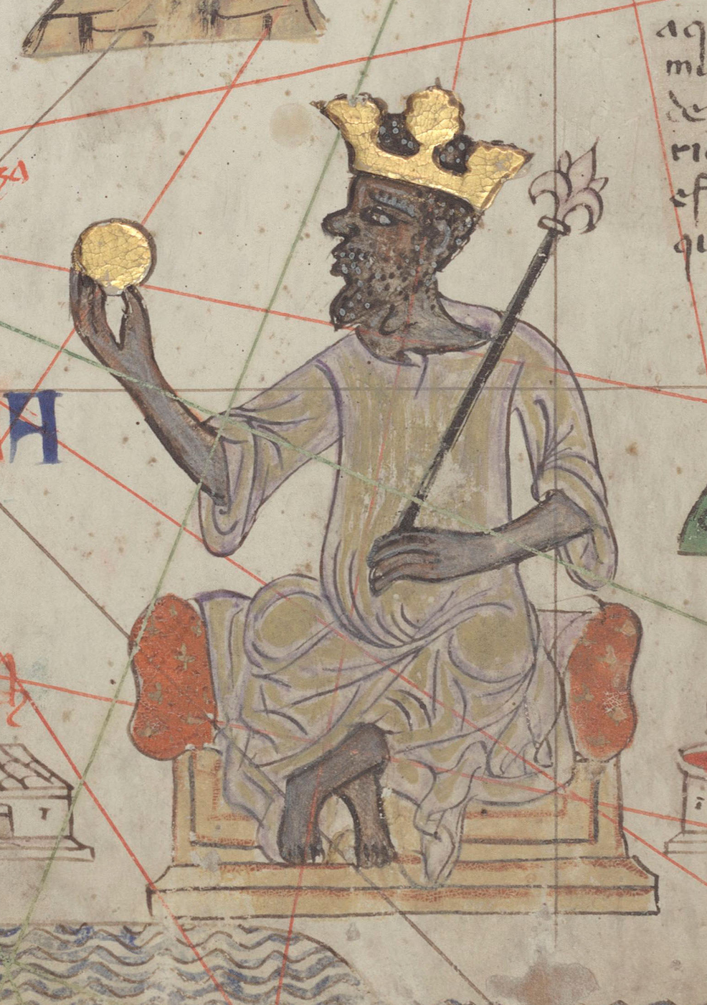
Mansa Musa in the Catalan Atlas (1375)
Detail of Mansa Musa holding gold, from the 1375 Catalan Atlas.
© More Lessons Less Planning | morelessonslessplanning.com
Notes:
A real public-domain artwork: the detail of Mansa Musa from the 1375 Catalan Atlas (a faithful photographic reproduction of the original manuscript panel held at the Bibliotheque nationale de France). Use it purely as a reference image to make the consequence of the Hajj concrete. Point out three things: the gold CROWN and the SCEPTER, which mark him as a king; the large piece of GOLD he holds up in his hand, the detail the mapmakers chose to define him by; and his throne at the center of the West Africa section of the map. Explain that European mapmakers in 1375 - who had never been to Mali - drew him this way because news of his gold and his pilgrimage had made him famous across the known world. Note honestly that this is a European artist's imagined portrait, not a photograph or a likeness from life; no one knows exactly what Mansa Musa looked like. What the image proves is not his exact appearance but his fame: fifty years after the Hajj, a European map placed the king of Mali and his gold at the heart of West Africa. Image: detail of Mansa Musa from the Catalan Atlas (1375), Bibliotheque nationale de France, via Wikimedia Commons (public domain).
Reference labels (point to these chart features when teaching): Crown and scepter: a king; In his hand: a piece of gold

Slide 13
Key Takeaways
Mansa Musa ruled Mali, one of history's richest empires, built on gold.
★
His 1324 Hajj crossed the Sahara to Cairo with a gold-laden caravan.
★
So much gold flooded Cairo that its value fell for years (inflation).
★
The Hajj put Mali on the map - the 1375 Catalan Atlas shows its king.
★
© More Lessons Less Planning | morelessonslessplanning.com
Notes:
Let us recap Mansa Musa's pilgrimage. First, the empire and the king: Mansa Musa ruled MALI, the West African empire that rose after Ghana and grew rich on gold and the trans-Saharan trade - and he was a devout Muslim and one of the richest people in history. Second, the journey: in 1324 he made the HAJJ, the pilgrimage to Mecca, crossing the vast Sahara with an enormous CARAVAN loaded with gold - though we remember the famous huge numbers are later estimates. Third, the memorable heart of the story: in CAIRO he spent and gave away so much gold that gold became less scarce, its value FELL, and prices rose - INFLATION - with gold staying cheap in Cairo for about twelve years. Fourth, the source: our fullest account comes from AL-UMARI, an Arab historian in Cairo who recorded it about twelve years later from people who remembered it - a near-contemporary but secondhand source, later reproduced by Dubois in 1896. And the payoff, running through it all: the Hajj broadcast Mali's wealth across the Islamic world and into Europe, so that by 1375 the CATALAN ATLAS drew Mansa Musa holding gold - one journey had put West Africa on the map of the world. We have studied Mali respectfully as the achievement of a real and immensely wealthy West African empire.

