Slide 1
Magellan and the First Voyage Around the World
The first circumnavigation of the globe - and its human cost
© More Lessons Less Planning | morelessonslessplanning.com
Notes:
Open on the through-line. In 1519 Ferdinand Magellan led a fleet of five ships out of Seville on the voyage that would become the first all the way around the world. He never made it home - he was killed at Mactan in 1521. The voyage was completed by a single ship, the Victoria, under Juan Sebastian Elcano, which reached Spain in 1522. Along the way the crew endured a brutal Pacific crossing recorded by the eyewitness Antonio Pigafetta.

Slide 2
Learning Targets
Trace the route and key dates of the first voyage around the world.
★
Describe the human cost of the Pacific crossing from Pigafetta's account.
★
Explain why Magellan did not finish the voyage - and who actually did.
★
© More Lessons Less Planning | morelessonslessplanning.com
Notes:
Use the targets to preview the arc: the fleet's departure and route, the terrible Pacific crossing, Magellan's death at Mactan, and Elcano completing the circumnavigation.

Slide 3
The voyage begins: five ships leave Seville
In 1519, Ferdinand Magellan led a fleet of five ships out of Seville, Spain.
The fleet set sail on August 10, 1519, beginning the long voyage.
By Antonio Pigafetta's count, about 237 men sailed with the fleet.
Magellan was the captain-general - the leader - of the whole expedition.
Key Point: Magellan led five ships and about 237 men out of Seville in 1519 on the voyage that would become the first all the way around the world.
© More Lessons Less Planning | morelessonslessplanning.com
Notes:
Establish the departure before anything else. Magellan led a fleet of five ships out of Seville on August 10, 1519, carrying about 237 men by Pigafetta's count. This became the first voyage to sail all the way around the world. Note that Magellan is the leader - the captain-general - which matters later when he does not survive.

Slide 4
Through the Strait of Magellan into the Pacific
Finding the passage
Into a new ocean
The fleet found a narrow, twisting passage near South America's southern tip.
That passage is now called the Strait of Magellan.
On November 28, 1520, the fleet came out of the strait into a vast ocean.
They named it the Pacific, the world's largest ocean.
Key Point: On November 28, 1520, the fleet passed through the Strait of Magellan and entered the ocean they named the Pacific.
© More Lessons Less Planning | morelessonslessplanning.com
Notes:
The fleet found a narrow passage near South America's tip - now the Strait of Magellan - and on November 28, 1520 came out into a huge ocean they named the Pacific, the world's largest, which they were the first to cross. The next slide shows the first printed map of that ocean.

Slide 5
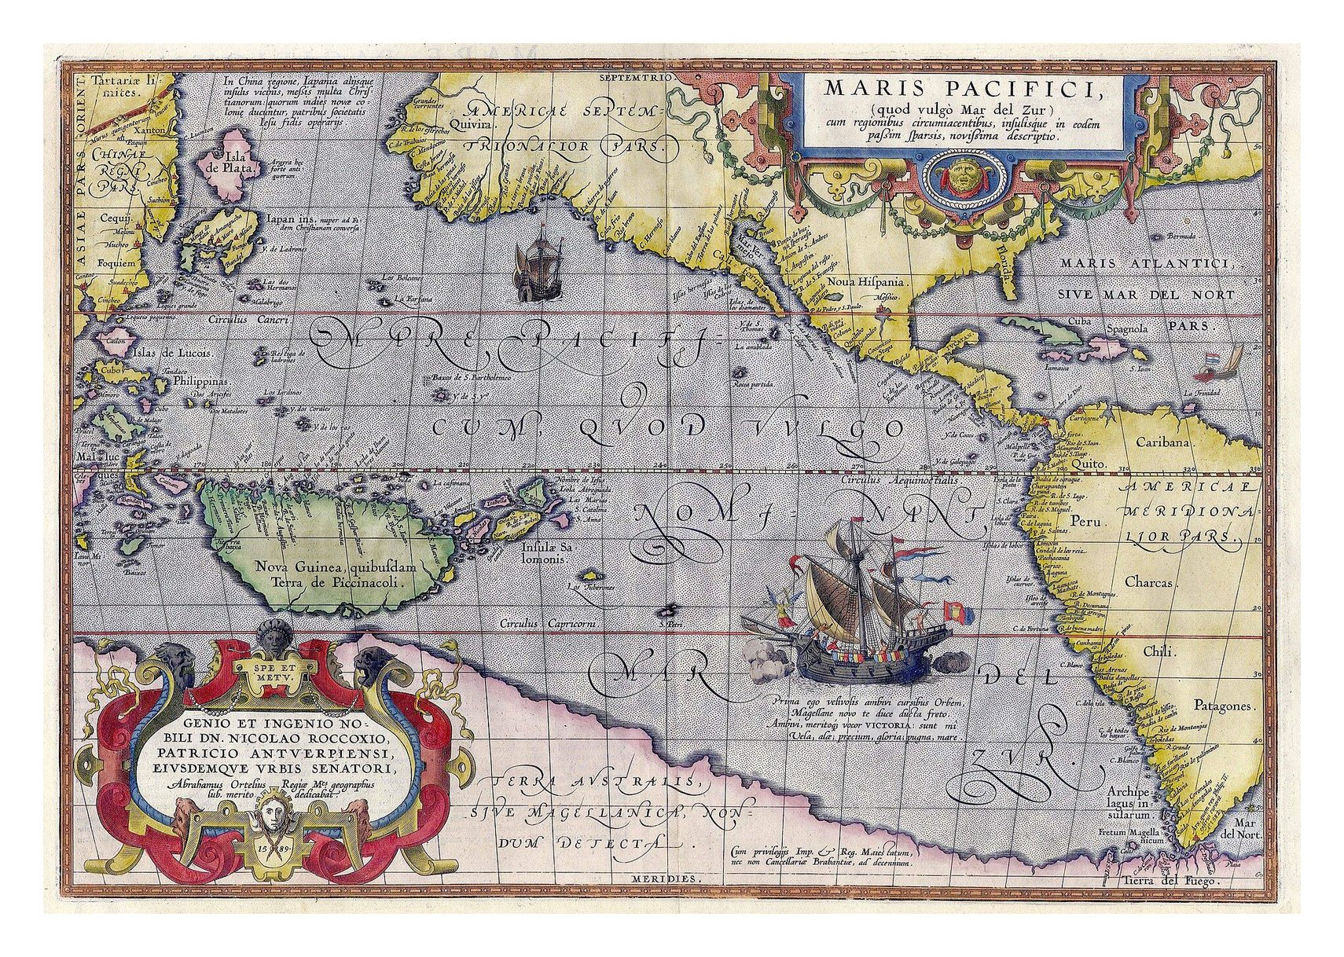
Mapping the Pacific: Ortelius, 1589
Ortelius, Maris Pacifici (1589) - first printed map of the Pacific.
© More Lessons Less Planning | morelessonslessplanning.com
Notes:
Frame the map honestly: it was printed in 1589, decades after the voyage. It is the first printed map of the Pacific and depicts the Victoria - the ship that completed the circumnavigation - crossing the ocean the fleet was first to sail. It shows how Europeans pictured the Pacific, not a photograph of the voyage.

Slide 6
The Pacific crossing: three months without fresh food
The crossing lasted three months and twenty days with no fresh food.
Sailors ate 'powder of biscuits swarming with worms' and putrid water.
They ate ox hides softened in the sea and even sawdust from the ship's boards.
Rats were sold for half a ducat each - and even then were hard to get.
Key Point: During the Pacific crossing the starving crew ate worm-ridden biscuit, ox hides, and sawdust, and paid half a ducat for a single rat.
© More Lessons Less Planning | morelessonslessplanning.com
Notes:
This is the human cost in Pigafetta's own words. For three months and twenty days the crew had no fresh food; they ate biscuit that was powder swarming with worms, drank putrid yellow water, ate ox hides softened in the sea and sawdust, and paid half a ducat for a rat. Keep the tone sober and documentary - the facts are strong enough without embellishment.

Slide 7
Scurvy and the cost of the crossing
What is scurvy?
A deadly disease caused by a lack of vitamin C, which comes from fresh food.
✔
The symptom Pigafetta saw
The gums of some men swelled so badly they could not eat, and so they died.
✔
How many died
Nineteen men died of that sickness during the Pacific crossing.
✔
Why fresh food mattered
With no fruit or vegetables for over three months, the crew had no source of vitamin C.
✔
Key Point: Scurvy - caused by a lack of vitamin C from fresh food - killed nineteen men during the Pacific crossing.
© More Lessons Less Planning | morelessonslessplanning.com
Notes:
Scurvy is the disease behind the deaths. It is caused by a lack of vitamin C, which the crew would normally get from fresh food. Pigafetta describes gums swelling so badly that men could not eat and died. Nineteen men died of scurvy on the crossing. Connect the cause (no fresh food for months) to the effect (scurvy).

Slide 8
Antonio Pigafetta: the eyewitness
Who he was
Why he matters
Antonio Pigafetta was an Italian who sailed with Magellan's fleet.
He kept the fullest eyewitness journal of the whole voyage.
Almost everything we know about the crossing comes from his journal.
His account records the route, the suffering, and the losses in detail.
Key Point: Antonio Pigafetta, an Italian crewman, kept the fullest eyewitness journal of the voyage - our main source for what happened.
© More Lessons Less Planning | morelessonslessplanning.com
Notes:
Introduce the source before students read it. Antonio Pigafetta was an Italian crewman who kept the fullest eyewitness journal of the voyage. Almost everything we know about the Pacific crossing comes from his account. Because he was there, his testimony carries the weight of direct experience.

Slide 9
Magellan is killed at Mactan
On April 27, 1521, Magellan was killed in battle on the island of Mactan.
He died over a year before the voyage finally ended.
Magellan led the expedition, but he never sailed all the way around the world.
The common belief that Magellan circumnavigated the globe is not accurate.
Key Point: Magellan was killed at Mactan on April 27, 1521 - he led the voyage but died before it ended, so he did not sail around the world.
© More Lessons Less Planning | morelessonslessplanning.com
Notes:
This is the misconception correction. Magellan was killed in battle on the island of Mactan on April 27, 1521, over a year before the voyage ended. He led the expedition, but he never completed a journey around the world. State this plainly: it is not accurate to say Magellan circumnavigated the globe.

Slide 10
Elcano and the Victoria complete the voyage
One ship of five
The first circumnavigation
Only one of the five ships, the Victoria, made it back to Spain.
Juan Sebastian Elcano captained the Victoria home.
The Victoria reached Spain on September 6, 1522.
About 18 of the roughly 237 men who set out survived.
Key Point: The Victoria, under Elcano, reached Spain on September 6, 1522, completing the first circumnavigation with about 18 survivors.
© More Lessons Less Planning | morelessonslessplanning.com
Notes:
This is who actually completed the voyage. Only the Victoria, captained by Juan Sebastian Elcano, made it back to Spain, arriving September 6, 1522 - the first time anyone had sailed all the way around the world. About 18 of the roughly 237 men who set out survived. Credit Elcano and the surviving crew, not Magellan, with completing the circumnavigation.

Slide 11
Voyage vocabulary: route and hardship
Circumnavigation
A complete journey all the way around the world.
Strait of Magellan
The narrow sea passage near South America's tip linking the Atlantic and Pacific.
Pacific Ocean
The world's largest ocean; Magellan's fleet was the first to cross it and named it.
Scurvy
A deadly disease caused by a lack of vitamin C (fresh food).
Victoria
The only one of Magellan's five ships to complete the voyage around the world.
Key Point: These terms name the voyage's goal, its route, the ocean, the disease, and the ship.
© More Lessons Less Planning | morelessonslessplanning.com
Notes:
These are the first five reference-guide terms. Connect each to a moment in the voyage: circumnavigation is the goal, the Strait of Magellan is the passage, the Pacific is the ocean crossed, scurvy is the killer, and the Victoria is the ship that finished.

Slide 12
Voyage vocabulary: people, coins, and places
Antonio Pigafetta
The Italian crewman whose journal is the fullest eyewitness account of the voyage.
Ducat
A gold coin; starving sailors paid half of one for a single rat.
League
An old unit of distance, very roughly three miles.
Juan Sebastian Elcano
The captain who brought the Victoria home, completing the first circumnavigation.
Mactan
The Philippine island where Magellan was killed in battle in April 1521.
Key Point: These terms name the eyewitness, the coin, the distance unit, the captain, and Mactan.
© More Lessons Less Planning | morelessonslessplanning.com
Notes:
These are the last five reference-guide terms. Pigafetta is the eyewitness source; the ducat measures how desperate the crew was; the league measures the vast distance; Elcano is the captain who completed the voyage; Mactan is where Magellan was killed.

Slide 13
Reading the first voyage around the world
The Victoria's return was the first time anyone had sailed around the world.
But at a staggering cost: about 237 men set out, and only about 18 returned.
Magellan led it and died at Mactan; Elcano and the crew completed it.
We know the crew's suffering because Pigafetta recorded it as an eyewitness.
Remember: Credit the whole crew - Magellan led, Elcano completed, and nineteen men died of scurvy on the Pacific crossing alone.
© More Lessons Less Planning | morelessonslessplanning.com
Notes:
Pull the arc together for the synthesis writing. The voyage was the first ever around the world, but the cost was staggering: of about 237 men, only about 18 returned. An accurate account credits Magellan as leader, Elcano as completer, and Pigafetta as the eyewitness who preserved the record - and it does not hide the human cost.

Slide 14
Key Takeaways
Magellan led five ships and about 237 men out of Seville in 1519.
★
The Pacific crossing was brutal: worm-ridden food and nineteen scurvy deaths.
★
Magellan was killed at Mactan in 1521 - he did not sail around the world.
★
Elcano brought the Victoria home in 1522, completing the first circumnavigation.
★
© More Lessons Less Planning | morelessonslessplanning.com
Notes:
Close by returning to the essential question. Ask students for one accurate sentence that names Magellan as the leader who died at Mactan and Elcano as the captain who completed the first circumnavigation, and that acknowledges the human cost.

