Slide 1
Machiavelli's The Prince
How rulers actually keep power - and the famous question: is it better to be feared or loved?
© More Lessons Less Planning | morelessonslessplanning.com
Notes:
Opening slide. This lesson examines Niccolo Machiavelli's The Prince (1513), the most famous - and most argued-about - book of political advice from the Renaissance. Machiavelli wrote it in Florence after the Florentine Republic fell and the Medici returned to power, at a moment when he had been dismissed from office, imprisoned, and tortured. Rather than describe how a good Christian ruler should behave, Machiavelli described how rulers actually gain and keep power. The lesson centers on his most famous question - is it better for a ruler to be feared or loved? - and stays honest about the debate: Machiavelli was himself a lifelong republican, and scholars still argue about whether The Prince endorses these methods or coldly analyzes them.

Slide 2
Learning Targets
Explain who Machiavelli was and the crisis in which he wrote The Prince.
★
Explain realpolitik: describing how power really works, apart from morality.
★
Analyze his argument on being feared or loved - and avoiding being hated.
★
Analyze an excerpt from The Prince (Ch. XVII) and weigh the honest debate.
★
© More Lessons Less Planning | morelessonslessplanning.com
Notes:
Learning targets. Target 1 places Machiavelli in his moment: a Florentine official who lost everything when the Republic fell and the Medici returned in 1512, and who wrote The Prince in 1513. Target 2 introduces realpolitik - describing how rulers actually gain and keep power, separated from conventional Christian morality. Target 3 is the heart of the lesson: his argument that it is safer to be feared than loved, together with his crucial qualification that a ruler must avoid being hated. Target 4 practices sourcing on an adapted excerpt from Chapter XVII and weighs the scholarly debate over whether Machiavelli endorsed or coldly analyzed these methods.

Slide 3
Florence in Chaos: A World of Warring City-States
Renaissance Italy was split into rival city-states, often at war.
Florence was one such city, ruled at times as a republic.
The FLORENTINE REPUBLIC was Florence's self-governing government.
Foreign armies and shifting alliances made power unstable.
In this dangerous world, holding on to power was a real problem.
Key Concept: The FLORENTINE REPUBLIC was Florence's self-governing government in an age of warring, unstable Italian city-states.
© More Lessons Less Planning | morelessonslessplanning.com
Notes:
Set the scene. Renaissance Italy was not a single country but a patchwork of rival city-states - Florence, Venice, Milan, the Papal States, Naples, and others - that frequently fought one another and were often invaded by larger foreign powers like France and Spain. Florence was one of these city-states, and for stretches of time it governed itself as a republic. The FLORENTINE REPUBLIC was that self-governing republican government, run by councils of citizens rather than a single king. But power in this world was dangerous and unstable: alliances shifted, foreign armies marched in, and governments could collapse almost overnight. This is the practical, high-stakes environment in which Machiavelli lived and worked, and it shaped his hard-headed view of how rulers actually survive.

Slide 4
Who Was Niccolo Machiavelli?
Niccolo Machiavelli
A Florentine writer and diplomat (1469-1527) who served the Florentine Republic and later wrote The Prince.
A diplomat and official
For years he ran missions and negotiations for Florence, watching real rulers up close.
A close observer of power
He studied how leaders actually won, kept, and lost power - not how they were supposed to.
Key Concept: NICCOLO MACHIAVELLI (1469-1527) was a Florentine writer and diplomat who watched real rulers up close.
© More Lessons Less Planning | morelessonslessplanning.com
Notes:
Introduce the man. NICCOLO MACHIAVELLI (1469-1527) was a writer and diplomat from Florence. For about fourteen years he was a senior official of the Florentine Republic, running diplomatic missions and helping manage the city's affairs and defenses. That job put him in the room with real rulers - popes, kings, and warlords - during tense negotiations, and he watched closely how they actually gained, kept, and lost power. Stress that Machiavelli was not a distant philosopher inventing ideal governments; he was a practical, experienced insider who had seen politics up close and often up ugly. That firsthand experience is exactly what gives The Prince its blunt, realistic tone. The next slide shows a portrait of him.

Slide 5
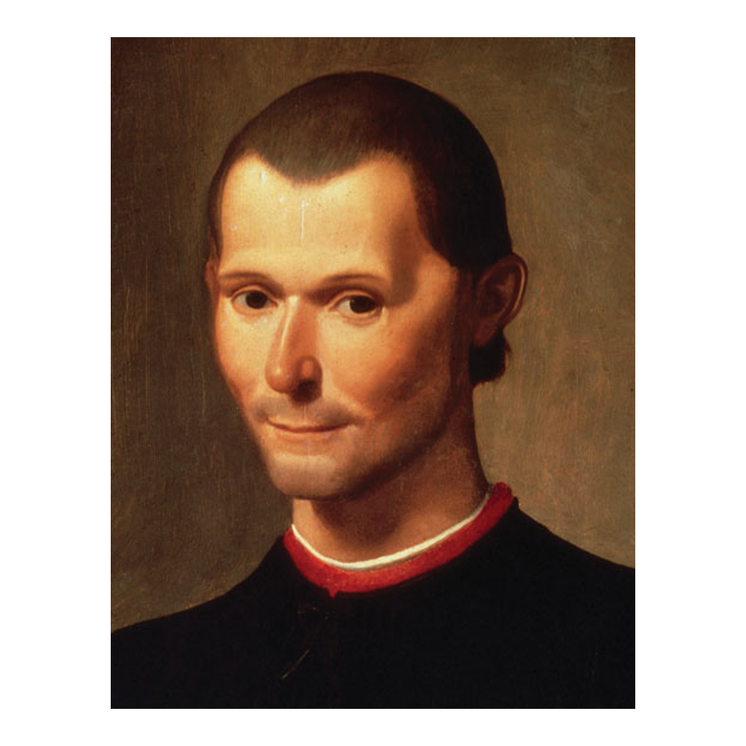
A Portrait of Machiavelli
Portrait of Niccolo Machiavelli by Santi di Tito (16th century).
© More Lessons Less Planning | morelessonslessplanning.com
Notes:
This is a portrait of Niccolo Machiavelli painted by Santi di Tito in the 16th century (now in the Palazzo Vecchio in Florence). Use it simply to put a human face to the writer students are studying. Note honestly that this is a portrait painted after Machiavelli's lifetime by an artist working in the traditional style, so it is a historical image of him rather than a photograph - it shows how Florence remembered him. It is a real Renaissance-era painting in the public domain, not a modern illustration.
Reference labels (point to these chart features when teaching): A Florentine diplomat; Painted in the 1500s

Slide 6
1512: The Republic Falls and the Medici Return
The Republic falls (1512)
The FLORENTINE REPUBLIC collapsed and Machiavelli lost his government job.
✔
The Medici return
THE MEDICI, Florence's powerful family, took back control of the city.
✔
Machiavelli's downfall
He was dismissed, then jailed and even tortured, before being released.
✔
Key Concept: In 1512 the Republic fell and THE MEDICI returned; Machiavelli was dismissed, imprisoned, and tortured.
© More Lessons Less Planning | morelessonslessplanning.com
Notes:
This is the turning point that produced the book. In 1512, the Florentine Republic collapsed under military and political pressure, and THE MEDICI - the wealthy and powerful family that had long dominated Florence - returned to power. Machiavelli, who had loyally served the Republic, suddenly lost his position. Worse, the new Medici rulers suspected him of plotting against them: he was arrested, imprisoned, and even tortured (with a rope-and-pulley method called the strappado) before being released and sent to live quietly in the countryside outside Florence. Make sure students feel the reversal: a respected insider was thrown out, jailed, and broken almost overnight. It was in this disgrace, cut off from the political life he loved, that Machiavelli sat down and wrote The Prince.

Slide 7
Why He Wrote The Prince (1513)
In 1513, out of office, Machiavelli wrote THE PRINCE.
THE PRINCE is a short book of advice for rulers on keeping power.
He dedicated it to the Medici, partly to win back their favor.
He hoped to prove his usefulness and return to public life.
The book gathered the hard lessons he had learned as a diplomat.
Key Concept: THE PRINCE (1513) is Machiavelli's book of advice for rulers, dedicated to the Medici to win back favor.
© More Lessons Less Planning | morelessonslessplanning.com
Notes:
Explain the book and its purpose. In 1513, living in forced retirement, Machiavelli wrote THE PRINCE (in Italian, Il Principe) - a short, sharp book of practical advice for rulers about how to gain, hold, and use political power. Crucially, he dedicated it to the Medici (to Lorenzo de' Medici), the very family that had thrown him out. Historians point out the honest motive here: Machiavelli hoped the book would prove how useful and knowledgeable he was, win back Medici favor, and get him a job back in government. So The Prince is partly a job application from a brilliant but disgraced insider. That practical purpose matters when we read it: he is trying to impress powerful rulers by showing he understands the real, unsentimental rules of power better than anyone.

Slide 8
Realpolitik: A New Kind of Advice Book
The old advice books
Machiavelli's approach
Told rulers to be good, just, and holy.
Described the ideal Christian prince.
REALPOLITIK: describe how power really works.
Separate politics from moral and religious ideals.
Big Idea: REALPOLITIK means judging politics by how power really works, not by moral or religious ideals.
© More Lessons Less Planning | morelessonslessplanning.com
Notes:
Explain what made the book shocking. For centuries, advice books for rulers (a genre sometimes called 'mirror for princes') told a ruler to be good, just, generous, and holy - to be the ideal Christian prince. Machiavelli broke sharply from that tradition. His approach is often described by the modern term REALPOLITIK: politics based on the practical realities of power rather than on moral or religious ideals. Instead of asking how a ruler SHOULD behave to be virtuous, Machiavelli asked how rulers ACTUALLY gain and keep power in a dangerous world - even when the honest answer is uncomfortable. He deliberately separated the study of politics from conventional Christian morality. Be careful and fair here: this does not mean Machiavelli was simply 'evil.' He was doing something closer to describing politics like a scientist describes nature - coldly and realistically. Whether he approved of what he described is a genuine debate we will return to.

Slide 9
Fortune and Virtu: Mastering Chance
Fortune (Fortuna)
Machiavelli's word for chance or luck in politics, which a wise ruler must prepare for and try to master.
Virtu
A ruler's skill, boldness, and adaptability in seizing and holding power - not the same as being 'virtuous.'
The mix that wins
The most successful rulers use virtu to prepare for and control the blows of fortune.
Key Concept: A ruler needs VIRTU (skill and boldness) to master FORTUNE (chance) - virtu is not the same as being morally good.
© More Lessons Less Planning | morelessonslessplanning.com
Notes:
Introduce two of Machiavelli's key ideas. FORTUNE (in Italian, fortuna) is his word for chance or luck in politics - the sudden, unpredictable blows of events that can wreck even a careful ruler. Machiavelli said fortune controls perhaps half of what happens, but a wise ruler can prepare for it, like building dikes and dams before a flood. VIRTU (his special term) is a ruler's skill, boldness, energy, and adaptability in seizing and holding power. Warn students about a false friend here: virtu does NOT mean 'virtue' in the moral sense of being good and kind. For Machiavelli, virtu is closer to effective, forceful capability - the ability to act decisively and adapt when circumstances change. The rulers who succeed, he argued, are the ones who use their virtu to prepare for and master the twists of fortune, rather than passively hoping for good luck.

Slide 10
The Big Question: Feared or Loved?
Machiavelli asks: is it safer to be feared or to be loved?
Ideally a ruler would be both, but that is hard to hold together.
If forced to choose, he argues it is SAFER to be FEARED.
Love, he says, can be dropped when it is inconvenient.
Fear of punishment, he argues, holds people more reliably.
Big Idea: Machiavelli argues that if a ruler cannot be both, it is SAFER to be FEARED than loved - this is his claim, and it is debated.
© More Lessons Less Planning | morelessonslessplanning.com
Notes:
This is the most famous idea in the book. In Chapter XVII, Machiavelli asks a blunt question: is it better for a ruler to be loved or feared? His answer is that ideally a ruler would be both - but because that is difficult to manage, if you must choose one, it is SAFER to be FEARED than loved. His reasoning is coldly practical: love, he argues, is a bond people will break the moment it serves their own advantage, but fear rests on a dread of punishment that does not fail. Teach this carefully as HIS ARGUMENT, not as a simple command to 'be cruel.' Machiavelli is making a claim about human nature and reliability, and it is exactly the kind of claim scholars still debate. The very next slide adds the qualification that is almost always left out - and it changes the meaning a lot.

Slide 11
Feared, But Never Hated
Fear yes, hatred no
A ruler should be FEARED but must avoid being HATED - the key qualifier.
✔
Keep your hands off
Above all, do not seize your subjects' PROPERTY or their women.
✔
Why it matters
A feared ruler can survive; a hated ruler invites revolt and ruin.
✔
Important: Machiavelli's real rule is FEARED but NOT HATED - a ruler avoids hatred by not seizing subjects' PROPERTY or women.
© More Lessons Less Planning | morelessonslessplanning.com
Notes:
This is the qualification that changes everything, and students must not miss it. Right after arguing that it is safer to be feared, Machiavelli adds a crucial limit: a ruler should make himself feared in a way that AVOIDS being HATED. Fear and hatred are not the same. A ruler can be feared and still not hated - and he must stay on that side of the line, because a hated ruler invites conspiracies, revolts, and his own destruction. How does a ruler avoid hatred? Machiavelli is specific and practical: above all, keep your hands off your subjects' PROPERTY and their women, and do not act without cause. Emphasize this hard: any accurate summary of Machiavelli's 'feared vs loved' argument MUST include 'but not hated.' Leaving it out turns a careful political argument into a cartoon of cruelty - which is exactly the myth this lesson corrects.

Slide 12
'Machiavellian': The Word He Never Used
Over time, Machiavelli's name became an insult.
MACHIAVELLIAN means cunning and unscrupulous in politics.
It is a LATER label people attached to his ideas.
It is not a word or a quote from Machiavelli himself.
The famous 'ends justify the means' is not a real quote from the book.
Note: MACHIAVELLIAN is a later insult for cunning, ruthless politics - it is reception history, not a quotation from Machiavelli.
© More Lessons Less Planning | morelessonslessplanning.com
Notes:
Separate the man from his reputation. Over the centuries after his death, Machiavelli's name turned into an insult. The word MACHIAVELLIAN came to mean cunning, scheming, and unscrupulous in the pursuit of power. This is important to label honestly: 'Machiavellian' is a LATER reputation that critics and later readers attached to his ideas - it is reception history, not something Machiavelli called himself or wrote. In the same way, the famous saying 'the ends justify the means' is often blamed on Machiavelli, but it is NOT a verbatim line from The Prince; it is a paraphrase people use to sum up (and often to attack) his thinking. Teach students to be precise: they can describe how Machiavelli's reputation became 'Machiavellian,' but they should never quote 'the ends justify the means' as his actual words. Getting this right is part of reading a historical figure fairly rather than through a later caricature.

Slide 13
An Honest Debate: Was Machiavelli a Republican?
The surprising fact
So what is The Prince?
Machiavelli spent his life serving a republic.
His DISCOURSES ON LIVY praise republican government.
Maybe sincere advice to a Medici ruler.
Maybe cold analysis - or even a veiled critique.
Key Concept: Machiavelli was a lifelong republican whose DISCOURSES ON LIVY praise republics - so scholars debate what The Prince really means.
© More Lessons Less Planning | morelessonslessplanning.com
Notes:
Complicate the simple story honestly - this is the heart of the lesson's fairness. Here is the surprising fact: Machiavelli was, for his whole career, a devoted servant of the FLORENTINE REPUBLIC, and in another major work, the DISCOURSES ON LIVY, he argues warmly that republics - governments run by their citizens - are better and more stable than rule by one man. In other words, the man famous for advising a prince personally favored republican government. That is why scholars genuinely debate what The Prince really is. Some read it as sincere, ambitious advice to win a Medici job. Others read it as cold, clear-eyed analysis of how power works, with no personal endorsement of tyranny. A few even read it as a kind of veiled critique - exposing the ruthless logic of one-man rule so that readers will distrust it. Tell students plainly: we do not have to settle this debate, but an honest account of Machiavelli must present feared-vs-loved as his argument AND acknowledge that this debate exists. Do not flatten him to 'Machiavelli said be cruel.'

Slide 14
How Do We Know? Reading The Prince Critically
Our primary source is a short excerpt from The Prince itself.
It comes from Chapter XVII, the 'feared or loved' chapter.
We read it in the W. K. Marriott TRANSLATION, published 1908.
That translation is public domain because of its age.
Read it as one man's persuasive argument, not neutral fact.
Tip: The Prince is a persuasive argument, not neutral fact - read the excerpt critically and weigh Machiavelli's claims about power.
© More Lessons Less Planning | morelessonslessplanning.com
Notes:
Set up the Primary Source Spotlight and teach how to read it. Our primary source is a short passage from The Prince itself, drawn from Chapter XVII - the chapter that asks whether it is better to be loved or feared. Because Machiavelli wrote in Renaissance Italian, students read it in an English TRANSLATION by W. K. Marriott, published in 1908, which is in the public domain because of its age; the wording has been lightly modernized for readability. Teach students what kind of source this is: unlike a court record or a news report, The Prince is a work of political ARGUMENT - Machiavelli is trying to persuade a ruler that his hard-headed view of power is correct. So we read it critically: we can trust it as genuine evidence of what Machiavelli argued and how he reasoned, but we should not treat his claims about human nature ('men are ungrateful and changeable') as neutral, proven fact. A good historian weighs the argument rather than simply accepting it.

Slide 15
Key Takeaways
Machiavelli wrote THE PRINCE in 1513, after the Republic fell to the MEDICI.
★
REALPOLITIK: he described how rulers really keep power, apart from morality.
★
It is safer to be FEARED than loved - but a ruler must avoid being HATED.
★
VIRTU (skill) masters FORTUNE (chance); virtu is not the same as being good.
★
'MACHIAVELLIAN' is a later insult, not a quote; he was a lifelong REPUBLICAN.
★
Read The Prince critically: it is his persuasive, much-debated argument.
★
© More Lessons Less Planning | morelessonslessplanning.com
Notes:
Close the loop and hold the honesty frames. If students remember a few things, make them these: Niccolo Machiavelli wrote THE PRINCE in 1513, disgraced and out of office after the Florentine Republic fell and the MEDICI returned, and he dedicated it to the Medici to win back favor. His approach was REALPOLITIK - describing how rulers actually gain and keep power, separated from conventional morality. His most famous argument is that it is safer to be FEARED than loved, but always with the crucial qualifier that a ruler must avoid being HATED (by not seizing subjects' property or women). He prized VIRTU, a ruler's skill and boldness, as the way to master FORTUNE, or chance - and virtu is not the same as being morally good. Keep the honest edges: 'MACHIAVELLIAN' is a later insult and 'the ends justify the means' is not his actual line, and Machiavelli was himself a lifelong REPUBLICAN whose Discourses praise republics, so what The Prince truly means is still debated. Read it critically as one man's powerful argument.

