Slide 1
Luther's 95 Theses
How one monk's protest over indulgences in 1517 sparked the Protestant Reformation.
© More Lessons Less Planning | morelessonslessplanning.com
Notes:
Opening slide. This lesson examines Martin Luther's Ninety-Five Theses (1517) as HISTORY: how a German monk's protest over the sale of indulgences grew into the Protestant Reformation. We study the causes (the sale of indulgences, grievances about Church corruption, and the printing press), the act itself (Luther writing and, by tradition, posting the theses at Wittenberg), and the consequences (the Reformation spreads and western Christianity splits from Rome). Keep the treatment academic and comparative: we analyze the Catholic doctrine of indulgences and Luther's grievances as historical and theological positions being contested, not as matters of personal faith.

Slide 2
Learning Targets
Explain who Martin Luther was and why he objected to the sale of indulgences.
★
Explain indulgences and purgatory, and Luther's belief in salvation by faith.
★
Analyze the causes and the act: indulgences, the printing press, and 1517.
★
Analyze selected theses and the consequences: Reformation and break with Rome.
★
© More Lessons Less Planning | morelessonslessplanning.com
Notes:
Learning targets. Target 1 places Luther in his moment: a German monk and professor at Wittenberg who objected when the friar Johann Tetzel sold indulgences nearby, partly to fund rebuilding St. Peter's Basilica. Target 2 introduces the Catholic ideas of indulgences and purgatory and Luther's central grievance, salvation by faith. Target 3 analyzes the causes of the protest (indulgence sales, Church grievances, the printing press) and the act itself in 1517. Target 4 practices sourcing on selected theses and traces the consequences: the Reformation spreads and western Christianity breaks with Rome.

Slide 3
The Church at the Center of Life (c. 1500)
Around 1500, the Roman Catholic CHURCH dominated western Europe.
It shaped daily life, education, law, and above all salvation.
Catholic teaching said sinners might spend time in PURGATORY after death.
PURGATORY was described as a state of purification before heaven.
The Church offered ways to reduce the punishment owed for sin.
Key Concept: Around 1500 the Roman Catholic CHURCH dominated western Europe; its teaching included PURGATORY, a state of purification after death.
© More Lessons Less Planning | morelessonslessplanning.com
Notes:
Set the scene, academically. Around the year 1500, the Roman Catholic CHURCH was by far the most powerful institution in western Europe. It shaped daily life, education, law, art, and, most importantly to people at the time, the fate of the soul after death. Explain the relevant Catholic teaching plainly and neutrally, as a historical belief: sinners who died were thought to face a period of purification in PURGATORY, a state after death but before heaven, where souls suffered for a time for their sins. The Church taught that certain acts of penance, and later indulgences, could reduce the punishment a person owed. Present all of this as the religious world Luther lived in and would soon challenge, not as a claim we are endorsing or rejecting.

Slide 4
Who Was Martin Luther?
Martin Luther
A German monk and professor (1483-1546) who challenged the sale of indulgences and helped start the Reformation.
An Augustinian monk
Luther was a monk in the Augustinian order who was troubled by questions about sin, guilt, and forgiveness.
A professor at Wittenberg
He taught theology at the University of Wittenberg in Germany, where he would post his theses.
Key Concept: MARTIN LUTHER (1483-1546) was a German monk and professor at Wittenberg who challenged the sale of indulgences.
© More Lessons Less Planning | morelessonslessplanning.com
Notes:
Introduce the man, factually. MARTIN LUTHER (1483-1546) was a German monk and university professor. He belonged to the Augustinian order and had spent years wrestling with deep personal questions about sin, guilt, and how a person could be forgiven by God. He became a professor of theology at the University of Wittenberg, a town in the German region of Saxony. Stress that Luther was a serious, educated member of the Church, not an outsider or a troublemaker looking for a fight - which is exactly why his protest carried weight. The next slide shows a portrait of him painted by a leading artist of his day.

Slide 5
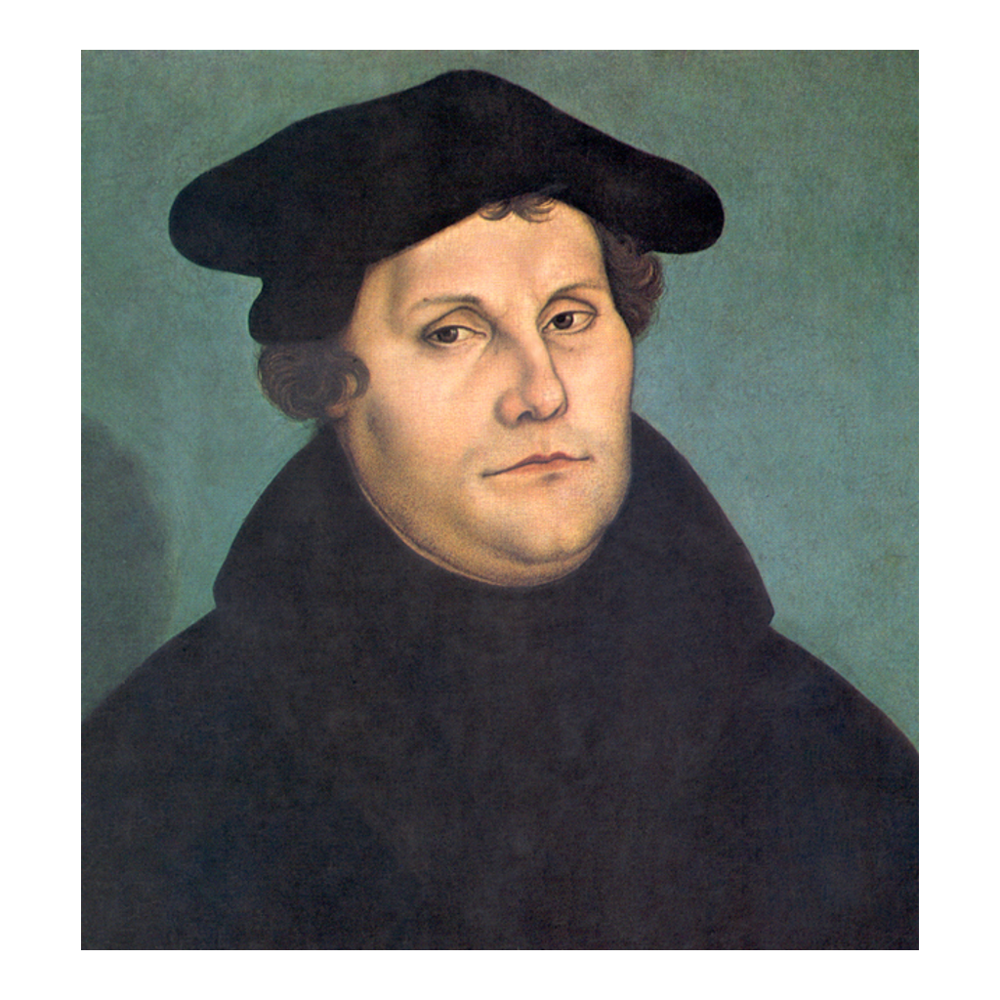
A Portrait of Martin Luther
Portrait of Martin Luther by Lucas Cranach the Elder (1529).
© More Lessons Less Planning | morelessonslessplanning.com
Notes:
This is a portrait of Martin Luther painted by Lucas Cranach the Elder in 1529. Cranach was a leading German artist of the Reformation era and a friend of Luther, so this is a portrait made during Luther's own lifetime. Use it simply to put a human face to the figure students are studying. Note honestly that it is a painting, not a photograph, and that Cranach's workshop produced many images of Luther that helped spread his likeness. It is a real 16th-century painting in the public domain, not a modern illustration.
Reference labels (point to these chart features when teaching): A German monk and professor; Painted in 1529

Slide 6
What Were Indulgences?
Indulgence
A Church pardon said to reduce the punishment a person owed for sin, including time in purgatory.
Linked to purgatory
Buyers were told an indulgence could shorten the time a soul spent in purgatory after death.
Why they were sold in 1517
The Church was raising money to rebuild St. Peter's Basilica in Rome, so indulgences were sold for donations.
Key Concept: An INDULGENCE was a Church pardon said to reduce the punishment owed for sin, including time in PURGATORY.
© More Lessons Less Planning | morelessonslessplanning.com
Notes:
Explain the practice at the center of the dispute, neutrally. An INDULGENCE was, in Catholic teaching, a pardon that reduced the temporal punishment a person owed for sins already forgiven - including, people were told, the time a soul would spend in PURGATORY. Indulgences had a long history in the Church, often tied to acts of penance, pilgrimage, or charity. By 1517, however, indulgences were increasingly being granted in exchange for money donations, and one major campaign raised funds to rebuild St. Peter's Basilica in Rome. Present this factually: the sale of indulgences was a real and officially sanctioned Church practice, and the argument Luther started was about whether that practice was right, not about whether the Church itself should exist. Keep the tone analytical.

Slide 7
Tetzel and the Sale of Indulgences
The salesman
A friar named Johann TETZEL sold indulgences in Germany, near Wittenberg.
✔
The slogan
A famous saying claimed that as soon as a coin in the coffer rings, a soul from purgatory springs.
✔
Luther's reaction
Luther was angered that forgiveness was being made to sound like something people could simply BUY.
✔
Key Concept: The friar Johann TETZEL sold indulgences near Wittenberg, promising to free souls from purgatory - which is what provoked Luther.
© More Lessons Less Planning | morelessonslessplanning.com
Notes:
Introduce the immediate trigger. The friar most associated with the 1517 indulgence campaign in Germany was Johann TETZEL, a Dominican preacher who sold indulgences energetically in towns near Wittenberg. Tetzel's preaching is remembered for a catchy slogan often summarized as 'As soon as the coin in the coffer rings, the soul from purgatory springs' - the idea that a payment could instantly release a loved one's soul. Luther was deeply angered by this, not because he wanted to attack the Church, but because he believed it dangerously distorted Christian teaching: it made God's forgiveness sound like something people could simply BUY with money. This local sales campaign is the spark that led Luther to write down his objections. Keep Tetzel's slogan framed as the doctrine Luther is contesting, presented historically.

Slide 8
The Ninety-Five Theses (1517)
In 1517 Luther wrote the NINETY-FIVE THESES against the sale of indulgences.
The theses were written in Latin, as points for scholarly debate.
Tradition says he posted them on the castle church door in WITTENBERG.
He also sent them to Church leaders to raise his concerns.
The date, October 31, 1517, is often used to mark the start of the Reformation.
Key Concept: In 1517 Luther wrote the NINETY-FIVE THESES against indulgences and, by tradition, posted them at WITTENBERG.
© More Lessons Less Planning | morelessonslessplanning.com
Notes:
Explain the act itself. In 1517, Luther wrote the NINETY-FIVE THESES - ninety-five short statements, or 'theses,' arguing against the sale of indulgences and inviting scholars to debate them. He wrote them in Latin, the language of the university, because he intended them as points for academic discussion, not as a public call to rebellion. Tradition holds that on October 31, 1517, Luther posted the theses on the door of the castle church in WITTENBERG - which functioned like a university bulletin board - and he also sent them to Church leaders, including his archbishop. Historians note we cannot be fully certain the door-posting happened exactly as the story says, but Luther's writing and circulating of the theses in 1517 is well documented. This date is often used to mark the beginning of the Reformation. Present the 'nailing to the door' as tradition, honestly.

Slide 9
Luther's Core Belief: Salvation by Faith
The practice Luther challenged
Luther's answer
Indulgences suggested punishment could be reduced by payment.
Forgiveness seemed tied to the Church's transactions.
SALVATION BY FAITH: saved by faith in God's grace.
Forgiveness cannot be bought with money.
Big Idea: Luther argued for SALVATION BY FAITH - that people are saved by faith in God's grace, not by buying indulgences.
© More Lessons Less Planning | morelessonslessplanning.com
Notes:
Explain Luther's central grievance as a theological position being contested, comparatively. At the heart of Luther's protest was a belief he called, in effect, SALVATION BY FAITH: the conviction that people are made right with God through faith in God's grace, not by buying indulgences or by piling up enough good works to earn forgiveness. Present the two positions side by side, historically and neutrally. The practice Luther challenged suggested that the punishment for sin could be reduced through payments and the Church's system of penance; Luther answered that genuine forgiveness comes from God through faith and true repentance and cannot be purchased. Be careful to present this as the historical disagreement between Luther and the indulgence campaign - a contest between two theological positions - rather than as a claim about which side was correct. This idea is what made the dispute about far more than money.

Slide 10
The Printing Press Spreads the Theses
Gutenberg's PRINTING PRESS could copy texts quickly and cheaply.
Luther's theses were printed and translated into German.
Within weeks, copies spread across Germany and beyond.
A local university dispute became a public movement.
Church leaders could no longer quietly silence Luther.
Key Concept: The PRINTING PRESS spread the Ninety-Five Theses across Germany within weeks, turning a local dispute into a movement.
© More Lessons Less Planning | morelessonslessplanning.com
Notes:
Explain the accelerant. One key reason Luther's protest did not stay a small local argument was technology: the PRINTING PRESS, developed by Johannes Gutenberg in the mid-1400s, could copy texts far faster and cheaper than hand-copying. Luther's Ninety-Five Theses were quickly printed, translated from Latin into German so ordinary people could read them, and distributed across the German-speaking lands within weeks. This is a crucial cause-and-effect point for students: the same protest, a century earlier, might have been quietly contained, but the printing press turned Luther's theses into a public sensation and spread his later writings even faster. Once his ideas were everywhere, Church authorities could no longer simply silence one troublesome monk. Emphasize the printing press as a major cause of why the Reformation spread.

Slide 11
The Break with Rome
The Church demands a retraction
Church leaders ordered Luther to take back his ideas about indulgences and authority.
✔
Luther refuses
Luther REFUSED to recant unless shown he was wrong by Scripture, and was excommunicated in 1521.
✔
A permanent break
The dispute became a lasting BREAK with the Roman Catholic Church, not a reform within it.
✔
Key Concept: When Luther REFUSED to take back his ideas, he was excommunicated in 1521, leading to a permanent BREAK with Rome.
© More Lessons Less Planning | morelessonslessplanning.com
Notes:
Explain the escalation and the split, factually. What began as a scholarly protest quickly became a confrontation with the highest Church authority. Church leaders, and eventually the pope, demanded that Luther take back (recant) his criticisms of indulgences and, increasingly, his challenges to papal authority. Luther REFUSED, famously insisting he could not go against his conscience and Scripture unless someone proved him wrong. In 1521 he was excommunicated - formally expelled from the Roman Catholic Church - and declared an outlaw at the Diet of Worms. Instead of ending the movement, this hardened it: Luther's challenge became a permanent BREAK with Rome rather than a reform inside the existing Church. Present this as the historical outcome of the conflict, without judging either side. This is the turning point from protest to schism.

Slide 12
The Reformation Spreads
Luther's protest grew into the REFORMATION, a movement to reform the Church.
It split western Christianity into Catholic and Protestant.
Christians who broke from Rome became known as PROTESTANTS.
New churches formed across Germany, Scandinavia, and beyond.
The religious map of Europe was reshaped for centuries.
Key Concept: Luther's protest grew into the REFORMATION, splitting western Christianity and creating the PROTESTANTS.
© More Lessons Less Planning | morelessonslessplanning.com
Notes:
Explain the large-scale consequence. Luther's local protest over indulgences grew into the REFORMATION - the broad sixteenth-century movement to reform Christian belief and practice that ended up splitting the western Church. Christians who followed Luther and other reformers in breaking away from the authority of the pope and the Roman Catholic Church became known as PROTESTANTS (from 'protest'). New Protestant churches formed across Germany, Scandinavia, and other parts of Europe, and the religious unity of western Christianity - which had lasted for centuries - was permanently broken. Stress the scale for students: a single monk's argument about the sale of indulgences helped set off a chain of events that reshaped the map of European religion, politics, and society for centuries. Keep the framing historical and neutral about the competing churches.

Slide 13
Rebel or Reformer? An Honest View
What Luther set out to do
How historians analyze it
He aimed to debate and reform, not to found a new church.
His first target was the sale of indulgences.
As HISTORICAL analysis: causes, the act, and consequences.
His PROTEST grew far larger than he first intended.
Key Concept: Historians analyze Luther's protest as HISTORICAL analysis - weighing causes, the act, and consequences - not simple heroes and villains.
© More Lessons Less Planning | morelessonslessplanning.com
Notes:
Complicate the simple story honestly, and model the academic stance. It is tempting to tell Luther's story as a simple tale of a brave hero versus a corrupt villain, but historians approach it more carefully. Explain to students that we treat this episode as HISTORICAL analysis: we weigh the causes (the sale of indulgences, real grievances about Church corruption, and the printing press), the act itself (the Ninety-Five Theses in 1517), and the consequences (the Reformation and the break with Rome), rather than cheering for a side. Emphasize an honest point: Luther did not set out to destroy the Catholic Church or found a new one. His PROTEST began as a request to debate and reform a specific practice, and it grew into something far larger than he first intended, carried along by politics, technology, and other reformers. Remind students that both the Catholic Church and Luther's supporters were made up of sincere people, and that our job is to understand what happened and why, not to declare a winner in a religious argument.

Slide 14
How Do We Know? Reading the Theses Critically
Our primary source is a set of selected theses from the Ninety-Five Theses.
We read them in an English TRANSLATION from the 1915 Philadelphia Edition.
That translation is public domain because of its age.
The theses are a persuasive ARGUMENT against indulgences.
Read them as Luther's case to weigh, not as neutral fact.
Tip: The Ninety-Five Theses are a persuasive ARGUMENT - read the excerpt critically as Luther's case against indulgences.
© More Lessons Less Planning | morelessonslessplanning.com
Notes:
Set up the Primary Source Spotlight and teach how to read it. Our primary source is a set of selected theses drawn from Luther's Ninety-Five Theses (1517). Because Luther wrote in Latin, students read the theses in an English TRANSLATION from the Works of Martin Luther, Philadelphia Edition (1915), which is in the public domain because of its age; the wording has been lightly modernized for readability. Teach students what kind of source this is: the theses are a work of persuasive ARGUMENT - Luther is trying to convince readers that the sale of indulgences is wrong and that forgiveness comes from God through faith. So we read them critically. They are excellent, direct evidence of what Luther argued and why, but they are one side of a religious debate, not a neutral report, and they do not by themselves prove the Church's actual official teaching. A careful historian weighs Luther's argument and also asks what the other side would say.

Slide 15
Key Takeaways
MARTIN LUTHER wrote the NINETY-FIVE THESES in 1517 against indulgences.
★
An INDULGENCE reduced punishment for sin, including time in PURGATORY.
★
Luther argued SALVATION BY FAITH: saved by God's grace, not by payments.
★
The PRINTING PRESS spread the theses across Germany within weeks.
★
Luther's protest grew into the REFORMATION, creating the PROTESTANTS.
★
Read the theses critically as Luther's persuasive argument in a real debate.
★
© More Lessons Less Planning | morelessonslessplanning.com
Notes:
Close the loop and hold the honesty frames. If students remember a few things, make them these: MARTIN LUTHER, a German monk and professor at Wittenberg, wrote the NINETY-FIVE THESES in 1517 to protest the sale of indulgences, which the friar Johann Tetzel was selling nearby partly to fund St. Peter's Basilica. An INDULGENCE was a Church pardon said to reduce the punishment owed for sin, including time in PURGATORY. Luther's central grievance was SALVATION BY FAITH - the belief that people are saved by faith in God's grace, not by buying pardons. The PRINTING PRESS spread his theses across Germany within weeks, turning a local dispute into a movement, and when Luther refused to recant he was excommunicated in 1521. His protest grew into the REFORMATION, splitting western Christianity and creating the PROTESTANTS. Keep the academic frame: we analyze this as history - causes, act, and consequences - and read the theses critically as Luther's persuasive argument in a genuine religious debate.

