Slide 1
Loan Default: What Happens When You Can't Pay
Missing payments can escalate from delinquency to default, collections, and wage garnishment—learn how to act before it does.
© More Lessons Less Planning | morelessonslessplanning.com
Notes:
Open with the human reality behind this lesson: almost everyone will face a month when money is tight, and for many people that means a loan payment they cannot make. The point of this toolkit is that loan default is not a single moment - it is a TIMELINE, a series of steps that get worse the longer a debt goes unpaid, and most of those steps can still be stopped if you act early. Students follow Devon Carter, who borrowed $9,000 for a used car at a $300 monthly payment and started out paying on time with a solid 720 credit score. Then Devon loses a job and can no longer make the payment. Walk students through the words they will master: DELINQUENCY (being late on a payment), DEFAULT (falling so far behind the lender treats the loan as broken), COLLECTIONS (the debt handed to an agency to recover), and WAGE GARNISHMENT (a court letting the creditor take part of your paycheck). As the ninth toolkit of Unit 5, this builds on what a loan is (TK41), interest and APR (TK42), and auto loans (TK43), turning the focus to the real-world consequences of not being able to pay - and what to do about it before it gets that far.

Slide 2
Learning Targets
Define delinquency, default, collections, and wage garnishment
★
Trace the default timeline from a missed payment to wage garnishment
★
Read a line chart of a credit score dropping across the milestones
★
Identify a borrower's options BEFORE default and how each one helps
★
© More Lessons Less Planning | morelessonslessplanning.com
Notes:
Read the four targets aloud and tell students the whole lesson follows Devon Carter, who borrowed $9,000 for a car at $300 a month and could not keep paying after a job loss. Target 1 is the vocabulary that runs through everything: DELINQUENCY is being late on a payment; DEFAULT is falling so far behind the lender treats the loan as broken; COLLECTIONS is when the debt is handed to an agency to recover; and WAGE GARNISHMENT is when a court lets the creditor take part of your paycheck. Target 2 is the big skill - putting the steps in order: on time, then 30, 60, 90, and 120+ days delinquent, then charge-off, then collections, then a possible court judgment, then wage garnishment. Target 3 is reading the line chart that tracks Devon's credit score as it falls across those milestones (720 all the way down to 505, a 215-point drop), so students see that the damage compounds. Target 4 is the hopeful part: the options a borrower has BEFORE default - calling the lender, asking for a deferment or a hardship plan, refinancing - and how each one can stop the slide. The lesson balances the scary consequences with the concrete actions that prevent them.

Slide 3
When You Can't Pay: It Starts a Clock
Life happens to everyone
One missed payment starts a clock
Job loss, medical bills, or cut hours can make a payment impossible
Devon paid a $9,000 car loan ($300/month) on time until a job loss
A missed payment is common and survivable; it is not the end of the road
An unpaid due date makes you LATE (delinquent)
The lender counts 30, 60, 90, then 120+ days past due
Consequences worsen with time, but early action can stop most steps
Key Concept: Missing a payment is survivable, but it starts a clock. The longer a debt goes unpaid, the worse it gets - so acting early matters most.
© More Lessons Less Planning | morelessonslessplanning.com
Notes:
Set the tone for the whole lesson: this is not about shaming people who fall behind - it is about understanding what happens and how to take control. Start with the truth that money trouble happens to almost everyone at some point: a job loss, a surprise medical bill, a car repair, or a cut in work hours can make a loan payment impossible for a while. Devon Carter is in exactly that spot. Devon borrowed $9,000 for a used car at a $300 monthly payment and made the payments on time for a while with a good 720 credit score - then lost a job, and the $300 became impossible. Devon stopped paying. Make two points clearly. First, the moment a payment is due and not paid, you are LATE, also called DELINQUENT, and the lender starts counting the days you are past due - 30, then 60, then 90, then 120 or more. Second, and just as important: the consequences get worse the longer the debt goes unpaid, but most of the early steps can still be stopped if the borrower acts. A single missed payment is survivable; ignoring it for months is what causes the real damage. This slide sets up the timeline the rest of the lesson walks through.

Slide 4
Delinquency vs Default: Two Different Words
DELINQUENCY = you are late
You missed a payment. The account is reported 30, 60, 90, or 120+ days delinquent - each step worse for your credit
DEFAULT = the loan is broken
You have fallen so far behind (usually 90-120+ days) that the lender treats the loan as broken
Delinquency comes first
You are delinquent for a while BEFORE you default. Delinquency is the warning stage; default is the point of no easy return
Default triggers the worst steps
In default, the lender can charge it off, send it to collections, repossess the car, and sue - the real damage
Key Concept: DELINQUENCY is being late; DEFAULT is being so far behind the lender treats the loan as broken. You are delinquent before you default.
© More Lessons Less Planning | morelessonslessplanning.com
Notes:
Teach the single most important vocabulary distinction in the lesson: delinquency and default are NOT the same thing, and mixing them up is the most common student mistake. DELINQUENCY simply means you are LATE - you missed a payment. The account gets reported to the credit bureaus as 30 days delinquent, then 60, then 90, then 120 or more days delinquent the longer it stays unpaid, and each of those steps does more damage to your credit. DEFAULT is the more serious word: it means you have fallen so far behind - usually around 90 to 120 or more days, depending on the loan agreement - that the lender no longer treats the loan as a normal account being repaid. The lender considers the loan BROKEN. The key relationship students must lock in: delinquency comes FIRST. You are delinquent for a while before you hit default. Delinquency is the warning stage, where the lender is still calling and the situation is fixable; default is the point where the lender gives up on normal repayment and starts the harsher steps. Once a loan is in DEFAULT, the lender can charge the debt off, hand it to collections, repossess the car on an auto loan, and ultimately sue to collect - all of which we trace next. Use Devon as the example: Devon was delinquent at 30, 60, and 90 days, and then defaulted once the account was far enough past due that the lender stopped expecting Devon to catch up.

Slide 5
The Timeline of Missed Payments
30 days late: first ding
After about 30 days unpaid, you are reported 30 days DELINQUENT - the first and biggest single hit to your credit score
✔
60-90 days late: it deepens
At 60 and 90 days delinquent the score keeps dropping; near 90-120 days the loan moves toward DEFAULT
✔
120+ days: charge-off
Around 120-180 days, the lender CHARGES OFF the debt (writes it off as a loss) - but you STILL owe it; it goes to collections
✔
Then collections and court
The debt goes to COLLECTIONS, and the creditor can sue; if it wins a JUDGMENT, it can garnish your wages
✔
Key Concept: Default is a staircase: 30/60/90/120+ days late -> charge-off -> collections -> judgment -> garnishment. Each step is harder to undo.
© More Lessons Less Planning | morelessonslessplanning.com
Notes:
Walk students through the full default timeline as a staircase, because seeing the ORDER is the heart of this lesson. Step one, about 30 days unpaid: the lender reports the account to the credit bureaus as 30 days DELINQUENT. This first 30-day late is the single biggest hit to a credit score - for Devon it drops the score from 720 to 640, an 80-point fall. Step two, 60 and then 90 days: the account is reported 60 and then 90 days delinquent, the score keeps dropping at each step, and the lender's contact gets more serious - more calls, sterner letters. Somewhere around 90 to 120 days, the loan crosses into DEFAULT. Step three, around 120 to 180 days unpaid: the lender CHARGES OFF the debt, meaning it writes the loan off as a loss on its own books for accounting purposes. Students must understand the catch: a charge-off does NOT mean the debt is forgiven - you still owe every dollar. It just means the original lender has given up collecting it directly, so it usually sells the debt or sends it to a collection agency. Step four: the debt lands in COLLECTIONS, and the creditor or collection agency can take you to court. If they win a court JUDGMENT, they gain legal power to garnish your wages - take money straight from your paycheck. That is the end of the timeline, and the next slide's chart shows how Devon's credit score falls at each of these milestones. The takeaway: every step is harder to undo than the one before, which is exactly why acting early - before default - matters so much.

Slide 6
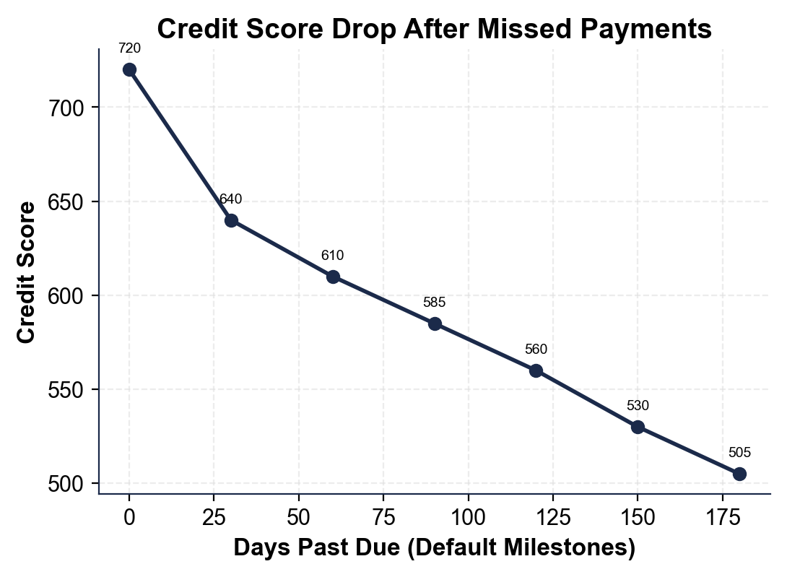
Credit Score Drop After Missed Payments
Devon's credit score falls 215 points from on-time to collections.
© More Lessons Less Planning | morelessonslessplanning.com
Notes:
Have students read the line chart. The x-axis is the number of days past due across the default milestones, and the y-axis is Devon's FICO credit score. The line starts high on the left at 720 while Devon is paying on time. Then it falls in steps: at 30 days delinquent the score drops to 640 - an 80-point fall, the steepest single drop on the whole chart, which is why the first late payment matters so much. At 60 days it is 610, at 90 days 585, at 120+ days 560, at charge-off (around 150 days) 530, and at collections (around 180 days) 505. From start to finish Devon's score falls 215 points, from a good 720 to a damaged 505. Point out two things students should take from the shape of the line. First, the drop is biggest at the very first step - one missed payment that becomes a 30-day late does enormous damage, far more than people expect. Second, the line never recovers within this timeline; it only steps downward, because each new milestone (a deeper delinquency, a charge-off, a collections account) is a fresh negative mark. This is the chart students read in Activity Part 3, and it makes the lesson's point visible: the credit damage of default compounds the longer you go unpaid.
Reference labels (point to these chart features when teaching): On time 720; Collections 505

Slide 7
Collections and Credit Damage
The debt goes to COLLECTIONS
After charge-off, the debt is handed or sold to a COLLECTIONS agency whose job is to recover it; the agency calls, writes, and pressures you to pay
It wrecks your CREDIT SCORE
Your CREDIT SCORE is a number that shows how reliably you repay debt; missing payments and collections drop it sharply - a serious mark for up to 7 years
You still owe the money
A charge-off and collections do NOT erase the debt; you still owe it, and now an agency that paid little for it is trying to collect the full amount
Damaged credit costs you later
A low score (Devon's fell to 505) means future loans are harder to get and cost MORE - higher APRs, bigger deposits, even trouble renting an apartment
Key Concept: After charge-off, the debt goes to COLLECTIONS - a mark for up to 7 years. You still owe the money, and a low score costs you for years.
© More Lessons Less Planning | morelessonslessplanning.com
Notes:
Teach what COLLECTIONS really means and why the credit damage matters long after the missed payments stop. When a lender charges off a debt, it almost always sends it - or sells it for pennies on the dollar - to a COLLECTIONS agency. That agency's entire business is recovering unpaid debts, so it calls, writes, and pressures the borrower to pay, sometimes for years. Make sure students understand the two hard truths here. First, a collections account is a serious NEGATIVE MARK on your credit report, and it can stay there for up to seven years - it is one of the biggest reasons Devon's score fell all the way to 505. Second, charge-off and collections do NOT make the debt disappear. Devon still owes the money; the difference is that now a collection agency, which may have bought the debt for a small fraction of its value, is trying to collect the full amount, often adding fees and interest. Then connect the damaged credit to real life. A credit score in the 500s, like Devon's, follows you. It makes future loans harder to get and far more expensive - higher APRs on a car loan or mortgage, larger security deposits on utilities or an apartment, and sometimes outright denials. Landlords, insurers, and even some employers check credit. So the cost of default is not just the original debt; it is years of paying more for everything because the score took a 215-point hit. This is the real-world stakes that make the prevention options on the next slides so important.

Slide 8
Wage Garnishment: Taken From Your Paycheck
How it happens
How much they can take
The creditor sues and wins a court JUDGMENT: Devon legally owes the debt
That judgment can authorize WAGE GARNISHMENT
Garnishment takes money from Devon's paycheck before Devon receives it
Federal law uses the lesser of 25% of disposable pay or pay over a floor
$600/week disposable pay x 25% = $150/week, about $649.50/month
That is over twice the original $300 payment and is hard to undo
Key Concept: After a creditor wins a JUDGMENT, it can order WAGE GARNISHMENT - part of your paycheck. The federal cap here is ~$649.50/month.
© More Lessons Less Planning | morelessonslessplanning.com
Notes:
Teach the final and costliest step of the timeline: WAGE GARNISHMENT. Walk the path clearly. After the debt has been charged off and sent to collections and Devon still has not paid, the creditor (or the collection agency that now owns the debt) can SUE Devon in court. If the creditor wins - and on a clear unpaid debt it usually does - the court issues a JUDGMENT, an official order stating that Devon legally owes the money. A judgment is powerful: it is what gives the creditor the legal right to garnish wages, meaning money is taken directly out of Devon's paycheck by the employer and sent to the creditor BEFORE Devon ever receives it. Then teach how much they can take, because students assume garnishment can wipe out a whole check - it cannot. Federal law (Title III of the Consumer Credit Protection Act) caps an ordinary-debt garnishment at the LESSER of two amounts: 25% of your disposable earnings, or the amount your disposable earnings exceed 30 times the federal minimum wage ($7.25 x 30 = $217.50 a week). For Devon, disposable pay is $600 a week. Twenty-five percent of $600 is $150; the second cap ($600 minus $217.50) is $382.50. The garnishment is the LESSER, so $150 a week is taken. Over a typical month (about 4.33 weeks) that is roughly $649.50 - more than twice Devon's original $300 car payment. Drive home the irony and the lesson: by not paying the $300, Devon now loses about $649.50 a month to garnishment, plus the wrecked credit score. Garnishment is the hardest step to undo, which is exactly why every option BEFORE default - the next slide - matters so much.

Slide 9
Options BEFORE Default: How to Stop the Slide
Call the lender FIRST
The instant you know you'll miss a payment, call. Lenders would rather work out a plan than charge off a loan - if you reach out early
✔
Ask for a deferment or hardship plan
A DEFERMENT pauses or lowers payments for a set time; a hardship plan reworks the schedule - both keep you OUT of default
✔
Refinance or restructure the loan
Refinancing into a lower payment or longer term can make the loan affordable again; the goal is a payment you can make
✔
Act early, while you're only delinquent
Every option is easier while DELINQUENT than after DEFAULT. Once a loan is in collections, your choices shrink fast
✔
Key Concept: Act BEFORE default - call the lender early, ask for a deferment or hardship plan, or refinance. Options shrink fast after collections.
© More Lessons Less Planning | morelessonslessplanning.com
Notes:
End the consequences with the hope: most of the default timeline can be stopped if the borrower acts early, so spend real time on these options. Option one, and the most important: CALL THE LENDER FIRST - the moment you realize you are going to miss a payment, before you actually miss it if possible. Lenders genuinely do not want to charge off loans; a charged-off loan is a loss for them. They would much rather work out an arrangement that gets them paid eventually - but they can only help a borrower who reaches out. Silence is what forces them down the default path. Option two: ask for a DEFERMENT or a hardship plan. A deferment is a lender-approved pause or reduction of payments for a set period, designed exactly for situations like Devon's job loss; a hardship plan reworks the payment schedule to something the borrower can manage. Arranged in time, these keep the loan OUT of default entirely - the missed payments are handled by agreement, not reported as delinquency. Option three: refinance or restructure the loan - for example, refinancing a car loan into a lower monthly payment or a longer term so it fits the new budget. The goal of all three is the same: turn an impossible payment into a payment you can actually make. Then the master point: every one of these options is far easier and far more available in the DELINQUENCY stage - while you are merely late - than after DEFAULT. Once a loan is charged off and sitting in collections, the lender has already taken its loss and your room to negotiate shrinks fast. The single most valuable habit students can take from this lesson: if you cannot pay, do not hide - call right away. Devon's whole timeline could have been stopped at the very first step with one phone call.

Slide 10
Scenario: Facing Default
Devon's situation
What you'll do in the Activity
$9,000 car loan, $300/month, started at a 720 credit score
A job loss makes the $300 payment impossible; Devon stops paying
30 days late: score 720 -> 640; then 60, 90, 120+ days delinquent
Charge-off (530) -> collections (505) -> a 215-point credit drop
Put the default timeline steps in the right ORDER
Read the credit-score chart: how far Devon's score fell and where
Explain delinquency vs default, collections, and wage garnishment
Advise Devon on the best options BEFORE default to stop the slide
Key Concept: In the Activity you will trace Devon's timeline, read the credit-score chart, explain each term, and advise Devon on moves to make early.
© More Lessons Less Planning | morelessonslessplanning.com
Notes:
Bring the whole lesson together with the scenario students will work in the Activity, and make the stakes concrete one more time. Recap Devon's story so the numbers are fresh: Devon borrowed $9,000 for a used car at a $300 monthly payment and started out responsible, with a good 720 credit score and on-time payments. Then a job loss made the $300 impossible, and Devon stopped paying instead of calling the lender. Walk the consequences once more as a single connected story: at 30 days late the credit score dropped from 720 to 640 (the biggest single hit); the account went 60, then 90, then 120+ days delinquent and crossed into default; the lender charged the loan off (score 530), the debt went to collections (score 505), and the creditor sued, won a judgment, and garnished about $150 a week - roughly $649.50 a month, more than twice the payment Devon could not make. All told, Devon's credit fell 215 points. Then preview exactly what students will do in the Activity, so they know the lesson has a clear payoff: they will put the default timeline in the correct order, read the credit-score line chart to see how far and where Devon's score fell, explain in their own words what delinquency, default, collections, and wage garnishment mean, and - most importantly - advise Devon on the smartest moves to make BEFORE default to stop the whole slide. Frame the Activity as students becoming the knowledgeable friend Devon needed at the very first missed payment.

Slide 11
Key Takeaways
DELINQUENCY = being late; DEFAULT = so far behind the loan is treated as broken
★
Timeline: 30/60/90/120+ days late -> charge-off -> collections -> garnishment
★
Charge-off and collections do NOT erase the debt - you still owe every dollar
★
Devon's score fell 215 points (720 -> 505); garnishment took ~$649.50/month
★
Best move: act BEFORE default - call the lender early for a plan or refinance
★
© More Lessons Less Planning | morelessonslessplanning.com
Notes:
Read each takeaway and tie it back to the learning targets. T1 (define) -> the two words students must never confuse: DELINQUENCY is being late on a payment (30, 60, 90, 120+ days), while DEFAULT is falling so far behind that the lender treats the loan as broken; you are delinquent before you default. T2 (the timeline) -> the heart of the lesson is the ORDER: 30, 60, 90, 120+ days delinquent, then charge-off, then collections, then a court judgment, then wage garnishment - each step harder to undo than the last. T1/T3 (collections and credit) -> a charge-off and a collections account do NOT make the debt disappear; you still owe every dollar, and a collections account is a serious negative mark that can sit on your credit report for up to seven years. T3 (the chart) -> Devon's credit score fell 215 points, from a good 720 to a damaged 505, with the biggest single drop at the first 30-day late; meanwhile wage garnishment took about $150 a week, roughly $649.50 a month - more than twice the $300 payment Devon could not make. T4 (the options) -> the hopeful bottom line: almost all of this can be prevented by acting BEFORE default - calling the lender the moment you know you will miss a payment and asking for a deferment, a hardship plan, or a refinance to make the payment manageable. As the ninth toolkit of Unit 5, this builds on what a loan is (TK41), interest and APR (TK42), and auto loans (TK43), turning the focus to the consequences of not paying and, just as important, how to avoid them.

