Slide 1
Life Insurance: Planning for the Worst
Learn what life insurance does, how term and whole life differ, who receives the money, and who actually needs a policy.
© More Lessons Less Planning | morelessonslessplanning.com
Notes:
Open where the unit is heading. Students have learned what insurance is, how a policy works, and the big policies most adults carry (auto, health, renters/homeowners). Today's policy is different: life insurance does not protect a thing you own - it protects the PEOPLE who depend on your income if you die. Tell students that by the end of class they will know exactly what life insurance does, the difference between term and whole life insurance, who a beneficiary is, who actually needs a policy, and how to estimate how much coverage a family needs. Set the practical tone: this is a policy they may buy the moment someone depends on their income - a child, a spouse, a shared mortgage - and knowing the difference between a $30-a-month term policy and a $450-a-month whole life policy for the same protection could save a young family thousands of dollars a year.

Slide 2
Learning Targets
Explain what life insurance does - it pays a death benefit to your beneficiaries
★
Tell term life (temporary, cheap) from whole life (permanent, builds cash value)
★
Explain who a beneficiary is and why you keep beneficiaries updated
★
Explain who needs life insurance and estimate coverage with a labeled model
★
© More Lessons Less Planning | morelessonslessplanning.com
Notes:
Read the four targets and connect them to the arc of the lesson. Target 1 is the purpose of the policy: life insurance pays a DEATH BENEFIT (a sum of money) to your BENEFICIARIES if you die, so the people who depend on you are protected. Target 2 is the central choice of the lesson: term life insurance is temporary and cheap with no cash value, while whole life insurance is permanent, builds cash value, and costs far more - students must be able to tell them apart. Target 3 is the practical mechanic: a beneficiary is the person who receives the death benefit, a primary beneficiary receives it first and a contingent beneficiary is the backup, and you keep beneficiaries updated after life events. Target 4 is the judgment and the math: who actually needs life insurance (people whose income others rely on), and how to estimate coverage with a labeled model (income x years to replace). By the end, students can read a life insurance choice and decide what fits a family.

Slide 3
Planning for the Worst - What Life Insurance Does
It protects people, not a thing
LIFE INSURANCE pays money to the people who depend on you if you DIE - it protects your family's income, not an object
✔
The payout is the death benefit
The DEATH BENEFIT is the money the policy pays to your beneficiaries when you die - often hundreds of thousands of dollars
✔
The money goes to beneficiaries
A BENEFICIARY is the person or people who receive the death benefit - like your children or a spouse
✔
You pay a premium to keep it active
You pay a PREMIUM (the regular payment) to keep the coverage active - stop paying and the coverage ends
✔
Key Concept: LIFE INSURANCE pays a DEATH BENEFIT to your BENEFICIARIES if you die, so the people who depend on your income are protected.
© More Lessons Less Planning | morelessonslessplanning.com
Notes:
Start with the purpose of life insurance, because it is different from every other policy in this unit. Auto, health, and renters insurance protect a thing you own or a cost you might face. LIFE INSURANCE protects the PEOPLE who depend on your income if you DIE - it does not fix a car or replace a laptop, it replaces the money your family would lose. Explain the payout: when you die, the policy pays a DEATH BENEFIT - a sum of money, often hundreds of thousands of dollars - to the people you have chosen. Those people are your BENEFICIARIES: the person or people who receive the death benefit, most often your children, a spouse, or another loved one who relies on you. And like every policy students have seen, you keep it active by paying a PREMIUM - the regular payment (monthly or yearly) that keeps the coverage in force; if you stop paying, the coverage ends. Frame the whole lesson: life insurance is about planning for the worst so the people you love are not left without your income. Key terms - Death benefit: the money a life insurance policy pays to your beneficiaries when you die. Beneficiary: the person or people who receive the death benefit. Premium: the regular payment you make to keep your coverage active.

Slide 4
Term Life Insurance - Temporary and Cheap
1. It is temporary
TERM LIFE INSURANCE covers you for a set number of years - the TERM - such as a 20-year policy, then it ends
2. Pays only during the term
It pays the DEATH BENEFIT only if you die DURING the term; if you outlive the term, the coverage simply ends
3. It is cheap
A healthy 30-year-old pays about $30 a month for a 20-year, $500,000 term policy - a small premium for large protection
4. No cash value
Term life has NO CASH VALUE - it is pure protection, with no savings built in, which is why it costs so little
Key Concept: TERM LIFE is TEMPORARY (a set number of years), pays only if you die during the TERM, is CHEAP, and has NO CASH VALUE.
© More Lessons Less Planning | morelessonslessplanning.com
Notes:
Now teach the first kind of life insurance: TERM life insurance, the one most families choose. Four features define it. First, it is TEMPORARY: it covers you for a set number of years called the TERM - a 20-year or 30-year policy is common - and when the term ends, so does the coverage. Second, it pays the DEATH BENEFIT only if you die DURING the term: if you die in year 8 of a 20-year policy, your beneficiaries get the full death benefit; if you outlive the 20 years, the policy simply ends and pays nothing. That sounds like a downside, but it is exactly why term life is cheap and why it fits a family's real need. Third, it is CHEAP: a healthy 30-year-old can buy a 20-year, $500,000 term policy for about $30 a month - a small premium for a large amount of protection during the years the family needs it most (raising kids, paying off a mortgage). Fourth, term life has NO CASH VALUE: it is pure protection with no savings component built in, so every dollar of premium buys coverage, not savings - which is the reason it costs so little. Bottom line: term life gives a family a large death benefit for a small monthly premium during a set number of years. Key terms - Term life insurance: temporary life insurance that covers a set number of years and pays the death benefit only if you die during the term. Term: the set number of years that a term life policy covers you.

Slide 5
Whole Life Insurance - Permanent and Builds Cash Value
1. It is permanent
WHOLE LIFE INSURANCE is PERMANENT - it lasts your whole life as long as you keep paying the premium, not just a set term
2. It builds cash value
Part of your premium builds CASH VALUE - a savings component inside the policy that you can borrow against over time
3. It costs far more
Whole life is EXPENSIVE - about $450 a month for the same $500,000 death benefit, roughly 15 times the term premium
4. Why it costs more
It costs more because it is PERMANENT and part of the premium goes into savings (cash value), not just protection
Key Concept: WHOLE LIFE is PERMANENT, builds CASH VALUE, and costs far more (about $450/month vs $30 for term) for the same death benefit.
© More Lessons Less Planning | morelessonslessplanning.com
Notes:
Now teach the second kind: WHOLE life insurance, the permanent alternative. Four features again. First, it is PERMANENT: unlike term life, whole life lasts your WHOLE life as long as you keep paying the premium - there is no term that ends. Second, it builds CASH VALUE: part of each premium goes into a savings component inside the policy called cash value, which grows over time and that you can borrow against or withdraw later - so a whole life policy is part insurance and part savings account. Third, it is EXPENSIVE: for the SAME $500,000 death benefit, that healthy 30-year-old who paid $30 a month for term life would pay about $450 a month for whole life - roughly 15 times as much. Fourth, explain WHY it costs so much more: it costs more because it is PERMANENT (the insurer expects to pay a death benefit eventually, not just during a term) AND because part of every premium is going into savings (the cash value), not just buying protection. Be balanced but honest: whole life is not a scam - the permanence and the cash value are real - but for most families the huge premium buys far less protection per dollar than term life, and there are usually better places to save. The next slides put the two side by side. Key terms - Whole life insurance: permanent life insurance that lasts your whole life and builds cash value, but costs far more. Cash value: a savings component that builds up inside a whole life policy and can be borrowed against. Permanent: coverage that lasts your whole life as long as you keep paying.

Slide 6
Term vs Whole - A Labeled Model for Cost
A LABELED MODEL (annual premium)
ANNUAL PREMIUM = monthly premium x 12; TERM: $30 x 12 = $360 a year; WHOLE: $450 x 12 = $5,400 a year
✔
A LABELED MODEL (cost over the term)
COST OVER THE TERM = annual premium x years; TERM: $360 x 20 = $7,200 for 20 years of $500,000 coverage
✔
The same protection, a huge gap
Both policies pay the same $500,000 DEATH BENEFIT, but whole life costs $5,400 a year vs $360 - a $5,040 gap every year
✔
Why term wins for most families
TERM LIFE gives a family the large protection they need for a small PREMIUM, freeing money to save and pay off debt
✔
Key Concept: ANNUAL PREMIUM = monthly x 12. Term $360/year vs whole $5,400/year for the same $500,000 - a $5,040 gap. Term life wins on cost.
© More Lessons Less Planning | morelessonslessplanning.com
Notes:
This is the quantitative heart of the lesson - teach the labeled cost model explicitly before students calculate with it. When you compare two life insurance quotes, the price is usually given per MONTH, so put both on the board and convert them with a clear label. A LABELED MODEL: ANNUAL PREMIUM = monthly premium x 12. For TERM life at $30 a month: $30 x 12 = $360 a year. For WHOLE life at $450 a month: $450 x 12 = $5,400 a year. Now show the second labeled model for the total cost of a term policy: COST OVER THE TERM = annual premium x number of years. For the 20-year term policy: $360 x 20 = $7,200 for 20 full years of $500,000 coverage - about the price of a used car spread over two decades. Put the comparison plainly: both policies pay the SAME $500,000 death benefit, but whole life costs $5,400 a year while term costs $360 a year - a difference of $5,040 EVERY year. Make the takeaway explicit: for most families, TERM life gives them the large protection they need (a big death benefit while the kids are young and the mortgage is unpaid) for a small premium, and the $5,040 a year they are NOT spending on whole life can go toward saving and paying off debt - usually a better plan than whole life's cash value. Tell students the next slides show the monthly gap in a chart, and Activity Part 3 asks them to run exactly these calculations. Key term - Premium: the regular payment you make to keep your coverage active.

Slide 7
Naming Beneficiaries - Who Gets the Money
The beneficiary gets the death benefit
A BENEFICIARY is the person or people you name to receive the DEATH BENEFIT when you die - the reason the policy exists
Primary beneficiary is first
Your PRIMARY beneficiary receives the death benefit first - for example, a spouse or your children
Contingent beneficiary is the backup
A CONTINGENT BENEFICIARY is the backup who receives the money if the primary beneficiary cannot receive it
You can name more than one
You can split the death benefit among several beneficiaries by percentage - for example, 50% to each of two children
Key Concept: A BENEFICIARY receives the death benefit. The PRIMARY is first; a CONTINGENT beneficiary is the backup if the primary cannot.
© More Lessons Less Planning | morelessonslessplanning.com
Notes:
Now teach the mechanic that makes a life insurance policy actually do its job: naming BENEFICIARIES. A beneficiary is the person - or people - you name on the policy to receive the DEATH BENEFIT when you die. This is the whole reason the policy exists: the money goes to the people you choose. Teach the two levels students must know. Your PRIMARY beneficiary is the person who receives the death benefit FIRST - most often a spouse, a partner, or your children. A CONTINGENT beneficiary is the BACKUP: this person (or people) receives the money only if the primary beneficiary cannot - for example, if the primary has also died, or cannot be located. Naming a contingent beneficiary is smart because it makes sure the money still reaches someone you trust if the unexpected happens. Add one practical detail: you can name MORE than one beneficiary and split the death benefit among them by percentage - for example, 50% to each of two children, or 60% to a spouse and 20% to each of two kids. Explain why this matters: the beneficiary you name on the policy controls where the money goes - not your will - so getting it right is one of the most important choices you make on a life insurance policy. The next slides cover keeping beneficiaries updated. Key terms - Beneficiary: the person or people who receive the death benefit. Contingent beneficiary: the backup beneficiary who receives the death benefit if the primary beneficiary cannot.

Slide 8
Who Needs Life Insurance - A Labeled Model for Coverage
You need it if others rely on your income
You NEED life insurance if people rely on your income - a parent with children, or a spouse who helps pay a mortgage
✔
Those people are your dependents
Your DEPENDENTS are the people who rely on your income, such as children or a spouse - they are who the policy protects
✔
Young and single with no dependents? Little or none
A young SINGLE person with NO DEPENDENTS and no shared debt usually needs little or no life insurance
✔
A LABELED MODEL (how much you need)
COVERAGE NEEDED = annual income x years to replace; $50,000 x 10 years = $500,000 of coverage
✔
Key Concept: You NEED life insurance if you have DEPENDENTS. COVERAGE NEEDED = annual income x years to replace ($50,000 x 10 = $500,000).
© More Lessons Less Planning | morelessonslessplanning.com
Notes:
Now answer the practical question students actually have: do I need life insurance? The rule is simple: you NEED life insurance if other people RELY ON YOUR INCOME. The clearest cases are a parent whose children depend on their paycheck, or a spouse whose income helps pay a mortgage or other shared bills - if that person died, the family would lose the money and could not pay the bills. Those people who rely on your income are called your DEPENDENTS - your children or a spouse - and they are exactly who life insurance protects. Now the flip side, which surprises students: a young SINGLE person with NO DEPENDENTS and no shared debt usually needs LITTLE OR NO life insurance, because no one depends on their income - there is no family income to replace. That is important because insurance companies often try to sell whole life to young single people who do not actually need it yet. Then teach the labeled model for HOW MUCH coverage a person with dependents needs. A LABELED MODEL (income replacement): COVERAGE NEEDED = annual income x years of income to replace. Work the example: a parent earning $50,000 a year whose family would need about 10 years of that income replaced needs about $50,000 x 10 = $500,000 of coverage - which is exactly the death benefit in this lesson's example policy. Be clear this is a simplified rule of thumb: real needs also weigh debts, a mortgage, and future costs like college, but income x years is a clear starting point. Tell students Activity Part 5 asks them to run this model to advise a real family. Key term - Dependents: the people who rely on your income, such as children or a spouse.

Slide 9
Why Term Life Is So Cheap
It is temporary, not permanent
TERM LIFE only covers a set number of years and often pays nothing (you outlive it), so it costs far less than whole life
✔
It has no cash value to fund
Term life has NO CASH VALUE, so every premium dollar buys protection - none of it goes into a costly savings account
✔
About $30 a month for $500,000
A healthy 30-year-old pays about $30 a month for a 20-year, $500,000 term policy - roughly $1 a day for large protection
✔
Whole life is about 15 times more
Whole life runs about $450 a month for the same $500,000 - about 15 times term; the chart on the next slide shows the gap
✔
Key Concept: TERM LIFE is cheap (about $30/month for $500,000) because it is temporary and has no cash value; whole life costs about 15 times more.
© More Lessons Less Planning | morelessonslessplanning.com
Notes:
Now make the value case for term life concrete, because the biggest reason families overpay is that an agent steers them to whole life. Return to the two reasons term life is so cheap. First, term life is TEMPORARY, not permanent: it only covers a set number of years, and in many cases it pays nothing because the person outlives the term - so the insurer's expected payout is much lower, and the premium is much lower too. Second, term life has NO CASH VALUE: none of your premium goes into a costly savings component, so every dollar you pay buys protection, not savings. Put the real number on it again: a healthy 30-year-old pays about $30 a month for a 20-year, $500,000 term policy - roughly $1 a day - for a very large amount of protection during the exact years a family needs it. Now the contrast: whole life insurance runs about $450 a month for the SAME $500,000 death benefit - about 15 times the term premium - because it is permanent and part of the premium funds the cash value. Tell students the next slide is a bar chart that puts these two monthly premiums side by side - term next to whole for the same $500,000 policy - and that Activity Part 4 asks them to read it, compute the monthly gap, and turn it into an annual difference. Frame the decision: paying about 15 times as much for the same death benefit only makes sense in narrow situations; for most young families, term life is the clear choice. Key term reminder - Premium: the regular payment you make to keep your coverage active.

Slide 10
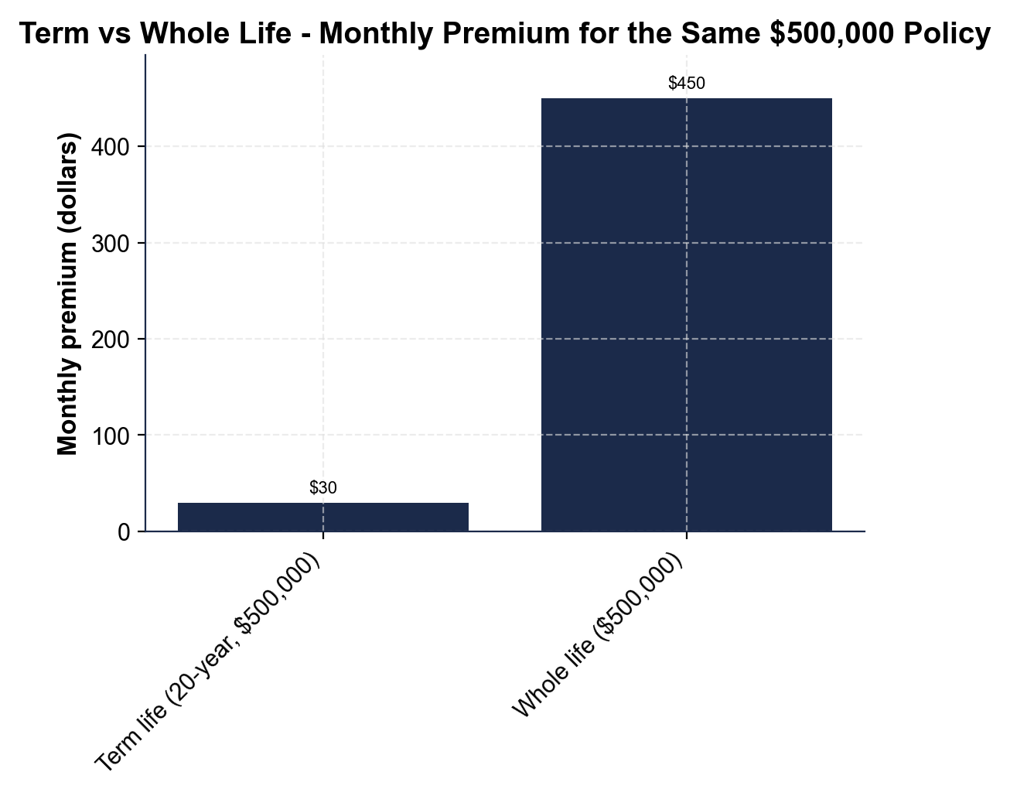
Term vs Whole Life - Monthly Premium
Monthly premium for the same $500,000 policy: term ($30) vs whole ($450).
© More Lessons Less Planning | morelessonslessplanning.com
Notes:
Give students a moment to read the two bars on their own before discussing. The chart contrasts two monthly premiums for the SAME $500,000, 20-year policy. The short left bar is TERM life at about $30 a month. The tall right bar is WHOLE life at about $450 a month. Point out the pattern that jumps out: the two bars are wildly different heights - the whole life bar towers over the term life bar. The gap between them is $450 - $30 = $420 per month, and whole life costs roughly 15 times what term life costs for the same death benefit. Turn the monthly gap into a yearly one so it really lands: $420 a month is about $5,040 more per year (using annual premium = monthly x 12: $5,400 whole vs $360 term). Explain WHY this matters: both policies pay the SAME $500,000 to your beneficiaries if you die, so the extra $5,040 a year for whole life buys you permanence and cash value, NOT more protection. Connect it to the whole lesson: for most families the smart move is to buy the large term policy for a small premium and put the difference toward savings and paying off debt. This is the chart Activity Part 4 reads and analyzes - students will read both values, compute the monthly gap and the annual difference, and explain why term life is the value choice.
Reference labels (point to these chart features when teaching): Term life: $30/month; Whole life: $450/month

Slide 11
Keeping Beneficiaries Updated
Update after big life events
Update your BENEFICIARY after a major life event - a marriage, a divorce, or a NEW child - so the money goes to the right person
The policy beats your will
The BENEFICIARY named on the policy controls the death benefit - it overrides your will, so an old name still gets the money
Name a contingent beneficiary
Always name a CONTINGENT BENEFICIARY (a backup) so the death benefit still reaches someone you trust if the primary cannot
Check it regularly
Review your beneficiaries every few years so an out-of-date choice never sends your money to the WRONG person
Key Concept: Keep your BENEFICIARY updated after life events - the named beneficiary overrides your will, so an old name still gets the money.
© More Lessons Less Planning | morelessonslessplanning.com
Notes:
Now teach the habit that keeps a life insurance policy doing what you intend: keeping your BENEFICIARIES updated. Start with the rule: update your beneficiary after any major life event - a marriage, a divorce, or the birth of a NEW child - because the people who depend on you change over time. The classic mistake: someone names an ex-spouse as beneficiary, gets divorced, forgets to change it, and years later the death benefit goes to the ex instead of the current family. Explain the reason this is so important: the beneficiary named on the POLICY controls the death benefit, and it OVERRIDES your will - so even if your will says something different, the insurance company pays whoever is named on the policy. An out-of-date name still gets the money. Reinforce the earlier idea: always name a CONTINGENT (backup) beneficiary, so if your primary beneficiary cannot receive the money, it still reaches someone you trust rather than getting tied up. And make it a routine: review your beneficiaries every few years and after any big change, so an out-of-date choice never sends your money to the WRONG person. Tie it together: a life insurance policy is only as good as the beneficiary information on it - keeping that current is a small task that protects the people you love. Key term - Contingent beneficiary: the backup beneficiary who receives the death benefit if the primary beneficiary cannot.

Slide 12
Choosing Your Coverage - The Process
Step 1 - Decide if you need it
Ask who relies on your income; you NEED life insurance if you have DEPENDENTS, and little or none if no one depends on you
✔
Step 2 - Estimate how much
COVERAGE NEEDED = annual income x years to replace; $50,000 x 10 = $500,000 to protect the family's income
✔
Step 3 - Choose term over whole (usually)
Pick TERM LIFE for large protection at a low PREMIUM (about $30/month) unless you have a specific reason for whole life
✔
Step 4 - Name and update beneficiaries
Name a PRIMARY and a CONTINGENT BENEFICIARY, and update them after every big life event
✔
Key Concept: Choose coverage in 4 steps - decide if you need it, estimate how much, choose term over whole, and name and update beneficiaries.
© More Lessons Less Planning | morelessonslessplanning.com
Notes:
Turn the whole lesson into a repeatable process a young adult can run when someone starts to depend on their income. Step 1 - DECIDE IF YOU NEED IT: ask who relies on your income. If you have DEPENDENTS - children, a spouse, anyone who could not pay the bills without your paycheck - you need life insurance. If you are young and single with no dependents and no shared debt, you need little or none, and you should not let an agent talk you into an expensive policy you do not yet need. Step 2 - ESTIMATE HOW MUCH: use the labeled model, COVERAGE NEEDED = annual income x years of income to replace. For a $50,000 income and 10 years to replace, that is $50,000 x 10 = $500,000 of coverage - enough to protect the family's income while the kids grow up. Step 3 - CHOOSE TERM OVER WHOLE (usually): pick TERM life insurance for a large death benefit at a low premium (about $30 a month for $500,000), unless you have a specific reason for whole life's permanence and cash value - which most young families do not. The money you save versus whole life can go to savings and debt. Step 4 - NAME AND UPDATE BENEFICIARIES: name a PRIMARY beneficiary and a CONTINGENT (backup) beneficiary, and update them after every big life event so the death benefit always reaches the right people. Tell students Activity Part 5 asks them to run exactly this process to advise a real family. This is the capstone skill: deciding whether you need life insurance, how much, what kind, and who receives it. Key term reminder - Premium: the regular payment you make to keep your coverage active.

Slide 13
Key Takeaways
LIFE INSURANCE pays a DEATH BENEFIT to your BENEFICIARIES if you die
★
TERM LIFE is temporary and cheap; WHOLE LIFE is permanent and costs far more
★
ANNUAL PREMIUM = monthly x 12; term is about $360/year vs $5,400 for whole
★
You need life insurance if you have DEPENDENTS: COVERAGE = income x years
★
Name a PRIMARY and a CONTINGENT beneficiary; keep them updated
★
© More Lessons Less Planning | morelessonslessplanning.com
Notes:
Read each takeaway and connect it back to the learning targets and the process. T1 (what life insurance does) -> LIFE INSURANCE pays a DEATH BENEFIT (a sum of money) to your BENEFICIARIES if you die, protecting the people who depend on your income. T2 (term vs whole) -> TERM LIFE is temporary (a set number of years), cheap (about $30/month for $500,000), and has no cash value; WHOLE LIFE is permanent, builds cash value, and costs far more (about $450/month for the same death benefit). T3 (the labeled cost model) -> ANNUAL PREMIUM = monthly x 12, so term life is about $360 a year while whole life is about $5,400 a year for the same $500,000 - a $5,040 gap every year. T4 (who needs it + how much) -> you need life insurance if you have DEPENDENTS (people who rely on your income), and you estimate coverage with COVERAGE NEEDED = annual income x years to replace ($50,000 x 10 = $500,000); a young single person with no dependents needs little or none. T5 (beneficiaries) -> name a PRIMARY beneficiary and a CONTINGENT (backup) beneficiary, and keep them updated after life events, because the named beneficiary overrides your will. Close by returning to the opening promise: you can now tell what life insurance does, choose between term and whole life, decide who needs it and how much, and name the right beneficiaries - real decisions for the day someone depends on your income.

