Slide 1
Life in the Factory
Inside the working day of an early textile mill, and how worker testimony won the Factory Act of 1833
© More Lessons Less Planning | morelessonslessplanning.com
Notes:
Open with the human question: what was it actually like to work a full day inside an early factory? Preview the arc of the lesson: the factory system and the long working day, who did the work (including children and women), the wages and conditions, and how reformers used first-hand worker testimony to win the Factory Act of 1833.

Slide 2
Learning Targets
Describe the factory system and how the working day was organized
★
Explain the work children and women did in the mills and why owners hired them
★
Describe the wages and conditions workers faced in early factories
★
Explain how the Sadler Committee gathered worker testimony
★
Explain how that testimony helped win the Factory Act of 1833
★
© More Lessons Less Planning | morelessonslessplanning.com
Notes:
The five targets keep the lesson centered on the factory system and the working day, who did the work, the wages and conditions, the Sadler Committee's investigation, and the Factory Act of 1833.

Slide 3
The Factory System: A New Kind of Workplace
Before, goods were made at home or in small workshops at the worker's own pace.
The factory system put many workers and machines in one building called a mill.
Water power and later steam power ran the machines all day long.
Work no longer followed the sun; it followed the factory clock and the whistle.
Owners set strict rules so the expensive machines were always running.
Key Concept: The factory system gathered workers and machines in one mill, where work ran by the clock and the whistle, not the worker's own pace.
© More Lessons Less Planning | morelessonslessplanning.com
Notes:
Before the factory system, most goods were made at home or in small workshops at the worker's own pace. The factory system brought many workers and machines together in one building called a mill. Water power and later steam power ran the machines all day long, so work no longer followed the sun; it followed the factory clock and the whistle. Owners set strict rules so the expensive machines were always running.

Slide 4
The Long Working Day
Hours and Shifts
Breaks and Discipline
A mill working day was long, often twelve to fourteen hours, six days a week
Workers were divided into shifts set by the factory clock
The working day began early in the morning and ended late at night
Meal breaks were short, and workers ate quickly before returning to the machines
An overseer supervised the floor and kept workers at their machines
The steady pace of the machines set the rhythm of the whole day
Key Concept: The factory working day was long, often twelve to fourteen hours set by shifts, short meals, and the watch of an overseer.
© More Lessons Less Planning | morelessonslessplanning.com
Notes:
A mill working day was long, often twelve to fourteen hours, six days a week, and workers were divided into shifts set by the factory clock. The working day began early in the morning and ended late at night. Meal breaks were short, and workers ate quickly before returning to the machines. An overseer supervised the floor and kept workers at their machines, while the steady pace of the machines set the rhythm of the whole day.

Slide 5
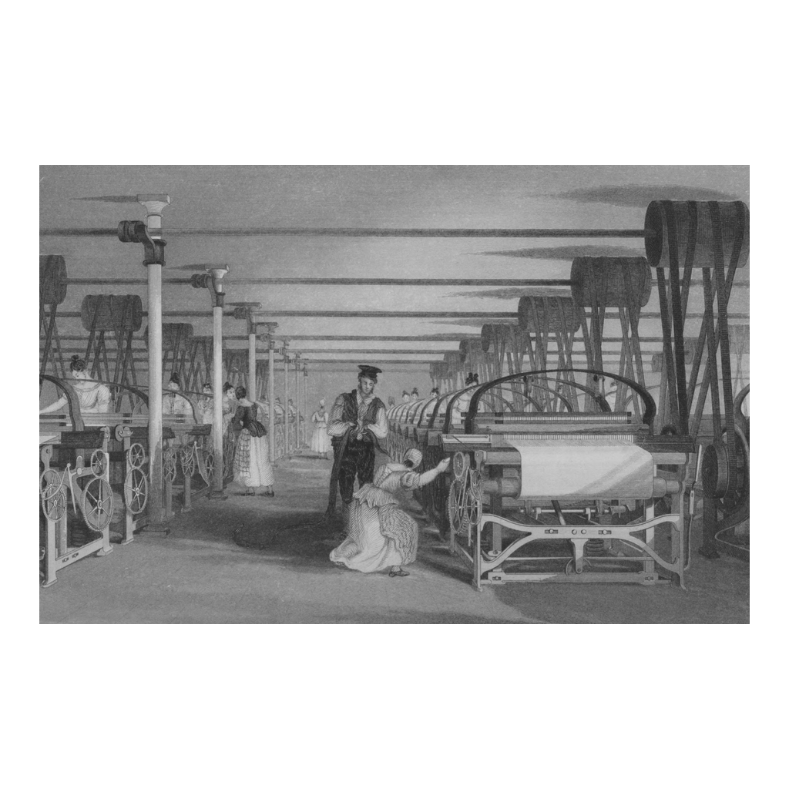
Inside a Textile Mill
Power-loom weaving in a textile mill, an 1835 engraving
© More Lessons Less Planning | morelessonslessplanning.com
Notes:
This is an 1835 engraving of a power-loom weaving shed inside a textile mill. Use it as a reference image to picture the working floor where the long day was spent, not as evidence for any specific claim.

Slide 6
Who Worked in the Mills: Children and Women
A Mixed Workforce
Why Owners Hired Children
Mills employed not just men but many women and children
Whole families sometimes worked in the same mill
Women and children often tended the spinning machines
Owners hired children because they worked for very low wages
Children were small and quick, able to reach into and under the machines
Low pay meant families needed the children's earnings too
Key Concept: Mills hired many women and children; owners hired children because they worked for very low wages and could reach into the machines.
© More Lessons Less Planning | morelessonslessplanning.com
Notes:
Mills employed not just men but many women and children, and whole families sometimes worked in the same mill. Women and children often tended the spinning machines. Owners hired children because they worked for very low wages, and because children were small and quick, able to reach into and under the machines. Low pay meant families needed the children's earnings too.

Slide 7
The Jobs Children Did
Doffing meant replacing full bobbins of thread with empty ones on the machines.
Piecing meant joining, or piecing, together threads that had broken.
In the mines, some children pulled heavy tubs of coal through the tunnels.
These jobs were repetitive and kept children on their feet for many hours.
The work was tiring, and children grew very fatigued by the end of the day.
Key Concept: Common children's jobs included doffing (changing bobbins), piecing (joining broken threads), and, in mines, pulling tubs of coal.
© More Lessons Less Planning | morelessonslessplanning.com
Notes:
Doffing meant replacing full bobbins of thread with empty ones on the machines. Piecing meant joining, or piecing, together threads that had broken. In the mines, some children pulled heavy tubs of coal through the tunnels. These jobs were repetitive and kept children on their feet for many hours, so the work was tiring and children grew very fatigued by the end of the day.

Slide 8
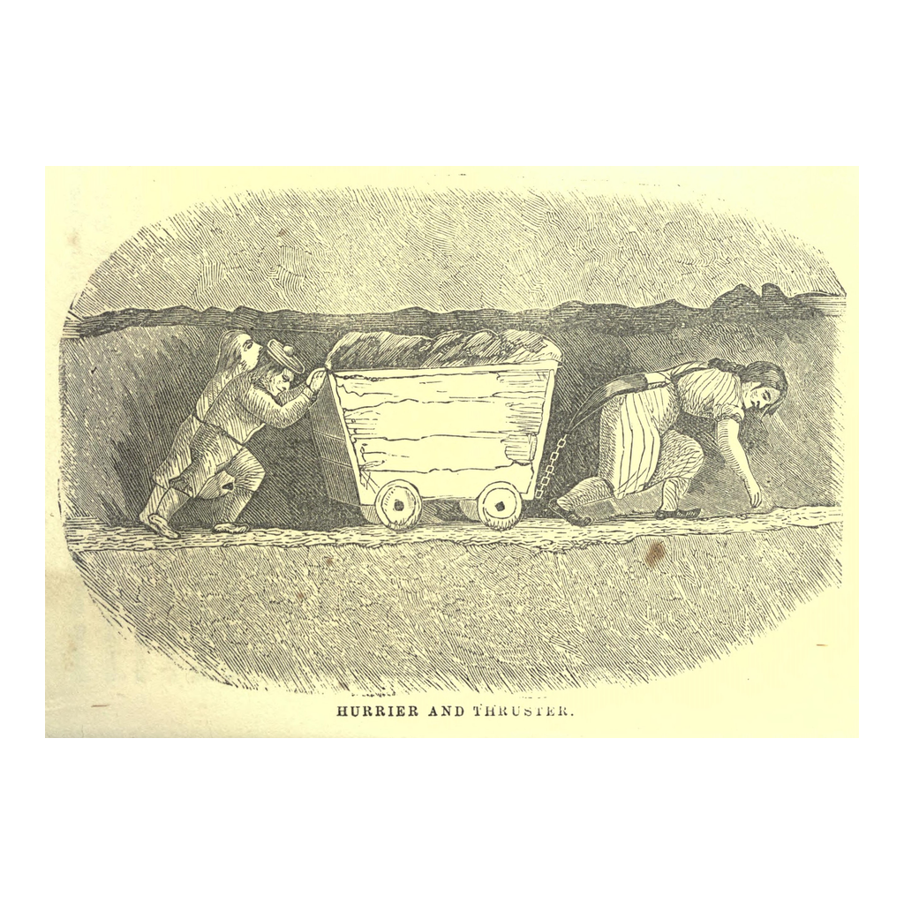
A Child at Work
A period illustration of a child hurrier pulling a coal tub
© More Lessons Less Planning | morelessonslessplanning.com
Notes:
This is a period illustration of a child hurrier pulling a heavy tub of coal, an image reformers used to show the public what child labor looked like. Use it as a reference image, not as evidence for any specific claim.

Slide 9
Wages and Conditions
Wages were low, so families needed everyone, including children, to work.
The working day was long and the pace was set by the machines.
Mills were often hot, loud, and filled with dust from the cloth.
With little rest, workers became very tired by the end of a shift.
These hard conditions were what reformers set out to change.
Key Concept: Factory wages were low and hours long; mills were hot, loud, and dusty, and it was these conditions that reformers set out to change.
© More Lessons Less Planning | morelessonslessplanning.com
Notes:
Wages were low, so families needed everyone, including children, to work. The working day was long and the pace was set by the machines. Mills were often hot, loud, and filled with dust from the cloth. With little rest, workers became very tired by the end of a shift. These hard conditions were what reformers set out to change.

Slide 10
Factory Towns Grow Up Around the Mills
Towns Around the Mills
Crowded and Smoky
Towns grew quickly around the new mills as workers moved in for jobs
Rows of small houses were built close to the factories
Families lived near the mill so they could walk to work
These industrial towns were often crowded and smoky from the coal
The whole town's life revolved around the factory whistle
Work, home, and daily life were all shaped by the mill
Key Concept: Crowded industrial towns grew up around the mills, where families lived close to the factory and life revolved around the whistle.
© More Lessons Less Planning | morelessonslessplanning.com
Notes:
Towns grew quickly around the new mills as workers moved in for jobs. Rows of small houses were built close to the factories, and families lived near the mill so they could walk to work. These industrial towns were often crowded and smoky from the coal. The whole town's life revolved around the factory whistle, so work, home, and daily life were all shaped by the mill.

Slide 11
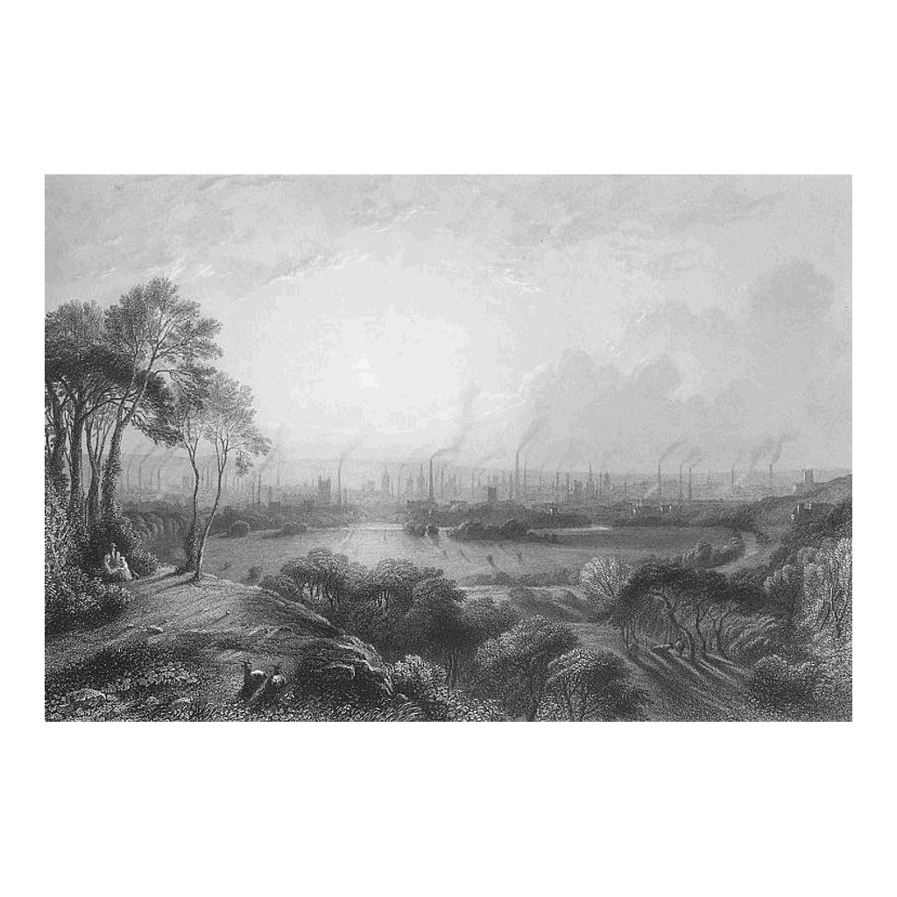
An Industrial Factory Town
Manchester as an industrial factory town, in a period engraving
© More Lessons Less Planning | morelessonslessplanning.com
Notes:
This is a period engraving of Manchester as an industrial factory town, showing rows of mills and smoking chimneys. Use it as a reference image to picture the crowded towns that grew around the factories, not as evidence for any specific claim.

Slide 12
Reformers Investigate: The Sadler Committee
Reformers wanted Parliament to limit the hours children worked.
In 1832 Michael Sadler led a committee to investigate factory conditions.
The Sadler Committee called in workers to testify about their jobs.
A young worker named Elizabeth Bentley described her long days in a Leeds mill.
Her first-hand testimony gave reformers powerful evidence.
Key Concept: In 1832 the Sadler Committee gathered first-hand worker testimony, like Bentley's, as evidence to push Parliament to reform factories.
© More Lessons Less Planning | morelessonslessplanning.com
Notes:
Reformers wanted Parliament to limit the hours children worked. In 1832 Michael Sadler led a committee to investigate factory conditions, and the Sadler Committee called in workers to testify about their jobs. A young worker named Elizabeth Bentley described her long days in a Leeds mill, and her first-hand testimony gave reformers powerful evidence to make their case.

Slide 13
The Factory Act of 1833
The testimony helped convince Parliament to pass the Factory Act of 1833.
The law said children under nine could not work in textile mills.
Children aged nine to thirteen could work only limited hours each day.
The Act required some schooling for child workers.
It also created factory inspectors to enforce the new rules.
Key Concept: The Factory Act of 1833 limited children's working hours, required some schooling, and created inspectors to enforce the rules.
© More Lessons Less Planning | morelessonslessplanning.com
Notes:
The testimony helped convince Parliament to pass the Factory Act of 1833. The law said children under nine could not work in textile mills, and children aged nine to thirteen could work only limited hours each day. The Act required some schooling for child workers, and it also created factory inspectors to enforce the new rules. It was a first step, not a complete fix, but it showed that testimony could win real reform.

Slide 14
Reference Guide: The Mill and the Working Day
factory system
Bringing many workers and machines together in one mill to make goods by the clock.
mill
A factory, especially a textile factory, powered by water or by steam.
working day
The long stretch of hours, often twelve to fourteen, that workers labored by the factory clock.
shift
The block of scheduled hours a worker was expected to work at the machines.
doffing
Replacing full bobbins of thread with empty ones on the spinning machines.
Tip: These five terms name the new workplace, the building, the long day, the scheduled hours, and one common child's job.
© More Lessons Less Planning | morelessonslessplanning.com
Notes:
Review the first five terms exactly as defined: the factory system, the mill, the working day, a shift, and doffing. Students use these definitions to complete the Reference Guide in the Activity.

Slide 15
Reference Guide: The Workers and the Reform
piecing
Joining, or piecing, together threads that had broken on the spinning frames.
overseer
The supervisor who kept workers at their machines and enforced factory discipline.
child labor
The widespread employment of young children in factories and mines.
Sadler Committee
Michael Sadler's 1832 committee of lawmakers that gathered worker testimony about factory conditions.
Factory Act of 1833
The reform law that limited children's factory hours, required some schooling, and created inspectors.
Tip: These five terms name a second child's job, the supervisor, the practice reformers targeted, the committee, and the law it helped win.
© More Lessons Less Planning | morelessonslessplanning.com
Notes:
Review the next five terms exactly as defined: piecing, the overseer, child labor, the Sadler Committee, and the Factory Act of 1833. Students use these definitions to complete the Reference Guide in the Activity.

Slide 16
Key Takeaways
The factory system gathered workers and machines in one mill, run by the clock.
★
The working day was long, often twelve to fourteen hours set by shifts.
★
Mills employed many women and children, who did jobs like doffing and piecing.
★
Wages were low and conditions hard, which is what reformers set out to change.
★
The Sadler Committee gathered first-hand testimony, like Elizabeth Bentley's.
★
That testimony helped win the Factory Act of 1833, limiting children's hours.
★
© More Lessons Less Planning | morelessonslessplanning.com
Notes:
Close with the essential question of how industrial work changed daily life and how reformers used testimony to change the law. Each takeaway connects the factory system and working day, who did the work, the wages and conditions, the Sadler Committee, and the Factory Act of 1833.

