Slide 1
Leonardo da Vinci - The Renaissance Man
How one man - artist, anatomist, and engineer at once - became the ultimate example of the Renaissance ideal of broad genius.
© More Lessons Less Planning | morelessonslessplanning.com
Notes:
Opening slide. This lesson explores how Leonardo da Vinci (1452-1519) became the ultimate 'Renaissance Man' - a person of broad genius skilled in art, anatomy, and engineering at once. The lesson is honest about four things: Leonardo left most of his projects unfinished and his flying machines never actually flew; his notebooks were private, mirror-written, and unpublished in his lifetime, so they influenced science only after later rediscovery; 'Renaissance Man' is an ideal of broad mastery, and Leonardo is its archetype, not literally the only genius of the age; and his Vitruvian Man is a study of ideal human proportion after the Roman architect Vitruvius. Our primary source is Leonardo's own notebooks.

Slide 2
Learning Targets
Explain what a Renaissance Man was and how Leonardo embodied that ideal.
★
Define humanism, anatomy, dissection, and the empirical method.
★
Describe Leonardo as artist, anatomist, and engineer - honestly.
★
Analyze Leonardo's notebooks as his private, observe-then-record evidence.
★
© More Lessons Less Planning | morelessonslessplanning.com
Notes:
Learning targets. Target 1 introduces the Renaissance Man ideal and Leonardo as its archetype. Target 2 builds the core vocabulary of humanism and Leonardo's empirical method. Target 3 is a key honesty point: describe his three careers while admitting he left most work unfinished, his flying machines never flew, and his notebooks were unpublished. Target 4 practices sourcing on his private working notebooks.

Slide 3
Who Was Leonardo da Vinci?
LEONARDO DA VINCI (1452-1519) was born near the town of Vinci in ITALY.
He trained as a painter in Florence in the workshop of the artist Verrocchio.
He worked across Italy and France for wealthy PATRONS who paid for his work.
His patrons included the Medici, the Sforza of Milan, and the French king.
He was a painter, but also studied the body, nature, water, and machines.
Key Concept: LEONARDO DA VINCI (1452-1519) trained as a painter but worked for wealthy PATRONS as an artist, thinker, and inventor.
© More Lessons Less Planning | morelessonslessplanning.com
Notes:
LEONARDO DA VINCI (1452-1519) was born near the small town of Vinci in ITALY - his name simply means 'Leonardo from Vinci.' As a teenager he trained as a painter in Florence in the workshop of the artist Verrocchio. Across his long career he moved between cities and worked for wealthy PATRONS - the backers who paid for an artist's work - including the Medici of Florence, the Sforza rulers of Milan, and finally King Francis I of France, where he died. Stress for students that although Leonardo started as a painter, he never stopped there: he also studied the human body, nature, water, and machines. That restless curiosity is what will make him the model of the Renaissance Man.

Slide 4
The Renaissance Man Ideal
Renaissance
A 'rebirth' of art and learning in Europe (about 1350-1600) that revived the study of ancient Greece and Rome.
Humanism
A Renaissance movement that studied classical texts and celebrated human potential, reason, and achievement.
Renaissance Man
A person of broad genius, skilled in many fields at once - art, science, and engineering; the ideal Leonardo came to represent.
Key Concept: A RENAISSANCE MAN was a person of broad genius skilled in many fields at once - the ideal Leonardo embodied.
© More Lessons Less Planning | morelessonslessplanning.com
Notes:
This slide sets up the central idea. The RENAISSANCE was a 'rebirth' of art and learning in Europe, running roughly from 1350 to 1600, that revived the study of ancient Greece and Rome. Its guiding movement was HUMANISM: the study of classical texts and a new celebration of human potential, reason, and achievement. Out of that spirit came the ideal of the RENAISSANCE MAN - a person of broad genius, skilled in many fields at once, from art to science to engineering. Tell students plainly: 'Renaissance Man' is an ideal, and Leonardo is its most famous archetype - not the only brilliant person of the age, but the one who best shows what the ideal meant. Emphasize the phrase 'broad genius, skilled in many fields at once' because it is the heart of the whole lesson.

Slide 5
Leonardo the Artist
A master painter
Leonardo painted two of the most famous works in history - the Mona Lisa and The Last Supper.
✔
Studied light and life
He observed light, shadow, faces, and living bodies closely to make his paintings lifelike.
✔
A slow perfectionist
He worked slowly and left MANY works UNFINISHED, moving on before completing his projects.
✔
Did You Know? Leonardo produced very few finished paintings - he was a slow perfectionist who left many projects UNFINISHED.
© More Lessons Less Planning | morelessonslessplanning.com
Notes:
Leonardo is remembered first as a master painter - he created two of the most famous works in the history of art, the Mona Lisa and The Last Supper. His secret was observation: he studied light, shadow, faces, and living bodies closely so that his paintings looked astonishingly lifelike. But be honest with students here, because it introduces a theme that runs through the whole lesson: Leonardo worked slowly and was a perfectionist who left MANY of his works UNFINISHED. He completed only a small number of paintings, often moving on to a new interest before finishing the last one. His genius was real, but so was his habit of leaving projects incomplete.

Slide 6
The Vitruvian Man
The VITRUVIAN MAN is Leonardo's drawing of ideal human PROPORTION.
It is based on the ancient Roman architect VITRUVIUS, who wrote on proportion.
A man's body fits inside both a circle and a square in the drawing.
It blends ART, mathematics, and the study of the human body all at once.
It is a study of proportion - NOT a self-portrait or a magic symbol.
Key Concept: The VITRUVIAN MAN is Leonardo's study of ideal human PROPORTION, based on the Roman architect Vitruvius - art, math, and anatomy.
© More Lessons Less Planning | morelessonslessplanning.com
Notes:
The VITRUVIAN MAN is Leonardo's most famous drawing, made around 1490. It shows a man's body drawn to fit inside both a circle and a square, and it is a study of ideal human PROPORTION - the mathematical relationships between the parts of the body. Leonardo based it on the ideas of the ancient Roman architect VITRUVIUS, who had written that a well-built human body has perfect proportions. Point out to students why this single drawing matters so much for our lesson: it blends ART, mathematics, and the study of the human body all in one image - exactly the many-sided thinking of a Renaissance Man. Be honest about what it is NOT: it is not a self-portrait of Leonardo, and it is not a magic or mystical symbol. It is a careful study of proportion. The next slide shows the drawing itself.

Slide 7
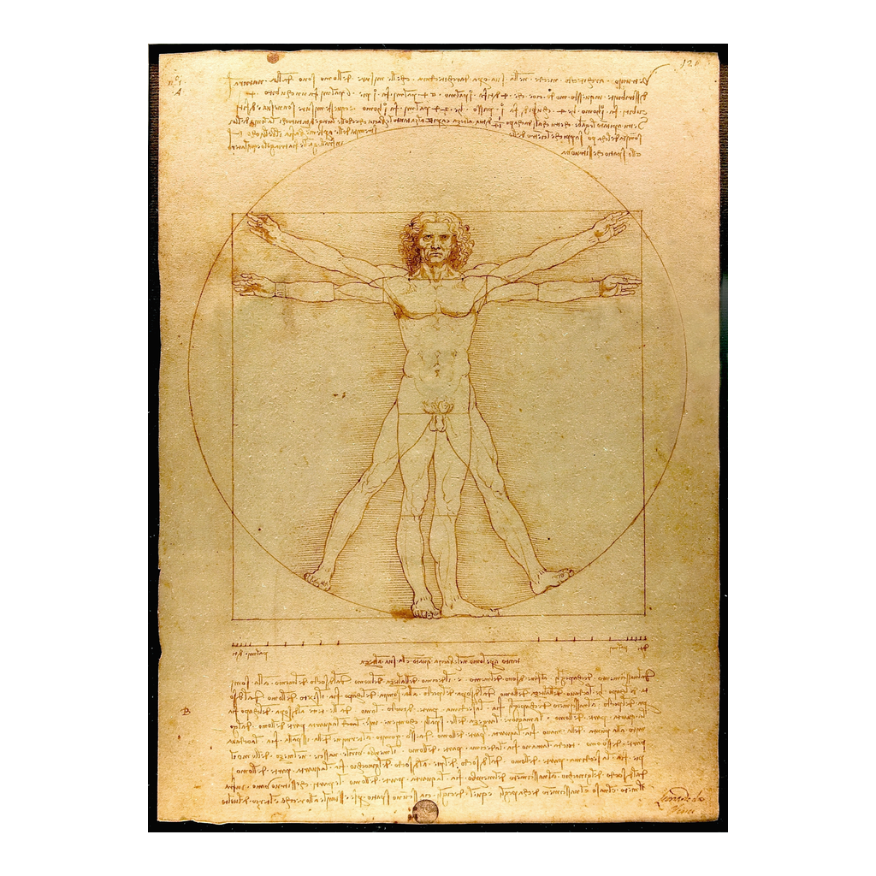
A Study of Ideal Proportion
Leonardo da Vinci, Vitruvian Man, c. 1490 (Gallerie dell'Accademia, Venice).
© More Lessons Less Planning | morelessonslessplanning.com
Notes:
This is Leonardo's actual Vitruvian Man drawing, made around 1490 and now kept at the Gallerie dell'Accademia in Venice. Give students a moment to see how the figure's outstretched arms and legs touch both a circle and a square - Leonardo's way of showing the ideal proportions of the human body. Remind them what it is and is not: it is a genuine Renaissance study of proportion that blends art, mathematics, and anatomy, but it is not a portrait of Leonardo and not a mystical symbol. It is a perfect visual example of a Renaissance Man thinking about art and science at the same time.
Reference labels (point to these chart features when teaching): Body fits a circle and square; A study of proportion

Slide 8
Leonardo the Anatomist
Anatomy
The study of the structure of the body, which Leonardo explored by dissecting human corpses.
Dissection
The cutting open and careful examination of a body to learn how it is built.
Private study
Leonardo's anatomy stayed in his unpublished notebooks - it did not advance the medicine of his own time.
Did You Know? Leonardo learned ANATOMY through DISSECTION - but his findings stayed private and did not change the medicine of his time.
© More Lessons Less Planning | morelessonslessplanning.com
Notes:
Leonardo did not only paint the human body - he studied its inside. ANATOMY is the study of the structure of the body, and Leonardo learned it through DISSECTION: cutting open and carefully examining real human corpses to see how they were built. Working often by candlelight, he dissected many bodies and filled pages with astonishingly accurate drawings of muscles, bones, the heart, and unborn children. But here is an essential honesty point for students: Leonardo's anatomical discoveries stayed locked in his PRIVATE, unpublished notebooks. Because he never published them, they did NOT advance the medicine of his own time. Doctors of the 1500s did not learn from Leonardo; his anatomy amazed the world only centuries later, when his notebooks were finally studied. So he was a brilliant observer whose science had almost no impact in his lifetime.

Slide 9
Leonardo the Engineer
The engineer
An ENGINEER is a person who designs machines and structures - Leonardo filled notebooks with such designs.
✔
War and work machines
He designed war machines, bridges, and water devices, often for his patron the Duke of Milan.
✔
Designs on paper
Most of his machines were never BUILT - they lived as brilliant designs on the page, not real inventions.
✔
Important: Leonardo the ENGINEER designed war machines, bridges, and flying devices - but most were never BUILT and stayed designs on paper.
© More Lessons Less Planning | morelessonslessplanning.com
Notes:
Leonardo was also an ENGINEER - a person who designs machines and structures. His notebooks overflow with mechanical designs: war machines, giant crossbows, armored carts, bridges, canals, and water-lifting devices. Many were sketched for his patron Ludovico Sforza, the Duke of Milan, who valued Leonardo as much for military engineering as for art. But keep students honest about what this means: most of Leonardo's machines were never actually BUILT. They lived as brilliant designs on paper, not as working inventions that changed his world. He imagined the future far more than he built it. This sets up the most famous example of all - his dream of human flight.

Slide 10
Dreams of Flight
Leonardo studied how BIRDS fly and how their wings push against the air.
He designed flying machines, including a flapping-wing 'ornithopter.'
He reasoned that a man with big enough wings might overcome the air.
But his flying machines were NEVER successfully FLOWN by anyone.
He was a visionary DESIGNER of flight - not a successful aviator.
Warning: Leonardo designed flying machines from studying BIRDS - but they were NEVER successfully FLOWN. He was a designer, not an aviator.
© More Lessons Less Planning | morelessonslessplanning.com
Notes:
Here is Leonardo's most famous engineering dream: human flight. He spent years watching how BIRDS fly - how their wings beat against the air and hold them up - and he filled pages with designs for flying machines, including a flapping-wing device we call an 'ornithopter.' From watching eagles and studying the wind in sails, he reasoned that a man with large enough wings might push against the air and rise. It is a thrilling idea, and it shows his empirical, observe-then-reason method. But students must hold the honest truth firmly: Leonardo's flying machines were NEVER successfully FLOWN. Not by him, not by anyone using his designs. He was a visionary DESIGNER of flight who imagined it centuries early - not a successful aviator who actually got off the ground. The next slide shows one of his flying-machine designs.

Slide 11
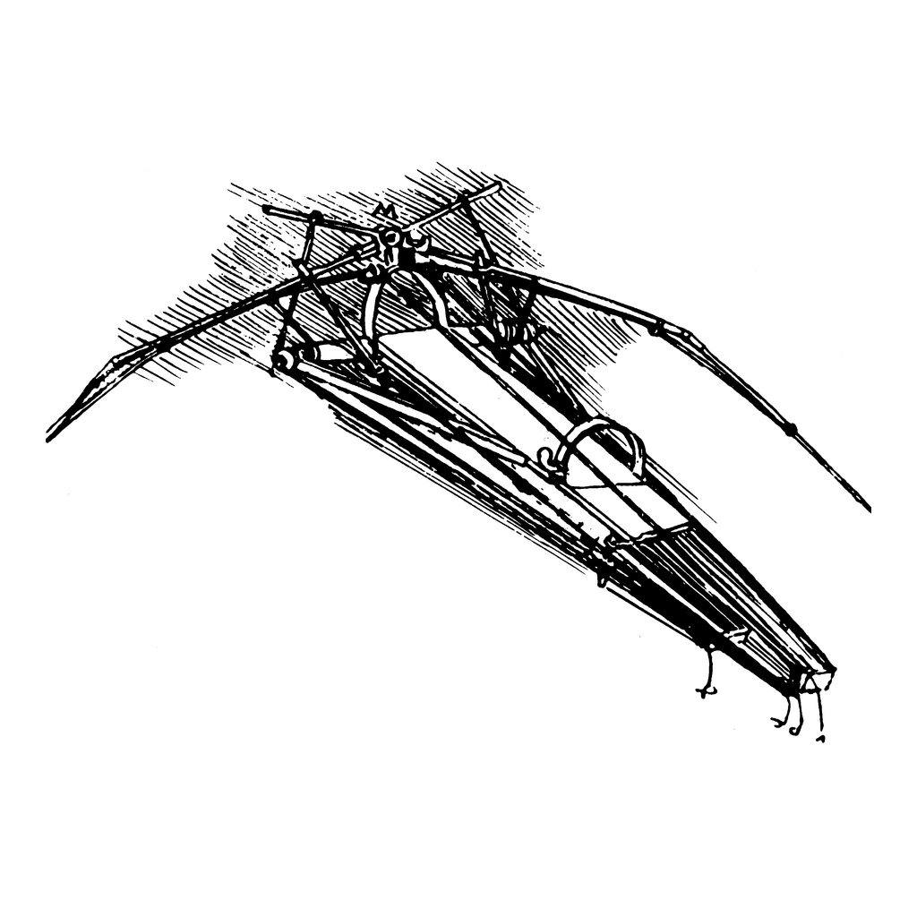
A Design for a Flying Machine
One of Leonardo da Vinci's flapping-wing flying-machine (ornithopter) designs.
© More Lessons Less Planning | morelessonslessplanning.com
Notes:
This is a reproduction of one of Leonardo's flying-machine designs - a flapping-wing 'ornithopter' meant to lift a person by beating great wings against the air, just as a bird does. Have students notice how closely the machine imitates a bird's wing, which is exactly where Leonardo got the idea. Then repeat the honest frame one more time: as beautiful and clever as this design is, no machine like it ever successfully carried a person into the air in Leonardo's lifetime. It is a design on paper - a record of a brilliant dream, not a working aircraft.
Reference labels (point to these chart features when teaching): Flapping wings, like a bird; A design, never flown

Slide 12
How Leonardo Worked - Observe, Then Record
His empirical method
Observe, then record
EMPIRICAL means based on direct OBSERVATION and experiment.
Leonardo trusted what he could see, not old books.
He called himself a 'disciple of experience.'
He watched nature closely - birds, water, bodies.
Then he RECORDED it in careful drawings and notes.
Seeing clearly, 'saper vedere,' was his real skill.
Key Concept: EMPIRICAL means based on direct OBSERVATION and experiment, not tradition or authority - Leonardo observed, then RECORDED it.
© More Lessons Less Planning | morelessonslessplanning.com
Notes:
This slide names the thread that ties all of Leonardo's careers together: his method. His approach was EMPIRICAL - based on direct OBSERVATION and experiment rather than on tradition or the authority of old books. In an age when many scholars simply repeated what ancient authors had written, Leonardo trusted what he could actually see, and he proudly called himself a 'disciple of experience.' His way of working was to OBSERVE the world extremely closely - birds in flight, moving water, the inside of a body - and then to RECORD exactly what he saw in careful drawings and notes. He believed the key skill was 'saper vedere,' Italian for 'knowing how to see.' Help students connect this to the primary source they are about to read: his notebooks ARE that record - the written trace of his observe-then-record method.

Slide 13
The Secret Notebooks
Thousands of pages
Leonardo left thousands of pages of NOTEBOOKS filled with sketches and notes.
✔
Written in mirror-writing
He wrote backwards in MIRROR-writing, readable only when held up to a mirror.
✔
Unpublished in his lifetime
The notebooks were PRIVATE and UNPUBLISHED in his lifetime; the world learned from them only much later.
✔
Did You Know? Leonardo's NOTEBOOKS were private, written backwards in MIRROR-writing, and UNPUBLISHED in his lifetime - shaping science only later.
© More Lessons Less Planning | morelessonslessplanning.com
Notes:
Almost everything we know about Leonardo's science comes from his NOTEBOOKS - thousands of surviving pages crammed with sketches, diagrams, and notes on art, anatomy, machines, water, and flight. Two things about them matter enormously for how we use them as evidence. First, Leonardo wrote most of his notes in MIRROR-writing - backwards, right to left - so that the text can only be read easily when held up to a mirror. Historians debate why: it may have been habit for a left-hander, or a wish for privacy. Second, and most important, the notebooks were entirely PRIVATE and UNPUBLISHED during his lifetime. He never turned them into finished, printed books. As a result, his brilliant ideas influenced later science only after his notebooks were rediscovered, studied, and published centuries later - not in his own time. So when we read them, we are reading a genius's private working papers, not published science.

Slide 14
The Honest Picture
Leonardo left most of his projects UNFINISHED - art, machines, and books.
His flying machines were never successfully flown by anyone.
His notebooks stayed private, so they changed his OWN time very little.
'Renaissance Man' is an IDEAL - Leonardo is its archetype, not the only genius.
His true greatness was his method - to observe closely and record honestly.
Remember: stay honest - most projects UNFINISHED, machines never flown, notebooks private. 'Renaissance Man' is an ideal Leonardo best represents.
© More Lessons Less Planning | morelessonslessplanning.com
Notes:
Pull the honesty threads together so students admire Leonardo accurately, not as a myth. First, he left most of his projects UNFINISHED - paintings abandoned, machines never built, planned books never written. Second, his flying machines were never successfully flown by anyone; he designed flight but did not achieve it. Third, because his notebooks stayed private and unpublished, his science changed his OWN time very little - its impact came centuries later. Fourth, 'Renaissance Man' is an IDEAL of broad mastery, and Leonardo is its greatest archetype - not literally the only brilliant person of the Renaissance. So what made him truly great? Not a pile of finished inventions, but his METHOD: his relentless drive to observe the world closely and record it honestly. That is the real lesson of Leonardo, and it is exactly what students will see in his notebooks.

Slide 15
How Do We Know? The Notebooks
Our evidence for Leonardo's thinking is his own surviving NOTEBOOKS.
They are private working notes - not finished, published science.
In 1883, Jean Paul RICHTER translated and published many of them in English.
The notebooks show his EMPIRICAL method: observe closely, then record.
We will read a short passage on his study of flight and the body.
Tip: We read Leonardo through his own NOTEBOOKS - private working notes, translated by Jean Paul Richter in 1883. They show his empirical method.
© More Lessons Less Planning | morelessonslessplanning.com
Notes:
This sourcing slide sets up the Primary Source Spotlight. Our best evidence for how Leonardo actually thought is his own surviving NOTEBOOKS. Remind students what kind of source that is: these are private working notes - the rough record of a man thinking on paper - not finished, published science meant for an audience. Much of what English readers know comes from the scholar Jean Paul RICHTER, who gathered and translated many of Leonardo's notebook passages into English in an edition published in 1883. In the activity, students will read a short excerpt from that translation, lightly modernized, in which Leonardo reasons about flight and describes his anatomical dissections. As they read, they should watch for his EMPIRICAL method in action: he observes the world closely - birds, the air, the human body - and then records what he sees and reasons out.

Slide 16
Key Takeaways
Leonardo was the ultimate RENAISSANCE MAN - artist, anatomist, and engineer.
★
The Vitruvian Man blends art, math, and anatomy in one study of proportion.
★
His method was EMPIRICAL - observe the world closely, then record it.
★
He left most projects unfinished, and his flying machines never flew.
★
His notebooks were private and unpublished, shaping science only much later.
★
We know Leonardo through his own private notebooks, not finished science.
★
© More Lessons Less Planning | morelessonslessplanning.com
Notes:
Close the loop. If students remember one thing, make it this: Leonardo da Vinci was the ultimate RENAISSANCE MAN - a person of broad genius who was artist, anatomist, and engineer at once, and whose method was EMPIRICAL: observe the world closely, then record it. Then hold the honesty frames firmly: the Vitruvian Man blends art, math, and anatomy in a study of proportion; he left most projects unfinished and his flying machines never actually flew; his notebooks were private and unpublished, so they shaped science only much later; and 'Renaissance Man' is an ideal he best represents, not a claim that he was the only genius. We know all of this because of his own notebooks - private working notes, not finished science - which is exactly the source students analyzed.

