Slide 1
Law of Supply: The Producer Side
When the price goes up, producers make more - and here is exactly why.
© More Lessons Less Planning | morelessonslessplanning.com
Notes:
Open with the everyday version from the SELLER side: if you could sell your lemonade for $5 a cup instead of $1, would you set up more stands and make more? Of course. That instinct IS the law of supply. Yesterday we did the buyer side (law of demand); today we flip to producers.

Slide 2
Learning Targets
State the LAW OF SUPPLY and read a supply curve and supply schedule
★
Tell a MOVEMENT ALONG the curve apart from the PROFIT MOTIVE and rising COSTS
★
Use a real supply schedule to predict quantity supplied when price changes
★
© More Lessons Less Planning | morelessonslessplanning.com
Notes:
Read the three targets aloud. Target 1 is the rule + the two ways to display it (table and graph). Target 2 is the WHY (profit motive and rising production cost). Target 3 is the application (read the schedule, predict quantity supplied).

Slide 3
What Is the Law of Supply?
The Rule in One Sentence
You Already Live This
Price UP - quantity supplied UP
Price DOWN - quantity supplied DOWN
Price and quantity move in the SAME direction
This is called a DIRECT relationship
Lemonade sells for $5 - you make MORE
Resale sneakers spike - sellers list MORE
Gas prices rise - oil firms drill MORE
Concert tickets resell high - more get listed
Key Concept: The law of supply says price and quantity supplied move in the SAME direction, all else equal.
© More Lessons Less Planning | morelessonslessplanning.com
Notes:
State the law of supply cleanly. Stress DIRECT relationship (same direction) - this is the mirror image of demand's INVERSE relationship. Ground it in everyday experience so the formal rule feels obvious.

Slide 4
Supply vs Quantity Supplied
SUPPLY
The WHOLE relationship - the quantity producers are willing and able to offer for sale at EVERY price; the entire curve, not one number
QUANTITY SUPPLIED
ONE amount at ONE specific price; a single point on the supply curve (e.g., 400 pizzas at $8)
Why it matters
A price change moves QUANTITY SUPPLIED along the curve; it does NOT change SUPPLY (the whole curve stays put)
Quick test
If a sentence names a specific price, it is talking about QUANTITY SUPPLIED, not supply
Warning: Supply is the whole curve; quantity supplied is one point on it. Mixing them up is the #1 error in this unit.
© More Lessons Less Planning | morelessonslessplanning.com
Notes:
This vocabulary distinction is the single biggest source of student error in Unit 2 - the exact same trap as demand vs quantity demanded. Drill it now. Supply = the whole curve. Quantity supplied = one point at one price.

Slide 5
The Supply Schedule - A Table of Price and Quantity
Price per Pizza | Quantity Supplied (pizzas/week)
$4 | 200
$8 | 400
$12 | 600
$16 | 800
Did You Know: A supply schedule is just a table - each row is one price and its quantity supplied. As price RISES, quantity supplied RISES.
© More Lessons Less Planning | morelessonslessplanning.com
Notes:
Introduce the running example: Bella's Pizza Kitchen. The supply schedule is the table form of the law of supply. As price climbs from $4 to $16, quantity supplied climbs from 200 to 800. These exact numbers reappear on the supply-curve chart and in the activity.

Slide 6
The Supply Curve - The Schedule Drawn as a Graph
How to Read the Axes
What the Next Slide Shows
PRICE goes on the vertical (Y) axis
QUANTITY SUPPLIED goes on the horizontal (X) axis
Each schedule row becomes one plotted POINT
Connect the points and you get the supply curve
The curve slopes UPWARD left to right
At $4 the curve reads 200 pizzas
At $12 the curve reads 600 pizzas
Upward slope = the law of supply, drawn
Tip: The supply curve slopes UP for one reason - the law of supply. Higher price, higher quantity supplied. Lower price, lower quantity supplied.
© More Lessons Less Planning | morelessonslessplanning.com
Notes:
Set up the supply-curve chart on the next slide BEFORE flipping. Price on Y, quantity supplied on X. Pre-load the points (200 at $4, 600 at $12) so students can verify on the chart. The UPWARD slope IS the law of supply - the mirror of the downward demand curve.

Slide 7
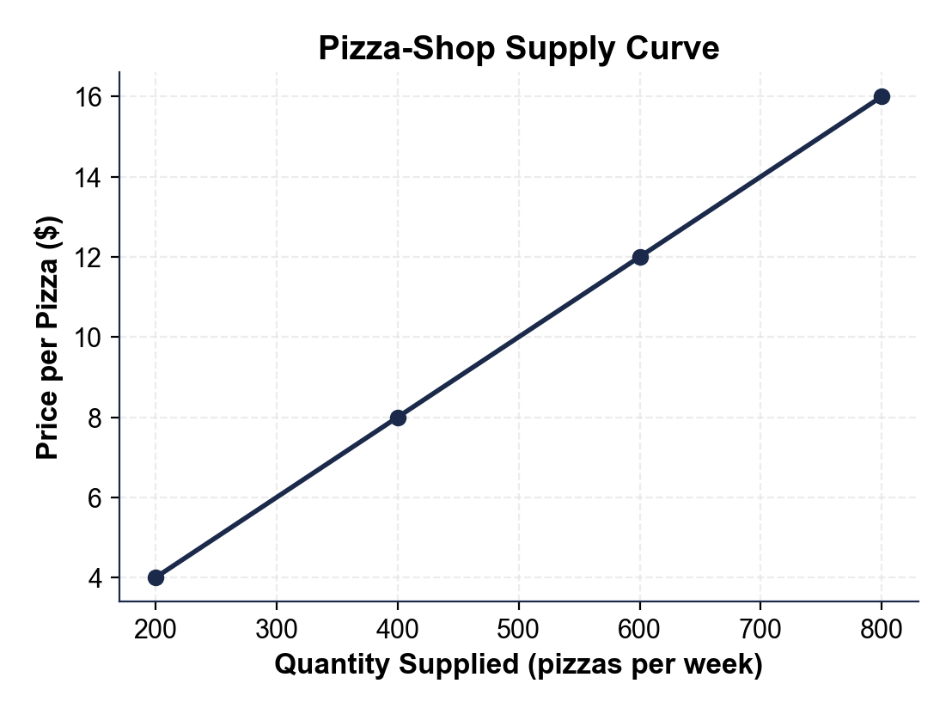
The Pizza-Shop Supply Curve
The supply curve slopes upward.
© More Lessons Less Planning | morelessonslessplanning.com
Notes:
Point to the bottom-left of the curve ($4, 200 pizzas) and the top-right ($16, 800 pizzas). Trace the upward slope with a finger. Every point on this curve is one row of the supply schedule.
Reference labels (point to these chart features when teaching): $4 = 200 pizzas; $16 = 800 pizzas

Slide 8
Same Data, Different Picture - The Bar Chart
A supply schedule can be drawn as BARS, not just a curve
Each bar = quantity supplied at one price
Taller bar = more pizzas offered at that price
On the next slide: $4, $8, and $12 side by side
Watch the bars GROW as the price rises
Note: Curve or bars, the message is identical - higher price, higher quantity supplied. The picture changes; the law of supply does not.
© More Lessons Less Planning | morelessonslessplanning.com
Notes:
Set up the bar-chart view of the same supply schedule. The point is to show students the same data displayed two ways. The bars climb as price RISES. Pre-load: at $4 -> 200, at $8 -> 400, at $12 -> 600.

Slide 9
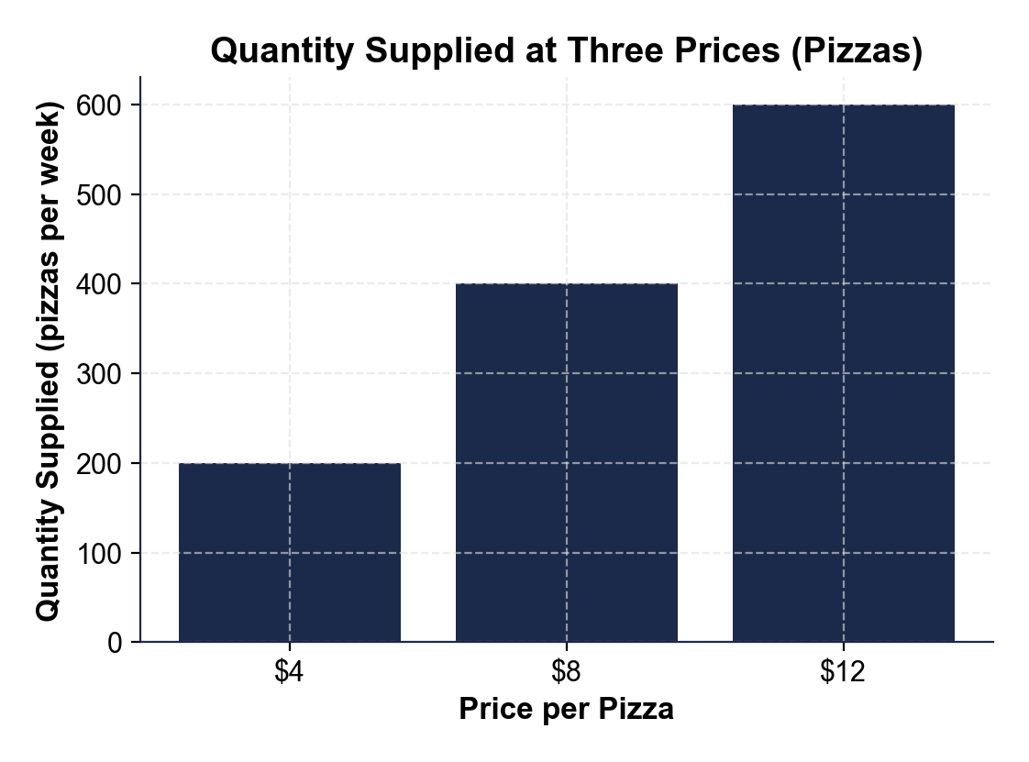
Quantity Supplied at Three Prices
Bars grow as price rises.
© More Lessons Less Planning | morelessonslessplanning.com
Notes:
Point to each bar. The $4 bar is shortest (200), the $12 bar is tallest (600). The bars grow as the price rises - the law of supply shown as height.
Reference labels (point to these chart features when teaching): $4 = 200 pizzas; $12 = 600 pizzas

Slide 10
WHY Does the Law of Supply Hold?
Two Reasons, Always Together
The Big Picture
Reason 1: the PROFIT MOTIVE
Reason 2: rising PRODUCTION COST
Both push the SAME direction
Together they bend the curve upward
Price rises - more profit per unit (profit motive)
Making more raises cost per unit (marginal cost)
A higher price covers that rising cost
Next two slides take them one at a time
Big Idea: Two forces - the profit motive and rising production costs - explain WHY higher prices pull out more quantity supplied.
© More Lessons Less Planning | morelessonslessplanning.com
Notes:
Preview the two reasons before taking them one at a time. The profit motive (higher price = more profit, so make more) and rising marginal cost (making more costs more per unit, so a higher price is needed to justify it) both make the supply curve slope upward.

Slide 11
Reason 1: The Profit Motive
1
2
The rule
Pizza up
A higher price means more profit on each unit, so producers want to make and sell MORE.
If pizzas sell for $16 instead of $4, each pizza earns more, so Bella's bakes more.
3
4
Oil up
Resale up
When oil prices spike, drillers open more wells to grab the higher profit.
When sneaker resale prices jump, more sellers list shoes to cash in.
Try this: If you could sell your old phone for $500 instead of $50, would you list more of your stuff? That pull toward profit IS the profit motive.
© More Lessons Less Planning | morelessonslessplanning.com
Notes:
The profit motive: a higher price means more profit per unit, so producers offer more. Use concrete cases (pizza, oil, sneaker resale). Quantity supplied rises because the higher price makes producing more worth it.

Slide 12
Reason 2: Rising Production (Marginal) Cost
Making each ADDITIONAL unit usually costs MORE than the last
Bella's must pay overtime, rent a second oven, buy pricier last-minute supplies
Producers will only make more if the price COVERS that rising cost
Example: the 800th pizza costs more to make than the 200th
Result: it takes a HIGHER price to pull out a higher quantity supplied
Key Concept: Marginal cost is the cost of ONE MORE unit. Because it rises as output grows, producers need a higher price to justify producing more.
© More Lessons Less Planning | morelessonslessplanning.com
Notes:
Rising marginal cost: each extra unit costs more to make (overtime, extra equipment, scarce inputs). So a producer will only ramp up output if the price rises enough to cover the higher cost. This is WHY the supply curve slopes upward, not just the profit motive. Keep marginal cost = cost of ONE MORE unit.

Slide 13
Ceteris Paribus - Holding All Else Equal
What It Means
Why We Need It
Latin for 'all else equal'
Hold EVERYTHING constant except price
Lets us isolate how PRICE alone affects quantity supplied
Input costs, technology, number of sellers - all frozen
Real markets change many things at once
Ceteris paribus strips it down to one variable
Then we can draw a single, fixed supply curve
Change anything else and the WHOLE curve would shift
Remember: The law of supply only works 'ceteris paribus' - all else equal. We freeze everything except price so we can see price's effect by itself.
© More Lessons Less Planning | morelessonslessplanning.com
Notes:
Ceteris paribus is the same assumption used on the demand side. Hold everything constant except price. This is what lets us draw ONE supply curve and slide along it. Changing anything else (input costs, technology, number of sellers) shifts the whole curve - a later toolkit topic.

Slide 14
Movement ALONG the Curve - Only Price Moves You
A movement along the curve is caused ONLY by the good's OWN price
You slide from one point to another on the SAME curve
Price up - slide to a bigger quantity supplied
Price down - slide to a smaller quantity supplied
A price change does NOT shift the whole curve - only non-price factors do
Warning: A price change moves you ALONG the supply curve. It does NOT shift the curve - only non-price factors do that.
© More Lessons Less Planning | morelessonslessplanning.com
Notes:
Movement along the supply curve is caused ONLY by the good's own price changing. You slide from point to point on the same curve. Contrast briefly with a shift (non-price factors like input costs or technology) but keep the focus on movement - shifts are a later topic.

Slide 15
Putting It Together - Price Is the Key Variable
Step 1 - Start with the law
Price up = quantity supplied up; price down = quantity supplied down (direct relationship)
✔
Step 2 - Read it two ways
The supply schedule (table) and the supply curve (graph) carry the SAME information
✔
Step 3 - Know WHY
The profit motive and rising marginal cost both pull more quantity supplied out at a higher price
✔
Step 4 - Hold all else equal
Ceteris paribus freezes everything but price, so a price change moves you ALONG one fixed curve
✔
Big Idea: In the law of supply, PRICE is the one variable in the spotlight. Hold all else equal, and price alone slides you along the supply curve.
© More Lessons Less Planning | morelessonslessplanning.com
Notes:
Synthesis slide. Walk the four steps: the rule, the two ways to display it, the two reasons it holds, and ceteris paribus. Price is the key variable - everything else is held constant. This mirrors the demand-side synthesis exactly so students see the parallel.

Slide 16
Law of Supply Vocabulary (1 of 3)
Law of supply
All else equal, when price rises quantity supplied rises and when price falls quantity supplied falls.
Quantity supplied
The amount producers will offer at ONE specific price - a single point on the supply curve.
Supply curve
The upward-sloping graph of quantity supplied at every price; it slopes up by the law of supply.
Note: Every term on this slide appears in Activity Part 2 (the Reference Guide) and on the Quiz - learn them here.
© More Lessons Less Planning | morelessonslessplanning.com
Notes:
Walk the three terms. LAW OF SUPPLY: all else equal, price up means quantity supplied up and price down means quantity supplied down - a direct relationship. QUANTITY SUPPLIED: the amount producers offer at ONE specific price - a single point on the supply curve. SUPPLY CURVE: the upward-sloping graph of quantity supplied at every price; it slopes up because of the law of supply.

Slide 17
Law of Supply Vocabulary (2 of 3)
1
2
3
Profit motive
Marginal cost
Supply schedule
A higher price means more profit per unit, so producers are willing to make and sell more.
The cost of making ONE more unit; it rises as output grows, so a higher price is needed.
A table of price and quantity supplied - the supply curve drawn as a table.
Note: These three terms appear in Activity Part 2 and on the Quiz - the profit motive and rising marginal cost explain WHY the law holds.
© More Lessons Less Planning | morelessonslessplanning.com
Notes:
Walk the three terms. PROFIT MOTIVE: a higher price means more profit per unit, so producers offer more. MARGINAL COST: the cost of making ONE more unit; it rises as output grows, so producers need a higher price to make more. SUPPLY SCHEDULE: a table listing the quantity supplied at each price - the supply curve drawn as a table.

Slide 18
Law of Supply Vocabulary (3 of 3)
Ceteris paribus
Latin for 'all else equal' - hold everything constant except price to isolate price's effect.
Movement along the curve
A change in quantity supplied caused ONLY by the good's own price change; you slide along it.
Direct relationship
When two variables move in the same direction; price and quantity supplied are directly related.
Note: These three terms also appear in Activity Part 2 and on the Quiz - drill ceteris paribus and movement-along.
© More Lessons Less Planning | morelessonslessplanning.com
Notes:
Walk the three terms. CETERIS PARIBUS: Latin for 'all else equal' - hold everything constant except price to isolate price's effect. MOVEMENT ALONG THE CURVE: a change in quantity supplied caused ONLY by the good's own price change; you slide along the same curve. DIRECT RELATIONSHIP: when two variables move in the same direction; price and quantity supplied are directly related.

Slide 19
Key Takeaways
Law of supply: price UP = quantity supplied UP (direct relationship)
Supply = the whole curve; quantity supplied = one point on it
Schedule (table) and curve (graph) carry the SAME information
WHY it holds: the profit motive AND rising marginal cost
Ceteris paribus: a price change moves you ALONG one fixed curve
Takeaway: When price rises, quantity supplied rises along the curve - producers chase profit and a higher price covers the rising cost of more units.
© More Lessons Less Planning | morelessonslessplanning.com
Notes:
Cycle through the five takeaways. Each maps to one part of the activity: the rule (Part 1), reference vocabulary (Part 2), schedule/curve reading (Part 3), the two reasons across scenarios (Part 4), and the production-plan memo (Part 5).

